Slide 1

Best Practices for
Addressing Homelessness
Vanessa Matheny, MSW
Community Services Administrator
June 2025
Notes:
Good afternoon, everyone. My name is Vanessa Matheny, and I serve as the Community Services Administrator for the Village of Oak Park, just outside of Chicago. I want to thank the National Community Development Association for the opportunity to present today.
It’s a privilege to share how our municipality is responding to the complex issue of homelessness in our region, and specifically, how we leverage CDBG and Village resources to support a coordinated, person-centered system of care.
During this presentation, I’ll walk you through the key strategies and partnerships that shape our local response — including innovative collaborations with nonprofit providers, local and regional initiatives. My goal is to offer practical insight into how municipal governments can actively lead and support systems-level solutions to housing instability and homelessness.

Slide 2
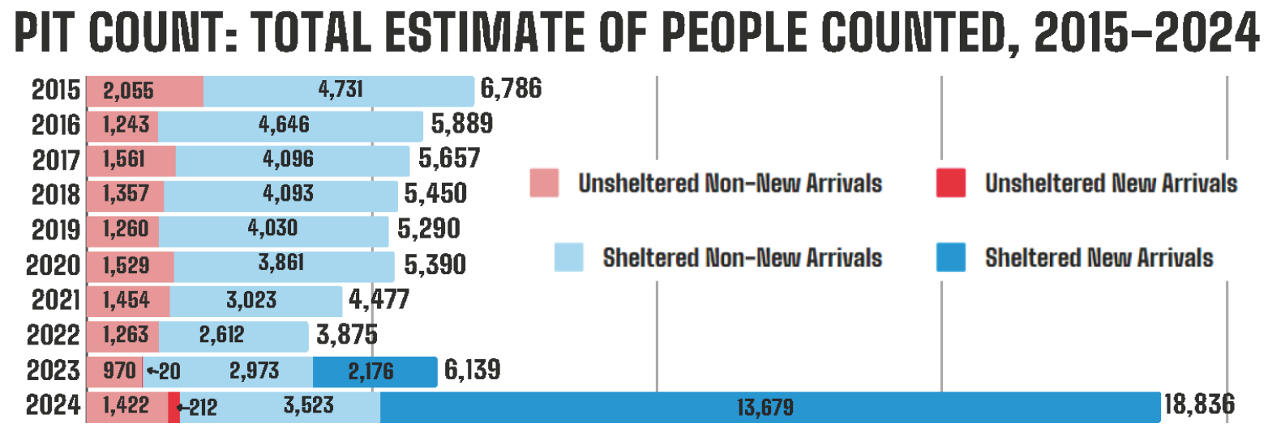
Chicago/Cook County – Point In Time Counts
Information provided by the National Alliance to End Homelessness What Causes Homelessness: Systemic racism and marginalization - National Alliance to End Homelessness
Notes:
To begin, I think it’s important to ground our conversation in the current data we’re seeing across Cook County. Between 2023 and 2024, Chicago experienced a 207% increase in overall homelessness. Even when excluding recent New Arrivals, unsheltered homelessness alone rose by 47% — a staggering trend that speaks to the mounting challenges across the region.
According to the National Alliance to End Homelessness, several interrelated factors are driving this increase:
A sharp rise in rental prices, outpacing stagnant wages
A severe shortage of affordable housing units
Limited access to healthcare, behavioral health, and wraparound services
Systemic racism and ongoing housing discrimination
These drivers are not unique to Chicago or Cook County. Communities across the country, rural, suburban, and urban alike are grappling with similar conditions. But by acknowledging the scale of the problem locally, we can better understand why municipal involvement and coordinated strategies are critical.

Slide 3
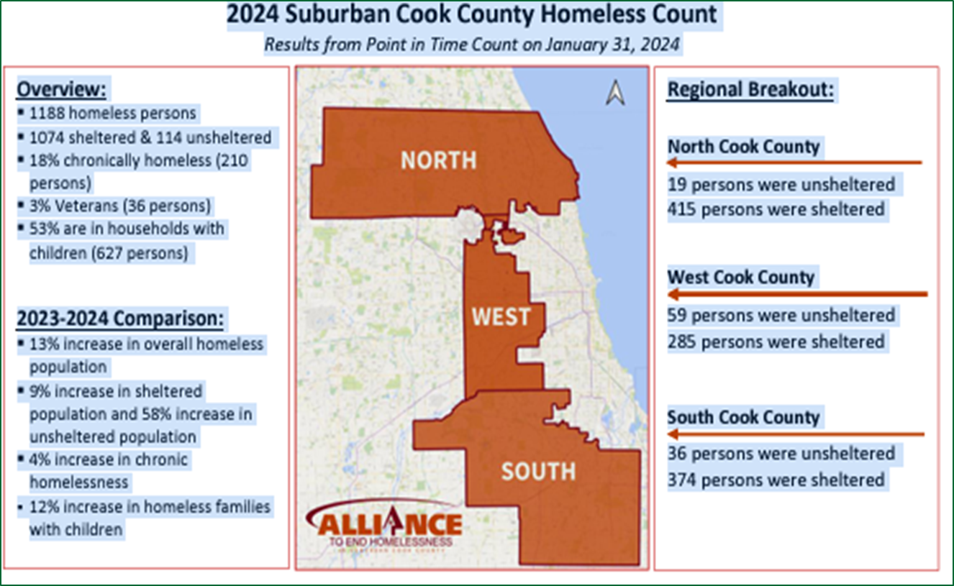
Suburban Cook County
Notes:
Breaking this down further, the Village of Oak Park is located within suburban Cook County, and our focus is specifically on the West Cook region. Between 2023 and 2024, rates of homelessness across suburban Cook County increased by 12.5%, reflecting broader regional trends.
Our primary service partner, Housing Forward, serves 26 municipalities in West Cook County. Across all of their programs, they saw a 7% increase in the number of individuals served — from 637 in 2023 to 684 in 2024.
When we look at Street Outreach specifically, the rise is even more pronounced. Housing Forward’s outreach teams reported an 18% increase in the number of unsheltered individuals engaged across their 26-community service area — from 371 individuals in 2023 to 438 in 2024.
In the Village of Oak Park alone, the number of unsheltered individuals served through Street Outreach increased 23% — from 111 in 2023 to 137 in 2024.
Perhaps most striking but deceiving, we saw an 80% increase in unsheltered families with minors served through Street Outreach in Oak Park — from 5 families in 2023 to 9 families in 2024. This sharp rise emphasizes the growing need for family-specific interventions and accessible services.

Slide 4
Understanding the Local Landscape
Notes:
To better understand where we are today, it’s important to look at how the local homelessness landscape has evolved over the past four years — especially in response to COVID-19 and subsequent shifts in funding and service delivery.
In 2020, during the early months of the pandemic, we saw a temporary decrease in unsheltered homelessness. This was largely due to state and local shelter-in-place mandates, the closure of traditional congregate shelters, and the rapid development of non-congregate interim housing solutions, such as hotel-based shelter programs. This pivot allowed for safer distancing while still offering shelter and supportive services.
Throughout 2021 and 2022, Housing Forward — our lead homeless service provider — continued to operate under an interim housing model. During this time, they were also able to leverage federal pandemic relief funds, including CDBG-CV and other sources, to expand access to rental assistance and maintain hotel shelter capacity.
By 2023, however, many of those temporary federal resources had expired or been fully expended. As a result, communities like ours began to feel the pressure of returning to pre-pandemic service levels — but with a larger population in need and fewer financial resources to support flexible or expanded programming. This transition period also revealed the limitations of our existing shelter and housing infrastructure, especially in addressing rising unsheltered homelessness and increasing needs among families and individuals newly entering the system.

Slide 5
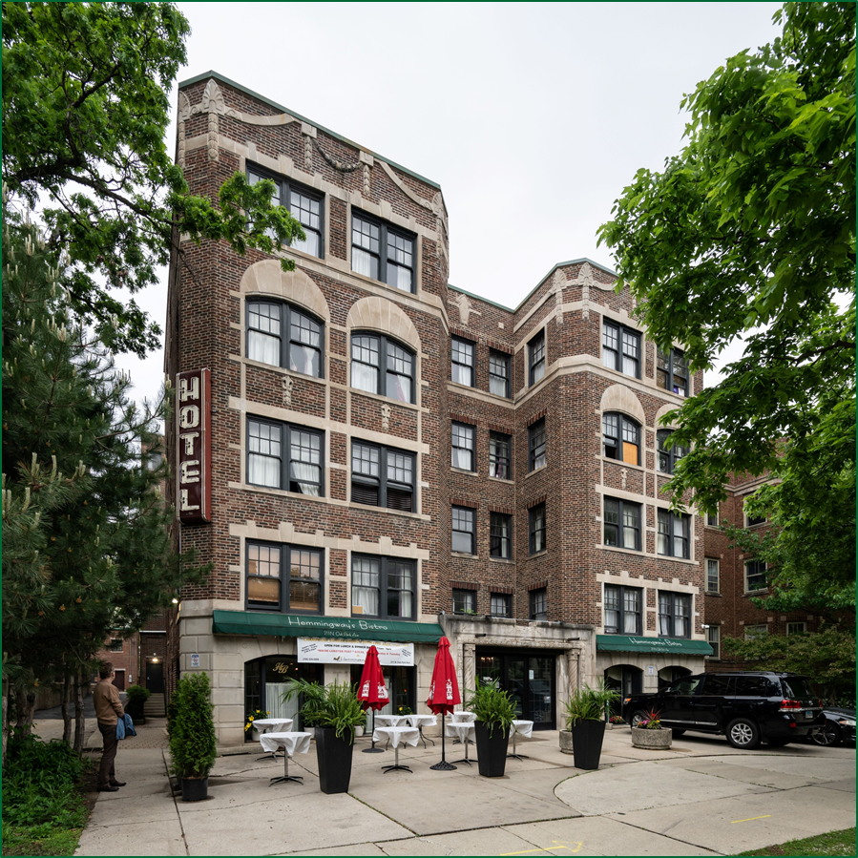

Interim Housing
Notes:
In 2023, our community partner Housing Forward made a significant investment in long-term solutions by purchasing the Write Inn, a local hotel in Oak Park that had already served as a successful interim housing site throughout the pandemic.
This acquisition was made possible through a $6.5 million allocation of American Rescue Plan Act (ARPA) funds, and it marked a pivotal shift from temporary hotel shelter to a permanent fixed-site interim housing model.
The total renovation costs were estimated at $9.7 million. The Village of Oak Park stepped in to support this effort by:
Contributing $1 million in funds,
Writing and administering a CDBG-CV grant that secured an additional $2 million,
And working with Housing Forward to leverage these combined public investments to secure the remaining $6 million in needed funding.
The redesigned Write Inn will offer 56 private rooms for individuals and families experiencing homelessness. This model provides short-term, dignified accommodations alongside structured programming focused on transitioning clients into permanent housing.
Key components include:
Wraparound services, such as case management, income supports, and housing navigation;
On-site health assessments and behavioral health services; and
A dedicated space for recuperative/respite care, offering a safe and stable environment for those recovering from medical or behavioral health episodes.
What’s exciting is that this model doesn’t just address immediate shelter — it builds a bridge to long-term housing stability, using coordinated care and community partnership as its foundation.

Slide 6
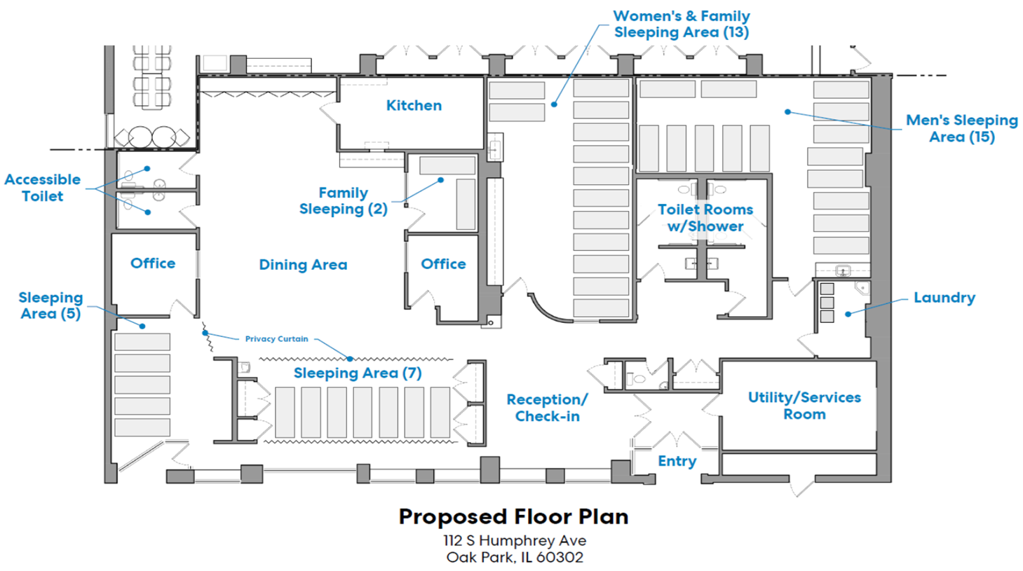
Congregate Shelter
Notes:
The Village of Oak Park has prioritized strong, ongoing partnerships with community-based organizations like Housing Forward. Our progress addressing homelessness in the region would not be possible without these trusted relationships.
Over the past three years, we've seen a noticeable increase in encampments throughout the community. In each case, the Village has worked closely with Housing Forward to quickly connect individuals to hotel vouchers and housing resources, helping reduce visible homelessness in a coordinated, compassionate way. One theme we consistently heard from people in encampments was: "This place feels safer, more stable, and it's close to the train line."
Oak Park’s accessibility, safety, and perceived welcoming environment have contributed to the growth of visible homelessness — but also underscore a broader regional gap in shelter options.
Neighboring communities, located between 7 to 40 miles away, operate shelters that are frequently at capacity. Within Housing Forward’s 26-community service area, Oak Park is the only municipality operating a congregate shelter.
For the past 2.5 years, Housing Forward has operated a 20-bed shelter at the St. Catherine–St. Lucy site, which has remained at full capacity every single night.
To address this urgent need, the Village led a collaborative effort to identify and repurpose an underutilized community facility owned by the Oak Park Housing Authority.
We:
Identified fire/life safety concerns and addressed code compliance needs,
Submitted and secured zoning changes to allow for shelter use, and
Secured $250,000 from the Cook County HOME Office to support rehabilitation.
The result is a new 4,500 square-foot shelter facility that will open with 45 beds, more than doubling local shelter capacity.
Key features of the new shelter:
5 bathrooms, 2 showers, 3 semi-private sleeping areas
Congregate dining space and commercial kitchen
Proximity to public transit (CTA Green Line, PACE & bus routes)
Year-round operations: Open 365 days/year, from 5:00 p.m. to 9:00 a.m. – which is essential to a late exit as individuals share they didn’t have another community space to visit when typically exiting at 6am
This expansion represents a strategic and community-driven solution — one that not only meets immediate needs, but also demonstrates how local governments can help fill critical regional service gaps.

Slide 7
E.C.H.O. –
Engaging Community For Healthy Outcomes
Notes:
The E.C.H.O. program—Engaging Community for Healthy Outcomes—is the Village of Oak Park’s Alternative Response to Calls for Service Program. It was developed in direct response to:
The Village Manager’s Mental Health Taskforce recommendations, (comprised of key stakeholders that live, work, and serve in the community)
The passage of the Community Emergency Services and Support Act (CESSA) in 2021, and
Findings from the BerryDunn report, which assessed local public safety operations and recommended innovative approaches to low-risk, non-emergency calls.
This initiative was community-driven, shaped by years of local advocacy, and is fully aligned with state legislation and national best practices in crisis response.
At its core, E.C.H.O. is about reimagining public safety—shifting from a one-size-fits-all emergency response model to a multidisciplinary, person-centered approach focused on community wellness.
Program Goals:
Enhance community safety and well-being.
Deliver compassionate, non-police responses to non-emergency, low-risk 911 calls.
Connect residents with social services and behavioral health supports—not citations or custody.
Support unhoused residents to better access housing, shelter, and alternative resources
Key Features of E.C.H.O.:
Specialized Response Teams that respond to:
Mental health concerns,
Calls involving individuals experiencing homelessness,
Low-risk behavioral health events, and
Traumatic community incidents.
Community Care Navigation, a cornerstone of the program, ensures:
Follow-up care after a 911 call or service interaction,
Connection to housing, mental health, substance use, and other vital resources, and
Ongoing case management, when needed, by trained care coordinators embedded within the Village.
E.C.H.O. represents Oak Park’s commitment to collaborative public safety, working hand-in-hand with public health agencies, first responders, and community-based partners to better meet the diverse and evolving needs of our neighbors. Here is a short video clip regarding part of the team.

Slide 8
100 – Day Challenge
Notes:
In 2024, the Village of Oak Park joined a regional cohort for the 100-Day Challenge, a nationally recognized initiative designed to accelerate progress on urgent issues—in this case, unsheltered homelessness.
The Challenge was facilitated by RE!NSTITUTE, an international nonprofit with a proven model for collaborative systems transformation. Their work centers on aligning local systems and stakeholders to achieve ambitious, time-bound goals that drive long-term change.
Suburban Cook County was one of five Illinois cohorts selected to participate. Over the course of 100 days, our cross-sector team committed to:
Housing 88 individuals experiencing unsheltered homelessness,
With a goal that 30% of those housed would be adults age 55 and older.
Our team included:
Frontline staff from homeless outreach, housing navigation, and shelter programs,
Local government and health agency representatives, and
Individuals with lived experience of homelessness, whose insights were critical in shaping our strategy.
Success in this challenge required us to strengthen coordination between every part of the housing response system from street outreach and case management to landlords and housing providers.
Innovative Strategy: Accelerated Moving Events
One of the core strategies we implemented was a series of Accelerated Moving Events:
These were community-based gatherings that brought together landlords with available units and households actively searching for housing.
Events served as a matchmaking platform—reducing delays, demystifying voucher processes, and highlighting the benefits of landlord participation in local housing programs.
Results:
We not only met our goal—we exceeded it:
123 individuals were successfully housed.
333 individuals were connected to emergency shelter and temporary housing.
30% of those housed were age 55 or older, achieving our equity goal for older adults.
This challenge reaffirmed that when systems align around shared goals, with a deep commitment to innovation and inclusion, real progress is not only possible it’s scalable. However, we did also experience a lot of stigma from landlords and limitations for housing availability.

Slide 9

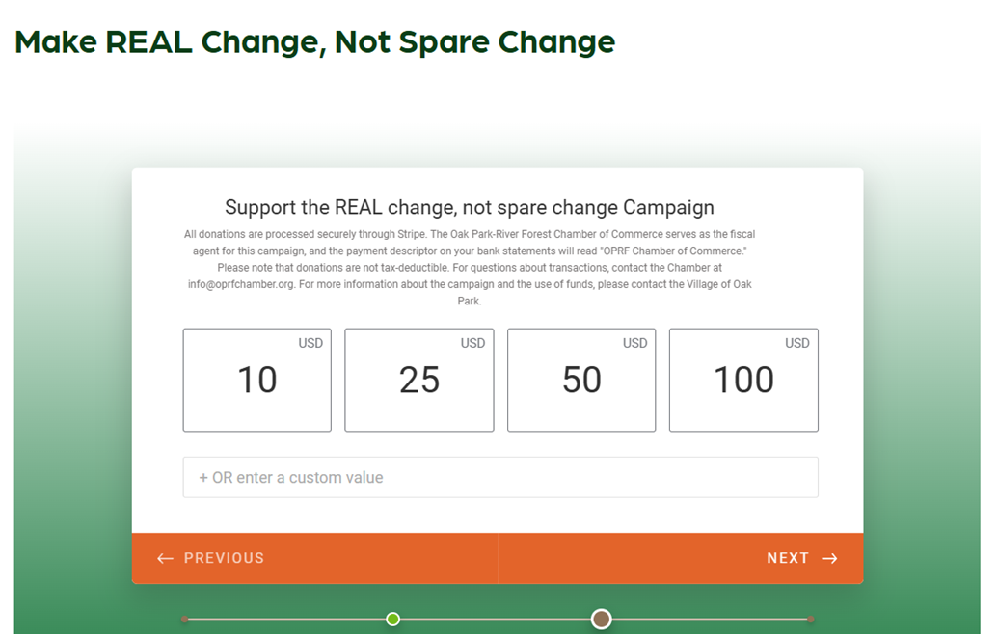
“Make REAL Change, Not Spare Change” Campaign
Notes:
In response to community concerns around panhandling, public safety, and business impact, while staying committed to supporting those who are truly in need, the Village of Oak Park launched a new public education and engagement campaign called “Make REAL Change, Not Spare Change.” The goal of this initiative is not to criminalize poverty, but rather to educate the public on the distinctions between homelessness, panhandling, and solicitation, and to encourage long-term, sustainable solutions over short-term giving.
Campaign Objectives:
Educate the Public:
Through signage, local media, and community forums, we’re informing residents that homelessness and panhandling are not the same. We share the root causes of homelessness and emphasize how directing support to service providers—rather than individuals—can have a greater, more lasting impact.
Promote Long-Term Solutions:
The campaign encourages the public to redirect financial generosity into community-based programs that address housing instability, mental health, job training, and food security. This also helps reduce visible panhandling by providing alternative ways for the public to contribute meaningfully.
Support Local Business:
We’ve heard directly from businesses that panhandling and unauthorized solicitation—especially in front of storefronts—creates discomfort for customers and staff. By providing them tools and messaging through this campaign, we’re aiming to preserve Oak Park’s welcoming atmosphere while still showing compassion and leadership on this issue.
Improve Public Safety and Perception:
The campaign is also about shifting public perception—moving away from fear or avoidance and toward community-based solutions. At the same time, we remind the public it is appropriate to call 911 or request E.C.H.O. support when safety concerns arise or when someone appears to need services.
How It Works: The Village partnered with the Oak Park-River Forest Chamber of Commerce to serve as fiscal agent for community donations. Contributions to the campaign are managed by the Village and distributed through our partner Housing Forward in the form of:
Hotel vouchers ($75 value)
Food gift cards ($50 value)
These supports are provided directly to unhoused individuals identified through our outreach teams.
Clarifying Legal Distinctions:
As part of this initiative, we’re also educating the public on the difference between panhandling (which is legal) and soliciting without a permit (which is not):
Panhandling:
Legal but discouraged via direct giving.
Residents are encouraged to refer individuals to Housing Forward or E.C.H.O.
If the behavior becomes aggressive or involves roadways, residents should contact the appropriate response line, including police non-emergency or E.C.H.O.
Soliciting without a permit:
Violates Village code.
Businesses or residents can report these instances. Initial encounters typically involve education and a warning.
Overall, this campaign is one part of a broader strategy to balance compassion with public safety, support our community partners, and build a more informed and engaged public. We believe that real change comes from systems that work together—and that includes residents, local businesses, government, and service providers.

Slide 10
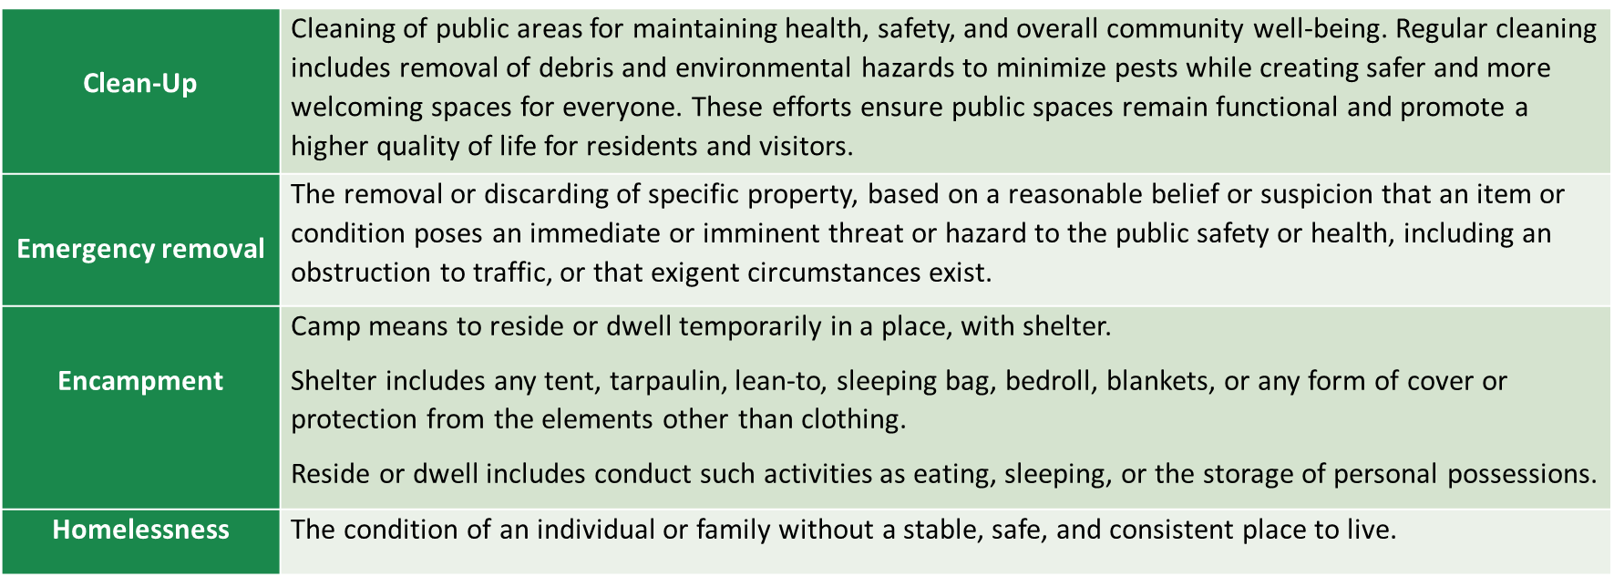
Village Protocols & Homeless Bill of Rights
The Village of Oak Park (Village) is committed to upholding the rights and dignity of all residents, including those experiencing homelessness. This policy establishes a process for addressing homelessness-related issues while respecting an individual’s rights and dignity in keeping with the State of Illinois Bill of Rights for the Homeless (775 ILCS 45/).
Notes:
As I close, I want to highlight how the Village is working to balance public health and safety protocols with our commitment to human dignity and rights. Recently, we implemented new internal procedures to proactively manage public spaces where encampments may occur. These new protocols were developed in collaboration with our Public Works, Legal, Development Customer Services, and Police Departments and are rooted in transparency, accountability, and respect.
What the Protocol Looks Like:
On a weekly basis, Village staff survey areas where encampments have previously formed or may form.
If a location is identified as a potential encampment site, a notice is posted, and the observation is reported back to internal partners including outreach and housing teams.
A seven-day window is given before returning to the site to assess whether any belongings remain. At that point, items may be removed as part of public space maintenance but only after outreach efforts have been attempted.
These protocols are not about punishment or removal they are about balancing the needs of residents, businesses, and unhoused individuals while keeping public spaces clean, accessible, and safe for everyone.
Recognizing the Homeless Bill of Rights - Importantly, all of this work is done through the lens of the Illinois Homeless Bill of Rights, which asserts that individuals experiencing homelessness:
Have the right to use public spaces without discrimination,
Cannot be denied services due to housing status,
And deserve to be treated with respect, dignity, and fairness.
We recognize that homelessness is not a crime—and our efforts are focused on connecting people to resources, not pushing them further into the margins.
These protocols reflect the Village’s values: we are listening to the community, coordinating across departments, and ensuring that our responses are compassionate, measured, and grounded in human rights.

Slide 11
Key Takeaways & Lessons Learned
Partnerships are essential
Funding flexibility matters
System transformation takes time and trust
Data tells the story
Notes:
Partnerships are essential – No single agency or department can do this work alone. Our success is rooted in collaborative partnerships across sectors.
Funding flexibility matters – The ability to leverage ARPA, HOME, ESG, and CDBG-CV dollars has allowed us to respond with agility and creativity.
System transformation takes time and trust – Programs like E.C.H.O. and the hotel conversion didn’t happen overnight. They required years of groundwork, community engagement, and the political will to try something different.
Data tells the story – PIT counts, outreach metrics, and system-wide data helped us understand emerging trends and tailor interventions quickly.
Our work is far from finished. Looking ahead, the Village of Oak Park is:
Exploring permanent supportive housing models as part of our long-term housing strategy.
Continuing to strengthen the E.C.H.O. response team with additional training, coordination, and expanded service hours.
Monitoring policy updates at the state and federal level to align with new guidance and funding opportunities.
Deepening community education efforts tied to the Make REAL Change campaign.

Slide 12
Questions?
Vanessa Matheny, MSW
vmatheny@oak-park.us
708-358-5416

