Slide 1
MOTEL 8 ACQUISITION AND CONVERSION PROJECT
The Haven on Vine

Slide 2
About the City of Kissimmee
Located in Central Florida just south of Orlando.
County seat for Osceola County
It’s defined by its proximity to the region’s multitude of amusement parks, including the massive Walt Disney World complex.
Kissimmee’s average per capita income is $32,332. The poverty rate stands at 23.73%.

Slide 3
State of Homelessness in Kissimmee
The Florida Project
Continue to attract new residents
Growth = Increase in needs especially affordable housing
Challenges to getting families into permanent housing

Slide 4
State of Homelessness in Kissimmee
City of Kissimmee is a participant of the Central Florida Commission on Homeless (CoC)
In 2024, the Point In Count found a 28% increase in the number of those experiencing homelessness in our region.
Osceola County saw an increase of 8.7% over last year (373 sheltered/unsheltered)
There is no emergency shelter in Osceola County

Slide 5
House Bill 1365
Enacted in 2024
Prohibits camping or sleeping on public property, at public buildings, or on public rights-of-way, and makes it illegal for local governments to permit it.
Kissimmee approved the No-camping Ordinance to comply with the law.
The City has a protocol in place to help the homeless with the aid that they need at the moment:
Community Engagement Team
Partnership with Park Place Behavioral Care
Other partnerships with various homeless organizations that will provide case management
Haven on Vine Campus

Slide 6
Haven on Vine Site Layout

Slide 7
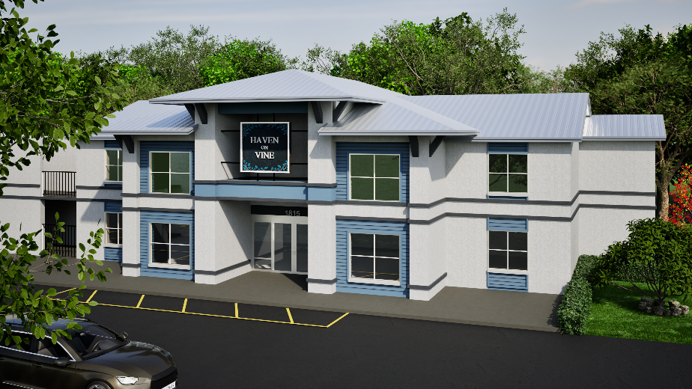
Description
Acquisition of 43 hotel rooms and conversion to studios.
Acquisition and rehabilitation of 40 apartment units located on the same property.
Acquisition and conversion of 40 units into a non-congregate shelter facility for unsheltered individuals and families in a 24/7/365 non-congregate setting for as long as is necessary to end/respond to their homelessness (bridge/transitional housing).

Slide 8
Hotel Units

Slide 9
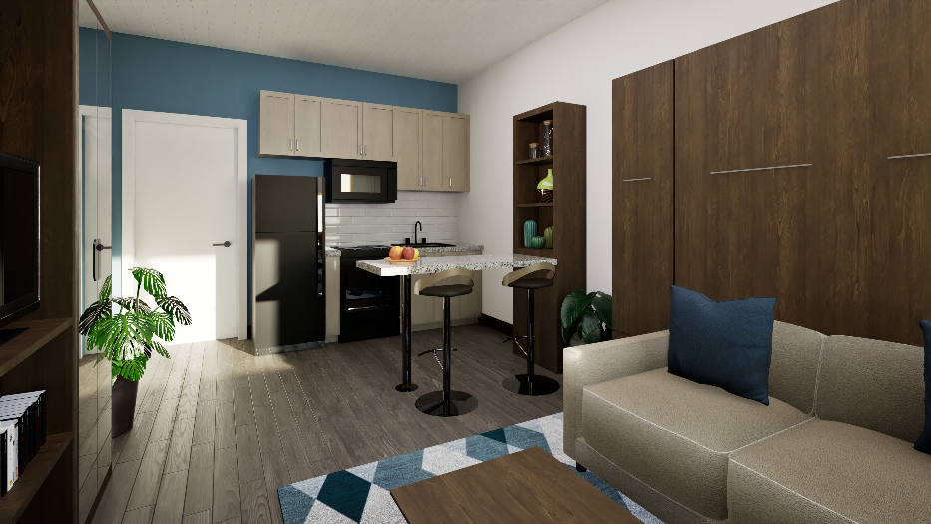
Hotel Units

Slide 10
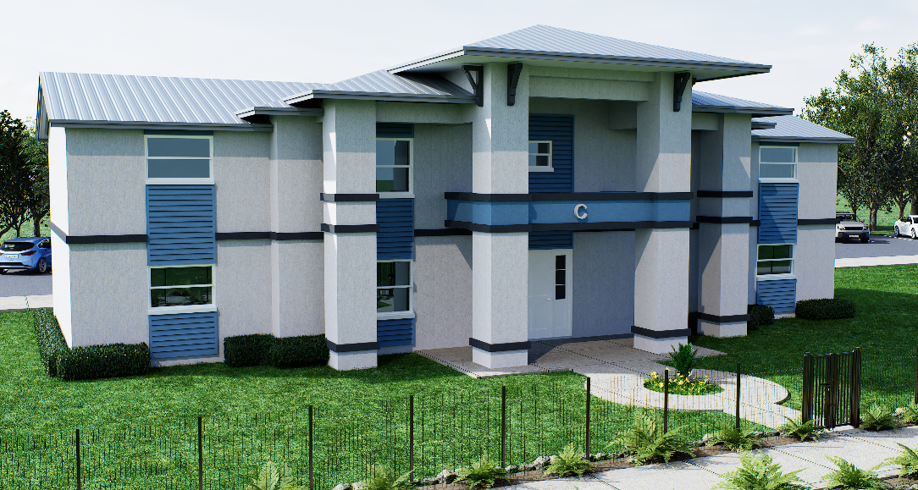
Hotel/Apartments

Slide 11
Apartments

Slide 12
Bridge/Temporary Housing
This Bridge Housing program will provide a housing solution aimed to quickly bring homeless individuals off the street and help them rebuild their lives by providing on-site:
Temporary Housing
Support Services

Slide 13
Funding Sources
Acquisition
American Rescue Plan Act (ARPF)
CDBG
HOME
CDBG-CV (1&3)
Osceola County
Rehabilitation
Community Project Funding (CPF)
CDBG
HOME
HOME-ARP

Slide 14
Income Set Asides/Rents
Number of Units | Type of Unit | Proposed Income Set Asides | Proposed Rent
15 | Studio | 50% | $768
28 | Studio | 60% | $900
10 | 2 Bedroom Apartment | 50% | $988
20 | 2 Bedroom Apartment | 60% | $1,262
10 | 2 Bedroom Apartment | 80% | $1,580
83

Slide 15
Program Requirements
Environmental Review
Uniform Relocation Act (URA)
Property Inspections
Lead Based Paint
Section 3
Davis Bacon
Program Income
Land Use Covenants
Agreements
Fair Housing
Violence Against Women Act (VAWA)
Build America, Buy America (BABA)

Slide 16
Additional services
Eviction Prevention Programs
One time payment of arrears
Payment Plan
Housing Stability and Hardship Assistance
Employment Assistance
Education
Employment training and referral
Financial Literacy
Budgeting
Pre-purchase Assistance

Slide 17
Contact Information
Frances De Jesus
Housing and Community Development Manager
(407) 518-2156
Frances.dejesus@Kissimmee.gov

