Slide 1
Management Roles & Responsibilities – Training & Development
NCDA Annual Conference 2025
Nicole Wyse, Chief Operations Officer
Housing and Revitalization Department

Slide 2
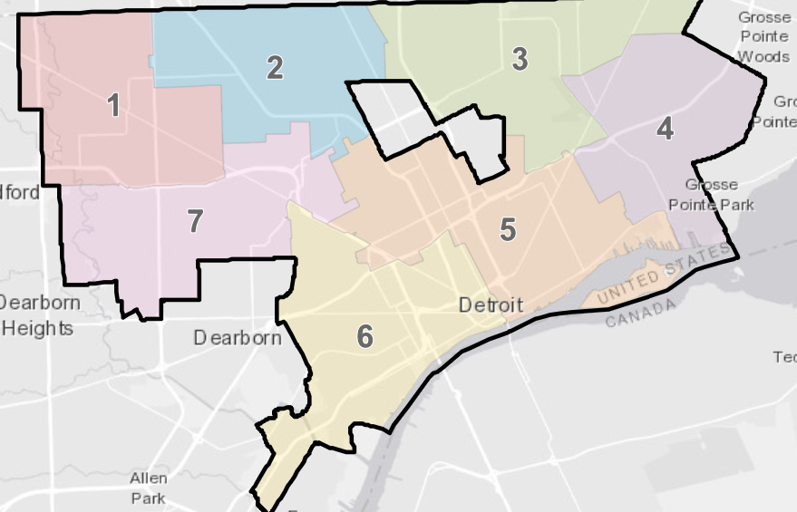
Background – City of Detroit
Largest City in Michigan
Pop 639,111 (2020 Census)
139 Sq. Miles
HUD Large Entitlement
$32M CDBG, $6M HOME, $2.8M ESG, $3.5M HOPWA
$442M CDBG-DR across two disasters
CHOICE, Lead, Healthy Homes, PRO Housing
Housing and Revitalization Department
Created 2015
Administers of all HUD funding received by City of Detroit
300+ employees (doubled since 2020)

Slide 3
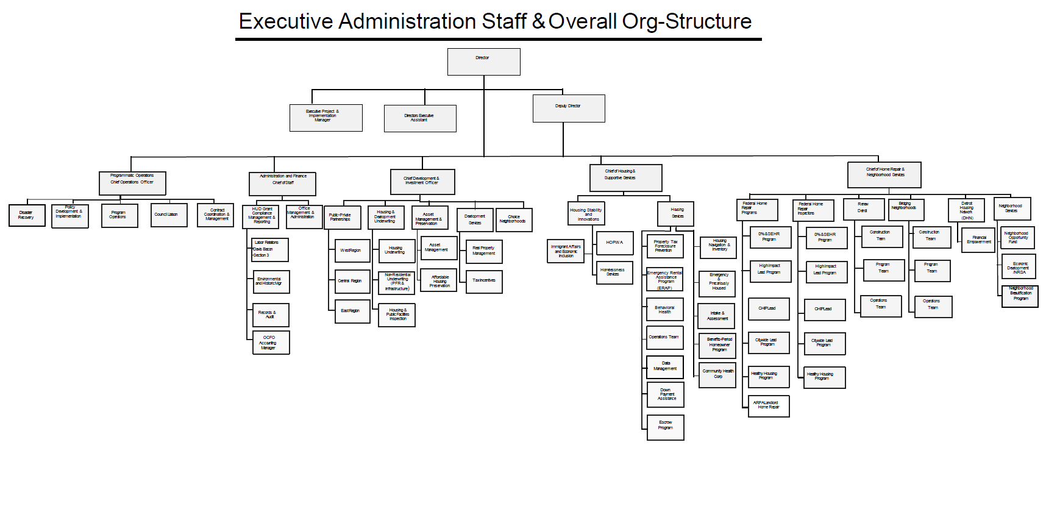

Slide 4
Why Training and Development?
Fosters a culture of continuous learning
Improves employee performance and productivity
Reduces error in work – regulations, policies and procedures change all the time

Slide 5
Analysis of Training Needs
Multiple Divisions/Teams
Who needs what?
What applies to everyone?
Partners
Other Departments (i.e. procurement)
Subrecipients
Developers
Types of Training
Organizational Goals & Strategies
What skills are needed to achieve this?
SME – HOME, CDBG, 2 CFR 200 etc.
Resources needed
Budget
Tools

Slide 6
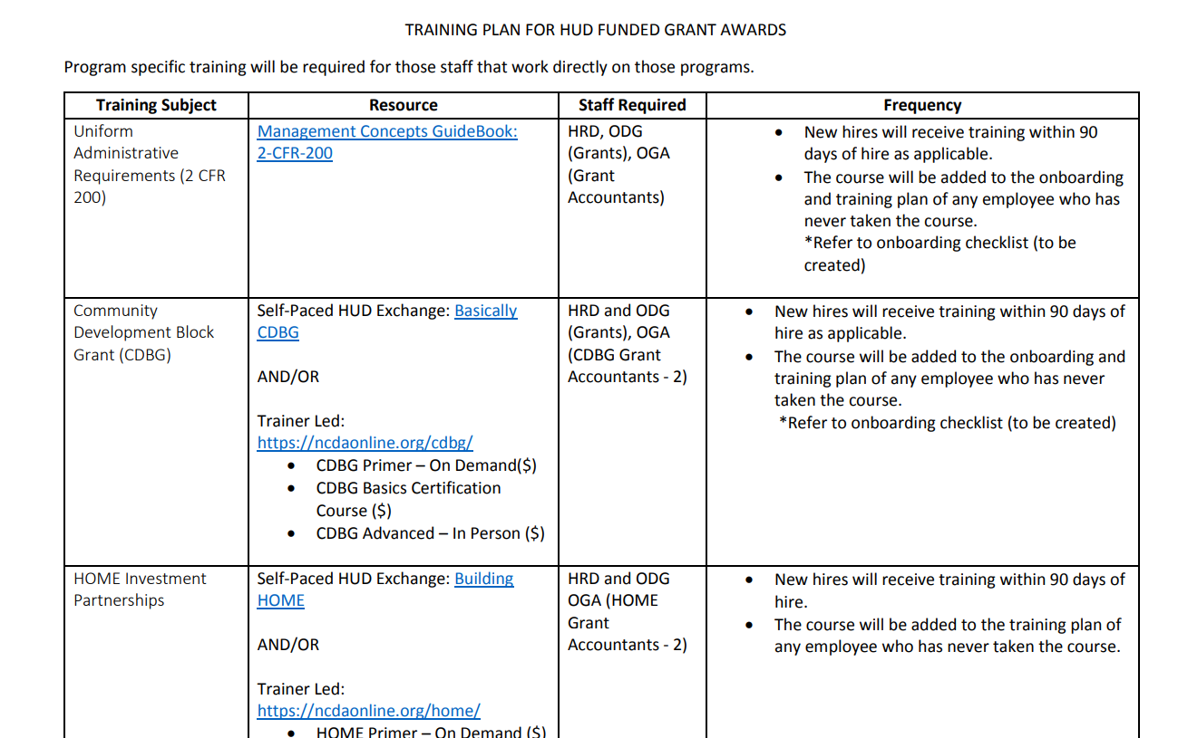
Developing a Training Plan
Who needs to attend? How Often?
How will it be delivered?
Self Paced, Virtual, In Person
Consider understanding employee preferences in order to provide the best method
Who will deliver it?
HR, SME, Internal/External?
Budget?
Optimize your training investments
Free – (i.e. HUD Exchange)
Training Organizations (i.e. NCDA)
Procurement of SME’s

Slide 7
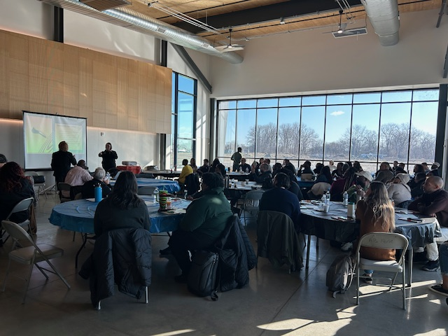
Don’t Forget about Professional Development!
Manager Training
Leadership Training
Succession Planning
Conferences
i.e. HRD Manager Retreat 2025
Two full day sessions
HR collaboration
Topics included - Multi-generational leadership, emotional intelligence, building high performing teams

Slide 8
HRD Annual Self Assessment and Training Plan for HUD Funded Programs
HRD will perform an Annual and Ongoing Self-Assessment to identify potential service, compliance and training gaps in the administration and oversight of its HUD funded programs.
In addition, it will allow HRD to highlight achievements throughout the program year and assess effective outcomes.
An assessment of strengths, weaknesses, opportunities, and threats/growth (SWOT Analysis) will be used to adjust the City’s HUD program policies, procedures, program implementation and training of staff as necessary.

Slide 9
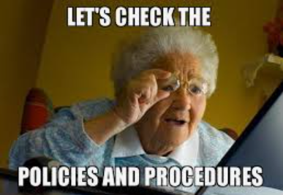
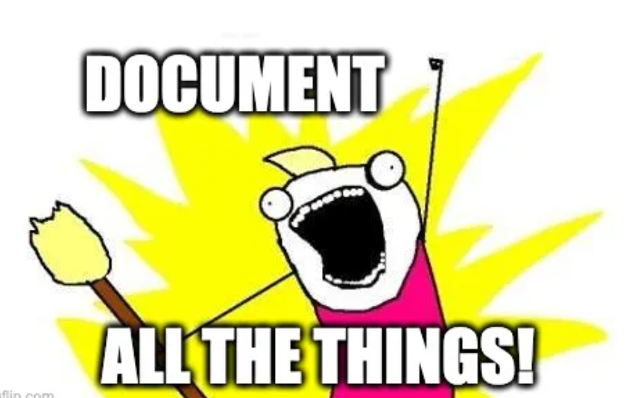
Training isn’t enough – Time for P&P’s!

Slide 10
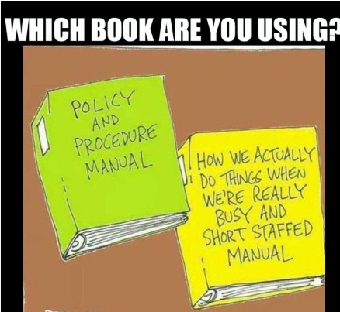
Policies and Procedures
Having updated and effective P&P’s, and training your staff regularly on them, is important to the administration of your programs and the development of your staff.
Policies and procedures are necessary for a number of reasons:
To provide clarity on expectations/requirements
To streamline internal processes
To provide consistency
To ensure compliance with laws/regulations

Slide 11
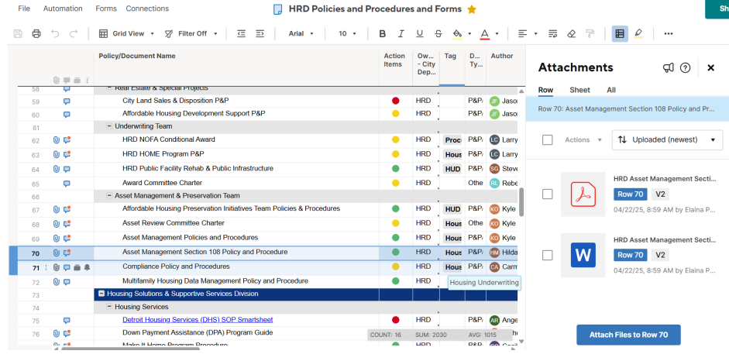
Policies and Procedure Management
Policies and Procedures to the Policies and Procedures (PPOPS)
P&P Management Plan
P&P Template
P&P Administrator & Committee
P&P Storage

Slide 12
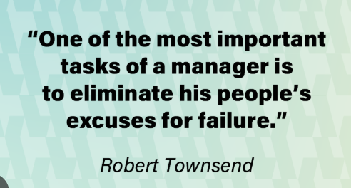
Conclusion
As a manager, it is your responsibility to ensure the overall training and development for your teams
When you invest in the growth of your team, you empower them to overcome challenges and achieve goals
Proper training and development, along with access to resources and tools, provides a clear roadmap to success for your employees.

Slide 13
Nicole Wyse, Chief Operations Officer
City of Detroit, Michigan
Housing and Revitalization Department
roddenbowenn@detroitmi.gov

