Slide 1
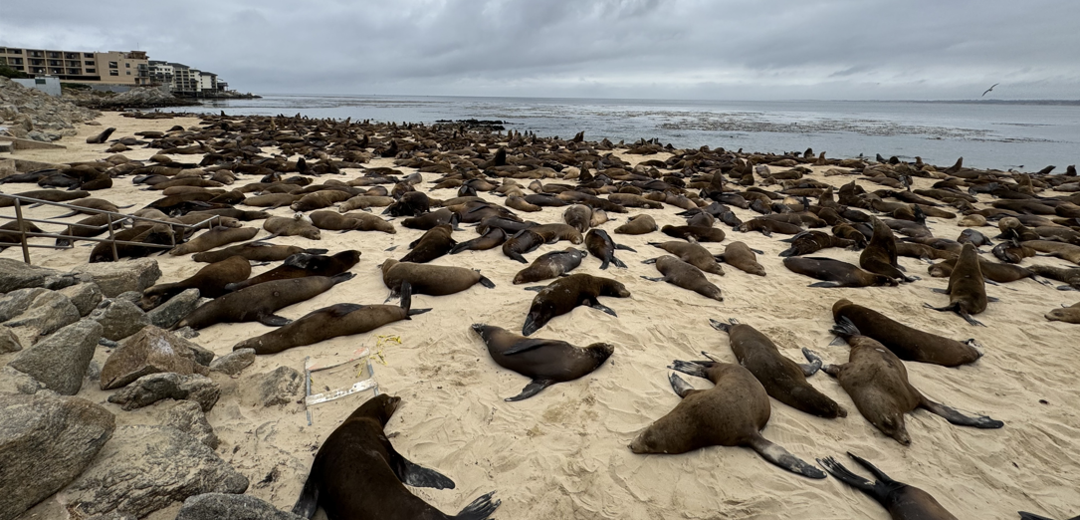
City of Monterey NCDA Management Roles and Responsibilities Thursday, June 12, 2025
San Carlos Beach/Sea Lion Invasion 2024

Slide 2
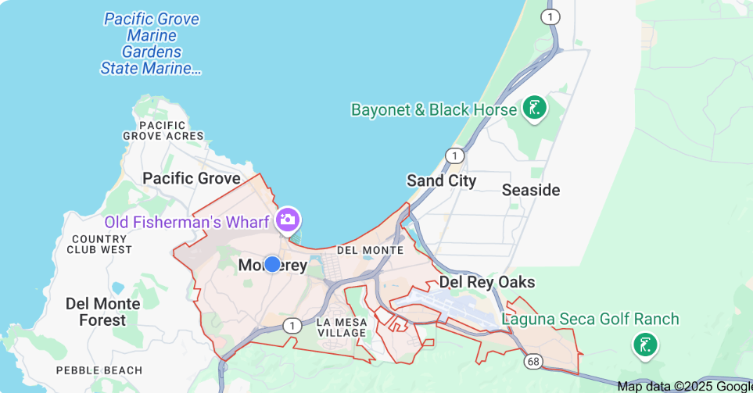
Monterey is a coastal community
Approximately 29,000 residents
8.67 square miles of land
29 miles north of Big Sur and 115 miles south of San Francisco
Third most populous jurisdiction in Monterey County behind Salinas and Seaside

Slide 3
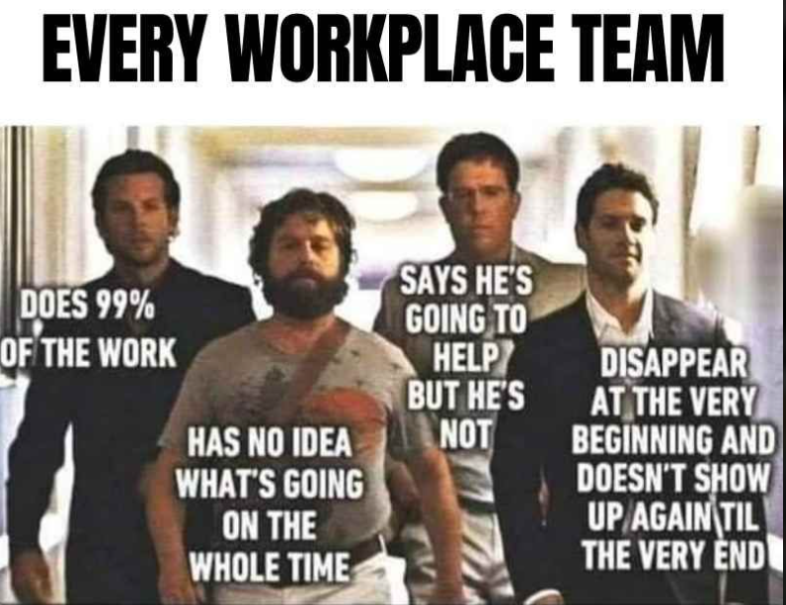

Slide 4
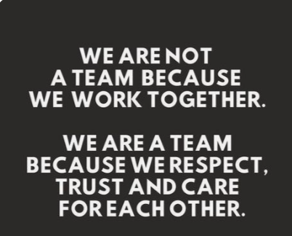

Slide 6
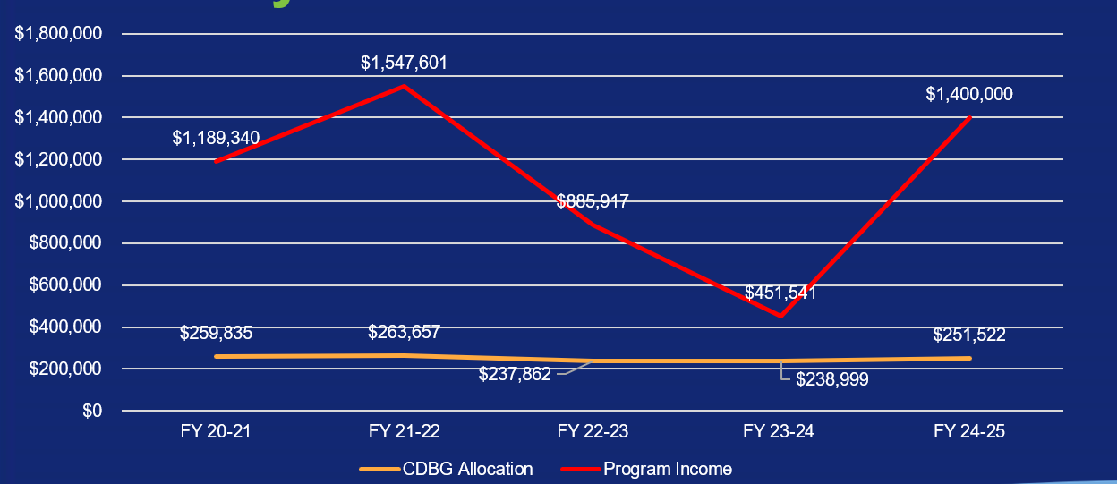
Monterey CDBG Allocations

Slide 7
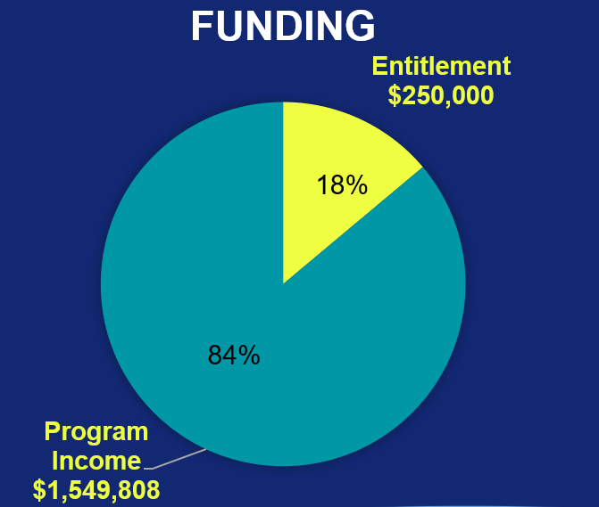
CDBG Action Plan Priorities

Slide 8
Priority Needs Five Year Consolidated Plan
Provide public services benefitting all City residents, specifically low- to moderate-income households and special needs populations, including the homeless;
Expand and improve affordable housing opportunities, including both rental and ownership housing ;
Improve public facilities and Infrastructure, particularly in low- to moderate-income communities;
Provide optimal program administration and oversight of the CDBG program.

Slide 9
CDBG Allocation & Expenditures

Slide 12
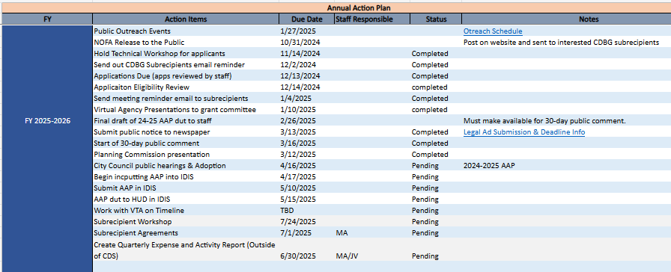

Slide 13
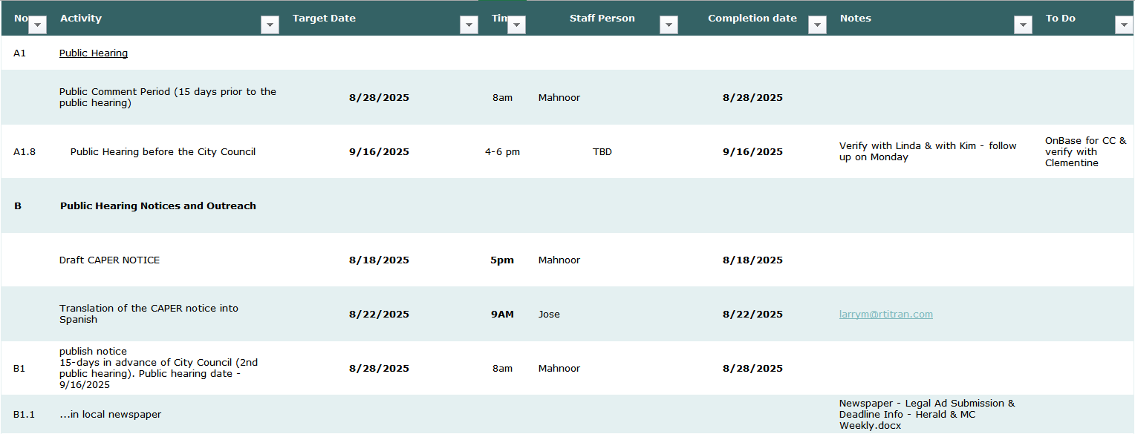

Slide 14
Have FUN and Celebrate Wins

Slide 16
City of Monterey
Anastacia Wyatt, Housing Manager
wyatt@monterey.gov
831-646-5614

