Slide 1
MANAGEMENT & COMMUNICATION
June 2025 NCDA Conference

Slide 2
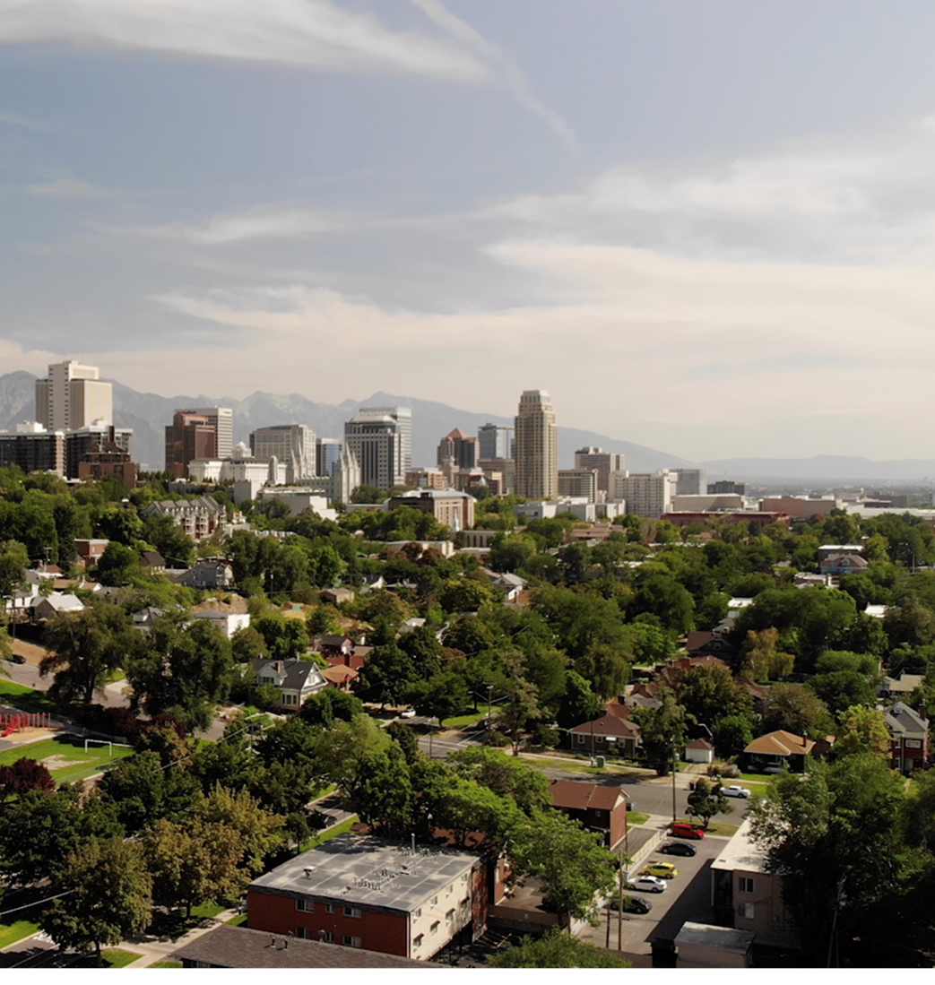
SALT LAKE CITY
Population | 209,592
Metro Population | 1,257,936
Our Team
Housing Stability Division | 33 staff
Community Development Team | 8 staff
HUD Funding (2025)
CDBG - $4.8M
HOME - $1.6M
HOPWA - $972K
ESG - $293K
City Funding (2025)
FOF - $2.6M
General Fund - $3.8M

Slide 3
How do you communicate with your team in
times of uncertainty?

Slide 4
SOURCES OF UNCERTAINTY
Organizational Changes
• New Policy
• New Software
• Restructuring
Office Politics
• Team
• Department
• Interdepartmental
External Politics
• Local
• State
• Federal
Emergencies
• Pandemic
• Natural Disaster
• Recession

Slide 5
BUILD A BUBBLE OF CERTAINTY
Build a Vision
Respond Strategically
Be Good with
Bad News
Follow Through

Slide 6
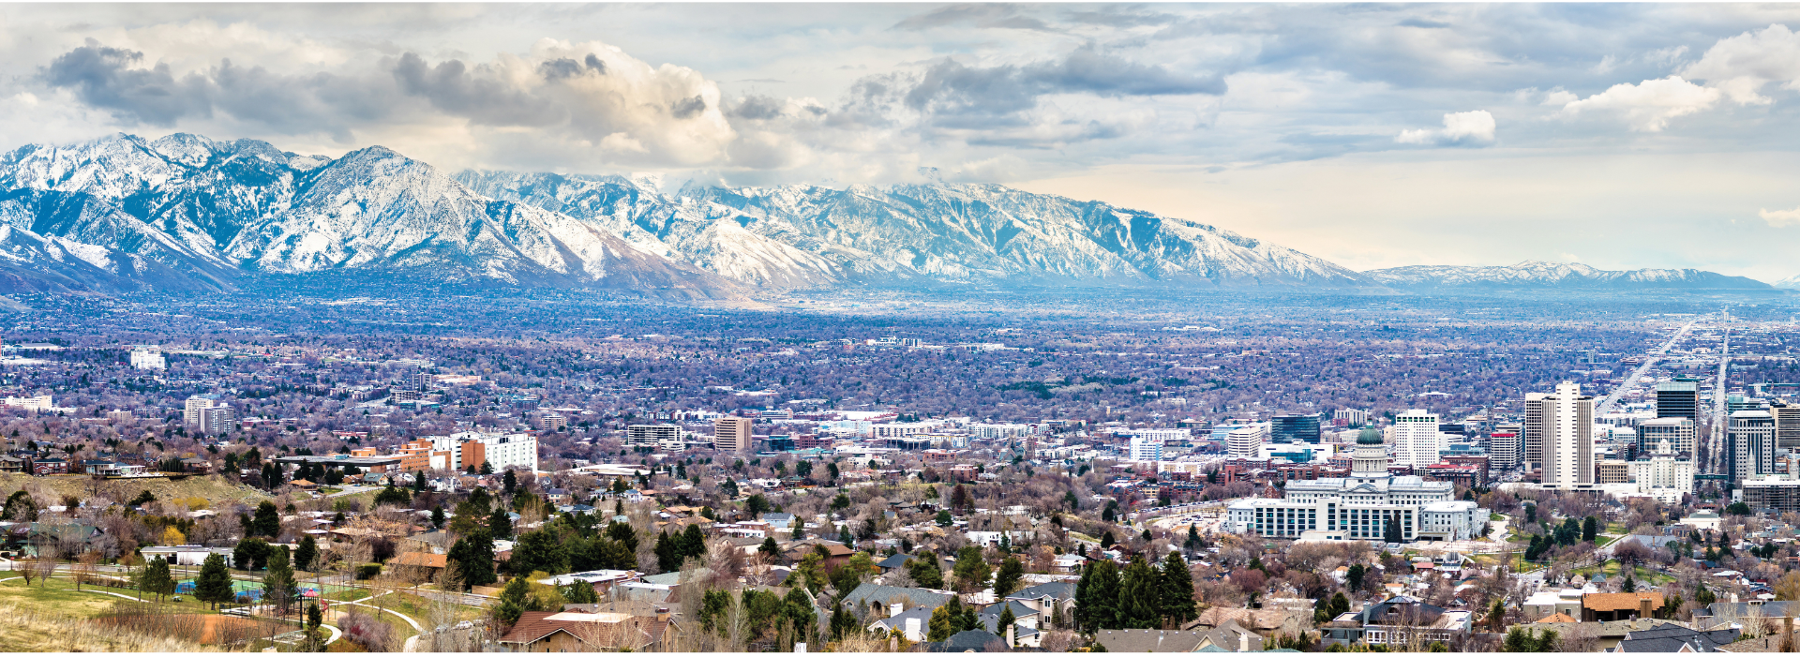
BUILD A VISION

Slide 7
FIND THE WHY
What Motivates Each Team Member?
Financial stability
Promotions
Assignments
Respect
Recognition
Team relationships
Professional pride
Public service
Create a Vision, Mission, and Objectives

Slide 8
RESPOND STRATEGICALLY

Slide 9
STAY INFORMED
Intentionally Seek Information
Community concerns
Team concerns
Subject matter experts
Professional networks
National organizations
News from a range of perspectives
Academic research
Official documents

Slide 10
SHARE v. SHIELD
Share With Your Team
Things that directly impact their job
Things they will need to do
Major changes
Shield Your Team From
Gossip
Wild speculation
Ongoing, minor changes
Undermining leaders or team members

Slide 11
BE GOOD WITH BAD NEWS

Slide 12
TIME IT RIGHT
Don’t Wait
Bad news ages like milk, not wine
Respect the Weekend
Give good news on Fridays
Give bad news on Mondays
Respect Your Team’s Time
Several short meetings?
One long work session?
End meetings early

Slide 13
PREP THE SPACE
Pick the Right Medium
Text/email for brief communication
Call/video for longer conversations
In-person for serious problems
Stage the Space
Print an agenda
Arrange the chairs
Dust the furniture
Open the window blinds
Turn your camera on (if virtual)

Slide 14
DON’T LIE
Be Honest and Direct
Don’t promise things you can’t deliver on
If you don’t know, say you don’t know
If you can’t say, say you can’t say
Don’t use 10 words, when 1 word will do

Slide 15
Our funding was cut.
vs.
Unfortunately, due to a range of macroeconomic forces and political machinations, the range of funding sources we depended on have been, at this time, put in jeopardy of being eliminated.

Slide 16
LISTEN, ACT
Give Them Space
Block out time for questions
Let your team adjust to the news
Follow up individually a day or two later
Don’t Exaggerate
Don’t oversell the problem
When people are upset, excessive optimism is usually more annoying than helpful
Focus on the Solution
Direct energy and focus on practical tasks

Slide 17
FOLLOW THROUGH

Slide 18
PREPARE A PLAN
Understand Your Role
What must be implemented?
Where do you have discretion?
Outline a Strategy
It’s easier to react to something that already exists
Don’t Poison the Well
Ask the team their opinion before you share
Never punish the team for sharing ideas

Slide 19
GET FEEDBACK
Don’t Ask for Feedback…
…if there’s no chance of it being implemented
What can you control? Seek feedback on that
Facilitate Constructive Disagreement
Get in the mindset to be open to feedback
Walk your team through the process
Push back on all ideas, especially your own
Ask why this idea is incomplete
Ask how it can go wrong
You Decide Which Ideas to Implement

Slide 20
GET IT DONE
Maintain Standards
Address problems early on
Use the minimum force necessary to restore standards
How Do You Know if it’s Working?
Use quantitative and qualitative measures
Assign deadlines and adjust as needed
You Can Change Your Mind
Check in on team’s tone, morale, and workload
Seek iterative rounds of feedback

Slide 21
FIND THE VISION
Remind Your Team Why They’re Here
Refocus on the vision, mission, and objectives
Model grounded optimism
Remind them of the strategic picture—Why we do what we do?

Slide 22
Person X may be doing Bad Thing Y, but we will continue to maintain high standards of public service and transparency.

Slide 23
TAKEAWAYS

Slide 24
BUILD A BUBBLE OF CERTAINTY
Build a Vision
Respond Strategically
Be Good with
Bad News
Follow Through

Slide 25
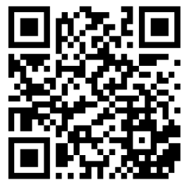
TYLER DURFEE
Policy & Program Manager
tyler.durfee@slc.gov
Salt Lake City
Housing Stability Division
www.slc.gov/housingstability/data/
SCAN ME
JUNE 2025 NCDA CONFERENCE

