Slide 1
Resident Engagement Best Practices
June 2025
Presented by: Phil Keeve
West Valley City, UT

Slide 2
How We Approach Our Community
Openness and event awareness
Direct community engagement
Harnessing partner resources
Survey says…
Always ask…

Slide 3
A little about West Valley City…
Around 140,000 residents; until recently, majority-minority and over 51% LMI
Historically 4 disparate unincorporated areas
Little community trust in government resources

Slide 4
Openness and Event Awareness
Those required by laws and codes
Tried and true methods
Utilizing technology
Precision and breadth alleviates tension
Notes:
Utilizing technology can include things like QR codes which enable event-goers to jump on your website, application, etc. Finding ways to be clear about what you are doing can reduce confusion; broadening the message and outreach ensures more people are heard.

Slide 5
Direct Community Engagement
Events, events, events
City resources for use, including:
Mailers
Flyers
Social media
Other facilities
Notes:
Such events can be officially put on by your governing municipality or other interest groups in the community, such as churches and schools. They love having a presence from city government because it helps them to better serve their constituencies as well. It’s quite cyclical.

Slide 6
Harnessing Partner Resources
Who else operates in your community?
My Hometown Initiative
Boots on the ground
Share information
Develop trust
Schools
Understanding community needs of many vulnerable residents
Share information
Affiliated government entities: joint SLCo Housing survey

Slide 7
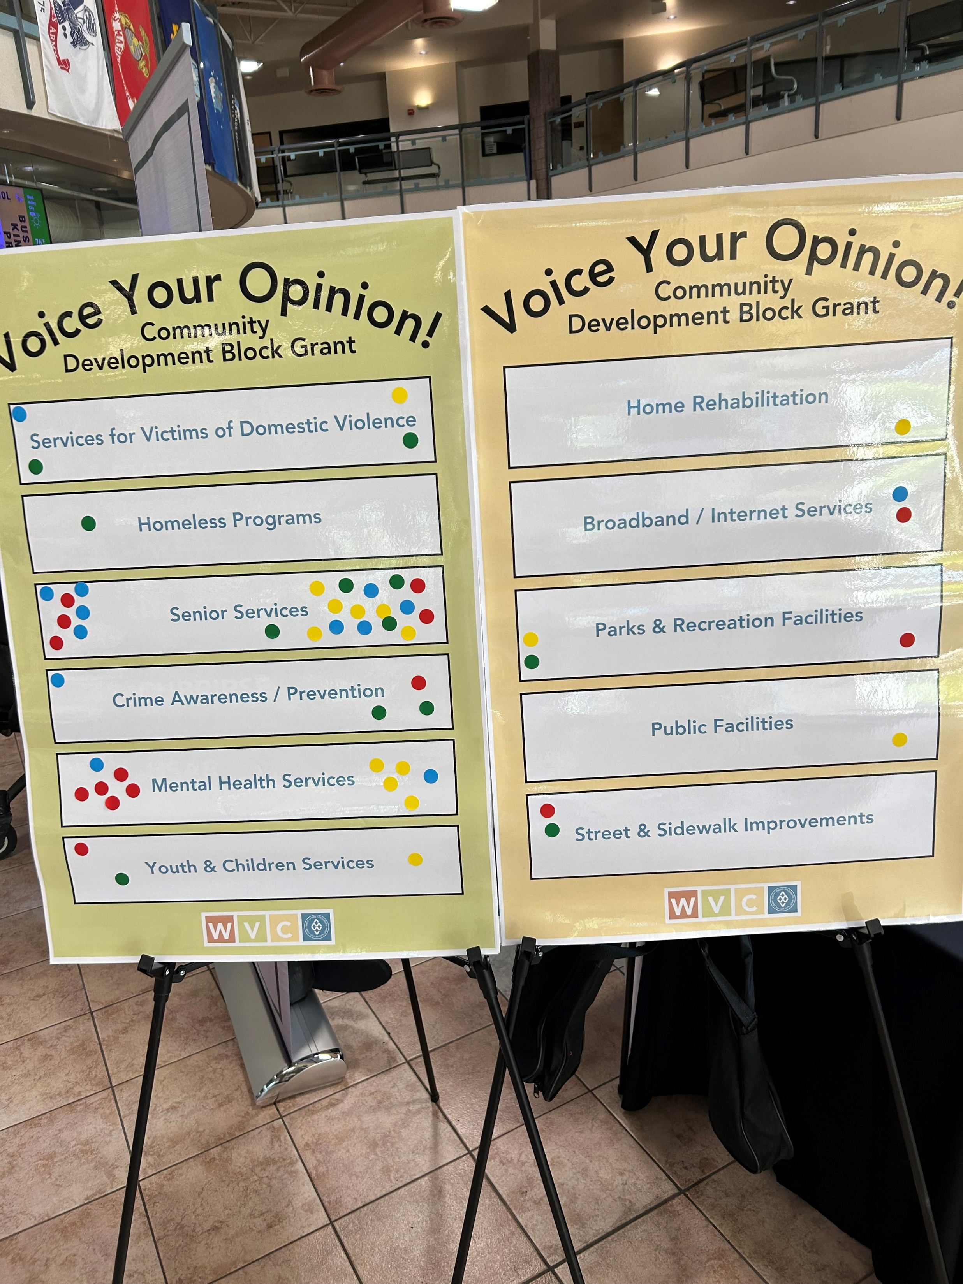
Survey says…
Structured to solicit feedback from community residents
Outline priorities
Simplicity = can be replicated and refined

Slide 8
Always ask…
Why does this (not) work?
What may work better?
What is unique about our community?

Slide 9
Questions?
Phil Keeve
philip.keeve@wvc-ut.gov
801-963-3369
3600 S Constitution Blvd
West Valley City, UT 84119
Special thanks to input from
Peggy Calda for this presentation

