Slide 1
Community Engagement and Housing City of Alexandria, VA
Eric Keeler, Deputy Director
Office of Housing

Slide 2
Approach

Slide 3
Approach
Guiding Principles
Inclusive and meaningful engagement
Accessible and convenient
Partnerships
Engagement paired with education
Translation/interpretation provided
Refreshments and food (culturally appropriate during major religious holidays) provided depending on timing of event
Family-friendly design
Accessible locations for individuals of all abilities
Geographically dispersed locations accessible by multimodal transit
Events held during different days of the week and times of the day
Different engagement formats (formal vs informal; in person vs hybrid vs virtual)
Interdepartmental: Planning & Zoning, Health, Community and Human Services; Code; Transportation and Environmental Services
Community and stakeholder groups
Funders

Slide 4
Approach
Tools—Tailored to Audience and Project
In person engagement
Meetings, listening sessions, briefings, panel discussions, and pop-ups
Stakeholder led community conversations
Online engagement Comment form, surveys, virtual meetings
Printed materials
Citywide postcard mailout
Website
Social media
Project updates via citywide eNews releases and videos

Slide 5
Arlandria-Chirilagua
Small Area Plan

Slide 6
Approach
Spanish first approach, enabled by state funding
Bilingual materials
Spanish-speaking staff
Community conversations coordinated by local partners
Other considerations
COVID-19 pandemic (re)shaped engagement
Expanded use of WhatsApp
Ready to Rent initiative

Slide 7
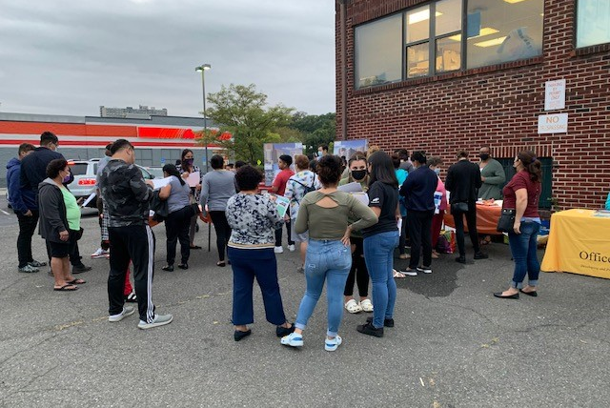
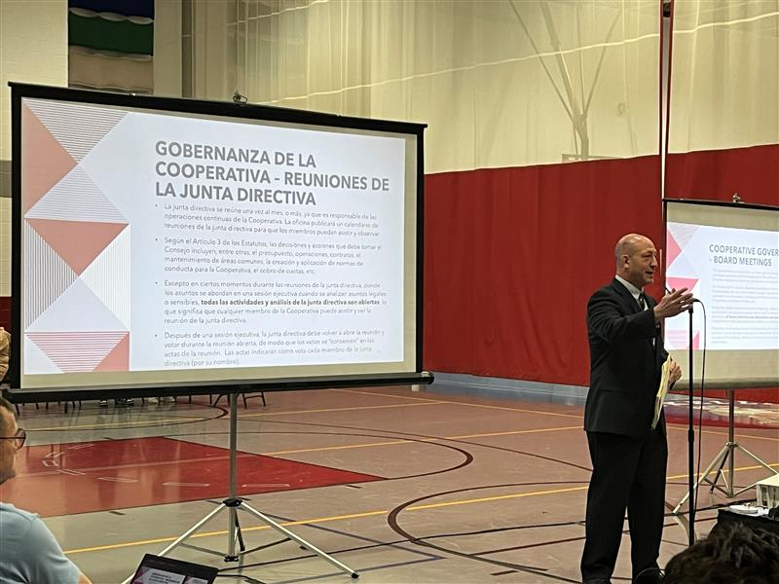
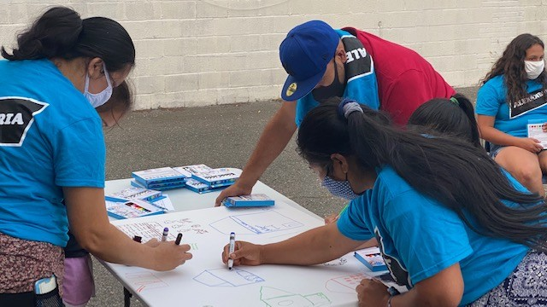
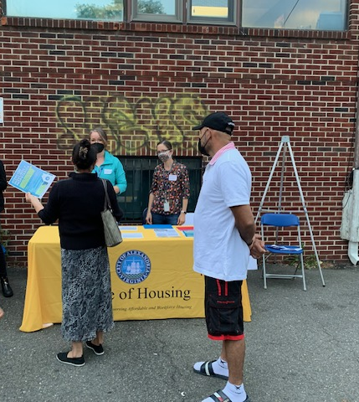
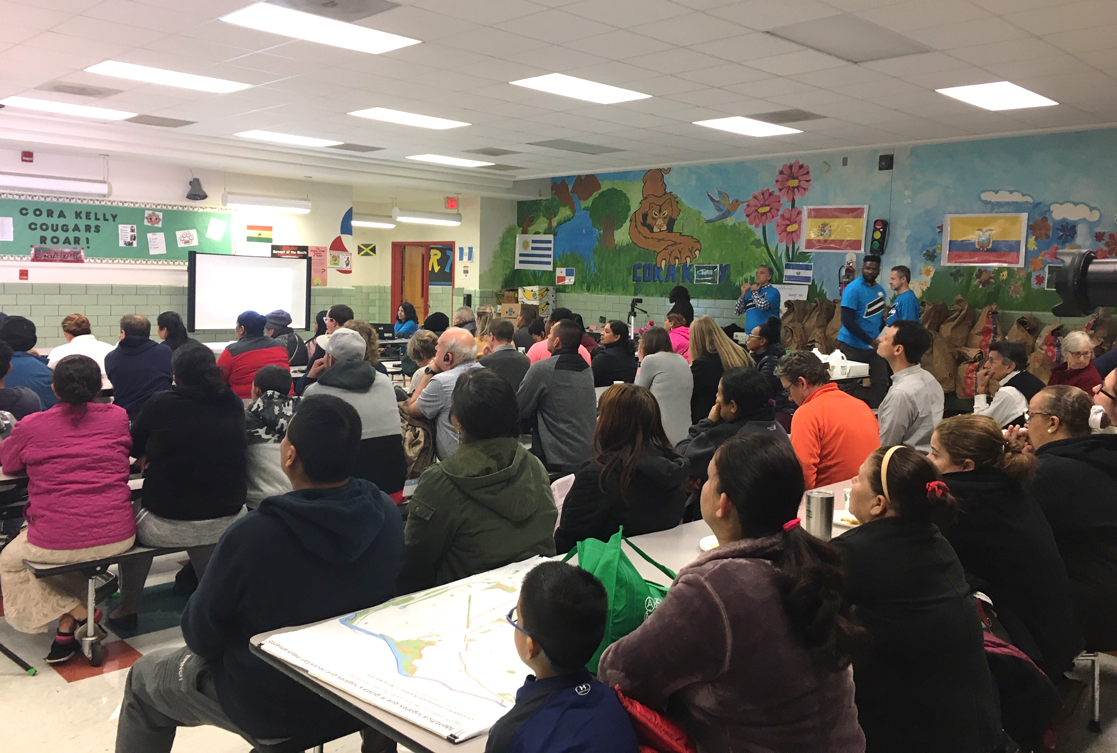
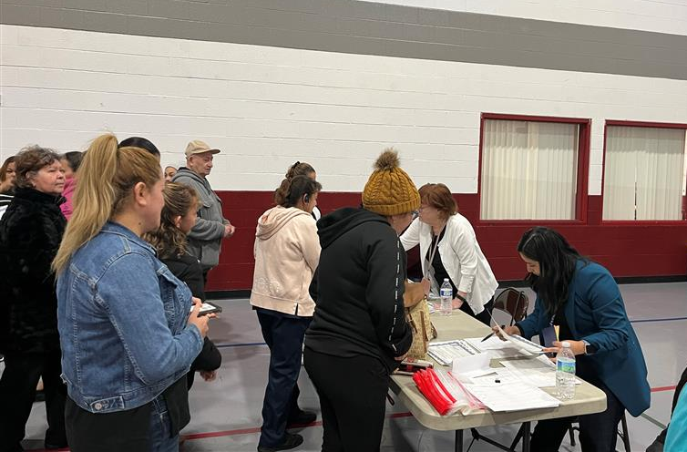

Slide 8
Alexandria West
Small Area Plan

Slide 9
Approach
State funding enabled broader community engagement
Competitive grants issued to six community partners with diverse stakeholders
Translation and interpretation available in Spanish, Amharic, Arabic, Dari, and Pashto
Culturally Sensitive and Targeted Engagement
Goal of ensuring an equitable and inclusive process
Meetings and pop-ups at a variety of times and locations throughout the Plan area
All engagement materials and feedback was posted to the project website and shared with the community
Variety of In-Person and Online Strategies

Slide 10
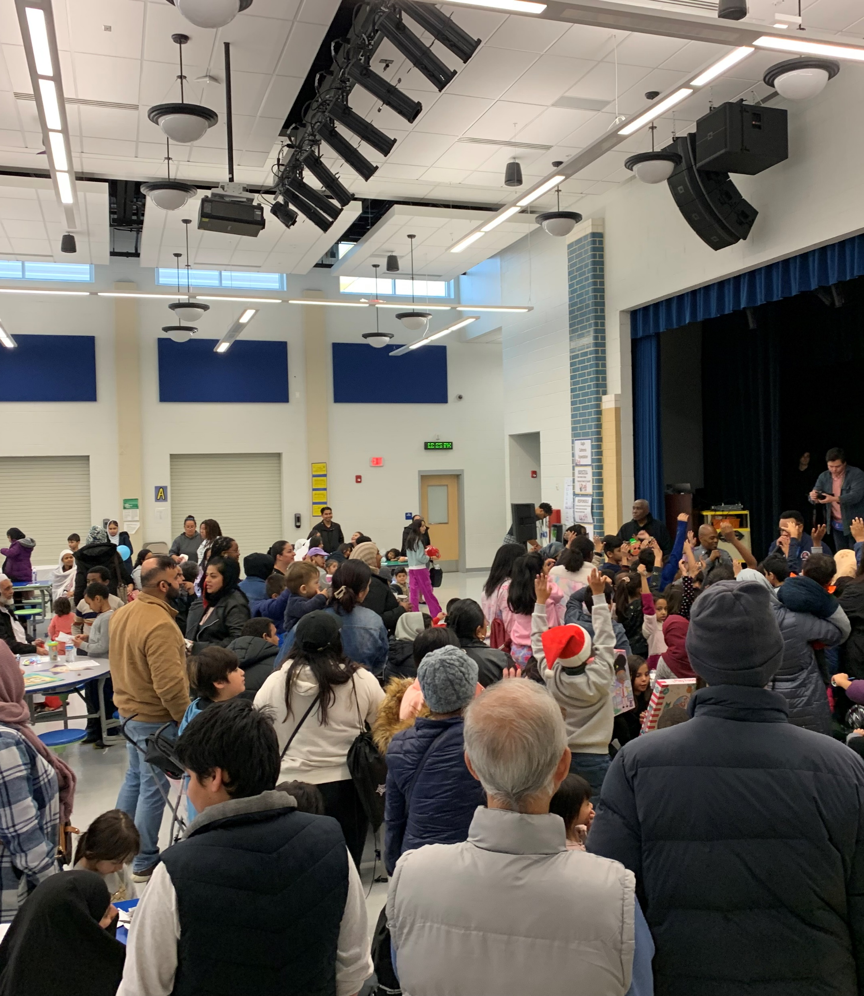
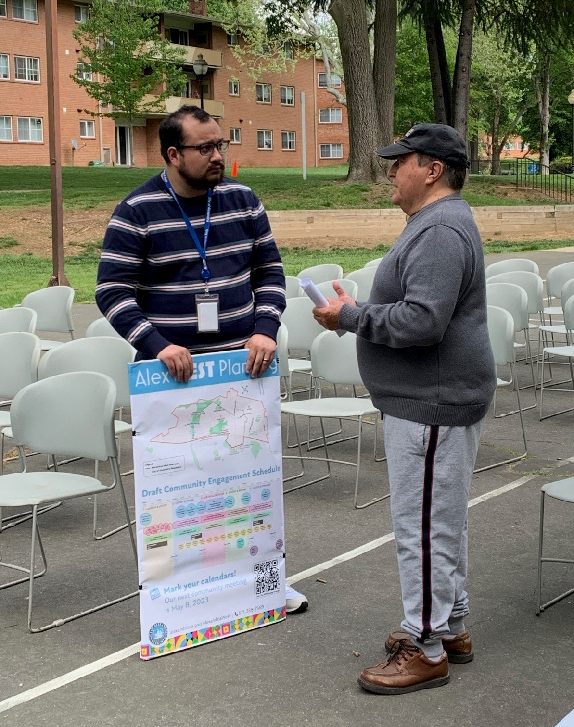
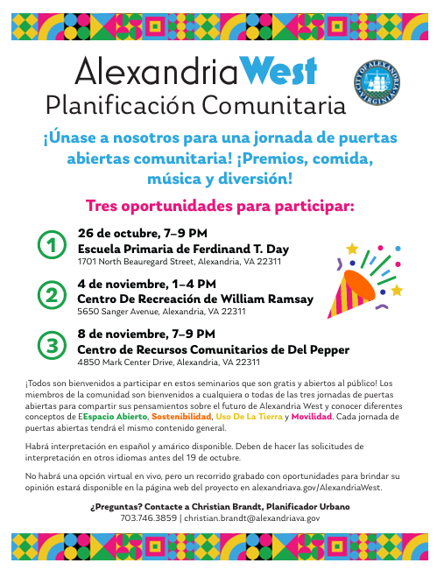
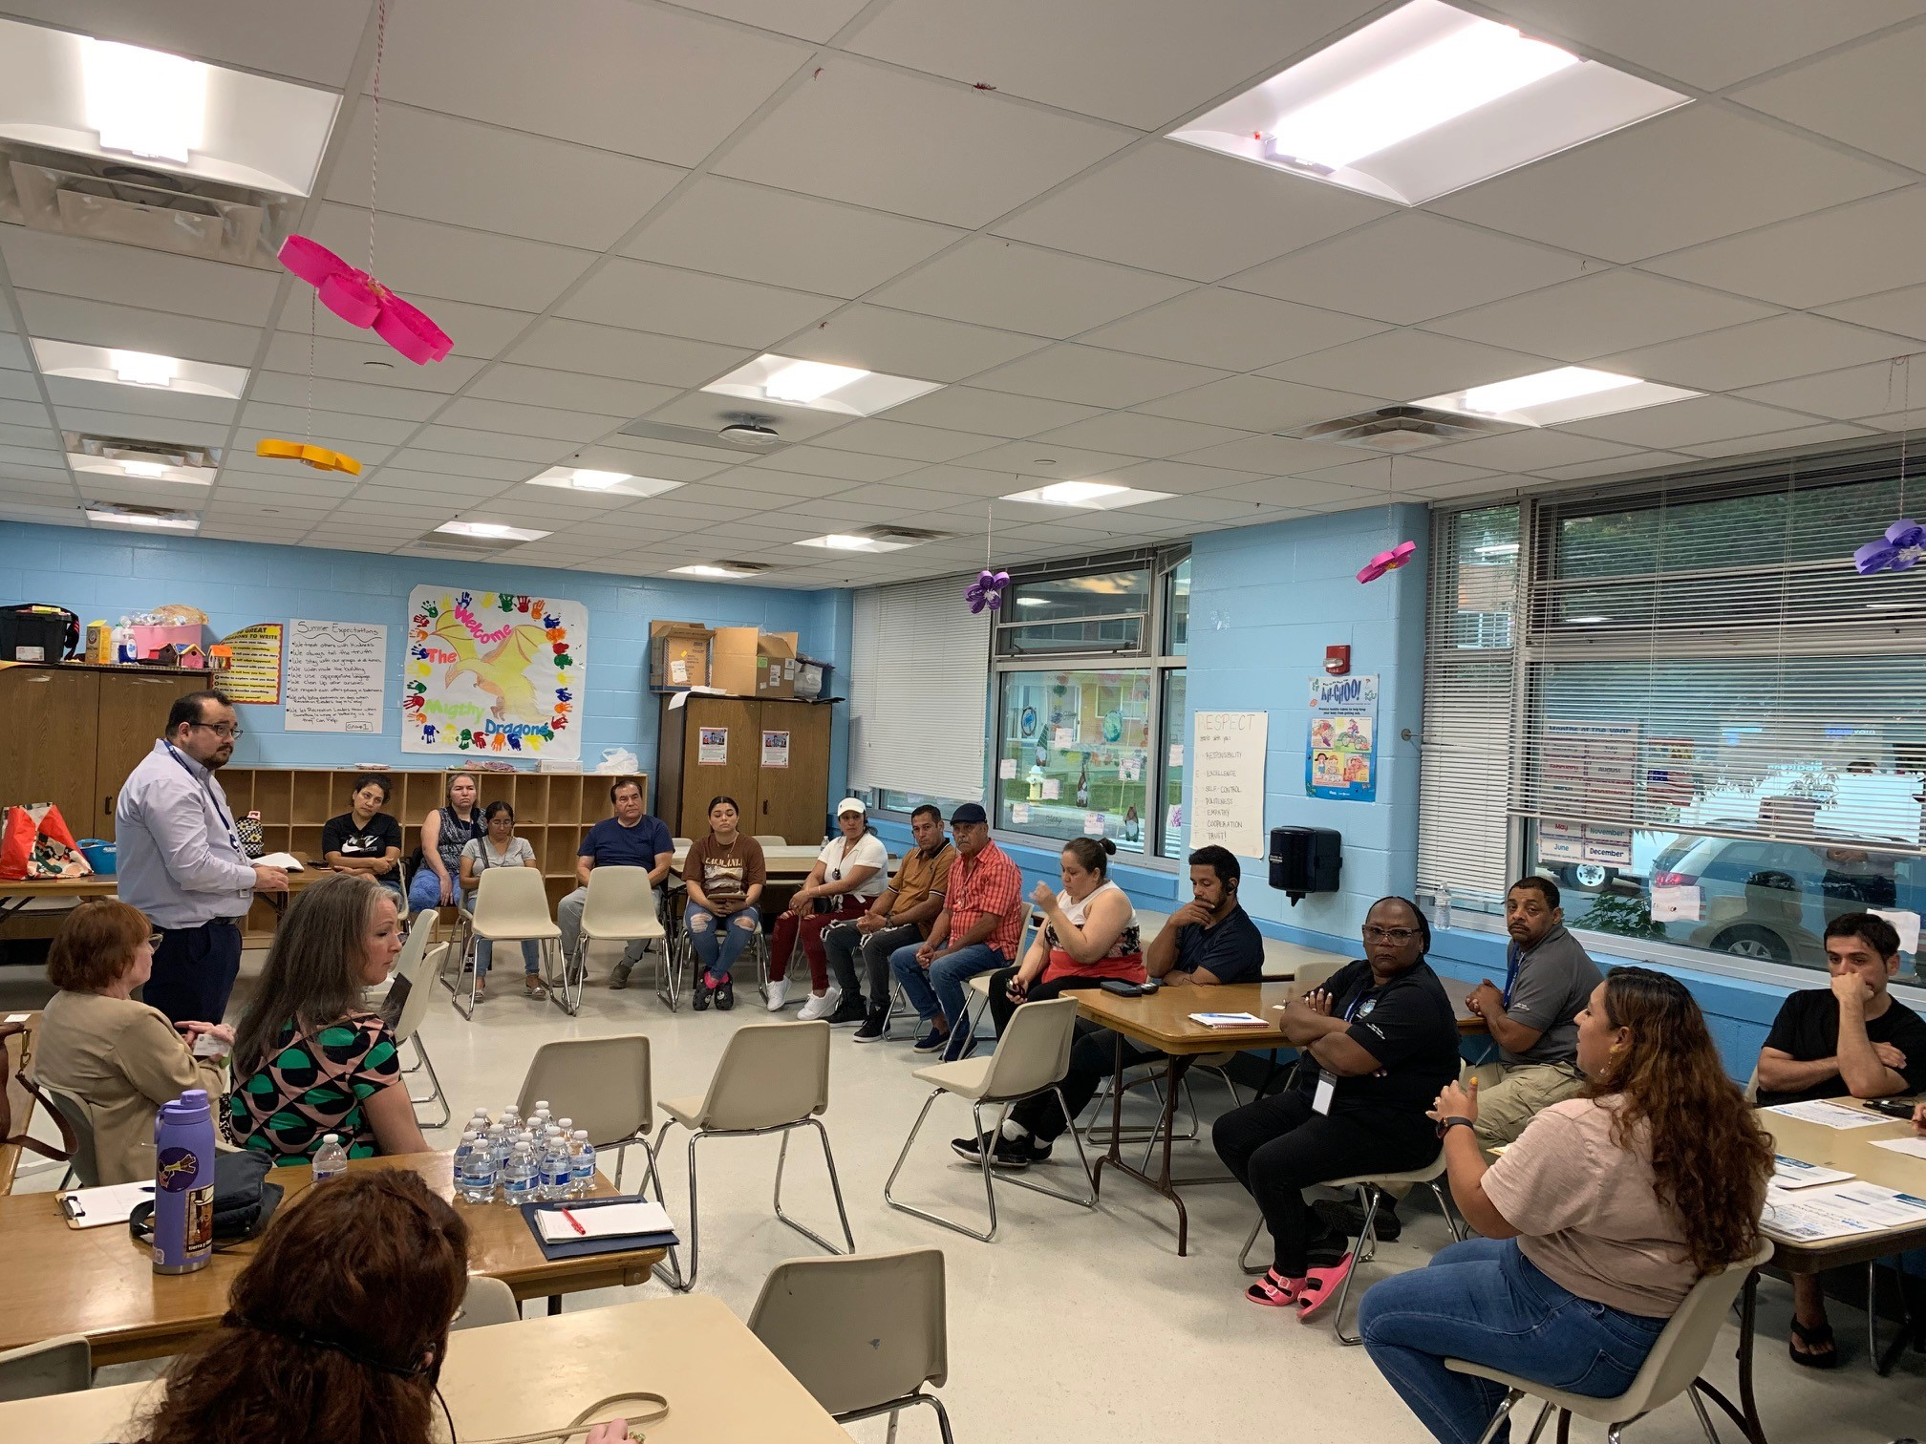
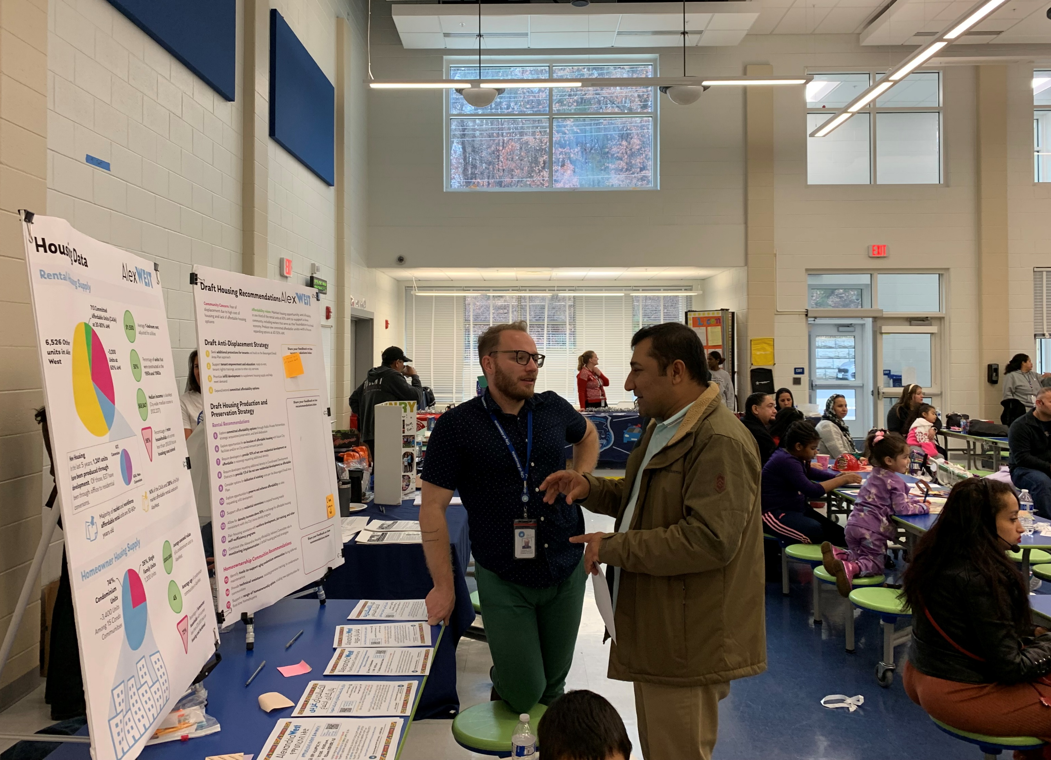
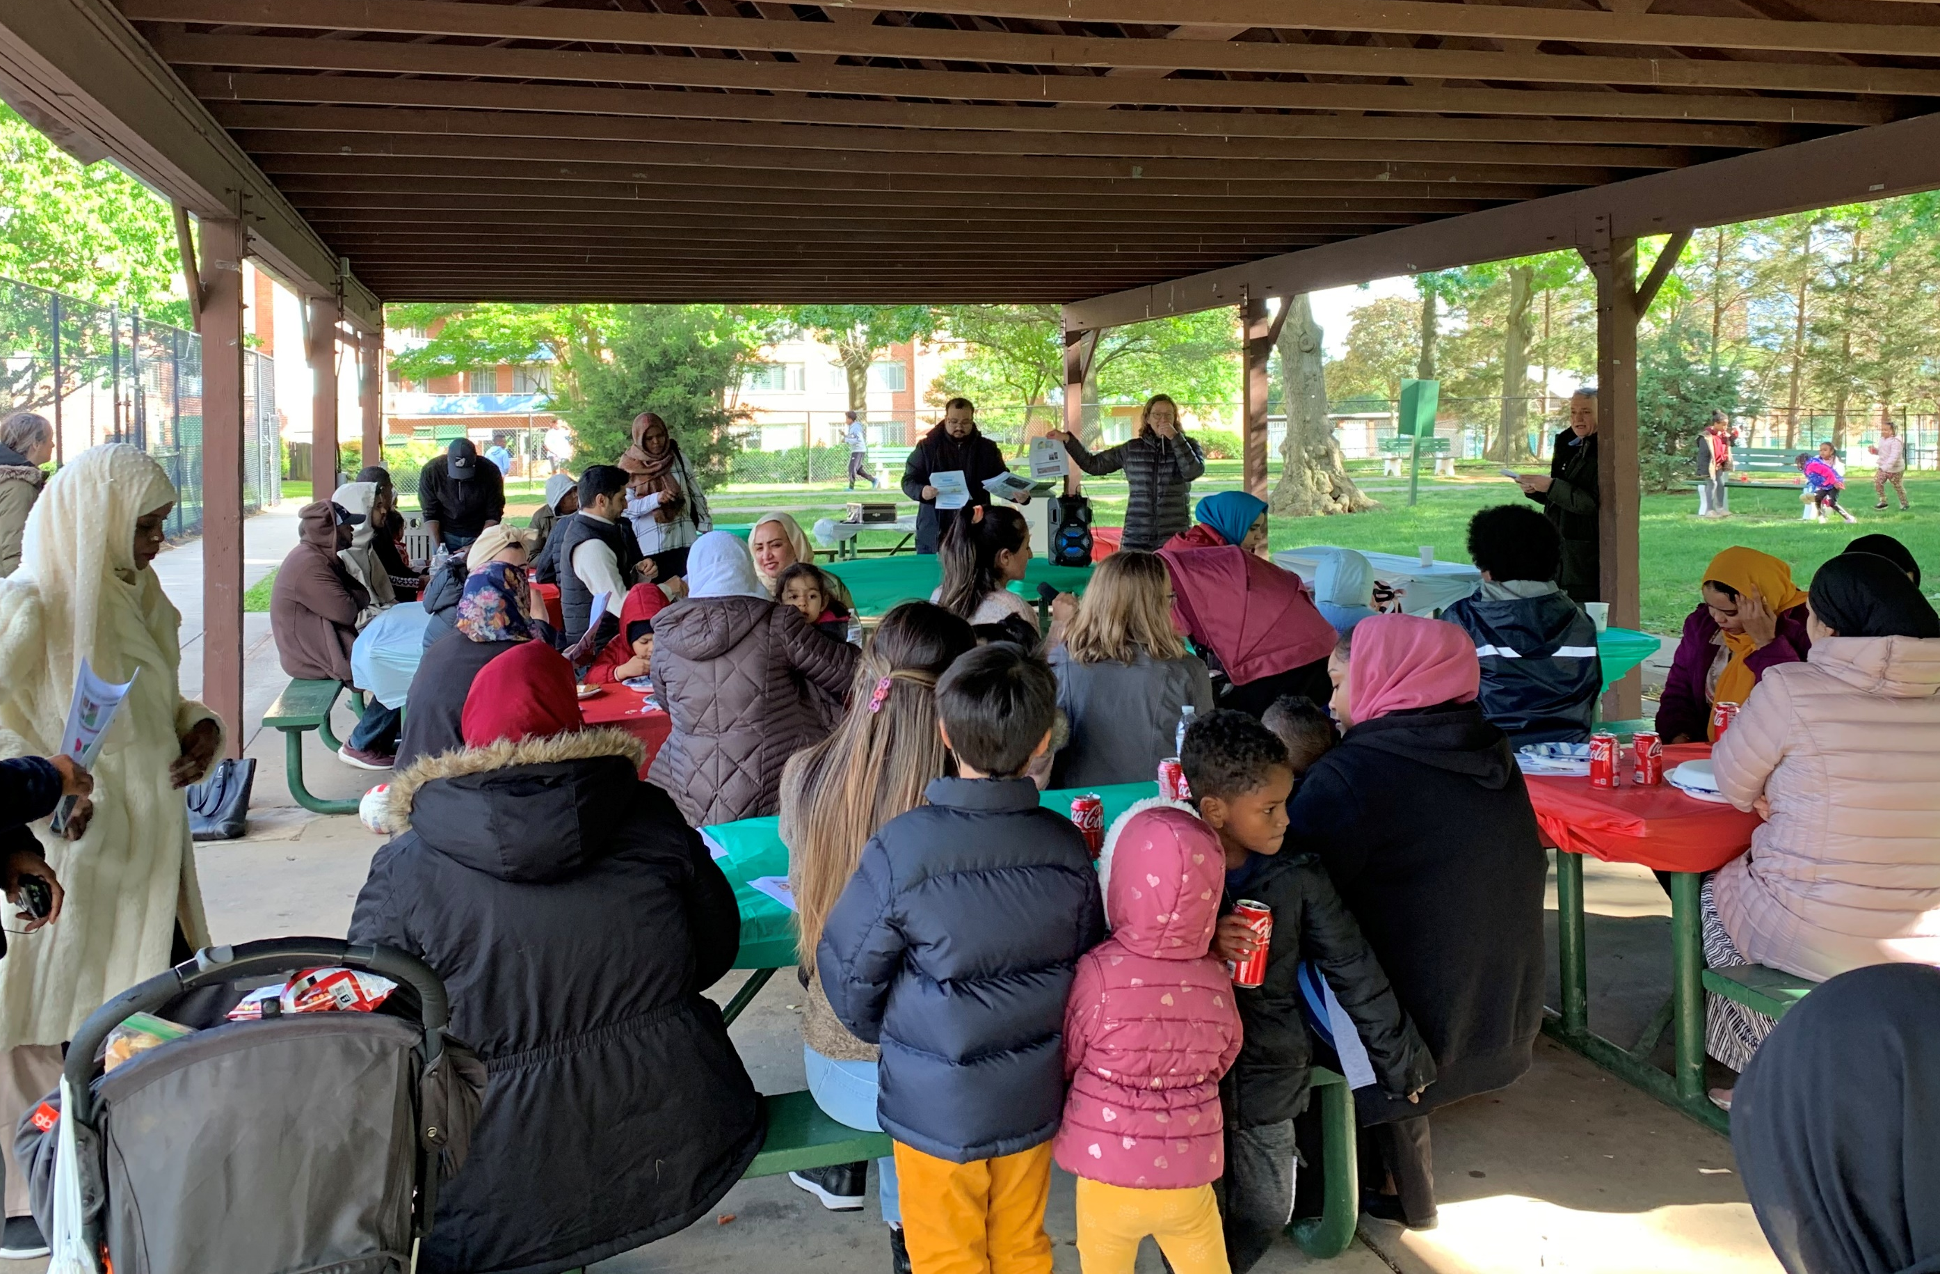
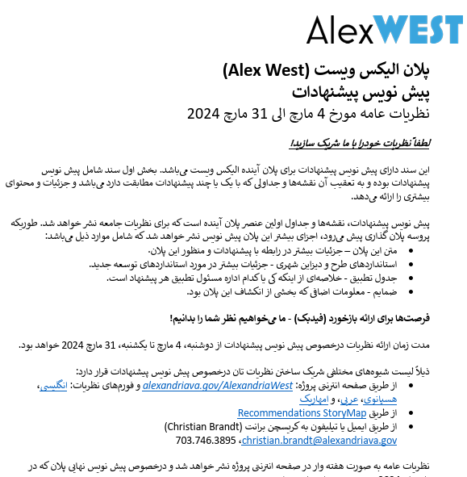

Slide 11
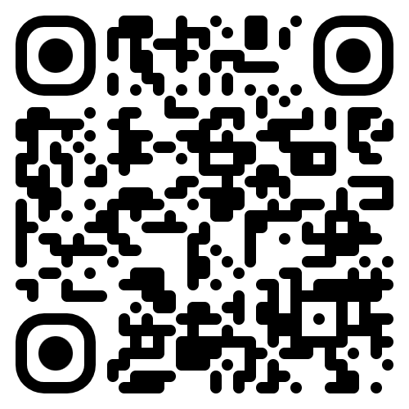
Housing 2040
Housing Master Plan Update

Slide 12
Approach
Engagement strategy builds off prior experiences and lessons learned, leverages partnerships, and emphasizes inclusivity and accessibility, and education
Tools used include:
Project website
Citywide postcard mailed
Printed materials w/QR code
Community meetings and thematic/project meetings
Pop ups + tabling events
Social media & WhatsApp
Listening sessions + briefings
Online and Printed Housing Survey available in six languages
Online Comment Form available for duration of process
Engagement paired with education:
Alexandriava.gov/housing/housing-2040-education-month

Slide 13
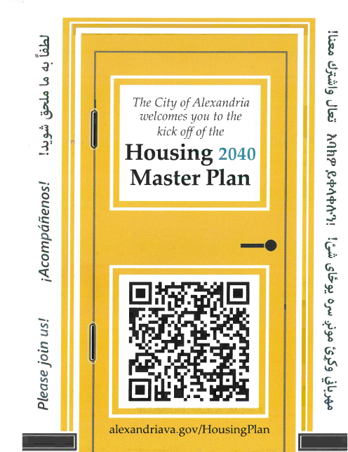
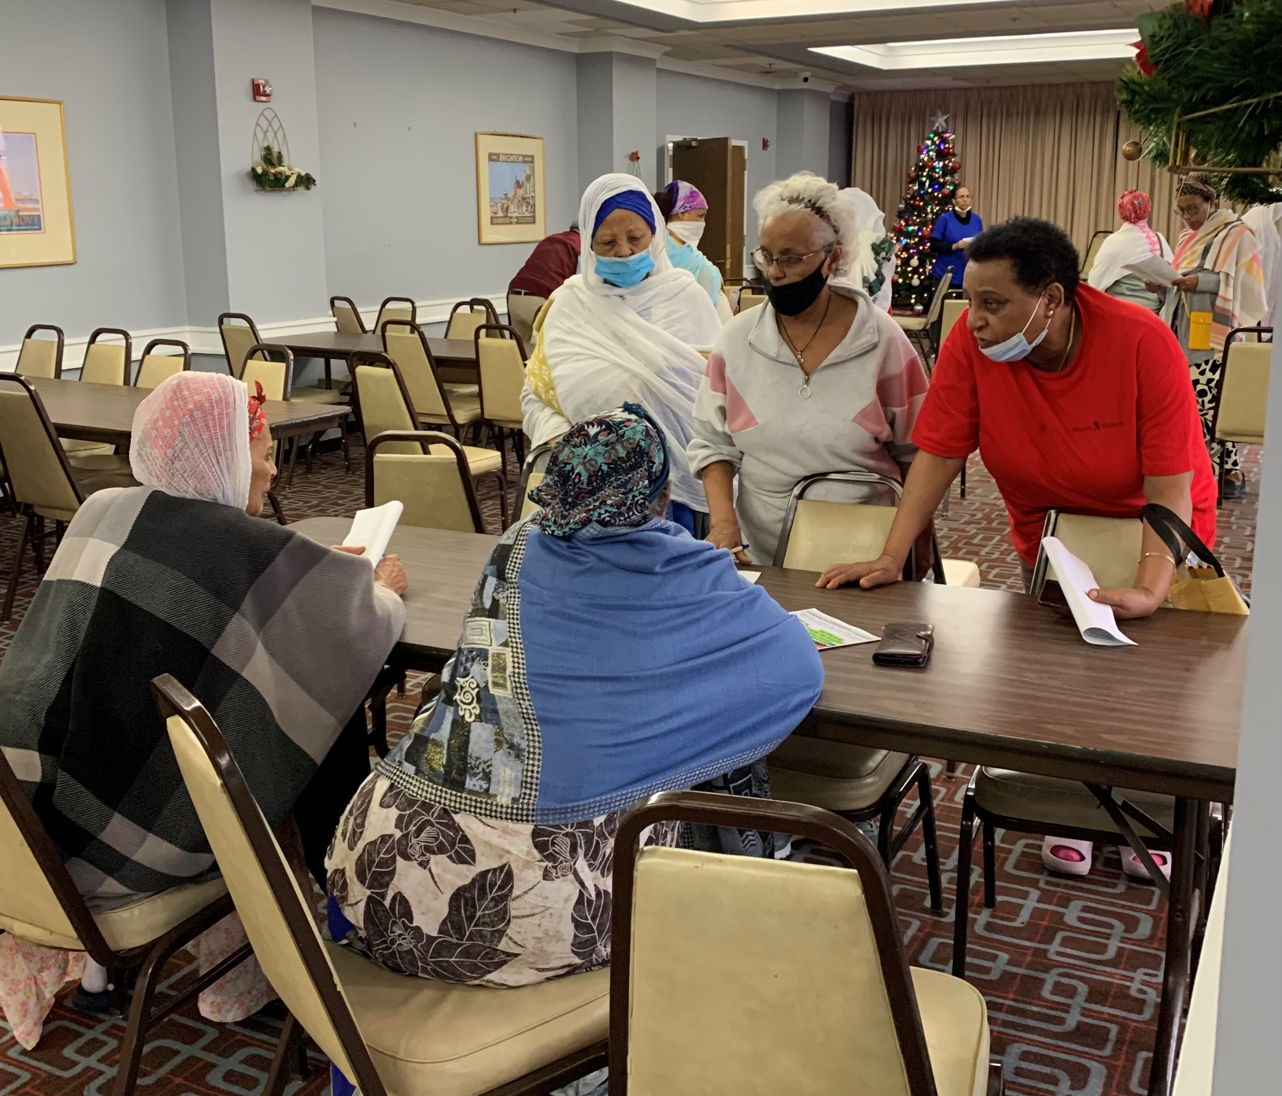
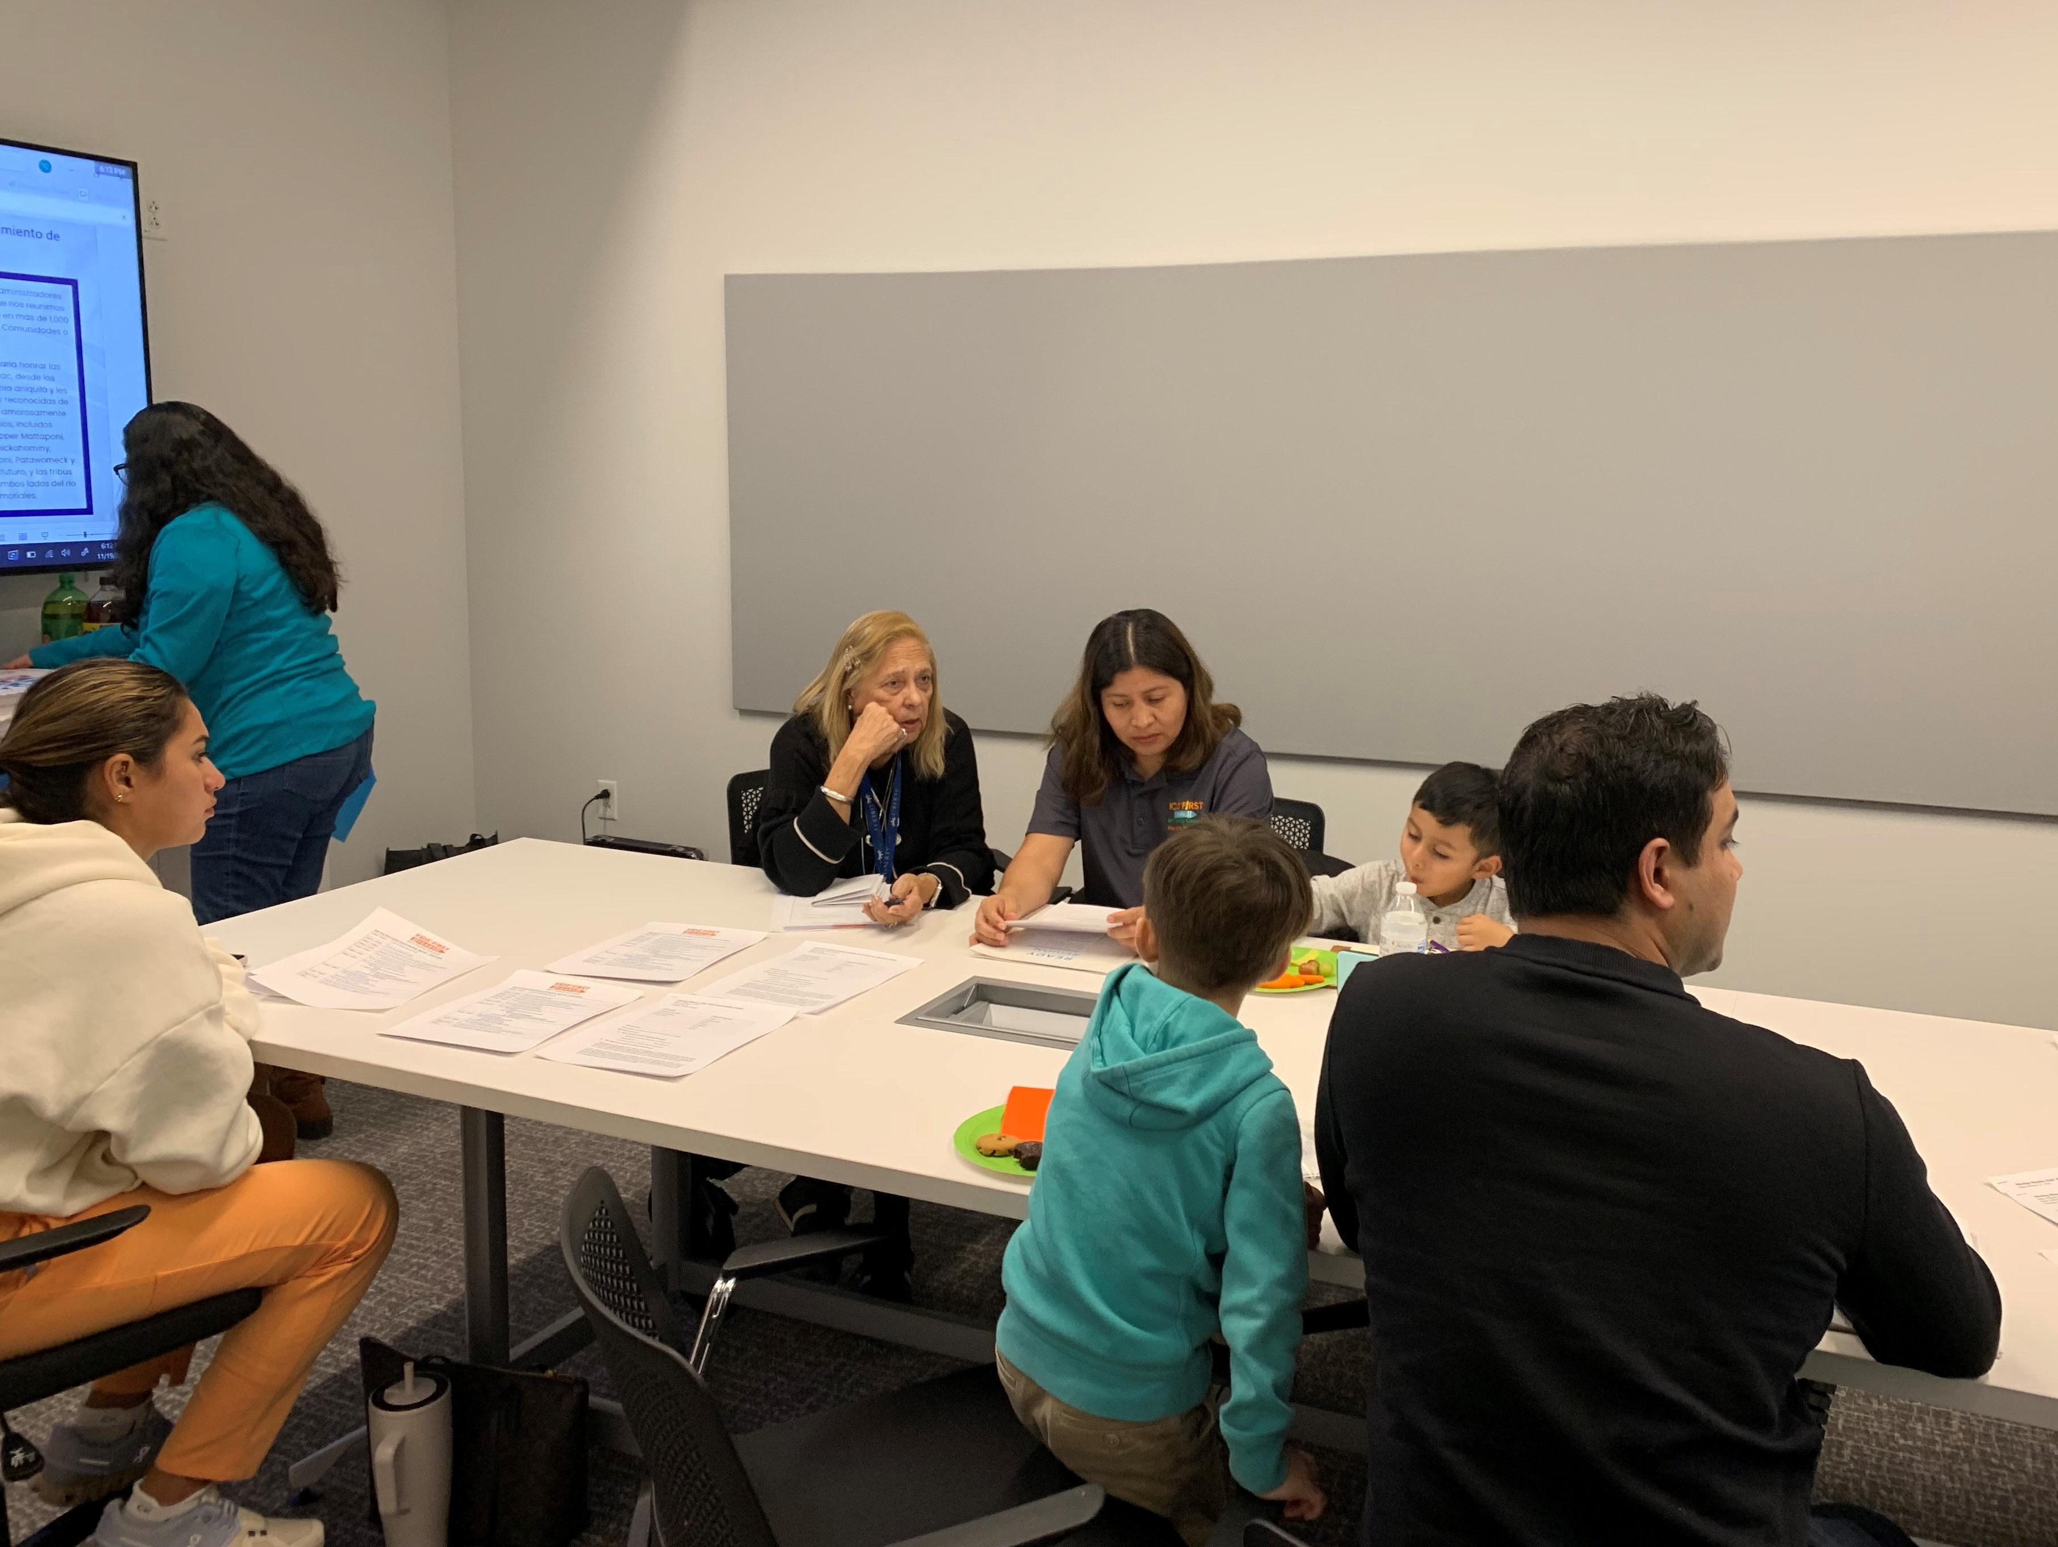
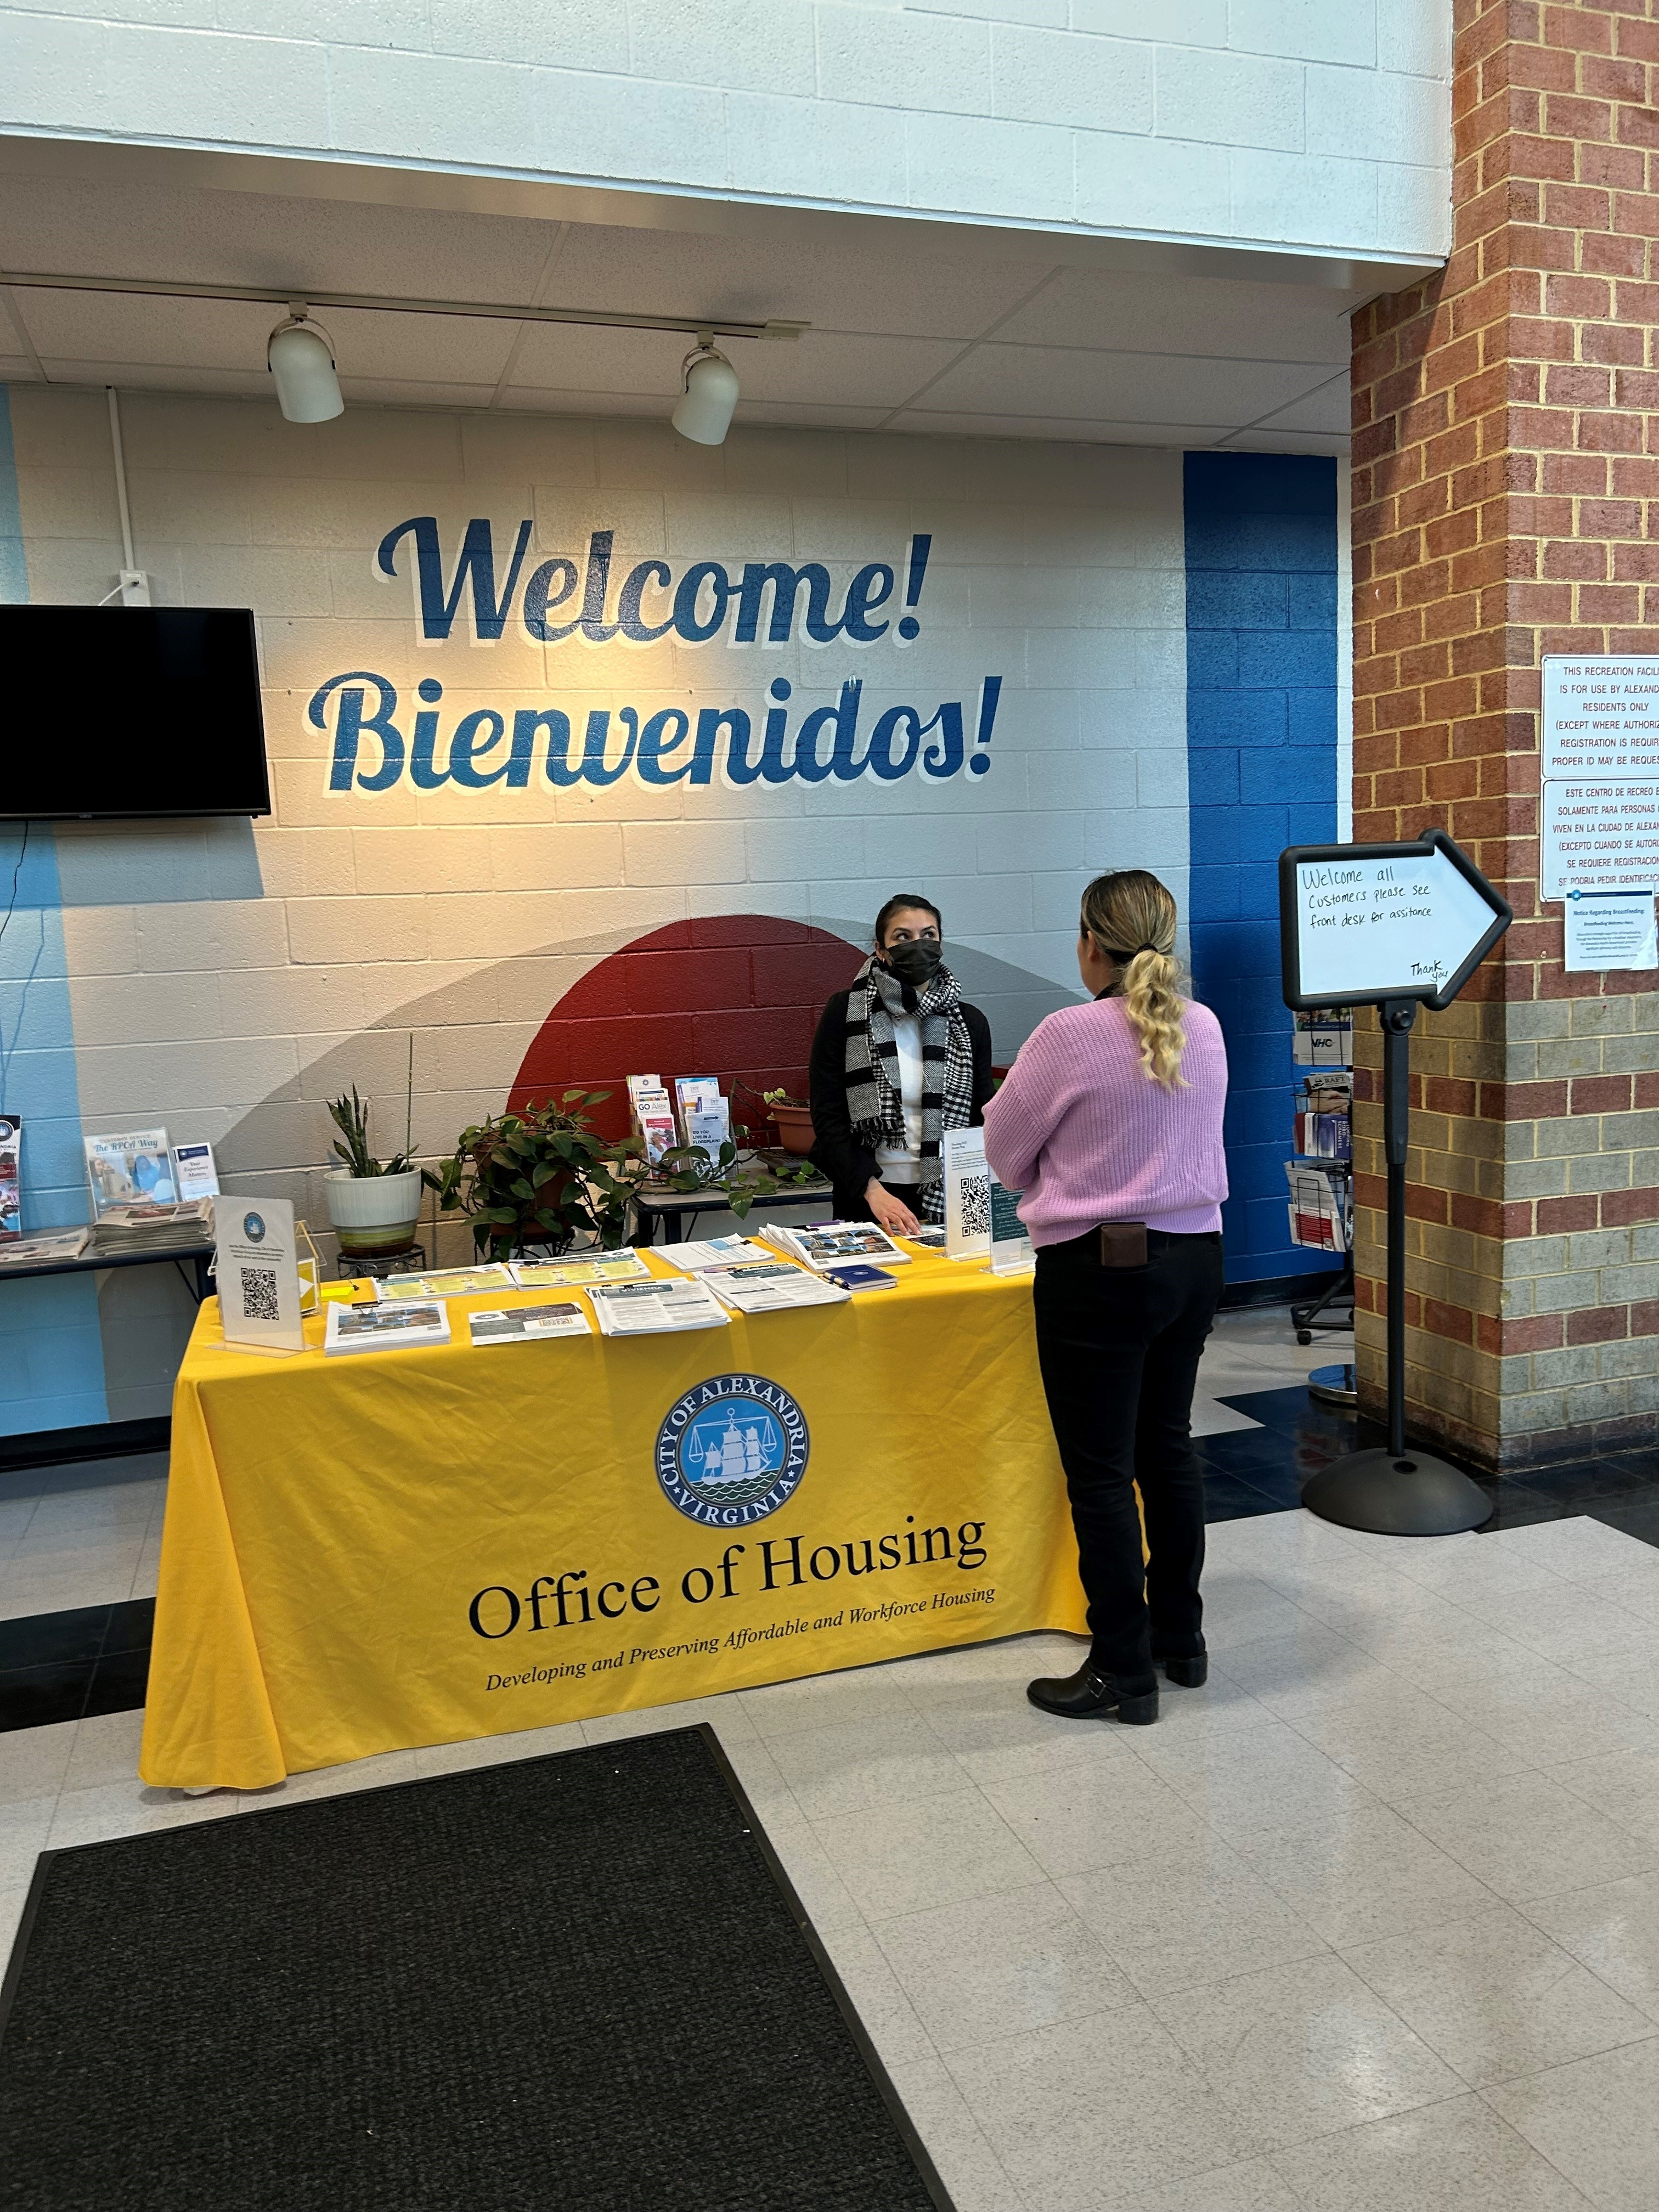
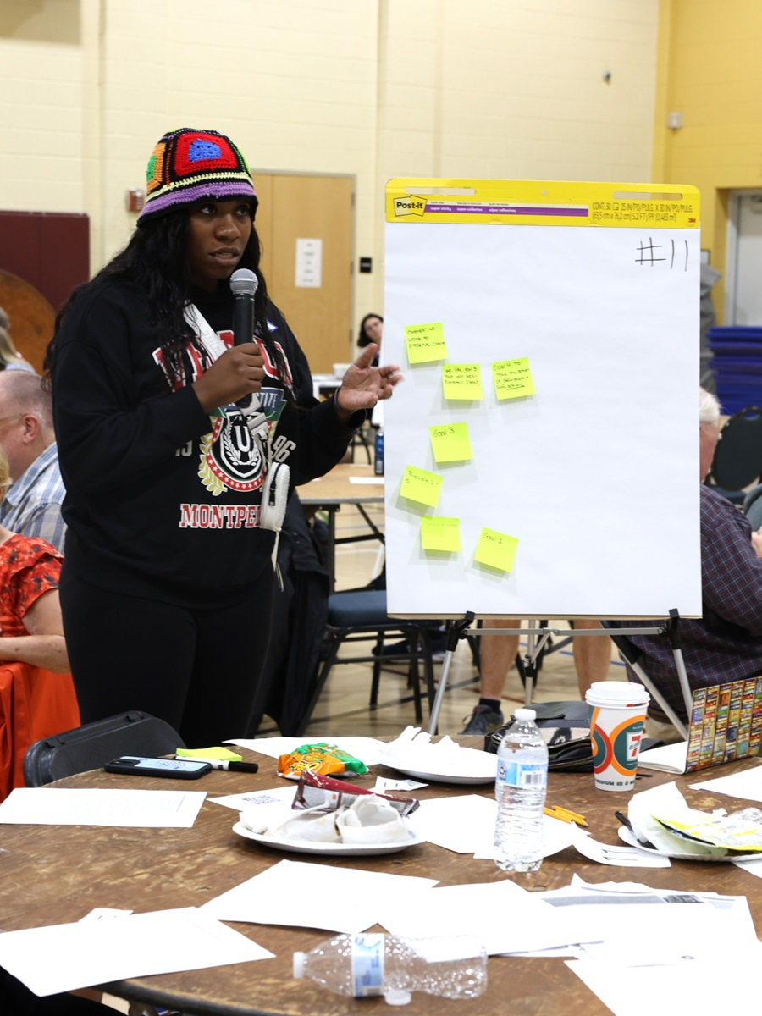
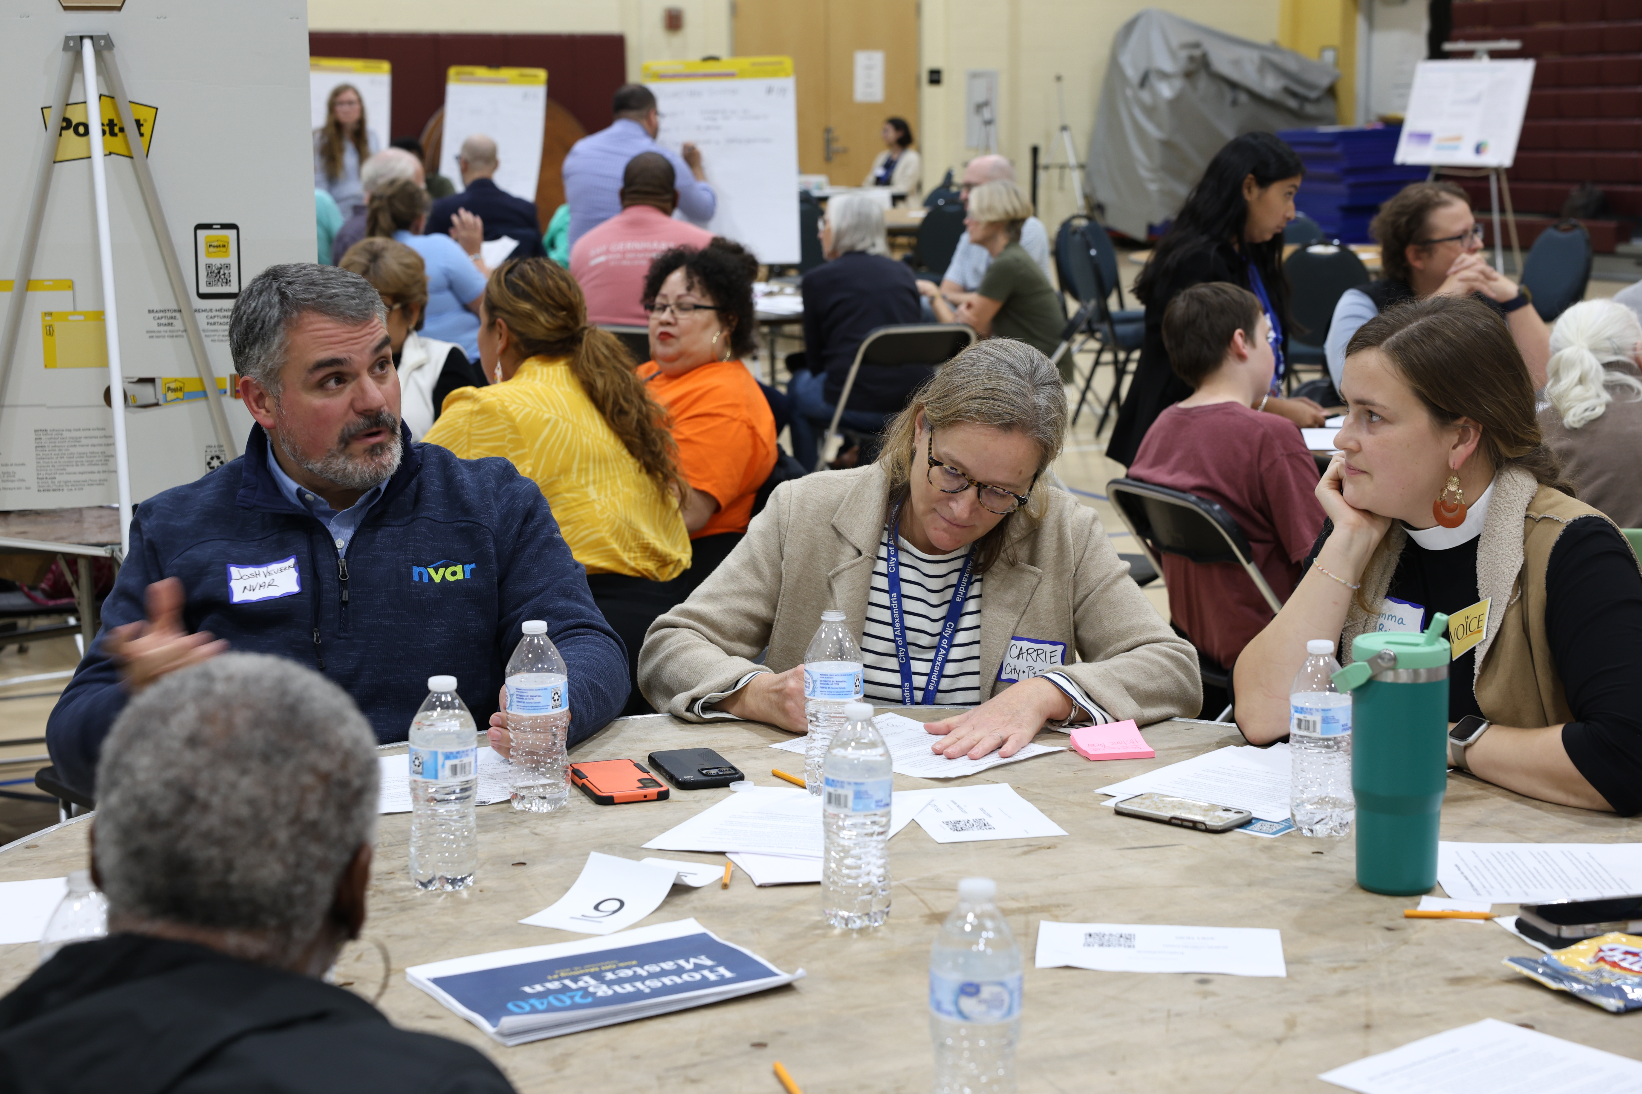
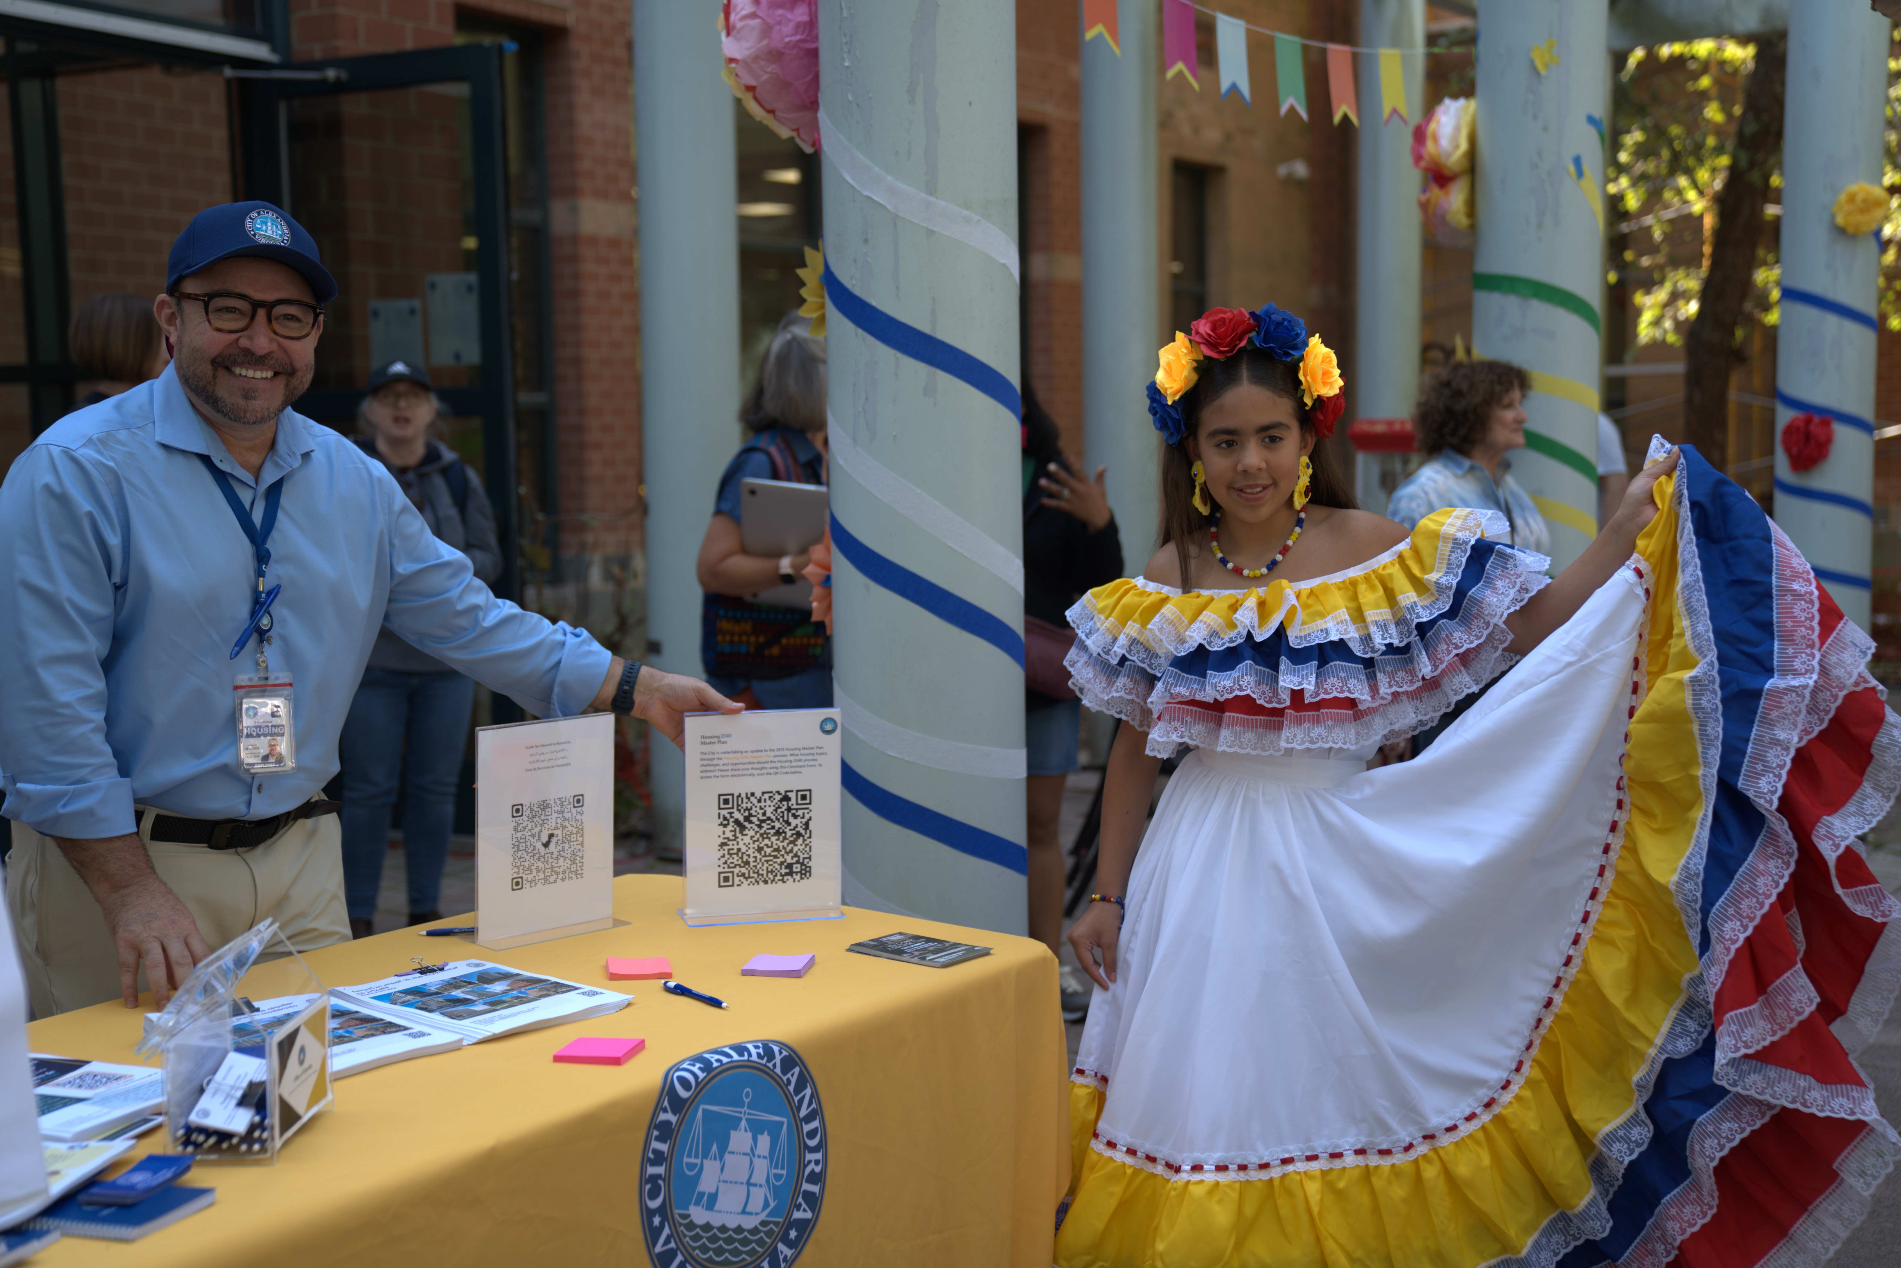

Slide 14
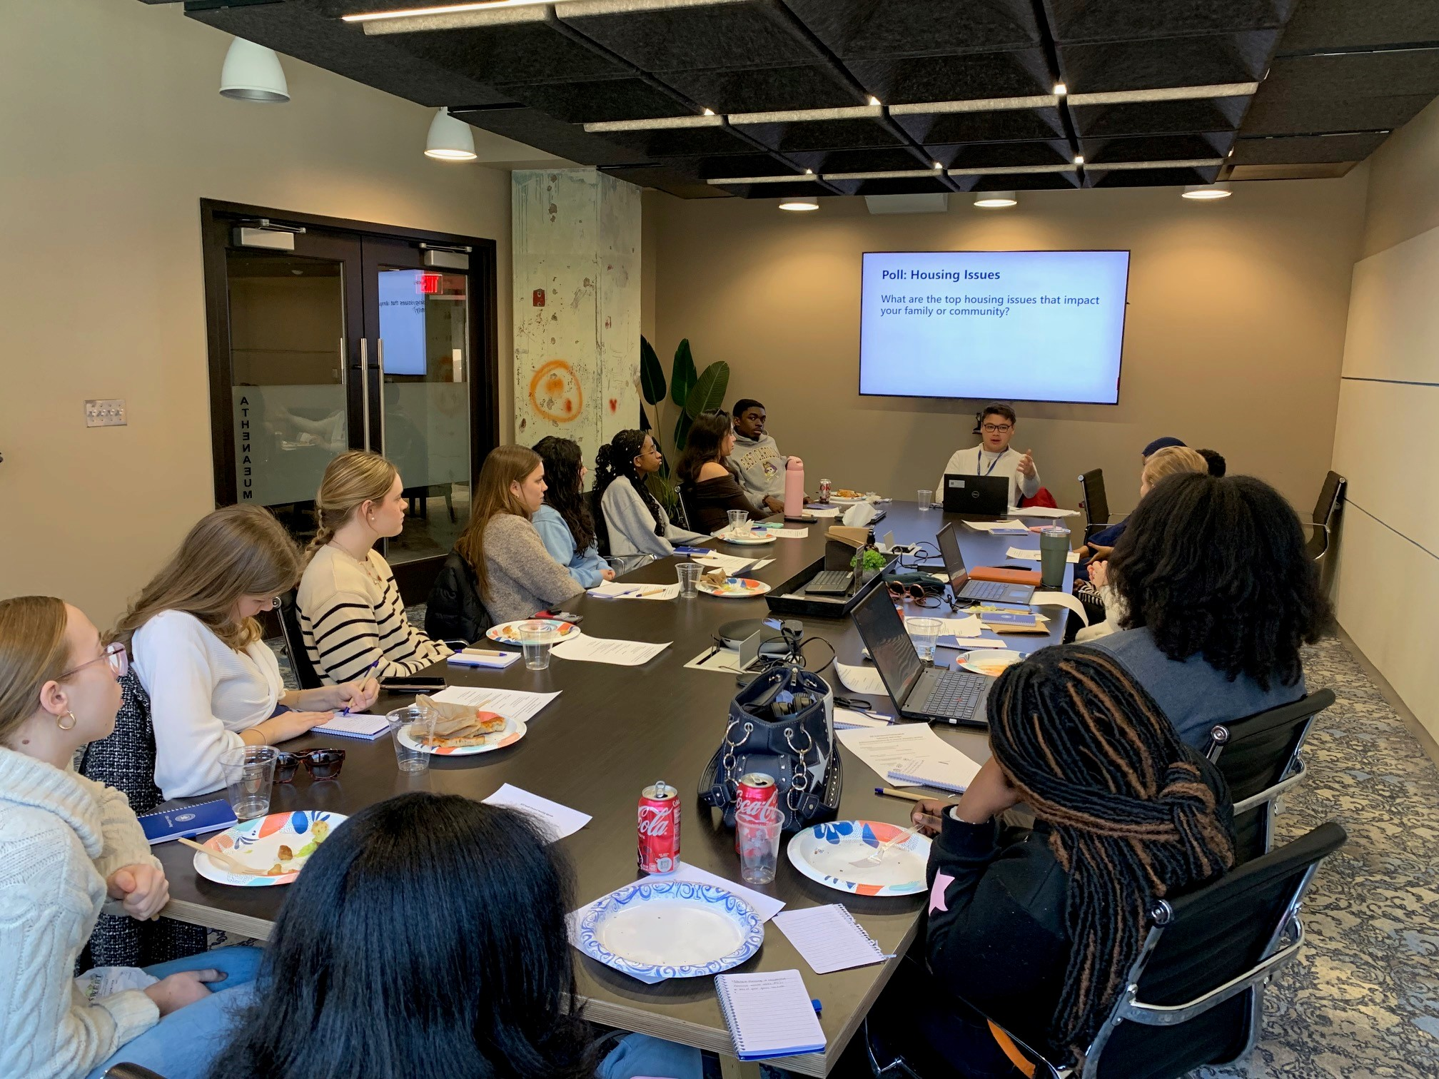
Youth
Engagement
Youth ambassadors
High school engagement
Youth council

Slide 15
Impact of Engagement

Slide 16
Impact
Builds community trust
Strengthens partnerships
Elevates key community issues, with a focus on housing
Importance of tenant rights, resources, and protections and need for expanded legislative authority
Demand for deeply affordable rental housing (affordable up to 40% AMI)
Call for housing preservation, in particular of naturally occurring affordable housing (affordable up to 60% AMI)
Broad concerns over housing conditions [synergy with Healthy Homes Initiative]
Pinpoints housing issues specific to different demographic groups

Slide 17
Q&A
Eric Keeler, Deputy Director
Office of Housing
eric.keeler@alexandriava.gov
703.746.4990

Slide 18
Resources
Alexandriava.gov/housing
Alexandriava.gov/housingplan

