Slide 1
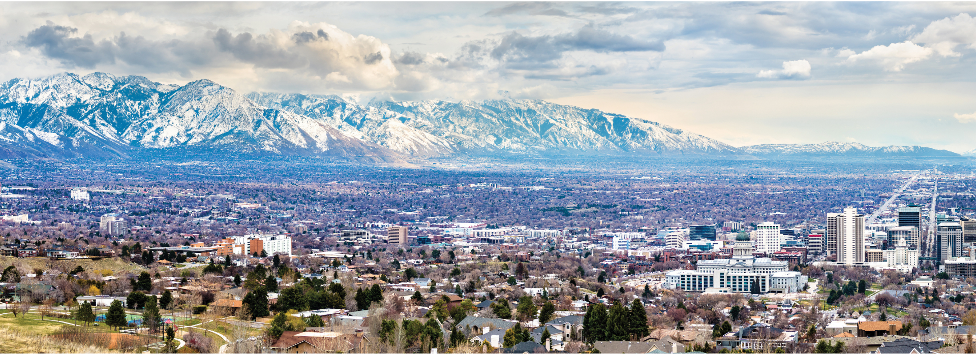
ENGAGING RESIDENTS
Amanda Best Housing Stability Salt Lake City

Slide 2
Salt Lake City
Population: 217,783 (2024 estimate)
Originally inhabited by the Shoshone, Paiute, Goshute, and Ute Nations
Nestled between the Wasatch Mountains and the Great Salt Lake at 4,330 feet above sea level
Just 30 minutes away from 4 world-class ski resorts
Over 80 languages spoken by students and families in the Salt Lake City School District
Over 320 miles of trail in and around Salt Lake City
FY25-26 CPD Allocations:
CDBG – $3.3M
ESG – $300K
HOME – $800K
HOPWA – $950K
PI from CDBG & HOME $2,317,999
Between 40 and 60 awarded activities annually:
CDBG – 26
ESG – 8
HOME – 6
HOPWA – 4

Slide 3
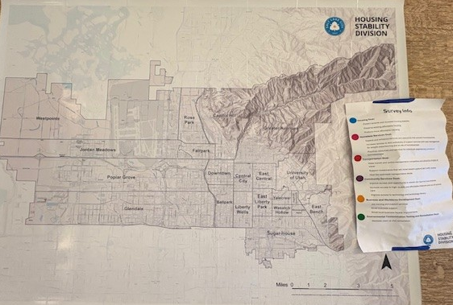
Resident
Feedback
Interactive
Variety
Short
Follow Up
SALT LAKE CITY
Notes:
There is also a survey that individuals can do online from a flier – if they want to take it home and do it later.

Slide 4
SLC Neighborhood Improvement & Stabilization Programs
Homeowner Programs
Home Repair, Minor Repair, Fix the Bricks
Homebuyer Programs
Community Land Trust
Local Business Programs
Neighborhood Business Improvement Program, Business Stabilization Program
Each program has a different population to focus on for engagement and education.
SALT LAKE CITY

Slide 5
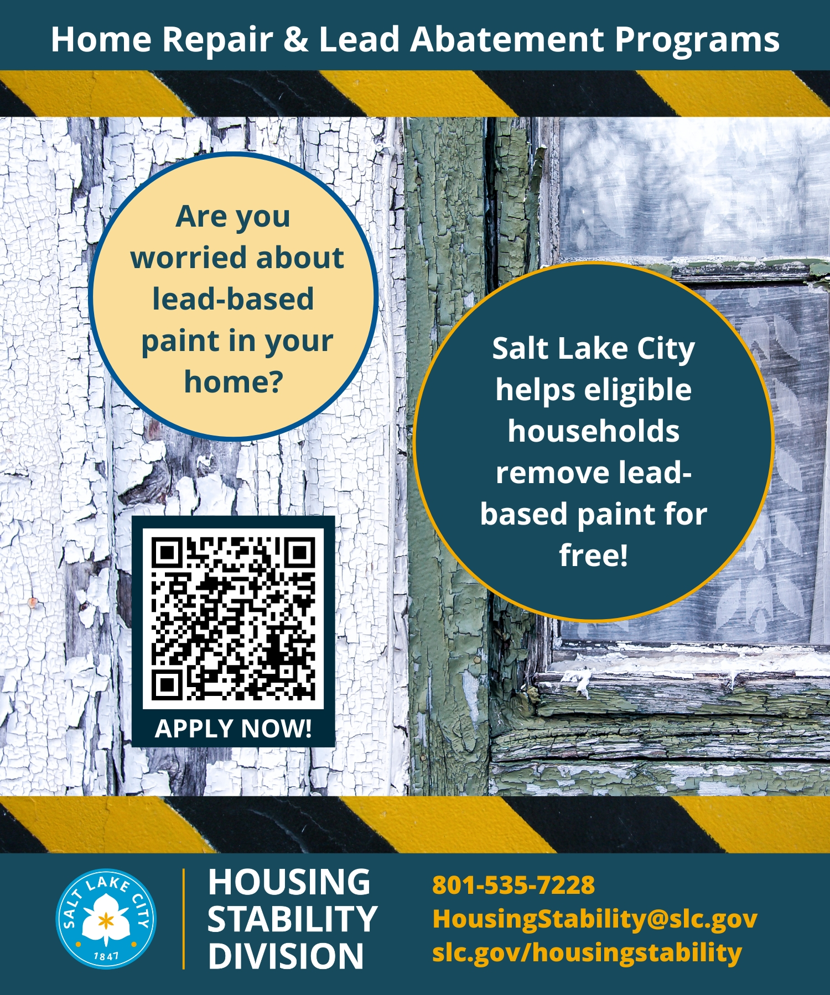
Resident Education
Mailers
Simple, direct & concise language
Tabling/Events
What can bring people over to your table?
SALT LAKE CITY

Slide 6
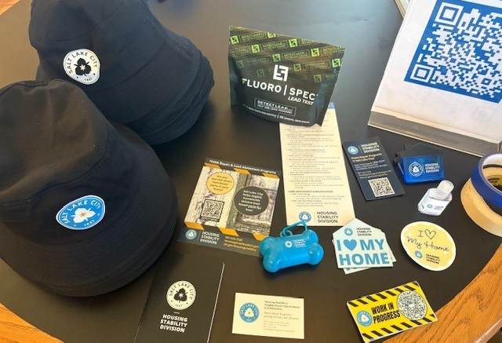
SALT LAKE CITY

Slide 7
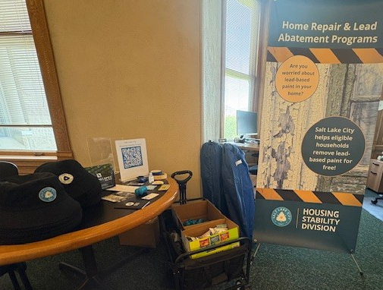
SALT LAKE CITY

Slide 8
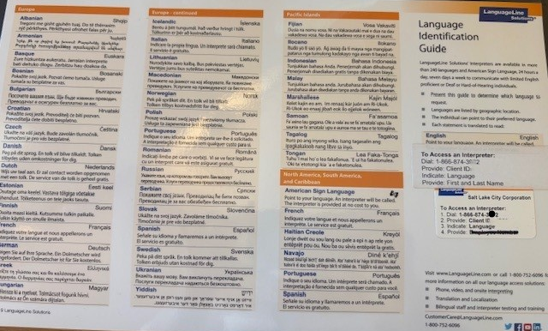
SALT LAKE CITY

Slide 9
Communication
The public sees the City as one big thing, not separate departments and divisions.
Listen – to the story (find the real question)
Offer – what you can control
Refer – to further help
Languages
Different generations like different things – tech savvy vs not tech savvy & how to utilize that in a tech world
SALT LAKE CITY

Slide 10
Building Trust
And keeping it!
Word of Mouth – Neighbors talking to Neighbors, Business Owners talking with their different chambers or associations, Community Councils.
Community Organizations and Advocates – They already have the trust built.
Community Partners – engaging with other entities to assist those that you are working with.
SALT LAKE CITY

Slide 11
THANK YOU
Amanda Best
Amanda.Best@slc.gov
801-718-3964

