Slide 1
Best Practices for Choosing and Monitoring Your Subrecipients
June 13, 2025
Sarah Nielsen, Community Development Grant Specialist
Beth Ulrich, Grant Program Administrator

Slide 2
Agenda
1. City Demographics
2. Gauging Risk During Subrecipient Selection
3. Ongoing Monitoring/Desk Audits
4. Selecting Subrecipients for On-site Review
5. Questions

Slide 3
Salt Lake City
Population: 217,783 (2024 estimate)
Originally inhabited by the Shoshone, Paiute, Goshute, and Ute Nations
Nestled between the Wasatch Mountains and the Great Salt Lake at 4,330 feet above sea level
Just 30 minutes away from 4 world-class ski resorts
Over 80 languages spoken by students and families in the Salt Lake City School District
Over 320 miles of trail in and around Salt Lake City
CPD Allocations:
CDBG – $3.3M
ESG – $300K
HOME – $800K
HOPWA – $950K
Between 40 and 60 awarded activities annually:
CDBG – 26
ESG – 8
HOME – 6
HOPWA – 4

Slide 4
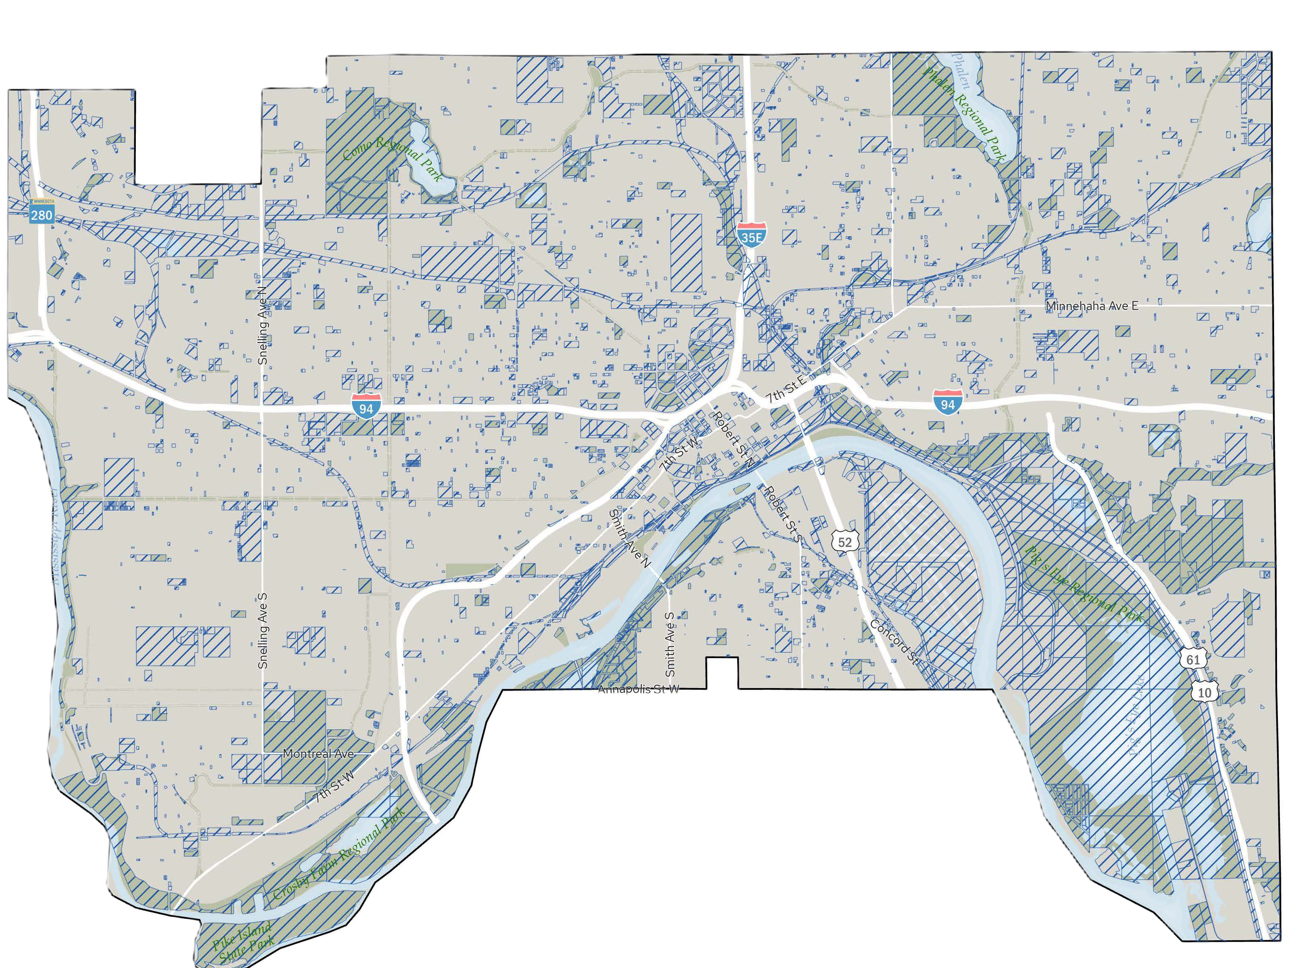
City of Saint Paul
Home of Snoopy, the Post-it Note, and Two-Time Walter Cup PWHL Winners…the MN Frost
Capital City, pop = 311,527 (2020)
Smaller half of the “Twin Cities” at 56 sq. miles
16 sq. miles of non-taxable land
Over 160 parks consuming 4,000 acres
100 miles of trails
14 colleges and universities
City with the most shoreline on the Mississippi at 26 linear miles
Originally inhabited by Sioux and Ojibwe peoples
Currently more than 114 languages spoken at Saint Paul schools
2025 HUD Allocations:
CDBG = $6,756,518
HOME = $1,423,385
ESG = $594,589

Slide 5
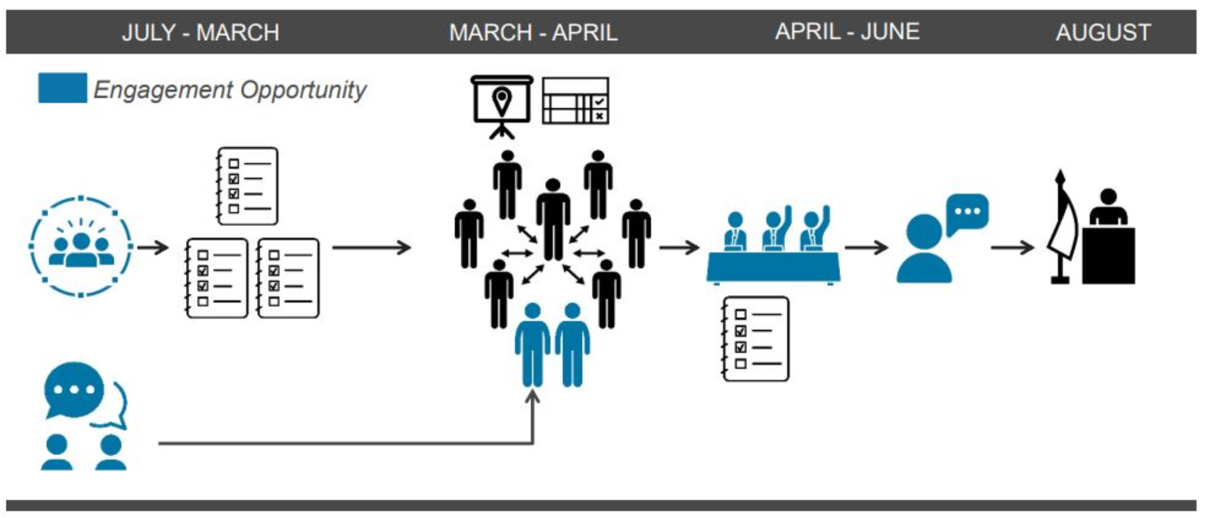
Sub-recipient Selection
Have a documented Selection Process that includes a framework for Risk Assessment

Slide 6
City of Saint Paul’s Selection Process
Capital Improvement Budget Committee (CIB)
Risk Assessment
Applicant Presentation
CIB committee recommendation
Mayor
City Council

Slide 7
Risk Assessments – Pre-award
Initial Risk Assessment (Low, Med, and High)
Sams UEI check
Review of proposed project/program for eligibility
National objective
Eligible activity
Align with City goals/priorities (Consolidated Plan)
Request for $250,000+
Capacity
City’s adverse lending list
CDBG experience
Financial concerns
Staffing issues
Timeliness (can funds be expended)
High
5 or more Risk Factors
Medium
2-4 Risk Factors
Low
Less than 2 Risk Factors

Slide 8
Subrecipient Selection
Public Comment Period
Application Submission
Staff Review
(Eligibility & Risk)
CDCIP Board’s Recommendation
Mayor’s Recommendation
City Council’s Final Decision
Public Comment Period

Slide 9
Initial Risk Assessment
Size of request
New or existing program
Experience with Federal, State, or Salt Lake City Funding
Employee Turnover (program staff, financial staff, leadership)
Spend down
Previous Monitoring Results

Slide 10
Monitoring Basics
Monitoring is an ongoing process
Set subrecipients up for success
Review of compliance throughout the year
In-depth review mid-year vs end of year
Monitor 10% of subrecipients or 2 per program, whichever is greater
Create program specific monitoring checklists
Five steps in a monitoring visit

Slide 11
Subrecipient Oversight
All grantee training
Track agency behavior
Reporting
Reimbursement Requests
Spenddown
Timely Communication
Etc.
Provide technical assistance as needed (formal/informal)

Slide 12
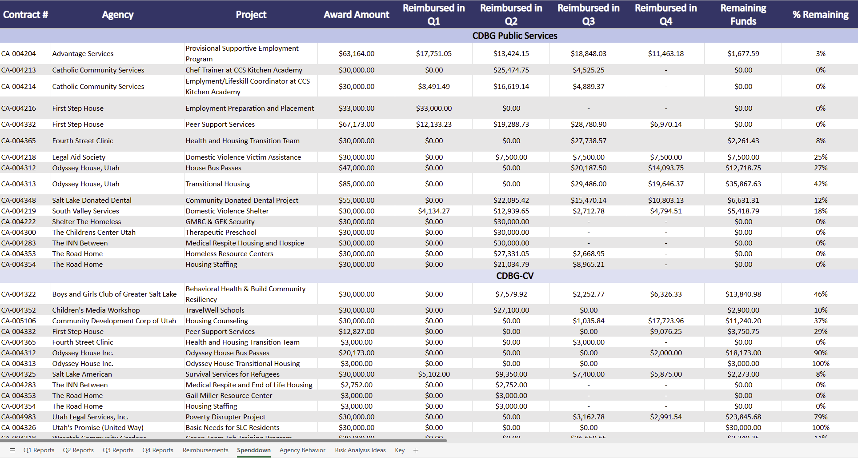

Slide 13
Selecting Subrecipients to Monitor
Previous Monitoring Results
Reoccurring Findings
Amount of Funding
Complaints
Time Since Last Monitoring
Employee Turnover
New Project
Program Performance
Timeliness
Success Meeting Goals

Slide 15
Risk Assessments – Post Award
Annual Risk Assessment (Low, Med, and High)
$250,000+ award
Funds expended
National Objective/accomplishment
Program income – will it revolve
Performance issues (citizen complaints, complied with City & Federal compliance requirements etc.)
Staffing issues

Slide 16
Monitoring Objectives
Identify potential problem areas and assist the subrecipient in complying with applicable laws and regulations.
Provide adequate follow-up measures to ensure that performance and compliance deficiencies are corrected by subrecipients and not repeated.
Assist grant recipients by providing insight on performance and recommendations for improvement of program implementation.
Provide a record of accomplishments, and maintain contact with sub-recipients, their activities, and programs.
Ensure that HUD funds are expended on eligible and fundable activities.
Provide TA and always document!

Slide 17
Types of Monitoring
Desk Review
Review of monthly/quarterly reimbursements reports for completeness and compliance (eligible expenditures, financial documents, lien waivers and other relevant docs etc.)

Slide 18
Types of Monitoring
On-site Review:
Annually (High Risk)- 3-year rotation
Examination of program documents and project files (ER, procurement process).
Financials
Interview PM staff
Project site visits

Slide 19
Monitoring Conclusions:
Concerns- need to be brought to the attention of the program participant, could lead or develop into a finding if not addressed.
Findings- requires a written corrective action plan needed to resolve the problem.
Corrective Action Plan – needs reasonable timeframe for subrecipient to achieve compliance

Slide 20
Monitoring Guide – CDBG
Eligibility
Conformance with Subrecipient Agreement
Record-keeping Systems
Financial Management Systems
Procurement
Equipment and Real Property

Slide 21
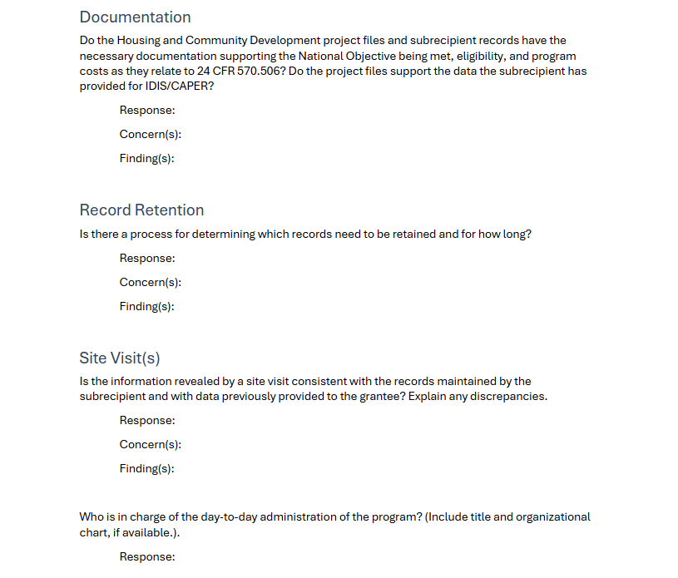
Record Keeping Systems

Slide 22
Monitoring Guide – HOME
Homeowner Rehabilitation
Homebuyer Assistance (Development and/or Rehabilitation)
Homebuyer Down Payment Assistance (DPA)
Rental Development or Rehabilitation
Tenant-based Rental Assistance (TBRA)

Slide 23
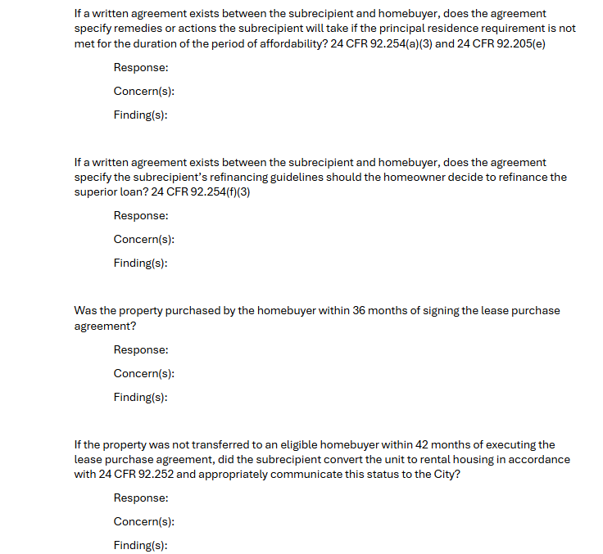
Homebuyer Assistance (Development and/or Rehabilitation)

Slide 24
Highlights
Start with the end in mind
Monitor internal programs
Make monitoring guides program specific
Monitoring is a team effort – work with subrecipients, not against them

Slide 25
Resources
Managing CDBG: A Guidebook for Grantees on Subrecipient Oversight
Subrecipient Oversight and Monitoring – A Roadmap for Improved Results
HUD Notice on Implementing Risk Analyses for Monitoring CDBG Programs
HUD Monitoring Desk Guide
Monitoring HOME Slide Deck
Subpart D - Subrecipient Monitoring and Management
www.sam.gov/search

Slide 26
Questions?

Slide 27
Contact Us
Sarah Nielsen, Sarah.Nielsen@slc.gov
Department of Community and Neighborhoods
Salt Lake City, UT
Beth Ulrich, Beth.Ulrich@ci.stpaul.mn.us
Department of Planning and Economic Development
City of St. Paul, MN
Tchu Yajh, Tchu.Yajh@ci.stpaul.mn.us
Department of Planning and Economic Development
City of St. Paul, MN

