Slide 1
Quincy, MA John Sasso Presentation
June 2025

Slide 2
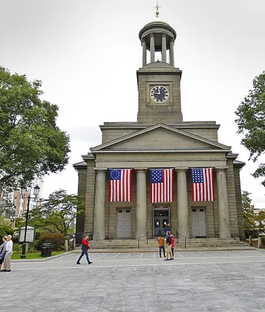
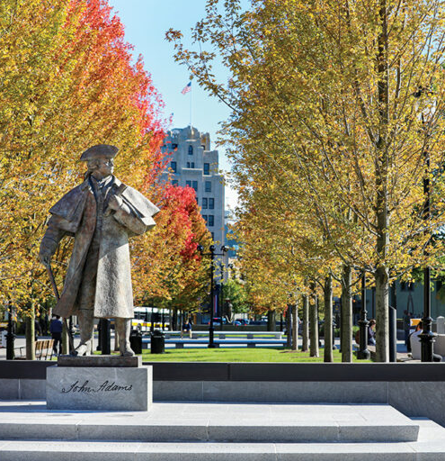
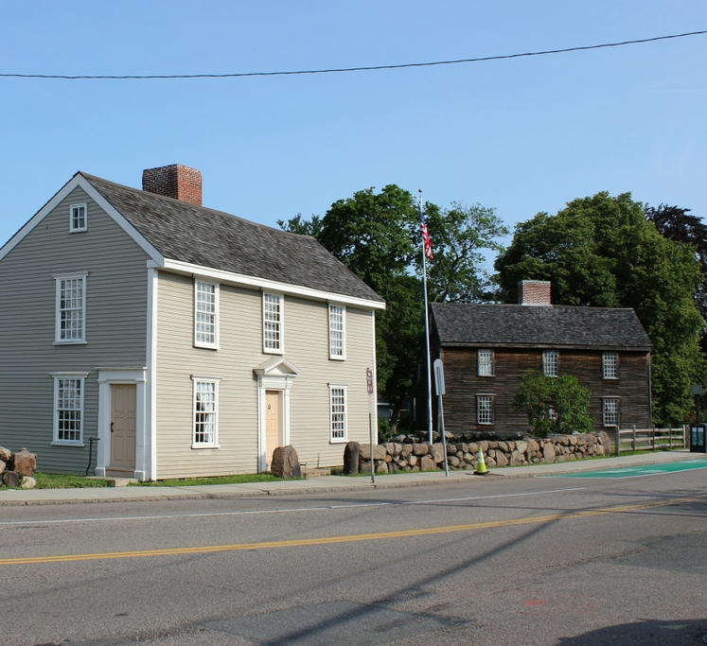
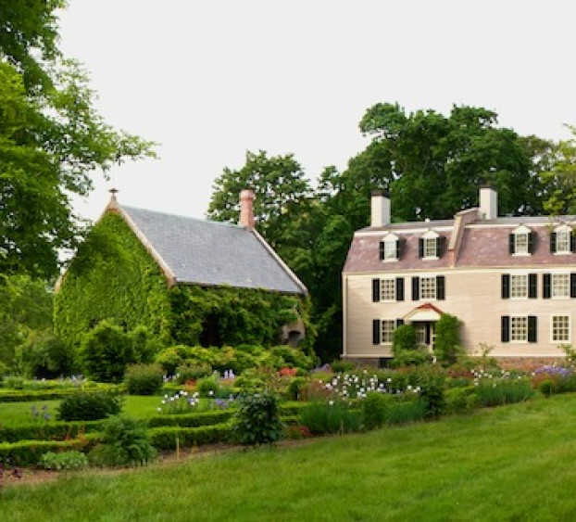
Quincy Facts
Population: 101,000
“City of Presidents” - John Adams & JQA
Location of “Old House” at “Peacefield”
Birthplace of John Hancock
CPD Funds: $9M CoC; $1.8M CDBG; $800K HOME (5); $150K ESG
Other HUD Funds: Lead Paint Abatement (over $5M since 2019)

Slide 3
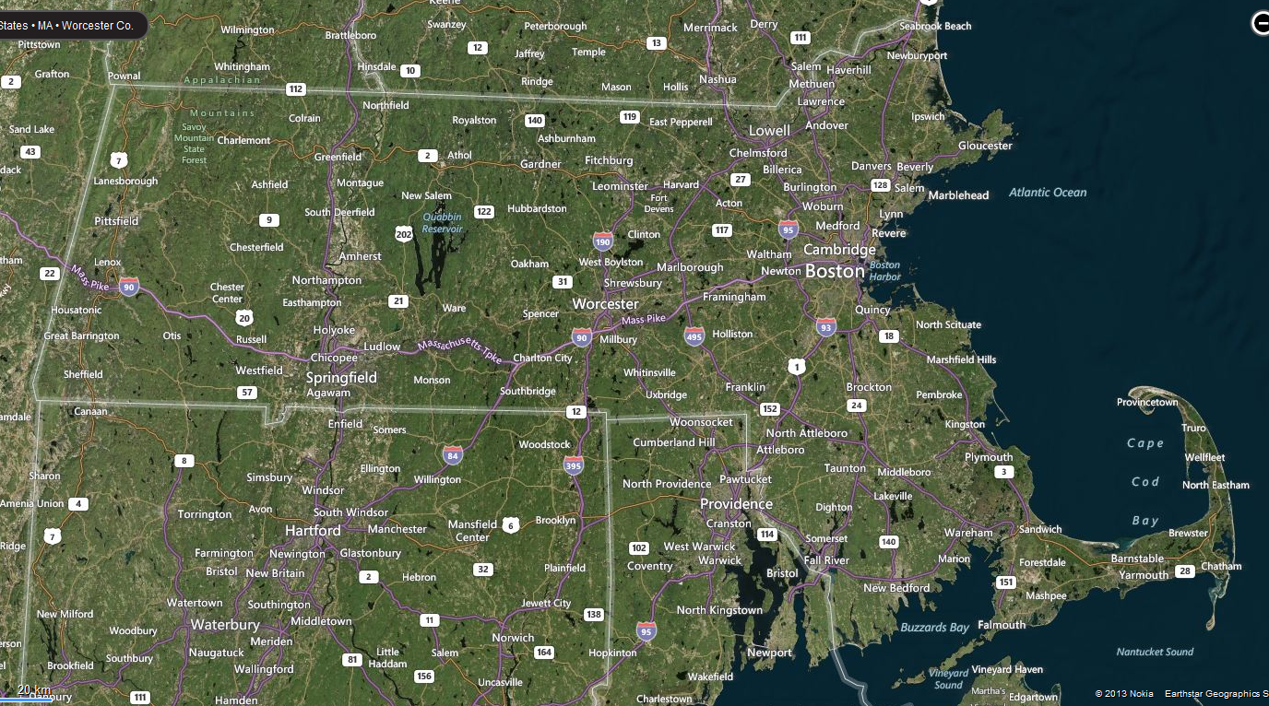
Overview

Slide 4
CD Week Activities…

Slide 5
“Home Sweet Healthy Homes” Podcast

Slide 6
Quincy Access Television interview

Slide 7
Cultural Dance Performance @ AASA

Slide 8
Senior Luncheon @ HNCC

Slide 9
Public Services Summit w/ Police Chief

Slide 10
50th Anniversary Celebration @ FRCC

Slide 11
Remarks by Mayor and Congressman

Slide 12
Premier of Public Services Video

Slide 13
Awards

Slide 14
Staff Photo with Congressman Lynch

Slide 15
Lifetime Achievement Award

