Slide 1
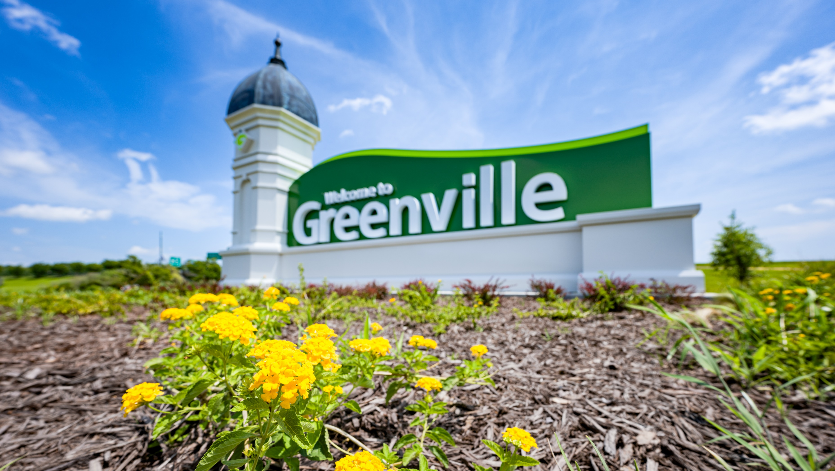
City Of Greenville, NC
An Overview of National Community Development Week 2025

Slide 2
National Community Development Week Kickoff Luncheon

Slide 3
A local homeowner shares her powerful story of home rehabilitation, highlighting the impact of our housing programs.

Slide 4
Land Loss Prevention Lunch & Learn

Slide 5
The Land Loss Prevention Project providing guidance on protecting heir property.

Slide 6
Contractors Workshop

Slide 7
Construction managers from our team outlined the steps and opportunities involved in becoming a certified contractor through the Community Development Division.

Slide 8
Down Payment Assistance Seminar

Slide 9
Staff presented our Down Payment Assistance Program to local banks, lenders, and future homeowners.

Slide 10
Community Service Day

Slide 11
Community Development staff volunteered with the Council on Aging and local homeless shelter.

Slide 12
Thank you NCDA!

