Slide 1
Section 3 & Workforce Development
Susan M Ludwig - Deputy director
City of jersey City Division of Community development
Notes:
Good afternoon, everyone and thank you to NCDA for having me.

Slide 2
Our Mission
is to strengthen Jersey City through fostering solid partnerships and responsibly investing our funding resources in the community.
Notes:
It is our mission to strengthen the human and physical landscape of Jersey City through fostering.
solid partnerships
and responsible investment our funding resources in the community

Slide 3
Our community
has population of 292,449 (2020 census), an increase of 44,852 (+18.1%) from the 2010 census count of 247,597.
a population density of 17,954.6 persons per square mile.
one of the most ethnically diverse cities in the world, as a major port of entry for immigration to the United States. It is also a major employment center at the approximate core of the New York City metropolitan area.
Notes:
I thought I would start with a little bit of history, so that you could better understand this culturally rich community…
In 1609, Henry Hudson, seeking an alternate route to East Asia, anchored his small vessel on the shores of what is now know now as Jersey City, Hoboken, and Weehawken. After spending nine days surveying the area and meeting its inhabitants, he sailed north to Albany NY.
In 1804, Alexander Hamilton, focused on increasing manufacturing in the greater New York City area. Which, helped to create the Associates of the Jersey Company which would lay the groundwork for modern Jersey City through the intersection of private development.
Today, JC has population of 292,449 (2020 census), an increase of 44,852 (+18.1%) from the 2010 census count of 247,597. Now that might not seem like a large population, compared to other cities, but you have to consider JC’s footprint size.
the city had a total area of 21.13 square miles (54.74 km²), including 14.74 square miles (38.19 km²) of land and 6.39 square miles (16.55 km²) of water (30.24%).
Breaking down to a population density of 17,954.6 persons per square mile.
In addition, JC is one of the most ethnically diverse cities in the world, as a major port of entry for immigration to the United States. It is also a major employment center at the approximate core of the New York City metropolitan area.

Slide 4
Our funding
Jersey City Division of Community Development receives an annual allocation of HUD Entitlement funding based on the defined need in the community.
Our 2022 award:
$5,333,792 in Community Development Block Grant (CDBG) funds;
$2,388,869 in HOME Investment Partnerships Program (HOME) funds;
$2,320,676 in Housing Opportunities for Persons with AIDS (HOPWA) funds;
$496,319 in Emergency Solutions Grant (ESG) funds for Fiscal Year 2022.
Notes:
JC Division of Community Development has a portfolio of $10,5 million in HUD Entitlement Funding
Focused on programs and projects funded by what we like to call “the alphabet soup… nuts to bolts….
CDBG
HOME
HOPWAS
ESG
In addition, we received HOME ARP funding, which we are developing that program now, which we intent to release an RFP for in early spring.

Slide 5
Our functions
act ion
Affordable Housing & Construction
Gap Finance
Direct Services
Emergency Shelter
Emergency Relocation
Homeownership Program
Home Improvement Program
Housing Navigator
Nonprofit Services
Resource Support
CSBG
ESG
HOPWA
Notes:
Gap Finance for Public Infrastructure, New Affordable housing Residential owner/rental, Rehabilitation owner/rental

Slide 6
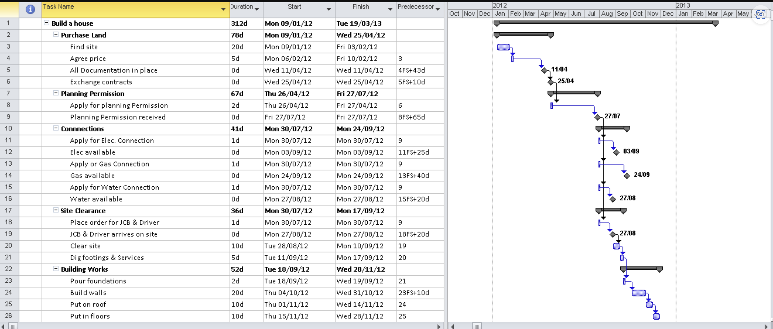
Our workflow

Slide 7
Section 3 Compliance
BMP’s
Recipients/Contractors/Subcontractors Packet
Compliance Forms
Certification Requirements
Reports
Overview of compliance
Key definitions & New Final Rule Identification of Section 3 Coordinator
Contract Provisions for Section 3 Projects
Section 3 Contracting Policy and Procedure
Section 3 Eligibility Certifications
Section 3 Procedures for Contractors/Subcontractors
Reporting Requirements
Records Required to Maintain
Monitoring Requirements
Contractors/Subcontractors
certify that they will comply with all relevant regulations, submit all relevant documentation, include the Section 3 Clause in every subcontract, and will not contract/subcontract with any who have previously violated 24 CRF Part 75 regulations.
Documentation of…
Section 3 Business Concern Certification
Worker Self-Certification
Provide & Maintain
Section 3 Contractor/Subcontractor Hours Report
Master Hours Sheet
Labor Hours Report
Qualitative Efforts Report
Notes:
So with that said, how do we integrate Section 3 into our workflow

Slide 8
partners
TRANSPORTATION, LOGISTICS AND DISTRIBUTION (TLD)
4-week program with certification tests for a Forklift Operator and OSHA (Occupational Safety and Health Act) 10 certification.
WOMEN'S PRE-APPRENTICE PROGRAM
The Northeast Carpenters Apprentice Training and Education Fund along with Sisters in the Brotherhood run a Women’s Pre-Apprentice Program. Once completed the opportunity can lead to a five-year apprenticeship with the carpenter's union where you earn while you learn.
Rising tide capital
THE COMMUNITY BUSINESS ACADEMY
Hands-on business management training to start or grow your business
BUSINESS ACCELERATION SERVICES
A suite of support services to accelerate your business goals
CREDIT TO CAPITAL
Acquire the capital you need by working one-on-one with a business coach
Women rising
Notes:
RTC a new non-profit organization whose mission is to transform lives and communities through entrepreneurship.
WR
For over 117 years, WomenRising has been helping women and their families. Our clients are in need - in need of jobs, safety from domestic violence, freedom from homelessness, safe lives for children.

Slide 9
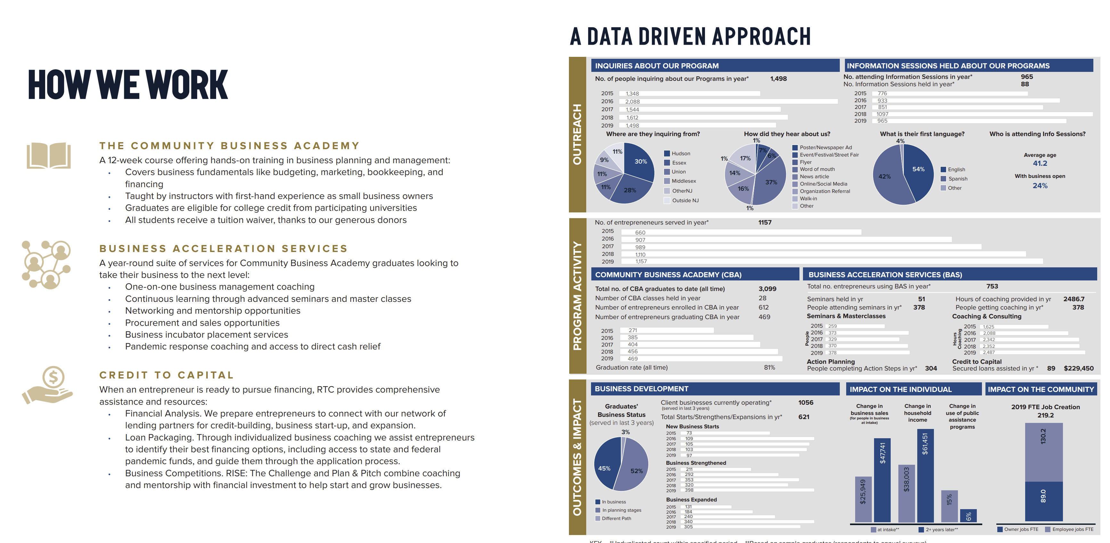
RTc dashboard
Notes:
Data Driven Approach to their mission

Slide 10
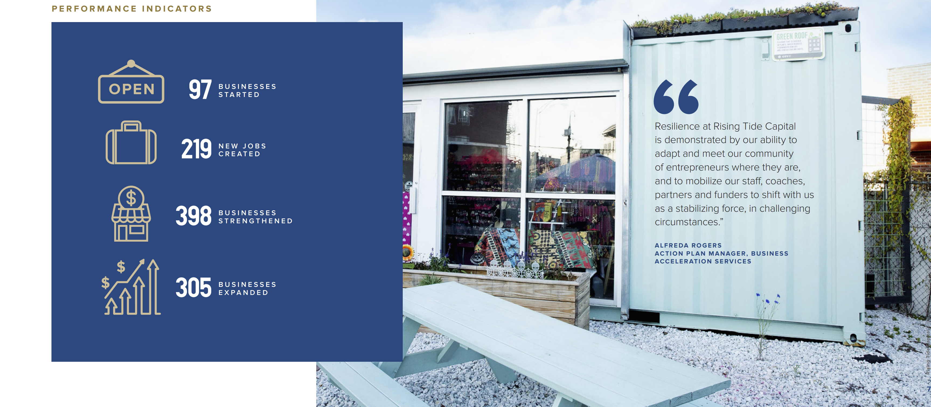
impact

Slide 11
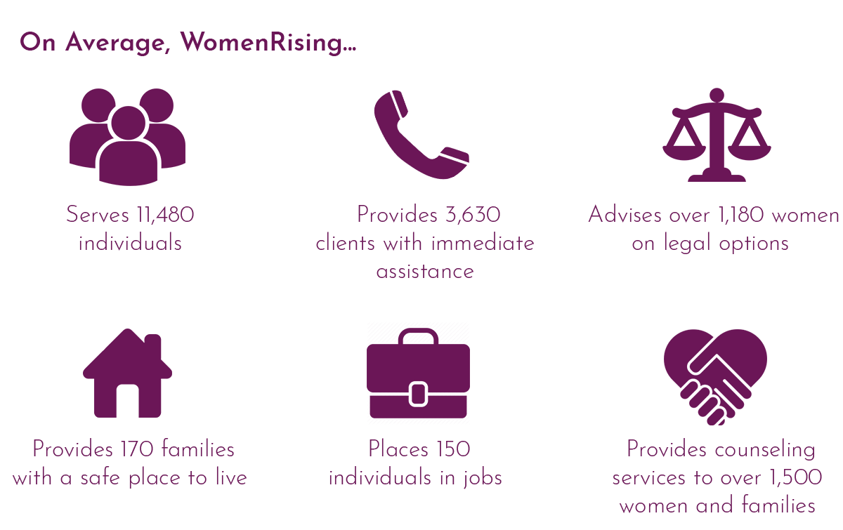
impact

Slide 12
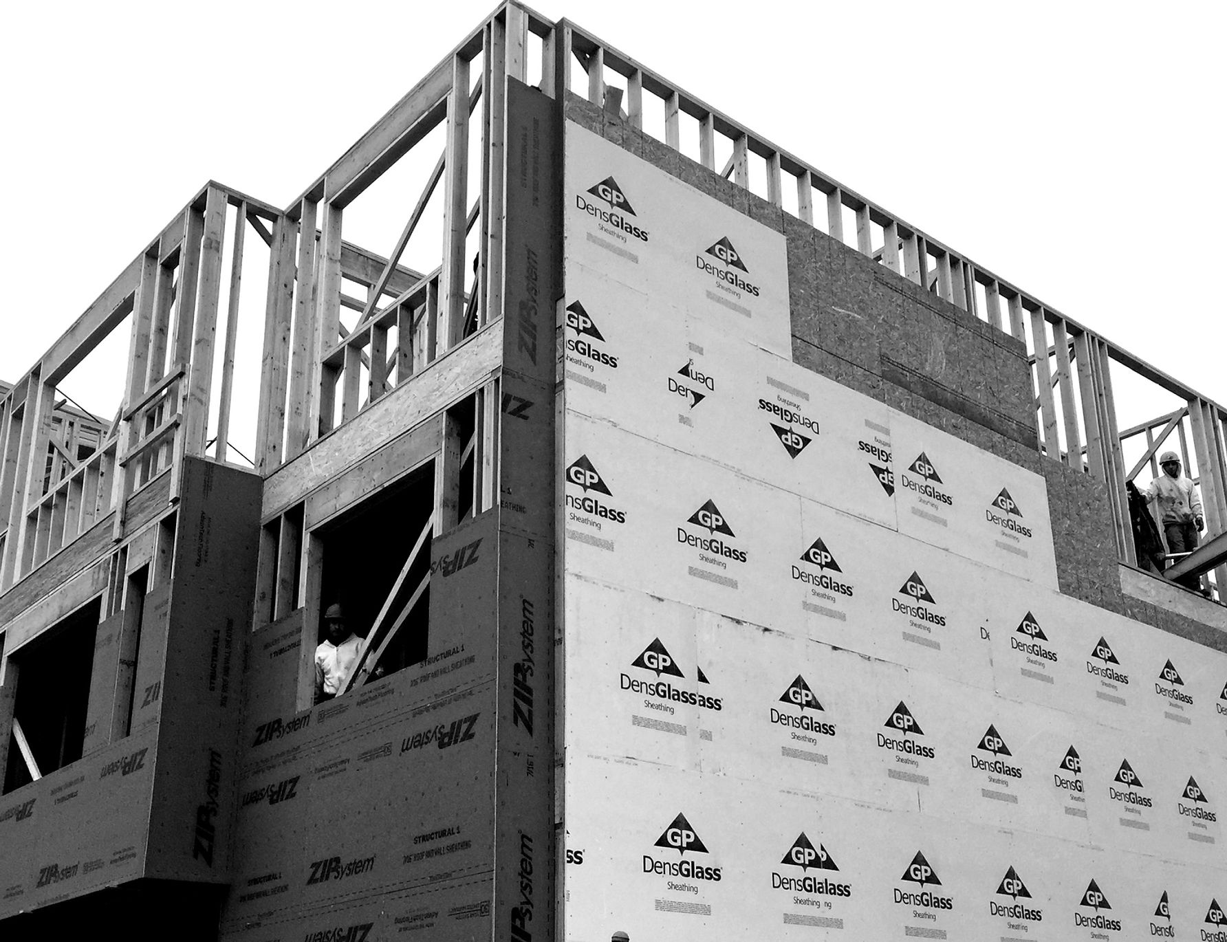
CARA SQUARED
our affordable housing development partner, along with our prior company JP Affordable Housing.
they have built in Jersey City 16 affordable housing projects.
accomplishments range from new construction to rehabilitated structures.
created thousands of jobs through their projects in the region.

Slide 13
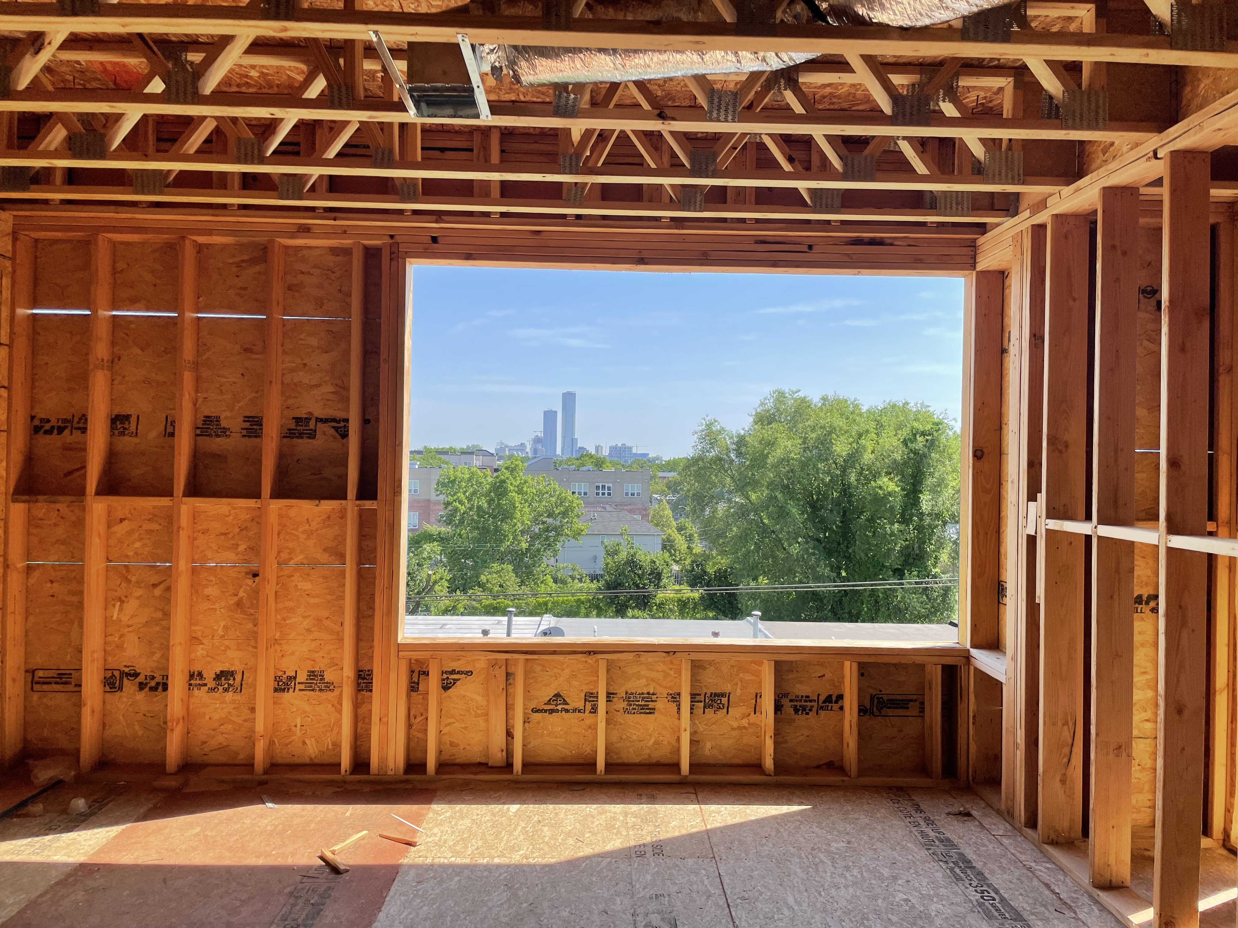
impact
Projects Result In The Following:
​
​Affordable Homeownership Opportunities 9
Job Creation 5
Energy Efficient Homes
Productive Land Use
Tax Revenues, Investor Capital
Neighborhood Beautification
Positive Community Impact
C
2

Slide 14
Our approach

Slide 15
Thank you!
sludwig@jcnj.org
Community Development - City of Jersey City (jerseycitynj.gov)

