Slide 1
SECTION 3 BEST PRACTICES
MDHA – NASHVILLE-DAVIDSON COUNTY Community Development Department

Slide 2
COMPONENTS OF SECTION 3 IMPLEMENTATION
Section 3 Overview and Technical Assistance for Contractors and Subcontractors
New documents created for Section 3 certifications and reporting
MDHA public service activity for Section 3 implementation and focus

Slide 3
SECTION 3 OVERVIEW AND TECHNICAL ASSISTANCE
At each pre-construction meeting, MDHA staff provide contractors and subcontractors with the following information:
Explanation of the HUD Section 3 final rule 24 CFR part 75 and requirements
Definitions of the following:
Section 3 Business Concern
Section 3 Worker,
Targeted Section 3 Worker
Section 3 Reporting Requirements
Explanation for self-certification and employer certification of Section 3 and Targeted Section 3 workers
Hiring Requirements and/or Exclusions clarification
MDHA staff are available for further technical assistance and guidance as needed.

Slide 4
SECTION 3 DOCUMENTS FOR IMPLEMENTATION
The following documents are provided to contractors and subcontractors at pre-construction meetings:
Section 3 Overview Power Point slides
Section 3 Contractor and Subcontractor Certification – Pre-Construction
Section 3 Business Concern Certification
Section 3 Worker and Targeted Section 3 Worker Self-Certification
Section 3 Worker and Targeted Section 3 Worker Employer Certification
Section 3 Compliance Monthly Report
** Samples of documents provided on the next slides(first pages only). Full versions can be requested via email after the conference.

Slide 5
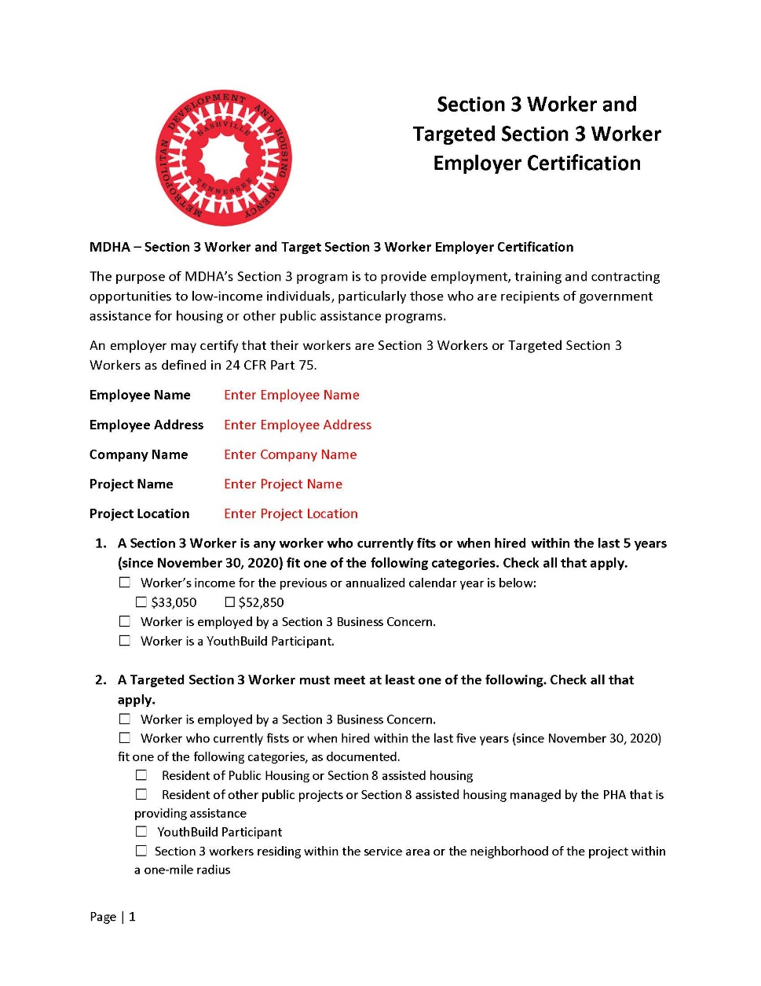
SAMPLE SECTION 3 DOCUMENTS

Slide 6
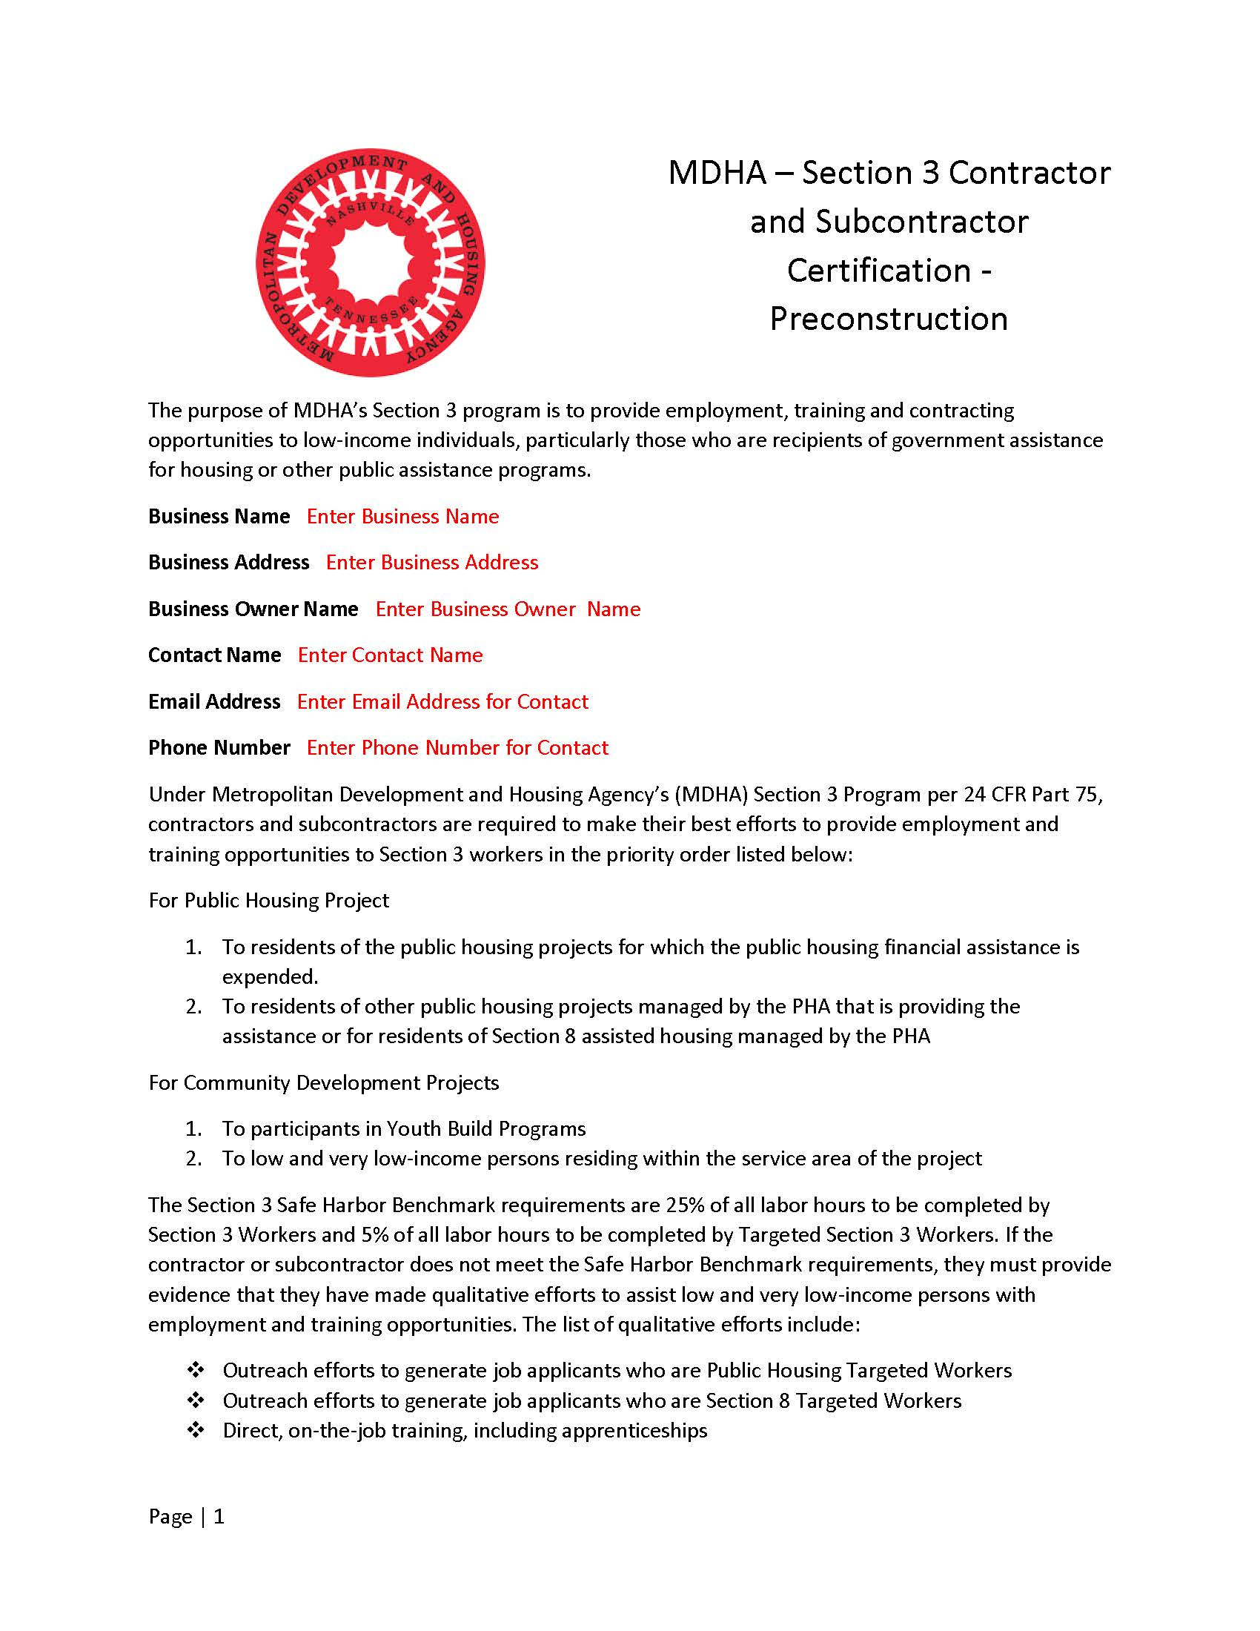
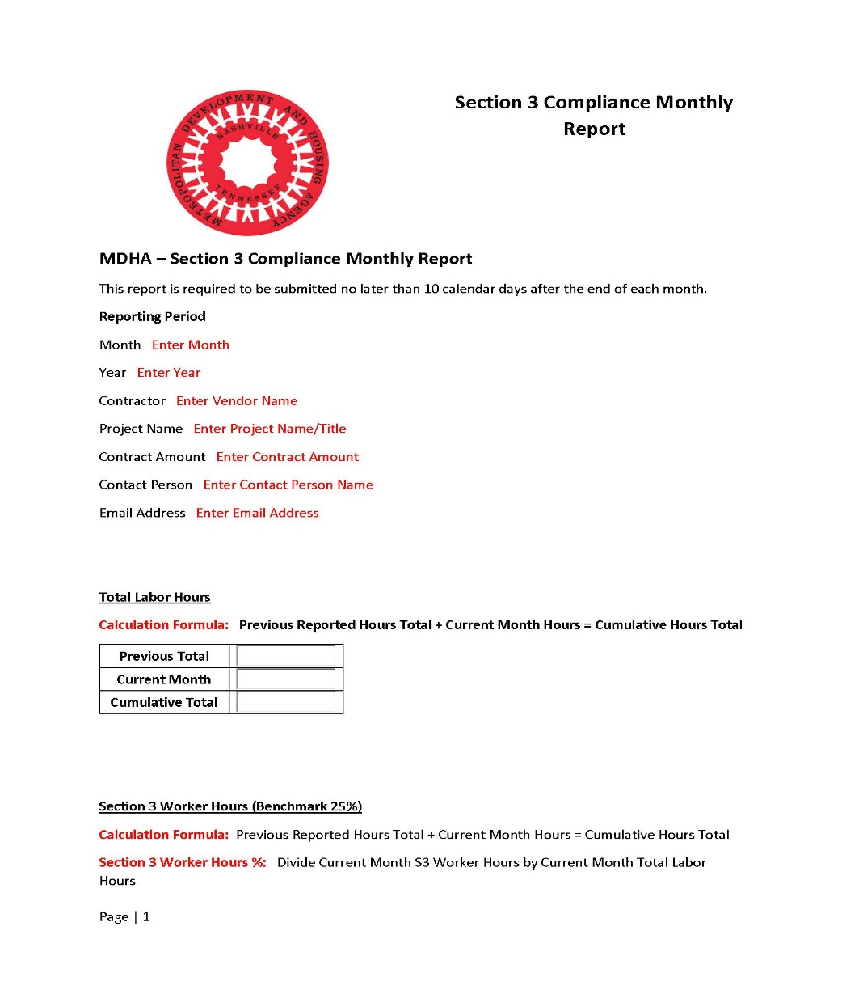
SECTION 3 SAMPLE DOCUMENTS

Slide 7
MDHA PUBLIC SERVICE ACTIVITY FOR SECTION 3 IMPLEMENTATION
MDHA EMPLOYMENT SERVICES PUBLIC SERVICE ACTIVITY
Employment training/counseling services for LMI persons to aid in Section 3 employment opportunities associated with housing construction and redevelopment projects being undertaken by MDHA.
Program started in PY 2018 and continuing through PY 2022
606 individuals served to date

Slide 8
Section 3 Final Rule
Questions?

