Slide 1

Workforce Development Training/Section 3 in the City of Newburgh, NY
Presenter: Ellen J. Fillo, Director of Community Development

Slide 2
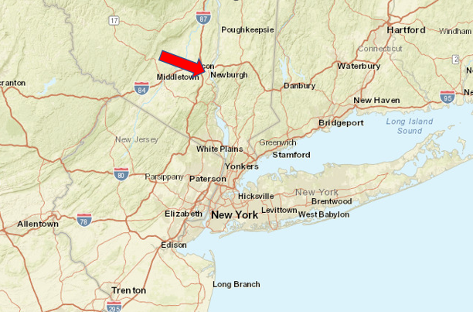
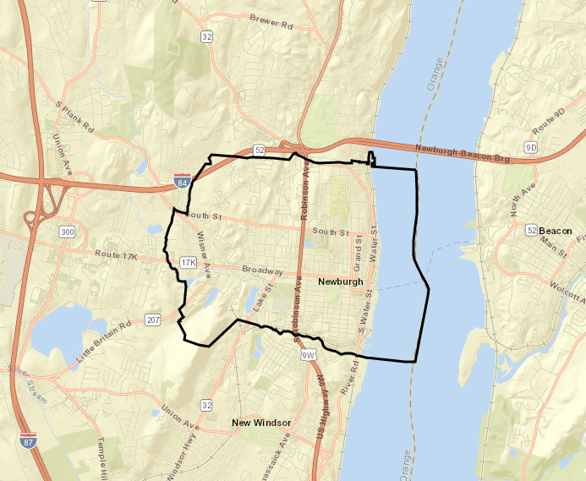
City of Newburgh, NY
Approximately 60 miles north of New York City on the west side of the Hudson River, Orange County
  Small, densely populated city, 28,834 people
  Surface area of 3.8 square miles
Fun Fact! Birthplace of the “I Love Lucy!” Show
Source: CPD Maps

Slide 3
City of Newburgh – Race & Hispanic Origin
Source: US Census

Slide 4
City of Newburgh – Additional Information
Source: US Census

Slide 5


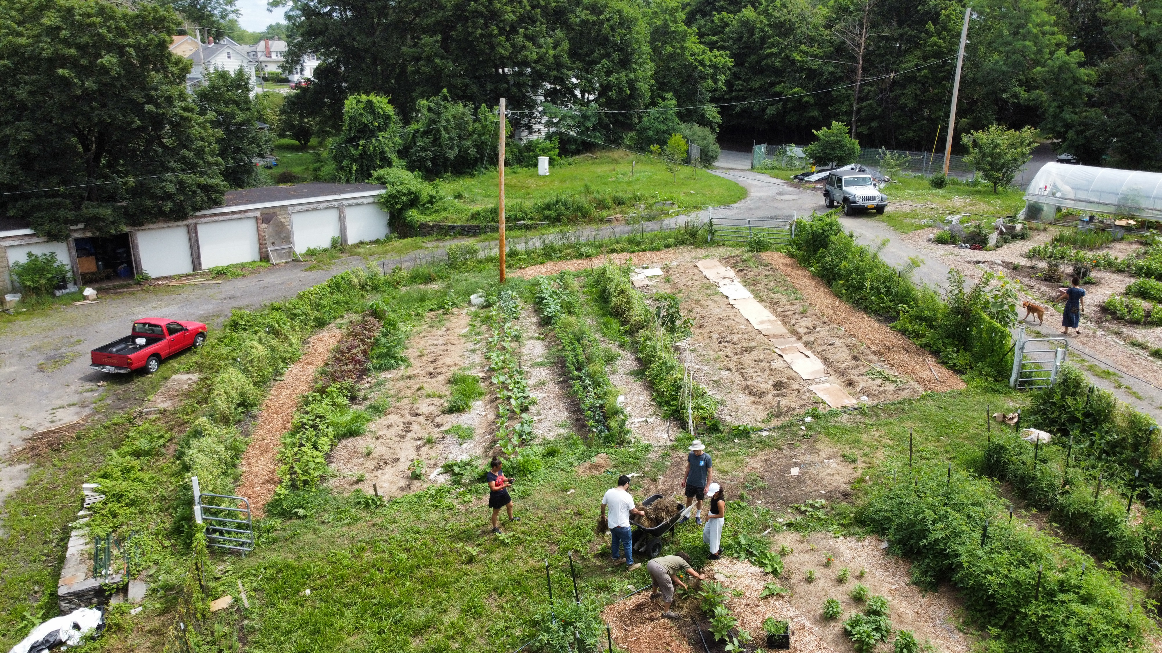
City of Newburgh
The City of Newburgh receives annual Community Development Block Grant (CDBG) Entitlement funding of approximately $850,000.00

Slide 6
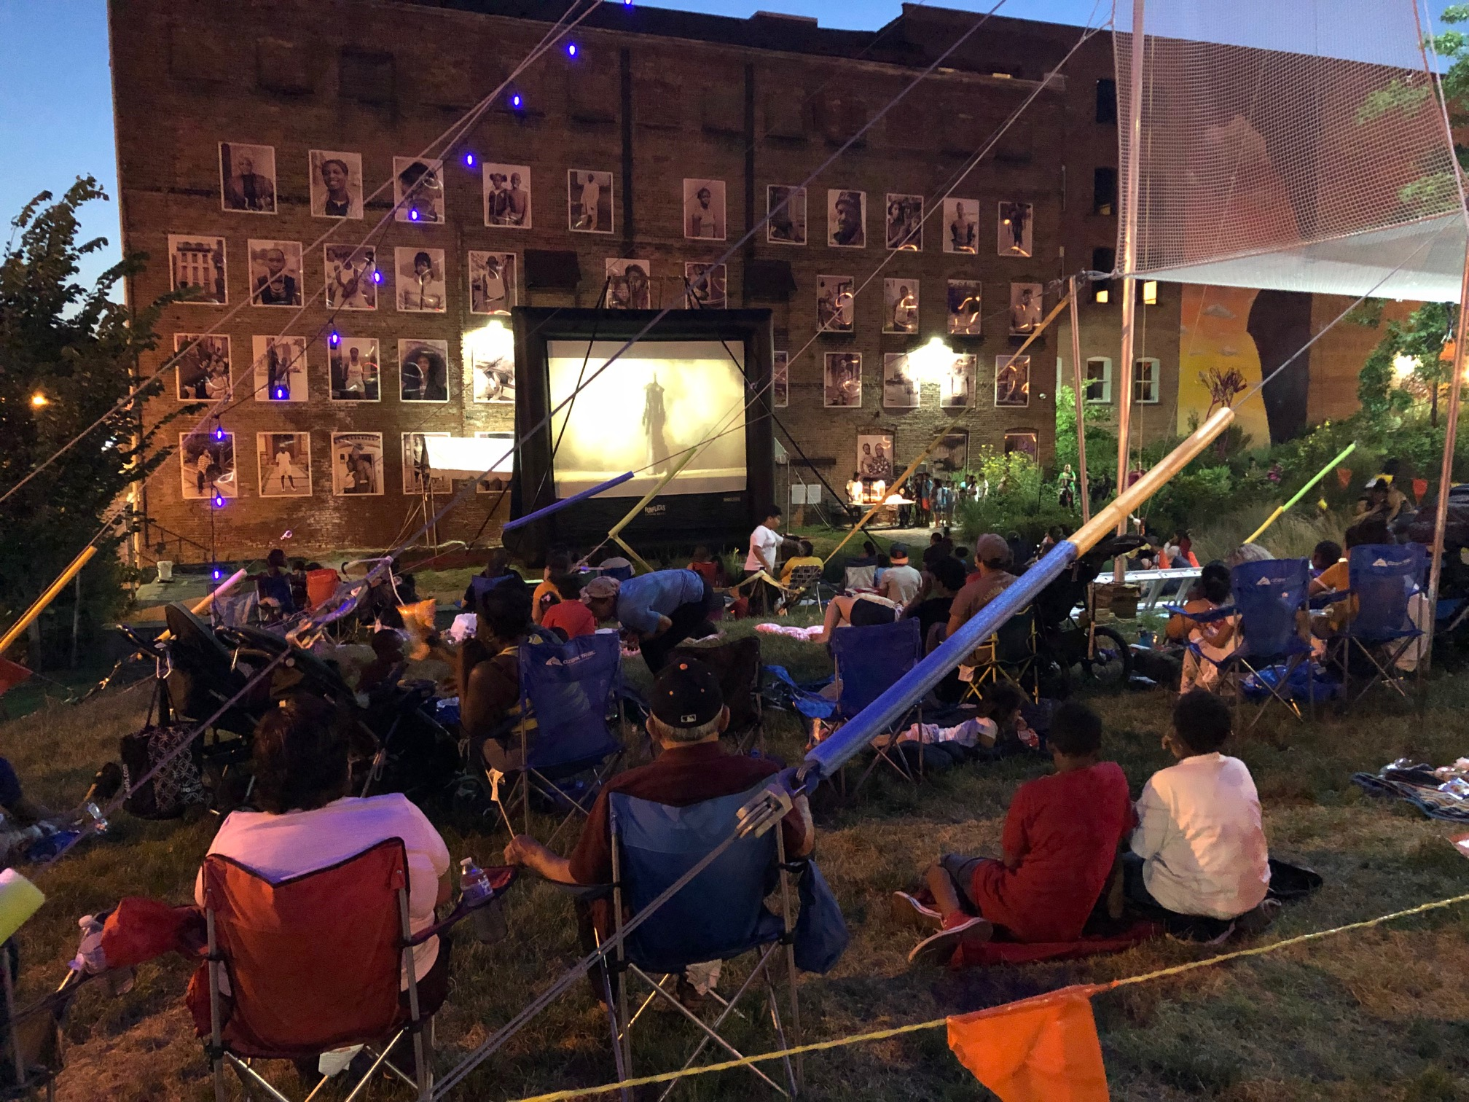

City of Newburgh
Projects Include Activities in:
Infrastructure Improvements
Public Facility Improvements
Housing
Neighborhood Services

Slide 7
City of Newburgh
One of the most frequent comments received each year (Elected Officials, Residents) through public meetings (CDBG and non-CDBG related):
“Provide opportunities for Good Paying Jobs”

Slide 8

City of Newburgh – Section 3 Partners
U.S. Department of Housing & Urban Development (HUD)
U.S. Small Business Administration (SBA)
City of Newburgh Departments
City of Newburgh Elected Officials
City of Newburgh Housing Authority
Legal Services of the Hudson Valley
City of Newburgh Faith-Based organizations
Newburgh Free Library
Newburgh Enlarged City School District
Orange County, NY Employment & Training

Slide 9

City of Newburgh Workforce Development Opportunities
Choice Films - Below the Line Bootcamp
  In 2018, “Below the Line Bootcamp” was born. The program is dedicated to the training of underserved communities in the fundamentals of film production and giving students immediate opportunities for employment as Production Assistants. BTL Bootcamp also provides continuing mentorship to all graduates as they consider and navigate a career in the film/television sector.
“Below the Line” (BTL) refers to any production costs not included in the above-the-line portion of the budget. It also refers to technical crew roles: workers who do not provide input, guidance, creative development, or leadership on the project.

Slide 10
City of Newburgh Workforce Development Opportunities
  Below the Line graduates receive the opportunity for immediate placement in paying transitional and then fully paid jobs on set.
  Productions include HBO, Crown Media, Netflix, as well as several independent productions, including Choice Films.
  Several graduates have recently joined labor unions, including DGA, IATSE, Teamsters/Local 817, and are receiving much needed pension and health benefits.

Slide 11
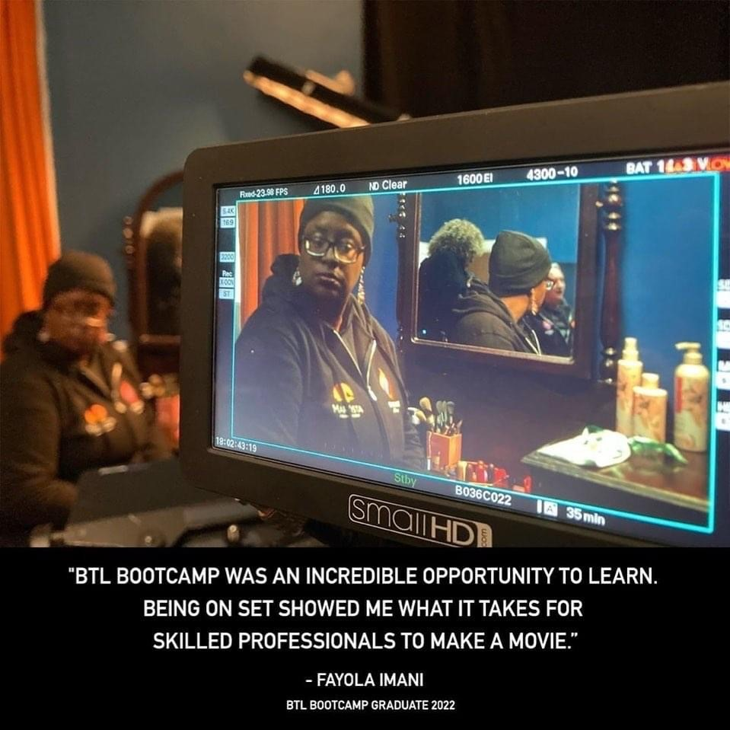
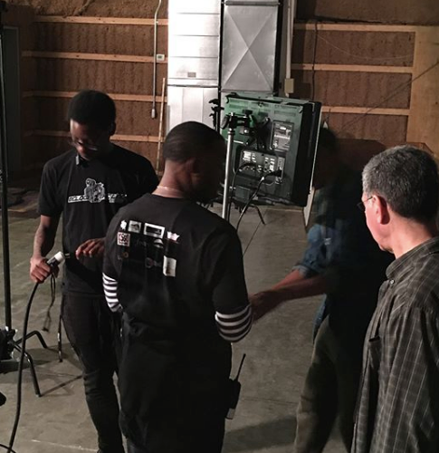
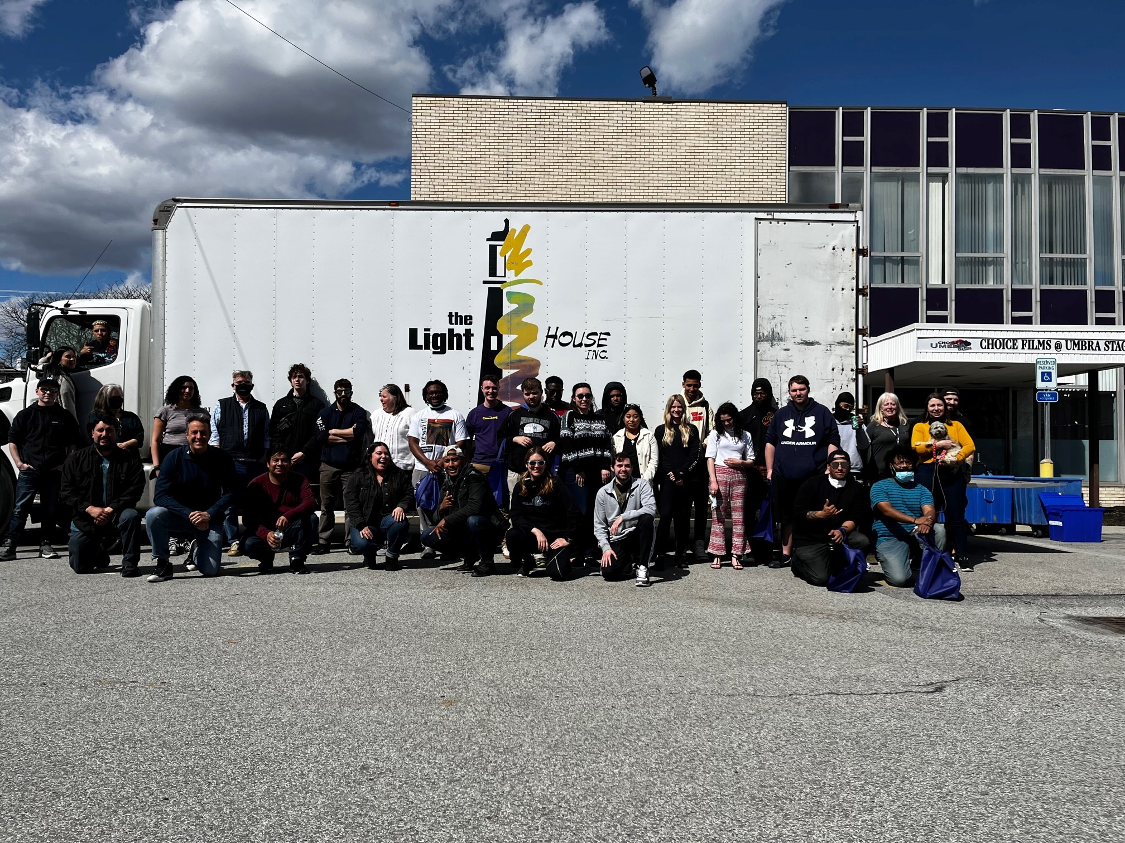
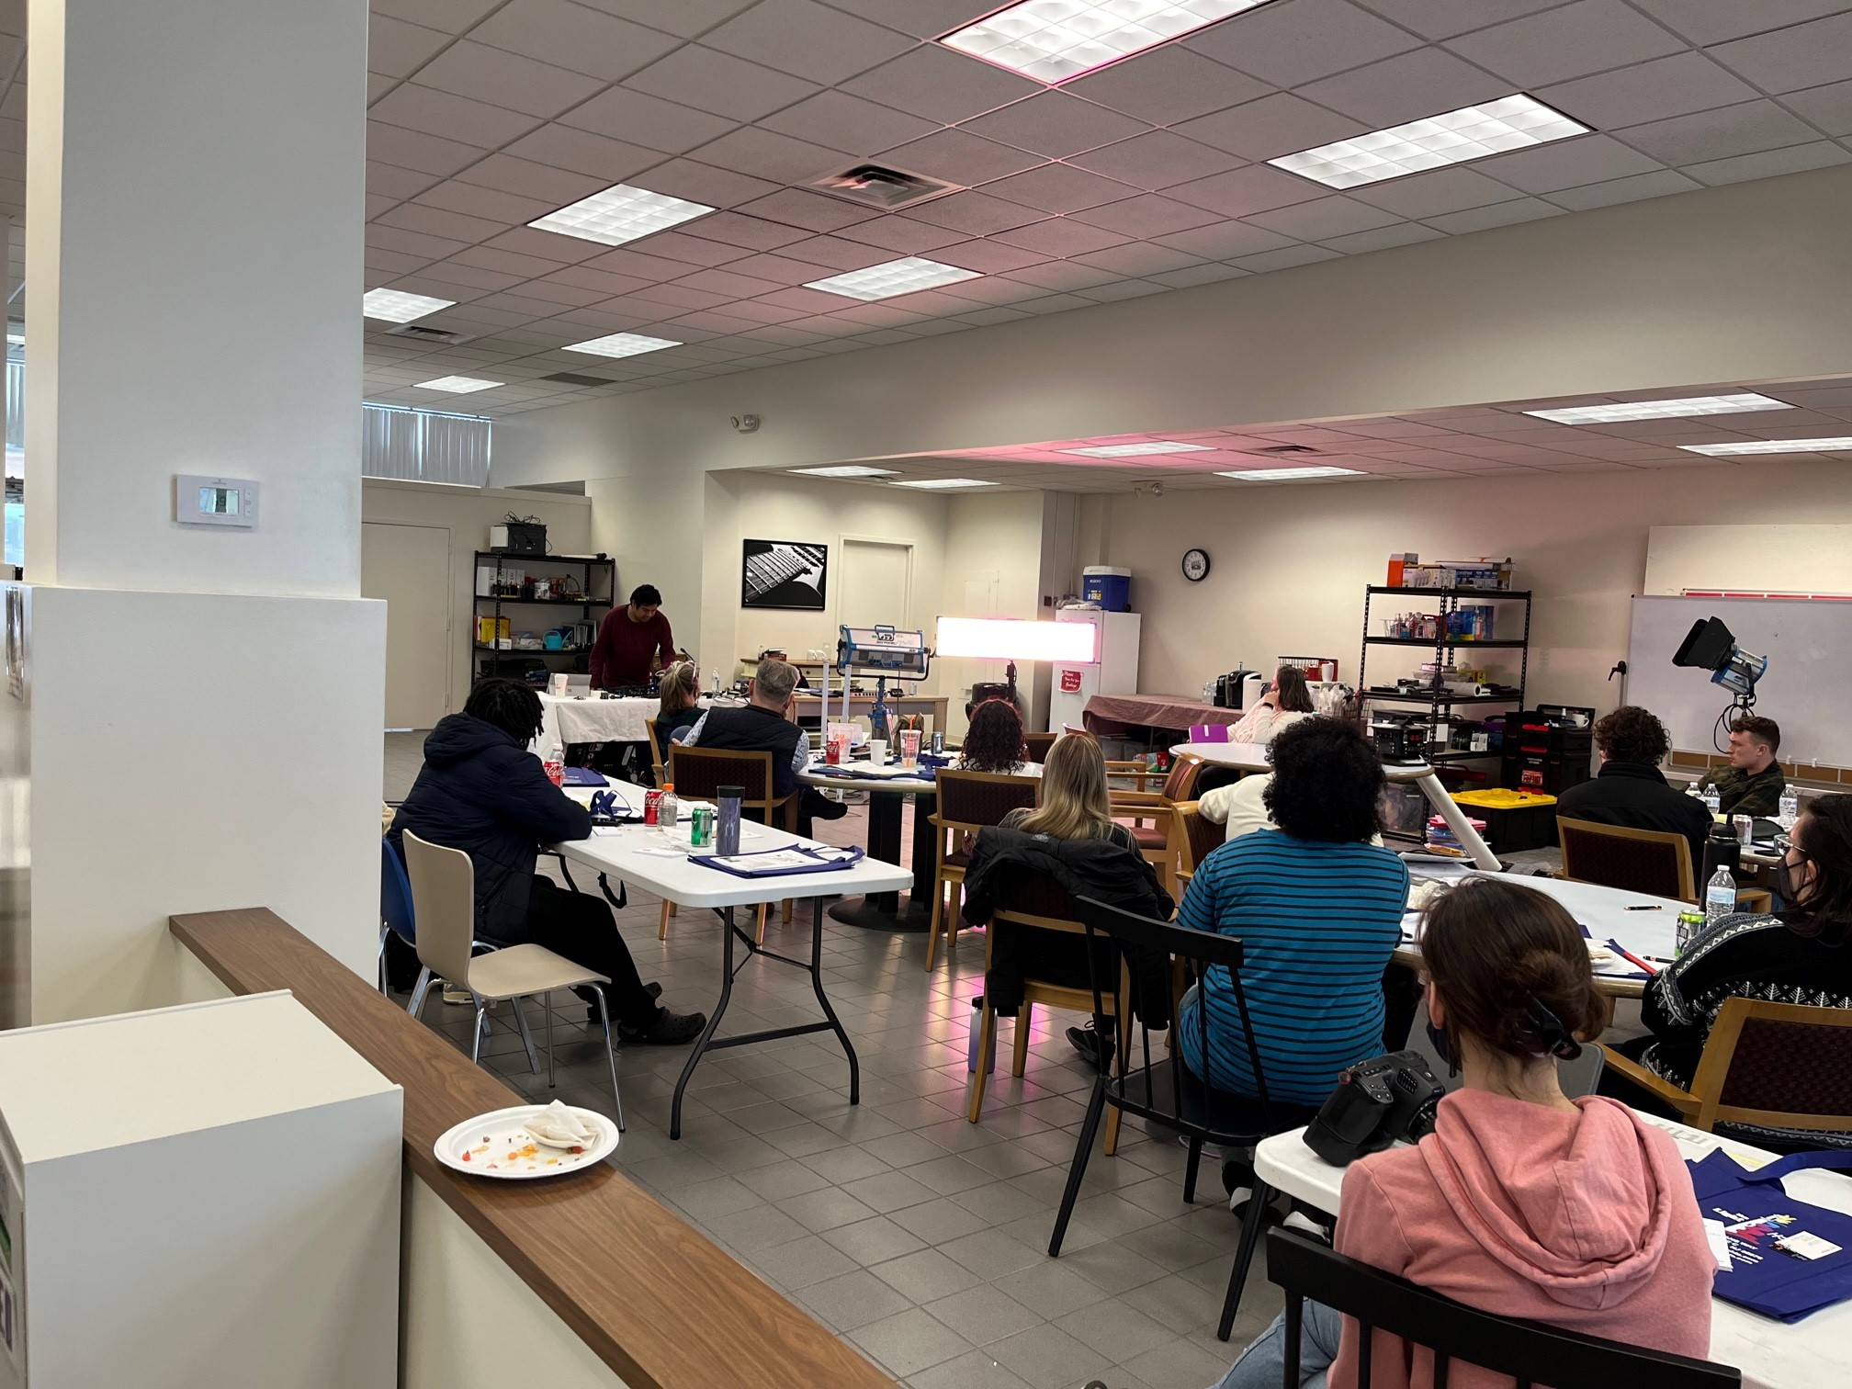
City of Newburgh Workforce Development Opportunities
  I

Slide 12
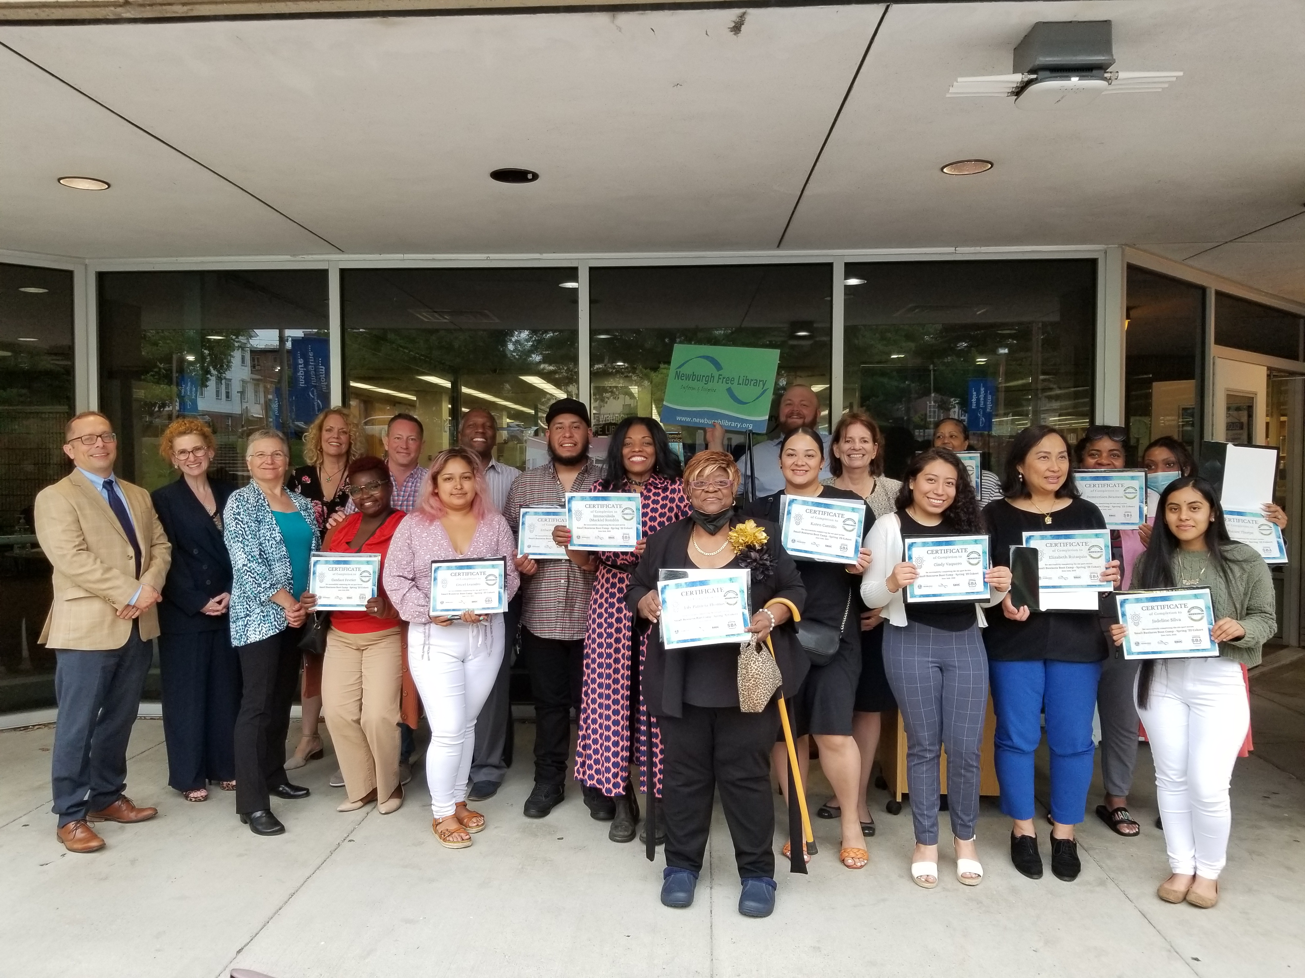
City of Newburgh Workforce Development Opportunities
  The City of Newburgh, through a Co-Sponsorship Agreement with the SBA, provides Small Business Bootcamps to provide City of Newburgh Residents with the tools needed to start their own business. Additional partners include HUD, the Newburgh Free Library, the local Small Business Development Center, and the Chamber of Commerce.

Slide 13

City of Newburgh Workforce Development Opportunities
The City of Newburgh, along with HUD, SBA and the Orange County, NY Career Center, provides “HUD Section 3” Workshops , for City Staff and businesses.

Slide 14
  Questions?

Slide 15
Contact Information
Ellen J. Fillo
Director of Community Development
City of Newburgh
City Hall – 83 Broadway
Newburgh, NY 12550
(845) 569-7386
efillo@cityofnewburgh-ny.gov

