Slide 1
New Member/First Time Attendee Orientation
NCDA 54th Winter Conference
Washington, DC
January 25, 2023

Slide 2
Speakers
Vicki Watson
Executive Director
National Community Development Association
vwatson@ncdaonline.org
Marcy Esbjerg
Director
Community Development
Pasco County, FL
NCDA Membership Subcommittee Co-Chair
mesbjerg@pascocountyfl.net

Slide 3
NCDA History - Origins
1968 – Model Cities Program legislation passed by Congress (LBJ’s “War on Poverty”)
1968 – Model Cities Directors’ Association formed
1974 – Community Development Block Grant replaces Model Cities Program
1974 – Association name changed to National Model Cities and Community Directors’ Association
1979 – Association name changed to National Community Development Association
June 2019 – NCDA Celebrates 50 Years
President Gerald Ford signs legislation for CDBG, 1974

Slide 4
NCDA Membership
516 members
Primary members: local CDBG entitlements
cities, counties, towns, villages
All members administer the CDBG program
Members also administer other HUD CPD programs
States and non-entitlement communities can be non-voting members

Slide 5
NCDA Staff
Primary Staff
Vicki Watson, Executive Director
Michael Lightfield, Controller
Jim Welfley, IT Director
Heather Johnson, Training Manager
Bob Gehret, Policy Analyst
Marcy Esbjerg, Conference Coordinator
Ashley Mason, Social Media Manager
Amaya Daniel, Intern
In Addition…
Numerous trainers

Slide 6
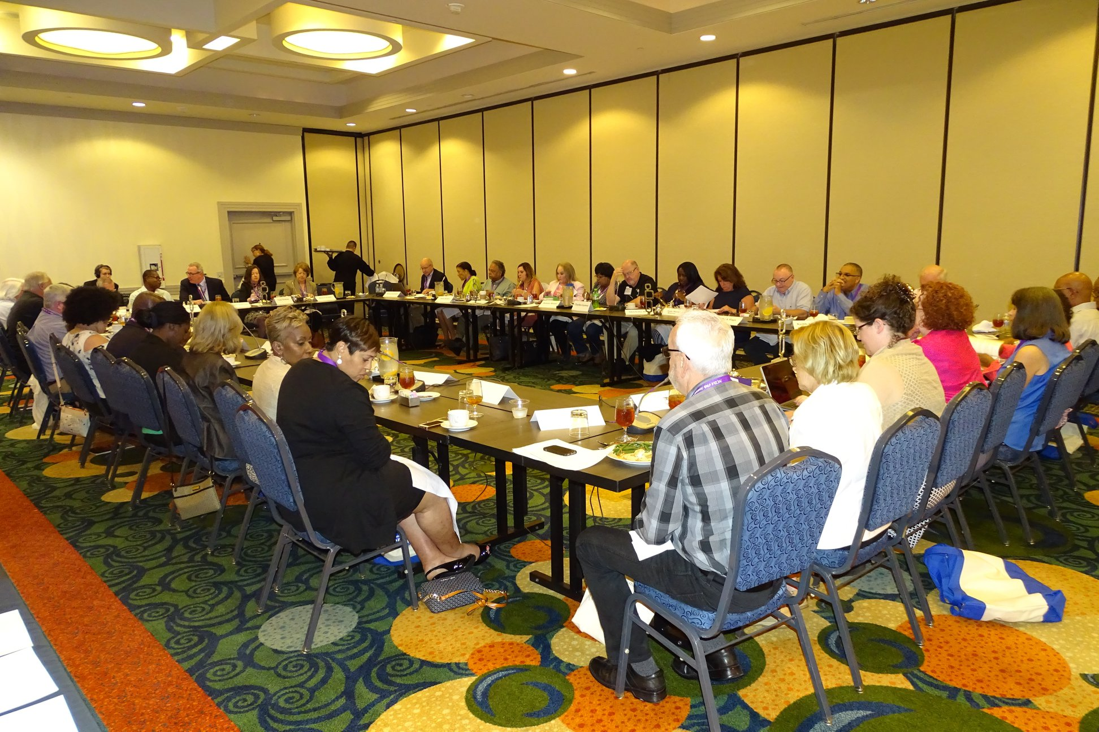
Board of Directors
41 Board Members
All regions represented
OFFICERS
President – Debra Rhinehart, Seattle, WA
Vice-President – Shirletta Best, McKinney, TX
Secretary – Marcy Esbjerg, Pasco County, FL
Treasurer – David Bachrach, East Providence, RI

Slide 7
NCDA Regions
Region 1 – New England
Region 2 – New York/ New Jersey
Region 3 – Mid-Atlantic
Region 4 – Southeast/ Caribbean
Region 5 – Midwest
Region 6 – Southwest
Region 7 – Great Plains
Region 8 – Rocky Mountain
Region 9 – Pacific
Region 10 – Northwest

Slide 8
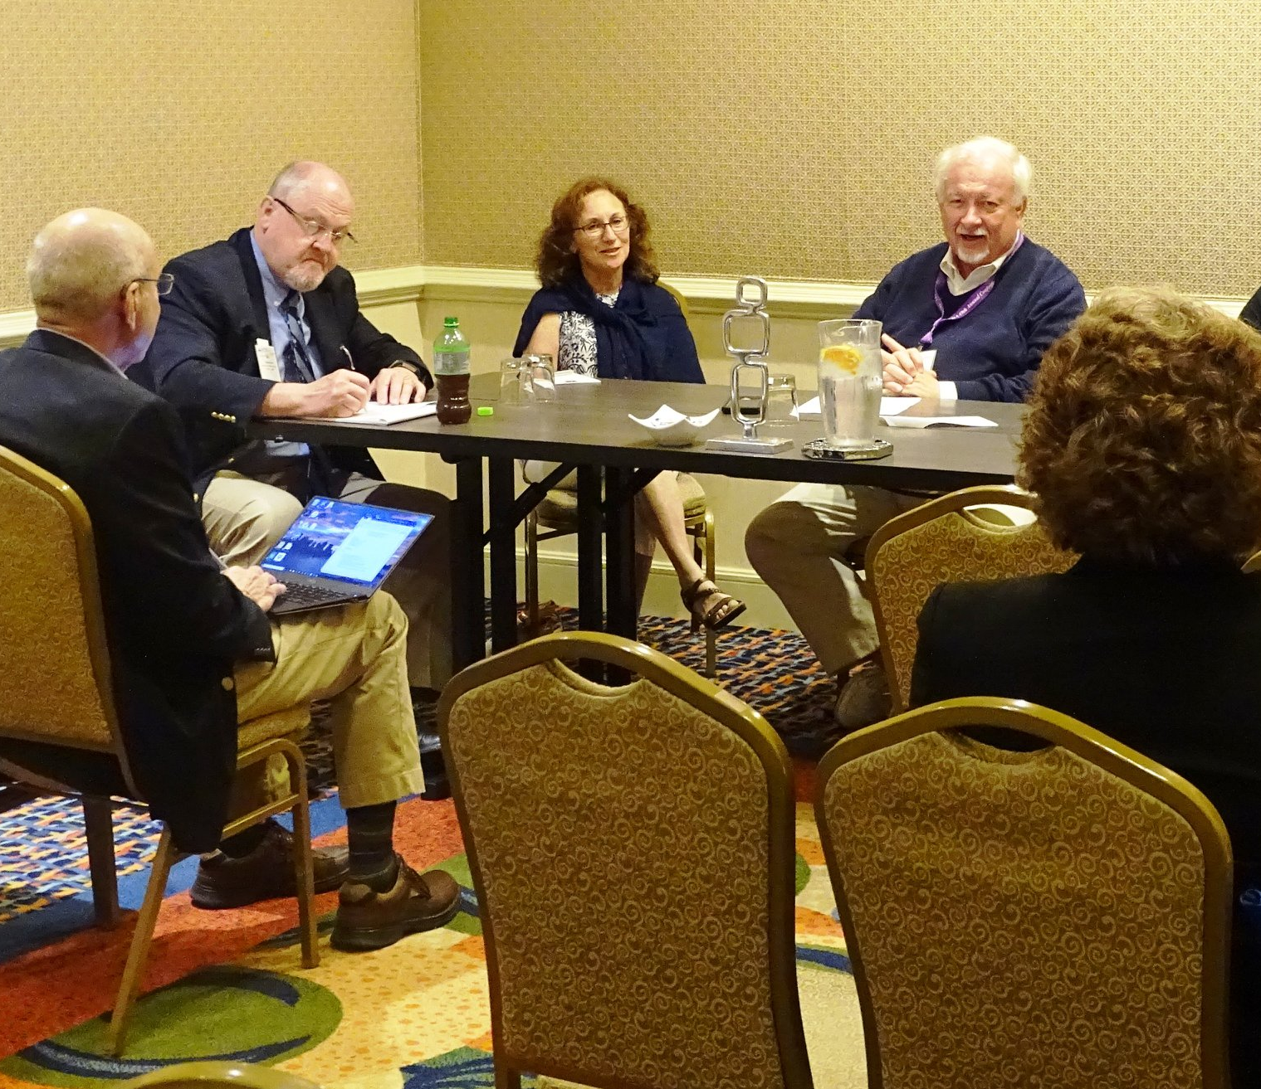
NCDA Subcommittees
Six Subcommittees
• Community Development
• Housing
• Economic Development
• Membership
• Planning and Professional Development
• Technology

Slide 9
NCDA Membership Benefits
Responsive Staff
National Network of Practitioners
Voice in Washington, DC
Email Alerts & Monthly Newsletter
Training & Conferences
National Community Development Week Campaign

Slide 10
NCDA Member Benefits: Advocacy 2023 Program Priorities
Protect/Increase Program Funding
CDBG, HOME, ESG, CoC, Section 108
Reduce Statutory Burden/Increase Program Flexibility/Streamline Operations
CDBG program reforms
HOME program reforms
Streamline the Con Plan, Annual Action Plan, IDIS

Slide 11
NCDA Member Benefits: Advocacy CDBG Coalition

Slide 12
NCDA Member Benefits: Advocacy National Community Development Week
April 10-14, 2023

Slide 13
Membership Benefits: Advocacy Special Reports
CDBG Impact Report
Completed and distributed April 2022
Will be updated in 2023

Slide 14
NCDA Member Benefits: Professional Development / Training
Shirletta Best provides Advanced CDBG Training

Slide 15
NCDA Member Benefits Professional Development/Training
Online primers
CDBG, HOME, Subrecipient Management, IDIS, Con Plan
Online basic courses
CDBG, Subrecipient Management, IDIS, HOME, Financial Management of HUD Grants: 2 CFR Part 200
In-person courses
Advanced CDBG + Underwriting, Advanced HOME + Underwriting
Upcoming course
Housing Rehab Management

Slide 16
NCDA Member Benefits: Leadership Institute
Leadership development program for community development professionals
Initial stages of development – RFP released
Flexible, affordable, program for all levels of management
Expected to launch in 2024

Slide 17
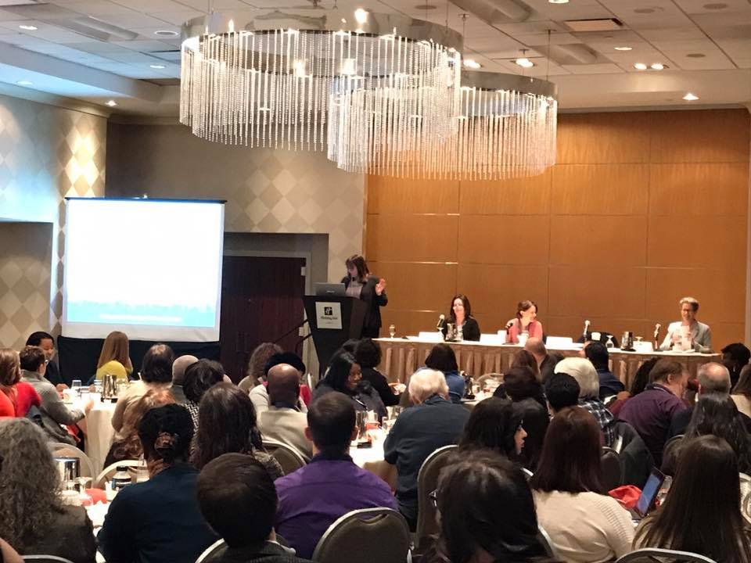
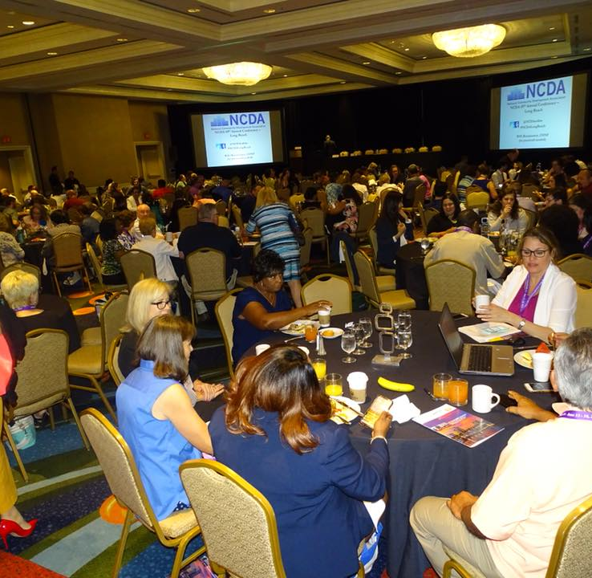
NCDA Member Benefits: Conferences
Winter Conference
HUD Headquarters participation
Peer best practices
Networking
Awards
Annual Conference
Project tours
Peer best practices
Networking

Slide 18
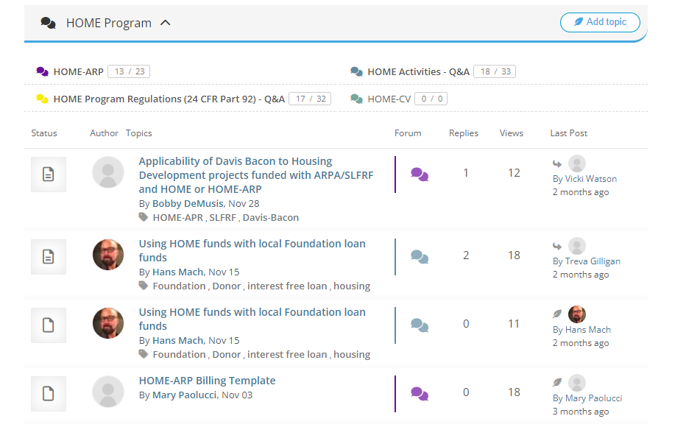
NCDA Member Benefits: Peer Learning NCDA Online Forum

Slide 19
NCDA Member Benefits: NCDA Website Members Only Log-in

Slide 20
NCDA Member Benefits: NCDA Website Jobs Board

Slide 21
NCDA Member Benefits: NCDA Provides You With The Latest Information
Email alerts
Webinars
Past Webinars:
CARES Act Funding, Section 3, Section 108,CDBG grant close-out webinar, community development software
Series of federal crosscutting webinars with COSCDA and HUD – Lead based paint, fair housing, acquisition/relocation, environmental reviews, Davis-Bacon and labor standards
Washington Report Newsletter

Slide 22
We Invite You to Join NCDA
Go to the following link for membership information:
https://ncdaonline.org/membership/
Membership Dues
Based on population
Membership Commitment Form
July 1 – June 30

Slide 23
Questions?

