Slide 1
Using HOME funds for Multifamily Construction
Rita Parise, Housing Administrator

Slide 2
Columbus, Ohio
2022 Population 913,129, metro area 1,687,000
14th largest city in the country
Population growth in the Columbus area accounts for more than all the population growth in Ohio
Economic Development
– Intel to build a $20 million manufacturing operation in nearby New Albany – will employ 7,000 construction workers to build and 3,000 high paying jobs when complete
- Honda to build a $3.5 billion battery plant with LG in Fayette County which is 30-45 minutes away

Slide 3
Columbus Housing Market
Insufficient supply of housing at all price points and tenures
Rapidly rising wages leave apartment communities without management and maintenance staff
Bidding wars for single family homes lead to excessive prices for homes
Rents are increasing at a high rate
Homelessness is increasing and some of the homeless have jobs but cannot afford rent
Columbus is in the process of rewriting the zoning code – currently almost every development needs zoning variances
The City of Columbus includes Columbus City Schools and numerous suburban school districts. Columbus City Schools test scores are in the bottom 50% of Ohio

Slide 4
Selecting Shovel Ready Multifamily New Construction Projects
What is being proposed? Does it address the most pressing needs?
Family housing – need three and four bedroom units
Permanent supportive housing – limited by availability of rental subsidy
Lower rents – developers who want more than the standard $300,000 per project in HOME funds must commit to providing 30% units to households in shelter with an income sufficient to support a 30% rent. Most LIHTC developments commit to at least some 30% units.
Proximity to transit
What other forms of leverage are there?
State HOME funds
County funding
Project based vouchers

Slide 5
Review of Sources and Uses
What is the total development cost?
If it is higher than the Section 234 limits, why is that?
What sources are in the project? How real are the commitments?
How to handle sources that may come but are not committed yet (ex Federal Home Loan Bank)?
What kind of reserves does the project have?
Construction contingency
Rent up
Operating reserve

Slide 6
Income and Operating Expenses
Are rent requirements met for all funders?
What are the projected operating costs? How do they compare to your standard (we use OHFA’s standard)?
What happens after the 15 year tax abatement expires?
Do operations allow for funding a replacement reserve?
What is the debt coverage ratio (we require 1.2-1.5)?
If there is no debt, look at operating expense to income (should be no more than 90%)

Slide 7
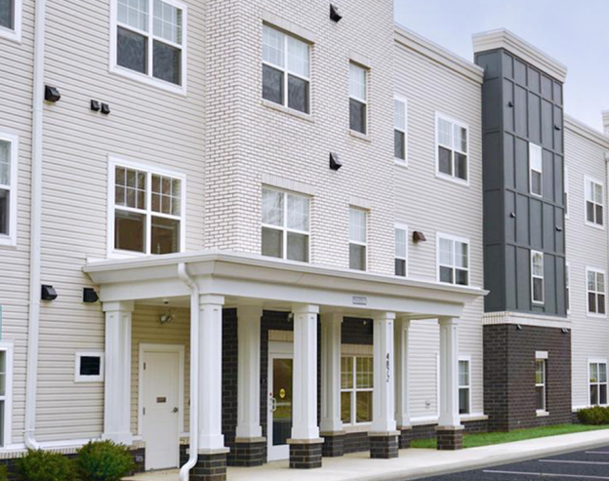
Developer Capacity
Developer history and experience
New developer with significant experience may outweigh and existing developer with all new staff
Financial capacity – ability to weather difficulty – delays, supply chain issues, COVID shut downs
Equity provider – for developers without deep pockets, will the equity provider stand behind the project if problems occur?
CHDO Set Aside – staying in contact with CHDOs and finding out what is in the pipeline – paying attention to how projects get done – CHDOs don’t often have capacity to do LIHTC projects – more risk

Slide 8
Market Demand
For rental housing, market demand is very high.
For LIHTC projects we require a market study (they have to have one anyhow)
Make sure to consider other projects under development in the market area
For non-LIHTC projects, we accept census data for the site and surrounding areas on number of households, number of income qualified households and how those compare to the number of units being created
For phase 2 projects, inquire about the waiting list

Slide 9
Best Laid Plans
Current development market is chaotic – prices are up and down every day and funders need to be aware of what is changing and how
Interest rates increasing means less mortgage funding for projects, check mortgage amortization
Be prepared to pivot – look at the benefit of the project, the status of development and determine if additional funds are worthwhile
Sometimes you have to say no

