Slide 1
Using HOME Funds for New Multi-Family Construction
NCDA Winter Meeting
January 25, 2023
Heather Johnson, Community Development Resources Manager
Davenport, Iowa

Slide 2
HOME is a Complicated Subject
And Multifamily development is probably the most complicated way to use it
Involves more players, more money, more steps, and more oversight than any other HOME eligible use
But affordable rental is among the highest need in almost every community – so we need to find a way to make it work!

Slide 3
Working with Developers
HOME requires you to check capacity
Non-Profit v. For Profit
Organizations change over time – don’t make assumptions
Capacity includes both financial and staff ability to complete and maintain the project throughout affordability
Be transparent and upfront about requirements both during the construction phase and long term commitments

Slide 4
Know Your Role
They need you…but not that much!
  HOME is usually a small part of a LARGE project, they may need you for gap funding, or just to get points on their LIHTC Application
  Every speedbump and roadblock is an excuse to walk away from HUD funds
You (probably) need them more than they need you
  Shortage of affordable housing
  Lack of other developers in the area/willing to do affordable housing
  HOME obligation/expenditure deadlines
Assist however you can – be a liaison between them and plan/zone, permitting, inspections, etc.

Slide 5
Meet The Players
Which companies & individuals are in which role
  Owner
  General Partner (for tax credits)
  Investor
  Developer
  Contractor
  Property Manager
  Consultants (environmental, historic, tax credit, etc.)
What are the legal/financial relationships between the parties
  LLCs, Partnerships, Sole Proprietorship, Subsidiary, Contractor, Employee, etc.

Slide 6
Speak Their Language
LTV, ROI, BEP, FMR, LIHTC, HTC, GP, GC, Syndicator, LLC, site control, basis, hard vs. soft costs, holding costs, operating vs. replacement reserves
It can seem very confusing! (and it is sometimes intended to be)
Try to brush up on language and meaning so that you can keep up with them (and keep them honest)
Get very familiar with their site (topography, nearby features, trees, neighbors, directions) so you know you are talking about the same thing
NCDA has great training courses: HOME Basics Online, HOME Underwriting Primer, and HOME Advanced + Underwriting will help immensely!
Also, National Development Council has invaluable courses on Housing Development Finance that are worth every penny

Slide 7
Move At Their Speed
Experienced developers talk and move fast – they have a lot of projects under their belt and confidence in their process
They have timelines they need to meet (tax credit start & in service dates, lender deadlines, construction scheduling, weather)
Less experienced developers have the same timelines, but may need more help
HUD requirements are time consuming, and they may not want to slow down for you
Some timelines you can’t change (comment periods, SHPO, etc.)
Look for ways to speed up your side:
  Underwrite quickly, Start ERs as early as possible
  Work with building department to expedite zoning/plan/design reviews/permitting
  “Stack” approvals and comment periods if possible – start down the path of contingent council approval while other processes are playing out

Slide 8
Check the Specs – Then Check them Again!
Be sure you know from the beginning what they intend to build
  # of units, style of building, materials, method of heating/cooling, exterior features/amenities, common areas, etc.
  All of these can affect your underwriting and environmental review process
  And, if you have something built that doesn’t meet expectations, it can sour neighborhood/city council opinion
Then track changes all the way through to the end
  Adding/subtracting units, common areas, or commercial space?
    It can change your underwriting/subsidy limits/unit counts!
  Changing footprint, exterior finishes, features, or amenities?
    Could require you to revisit SHPO/Environmental Review!

Slide 9
Get It In Writing
HOME Requirements (Investment, affordability, income limits, address, when/how affordable units will be selected and by who)
Timeline (expected start dates/completion dates, milestones)
Reporting Requirements (Davis Bacon, Section 3, BABA, FFATA)
Inspection/Permit Requirements (both program and building dept.)
Environmental Requirements (if there were environmental/noise mitigation requirements, flood insurance, historic studies/protections/documentation)
Municipal Requirements (if added during rezoning/design review/permitting process)

Slide 10
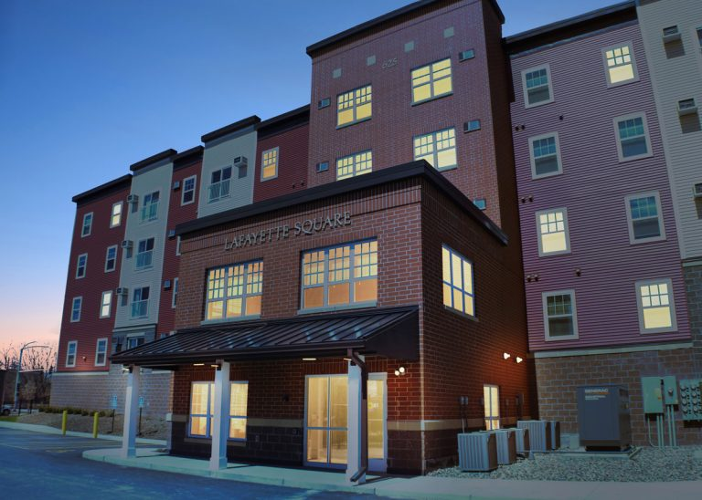
Story Time Part 1:

Slide 11
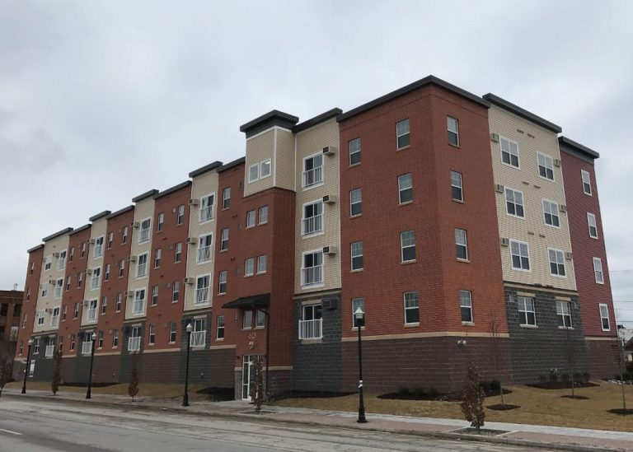

Slide 12
Story Time Part 2:

Slide 13
Trust – But Verify
Developers don’t care what the rules are, they just want to know what they are and what they need to do for them
  Environmental Reviews, Subsidy Limits, Unit Allocation, Section 3, Davis Bacon, BABA, FFATA, Lead Paint, Program Inspections, etc.
  Explain up front, but try to frame it positively and emphasize what you can do to help them through the process (if anything)
Get regular reports/drawdowns/inspections throughout the project, don’t wait until the end to find out they don’t have info you need
Stay in communication, drive by often, ask questions

Slide 14
Build Relationships That Last
Developers know where they are welcome – and where they are not
Create an environment where they want to work with you again
Commiserate over HUD requirements together – but stick to them
Keep in touch not just through monitoring, but when projects come along they might be interested in.

