Slide 1
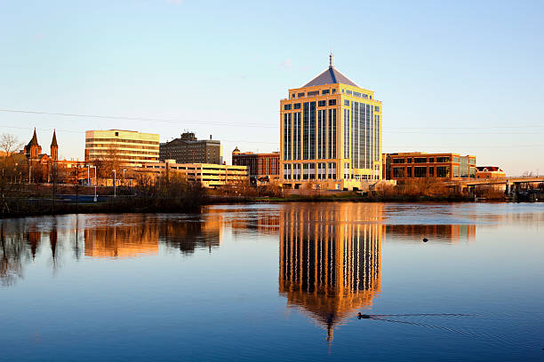
Community Development Department
Choosing and Monitoring Subrecipients
January 26, 2023

Slide 2
Where is Wausau?
Located in Central Wisconsin
Population just under 40,000*
The principal city of a Metropolitan Statistical Area

Slide 3
Wausau’s CDBG Statistics
Allocations have ranged between $597,000 - $647,000 the past 4 years
Public Service activities = 10 - 15% of annual allocation (max. $97,000/yr.)
Typically fund between 4 – 7 public service activities each year
Fund internal public facilities each year, possibly external public facility

Slide 4
Public Service Subrecipients
CDBG Application Process for New Applicants / New Non-Profits
MEET
With representative(s) of organization prior to them submitting a CDBG Application
DISCUSS
INFORM
Representative(s) of the requirements & responsibilities if awarded CDBG Funding
The organization’s services and their potential request for funding
VISIT
The organization’s facility to see and experience daily operations
Required Policies
Unique Identification Number
Reporting Requirements
Documentation of Beneficiary Income & Demographics
Documentation Required with Reimbursement Requests

Slide 5
Evaluating Repeat Subrecipients
Was funding from previous year fully expended per the agreement?
Did they submit their reports timely?
Did they submit supporting documentation as required or requested?
Were their funds expended timely?
Did Subrecipient display an acceptable organizational system during monitoring?
Is Subrecipient complying with record retention requirements?

Slide 6
Wausau’s Process
Notify
Meet
Summary Page
Public Hearings
Full Application
Committee
City Approval
Action Plan
Submit Action Plan to HUD for Approval and WAIT……
HUD Approval
Citizens Advisory Committee (CAC) meets to develop funding recommendations
Representative(s) from agencies who submitted a Summary Page are required to present to the Citizens Advisory Committee at one of two Public Hearings.
Indicates intent to apply for CDBG Funding with a brief overview of activity
Schedule Appointments to meet with agencies who have questions
Email, Website Announcement, Foundations Spread Word
CAC Recommendations presented to Finance for Approval
CAC Recommendations presented to Council for Approval
Receive Approval on Action Plan from HUD
Interested parties required to submit their application by deadline

Slide 7
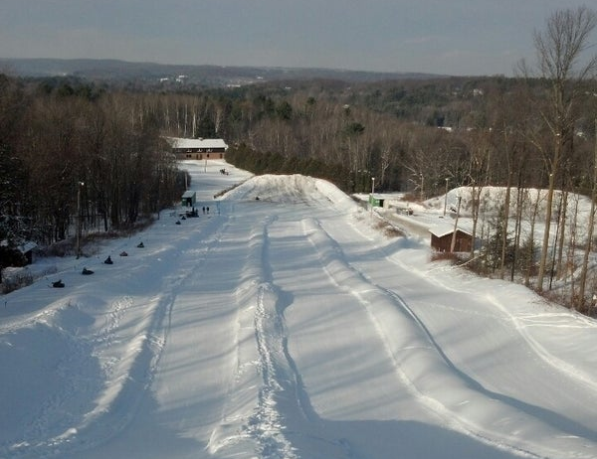
After HUD Approval
Agreement
Subrecipient and City staff sign Agreement.
Reimburse
Subrecipients begin submitting invoices for reimbursement along with supporting documentation.
Reports
Quarterly Reports begin the after the 1st quarter in which Agreement was signed.
Monitor
Subrecipients monitored to ensure proper organizational system and compliance with recordkeeping requirements.
Close Out
Activity closed in IDIS after funds are fully expended and quarterly reporting requirement is met.

Slide 8
Monitoring
3 - 6 months after initial payment
Schedule an appointment for in-person monitoring, typically 4 – 6 weeks out
Provide checklist of what will be reviewed
Review how clients are income qualified and verify the number of clients served matches quarterly reports
Just like HUD, go through the checklist with the subrecipient to look at their documents
Follow the money

Slide 9
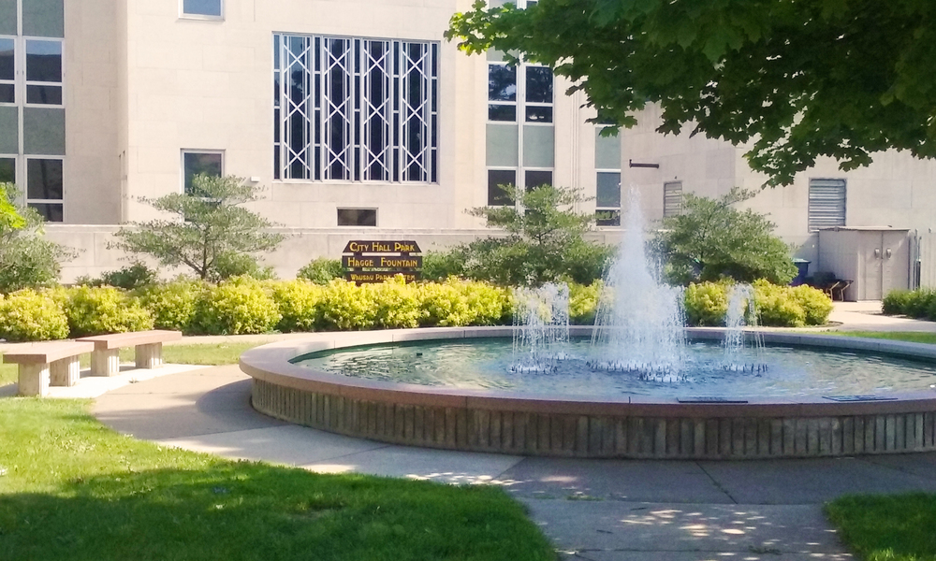
Questions?
Tammy Stratz
Community Development Manager
407 Grant St. | Wausau, WI
715-261-6682
tammy.stratz@ci.wausau.wi.us

