Slide 1


Pasco County, Florida
Using Federal, State or Local Funds for Homeless Initiatives
Marcy Esbjerg
Community Development Director
Hilary Bruno
Community Development
Assistant Director
NCDA Legislative Conference
January 25, 2023

Slide 2
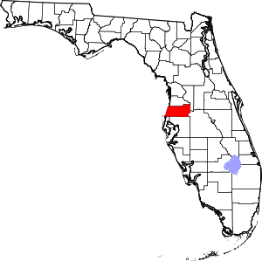
About Pasco County, FL
Population – 553,000 (just under 200,000 households)
Location – north of Tampa, FL on the Gulf of Mexico
Square Miles – 747
Owner-occupied/rental housing – 72/28%
LMI – 40% LMI, 54% Cost Burdened
CDBG - $2.9 million
HOME - $1.2 million
ESG - $247,000
CDBG-CV - $1.7 million/$1.99 million
ESG-CV - $834,000/$3.8 million

Slide 3

Mission Statements
Our mission at Community Development:
Improving the lives of Pasco’s citizens through homeless initiatives, neighborhood revitalization, affordable housing and community partnerships using state and federal funding.
The mission of St. Vincent de Paul CARES (SVdP):
To be a beacon of light by transforming lives in the Vincentian spirit of charity, justice, and mercy through interpersonal connectivity.

Slide 4
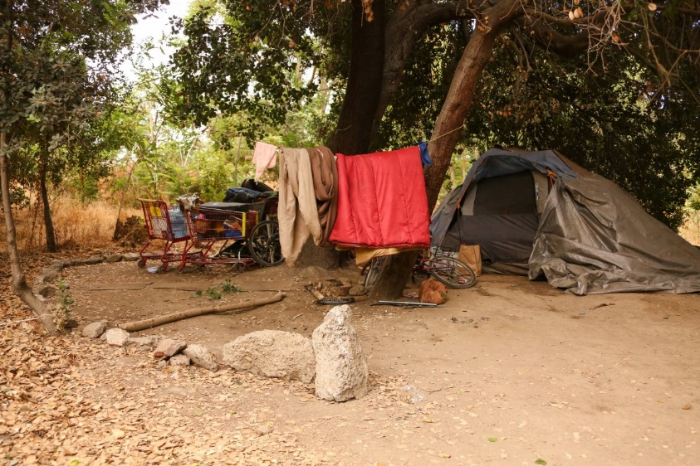
THE NEED: Homelessness in Pasco County
2021 Point in Time Count – 852 persons
Unsheltered Persons – 505 – 60%
  High percentage housed temporarily in motels
Chronically Homeless Adults – 361 – 42%
  Chronic Homelessness had increased by 26%
Only 7% of funding is targeted for Permanent Supportive Housing while our Chronically Homeless population represents 43% of the homeless.

Slide 5
THE OPPORTUNITY – “Pasadena”
An 8-unit complex on Pasadena Drive, built in 1972, was identified by SVdP
  2 units are efficiencies, and 6 units are 2 bedrooms
The availability of CDBG Corona Virus funds to acquire a property designed for non-congregate living and availability of state funds for the extensive renovations required
The support of the Board of County Commissioners and the partnership with SVdP.

Slide 6
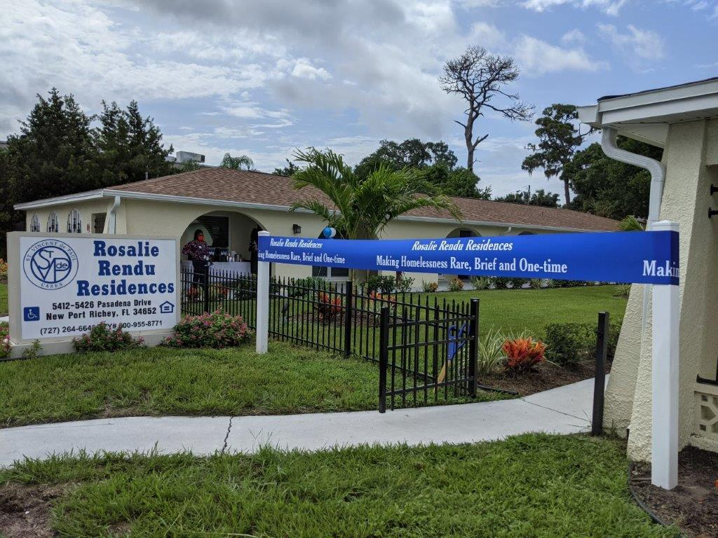
THE FUNDING – Leverage of Other Funds
$556,200 - Community Development Block Grant - Coronavirus funds
$400,000 in Florida’s State Housing Initiatives Partnership Funds
SVDP raised $ 124,867 in donations and also outfitted two units with furniture from their thrift store
Project funding: HUD funding represents 51% of the total cost
The cost per unit comes to $135,133 and the cost per PSH bed is $77,219.

Slide 7
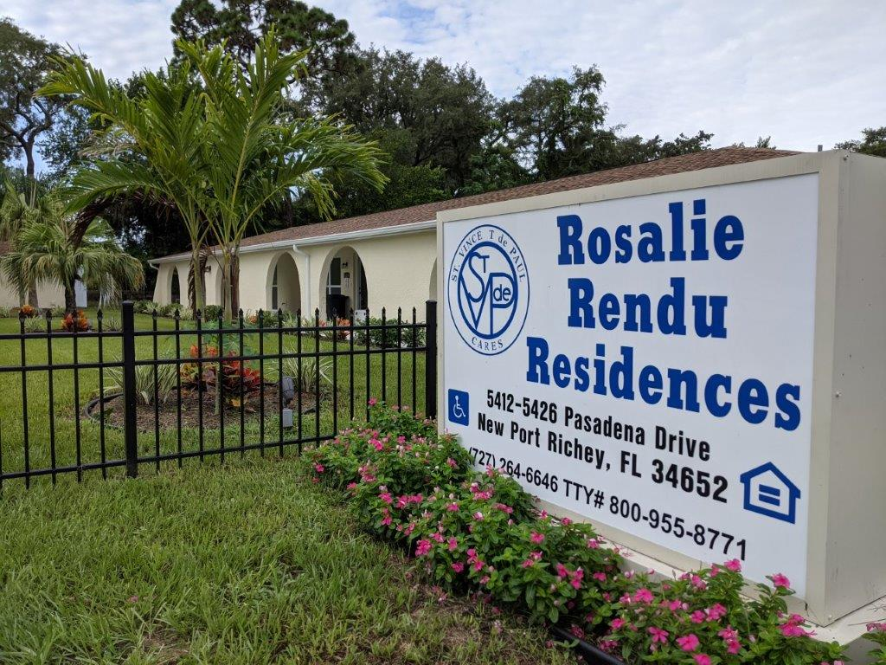
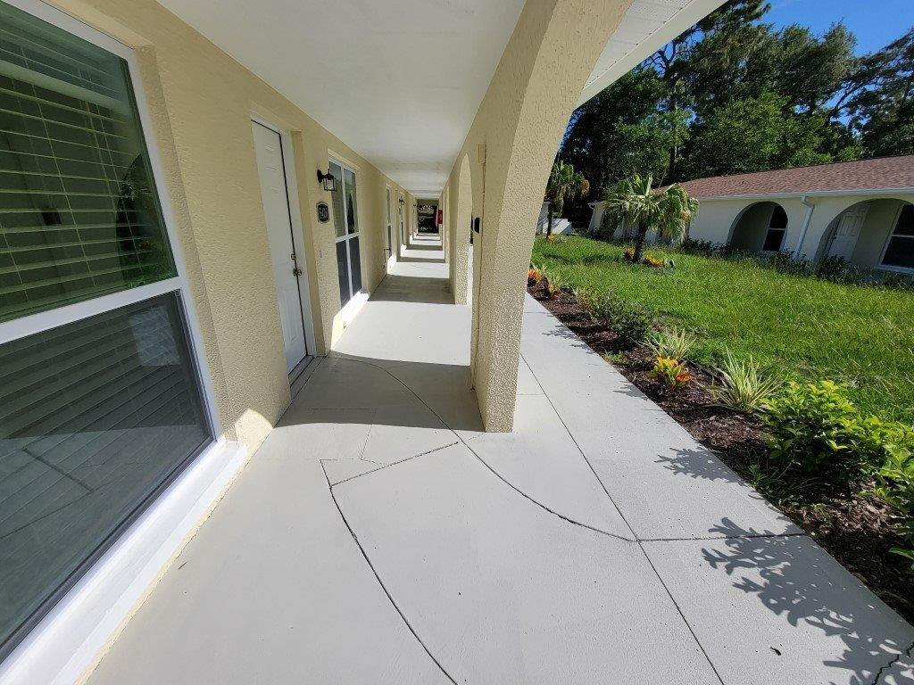
THE OUTCOME – Rosalie Rendu Residences
14 Permanent Supportive Housing beds were added to the CoC’s inventory
Tenants all came from unsheltered status, determined to be chronically homeless and were referred through Coordinated Entry
Outreach teams helped identify the potential clients in their encampments

Slide 8
LESSONS LEARNED
    New and progressive approach for the County
    Acquisition and rehab are options to use CDBG for eligible housing construction
    Each tenant has their own lease and own bedroom
    They share living space, kitchen and bath with a roommate
    Opens up options to house our single adult population
    With Housing First and a Housing Choice model – not all tenants choose a shared housing unit

Slide 9
SUSTAINABILITY
Grant funds enabled the purchase and renovation to take place without additional debt on the property.
  The project is secured with a deferred mortgage to ensure continued use
Rental subsidies for tenants included ESG-CV rapid rehousing, Emergency Housing Vouchers and Tenant Based Rental Assistance.
CDBG Public Services support for a Permanent Supported Housing Coordinator for two years

Slide 10
What Tenants Have Experienced
Secure housing with support services
Building trust and access to mental health services
Basic life skills, daily hygiene, maintaining household duties
Vocational rehabilitation and part time work
Working with SOAR specialists to gain disability income
Since opening, 14 formerly homeless adults found a safe, decent and affordable place to call home at Rosalie Rendu Residences.

Slide 11
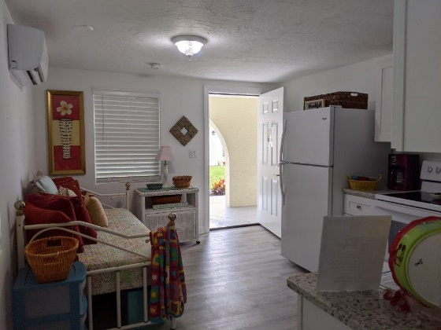
Before and After Studio

Slide 12
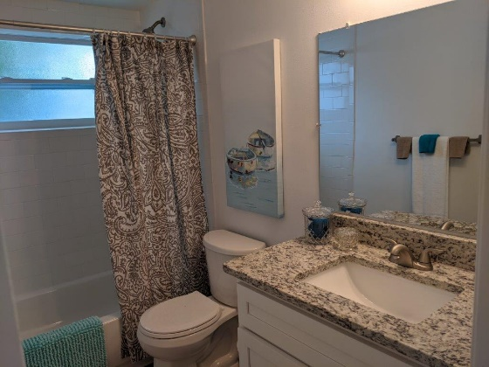
Before and After Bathroom

Slide 13
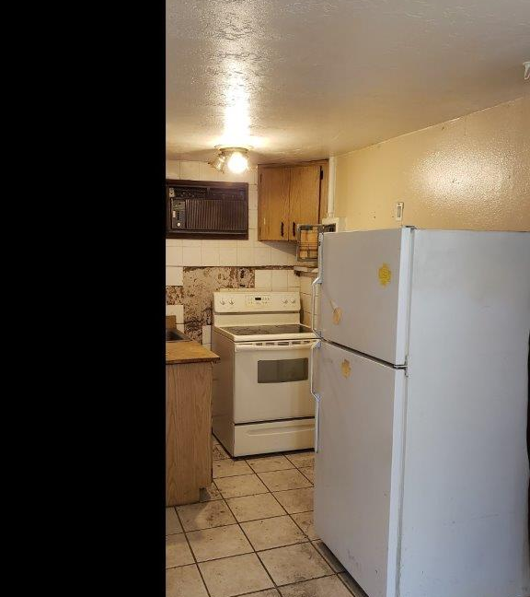
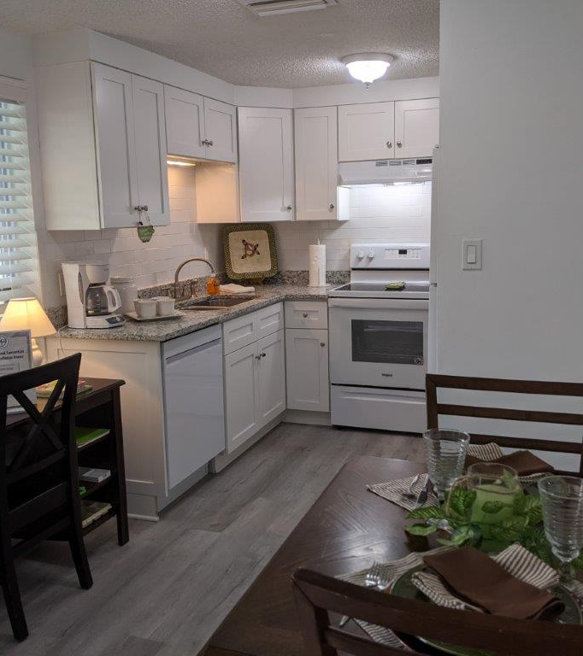
Before and After Kitchen

Slide 14
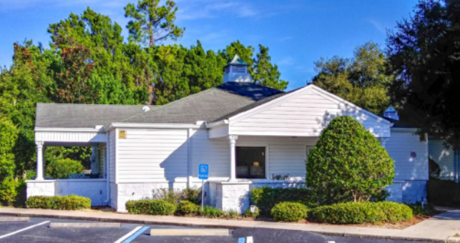
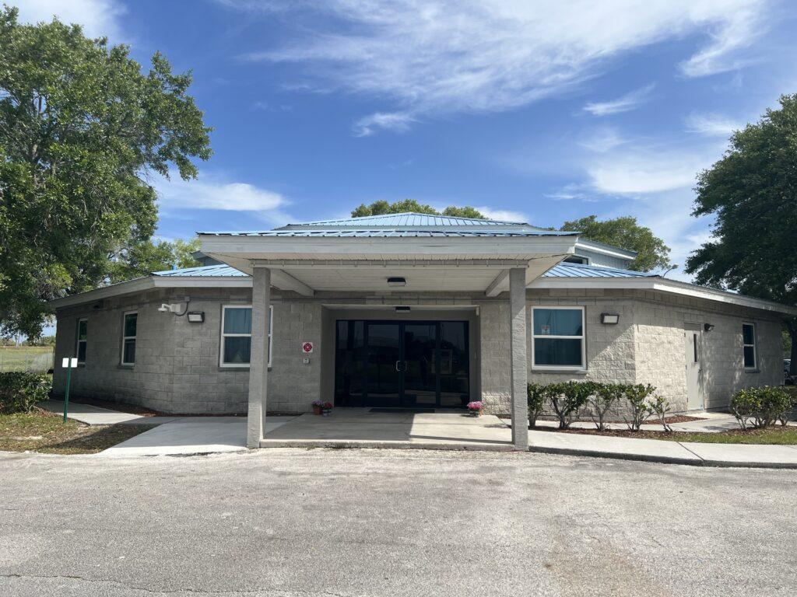
More Homeless Initiatives:
Family Service Shelter
Rehab of county owned building into 9 units of family shelter housing – $1.2m CDBG
First shelter in Pasco County that can accommodate families
Felicity House
Acquisition of building – $581,250 CDBG
Expands current Women and Children’s shelter beds from 20-40
Previous shelter being renovated into 5 units of affordable housing (HOME)

Slide 15

Contact Information:
Hilary Bruno
Pasco County Community Development
hbruno@pascocountyfl.net
727-834-3447

