Slide 1
Using Funds for Homeless Initiatives
Déjà Anderson
Director of Division of Community Development
City of Jersey City, New Jersey
January 25 2023

Slide 2
Agenda
Overview of Jersey City
Data
Projects
Garden State CDC Drop-in Center
St. Lucy's Shelter
Bergenview Apartments
Jersey City's Action Plan

Slide 3
Jersey City Homeless Services Funding Sources
CDBG
HOME
ESG
HOPWA
AHTF
​

Slide 4
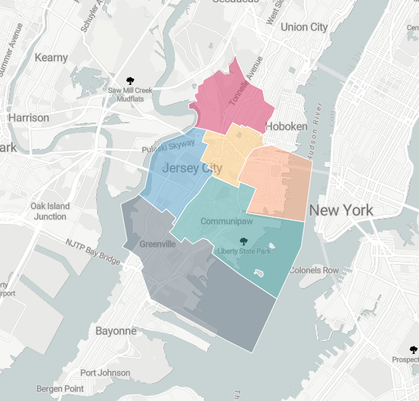
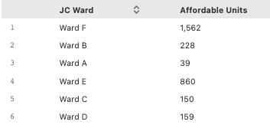
COJC Affordable Housing Units by Ward
Notes:
Barriers:
The scarcity of available land for housing development and buildings
The high costs associated with building new affordable units
Availability of affordable units in a range of sizes
Displacement of residents due to economic pressure
Lack of supportive services and operating funds for special needs housing developments
Insufficient targeting of resources for families below 30% of AMI, and families between 50 and 80% of AMI

Slide 5
Hudson County COC Data

Slide 6
PIT Count Data
566 households
665 persons
154 persons were identified as chronically homeless
143 persons were unsheltered on the night of the count
Notes:
night of January 25th, 2022

Slide 7
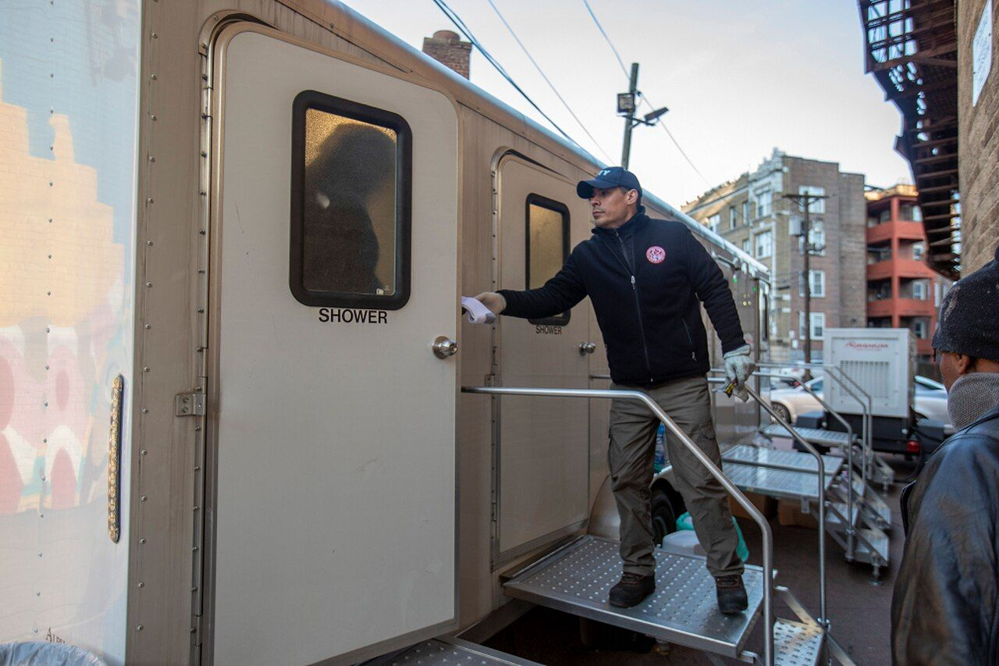
Garden State CDC
Notes:
$2 million in City funds bonded
Installation of permanent showers.
New congregate dining facility incorporating social distancing features.
New, free laundry facility.
Transformation of the building’s unused entry space into a new Welcome Center, incorporating social distancing features.
Renovation and expansion of the case management and intake facilities operated by Garden State CDC.
Renovation of bathrooms.
Installation of an elevator to ensure ADA compliance and to better serve residents.

Slide 8
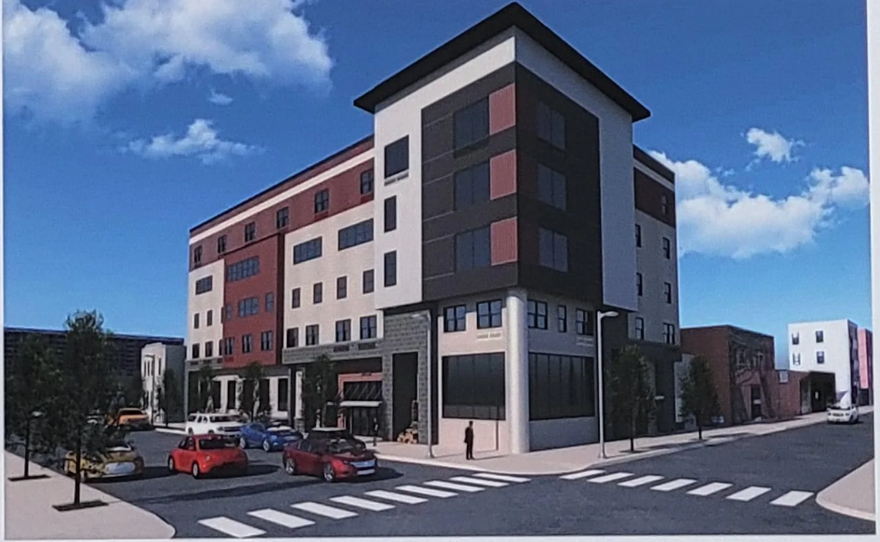
St. Lucy' s Shelter
Notes:
a total of 165 beds for individuals who are homeless- ESG
14 units of transitional housing for individuals with HIV- HOPWA
five permanent supportive housing units specifically for families – organization gift
15 permanent affordable housing studio apartments – Negoiated
Catholic Charities will have staff offices on the second floor of the new shelter where clients can be seen. The second floor will also include a drop-in area for nonresidents in need who can utilize St. Lucy’s services for showers, meals, and the new laundry facilities.
Once completed, the new $15 million St. Lucy’s Homeless Center will include increased housing for families, affordable housing solutions, and support services.

Slide 9
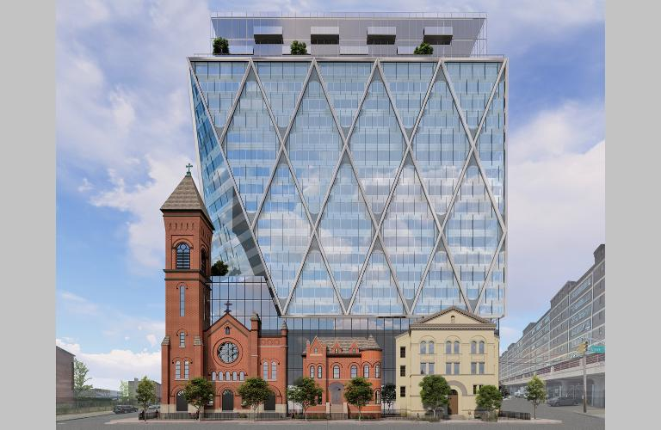
St. Lucy' s Shelter
Notes:
Collaboration with organizations and developers

Slide 10
Bergenview Apartments
Notes:
111 Studio Apartments
The preservation of the building was made through funding received from the Jersey City DCD funding AHTF, New Jersey Housing and Mortgage Finance Agency, TD Bank, additionally to FHLB-AHP funding and low-income housing tax credit equity. Boston Financial Investment Management will serve as syndicator, while the Community Preservation Corp. will service the permanent mortgage, a tax-exempt Freddie Mac loan. 210-unit, single-room occupancy community into a 131-unit building with 59 SRO units and 72 studios for formerly homeless individuals. The property’s new common-area amenities include a fitness center, social service suite, community room, demonstration kitchen and learning center. The HVAC system, roof and elevators were also upgraded. Units feature private bathrooms, kitchens and energy-efficient appliances. The property is environmentally friendly, receiving Enterprise Green Communities and ENERGY STAR certifications.

Slide 11
COJC Action Plan
Inclusionary Zoning Ordinance (IZO)
Affordable Housing Trust Fund (AHTF)
Affordable Housing Overlay (AHO) (WIP)
Bayfront Development (35% Affordable Housing)
Master Plan - Housing Element Update
Notes:
The City of Jersey City is committed to the rehabilitation, construction, and preservation of safe and affordable housing for all City residents. Strong and sustained support from the City’s Mayor and City Council in tandem with collaborative progress from senior members of the Department of Housing, Economic Development and Commerce have led to the creation of progressive policies and a new Division of Affordable Housing that seek to address the challenge of pervasive housing inequality These actions are the following

Slide 12
COJC Action Plan
Chapter 188 – UHAC (State Law)
Rent Control Ordinance
Resolution for Affordable Housing Portal (Intellectyx)
Participation in NYU Furman Housing Solutions Workshop
Notes:
COJC Goal is to Rehouse 1,500 families over a 3 year period

