Slide 1
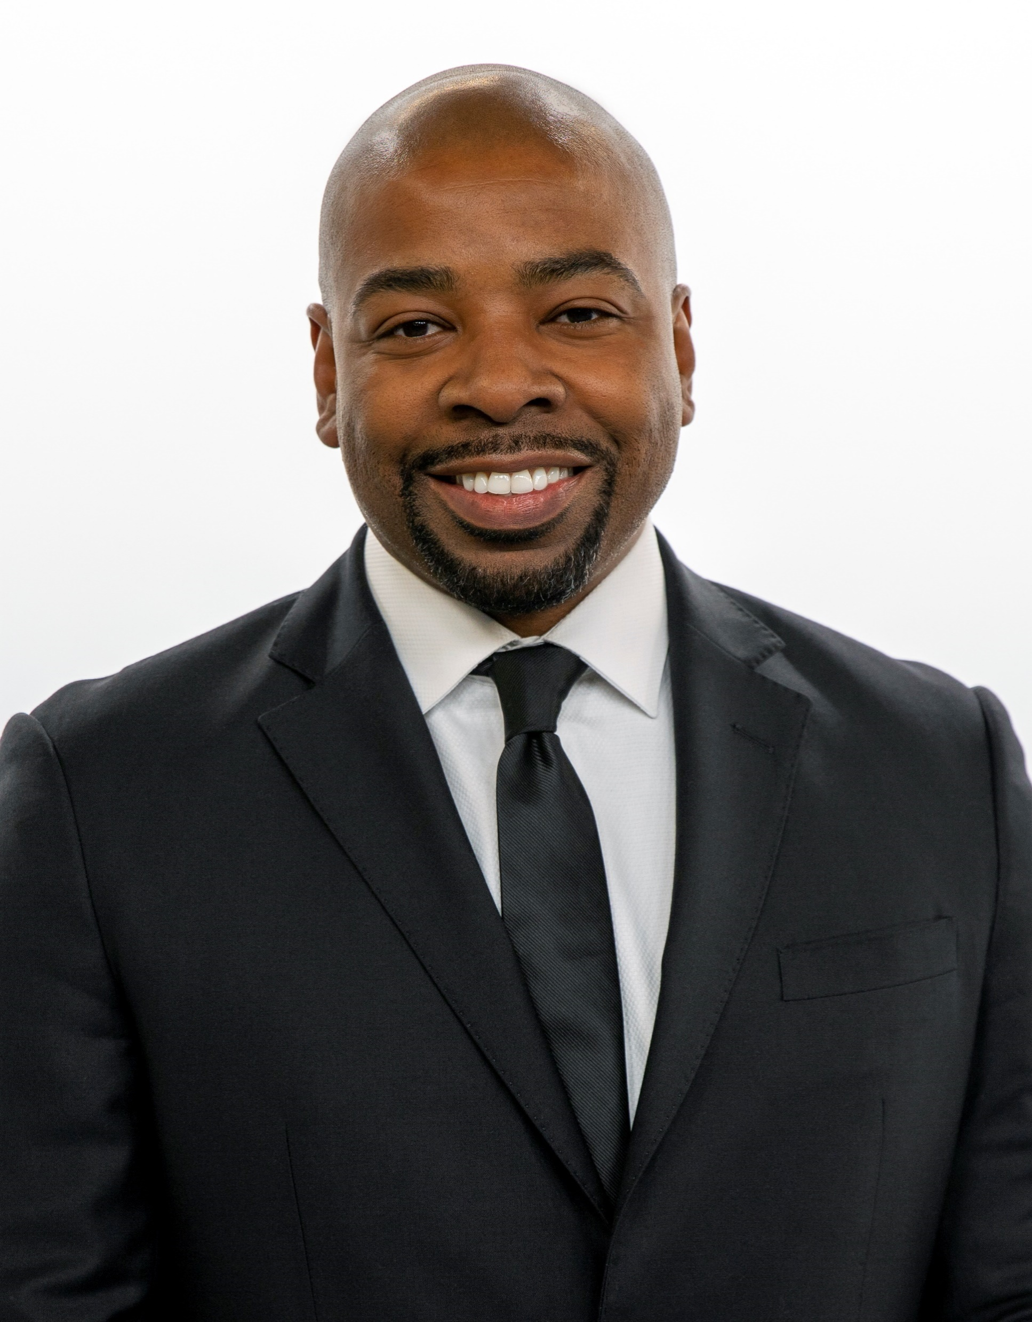
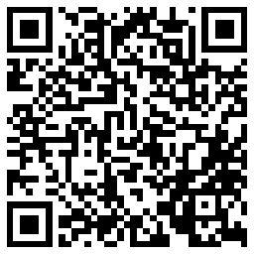
2023 NCDA Winter Legislative, Policy, and Professional Development Meeting
Washington, D.C.
Using CDBG for Eligible Activities (and Housing)
Darwin M. Wade, MBA, MPA, CPM
Area Redevelopment Manager
City of Dallas, Texas
Housing & Neighborhood Revitalization
Darwin.Wade@Dallas.gov
O: 214-670-3906 C: 469-404-6891
Notes:
The second slide: present the basic demographics of your program (population of your city, % of LMI beneficiaries, the amount of funds used either under CDBG and/or HOME and how you use your funds.

Slide 2
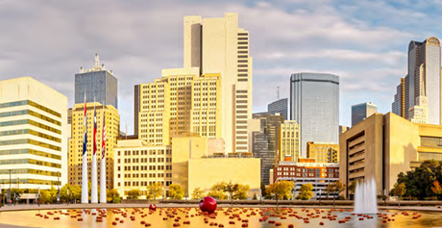
Dallas, TX by the Numbers
Population: 1.3 million
Median family income: $97,400
80% AMI for family of four: $77,900
% Low Mod: 52.8%
Poverty rate: 17.7%
Owner-occupied housing: 41.4%
Median home value: $230,000
Median gross rent: $1,178
Max HOME sales price: $271,000
Source: 2021 ACS 5-Year Data and HUD Exchange
Notes:
Median family income = $97,400
80% AMI for a family of four = $77,900
Population = 1,288,457
Poverty rate = 17.7%
Median household income = $58,231
% low mod = 52.8%

Slide 3
FY 2022-23 HUD Entitlements
Community Development Block Grant (CDBG) | $14,120,128
HOME Investment Partnerships | $6,440,498
Emergency Solutions Grant (ESG) | $1,268,197
Housing Opportunities for Persons With AIDS (HOPWA) | $8,469,139
TOTAL | $30,297,962
CDBG – Housing Activities
Home Improvement and Preservation Program (HIPP) | $4,654,038
Residential Development Acquisition Loan Program | $2,265,710
Dallas Homebuyer Assistance Program | $400,000
TOTAL | $7,319,748
FY 2022-23 Affordable Housing Development HOME Funds
HOME Housing Development Loan Program | $4,534,626
CHDO Development Loan Program | $966,076
Dallas Homebuyer Assistance Program | $400,000
TOTAL | $5,900,702

Slide 4
Use of CDBG in Support of New Housing Construction
Notice CPD-07-08 describes nine ways in which grantees can use CDBG to expand the development of decent, accessible and affordable housing
New Housing Construction and Related Activities:
Construction by eligible and qualified Community-Based Development Organization (CBDOs) [24 CFR 570.204(a)]
CBDOs must meet provisions in [24 CFR.570.204(c)]
Designate a geographic target area – Neighborhood Revitalization Strategy Area (NRSA) – Notice CPD 16-16
CBDOs can carry out new construction activities in NRSA
Notes:
Homeownership Assistance
Rehabilitation and Reconstruction
Conversion of Existing Structures for Housing
New Housing Constructions and Related Activities
Tornado Shelters
Housing Counseling
Fair Housing Activities
Housing Services and HOME program support
In Rem Housing

Slide 5
Use of CDBG in Support of New Housing Construction
Acquisition – A grantee or nonprofit may acquire property and resell it to an affordable housing developer. [24 CFR 570.201 (a) and (b)] CBDO may also acquire property for housing it will develop itself.
Clearance – Grantee may clear a site in preparation for housing [24 CFR 570.201(d)]
Site improvements/Street improvement – Grantee can make public improvements on publicly-owned property and streets [24 CFR 570.201(c)]
Notes:
§ 570.201 Basic eligible activities.
CDBG funds may be used for the following activities:
(a) Acquisition. Acquisition in whole or in part by the recipient, or other public or private nonprofit entity, by purchase, long-term lease, donation, or otherwise, of real property (including air rights, water rights, rights-of-way, easements, and other interests therein) for any public purpose, subject to the limitations of § 570.207.
(b) Disposition. Disposition, through sale, lease, donation, or otherwise, of any real property acquired with CDBG funds or its retention for public purposes, including reasonable costs of temporarily managing such property or property acquired under urban renewal, provided that the proceeds from any such disposition shall be program income subject to the requirements set forth in § 570.504.
The City of Dallas Housing Finance Corporation has an agreement with the City for acquisition of the property, an appraisal is used to substantiate price and fair market value and long-term lease agreement with developer.
A separate agreement between the COD and the developer for hard construction costs.

Slide 6
Project Overview
Palladium Redbird is located at 7502 S. Westmoreland Road
300 total units, 210 units reserved for residents earning at or below 80% area median income (AMI)
90 units at market rate/non-income restricted
4-Story construction with structured parking
Class A amenities such as:
Resort style pool, outdoor kitchen/grilling stations, community clubhouse, fitness center, business center, granite counter tops, stainless steel appliances, private balconies/patios
$60,000,000+ investment into mixed-income, workforce housing for the City of Dallas

Slide 7
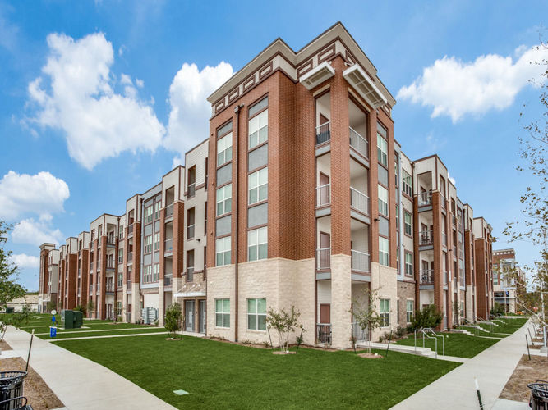
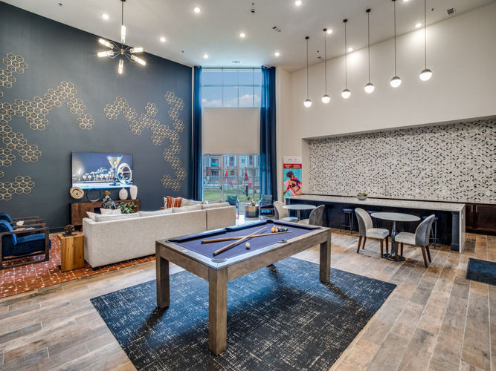
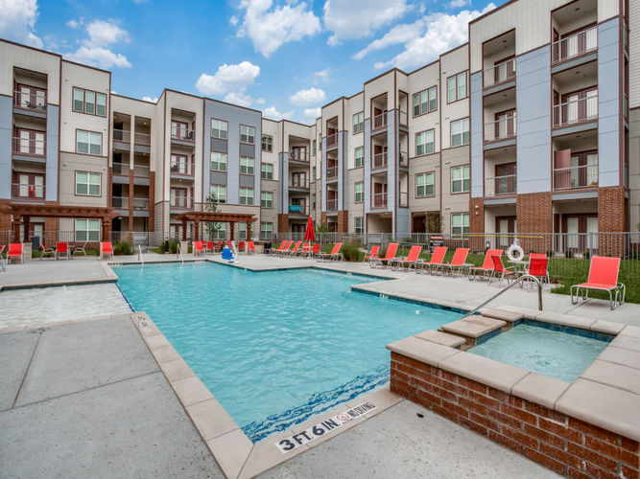
Project Overview
Project completed in 2021 and 100% occupied

Slide 8
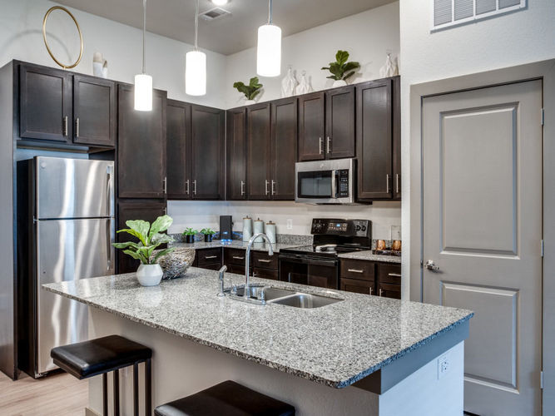
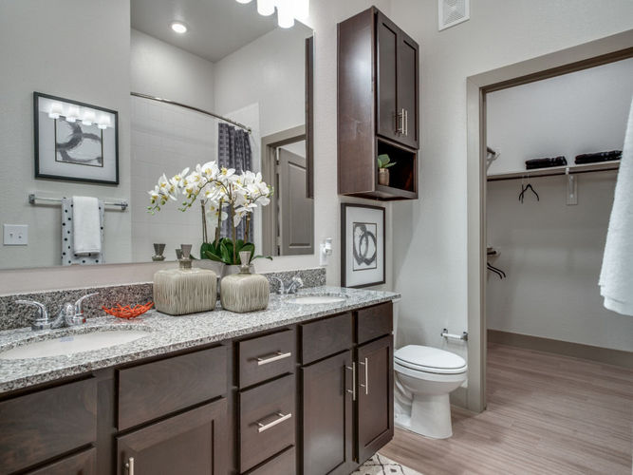

Slide 9
City of Dallas Participation
Invested CDBG, HOME, and Bond funds
CDBG: $1,271,576
HOME: $5,000,000
Bond: $2,028,424
Total: $8,300,000
Funds awarded through Housing Department’s Standing Notice of Funding Availability (NOFA)
Dallas Housing Finance Corporation (DHFC) is general partner of Palladium Redbird ownership entity to provide property tax exemption
DHFC issued $30,000,000 in private activity bonds
Remaining balance was funded using 4% low-income housing tax credits
Notes:
Palladium Redbird serves as a catalyst project for the Red Bird Community and is part of a 95-acre redevelopment of the Southwest Center Mall
In addition to Palladium Redbird, the redevelopment will include over 200,000 SF of office space and 150,000 SF of retail space in converted mall space
Non-residential development will total over $200M
City providing $20M in incentives and gap financing for the redevelopment
Tenants include Parkland Hospital, UT Southwestern Medical Center, Chime Solutions, Marriott (Courtyard + Residence Inn), other retailers

Slide 10
Project Overview
The Galbraith is located at 2400 Bryan Street in the heart of downtown Dallas
217 total units, 111 units reserved for residents earning at or below 80% area median income (AMI)
106 units at market rate/non-income restricted
15-Story construction with structured parking with 312 spaces
Class A amenities such as:
Resort style pool, multipurpose clubhouse with fitness center, business center, stainless steel appliances, early childhood education or childcare facility, and 10,000 square feet of retail space
$77,000,000+ investment into mixed-income, workforce housing for the City of Dallas

Slide 11
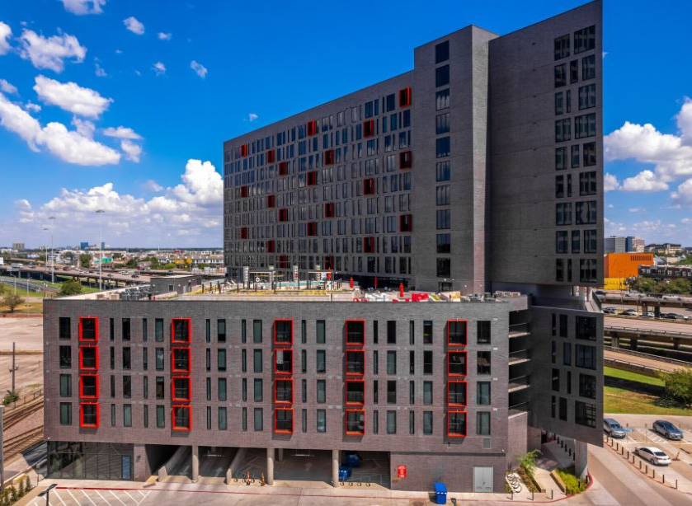
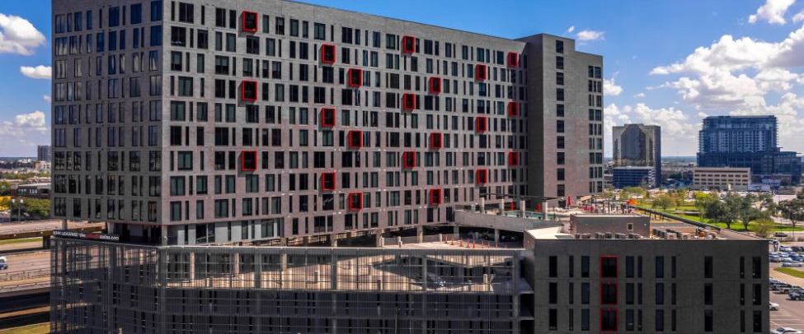
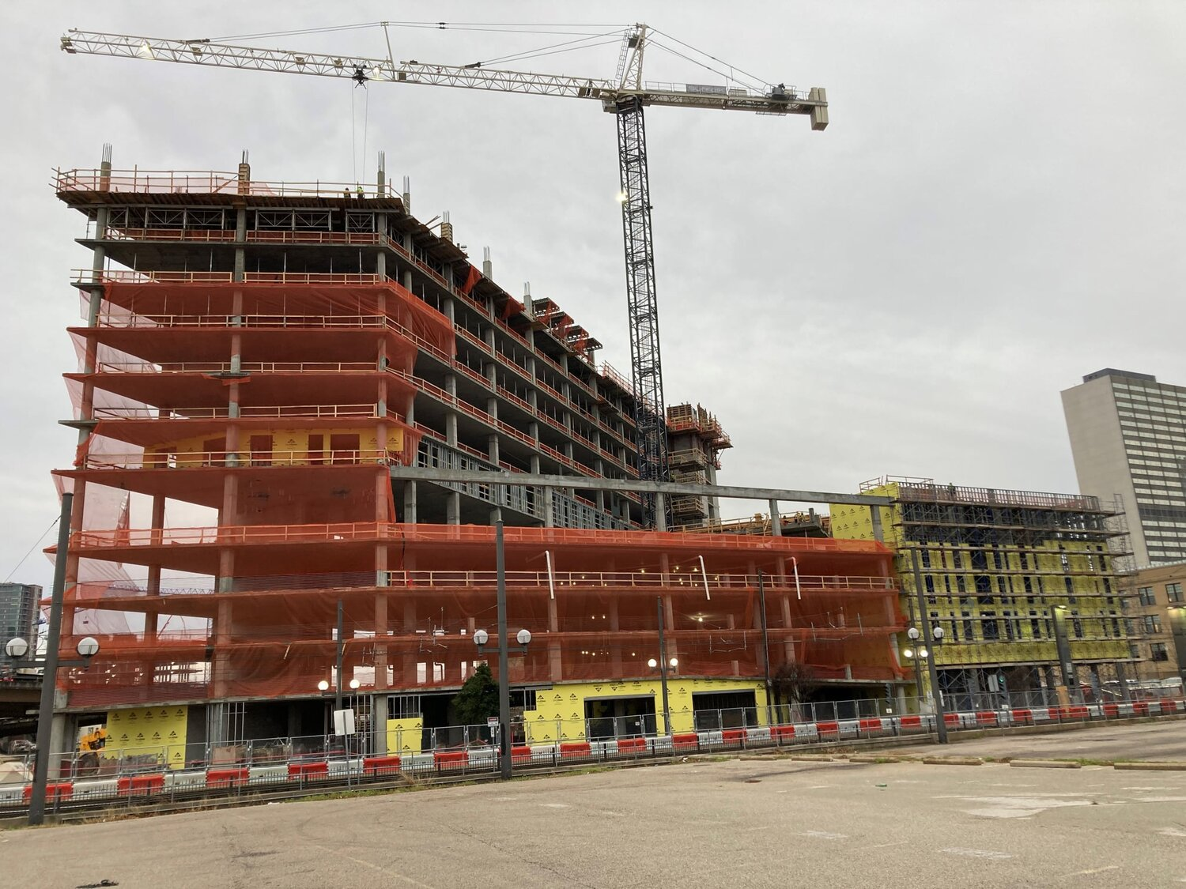
The Galbraith

Slide 12
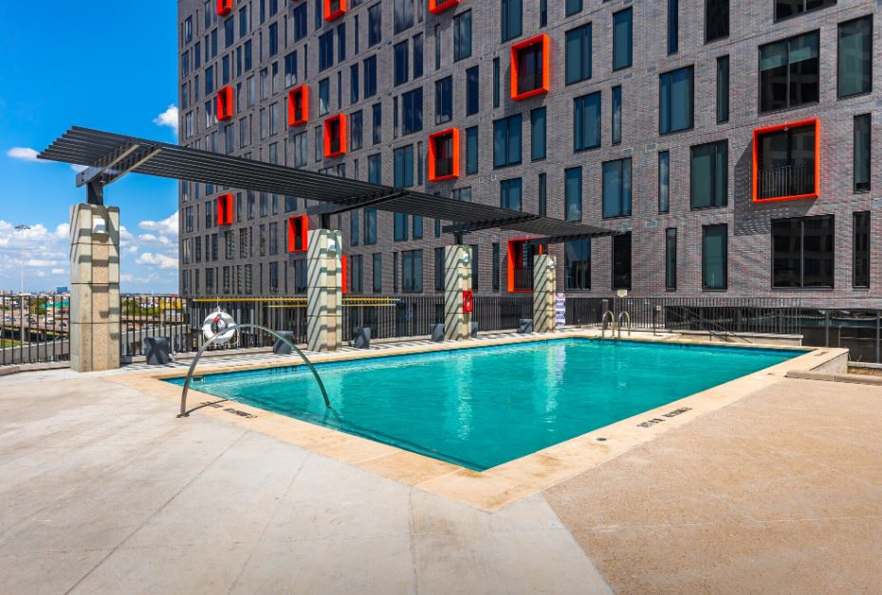
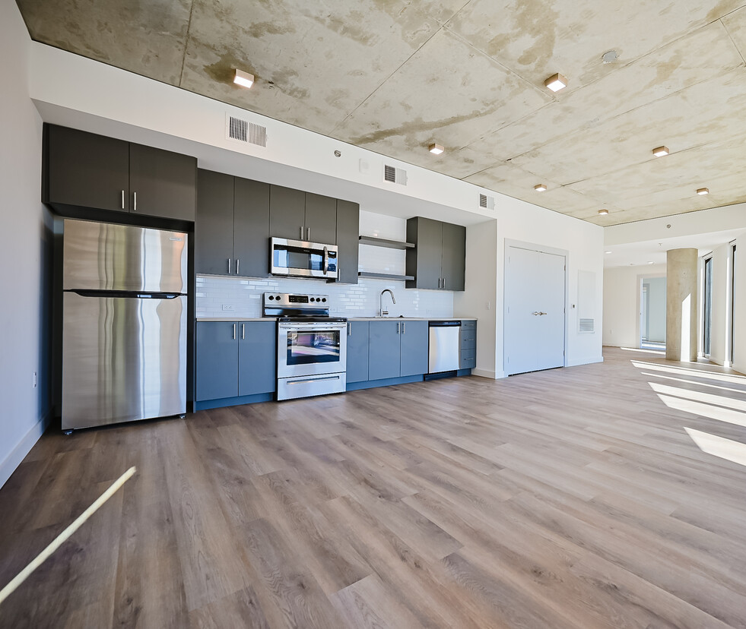
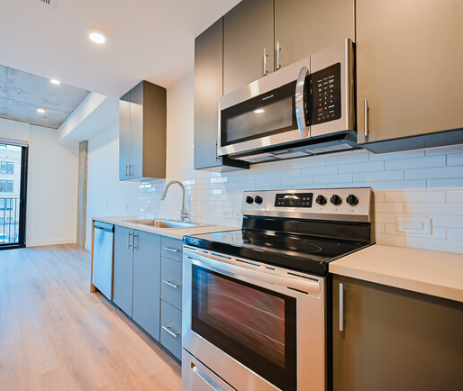
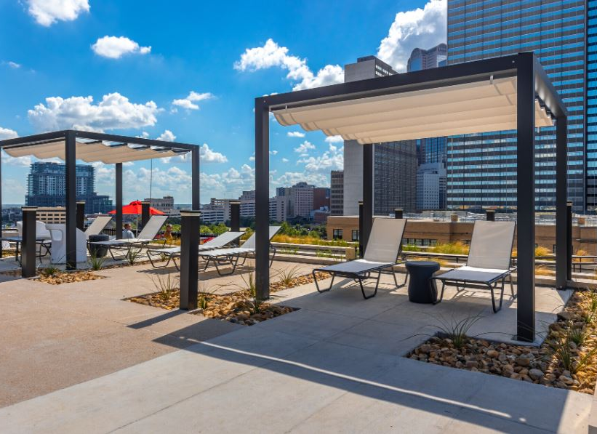
The Galbraith

Slide 13
City of Dallas Participation
Invested CDBG, General Obligation Bond funds and Public/Private Partnership (PPP) funds through Economic Development incentives
CDBG: $ 7,026,943
GO Bonds: $ 973,057
PPP EcoDev: $ 6,000,000
Total: $14,300,000
Funds awarded through Housing Department’s Standing Notice of Funding Availability (NOFA)
Dallas Housing Finance Corporation (DHFC) entered in agreement with City to purchase land and leased land to developer through long-term ground lease
Remaining balance was funded using 9% low-income housing tax credits and permanent debt

Slide 14
Upcoming Project – Westmoreland Station

