Slide 1
Using CDBG for Eligible Activities (and Housing)
Elizabeth McNannay
Caldwell, Idaho
January 2023

Slide 2
Agenda Smaller Entitlement Perspective
Overview
Capacity
Eligible Activities
Leveraging $$ for Housing Projects
Managing the Political Landscape
Questions

Slide 3
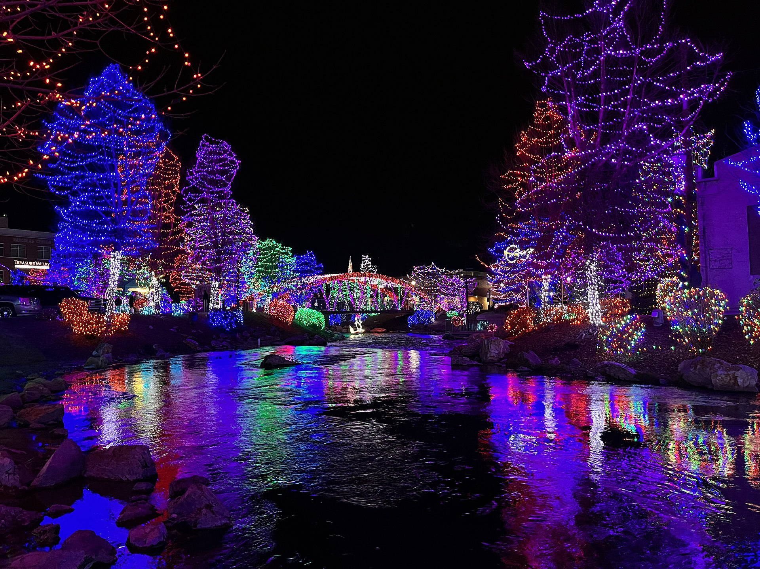
Using CDBG for Eligible Activities (and Housing) Information Geared Toward the Small/Medium Entitlement
Caldwell, Idaho ~ Recipient of Approximately $500,000 CDBG Annually
6th Year as an Entitlement Community in Program Year 2022
Significant Population Growth
1990 Population = 18,400
2000 Population = 25,967 increase of 41%
2010 Population = 46,237 increase of 78%
Population = 59,996 increase of 30%

Slide 4
CAPACITY
What is Realistic ~ Setting Expectations
Allocation Amount?
Staffing?

Slide 5
Eligible Activities
Keep it SIMPLE!
Decide what you will not do (ED? CE?)
This can be as important as what you will be undertaking – seriously
Where do you start?
Consolidated Plan/Annual Action Plan
Common Pitfalls?
How to Avoid?

Slide 6
Housing Activities with CDBG
You Typically Cannot Build Housing with CDBG Funds!
Now What?
Support for Housing Projects ~ Land Acquisition, Site Prep, Demo
Homebuyer Assistance (or DP Assistance as a Public Service)
Rehab for LMI Homeowners and/or Multifamily Dwellings
Not all City and County Entitlements face the same issues!
In Caldwell, ID support has primarily included Infill Ownership and Multifamily Project Support
Accomplishments Include Supporting over 120 new MF units and over 10 Homeowner units
During a 5-yr period.

Slide 7
Managing the Local Political Landscape
This Varies by Jurisdiction!
Who?
Why?
What?

Slide 8
THANK YOU!!
Contact Information:
Elizabeth McNannay
elizabeth@resourceconsultants.org
541-806-0868
ENJOY THE CONFERENCE

