Slide 1
Understanding Housing Data for Consolidated Plans
Kim Cadena
City of Alexandria, VA

Slide 2
Housing in the Consolidated Plan
Main focus of the Plan
Data pulled automatically from Census and CHAS
Split into Needs Assessment and Market Analysis
Basis for who the Plan will help and how
Notes:
IDIS pulls ACS and CHAS data automatically but may not pull most recent data. Check before you use!
Needs Assessment: what is most important and who needs most
Market Analysis: picture of current housing environment, what needs to change?

Slide 3
Needs Assessment: Housing Terms
Tenure = whether a household owns or rents
Area Median Income = middle income for all households in area
Cost burdened = paying more than 30% of gross income for housing
Notes:
HUD splits data into AMI bands: extremely-low, very low, and low income
AMIs vary by metropolitan area; AMIs also vary by household sizes; typical AMI is for four-person household
Housing costs depend on tenure; for renters it’s rent + utilities, for homeowners, it’s mortgage + taxes, insurance

Slide 4
Four Housing Problems
Problems
Severe Problems
Incomplete kitchen facilities
Incomplete bathroom facilities
More than 1 person per room
Housing cost burden >30%
Incomplete kitchen facilities
Incomplete bathroom facilities
More than 1.5 persons per room
Housing cost burden >50%

Slide 5
Using The Data: Needs Assessment
Use with other data
Identify greatest needs in the community
Identify groups with greatest needs
Don’t forget homeless and special population needs!
Notes:
Use Census data to determine the main housing problems.
What groups are disproportionately impacted? Disproportionate need: 10%+ than general population
Can use this info for HOME-ARP analysis, esp “other populations”
Homeless, disabled, seniors, etc; community development needs

Slide 6
Market Analysis: Housing Terms
Affordable = unit for which a household pays <30% of its income in housing costs
Fair Market Rent = rent paid by 40% of households in an area
Standard condition = meets HQS or state and local codes
Abandoned = 90 days delinquent on tax payments or code citation
Notes:
FMR is determined by HUD, either on metropolitan area level or on a county level; FMR is basis for what HCV pay
HUD has categories for “substandard” and “substandard suitable for rehab”
Abandoned buildings can be suitable or unsuitable for rehab

Slide 7
Using the Data: Market Analysis
Looks at current available supply and demand
Shows if there is a mismatch between them
Includes price, condition of units, vacant units
Also includes housing for homeless and special needs
Notes:
Focus mostly on renters
Mismatch can be between FMR and what is affordable to lower income groups
Mismatch can also be between what is available and what is needed
Condition of units is the same housing problems
Are abandoned properties suitable for rehab

Slide 8
What is CHAS?
Stands for Comprehensive Housing Affordability Strategy
Provides more detailed housing data than ACS
Focus on households by race and income
Provides info on housing problems and cost burdens
Notes:
Where most of the housing data in ConPlan populates from
Very granular
Complicated data set to use
Usually 3-4 years behind on data
Inaccurate for small sample sizes

Slide 9
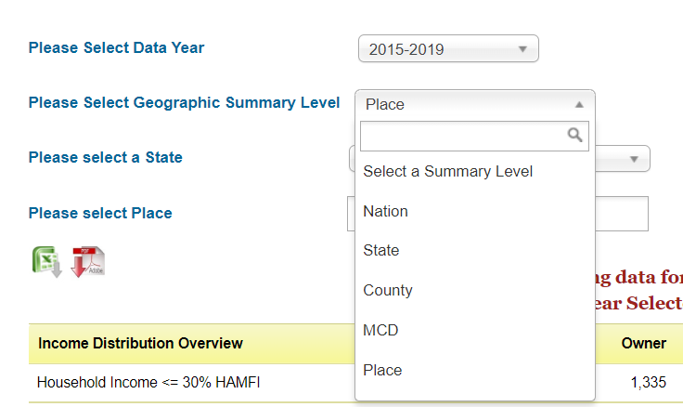
CHAS Query System
Select Year
Based on 5-Year ACS
2015-2019 most recent
Select Geography
Cities are usually under “Place”
Towns are usually under “MCD”

Slide 10
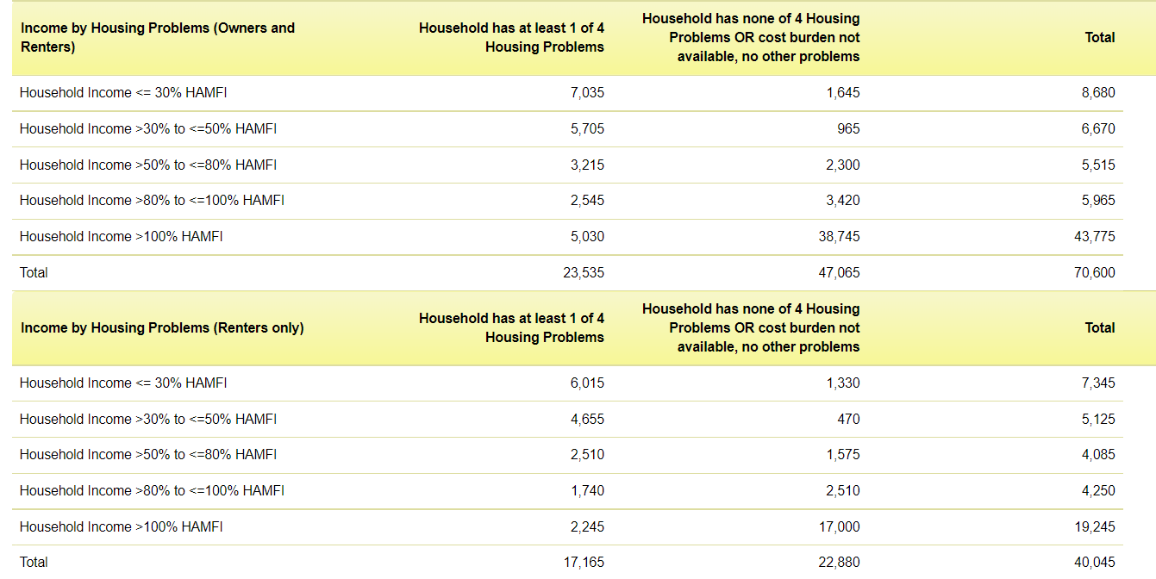
CHAS Query Output
Notes:
High level information at a glance
Easier to use than full data set
Does not cover all the nuanced info
Provides information by AMI band and tenure
Does not break down data by race and ethnicity

Slide 11
Questions?
Kim Cadena
kimberly.cadena@alexandriava.gov

