Slide 1
Understanding census data a summary overview
National Community Development Association
Winter Legislative Conference
January 25, 2023
Holiday Inn Capital, Congressional I Room
Washington, DC
Shirletta Best
Community Services Administrator
City of McKinney, Texas

Slide 2
Census data.
Helping you to tell your story about community needs
The support you need for data-driven decision making
Allows you to see growth in your population, housing, characteristics in helping your program grow.

Slide 3
As we know:
The CDBG Entitlement Program provides annual grants on a formula basis to entitled cities and counties to develop viable urban communities by providing decent housing and a suitable living environment, and by expanding economic opportunities, principally for low- and moderate-income persons.
HUD uses census data to determine the formula in funding, and the determination of need for programs.
If they use it, so should you to make data- driven decisions in your program planning.

Slide 4
How hud uses census data
American Community Survey LMI Summary Data
Disability Data, - Updates will come from Census 2020
Summary Census Data : Race, Ethnicity, Housing , Poverty Status
Income
Internet, Computer Use

Slide 5
aCS known as the American community survey
According to the U.S. Census Bureau, this is one of the most important data tools to access information on income, youth, age, education and other information. The ACS was conducted at the same time of Census 2020 .
It supports over 300 “evidence based federal Government uses and informs over $675 billion of Federal government annually.
Three Annual Releases:
5 year estimates for very small populations
1 year Supplemental estimates, small populations and
1 year Estimates for large populations

Slide 6
Acs Data the most has the most popular social, economic, housing, and demographic data for a single geographic area. The Data Profiles summarize the data, giving you estimates and percentages, to cover the most basic data Samples include:
Housing | Demographics | Social
Occupancy | Age | Commuting to Work
Computer/Internet use | Race | Disability
Structure | Hispanic Origin | Veterans

Slide 7
Acs VS CENSUS DATA: WHAT THE DIFFERENCE??
Purpose of | DECENNIAL (CENSUS 2020) | ACS AMERICAN COMMUNITY SURVEY
What? | Taken every 10 years – official counts | ESTIMATE SAMPLES
It Gives Me… | Population Totals | Population Characteristics
I get this information | Every 10 years; takes 1 year or more to roll out thereafter | Every year
How to I get info | Short form – a few questions | Longer form – was taken with Census 2020 ,

Slide 8
How to access acs data
Data Profiles –Data.census.gov
Census Business Builder
My Tribal Area
Quickfacts

Slide 9
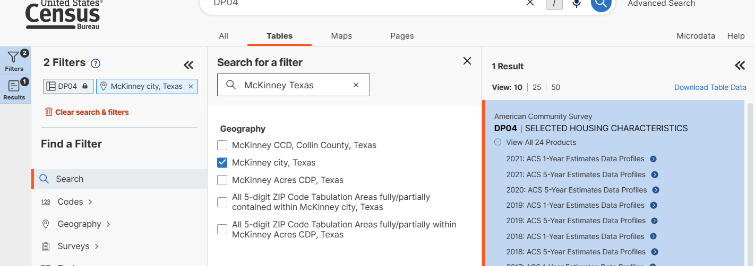
Searching under Acs
Search within the filter, select my geographic, determine which product I want to view

Slide 10
Contact information
Shirletta Best
Community Services Administrator
sbest@mckinneytexas.org
Phone: 972-547-7577

