Slide 1
Kayon Henderson
Manager, Housing and Community Development Division
City of Tampa

Slide 2
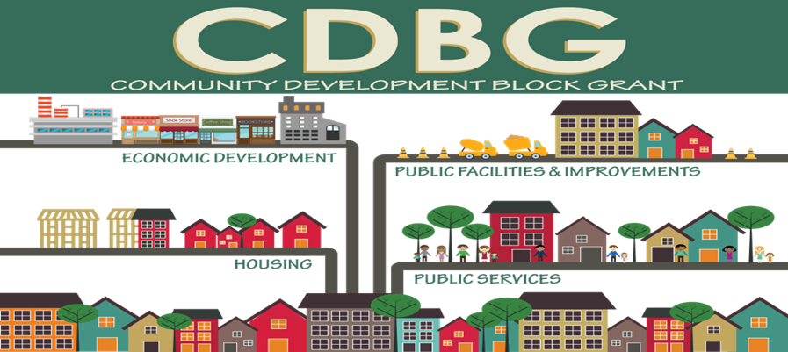

Slide 3
ELIGIBLE ACTIVITIES
24 CFR 570.201-206 and 570.500:
Acquisition/Disposition
Public Facilities Improvements
Clearance Activities
Public Services
Homeownership Assistance
Relocation/Interim Assistance
Rehabilitation
Economic Development
Special Economic Development
Microenterprise Assistance
Community-Based Development Organization (CDBO)
Revolving Loan/Lump Sum Draw Downs/Escrow Accounts/Section 108
Note: CDBG does not fund New Construction

Slide 4
ELIGIBLE ACTIVITIES
Homeownership Assistance 570.202(n)
CDBG funds may be used to provide direct homeownership assistance to LIMI households to:
Reduce the interest rate of a mortgage by applying funds toward the purchase price.
Reduce the principal amount of a mortgage by applying funds directly toward the loan or making a subordination loan to the purchaser at little or no interest so the first mortgage is affordable to the LMI household.
Assist the buyer with the down payment and/or closing costs within the following limitations:
The amount of assistance is limited to 50% of the required down payment AND
Closing costs to be paid with CDBG funds must be reasonable and customary
Homeownership assistance may be provided to any housing, whether it is for an existing property or newly constructed.

Slide 5
There is an affordable housing shortage

Slide 6
Renting and Affordability
Lower income households that rent, suffer the most severe housing cost burdens
Supply of low-cost rental housing units have not been sufficient to meet the demand
Rental subsidies have not been sufficient to meet the demands (Section 8 vouchers, Tenant Based Rental Assistance, etc.)

Slide 7
How do we address the problem? Homeownership

Slide 8
Path Program Community Impact
Increase the supply of affordable homeownership opportunities for first time home buyers
Move City owned lots back on the tax rolls
Increase Property Values & Tax Base
Build Energy Efficient homes for Low-Mod Income first time home buyers
Match Preapproved Recipients for the Down Payment Assistance program with available City Lots and Developers
Stabilize Tampa Neighborhoods

Slide 9
Low/Mod Income Buyers
The process!
City of Tampa
Vacant Lots
Affordable Housing
Developer
Notes:
Our recommended infill housing strategy matches <city-owned vacant lots> with <preapproved buyers receiving City of Tampa down payment assistance> and creates a funding strategy to incentivize an <affordable housing developer> to build energy star certified homes on those lots.

Slide 10
Infill Strategy “Path to Affordability”
Create Path to Affordability Program
Survey & Match the City’s Waiting List with 102 vacant city-owned lots
Phase 1: Start with 10 homes
Contract housing developers to build Energy Star Certified homes
Partner with East Tampa CRA
USF Architectural Students to assist in creating affordable, energy star certified home plans
Create a model village with three to four homes (Two builders and two homes each)
Notes:
Waiting list of 75 pre approved qualified buyer households; down payment assistance monies are already reserved

Slide 11
Buyer Waiting List Profile
Targeting clients in the 80-140% AMI
Average $44,000 household income
75 qualified buyer households
Can afford up to $136,000 sales price
Estimated mortgage $112,000 plus DPA
Down Payment Assistance – up to $90,000

Slide 12
Overcoming Challenges
Matching Buyers with Lots/Homes –
Surveys
Door-to-door Visitation
Partner with Neighborhood Associations
Public Meetings
Community Events
Managing Construction Costs
Maintaining Community Character
Notes:
Conduct surveys to determine household design and interior feature needs of the buyer’s waiting list

Slide 13
Sources and Uses of Funds
Sources of Funds (Revenues)
Sale of 10 homes at $130,000=$1,300,000
Donated lots $50,000 value
CRA TIF $120,000
CRA Down payment Assistance up to $50,000
City of Tampa Down payment Assistance up to $40,000
Uses of Funds
Debt (80%) $1,292,000
City of Tampa Construction Loan, 0%, 24 months

Slide 14
Construction Loan
City of Tampa SHIP Construction Loan for $1,292,000
0% interest
24 months
Loan Proceeds to the City of Tampa
$1,155,000 (can use as revolving loan fund)
$145,000 subsidy needed

Slide 17
Questions?

