Slide 1
Affordable Housing in Rising Cost Markets: Hamilton County, Ohio
National Community Development Association Conference | Washington DC
January 2023

Slide 2
Panelists
Thomas Carroll City Manager, Cambridge, Maryland
Joy Pierson Assistant City Manager, Covington, Kentucky
Liz Blume Principal, Blume Community Partners
Moderator George Mensah, Director, Housing and Community Development, City of Miami, FL

Slide 3
Overview
City
Village

Slide 4
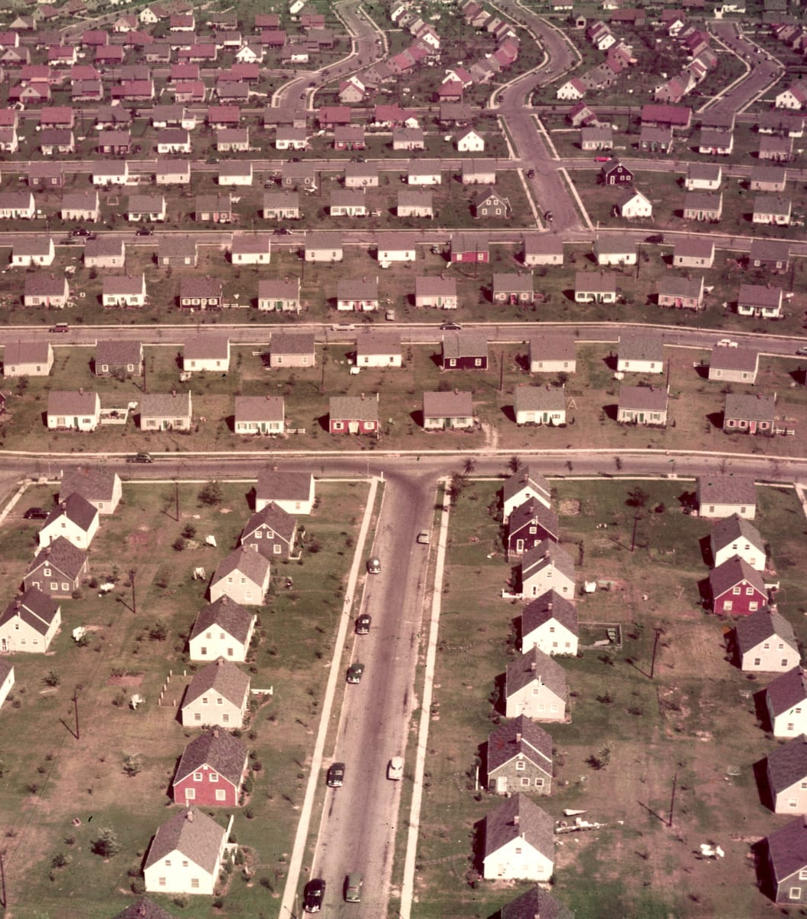
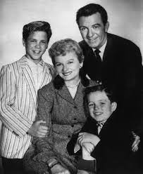
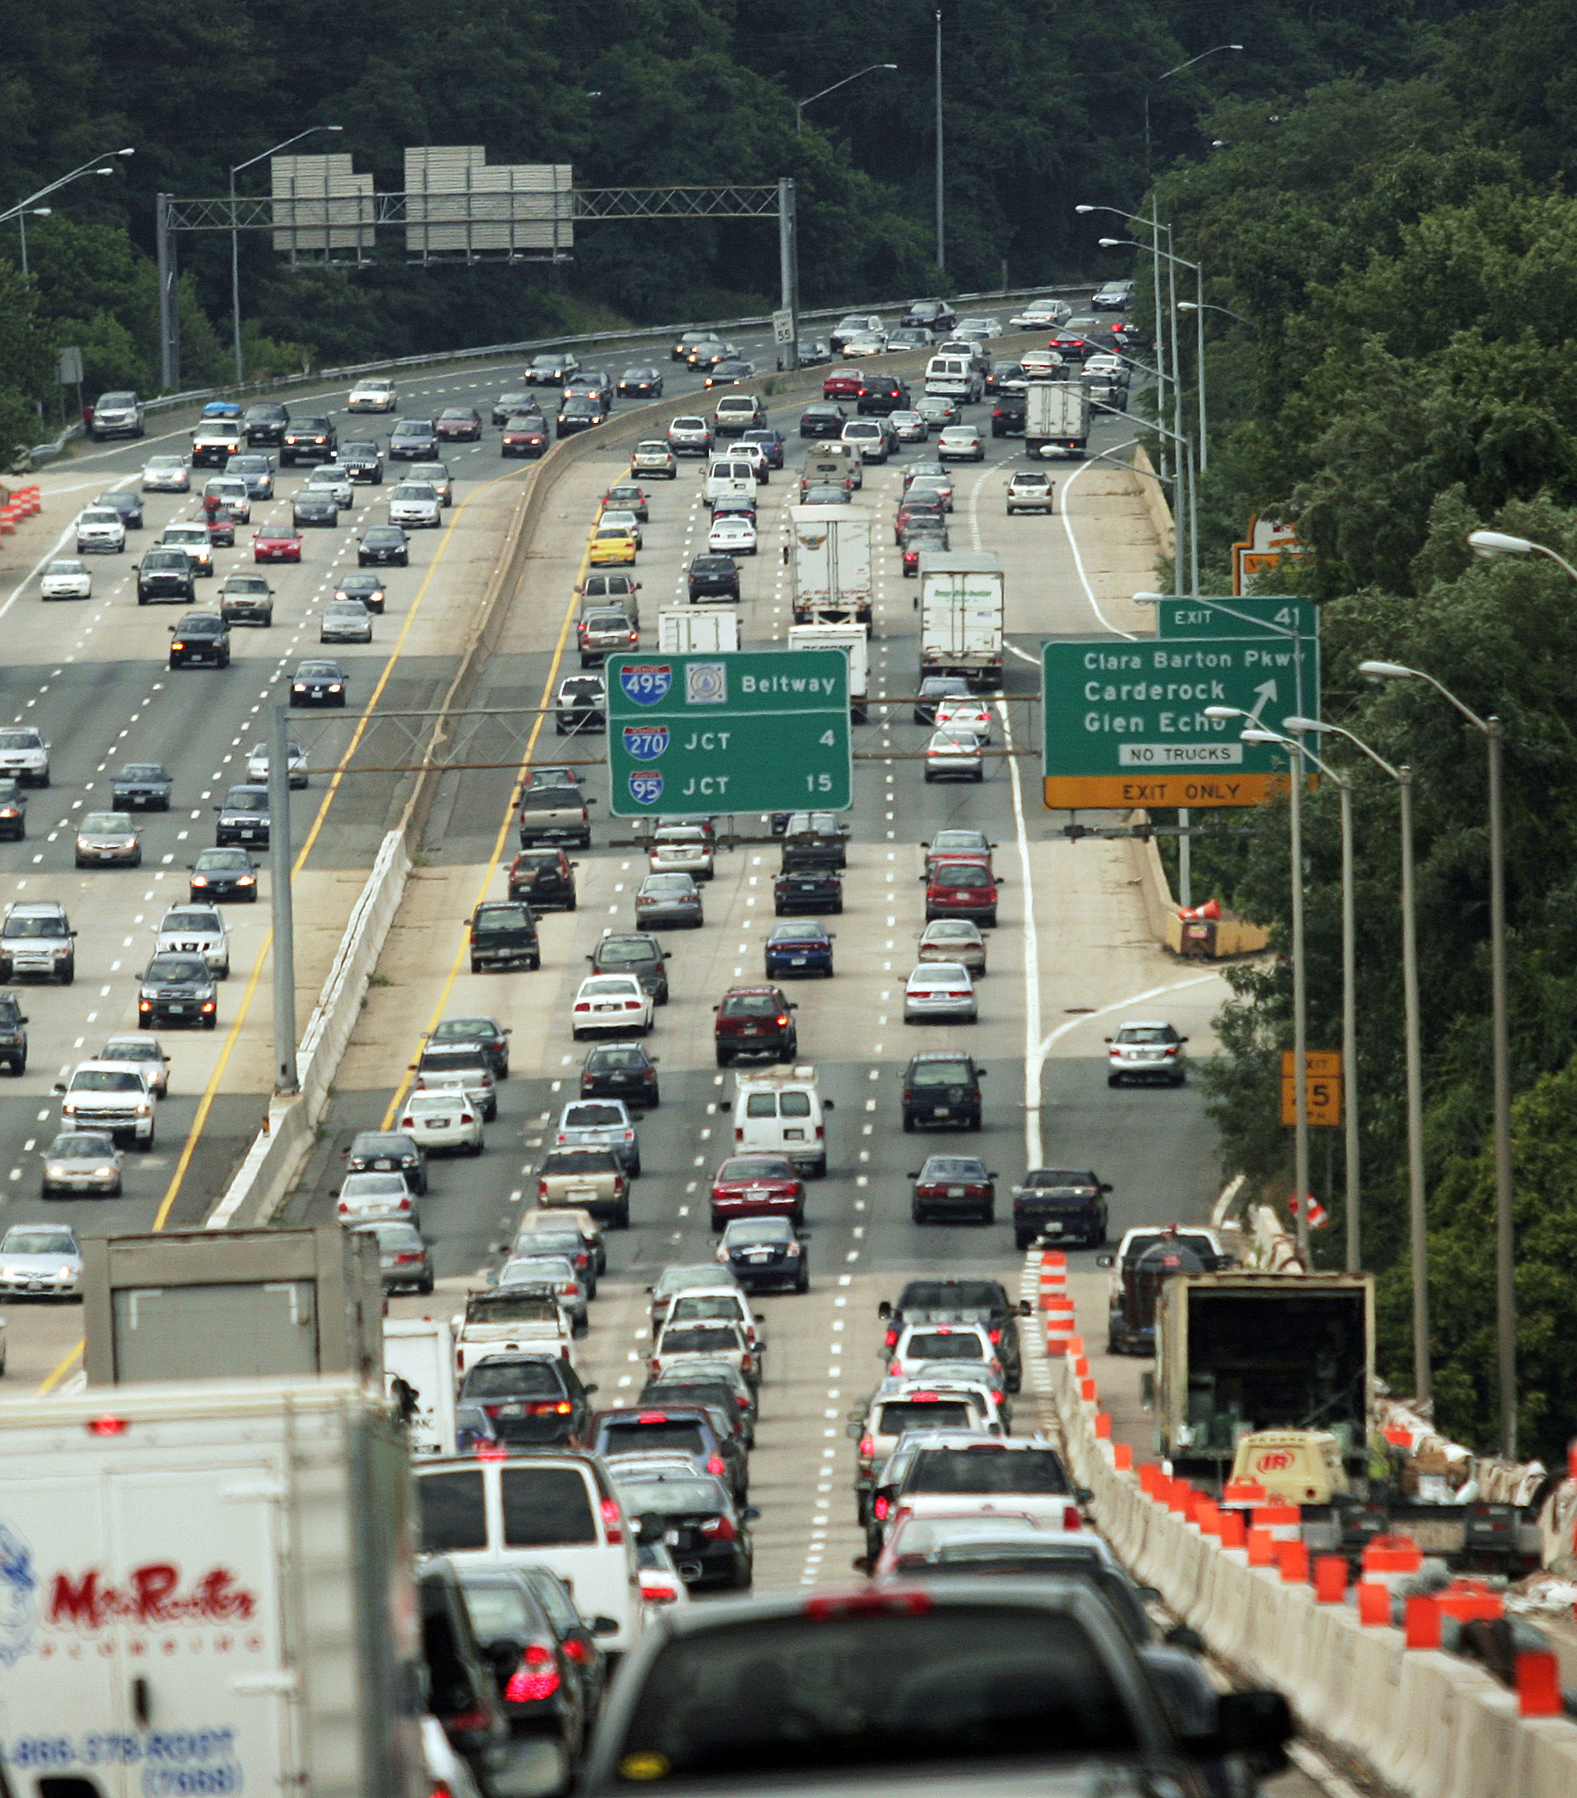
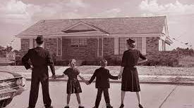
First suburbs become “ringed-in”

Slide 5
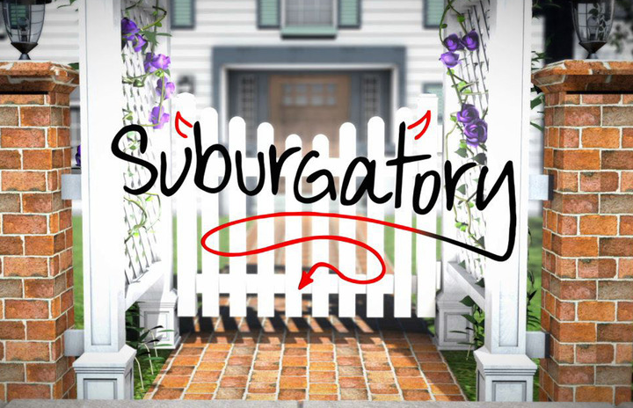
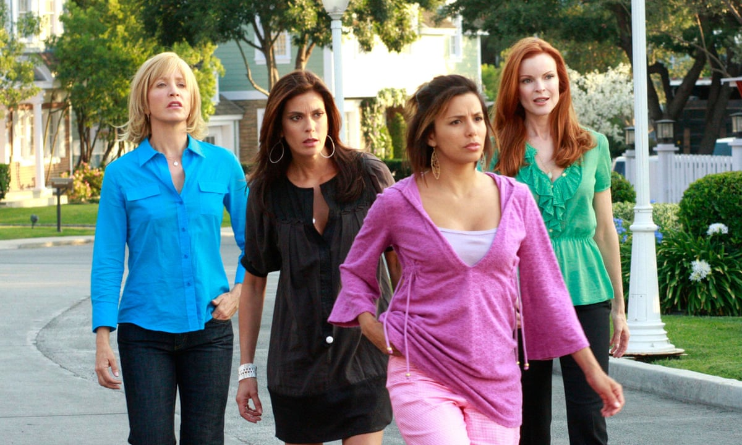
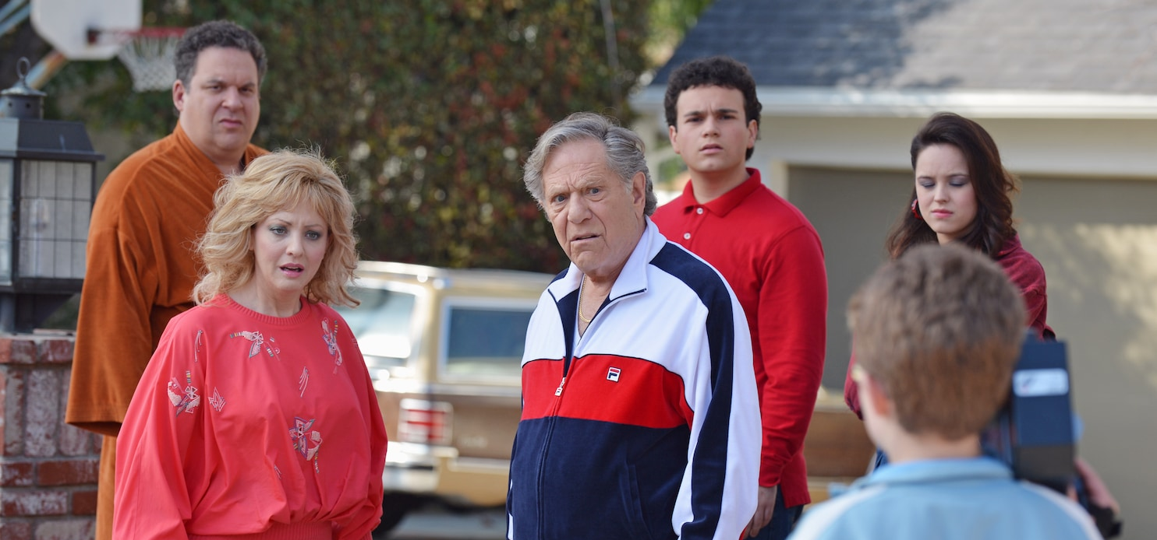
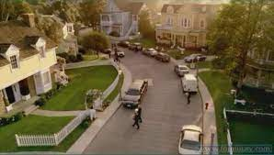
Giving way to contemporary, outer-ring suburbs

Slide 6
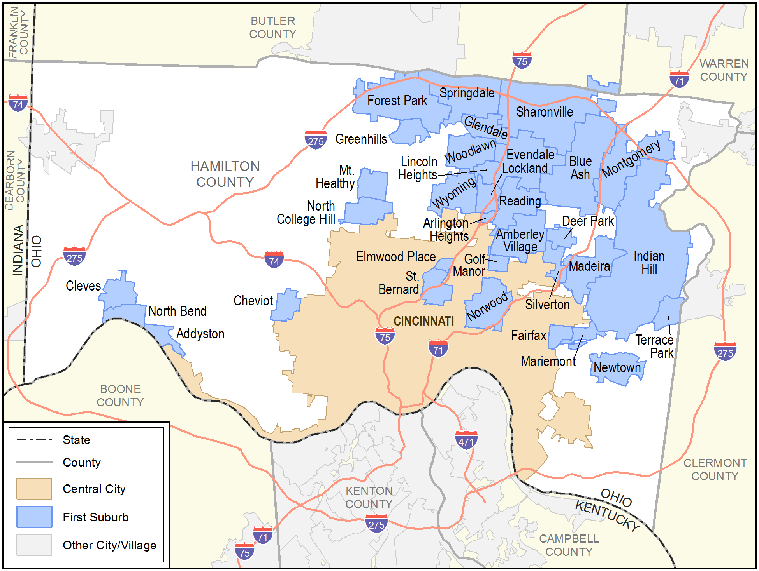
Overview
“If current trends persist for many first suburbs, these areas could look a lot more distressed over the next two decades. Now is the time to alter metropolitan policy.”
- Robert Puentes and David Warren
The Brookings Institute, 2006

Slide 7
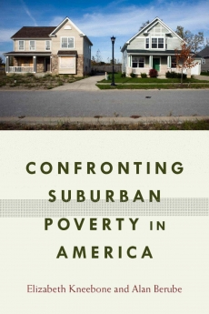
“…today, more Americans live below the poverty line in suburbs than in the nation’s big cities.”
“As poverty spread into more and different places in suburbia, it did not disperse evenly.”
“These shifts accompanied the emergence of a growing number of extremely poor neighborhoods in suburbia.”
“By 2010, one in three Americans was poor or near poor, meaning that 104 million people lived below twice the federal poverty line—23 million more than in 2000.”

Slide 8
The Suburbanization of Poverty
Community |  | 1999 Poverty Rate |  | 2017 Poverty Rate |  | Change in Poverty Rate, 1999-2017
Mariemont |  | 5.00% |  | 2.30% |  | -2.70%
Amberley Village |  | 3.50% |  | 3.30% |  | -0.20%
Wyoming |  | 1.40% |  | 2.00% |  | 0.60%
Madeira |  | 1.30% |  | 2.10% |  | 0.80%
Blue Ash |  | 4.70% |  | 5.60% |  | 0.90%
Montgomery |  | 2.80% |  | 3.90% |  | 1.10%
Newtown |  | 7.10% |  | 8.50% |  | 1.40%
Evendale |  | 0.30% |  | 1.90% |  | 1.60%
North Bend |  | 6.50% |  | 8.70% |  | 2.20%
Glendale |  | 2.10% |  | 4.60% |  | 2.50%
Deer Park |  | 5.30% |  | 8.10% |  | 2.80%
Indian Hill |  |  |  | 3.10% |  | 3.10%
Terrace Park |  | 2.00% |  | 5.30% |  | 3.30%
Fairfax |  | 5.10% |  | 8.90% |  | 3.80%
Cleves |  | 7.60% |  | 11.70% |  | 4.10%
St. Bernard |  | 8.70% |  | 13.00% |  | 4.30%
Silverton |  | 9.50% |  | 14.60% |  | 5.10%
Addyston |  | 11.60% |  | 17.00% |  | 5.40%
Reading |  | 7.30% |  | 13.50% |  | 6.20%
Woodlawn |  | 10.40% |  | 17.40% |  | 7.00%
Sharonville |  | 4.00% |  | 11.40% |  | 7.40%
Greenhills |  | 3.80% |  | 12.60% |  | 8.80%
Lockland |  | 26.50% |  | 35.60% |  | 9.10%
Norwood |  | 12.90% |  | 22.00% |  | 9.10%
Springdale |  | 8.90% |  | 18.80% |  | 9.90%
Forest Park |  | 6.00% |  | 16.40% |  | 10.40%
Golf Manor |  | 10.70% |  | 21.20% |  | 10.50%
Arlington Heights |  | 5.40% |  | 15.90% |  | 10.50%
Mt. Healthy |  | 8.90% |  | 19.40% |  | 10.50%
North College Hill |  | 8.70% |  | 19.20% |  | 10.50%
Elmwood Place |  | 19.00% |  | 30.00% |  | 11.00%
Lincoln Heights |  | 29.90% |  | 41.80% |  | 11.90%
Cheviot |  | 7.60% |  | 20.70% |  | 13.10%

Slide 9
The Divergence of First Suburbs

Slide 10
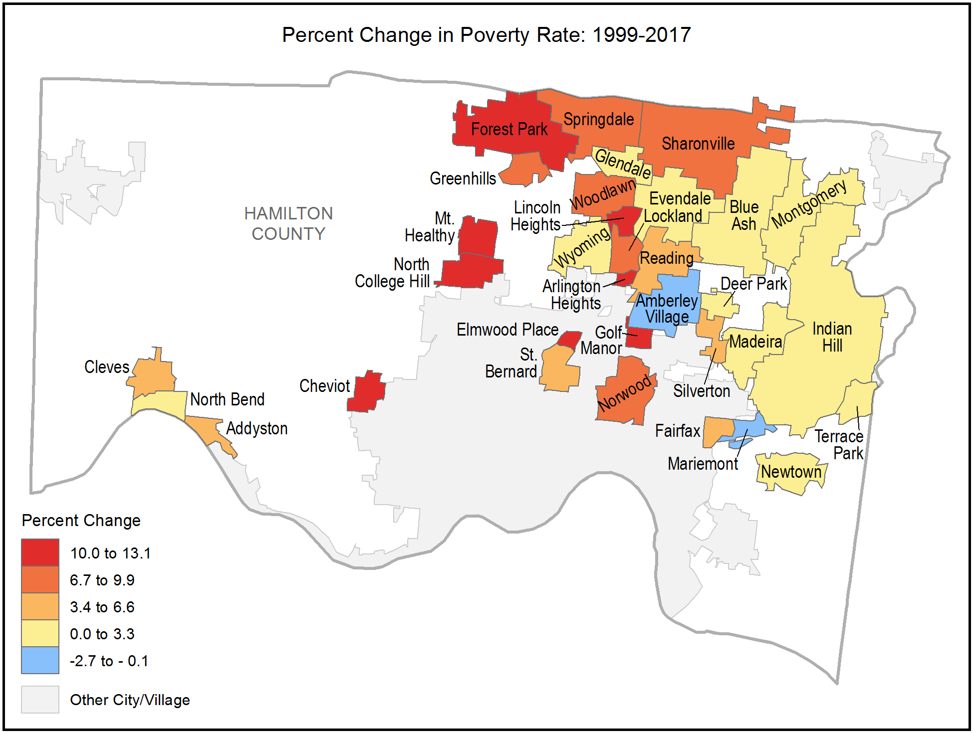
The Suburbanization of Poverty

Slide 11
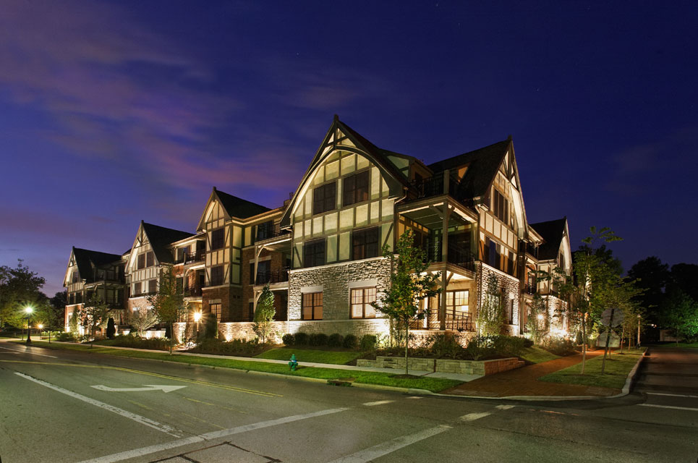
Community | Total 2008 Value | Total 2011 Value | Total 2014 Value | Total 2017 Value | 2008 vs 2017 Total Value | % Change in Total Value, 2008 to 2017 | Inflation Adjusted, 2008 vs 2017
Lincoln Heights | 30,143,840 | 26,555,260 | 20,621,000 | 20,182,980 | -9,960,860 | -33.04% | -48.54%
Springdale | 446,145,790 | 337,958,650 | 312,554,640 | 319,007,740 | -127,138,050 | -28.50% | -44.00%
Golf Manor | 53,123,500 | 43,050,740 | 39,977,640 | 40,562,940 | -12,560,560 | -23.64% | -39.14%
Elmwood Place | 23,854,790 | 19,311,410 | 18,696,700 | 18,583,580 | -5,271,210 | -22.10% | -37.60%
North College Hill | 138,020,230 | 117,491,930 | 109,246,180 | 110,524,110 | -27,496,120 | -19.92% | -35.42%
Mt. Healthy | 91,597,090 | 79,967,340 | 74,251,040 | 74,476,090 | -17,121,000 | -18.69% | -34.19%
Lockland | 57,100,450 | 50,274,770 | 47,592,860 | 47,159,640 | -9,940,810 | -17.41% | -32.91%
Greenhills | 63,592,710 | 56,157,450 | 52,257,320 | 52,785,510 | -10,807,200 | -16.99% | -32.49%
Addyston | 13,823,460 | 11,963,600 | 11,884,620 | 11,477,650 | -2,345,810 | -16.97% | -32.47%
Arlington Heights | 13,204,720 | 12,177,070 | 11,446,270 | 11,050,450 | -2,154,270 | -16.31% | -31.81%
Cheviot | 130,607,160 | 111,223,030 | 106,520,990 | 109,441,300 | -21,165,860 | -16.21% | -31.71%
Forest Park | 373,685,060 | 328,076,090 | 306,712,640 | 313,230,100 | -60,454,960 | -16.18% | -31.68%
Indian Hill | 984,490,420 | 846,131,180 | 848,868,790 | 867,158,360 | -117,332,060 | -11.92% | -27.42%
Reading | 200,250,540 | 180,594,100 | 176,386,750 | 178,432,890 | -21,817,650 | -10.90% | -26.40%
St. Bernard | 91,397,640 | 74,676,400 | 80,449,640 | 81,485,260 | -9,912,380 | -10.85% | -26.35%
Norwood | 435,262,340 | 377,917,640 | 374,685,560 | 406,153,090 | -29,109,250 | -6.69% | -22.19%
Glendale | 107,065,670 | 97,878,900 | 99,881,750 | 101,188,130 | -5,877,540 | -5.49% | -20.99%
Silverton | 91,081,550 | 85,036,690 | 83,075,080 | 86,226,270 | -4,855,280 | -5.33% | -20.83%
Newtown | 95,128,850 | 88,082,670 | 87,100,740 | 90,179,110 | -4,949,740 | -5.20% | -20.70%
Amberley Village | 185,300,120 | 165,811,690 | 166,931,030 | 179,500,050 | -5,800,070 | -3.13% | -18.63%
Woodlawn | 101,128,440 | 98,657,870 | 94,321,010 | 98,072,170 | -3,056,270 | -3.02% | -18.52%
Deer Park | 111,780,080 | 103,760,270 | 104,629,390 | 108,557,260 | -3,222,820 | -2.88% | -18.38%
Sharonville | 470,138,380 | 449,119,680 | 438,387,420 | 460,768,290 | -9,370,090 | -1.99% | -17.49%
Terrace Park | 130,661,280 | 121,193,730 | 125,216,870 | 129,030,020 | -1,631,260 | -1.25% | -16.75%
Evendale | 215,063,740 | 201,222,800 | 204,400,700 | 213,227,630 | -1,836,110 | -0.85% | -16.35%
Wyoming | 310,589,480 | 277,897,200 | 304,911,790 | 313,317,700 | 2,728,220 | 0.88% | -14.62%
Blue Ash | 767,632,110 | 706,449,050 | 712,604,150 | 779,315,550 | 11,683,440 | 1.52% | -13.98%
Cleves | 51,717,780 | 51,091,480 | 53,613,510 | 52,636,160 | 918,380 | 1.78% | -13.72%
North Bend | 36,551,550 | 35,098,020 | 36,111,680 | 38,614,610 | 2,063,060 | 5.64% | -9.86%
Fairfax | 59,026,550 | 56,388,620 | 62,516,600 | 63,219,420 | 4,192,870 | 7.10% | -8.40%
Montgomery | 519,378,370 | 481,043,250 | 516,228,830 | 576,634,020 | 57,255,650 | 11.02% | -4.48%
Madeira | 323,650,670 | 298,298,190 | 326,762,360 | 379,569,010 | 55,918,340 | 17.28% | 1.78%
Mariemont | 129,348,710 | 125,806,450 | 142,942,990 | 165,248,970 | 35,900,260 | 27.75% | 12.25%
Mariemont, Ohio
Data Source: Hamilton County Auditor

Slide 12
The Divergence of First Suburbs

Slide 13
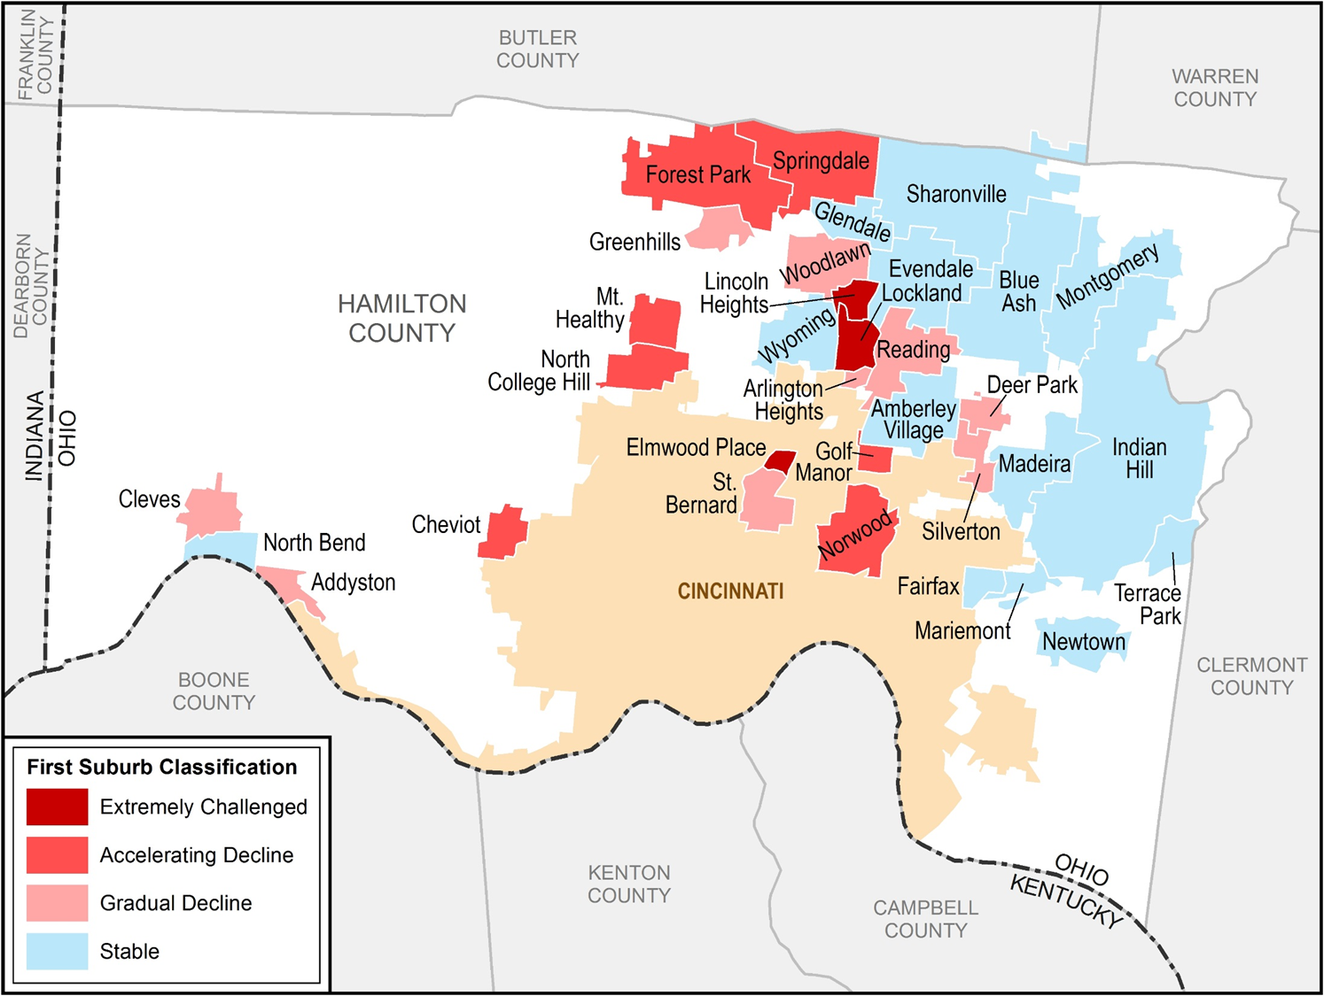
Community | Tax Base | Total Population | Poverty | Total
Lincoln Heights | -30 | -15 | -40 | -85
Elmwood Place | -30 | -15 | -30 | -75
Lockland | -20 | -15 | -30 | -65
Golf Manor | -30 | -8 | -20 | -58
Cheviot | -20 | -8 | -20 | -48
Addyston | -20 | -15 | -12 | -47
Springdale | -30 | 5 | -20 | -45
Mt. Healthy | -20 | -12 | -12 | -44
Arlington Heights | -20 | -15 | -8 | -43
Norwood | -8 | -12 | -20 | -40
Greenhills | -20 | -12 | -8 | -40
North College Hill | -20 | -8 | -12 | -40
St. Bernard | -12 | -12 | -8 | -32
Forest Park | -20 | 0 | -12 | -32
Silverton | -8 | -12 | -8 | -28
Reading | -12 | -8 | -8 | -28
Glendale | -8 | -8 | 5 | -11
Deer Park | 0 | -5 | -5 | -10
Newtown | -8 | 5 | -5 | -8
Fairfax | 10 | -12 | -5 | -7
Woodlawn | 0 | 5 | -12 | -7
Sharonville | 0 | 5 | -12 | -7
Evendale | 0 | -8 | 5 | -3
Indian Hill | -12 | 5 | 5 | -2
Terrace Park | 0 | 5 | 0 | 5
Cleves | 10 | 5 | -5 | 10
Amberley Village | 0 | 5 | 5 | 10
North Bend | 10 | 5 | -5 | 10
Madeira | 10 | 0 | 5 | 15
Blue Ash | 10 | 10 | 0 | 20
Mariemont | 10 | 5 | 5 | 20
Montgomery | 10 | 5 | 5 | 20
Wyoming | 10 | 5 | 5 | 20

Slide 14
Housing As Your Biggest Asset
For most suburban communities, housing valuation has been and continues to be the bulk of the tax base.
As housing stock goes, so goes the local government’s ability to serve.
Most local government leaders think in terms of operating and capital budgets. Brookings Institution scholars Puentes and Orfield pointed out in 2002 this framing is incorrect. They said,
“There are, however, three basic fiscal needs of every community…financing operating budgets, financing infrastructure building or repair, and financing redevelopment….”
It follows that in a residential heavy suburb, financing redevelopment means investing in housing.

Slide 15
Three impactful studies focused attention

Slide 16
Hamilton County’s Response
Housing Our Future – Strategies for Cincinnati and Hamilton County May 2020
Created Strategy Guide for communities
Implementation of HOF - Housing Action Plans

Slide 17
Hamilton County’s Response cont.
Struggle between City only and County Wide (830,000 pop)
Cincinnati population is 33% of County (300,000 pop)
Balance of 48 communities is 67% (530,000 pop)
County can fund smaller cities, villages, neighborhoods plans
Set aside $100K per year for two years

Slide 18
Communities Self-Selected
Silverton – 5,000 population
Lincoln Heights 3,118 population
Addyston – 913 population
Cheviot – 8,661 population
Deer Park – 5,354 population
Norwood – 18,790 population
Forest Park – 19,971 population

Slide 19
Hamilton County’s Response cont.
Goal was to convene stakeholders – meet one on one – get info from diverse perspectives
Data driven decision making – land use, homeownership rates, demographics
Having hard conversations
Providing funding for solutions
Thinking outside the box – Silverton land trust

Slide 20
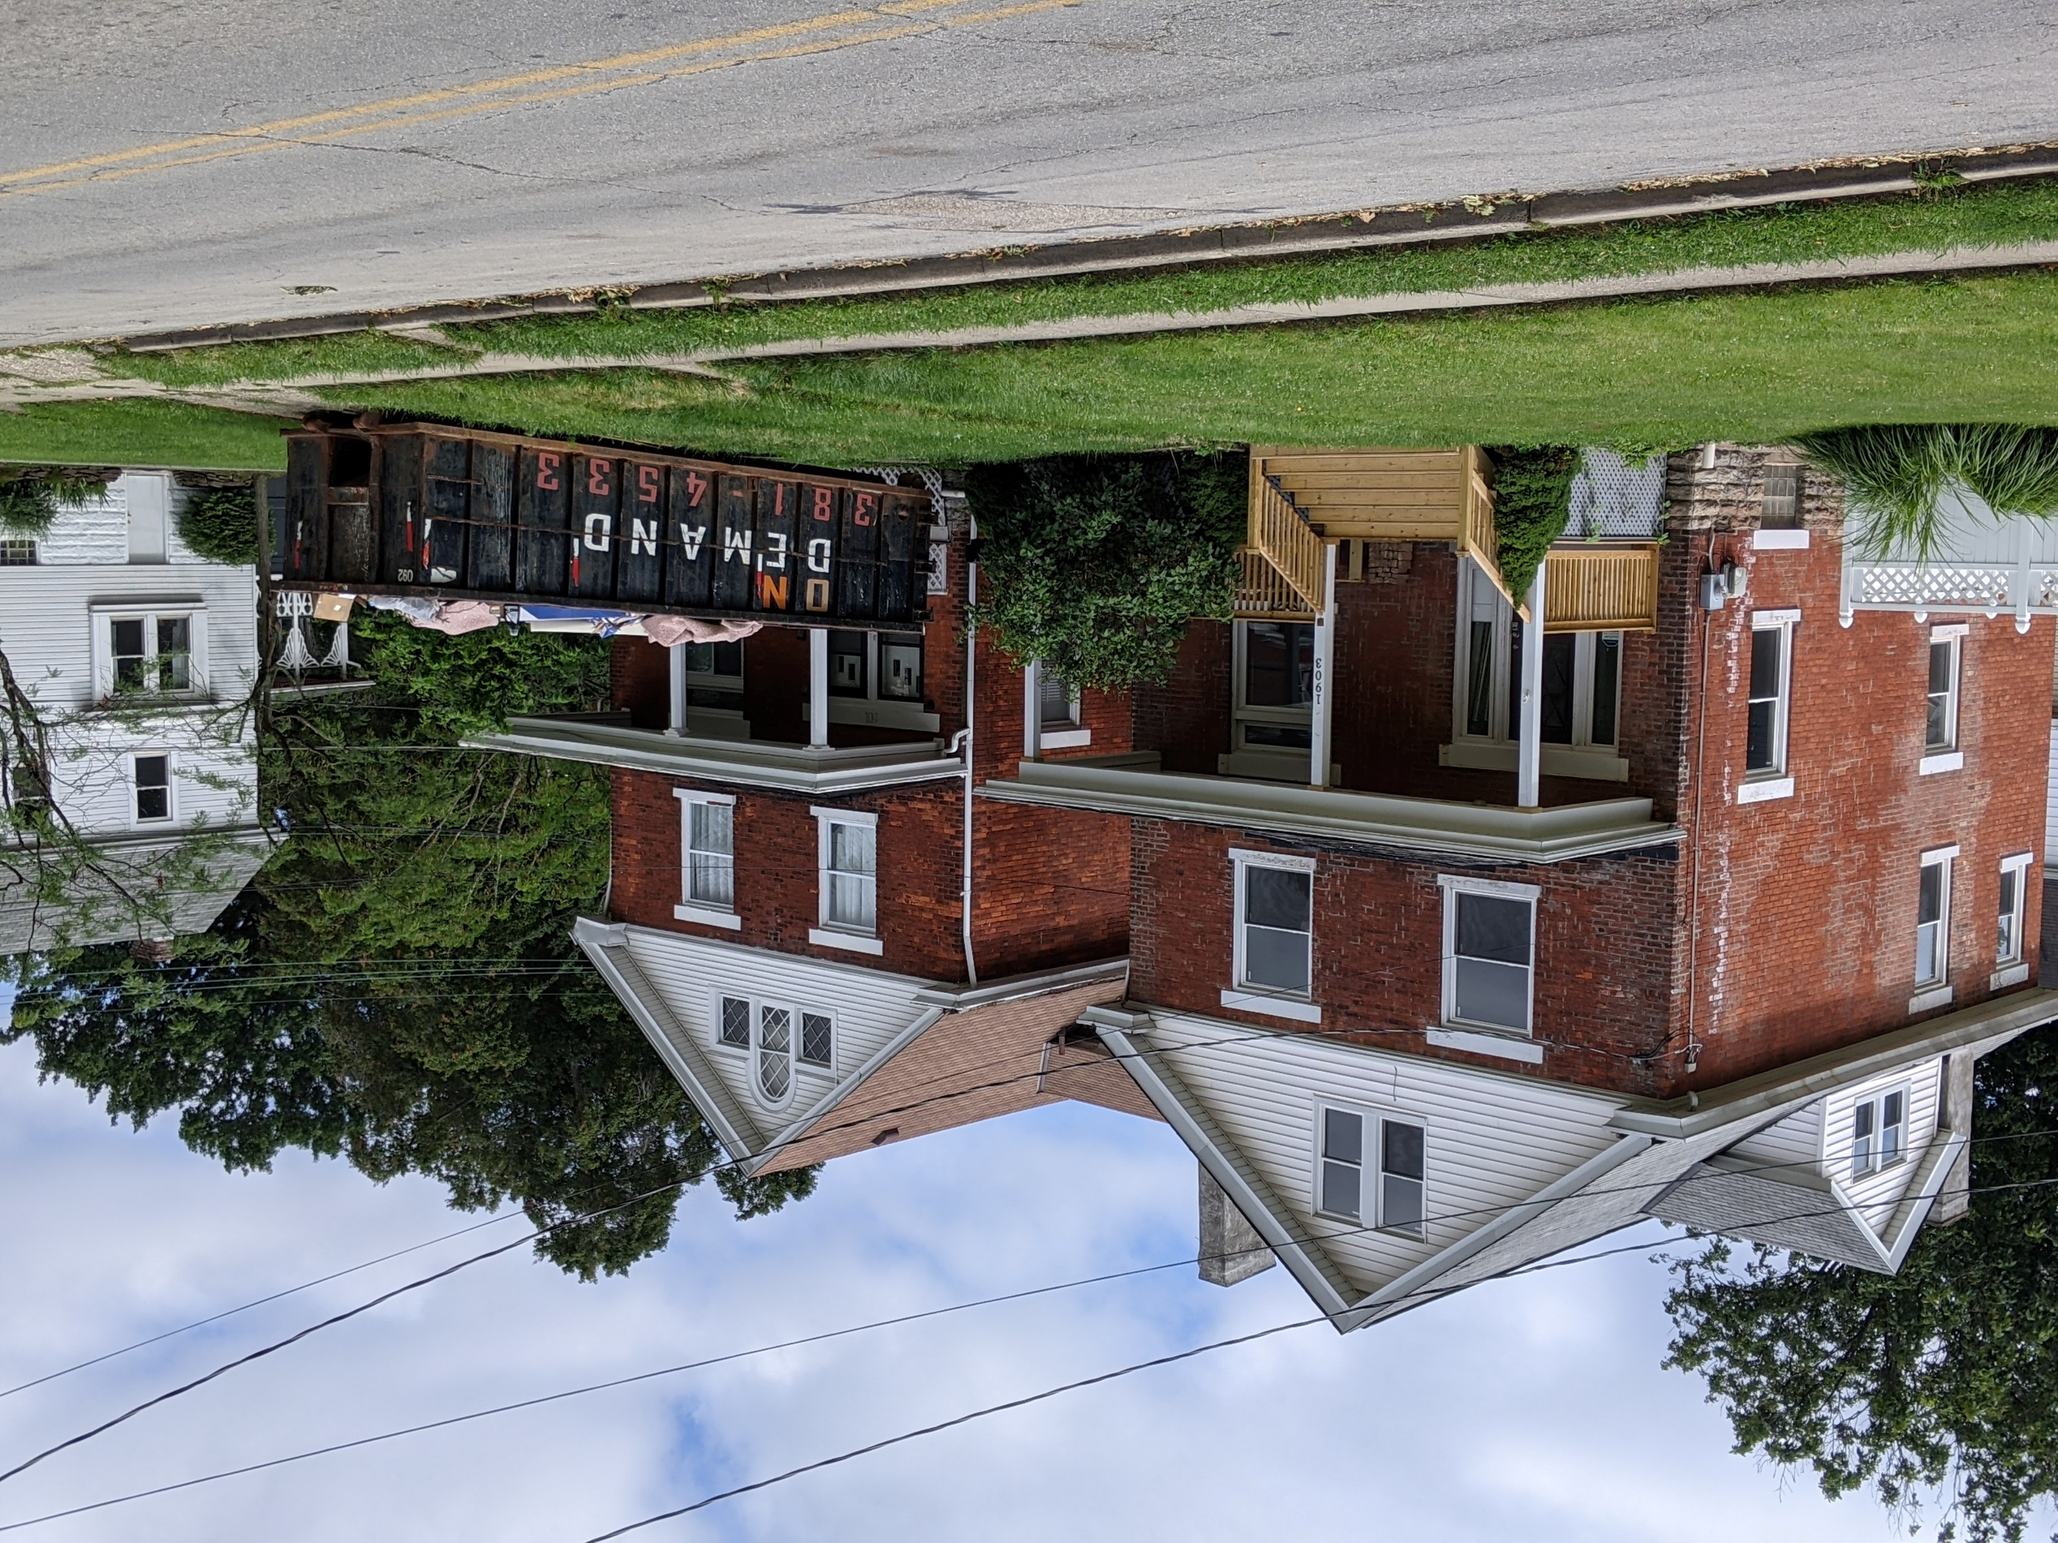
Use of CDBG Funds
Code enforcement
Homeowner repairs
Sidewalk revolving loan fund in low/mod areas – no need to verify income
Rent and utility assistance
Section 108 loans for larger acquisition/rehab projects
NOTE: Cincinnati had first project to use LIHTC, New Markets, Historic, HOME, CDBG, Section 108 and traditional private loans

Slide 21
Use of HOME Funds
Down Payment and Closing Costs
Find other down payment programs such as ARPA, other non-HUD grants
Habitat for Humanity – developer assistance and down payment assistance for buyers
Gap financing for LIHTC projects
Gap financing for smaller projects – 14 SF homes in West College Hill

Slide 22
Hamilton County’s ARPA Funding
Allocated $40 Million out of $159 million – 25% of total
Working with Cincinnati Development Fund - $33.5 million
$17 million to build new affordable housing
$8 million to preserve existing affordable housing
$8 million to build new affordable housing for priority populations: seniors, people with disabilities, and people returning from incarceration

Slide 23
Housing Action Plans
Give jurisdictions the tools and info to make good housing choices
Introduce affordability into the discussion
Support the County’s decision-making on programs and investments
Encourage use of CDBG funds on eligible, housing related projects
Roller-coaster of a planning period

Slide 24
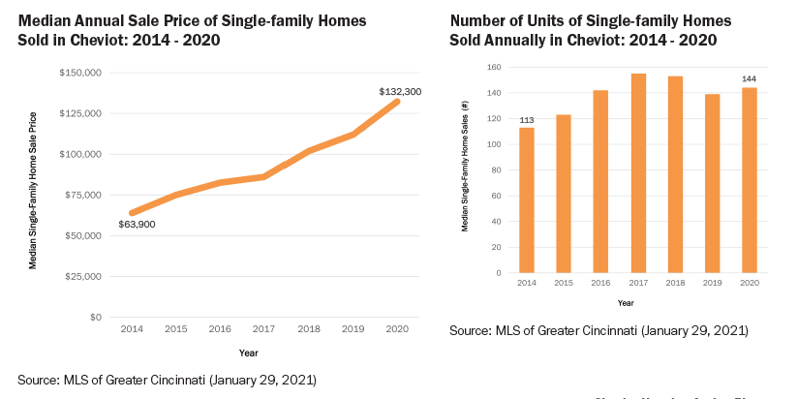
Market Dynamics in Cheviot

Slide 25
Process
Community engagement
One on one interviews
Community sessions
Diverse – complete - group of stakeholders
Local officials “own” the process
Field Investigation
Background and history
Implementation supports
Funding
Partners
Technical assistance

Slide 26
Collaboration
Start with local elected and appointed officials
Identify community partners – regional partners
Planning teams included County and jurisdiction staff
Support from the County
Regional housing strategy as context
Housing Our Future

Slide 27
Data
Census
Who lives in your community today?
What do they need? want?
Are people cost burdened? who?
Housing Markets
Current sale and rent ranges
Who’s buying? selling?
Size and condition of “product”
Schools and other community amenities
Investments – what’s being built? renovated? coming down?

Slide 28
Recommendations
Regional themes
Housing as a support for business district improvements
Protect existing, particularly senior, owners
Revitalize existing stock
Ensure housing options for next generation
Proactive zoning
Reuse of obsolete real estate
Code enforcement AND home repair programs
Individual issues
Infrastructure issues
Site opportunities

Slide 29
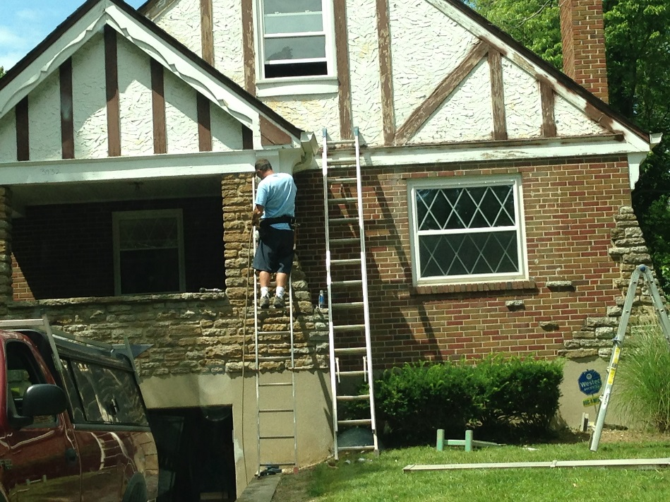
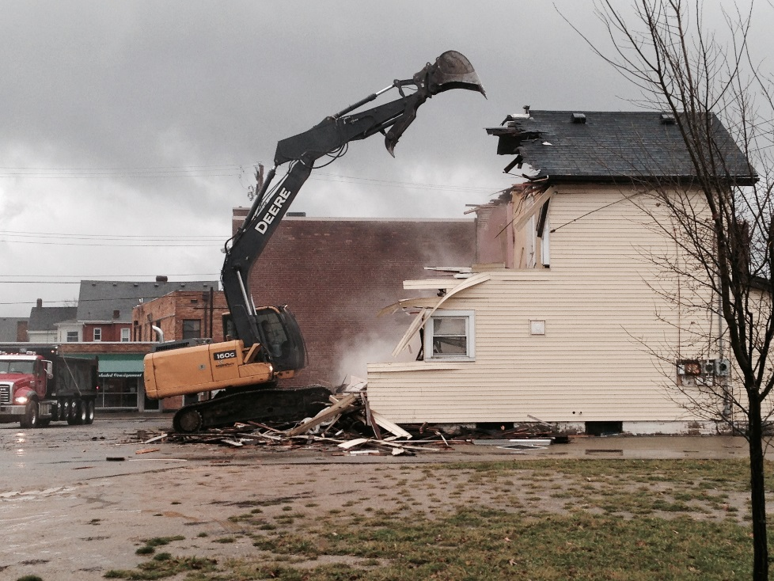
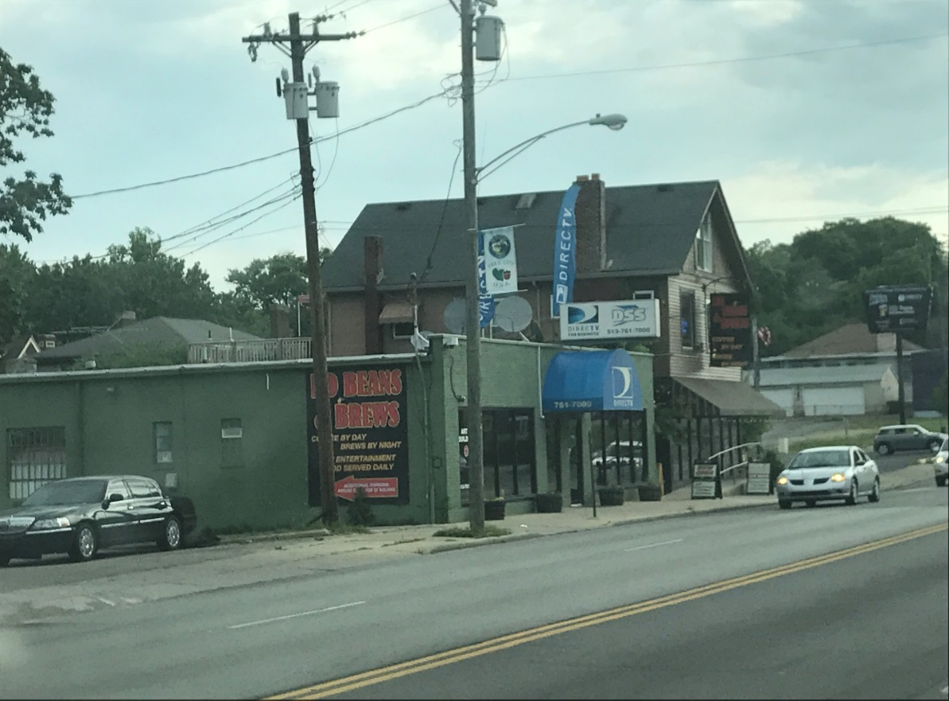
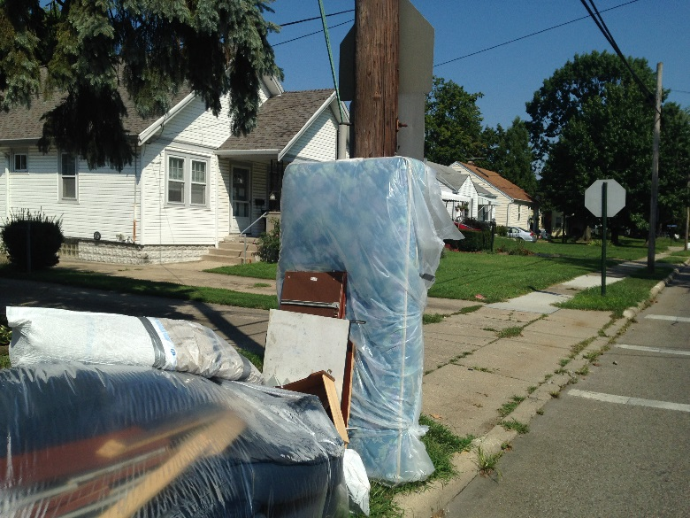
Revamp Code Enforcement

Slide 30
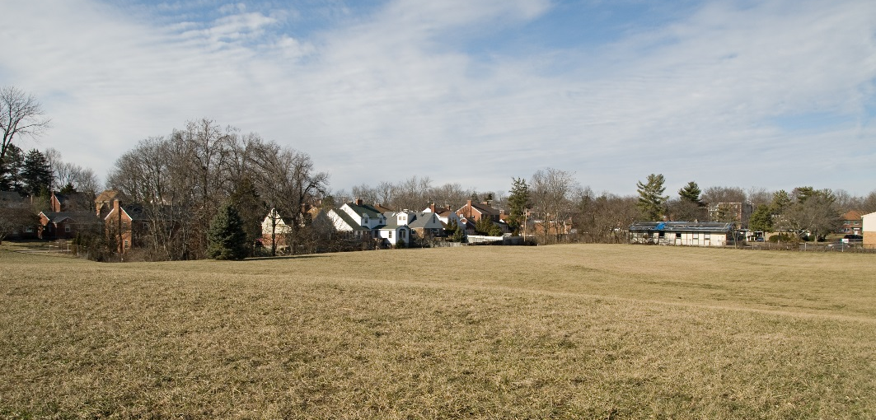
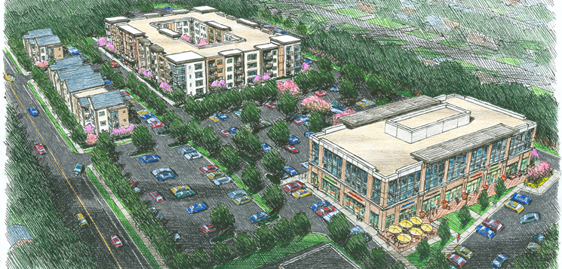
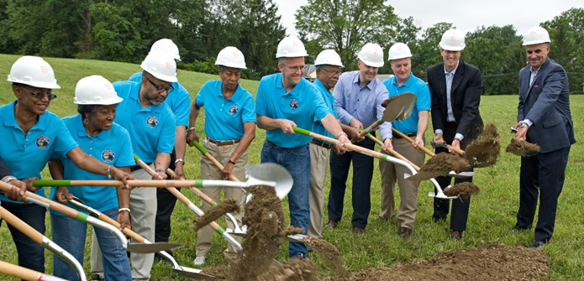
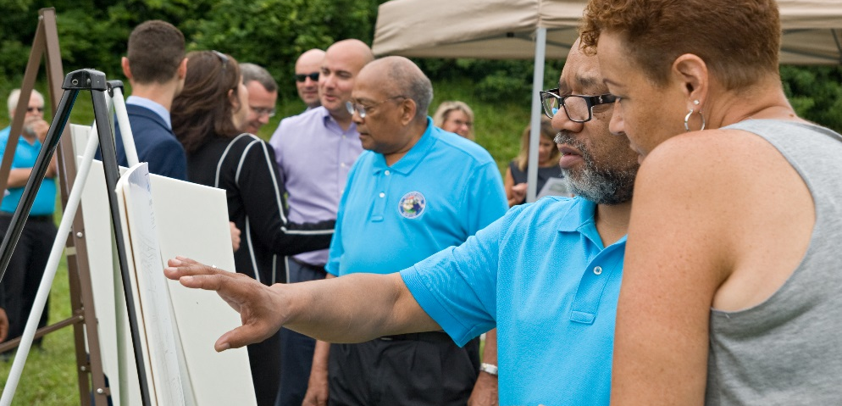
Land Assemblage

Slide 31
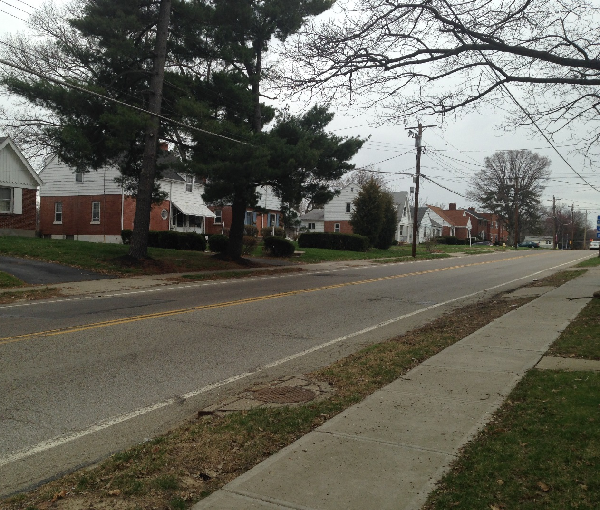
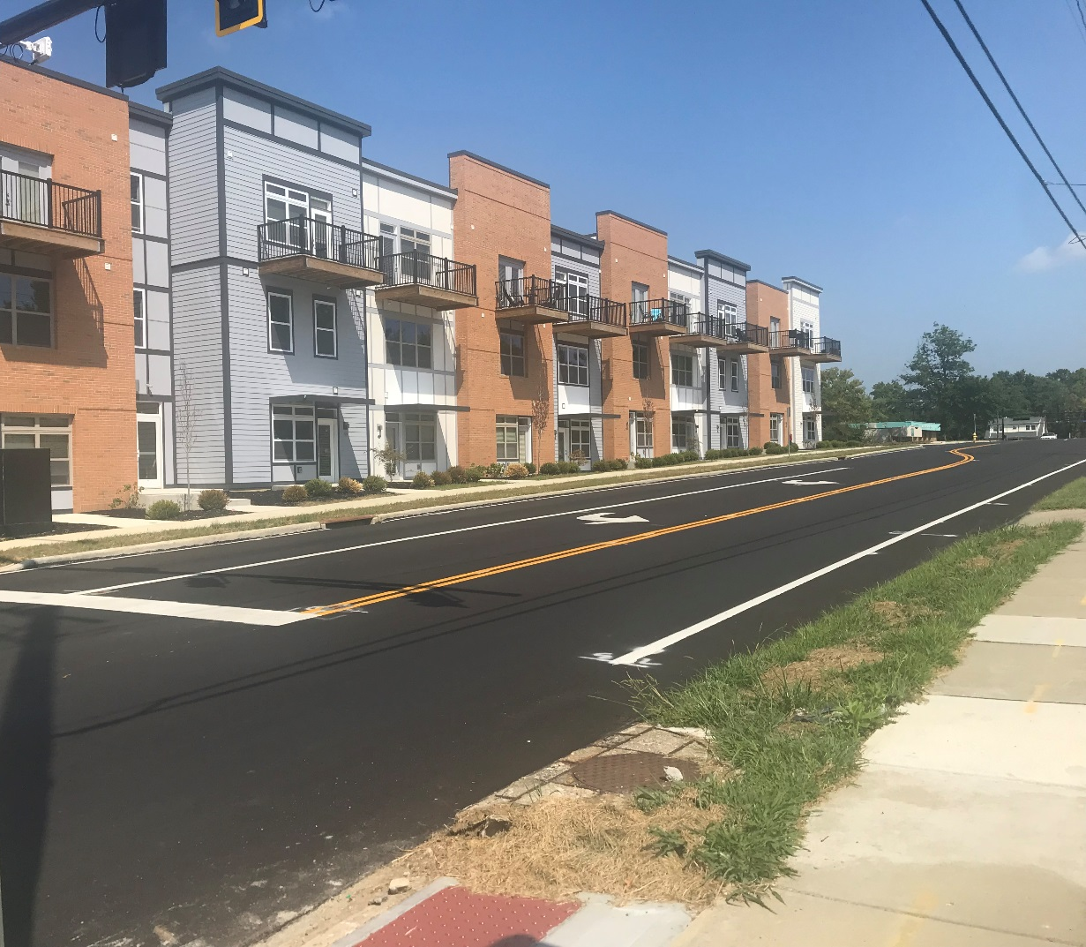
Densification

Slide 32
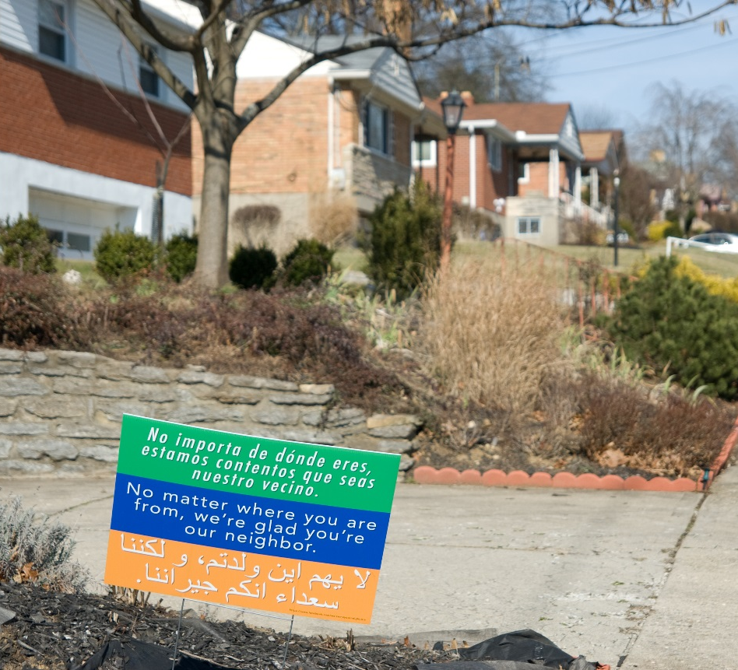
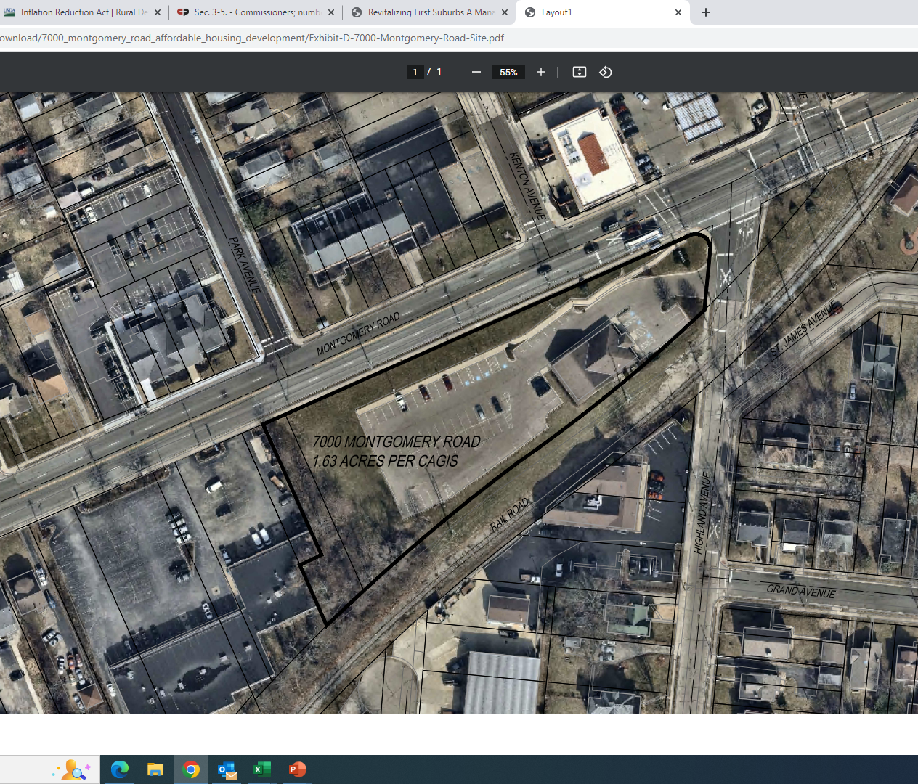
Inclusivity, Affordable Housing

Slide 33
ChangingGround.org

Slide 34
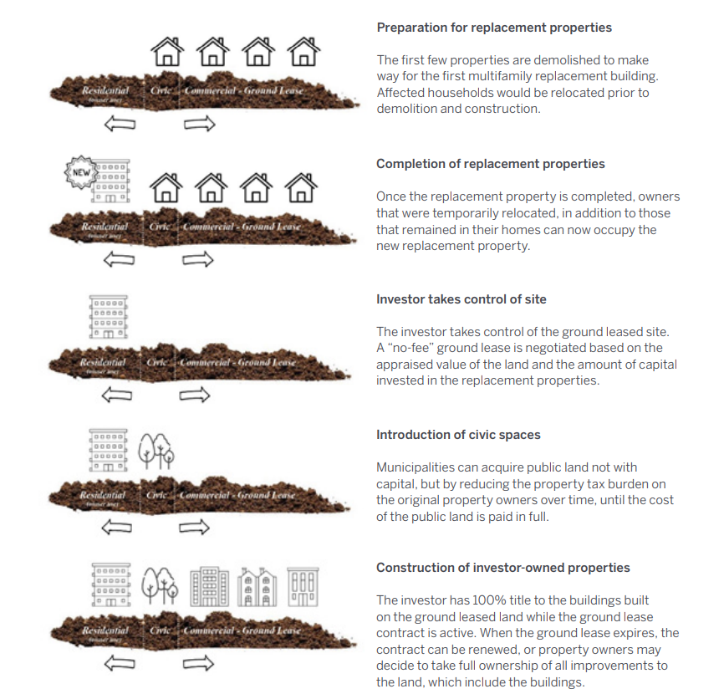
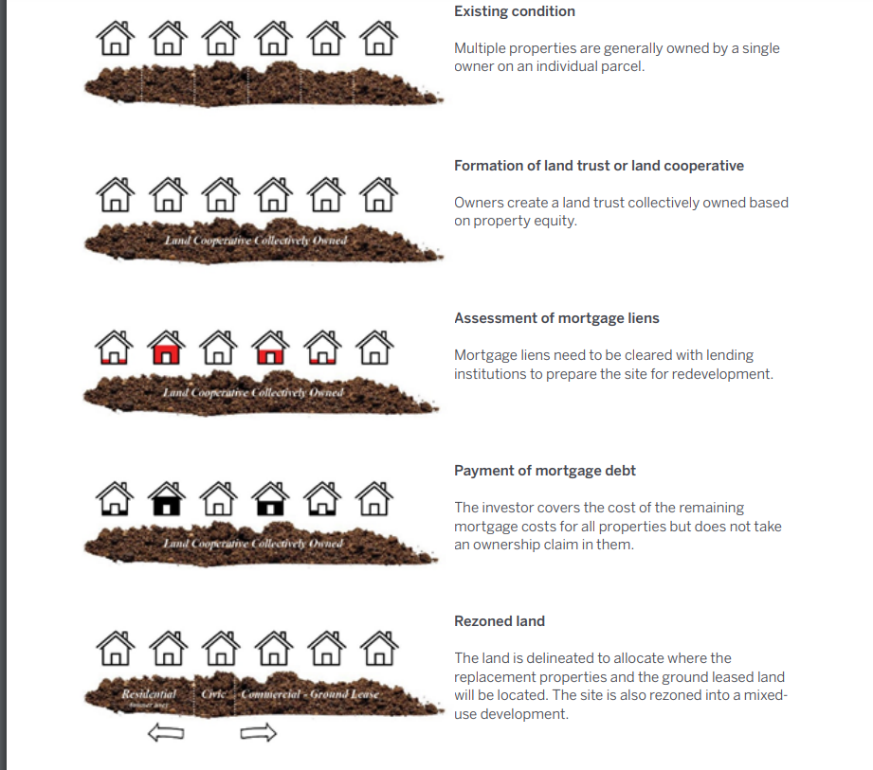
Land Readjustment: Changingground.org

Slide 35
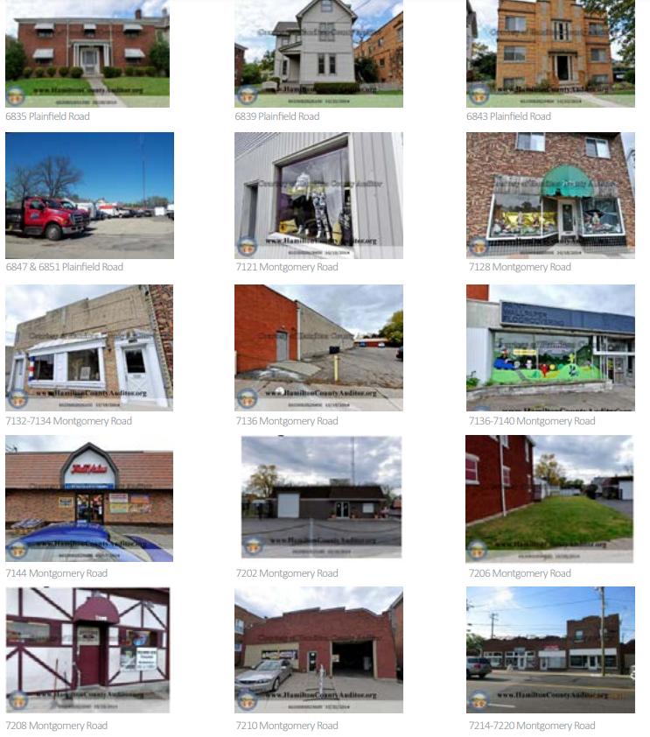
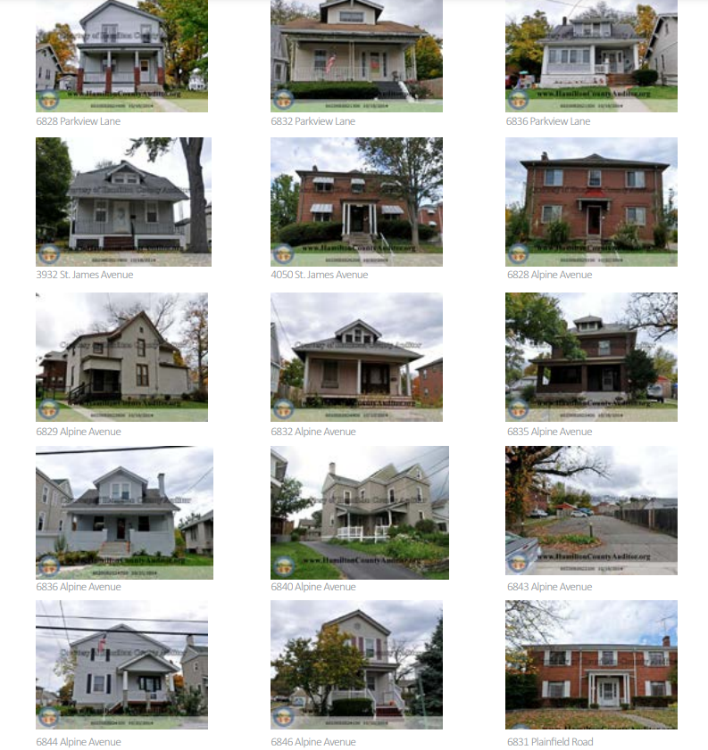
Legacy Land Uses

Slide 36
New Urbanism
Through urbanization of larger suburban properties with a denser, walkable, synergistic mix of uses and housing types, more significant reductions in carbon emissions, gains in social capital and public health, and changes to systemic growth patterns can be achieved.
Dunham-Jones, Ellen, and Williamson, June. (2009) Retroffitting Suburbia. Urban Land, June 2009.

Slide 37
“The solution as much the same for the suburban dimension of the New Urban Crisis as it is for the urban one: more and better urbanism. Overcoming the crisis of the suburbs and restoring their economic prosperity requires that suburbs become denser, greener, more mixed-use, and more connected to the urban centers via transit.”
“One thing is certain: if we do nothing, today’s urban crisis will only worsen and deepen. The gap between the winners of winner-take-all urbanism and the rest will widen….Our suburbs will grow poorer, more economically distressed, and more unequal.”
-Richard Florida, 2017
(emphasis added)

Slide 38
Questions?
Thank you.

