Slide 1

HELP!
HUD is Coming to Monitor
NCDA Annual Conference
January 26, 2023

Slide 2
/
David Bachrach, Director, City of East Providence, RI
Beth Ulrich, Grants Manager, City of Saint Paul, MN
Jessica Deegan, Grants Compliance Manager, City of Saint Paul, MN

Slide 3
Agenda
HUD’s Process and Procedures
Preparing for Your Monitoring
What to Expect During the Visit
Results: Reports and Follow up
Stories From the Field
Q & A

Slide 4


Slide 5
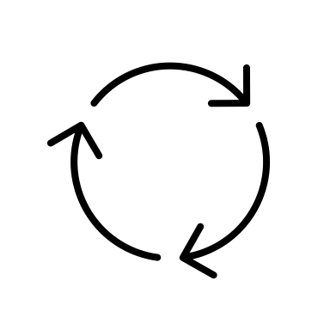
1. HUD’s Process and Procedures
Risk assessment
Notification
Scheduling

Slide 6
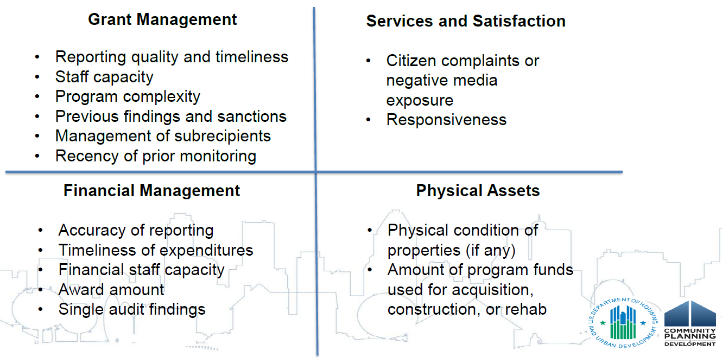
Risk Assessment
Source: Minneapolis HUD Field Office

Slide 7
Purpose & Types of Monitoring
Purpose of monitoring:
  Confirm regulatory compliance, identify areas of weakness, and provide technical assistance.
Types:
  CPD – Program and Financial
  Environmental
  Fair Housing – Civil Rights
  Davis-Bacon – Labor Standards
  Procurement

Slide 8
Notification Letter
Grants to be reviewed
Dates of visit
Who will be coming
Link to monitoring handbook
Specific exhibits to be reviewed
Outlines specific documents requested ahead of monitoring
Source: Minneapolis HUD Field Office

Slide 9
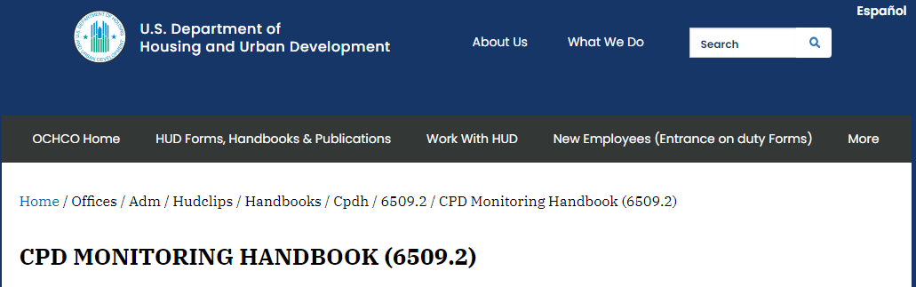
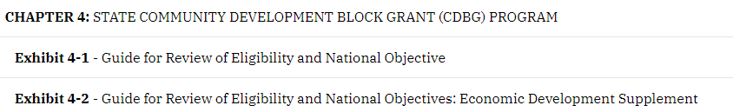
Monitoring Handbook – 6509.2

Slide 10
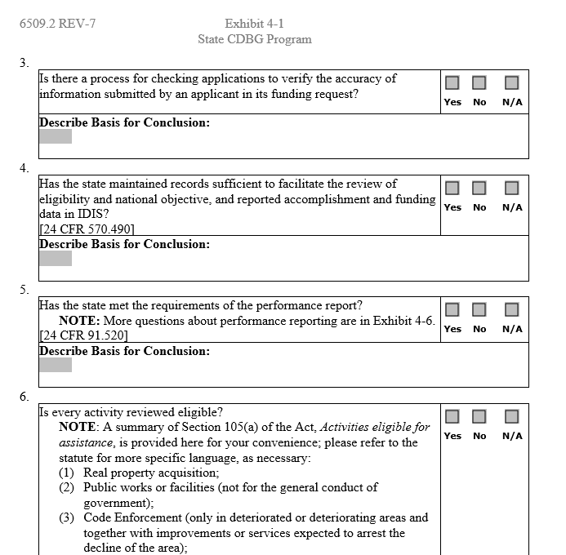
Monitoring
Exhibit
Refer to Regulatory Citation
Supporting Documentation
Other Relevant Regulations?
(Environmental/Section 3, Etc.)

Slide 11

2. Preparing for Monitoring

Slide 12

DEEP BREATHING

Slide 13
Audit Readiness is a Year-Round Activity (1)
Use HUD’s checklists in the 6509.2 to “self monitor” and conduct regular and appropriate monitoring of subrecipients
Review policies and procedures annually, typically at start of Consolidated Planning cycle for annual action plan
Track financials and draw downs monthly to meet timeliness factor
Train, provide Technical Assistance and communicate with funded partners (internally and externally)

Slide 14
Audit Readiness is a Year-Round Activity (2)
Review consistency between Consolidated Plan, Annual Action Plan and CAPER
Activities that are eligible and meet national objectives. Include in each activity’s folder prior to submitting Annual Action Plan:
  Regulatory reference that shows an activity is eligible
  Regulatory reference that a national objective is met by the activity (CDBG)

Slide 15
Other Resources to Prepare
NCDA Resources: Forums, conference attendance contact information, networking
HUD Rep: Your HUD CPD Representative is a resource to head off future monitoring findings or uncertainty with activities. Reach out before implementation!

Slide 16
You’ve been notified, now what?
Pre-Monitoring Prep
Review existing administrative and program files
  Update and modify policies and procedures
  Check documentation appropriately in files
Notify all parties that HUD is coming to monitor:
  Program and financial staff – choose leads and make sure of coverage
  Subrecipients and vendors
Conduct a pre-monitoring staff check in
  What to expect, answering questions and preparing for interview

Slide 17

3. What to Expect During the Visit

Slide 18
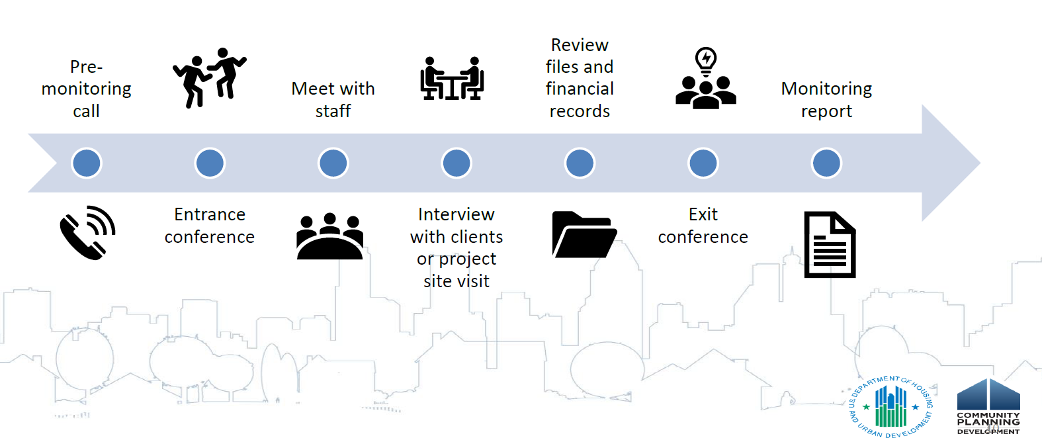
Overview of Monitoring Visit
Source: Minneapolis HUD Field Office

Slide 19
Form of Monitoring Visit
Monitoring could be in-person, hybrid, or fully remote
  Expect longer timeframes if fully remote. (1-2 weeks can lead to 3)
  Will need access to systems or paper for activities and project files
  If in person or hybrid, requires meeting space
  If remote, will need to remove all personally identifiable information before uploading

Slide 20



File Organization
Organize files logically, and provide details of where to find items in monitoring exhibits.
If paper files, organize consistently in folders for projects by exhibit/project file
If electronic, pay attention to file names and folder structure

Slide 21
Grantee Document Exchange (GDX)
Staff gain access to GDX by field office
  Needs existing IDIS, DRGR, or eLOCCS access first
Field office will send document requests through GDX and Grantee will upload and submit documents
Source: Minneapolis HUD Field Office

Slide 22
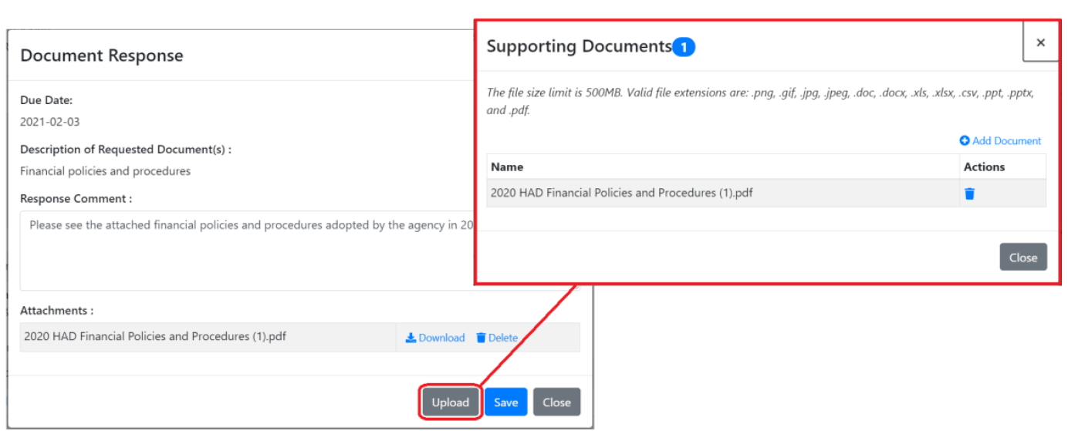
Grantee Document Exchange (GDX)
Source: Minneapolis HUD Field Office

Slide 23

4. Monitoring Results

Slide 24
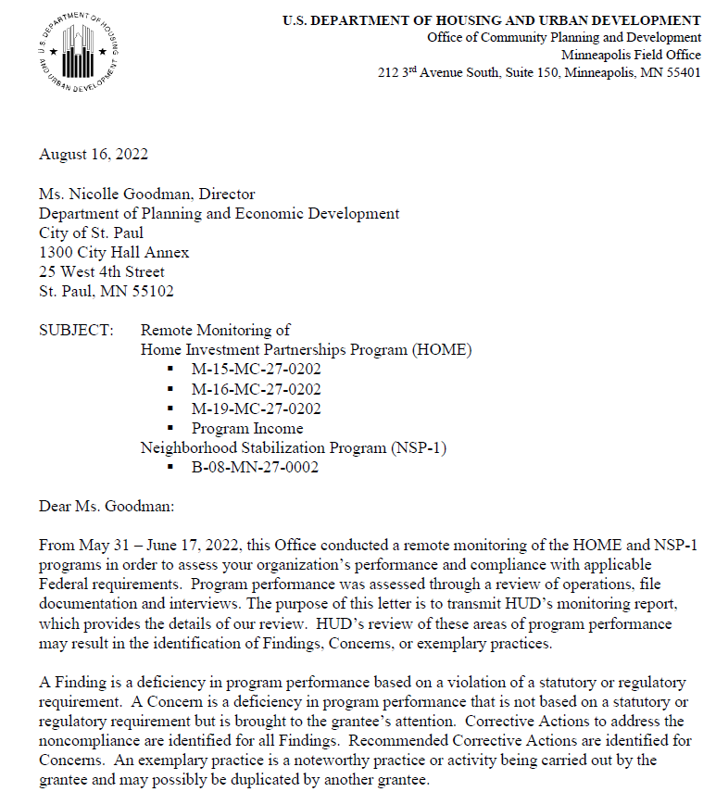
Monitoring Report
Report will be received within 60 days of the exit conference
Contains HUD’s conclusions from the report including any findings or concerns, if any
Findings must be responded to in writing within 30 days of receipt

Slide 25
Findings and Concerns
Findings require a response, while concerns do not require an official response
Anatomy of a Finding:
  Condition – the identified problem
  Criteria – regulation that was violated
  Cause – deficiency that led to the problem.
  Effect – the negative impact created
  Corrective Action – what must be done to fix it

Slide 26

5. Stories From the Field

Slide 28

Questions?
Thank you!

