Slide 1
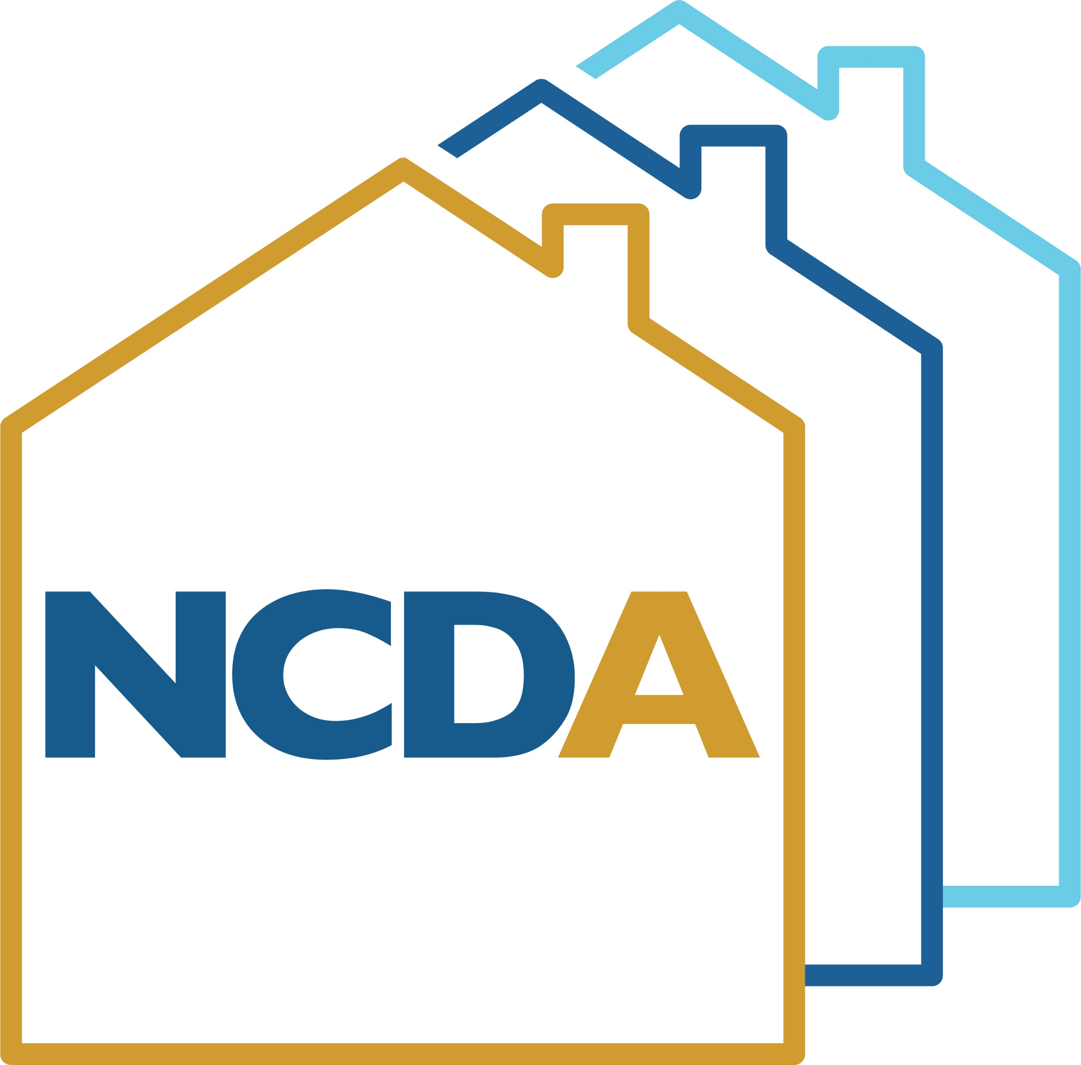
Homelessness and Housing – Becoming a Unified Funding Agency
NCDA Winter Legislative, Policy, and Professional Development Conference
January 24-27, 2023

Slide 2
Speaker
Hans Mach
Community Development Administrator
McHenry County, IL
hdmach@mchenrycountyil.gov

Slide 3
Programs Managed by Community Development – Potential UFA Match
Community Development Block Grant Program
HOME Investment Partnerships Program
Continuum of Care Program – HMIS Lead
Continuum of Care – Unified Funding Agency
Continuum of Care – Collaborative Applicant
Lead Safe Homes Program
Treasury – Emergency Rental Assistance Program (McEURAP)
Senior Services Grant Program
Emergency Food and Shelter Program
Emergency Solutions Grant – CV Funds

Slide 4
HUD officially designated McHenry County as a CoC in 2022
McHenry County was designated Collaborative Applicant in 2011
McHenry County was designated Homeless Management Information System (HMIS) Lead in 2016
Former direct grants with HUD began July 1, 2022 under the new UFA subrecipient arrangements with the County

Slide 5
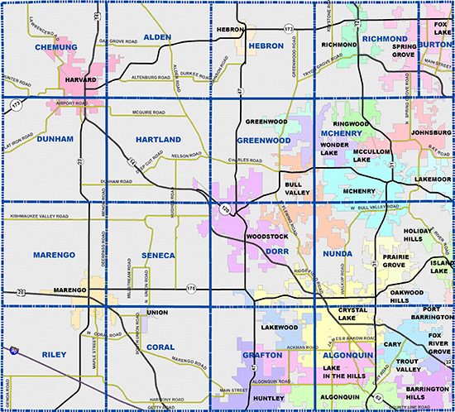
About McHenry County
Population: 310,229 (2020)
Flat Population: 308,760 (2010)
Urban, Suburban, Exurban Areas
113,269 households
80.1% Homeownership Rate
Exception Criteria 44.61% for Low-Mod Area Benefit

Slide 6
About McHenry County
$90,014 AMI for Family of 4
603.17 square miles
5 cities, 25 Villages, 17 TWP
Transportation is a challenge
METRA to Chicago available
High property taxes
Low availability of owner and rental housing

Slide 7
Why is Affordable Housing and Maintaining Stock and Grant Funds So Important?

Slide 8
McHenry County Rental Market Market
Census indicates $1,457 Median
Need to earn $58,280/yr. + to afford
State Median: $1,392
Housing cost burden is major problem, particularly in Northern portion of state

Slide 9
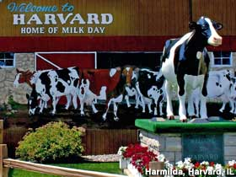
Evaluation of the Four Housing Problems
Lacks kitchen facilities
Lacks complete plumbing
Overcrowding
Cost burden of 30% or more

Slide 10
Evaluation of Data: Why was affordable housing the way to go? (NA-10 in Con Plan)
26,137 units are affected by cost burden of over 30% - 23% of the County’s households
This affects both renters and homeowners
35% of the affected are renters and 65% homeowners, which suggests underwriting of homebuying (rates do not match unit distribution)
Housing stock sells/rents very quickly; low vacancy rates
13,276 units are affected by cost burden of over 50% - 11.7% of the County’s households!
This affects both renters and homeowners
34% of the affected are renters and 66% homeowners, which suggests underwriting of homebuying (rates do not match unit distribution)
Of the 4,545 renter households at 50% CB, 3,011 are 30% or less AMI

Slide 11
At-risk populations
Of the 4,545 renter households at 50% Cost Burden, 3,011 are 30% or less AMI
In the Consolidated Plan evaluation, the County correctly predicted a Qualifying Population for HOME-American Recovery Plan Act funds

Slide 12
First Step: Is the UFA Right for Our CoC?
The high rent burden and very low income households can contribute to increases in homelessness
How did we come to conclusions about becoming the Unified Funding Agency (UFA) Lead?

Slide 13
First – What is a Unified Funding Agency?
Per 24 CFR 578.3, Unified Funding Agency (UFA) means an eligible applicant selected by the Continuum of Care to apply for a grant for the entire Continuum, which has the capacity to carry out the duties in 24 CFR 578.11(b), which is approved by HUD and to which HUD awards a grant.

Slide 14
Second – What is the UFA Selection Process on HUD’s end?
Per 24 CFR 578.11(b), (a) Becoming a Unified Funding Agency. To become designated as the Unified Funding Agency (UFA) for a Continuum, a collaborative applicant must be selected by the Continuum to apply to HUD to be designated as the UFA for the Continuum.
(b) Criteria for designating a UFA. HUD will consider these criteria when deciding whether to designate a collaborative applicant a UFA:
(1) The Continuum of Care it represents meets the requirements as defined
(2) The collaborative applicant has financial management systems that meet the standards set forth in 2 CFR 200.302, which is financial management;
(3) The collaborative applicant demonstrates the ability to monitor subrecipients; and
(4) Such other criteria as HUD may establish by NOFA – ALWAYS look to the NOFA for added guidance by funding year!

Slide 15
Second – What is the UFA Selection Process on HUD’s end?
(c) Requirements. HUD-designated UFAs shall:
(1) Apply to HUD for funding for all of the projects within the geographic area and enter into a grant agreement with HUD for the entire geographic area – this is similar to being a CDBG Grantee
(2) Enter into legally binding agreements with subrecipients, and receive and distribute funds to subrecipients for all projects within the geographic area a CoC area may be different than a CDBG Grantee PJ
(3) Require subrecipients to establish fiscal control and accounting procedures as necessary to assure the proper disbursal of and accounting for federal funds in accordance with the requirements of 2 CFR part 200, subpart D.
(4) Obtain approval of any proposed grant agreement amendments by the Continuum of Care before submitting a request for an amendment to HUD.

Slide 16
Third, Evaluate the Following:
What is the Capacity of the Collaborative Applicant (CA)? The UFA must also be the CA.
Does the CoC buy into the UFA model? Does the CA’s organizational structure support it?
How much in funding is being left on the table under current structure (CoC agencies receiving direct grants from HUD).
From a budget perspective, can the UFA operate on 3% of Annual Renewal Demand?

Slide 17
Evaluation of Capacity
Does the CA have at least 25% of Annual Renewal Demand in reserves?
Does the CA have the ability to monitor subrecipients, including an evaluation of annual audits of subrecipients?
A subrecipient is acting as the Grantee to carry out programs, meaning that the model is very much like CDBG or HOME
Relationship with Field Office and CoC

Slide 18
CoC/Leadership Support
Does the CA have the buy-in of the CoC?
Is the CoC aware of funding being “left on the table” by Grantees? Can be very challenging to know this.
Does the CA have the buy-in or its own leadership (if other than the CoC)

Slide 19
CoC/Leadership Support
Does the CA have the buy-in of the CoC?
Is the CoC aware of funding being “left on the table” by Grantees? Can be very challenging to know this.
Does the CA have the buy-in or its own leadership (if other than the CoC)

Slide 20
Funding Being Returned to HUD
HUD sends out a quarterly report related to CoC spend down
Depending on draw rate of project, may not be current (i.e.agency draws quarterly)
CoC awards tend to have varying dates with HUD, which can complicate spend down calculation

Slide 21
UFA Funding Request
Per Congress, HUD allows for 3% of ARD to be used as the basis for the UFA award
This amount is equal to the Planning Grant
CA must determine whether or not it can operate as a UFA with this funding level

Slide 22
What are the Steps We Took?
July, 2017 – Developed the Financial Capacity Log form locally to determine strength of Non-Profits
July, 2019 – determined that agencies had historically left between 3-8% of funds behind (annual ranking process)
August, 2019 – met with CoC Leadership and County Leadership (separately) about concerns of maintaining funds
September – November, 2019 – got buy-in from County Board and CoC – this included agreement to annually offer CoC Lead/HMIS/UFA role prior to registration
January, 2020 – UFA Registration opened at the same time as all CoC’s
March, 2020 – first CoC UFA Registration submitted for 2020 Competition

Slide 23
What Could Go Wrong, You Might Ask?

Slide 24
Well, What Was Supposed to Happen?
Registration as a UFA gets submitted
HUD goes through CoC Review
HUD determines that the CA meets the UFA requirements
The CoC gets “approved” as a UFA
HUD assigns a Special Needs Assistance Program staff to work with CA and Field Office
Grant Term (Uniform Start Date) negotiated with CA (Halloween spreadsheet)

Slide 25
The COVID-19 Outbreak
Registration was submitted in Early March, 2020
Shut-downs began to occur in Mid-March
March 27, 2020 CARES Act approved to respond to COVID-19
June, 2020 – Approved as the 12th UFA in the country!
July, 2020 – uh oh – we are cancelling the Competition

Slide 26
Now What?
Determination was to proceed with same process as 2020 Competition in 2021
Informed CoC and County Board
Registration process involved similar responses in 2021
The 2021 Registration was once again submitted in March, 2021

Slide 27
Remember With CoC You are Always Planning Far Ahead

Slide 28
What Happened Next?
CoC Registration submitted March, 2021
HUD Review Occurred
McHenry County Selected as UFA!
CoC 2021 Competition in Fall, 2021
UFA to take effect when 2021 awards issued (Summer, 2022)

Slide 29
This Delay Did Us a Favor
Our existing CDBG and HOME awards have a 10/2 start – we could not have had this date if we started earlier
We received over $16M in Treasury rental assistance funds in 2021
We received HOME-ARP, and were still working with CARES Act funds
We were able to consolidate two sets of policies for the UFA into a uniform policy manual (Summer, 2021)
We were able to overhaul our HMIS policy manual (Fall, 2021)
We updated our CoC Subrecipient Agreement (Winter, 2021) – this means that no agency had ever received the “initial” Agreement that was developed

Slide 30
After 2021 Approval
The Annual CoC/UFA Registration was approved by the CoC for 2022; County Board approval through budgeting
Assigned to work with Technical Assistance Provider, along with all other UFA’s
Completed 2022 Registration (March, 2022), which was substantially more technical than 2020/2021

Slide 31
What Does Current Registration Look Like?
Using performance and outcome measures
Using Housing First to remove barriers
Establishing performance targets
Evaluating outcomes of subrecipients
CoC Written Standards

Slide 32
What Does Current Registration Look Like?
Coordinated Entry System
Coordinated Entry Protocols
CoC Governance
HMIS Structure
Gaps Analysis

Slide 33
What Does Current Registration Look Like?
Con-Plan Participation
ESG (State) Consultation
UFA P & P
External Audits
Written Agreements with Subs

Slide 34
What Does Current Registration Look Like?
Monitoring Performance (Financial)
Non-Compliant/High Risk
Governance Charter
Attached Documents
…and MORE Attached Documents!

Slide 35
What Sort of Attachments?

Slide 36
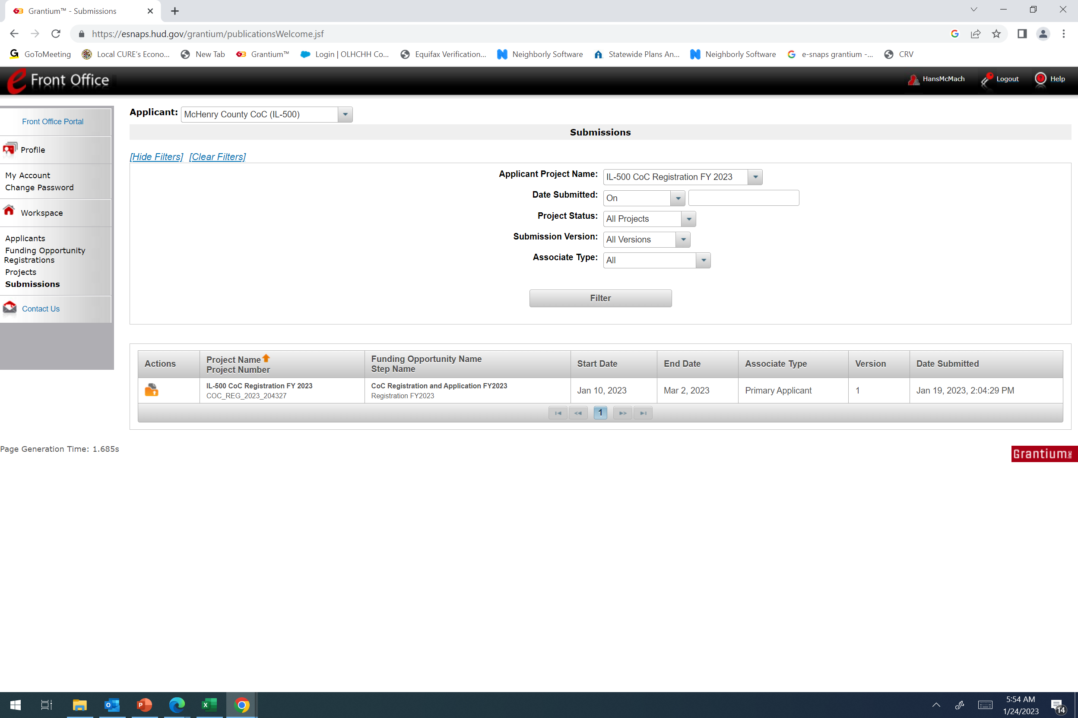
Preparation and a Long Journey Have Made Early Submission of UFA Registration Possible
Our 2023 Registration, due in March, 2023, was already submitted on January 19, 2023

Slide 37
The Uniform Start Date and Negotiating with HUD
Once you are approved as a UFA Grantee, HUD will create the Halloween Spreadsheet
HUD will negotiate a uniform start date with your CA
Remember that Grantees of HUD often have varying start dates throughout the year
Once a uniform date is set:
Former HUD Grantees with start dates PRIOR TO the uniform date will receive lengthier and higher awards based on monthly spending
Former HUD Grantees with start dates EQUAL TO the uniform date will receive a 12 month award
Former HUD Grantees with start dates LATER THAN the uniform date will receive shorter and smaller award based on monthly spending

Slide 38
The Halloween Spreadsheet
eSnaps PIN | Project Name | Award Amount | Monthly Amount | Previous Start Date | UFA Grant Start Date | # of Months from Desired Start Date (10/1) | Amount to be Added/Reduced from FY 2021 Grant | Total Amount of FY 2021 Grant
IL1580 | Transition to Home 2021 | $78,332 | $6,527.67 | 7/1 | 10/1 | 3 | $19,583.00 | $97,915.00
IL1616 | PC Coordinated Entry | $62,000 | $5,166.67 | 7/1 | 10/1 | 3 | $15,500.00 | $77,500.00
IL0001 | Jackson Lawndale GH | $175,702 | $14,641.83 | 7/1 | 10/1 | 3 | $43,925.50 | $219,627.50
IL0002 | McHenry Independence | $174,783 | $14,565.25 | 7/1 | 10/1 | 3 | $43,695.75 | $218,478.75
IL1619 | IL-500 McHenry County HMIS FY 2021 | $45,671 | $3,805.92 | 9/1 | 10/1 | 1 | $3,805.92 | $49,476.92
IL1577 | Homelessness to Housing - TH/RRH | $163,057 | $13,588.08 | 9/1 | 10/1 | 1 | $13,588.08 | $176,645.08
IL1581 | Scattered Site PSH 2021 | $63,380 | $5,281.67 | 10/1 | 10/1 | 0 | $0.00 | $63,380.00
IL1675 | Thresholds, Inc. - McHenry County Leasing Project | $102,761 | $8,563.42 | 10/1 | 10/1 | 0 | $0.00 | $102,761.00
IL1620 | HOS DV - RRH Funds Transition 2021 for 2023 | $51,816 | $4,318.00 | 11/1 | 10/1 | -1 | -$4,318.00 | $47,498.00
IL0546 | HOS RRH Renewal 2021 for 2023 | $68,407 | $5,700.58 | 11/1 | 10/1 | -1 | -$5,700.58 | $62,706.42
 | IL-500 McHenry County CoC UFA Costs FY 2021 | $29,119 | $2,426.58 |  | 10/1 | 0 | $0.00 | $29,119.00
 | IL-500 McHenry County Planning Project FY 2021 | $29,119 | $2,426.58 |  | 10/1 | 0 | $0.00 | $29,119.00
 |  | $1,044,147 |  |  |  |  | $130,079.67 | $1,174,226.67

Slide 39
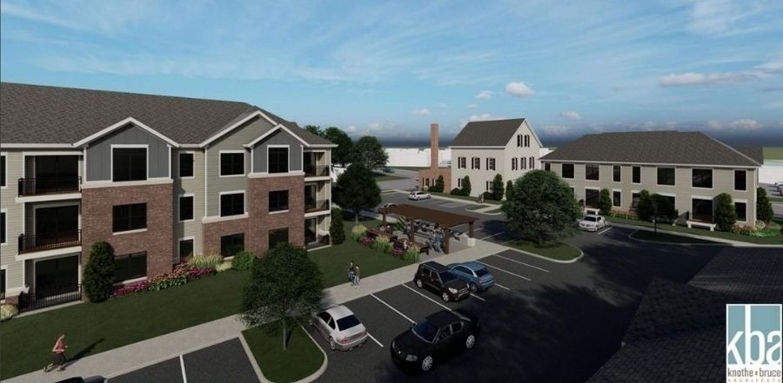
Next Steps
Determine what a shorter or lengthier budget looks like “By Line Item” (BLI)
Draft Subrecipient Agreements based on BLI’s
Auto-renewal of CoC Grants over time – exact categorical BLI spending may have been determined long ago
Follow-up with subreicpients early and often regarding the contracting process

Slide 40
UFA Agreement
The UFA Agreement will include the total funding BLI categorically
The UFA Agreement will list the total award by subrecipient
Up to 10% of the Planning award may be used for pre-award costs
There is no indication of uding UFA funds pre-award in the Agreement

Slide 41
The BLI Section of the Agreement

Slide 42
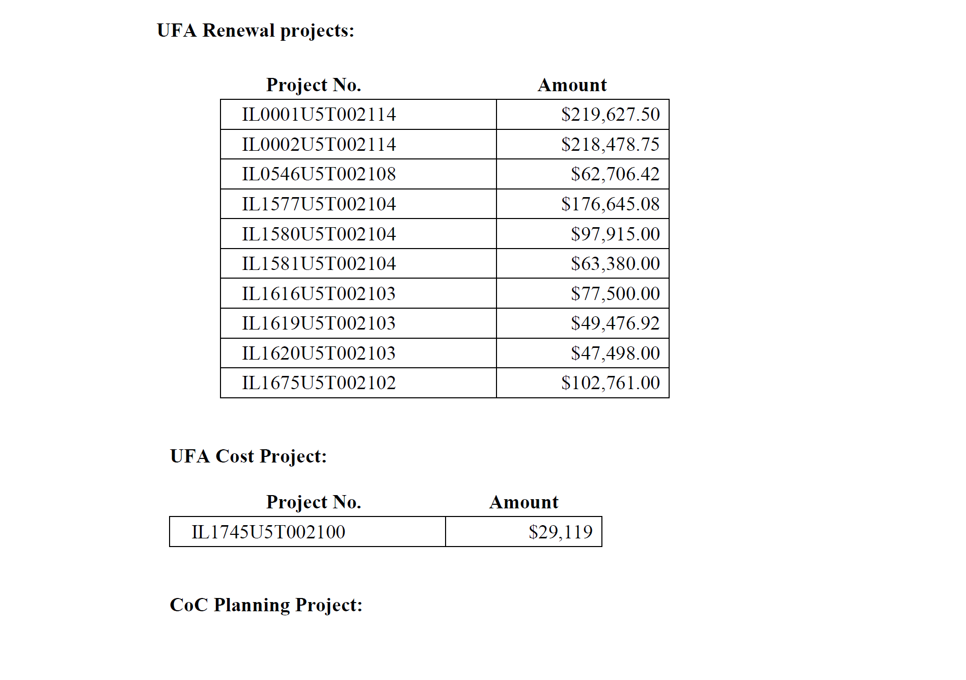
The List of Subrecipients

Slide 43
Key Takeaways
Remember that, as UFA, you are responsible for 25% Match on all BLI’s except Leasing
You will be making applications for all of your subrecipients
You will be responsible for submission of the Annual Performance Reports (and ensuring that agencies with HUD grants close our with HUD)
If you go into Agreement as the UFA with HUD for the first time during the Competition, you become the Applicant at that point
Encourage reviewing long-time renewal detail budgets (which could go as far back as 2017) when negotiated with Subrecipients
Your first year as a UFA will very likely trigger a monitoring, even though year is not complted

Slide 44
Questions?

