Slide 1
HOME-ARP Allocation Plan to Implementation 2023 NCDA Winter Conference January 26, 2023

Slide 2
HOME-ARP Panelists
PRESENTERS
Jeff McKittrick
Assistant Director of Housing
Pasco County, FL
Zachary Maher
Deputy Director of Business & Community Development
Auburn, ME
Sharon Burkley
Community Development Planning Manager
Neighborhood Services
Fort Worth, TX
MODERATOR
Victor Turner
Director
Neighborhood Services
Fort Worth, TX

Slide 3
HOME-ARP Allocation Plan
Jeff McKittrick
Assistant Director - Housing
Pasco County, Florida

Slide 4
Pasco County, Florida
Entitlement Community
CDBG, HOME, and ESG Funds as well as Program Income
CDBG $2,903,885
HOME $1,379,250
ESG $ 255,892
Population
Estimated at 585,000 (2021)
Growth rate of 2.5% annually
Ethnicity
75.5% White non-Hispanic
12.1% Hispanic
5.15% African American
7.25 Other

Slide 5
Homeless in Pasco County Point in Time Count Data
Demographics | 2019 | 2020 | 2021 | 2022
Total No. Households | 713 | 711 | 636 | 408
Total No. Person | 894 | 898 | 857 | 516
Age
Under 18 | 127 | 126 | 107 | 83
18-24 | 58 | 58 | 22 | 28
Over 24 | 709 | 714 | 728 | 405
Veterans | 92 | 92 | 90 | 32
Chronically Homeless | 265 | 265 | 361 | 126
Sheltered | 206 | 210 | 334 | 252
Unsheltered | 688 | 688 | 523 | 264

Slide 6
Pasco County HOME-ARP
Pasco County was allocated $4.45 million in HOME-ARP
Conducted consultation meetings with community partners:
Continuum of Care (CoC)
Catholic Charities
Pasco County Housing Authority
Salvation Army
Pasco County Sheriff’s Office
Sunrise Domestic Violence Shelter
United Way of Pasco County
Veterans Affairs
Vincent House

Slide 7
Consultation Meetings
Conducted consultation meetings throughout December 2021 and January 2022
Meetings were conducted either via Zoom or in person at agencies performance
Local Continuum of Care
First meeting held by Zoom in December 2021
Gave an overview of HOME-ARP to the general membership of our CoC
Invited all agencies to contact PCCD if they had comments or questions

Slide 8
Consultation Meetings
Asked all agencies what the biggest need is in Pasco County?
Also asked agencies about supportive services for homeless clients
Other topics in consultation meetings included:
Permanent Supportive Housing
Substance Abuse
Mental Health
Veterans
Transportation
Domestic Violence/Human Trafficking
Single Parents

Slide 9
Public Participation
P.J. must provide and encourage public participation in development of plan
Before submission reasonable notice and opportunity to comment on plan of at least calendar 15 days
Follow your current public participation requirements as outlined in the Citizen Participation Plan
At least one Public Hearing
P.J. must notice the following:
Amount of funding
Range of activities you will undertake

Slide 10
Needs Assessment and Gaps Analysis
PJ’s must evaluate size and demographics of qualifying populations
Identify any gaps in current shelter and housing inventory
Data Sources:
Point in Time Count
Housing Inventory Count
Other data available through CoC’s or other analysis

Slide 11
Pasco Continuum of Care Gaps Analysis October 2021
Data obtained from:
P.I.T., H.I.C., HMIS, Coordinated Entry, and Surveys
C.H. increased by 36%
50% of beds in CoC are dedicated to veterans and domestic violence victims
91% of households experiencing homelessness are adults w/o children
Families w/children comprise 7% of totals household experiencing homelessness
Families represent 17.7% of homeless, 49% of beds are dedicated to families
PSH is only funded at 7% while the C.H. represent 42% of homeless population
R.R. provided for over 250 to be housed during the pandemic
R.R. is the shortest pathway to housing – transitional and shelter are longest

Slide 12
Gaps…
KEY Findings
Permanent Supportive Housing is only funded at 7%
Chronically Homelessness are 42% of the homeless population.
Clients w/ previous homeless experiences reported agencies did not discuss housing with them.
Current clients experiencing homelessness report agencies have talked with them about getting into housing.
Supportive Services
The greatest need is more rental housing that is affordable.

Slide 13
Pasco County Timeline
Amendment to Action Plan
Public Comment period March 16, 2022 to April 15, 2022
Public Hearing conducted March 31, 2022
Request for Proposals for HOME-ARP projects due by April 8, 2022
Rejected applications not meeting criteria
New Request for Proposals due June 10,2022
Presented Draft Plan to our Board of County Commissioners July 12, 2022
Submitted HOME-ARP Plan to HUD Field Office July 17, 2022
Review Committee met August 3, 2022, and selected one project 33 units
Plan disapproved August 18, 2022
Resubmitted with corrections August 26, 2022
Currently waiting on approval letter

Slide 14
Lessons Learned
Plan, Plan, Plan! Will take longer than expected
Use the template from HUD as guidance (link provided at end)
Use the checklist that HUD Provides (link provided at end)
Make sure you have clearly identified agencies you have consultations with
I had to edit my plan to make sure this was easily seen by our Rep
Proofread your document. Have someone else proofread
Here I erred by submitting document with “Draft”
Make sure you complete all the necessary certification forms along with plan
Include your public notice proofs when submitting in IDIS
Submit and hopefully relax!

Slide 15
HUD Links for HOME-ARP Information
Main HUD HOME-ARP Page:
https://www.hudexchange.info/programs/home-arp/
FAQ’s:
https://www.hud.gov/sites/dfiles/CPD/documents/HOME-ARP/HOME-ARP-Allocation-Plan-Submission-Requirement-FAQs.pdf
Allocation Plan Template (with guidance):
https://www.hud.gov/sites/dfiles/CPD/documents/HOME-ARP_Allocation_Plan_Template_Tips.pdf
https://www.hudexchange.info/resource/6597/home-arp-allocation-plan-checklist/

Slide 16
Contact Information Jeff McKittrick jmckittrick@pascocountyfl.net Office (727) 834-3447 Ext. 231 Cell (727) 457-3778 https://www.pascocountyfl.net/207/Community-Development https://www.facebook.com/PascoCommunityDevelopment https://twitter.com/PascoCommDev

Slide 17
HOME-ARP Allocation Plan
Zachary Maher
Deputy Director of Business & Community Development
Auburn, ME

Slide 22
Contact Information Zachary Maher zmaher@auburnmaine.gov (207) 333-6601 x1336 www.auburnmaine.gov

Slide 23
Sharon A. Burkley
Community Development Planning Manager
Fort Worth, TX

Slide 24
FUNDING AWARDS
City of Fort Worth
$10,537,030
Tarrant County
$5,281,656
City of Arlington
$4,583,064
TOTAL: $20,401,750

Slide 25
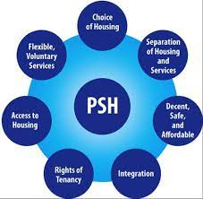
PROPOSED USE OF FUNDING:
Production or Preservation of Affordable Housing
Focus on development of Permanent Supportive Housing (PSH)
Develop competitive application process to identify developer(s) for potential projects
Develop up to three (3) PSH developments throughout City

Slide 26
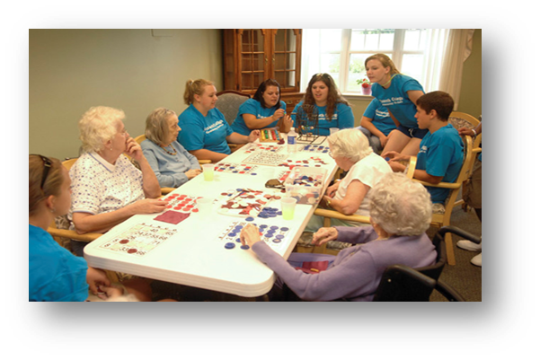
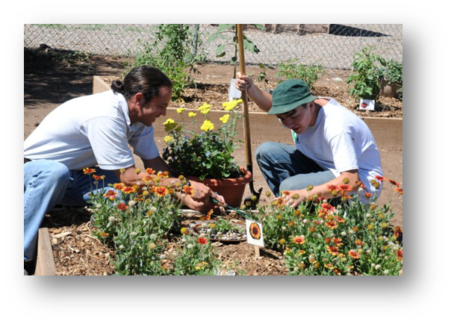
SUCCESS STORIES
On Site Services
Sense of Community
Lower barriers to entry
Close to public transportation
Casa de Esperanza
New Leaf
Palm Tree Apartments
Samaritan House Single Room Occupancy

Slide 27
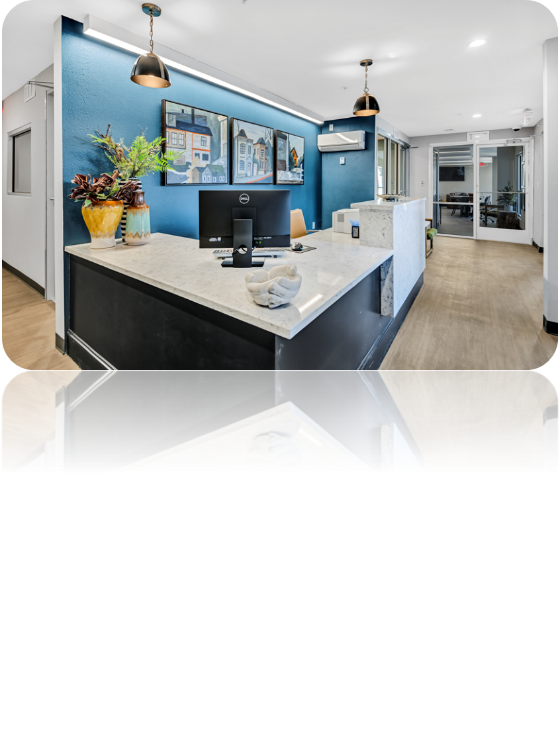
CASA DE ESPERANZA
3804 Tanacross Drive
Council District 4
119 Units of Permanent Supportive Housing for COVID-vulnerable population
Conversion of studio hotel into efficiency apartments
Bus stop onsite
Under $78,000 per renovated unit
Status: In operation 2 years (began leasing in November 2020)
Onsite Services
3 Case Managers (Presbyterian Night Shelter)
1 Licensed Chemical Dependency Counselor (MHMR)
1.5 Community Health Workers (JPS Health)

Slide 28
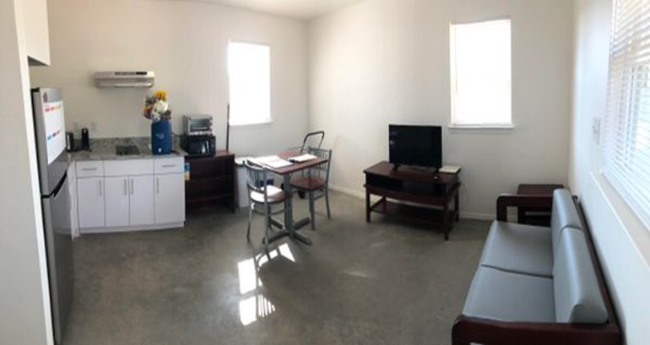
NEW LEAF COMMUNITY SERVICES
4444 Quail Trail
Council District 2
48 units of permanent supportive housing
New construction of one-story pinwheel quadplexes, community room and laundry room
Close to retail and transportation
Under $100,000 per newly constructed unit
In operation: 1 year (began leasing in September 2021)
Onsite Services
2 Case Managers (DRC Solutions)
1 Behavioral Health Case Manager (MHMR)
Part-time activity/volunteer coordinator
https://newleafcs.org/

Slide 29
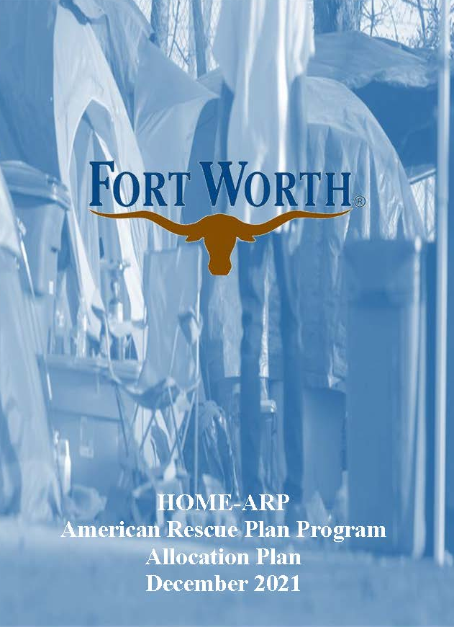
HOME-ARP
ALLOCATION PLAN
Required for access to HOME-ARP allocation
Consultation - Engage in consultation with required organizations
Public Participation – 15 Day Public Comment Period; Public Hearing
Plan Development
Needs Assessment and Gap Analysis
HOME-ARP Activities
HOME-ARP Production Goals
Preferences
Refinancing Guidelines
Plan Submission – submitted to HUD on December 31, 2021
Plan Approval – approved by HUD on January 27, 2022

Slide 30
FUNDING FOR NOFA #1:
Capital Funding Sources for PSH | Amount
Directions Home Capital | $1,262,801
Fort Worth Housing Finance Corporation | $2,550,000
Foundation Match to Fort Worth Housing Finance Corporation Funds | $2,550,000
HOME-ARP | $8,956,476
General ARPA | $5,000,000
TOTAL | $20,319,277
Combine Strengths of Funding Approaches:
Offer all funding eliminating fundraising time
Include some private funds to leverage FWHFC $1 for $ match
Have one application for all funding sources to streamline application process and enable units to be delivered faster

Slide 31
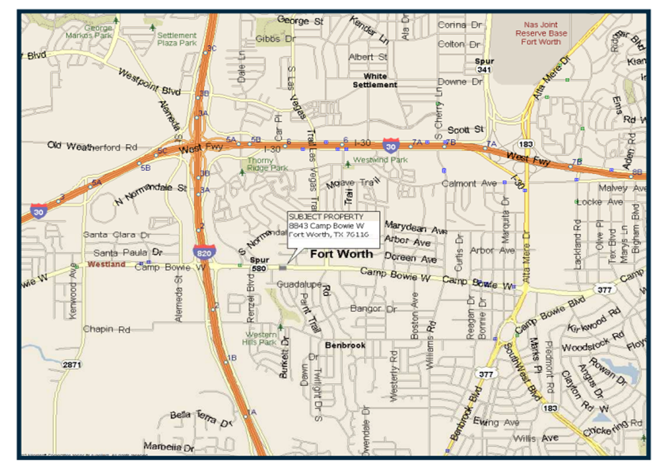
8843 Camp Bowie West
8843 Camp Bowie West, 76116
Council District 3
$4,896,000.00
New Construction - Multifamily
48 Units of Permanent Supportive Housing
Cost per unit = $102,000

Slide 32
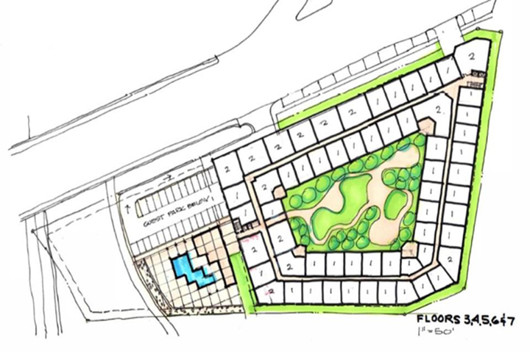
OPG CLIFTON RIVERSIDE
Clifton Riverside
2406 E. Belknap St., 76111
Council District 8
$2,000,000
New Construction – Multifamily
94 unit apartment complex
8 Units of Permanent Supportive Housing
Cost per unit = $250,000

Slide 33
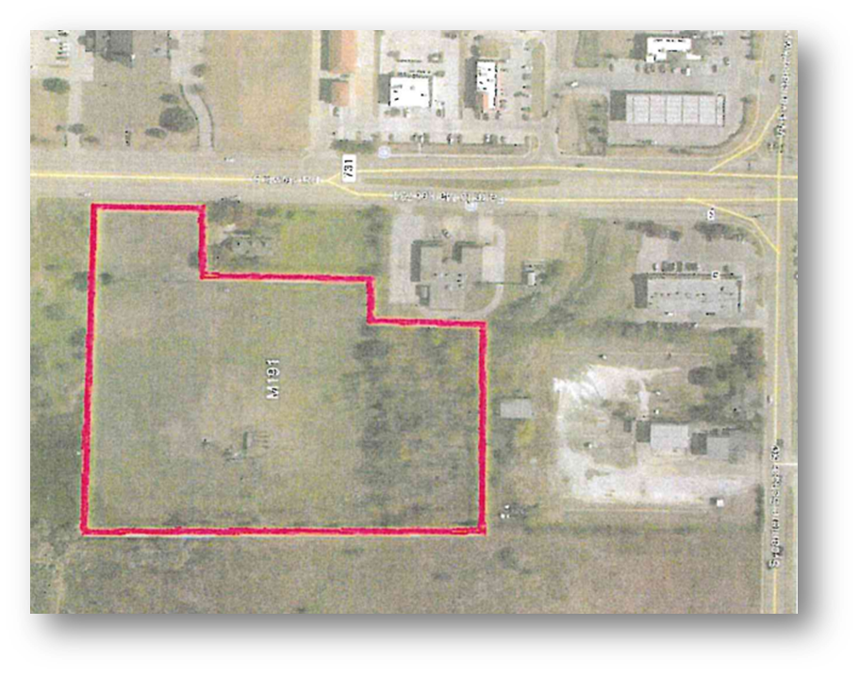
Journey Home Housing
7600 Crowley Road, 76134
Council District 8
$8,812,800
New Construction – Multifamily (Quadplexes)
72 Units of Permanent Supportive Housing
Cost per unit = $122,400

Slide 34
FUNDING ALLOCATIONS - NOFA #1:
ORGANIZATION NAME | FUNDING SOURCE |  |  |  |  | TOTAL ALLOCATION
 | HOME-ARP | FWHFC | Local Foundations Match | Directions Home | General ARPA
BEGINNING BALANCE | $8,956,476 | $2,550,000 | $2,550,000 | $1,262,801 | $5,000,000 | $20,319,277
New Leaf Community Services | $4,028,476 | $1,200,000 | $1,200,000 | $ ------ | $ ----- | $6,428,476
OPG Clifton Riverside | $ ----- | $ ----- | $ ----- | $ ------ | $1,000,000 | $1,000,000
Presbyterian Night Shelter | $4,928,000 | $1,350,000 | $1,350,000 | $1,262,801 | $421,999 | $9,312,800
TOTAL | $8,956,476 | $2,550,000 | $2,550,000 | $1,262,801 | $1,421,999 | $16,741,276
ENDING BALANCE | $ ---- | $----- | $----- | $------ | $3,578,001 | $3,578,001

Slide 35
FUNDING FOR NOFA #2
Capital Funding Sources for PSH | Amount
ARPA | $3,578,001
HOME (2022-2023 Entitlement Funding) | $1,057,963
TOTAL NOFA FUNDING | $4,635,964

Slide 36
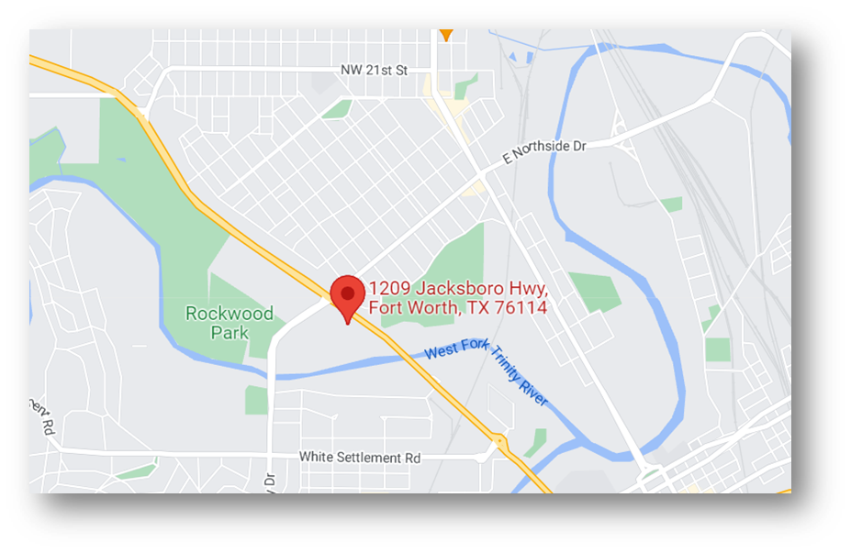
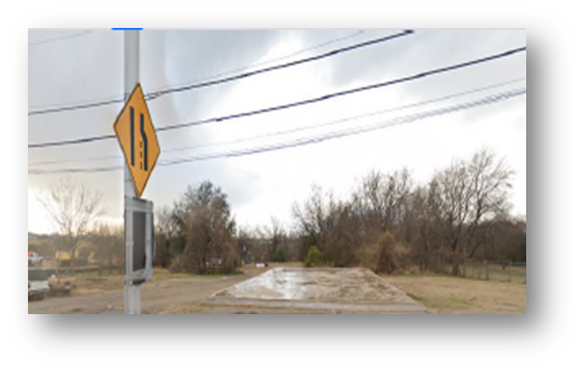
HTG Jacksboro LLC
The Park Tower
1209 Jacksboro Highway, 76114
Council District 2
$500,000
New Construction – Multifamily
4 Units of Permanent Supportive Housing, 90 total units
Cost per unit = $125,000

Slide 37
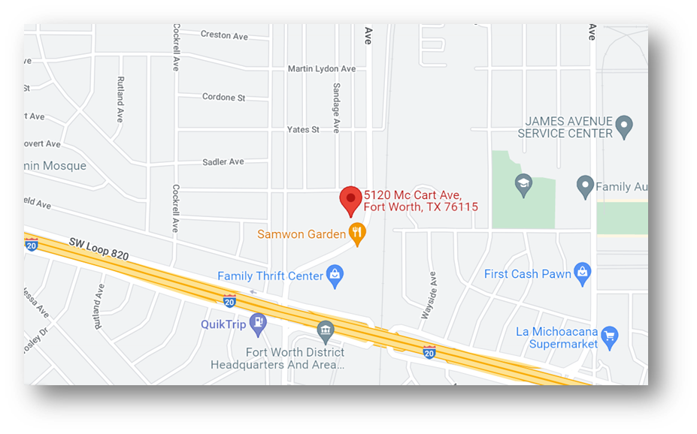
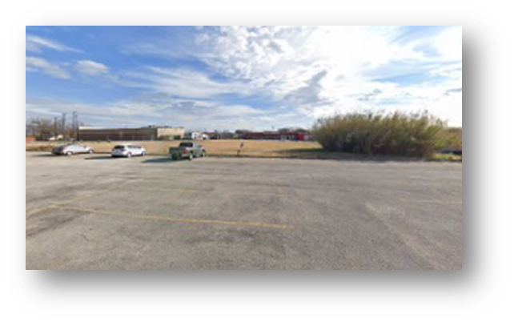
Tarrant County Samaritan House
5120 McCart Avenue, 76115
Council District 9
$4,635,964
New Construction - Multifamily
37 Units of Permanent Supportive Housing
Unit Cost = $125,296

Slide 38
FUNDING ALLOCATIONS - NOFA #2:
ORGANIZATION NAME | FUNDING SOURCE |  | TOTAL ALLOCATION
 | HOME | General ARPA
BEGINNING BALANCE | $1,057,963 | $3,578,001 | $4,635,964
HTG Jacksboro LLC – The Park Tower |  | $500,000 | $500,000
Tarrant County Samaritan Housing | $1,057,963 | $3,078,001 | $4,135,964
TOTAL | $1,057,963 | $3,578,001 | $4,635,964
ENDING BALANCE | $ ---- | $ ---- | $ ----

Slide 39
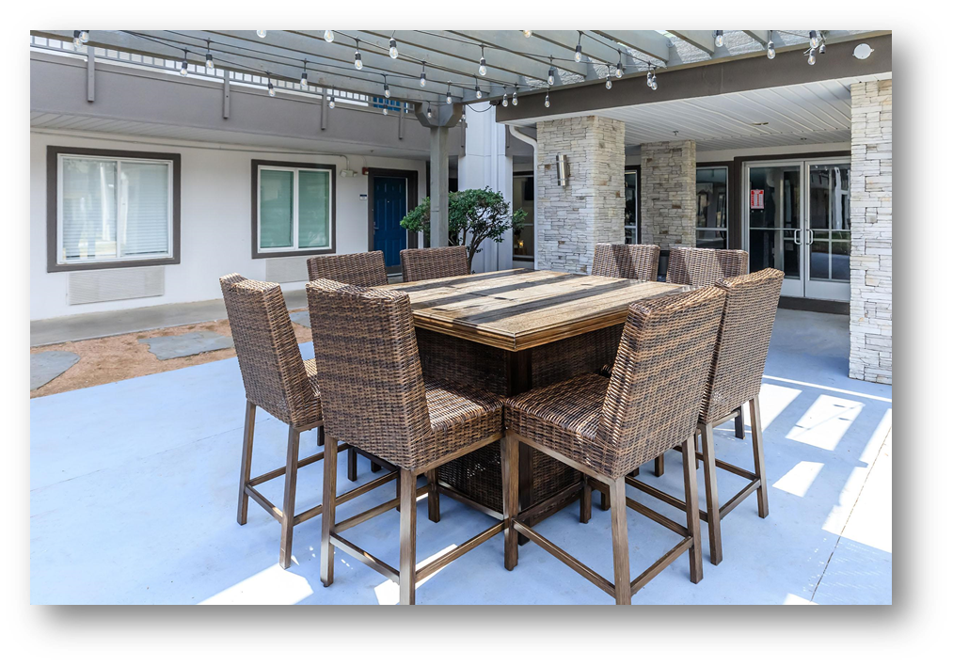
Reaching Unit Goal
Total PSH Unit Goal: 165
Goal Exceeded: 169

Slide 40
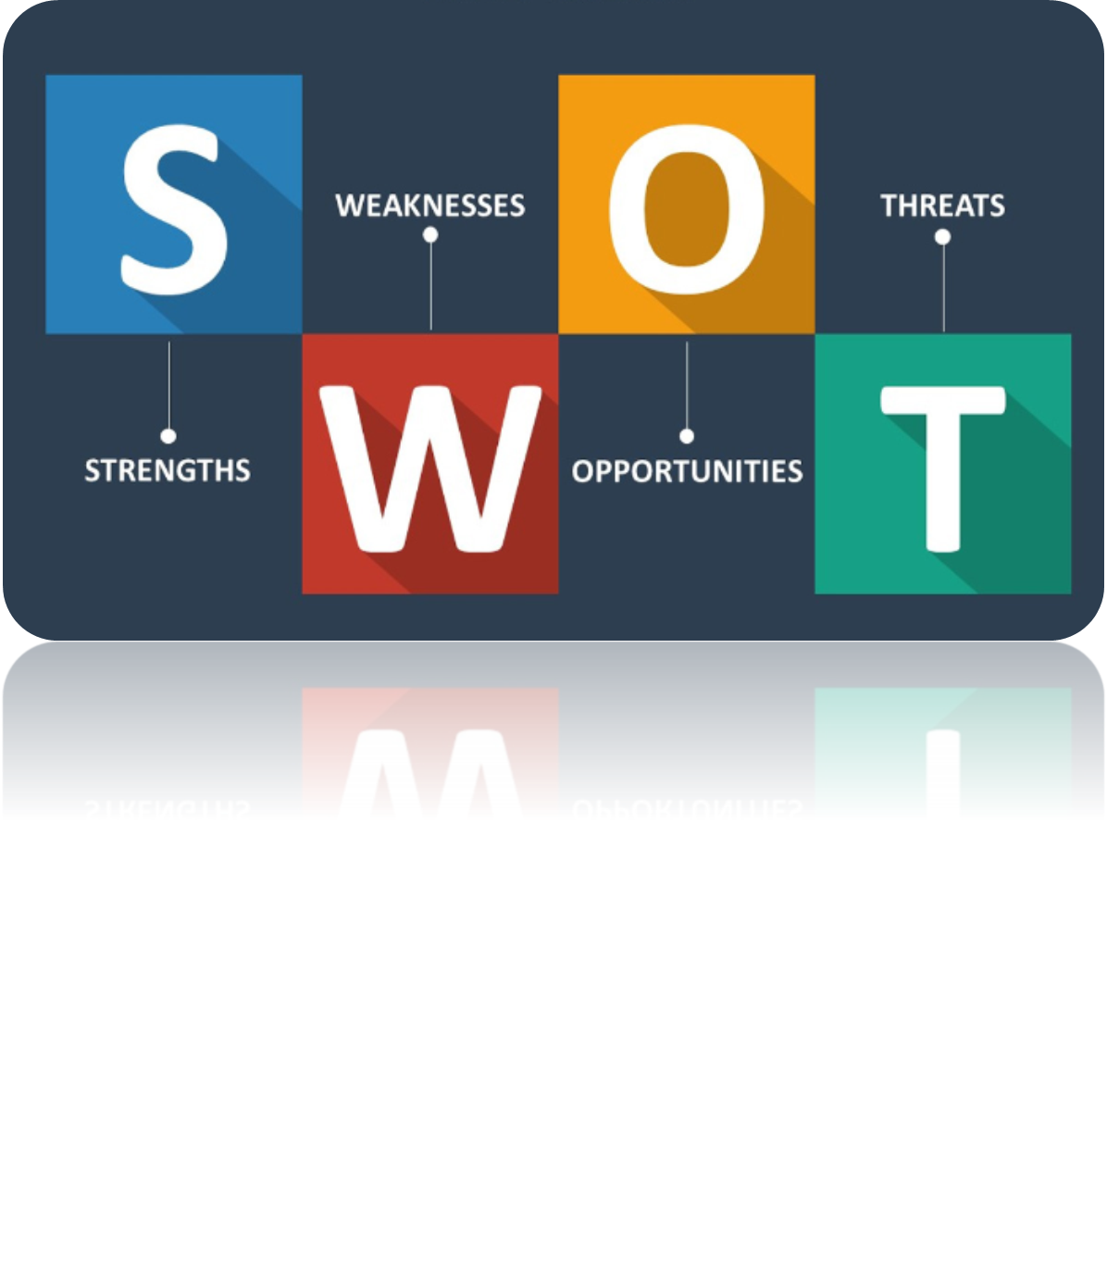
STRENGTHS
City Council Support
Strong Partnership with CoC
Community Support/Local Foundations
Vacant Land
Focused Allocation of Funding
Multiple Funding Sources
WEAKNESSES
Multiple Funding Sources
Timing/Process
Eligible Developers
Land Costs
STRENGTHS/WEAKNESSES

Slide 41
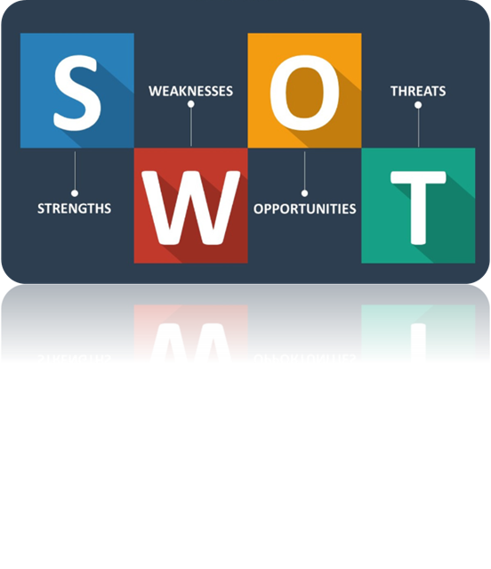
OPPORTUNITIES
Reduce/Eliminate Chronic Homelessness
Utilize Vacant Properties
Increase Awareness/Education
Provide Needed Services to Vulnerable Population
THREATS
Ignorance
Fear
NIMBYism
Political Aspirations
Housing Market
Limited Staffing
OPPORTUNITIES/THREATS

Slide 42
Sharon A. Burkley, MBA
Community Development Planning Manager
City of Fort Worth Neighborhood Services Department
(817) 392-5785
Sharon.Burkley@fortworthtexas.gov
www.fortworthtexas.gov/departments/neighborhoods/services/grants

