Slide 1
January 26, 2023
HUD Environmental Review Update: HUD’s Rulemaking Agenda and HEROS Overview
Office of Environment and Energy

Slide 2
HUD’s Rulemaking Agenda

Slide 3
HUD’s Rulemaking Agenda
Federal Flood Risk Management Standard (FFRMS)
HUD is proposing rulemaking to update the Department’s floodplain management and wetlands protection regulations in 24 CFR Part 55 to implement FFRMS and otherwise increase flood resilience standards in HUD projects.
HUD’s NEPA-Implementing Regulations
Following the goals established in HUD’s Climate Action Plan, HUD will revise the Department’s environmental regulations – including 24 CFR Parts 50, 55, and 58 – to better integrate strategies to mitigate climate- and EJ-related hazards and health risks in HUD-assisted activities.
Ongoing
HTF/HOME alignment - ongoing

Slide 4
HEROS: HUD Environmental Review Online System

Slide 5
What is HEROS?
HUD’s Environmental Review Online System (HEROS)
HEROS is an enterprise system that can be used to complete environmental reviews for all HUD programs (Part 50 and Part 58).
HEROS replaced HUD’s current paper-based environmental review process:
HEROS walks users through the entire environmental review process from beginning to end, including compliance with related laws and authorities.

Slide 6
Who Uses HEROS?
HEROS allows the environmental review procedures users already have in place now to be performed online.
HEROS can now be used by everyone who is involved in the environmental review process:
HUD Staff
Responsible Entities (local, state, and tribal governments)
Partners (consultants, PHAs, TDHEs, lenders, nonprofits, non-RE recipients)

Slide 7
Benefits of Using HEROS
HEROS makes complying with environmental requirements easier by:
Integrating guidance with formats
Facilitating communication with partners
Helping manage environmental reviews
HEROS also streamlines processes and saves paper.
It generates electronic environmental review records, eliminating the need for paper filing.

Slide 8
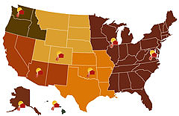
Who’s Who in HEROS?
HUD Preparer
Responsible Entity
City, State, Local, Tribal Government
Partner
3rd Party Consultants
Nonprofits
PHAs
Environmental Clearance Officer (ECO)
FEO/REO review and comment on EAs over 200 units

Slide 9
HEROS Demo

Slide 10
Getting Started

Slide 11
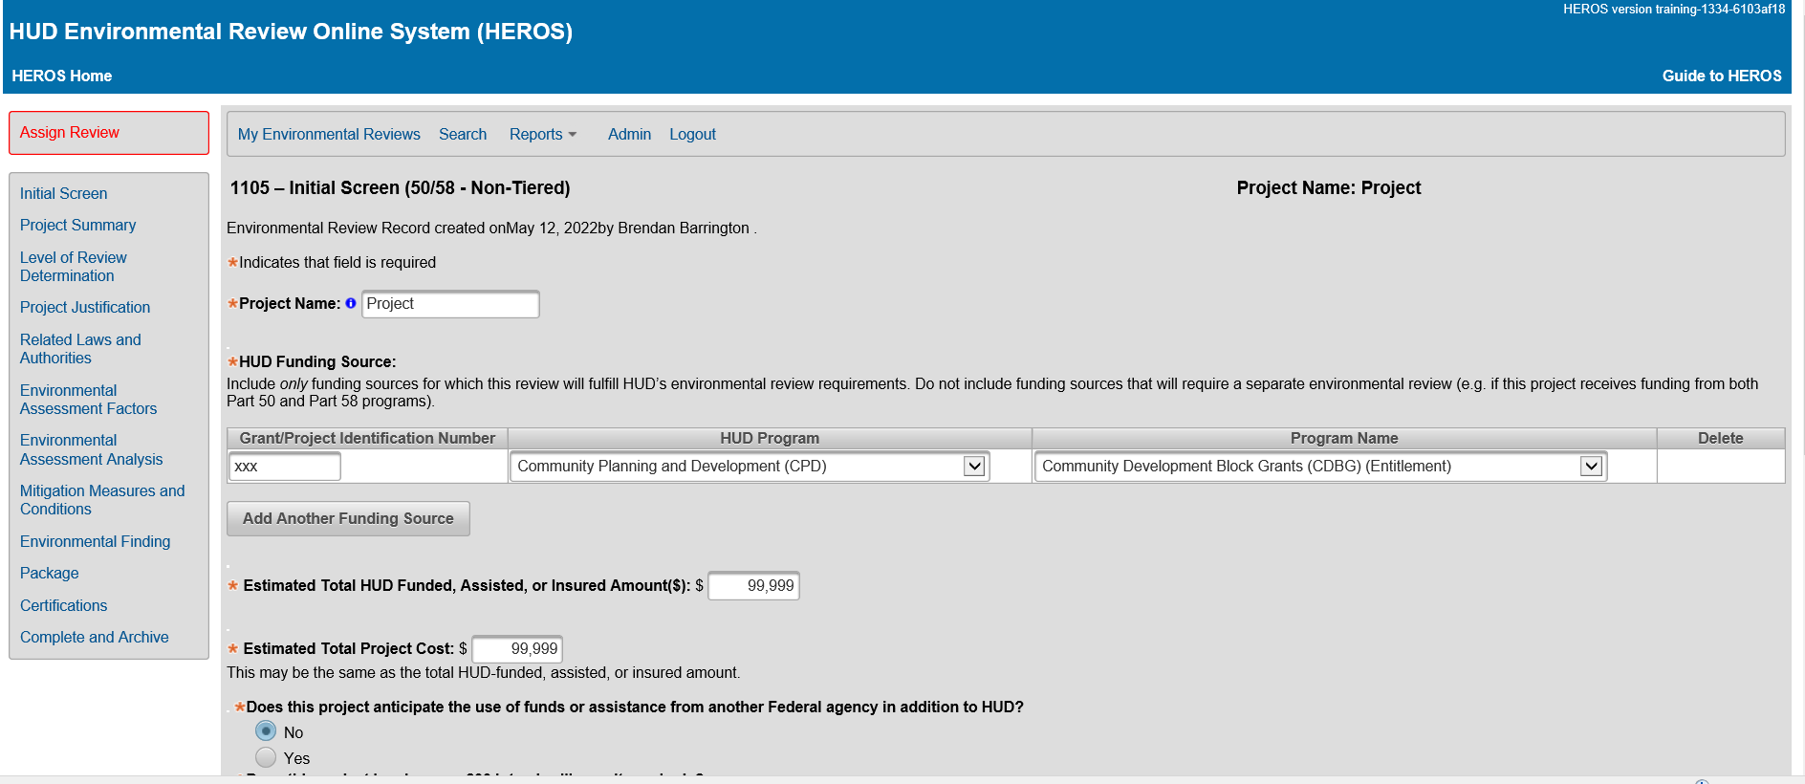
In
Initial Screen

Slide 12
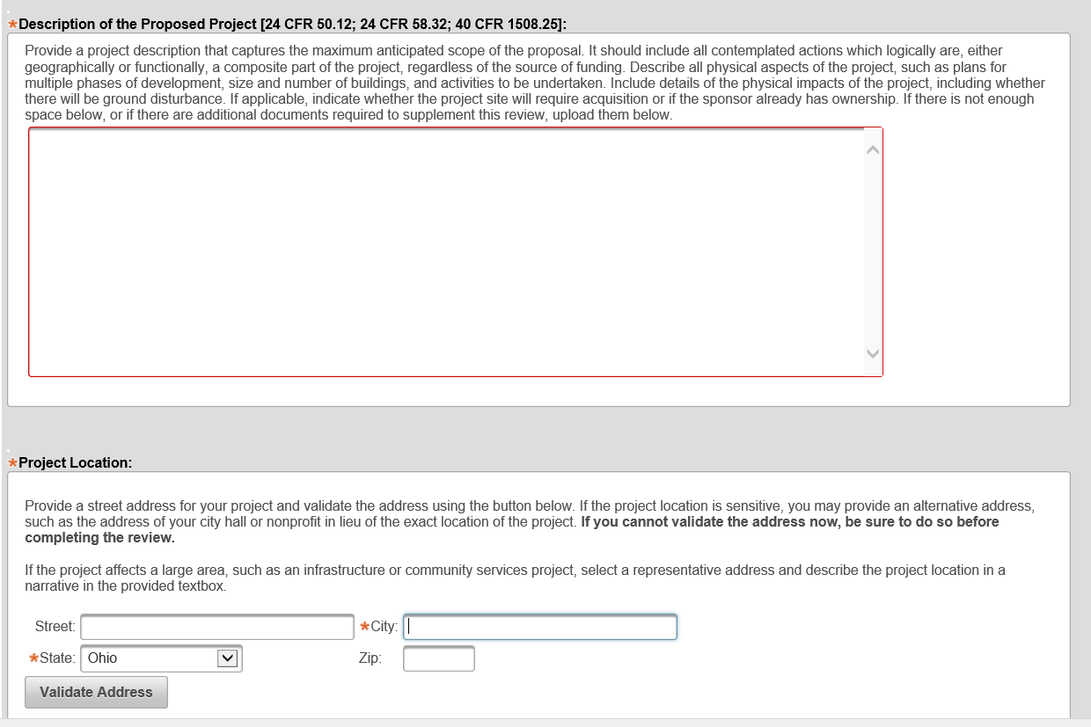
Project Summary

Slide 13
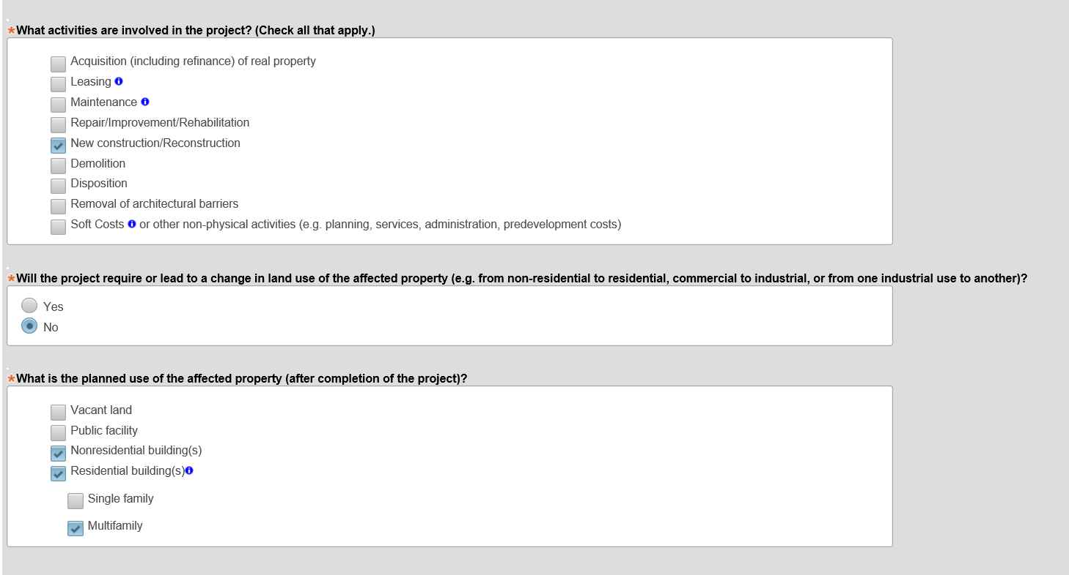
Project Summary (Continued)

Slide 14
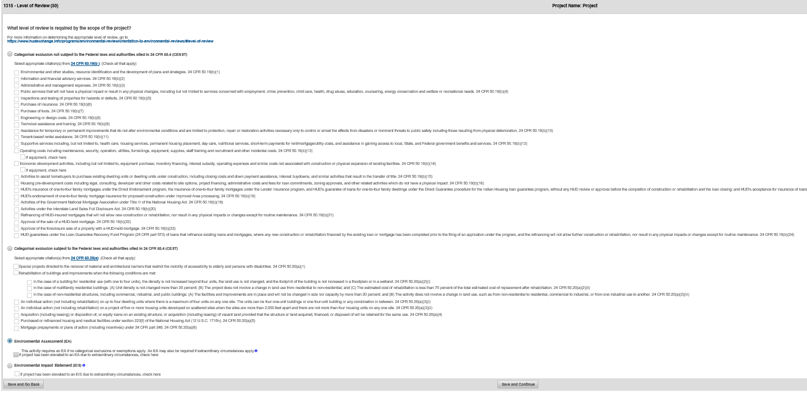
Level of Review Determination

Slide 15
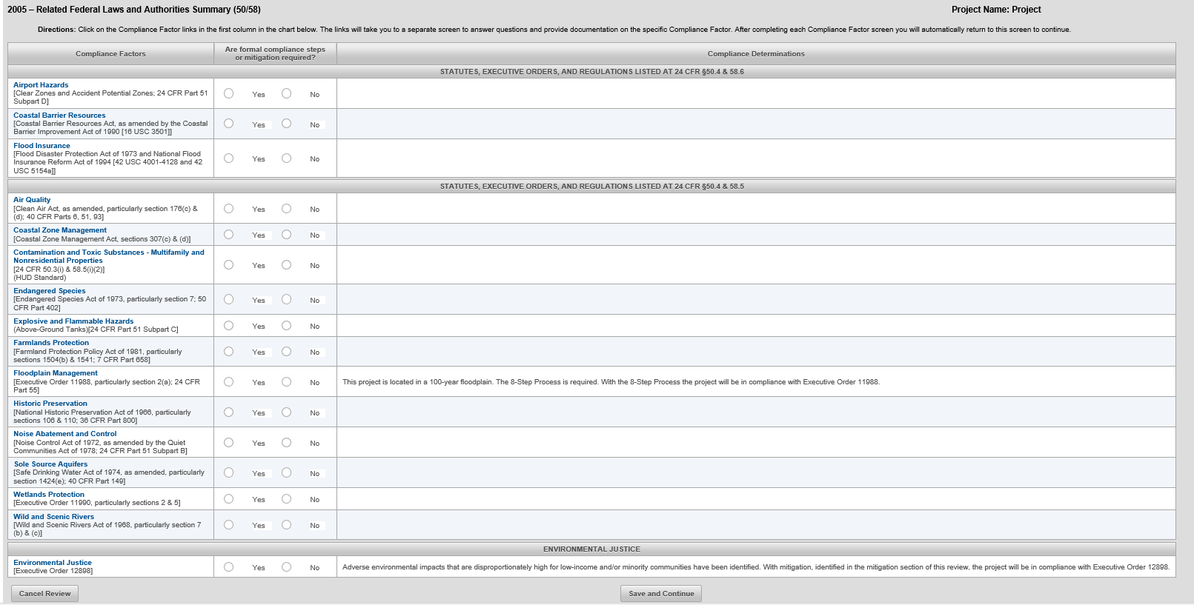
Related Laws and Authorities

Slide 16
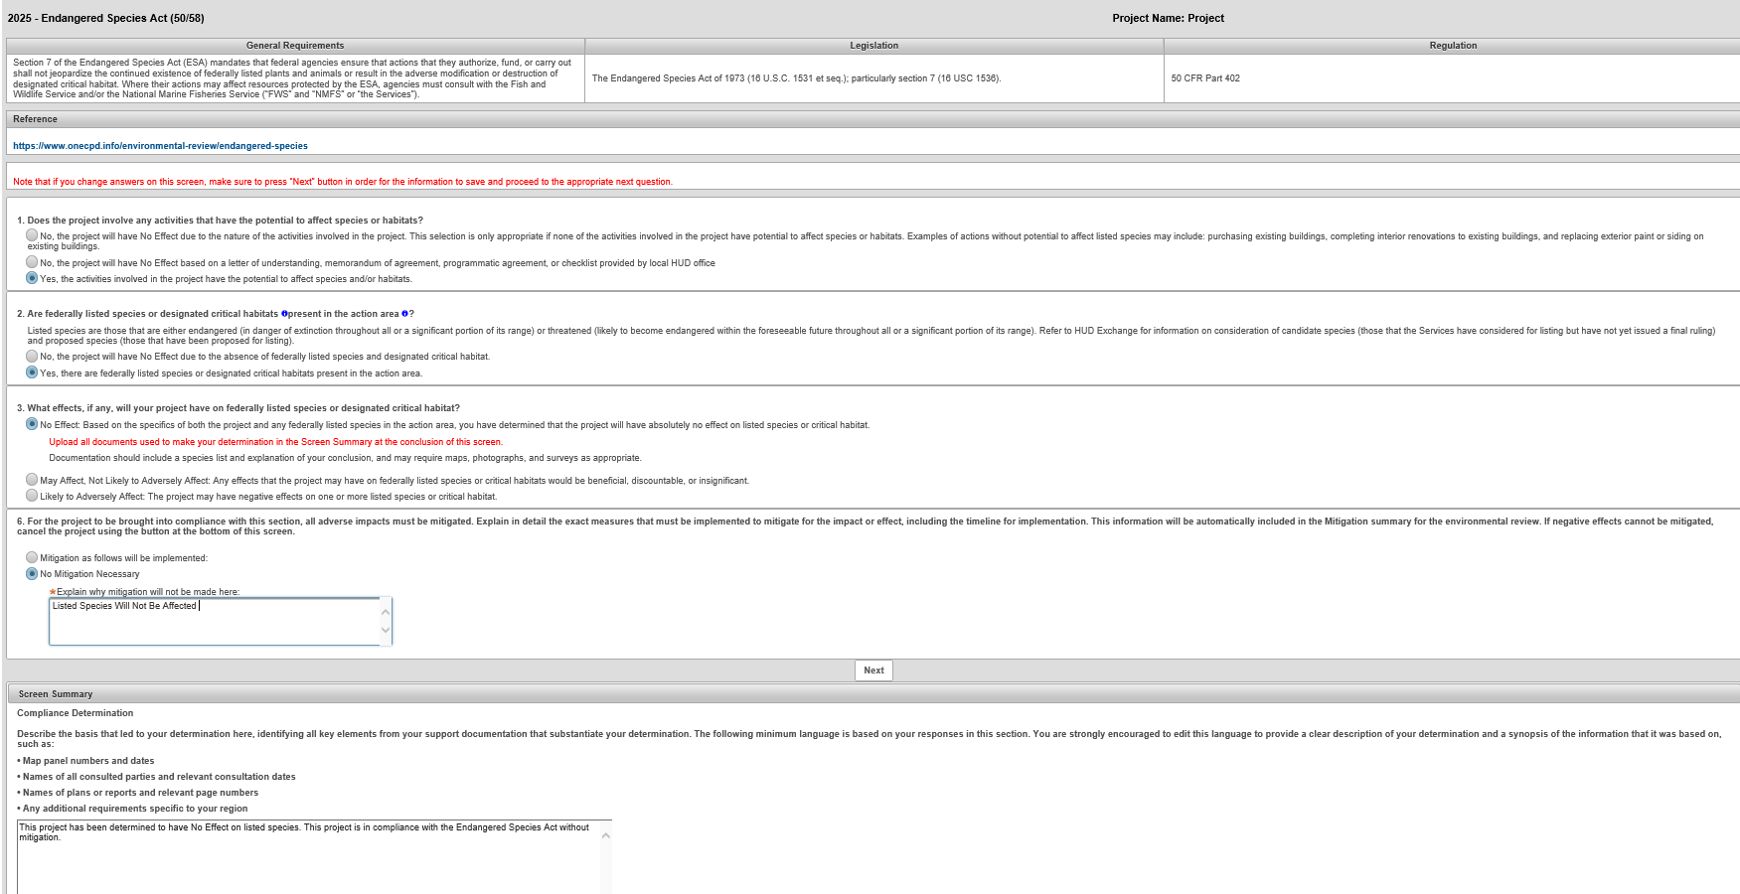
Related Laws and Authorities Example

Slide 17
Package Screen

Slide 18
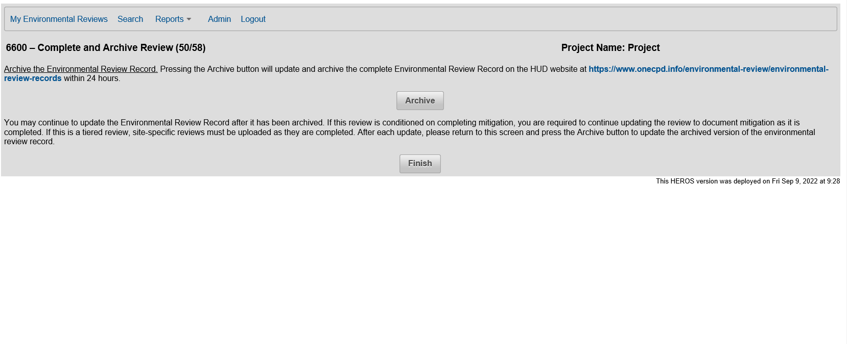
Final Steps

Slide 19
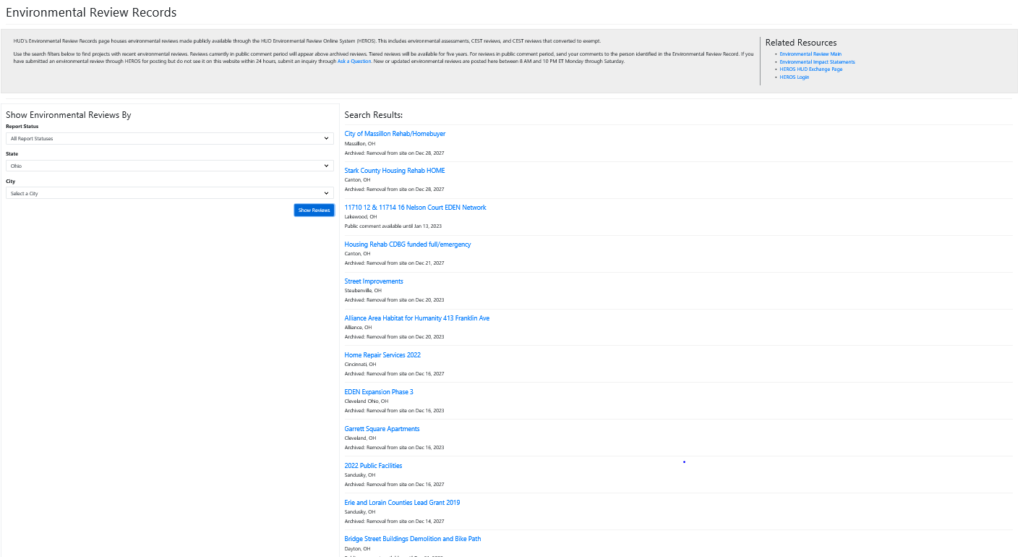
HUD.gov Archives

Slide 20
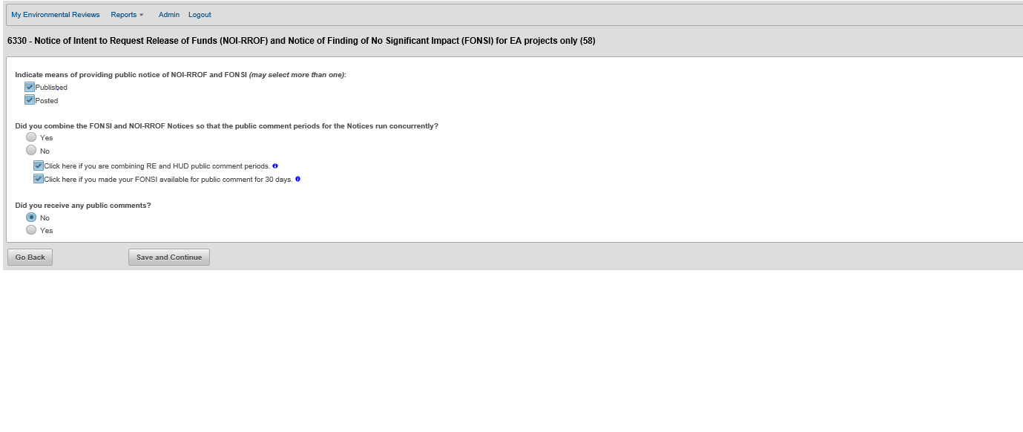
Request for Release of Funds

Slide 21
Public Notice

Slide 22
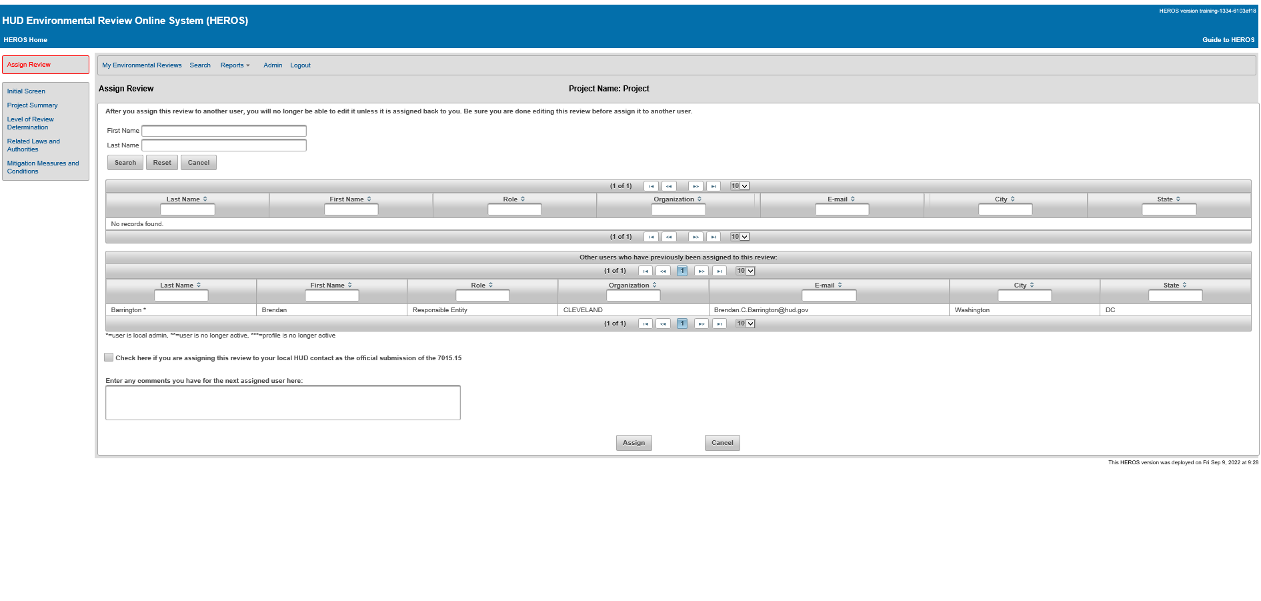
Assigning the Review

Slide 23
HEROS Support

Slide 24
Posting to the HUD.gov Website
New ERRs were posted at HUD.gov website after 5/21/22.
Older ERRs from the HUD Exchange have been moved over.
Reviews will be posted during public comment periods.
Completed reviews will be archived for 1 year for standard reviews and 5 years for tiered reviews.

Slide 25
HEROS Resources
HEROS "How To" Videos - HUD Exchange
HEROS User Guide (hudexchange.info)
HEROS Access Form (google.com)
HEROS FAQs - HUD Exchange
Ask A Question - HUD Exchange

Slide 26
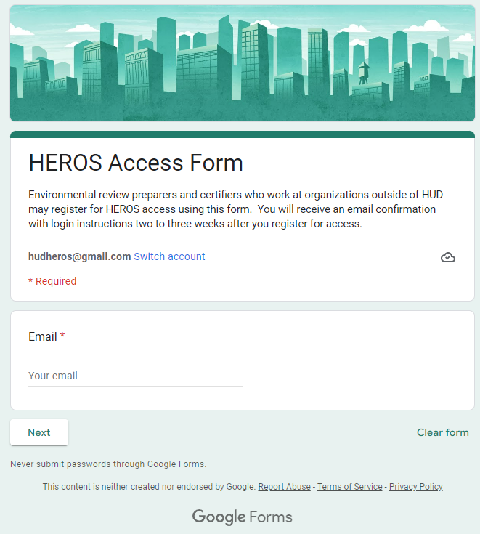
HEROS Access Form
Both Partner and RE Users can request access through the HEROS Access Form.
RE Users can request specific privileges utilizing this form including administrative and certification.
Partner Users can request accounts their organization and link their accounts with an RE or HUD.

Slide 27
Questions?

