Slide 1
CDBG: What’s New on the Planning Horizon?
January 2023

Slide 2
Agenda
Violence Against Women Act (VAWA)
Build America Buy America (BABA)
Resiliency & Broadband

Slide 3
Violence Against Women Act (VAWA)

Slide 4
Violence Against Women Act (VAWA)
VAWA is not new, but it has changed over the years
It was initially enacted in 1994
The housing title was added in 2005
Reauthorized (along with the housing title) in 2013 and 2022.
A portion of the 2022 reauthorization that went into effect on October 1, 2022, is our focus today

Slide 5
What’s New about VAWA?
The 2022 reauthorization of VAWA (P. L. 117-103) included a CDBG provision for the first time.
VAWA created the Right to Report Crime and Emergencies from One’s Home (34 U.S.C. § 12495)
This statute also directed HUD to collect information from CDBG grantees and "subgrantees"

Slide 6
What Type of Information is Collected?
HUD is completing the clearance and Paperwork Reduction Act process for the collection materials.
The law requires HUD to collect:
Grantee and Subgrantee laws or policies, that impose penalties on those reporting the crime and,
Grantee submission of a Right to Report compliance certification or 180 day steps to rectify local laws and policies in compliance with VAWA

Slide 7
What Type of Information is Collected?
The law (34 U.S.C §12495) specifically states
(c) REPORTING. —Consistent with the process described in section 104(b) of the Housing and Community Development Act of 1974 (42 U.S.C. 5304(b)), covered governmental entities shall—
(1) report any of their laws or policies, or, as applicable, the laws or policies adopted by subgrantees, that impose penalties on landlords, homeowners, tenants, residents, occupants, guests, or housing applicants based on requests for law enforcement or emergency assistance or based on criminal activity that occurred at a property; and
(2) certify that they are in compliance with the protections under this subtitle or describe the steps the covered governmental entities will take within 180 days to come into compliance, or to ensure compliance among subgrantees.

Slide 8
What does this mean for Grantees/Subgrantees?
Once HUD issues the collection material, Grantees and Subgrantees will need to take steps to compile their laws and policies and send them to HUD via the instructions that will be attached.
At this time, the collection materials have not yet been approved to be released.
In the meantime, ensure that your point of contact information in IDIS is up to date.
In preparation, grantees and subgrantees may wish to begin to examine local laws and policies

Slide 9
Resources
Websites
https://www.hudexchange.info/trainings/courses/vawa-right-to-report-from-home-for-cdbg-recipients-webinar/4780/
https://www.hud.gov/vawa
Points of Contact
Karlo Ng, (she/her)- Director on Gender-based Violence Prevention and Equity, HUD’s Office of the Secretary
Karlo.ng@hud.gov
Dr. Edkesha Anderson (she/her)- Assistant Director of Special Issues, Office of Block Grant Assistance
Edkesha.j.anderson@hud.gov

Slide 10
Build America Buy America (BABA)

Slide 11
What is BABA?
Enacted in the infrastructure Investment and Jobs Act (P.L. 117-58)
All iron, steel, manufactured products, and construction materials used in covered infrastructure projects must be produced in the United States
Applies to all Federal Financial Assistance (FFA) programs

Slide 12
Key Definitions
Covered Federal Financial Assistance Programs
Grants
Cooperative Agreements
Non-cash contributions/ donations of property
Direct Assistance
Loans
Loan Guarantees
Other financial assistance

Slide 13
Key Definitions (cont)
Covered Infrastructure
Buildings and real property
Includes housing
Utilities
Water Systems (drinking water and wastewater)
Electrical transmission facilities and systems
Broadband infrastructure
Transportation Infrastructure
Construction Materials
Includes all raw materials used in construction, including
Metals other than iron/steel
Plastic materials such as PVD Pipe
Glass
Lumber
Drywall
Does not include cement and aggregates (stone, sand, gravel)

Slide 14
Steps Taken
Established Department-wide leadership committee
Identified Impacted HUD Programs
Identified Difficult to Acquire Items
Requested HUD general Waivers
General applicability waiver
Exigent circumstances waiver (in effect for 5 years)
De minimis, small grants and minor components waiver (in effect for 5 year)
Engaged CPD stakeholders and Gathered public comment
Added BABA language to all FY22 Grant agreements

Slide 15
What does that all mean for CDBG?
While all CPD programs will be subject to BABA, CDBG is the first program to be impacted
All funds not obligated on or before November 14th, 2022 are now subject to BABA requirements
All other CPD programs are under HUD’s general waiver and will not be affected at this time.
CDBG-DR and CDBG-MIT fall under the Exigent Circumstances Waiver and are not subject to BABA at this time.

Slide 16
CDBG Impact?
BABA applies to some CDBG infrastructure and housing projects/activities
BABA will now apply to
Projects using CDBG funds obligated after November 14, 2022
Projects containing iron or steel
Projects with total FFA assistance of $250, 000 or greater
BABA will not apply to
Projects that do not contain iron or steel
Projects with total FFA less than $250,000
CDBG-DR/MIT projects
Projects that qualify for another HUD waiver

Slide 17
How do you determine if BABA applies?

Slide 18
What Measures Can You Take?
As we continue to roll out BABA requirements, you have some options
BABA allows for project specific Waivers
Public Interest Waiver: domestic content procurement preference would be inconsistent with the public interest
Nonavailability: covered materials are not produced in the US in sufficient and reasonably available quantities or of a satisfactory quality
Unreasonable cost: inclusion of domestically produced covered materials will increase the cost of the overall project by more than 25%
While these options are available to you, HUD’s waiver process is in development. You will be notified at such time that the process is approved.

Slide 19
What do you do now?
Start planning around BABA now.
Be sure to include BABA language in all your bid and contract documents. Language has been added to all FY22 and later grant agreements.
Stay aware of all trainings made available now and, in the future
Most importantly, ask questions.

Slide 20
Resources
Websites
TA materials are being developed and will be hosted on HUD Exchange
Point of Contact
CPDBABA@hud.gov

Slide 21
Resilience & Broadband

Slide 22
Resilience
Definition: a community’s ability to minimize damage and recover quickly from extreme events and changing conditions, aka what is called “natural hazard risks” in the regs.
24 CFR 91.210(a)(5) (Entitlements) Commencing with consolidated plans submitted on or after January 1, 2018, the jurisdiction must describe the vulnerability of housing occupied by low- and moderate-income households to increased natural hazard risks associated with climate change based on an analysis of data, findings, and methods identified by the jurisdiction in its consolidated plan.
Notes:
Definition for resilience is "a community’s ability to minimize damage and recover quickly from extreme events and changing conditions, aka what is called “natural hazard risks” in the regs."
HUD published a Final Rule amending 24 CFR Part 91 to require grantees to incorporate the consideration of resilience to natural hazards and broadband needs into the consolidated planning process. The Rule, issued in the Federal Register on December 16, 2016 (81 FR 90997), provided that the new requirements apply for a consolidated plan submitted on or after January 1, 2018. 24 CFR 91.210(a)(5) (Entitlements) Commencing with consolidated plans submitted on or after January 1, 2018, the jurisdiction must describe the vulnerability of housing occupied by low- and moderate-income households to increased natural hazard risks associated with climate change based on an analysis of data, findings, and methods identified by the jurisdiction in its consolidated plan. The regulations do not mandate that actions be taken to address broadband needs or natural hazard mitigation. HUD considers that a jurisdiction is in the best position to describe how to invest in HUD funds. The analysis and consultation requirement may highlight needs that grantees can address to create economic opportunities, but HUD leaves it the grantees to consider any appropriate methods and to choose any appropriate actions.

Slide 23
Risks for Consideration
Risks that grantees need to show they are mitigating and considering include:
increasing temperatures and extreme heat
sea level rise and coastal storms
inland flooding
wildfire
drought,
and erosion and landslides..
Notes:
In con-plan, the grantee should include the needs for resilience to natural hazard risks, taking care to anticipate how risks will increase due to changing environmental 2 conditions. The following are the examples of risks for consideration: increasing temperatures and extreme heat, sea level rise and coastal storms, inland flooding, wildfire, drought, and erosion and landslides...

Slide 24
Incorporating Resilience into Con Plan
CPD Notice 20-04cpdn.pdf (hud.gov)
Each grantee must evaluate increased vulnerability to natural hazard risks due to environmental conditions
A grantee must identify agencies, groups, organizations, and others who participated in the planning process and describe its consultations in the consolidated plan in accordance with the requirements at §91.200 and §91.300
Grantees should conduct evaluations using readily available data sources developed by Federal government agencies
Including State, Tribal, the Community Resilience Planning Guide for Buildings and Infrastructure Systems prepared by the National Institute of Standards and Technology (NIST), and local hazard mitigation plans that have been approved by the Federal Emergency Management Agency (FEMA)
HUD would not require these new requirements to be incorporated into consolidated plan process until HUD makes the data available to all grantees
Notes:
In May 2020, CPD published a notice (number 20-04cpdn). The notice summarized the requirements and provided information regarding available resources to support the planning process.
Each grantee must evaluate increased vulnerability to natural hazard risks due to environmental conditions
A grantee must identify agencies, groups, organizations, and others who participated in the planning process and describe its consultations in the consolidated plan in accordance with the requirements at §91.200 and §91.300
Grantees should conduct evaluations using readily available data sources developed by Federal government agencies
Including State, Tribal, the Community Resilience Planning Guide for Buildings and Infrastructure Systems prepared by the National Institute of Standards and Technology (NIST), and local hazard mitigation plans that have been approved by the Federal Emergency Management Agency (FEMA)
HUD would not require these new requirements to be incorporated into consolidated plan process until HUD makes the data available to all grantees

Slide 25
Enter Resilience info into IDIS
In December 2019, the Market Analysis section of the Consolidated Plan template was updated to include section MA-65 Hazard Mitigation
The MA-65 “Hazard Mitigation” section asks grantees to analyze and describe any low- and moderate- income communities at risk from natural hazards, including those that are expected to increase due to climate change
Notes:
In December 2019, the Market Analysis section of the Consolidated Plan template was updated to include section MA-65 Hazard Mitigation
The MA-65 “Hazard Mitigation” section asks grantees to analyze and describe any low- and moderate- income communities at risk from natural hazards, including those that are expected to increase due to climate change

Slide 26
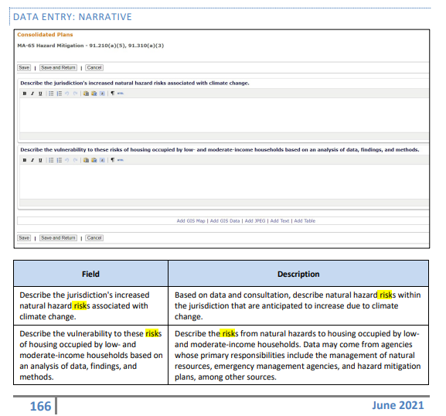
MA–65 Hazard Mitigation
Notes:
MA-65 has two fields, the first field "Describe the jurisdiction's increased natural hazard risks associated with climate change". In this field, the grantee should describe natural hazard risks within the jurisdiction that are anticipated to increase due to climate change. The second field "Describe the vulnerability to these risks of housing occupied by low- and moderate-income households base on an analysis of data, findings, and methods. In this field, the grantee will describe the risks from natural hazards to housing occupied by low- and moderate-income households. The grantee may use data form agencies whose primary responsibilities include the management of natural resources, emergency management agencies, and hazard mitigation plans, among other sources.

Slide 27
Broadband
HUD published a Final Rule amending 24 CFR Part 91 to require grantees to incorporate the consideration of broadband needs into the consolidated planning process.
24 CFR 91.210(a)(5) (Entitlements) Commencing with consolidated plans submitted on or after January 1, 2018, the jurisdiction must describe the broadband needs identified by the jurisdiction in its consolidated plan.
Notes:
24 CFR 91.210(a)(5) requires that consolidated plans submitted on after January 1, 2018, the jurisdiction must describe the broadband needs identified by the jurisdiction in its consolidated plan.

Slide 28
Data Sources for Broadband Needs
Recommended (not required) data sources, such as Federal Communications Commission (FCC) Form 477.
FCC Form 447 is a semi-annual reporting mechanism designed to determine the extent of local competition and deployment of broadband services, and provides detailed information of each census block serviced.
URL for FCC Form 477: https://www.fcc.gov/general/broadband-deployment-data-fcc-form-477.
Notes:
The sources for evaluate the broadband needs include Federal Communication Commission Form 477 (FCC-477). FCC-477 is a semi-annual reporting mechanism designed to determine the extent of local competition and deployment of broadband services, and provides detailed information of each census block serviced. The Form-477 can be found at the url listed in the slide.

Slide 29
Analysis for Broadband Needs
The broadband needs of housing occupied by low- and moderate-income households for its low- and moderate-income neighborhoods.
The Rule states that broadband needs include:
the need for broadband wiring and for connection to broadband service in the household units, and
the need for increased competition by having more than one Internet service provider serve the jurisdiction
Notes:
Grantees shall analyze the broadband needs of housing occupied by low/mod households for the low/mod income neighborhoods. The broadband needs may include: the need for broadband wiring and for connection to broadband service in the household units, and the need for increased competition by having more than one Internet service provider serve the jurisdiction.

Slide 30
Enter Broadband Needs into IDIS
In December 2019, the Market Analysis section of the Consolidated Plan template was updated to include MA-60 Broadband Needs of Housing
The MA-60 “Broadband Needs of Housing” section asks grantees to evaluate the availability of broadband access
Notes:
In December 2019, IDIS added a new screen MA-60 for grantees to enter the broadband needs of housing.

Slide 31
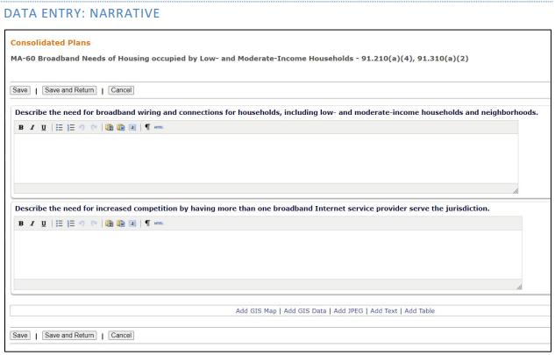
MA–60 Broadband Needs of Housing
Field | Description
Describe the need for broadband wiring and connections for households, including low- and moderate-income households and neighborhoods. | Describe broadband internet needs in housing occupied by low- and moderate-income households based on an analysis of data.
Describe the need for increased competition by having more than one broadband Internet service provider serve the jurisdiction. | Evaluate the availability and number of broadband internet service providers within the jurisdiction.
Notes:
MA-60 has tow fields. First one, "Describe the need for broadband wiring and connections for households, including low- and moderate-income households and neighborhoods." Grantees would describe broadband internet needs in housing occupied by low- and moderate-income households based on an analysis of data. The second field "Describe the need for increased competition by having more than one broadband Internet service provider serve the jurisdiction." Grantees may describe the availability and number of broadband internet service providers within the jurisdiction in this field.

Slide 32
Available Resources
CPD Notice 20-04:
https://www.hud.gov/sites/dfiles/OCHCO/documents/20-04cpdn.pdf
Resilience | NIST
Hazard Mitigation Planning | FEMA.gov
Fixed Broadband Deployment Data from FCC Form 477 | Federal Communications Commission
POC: James Höemann, Director, Entitlement Communities Division, Office of Block Grant Assistance james.e.hoemann@hud.gov
Notes:
We listed available resources for the resilience and broadband requirements. If you have any question, you can contact your field office and field offices may direct their questions to HQ to James Hoemann.

Slide 33
Questions

