Slide 1
Milwaukee County Home Repair Program
2023 NCDA
Winter Legislative Meeting

Slide 2
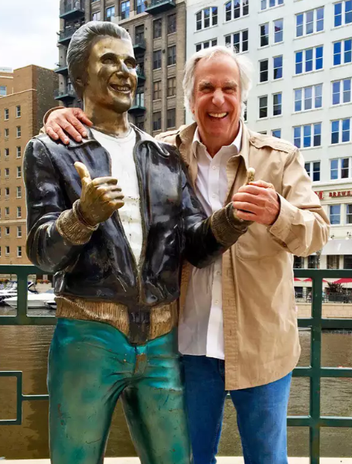
About Milwaukee County
Founded in 1835
Largest County in the State of Wisconsin
Urban County made up of 19 municipalities
Birthplace of Harley-Davidson
Nicknamed Brew City because of its rich brewing history – Miller, Pabst, Schlitz, Blatz and many other craft breweries.
Home of the Bronze Fonz

Slide 3
Home Repair Program
Part of Department of Health and Human Services
7 staff members
1 Manager – oversees HOME, HOME-ARP, CDBG, ESG and Home Repair programs
1 Administrative Assistant – newly created
1 Project Coordinator – Assists with intake, income qualifying, and general project follow up
4 Inspection Staff (3 full time and one part time) – conduct HQS/UPCS inspections, conduct lead risk assessments, create scope of work, and oversee work to be completed

Slide 4
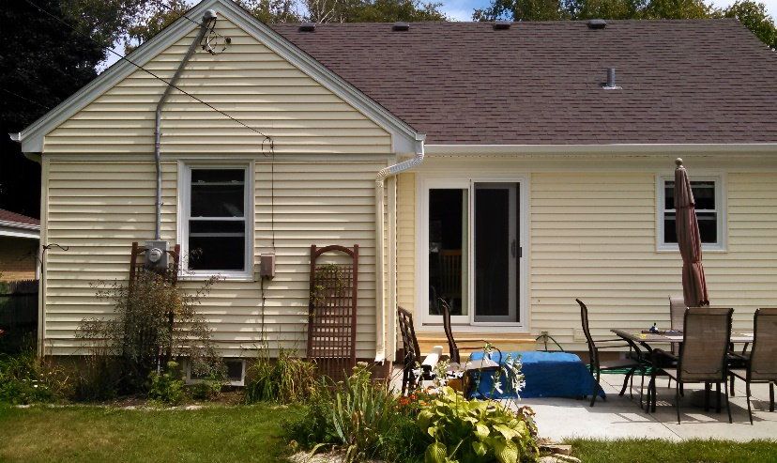
Home Repair Program Basics
Before
Provide no interest loans for rehab work
Loans repaid over time based on client’s income
Option for deferred loan
Provide grants for accessibility
Provide lead grants to offset costs.
After

Slide 5
Home Repair Program Basics
Loan and Grants are funded through HOME and CDBG funds
Some restrictions in municipalities on funding source
Municipalities have applied for municipal specific CDBG funds to provide grants to offset loans for clients
Internal Home Repair Review Board

Slide 6
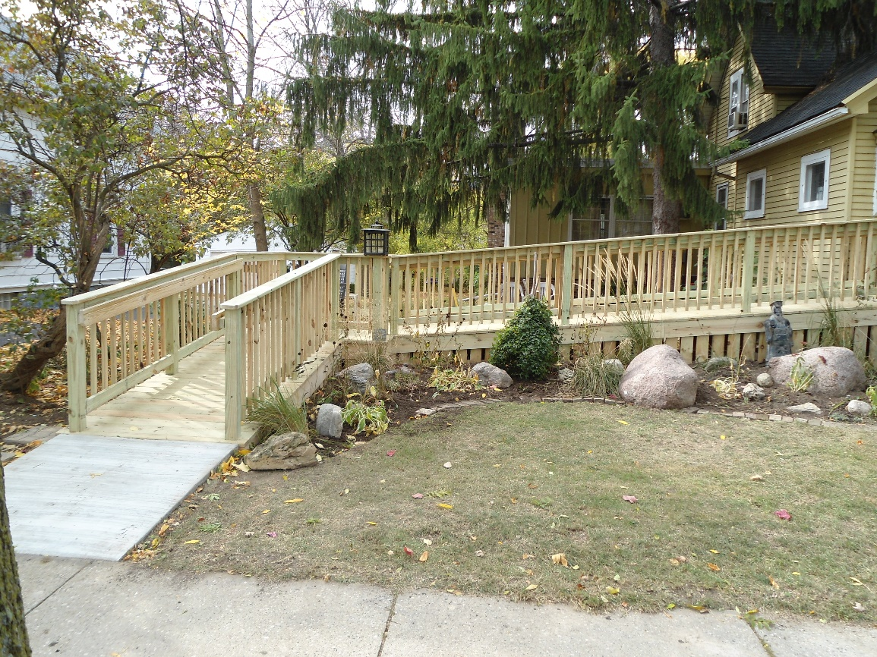
Home Modification Referrals
Provide project management services to Milwaukee County and two surrounding counties.
Projects are funded through the State’s Children’s Long Term Waiver program.
Source of revenue for Housing Division
Services include assessment and recommendations on home modifications, creating a scope of work, and project management once funding is approved.

Slide 7
Strengths
All internal staff
All project management is done in house.
Construction and building knowledge
Overhaul of Policy and Procedure Manual and all associated documentation
Partnership with Treasurer’s Office, Housing of Correction and Home Repair to rehab tax foreclosures.
Recent Software Conversion

Slide 8
Program Challenges
Software Conversion
Change of staff
Increased number of projects
Contractor and Supply Chain
Impacted completion time
Funds and Timeliness

