Slide 1
City of Quincy
Dept. of Planning and Community Development Office of Healthy Homes
Single Family Rehab Programs
Sherry Zou, Housing Programs Manager
Jane Berry, Lead Program Manager
January 27, 2023

Slide 2
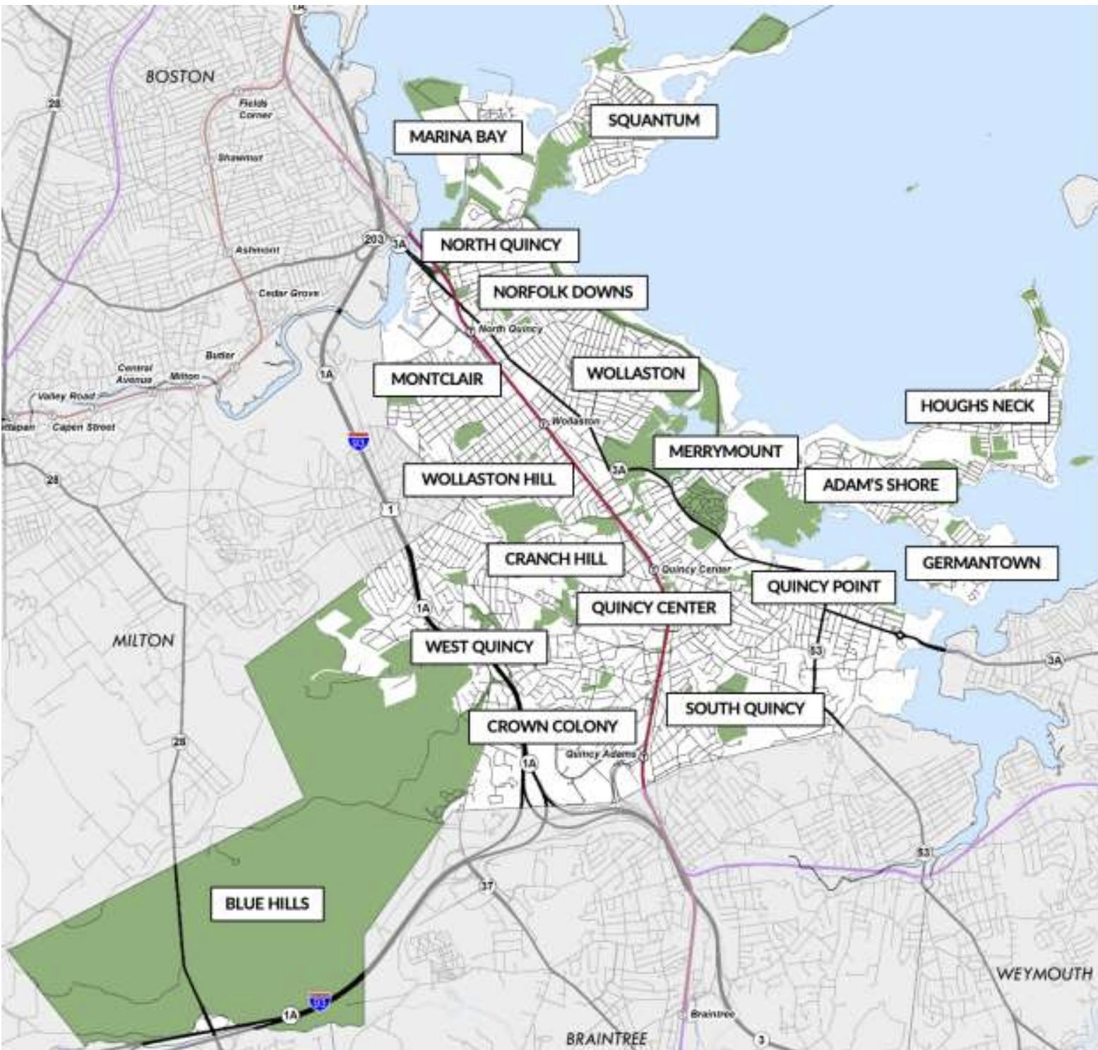
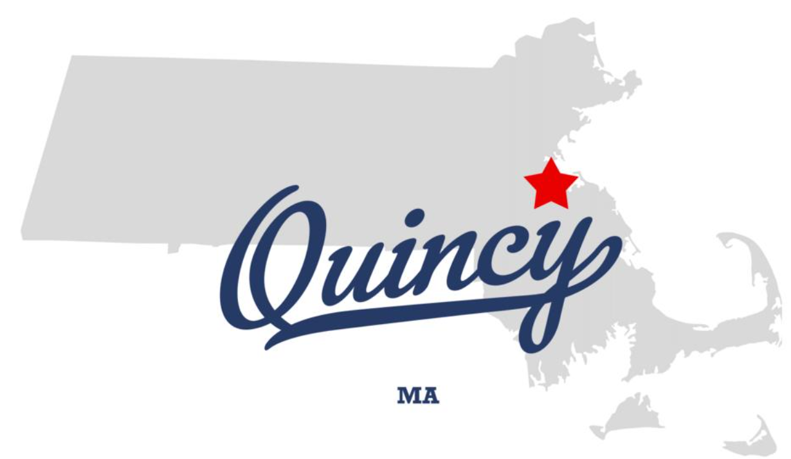
City of Quincy, Massachusetts
Notes:
Population, 10% increase 2010-2020, compare to 7% for the State.

Slide 3
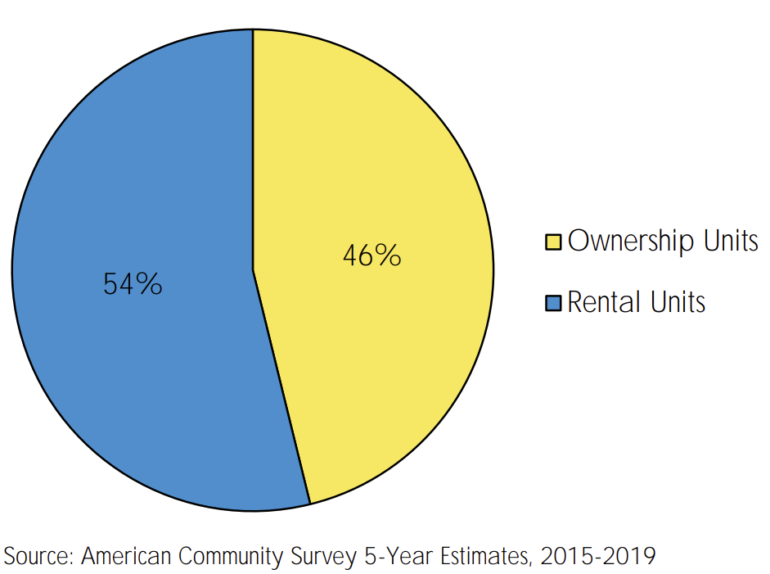
City of Quincy, Massachusetts
Population |  | 101,636 | Households | 41,322
Race |  | White 54% | Asian 31% | African American 5%
Tenure |  | 46% Owners | 54% Renters
Single Family Homes |  | 14,184 (33%) | ~75% built pre-1978 | 4-person HH 80% AMI $111,850
Notes:
Population, 10% increase 2010-2020, compare to 7% for the State.

Slide 4
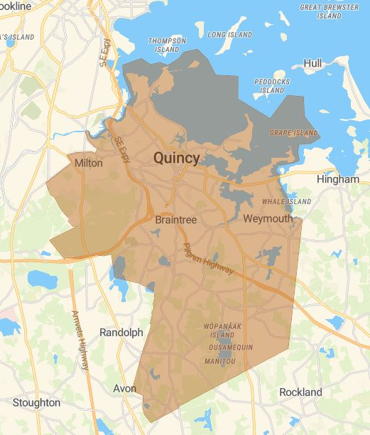
Overview
Personnel: Staff of 4 (in-house); 4 Consultants
HOME Consortium lead member
Administering 5 Programs with 5 Funding Sources
Housing Rehab, Lead Abatement, 1st-Time Homebuyer, HOME rental development, HOME TBRA
CDBG, HOME, Lead/Healthy Homes, AHTF
Notes:
Sherry Zou, Housing Programs Manager
Jane Berry, Lead Program Manager Consultants: Housing Rehab Specialist, Lead Inspectors, Title Examiner
Additional In-house Key Staff: Financial Manager, CD Director, Office Administrator, Principal Planner, City Asian Liaison, Intern

Slide 5
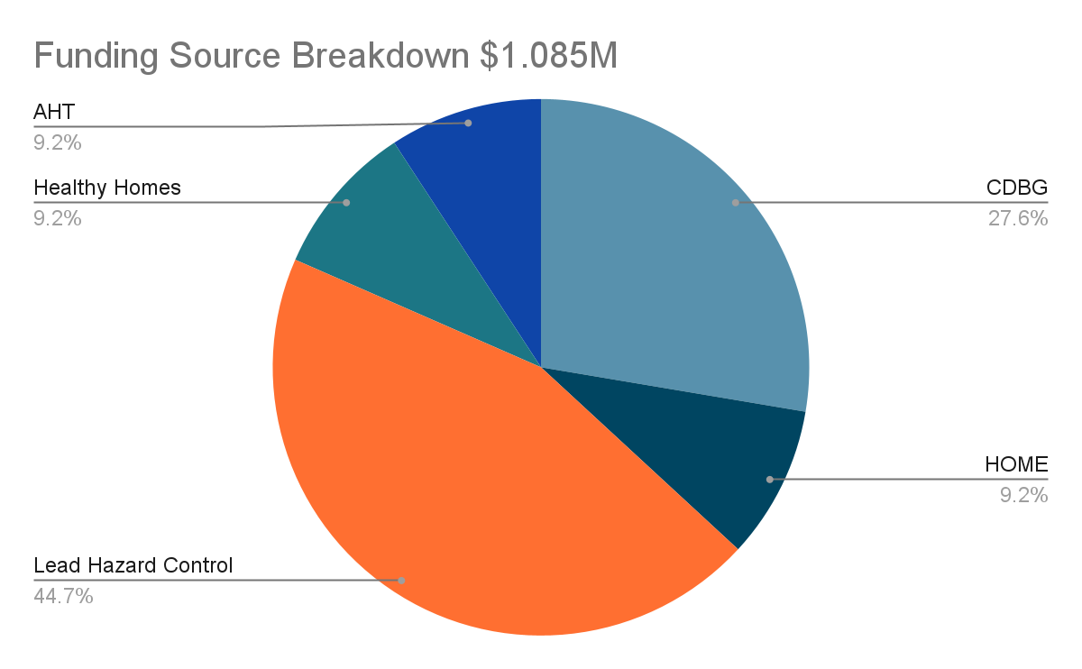
Funding
 | Assistance per unit | Terms | Annual Budget
CDBG | $30,000 | 0% deferred/amortized loan | $300,000
HOME | As needed | 0% deferred loan | $100,000
Lead | $20,000 | 5-year forgivable | $485,000
Healthy Homes | $5,000 | grant | $100,000
AHTF | As needed | 0% deferred loan | $100,000
Additional Funding:
State: Get The Lead Out; Home Modification; MassSave
Local: NeighborWorks Emergency Repair (non-profit), QCAP (Community Action Program) Weatherization
Notes:
Discuss pipeline, # of projects

Slide 6
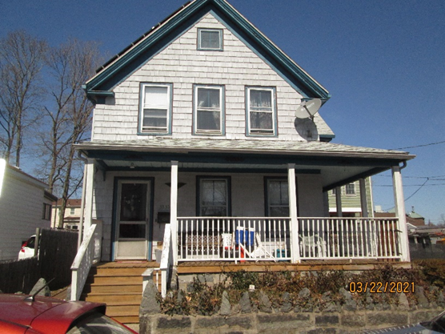
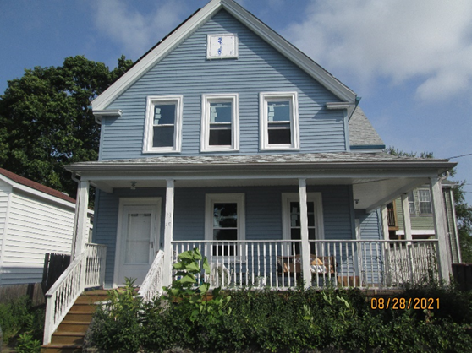
Past Projects
Notes:
Talk about this project budget

Slide 7
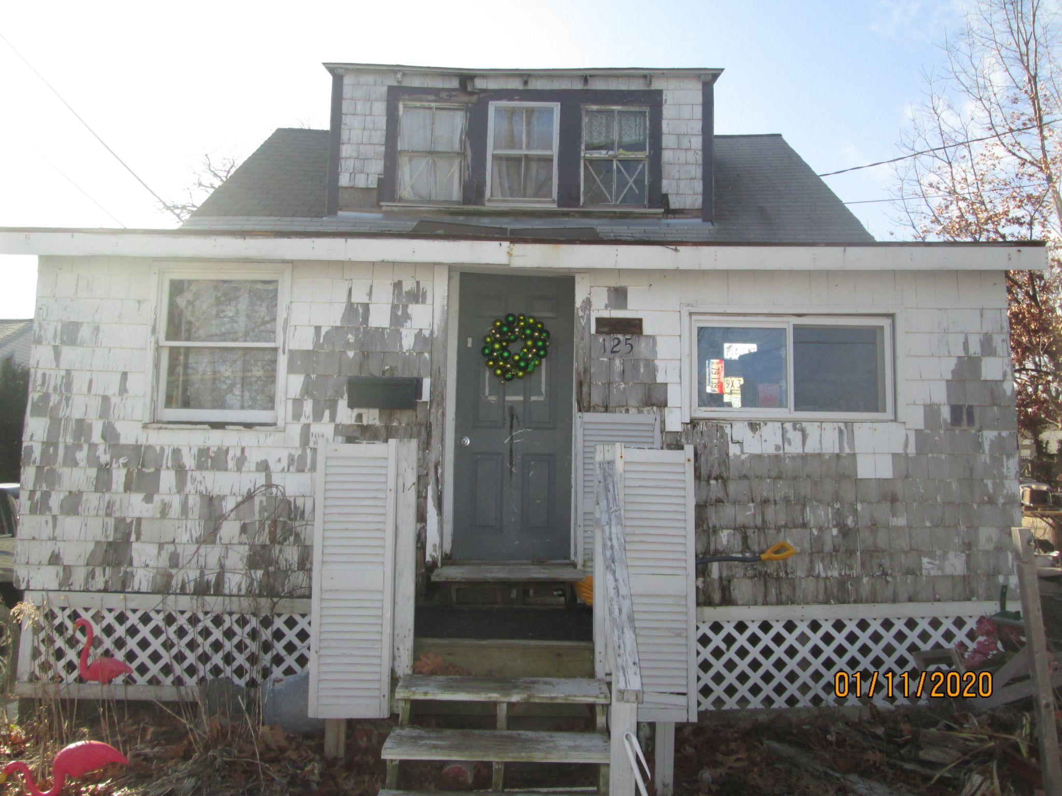
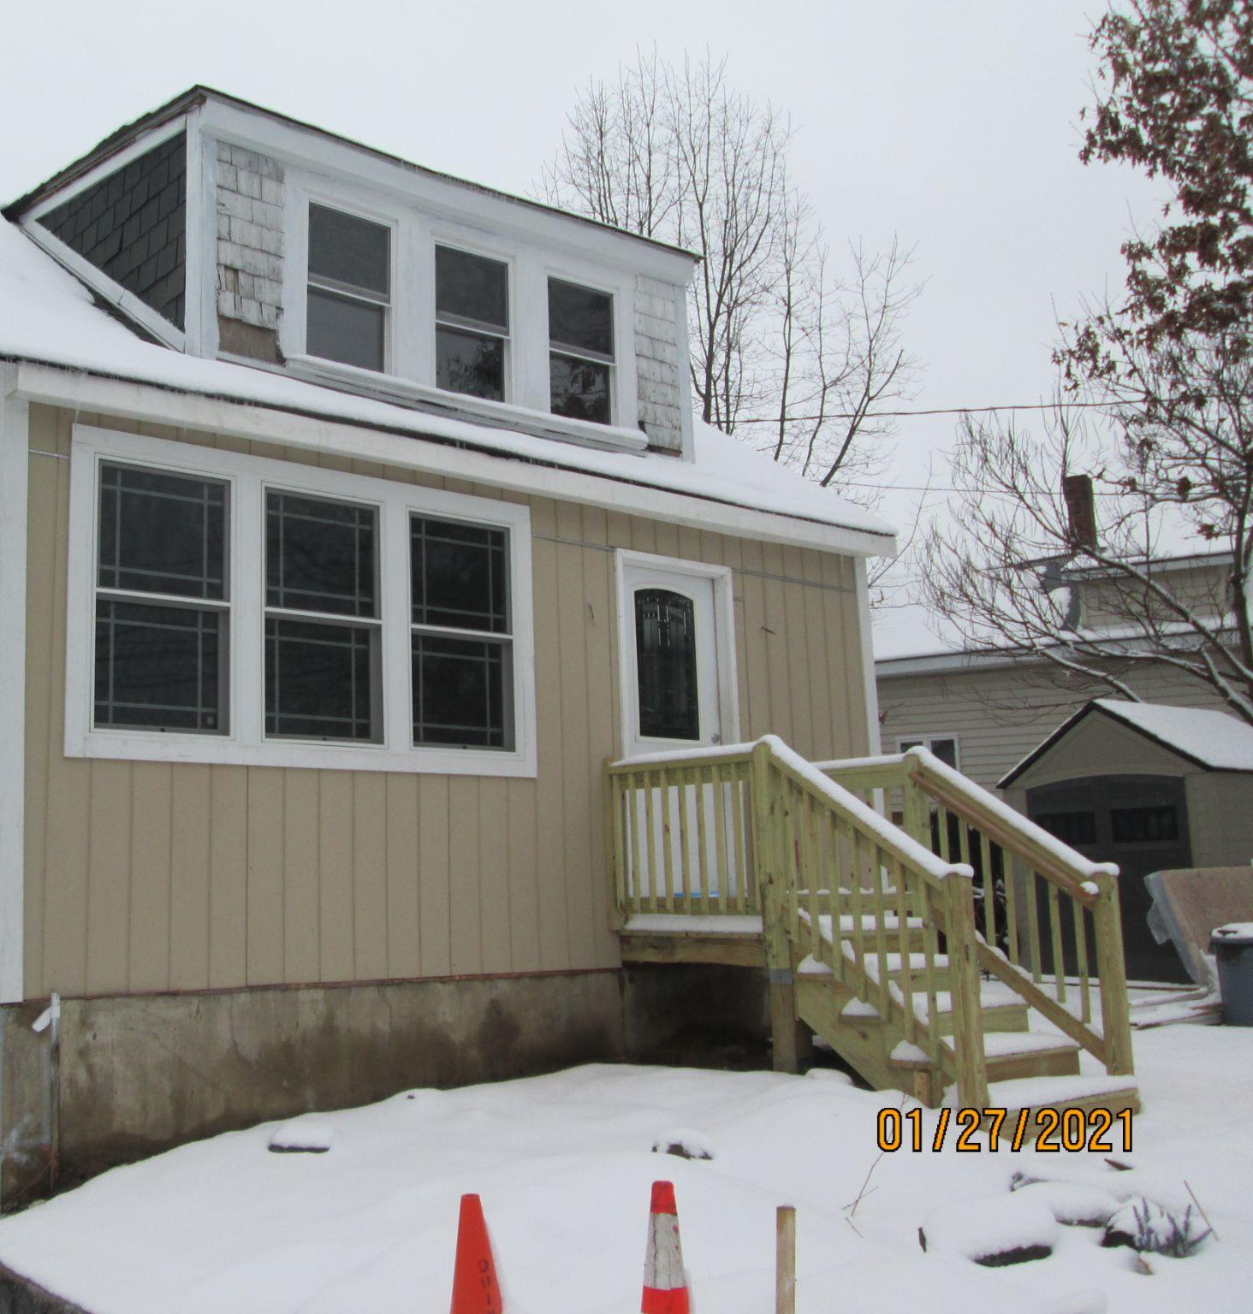

Slide 9
Implementing a Successful Program: 5 Bs
Be present
Be a partner
Be open to change
Be competitive
Be patient
Notes:
Lead with your largest grant - talk about lead program
Client’s perspective - talk about marketing the program and what benefits we lead with (grant vs. 0% loan, hotel stay, added home value),
Community partners - cities (weymouth, braintree, holbrook, milton), organizations (qcap, qari, neighborworks, state-run programs, etc.), businesses (hotels, the library, and places to market the program like walmart)
Embrace technology - keeping the team on the same page has been incredibly important, allowing us to take on more projects - any cloud-based software is a good start
Community Presence - we have a booth or table at all large community events and have even started hosting our own, like a family day at the library
Know your limits - being upfront with all our clients, particularly about how long the process will take has been key for us
Be open to change: policy, loan terms, staff,
Be competitive: grant opportunities

Slide 10
Education and Outreach
Information Sessions
Media Advertising
Community Events
Quincy Public Schools
Thomas Crane Public Library
South Shore YMCA
Quincy Braintree Family Network
BCNC
New Star Community Art School
QATV
Quincy Public Schools Newsletter
Mailing Blast
Thomas Crane Public Library Newsletter
Community Handouts - Law Firms, Dance Studios, Credit Unions, Martial Arts Studios, etc.
Manet Ribbon Cutting
Supermarket Tabling
South Shore Support Services
YMCA Family Fun Day
QARI Lunar Festival
Farmers Market Tabling next season
Notes:
We won’t always overlap. We want to be familiar with your initiatives so we can talk about them when asked and have some of your handouts available to distribute when needed. We hope you will do the same for us.

Slide 11
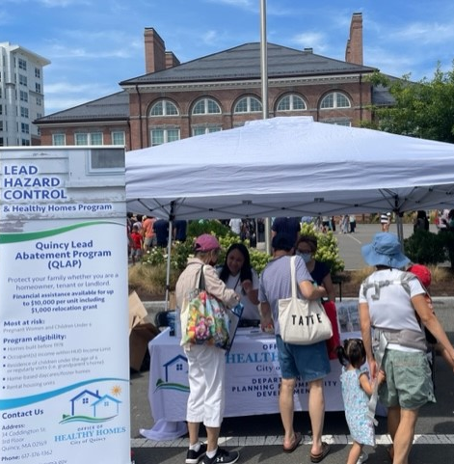
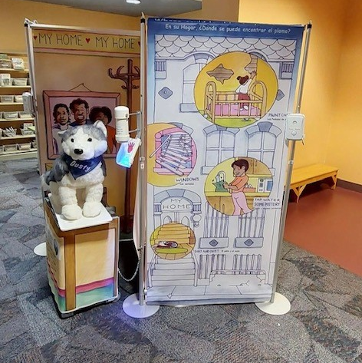
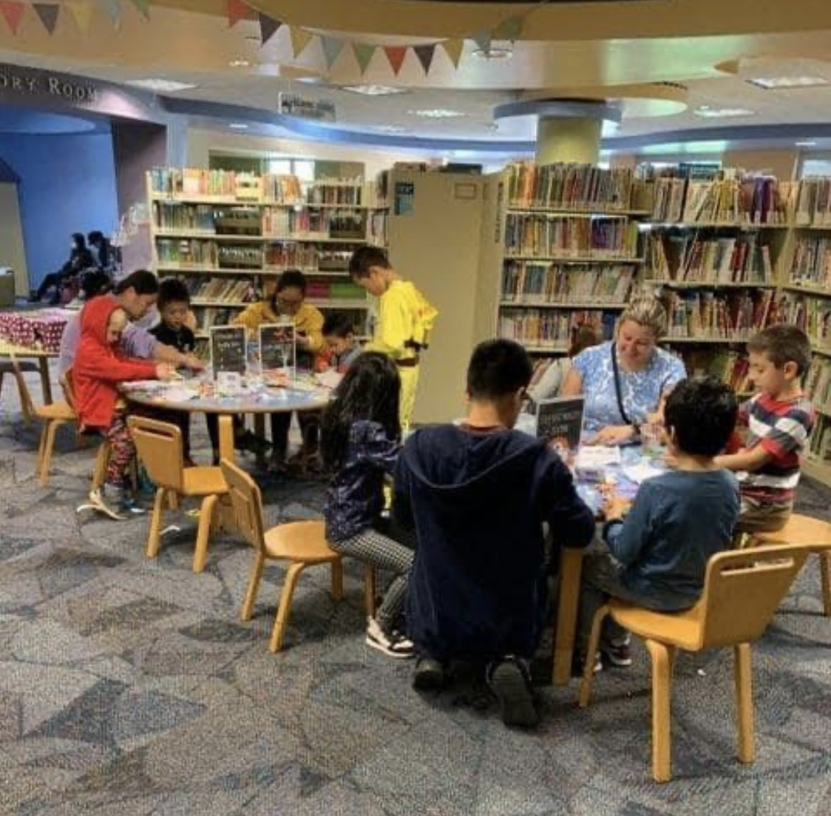
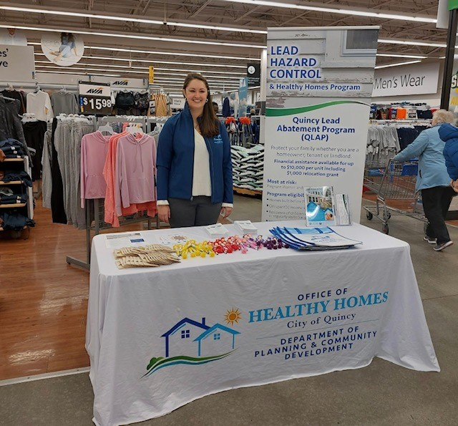
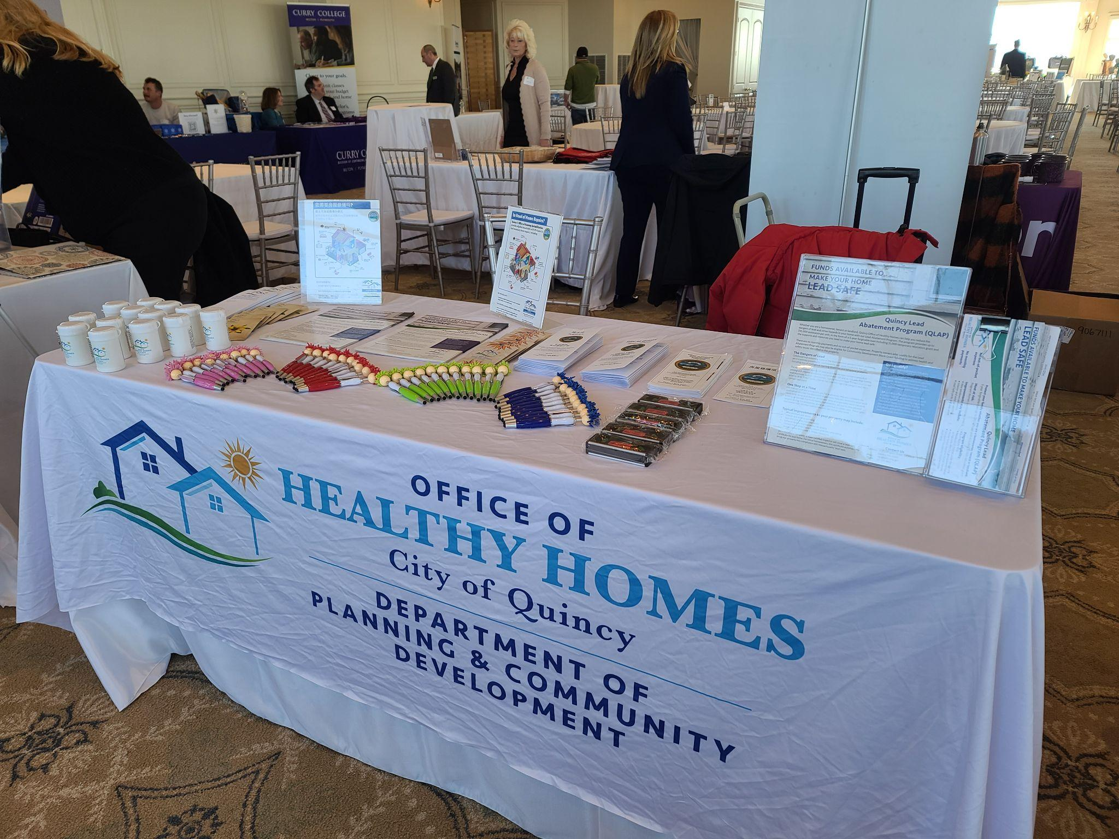
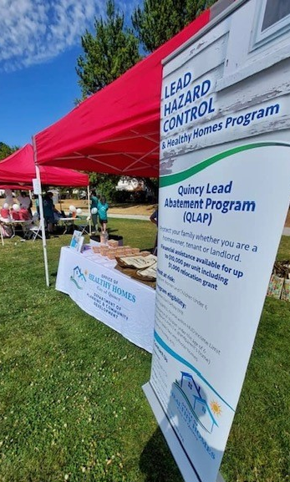
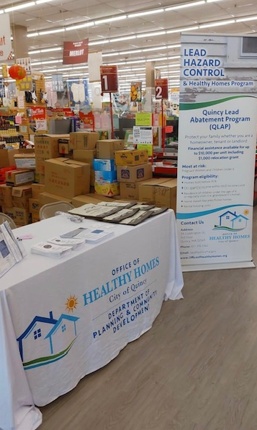
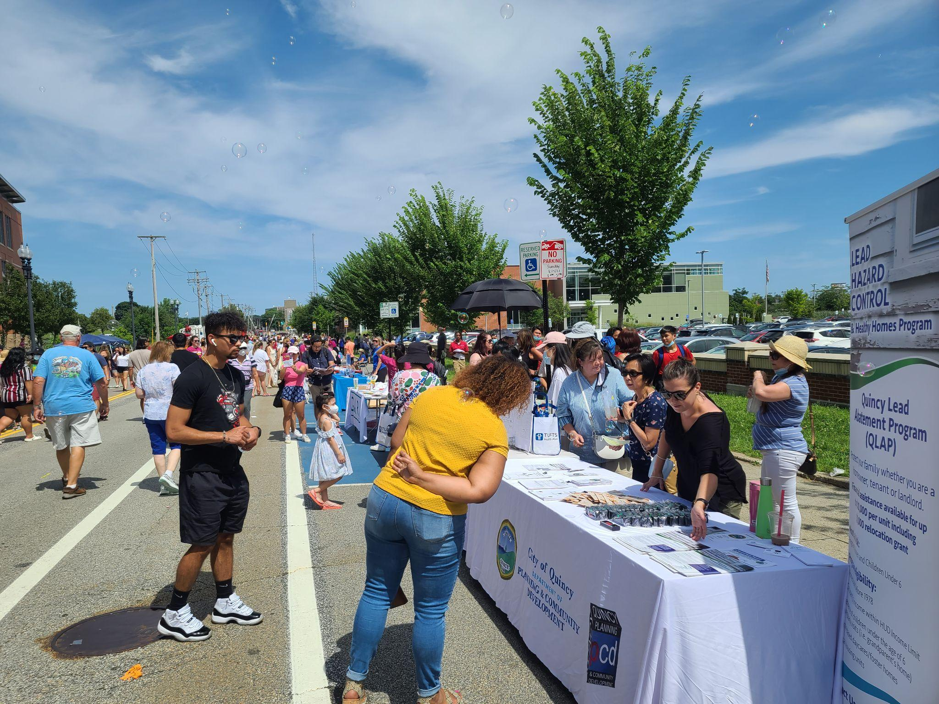

Slide 12
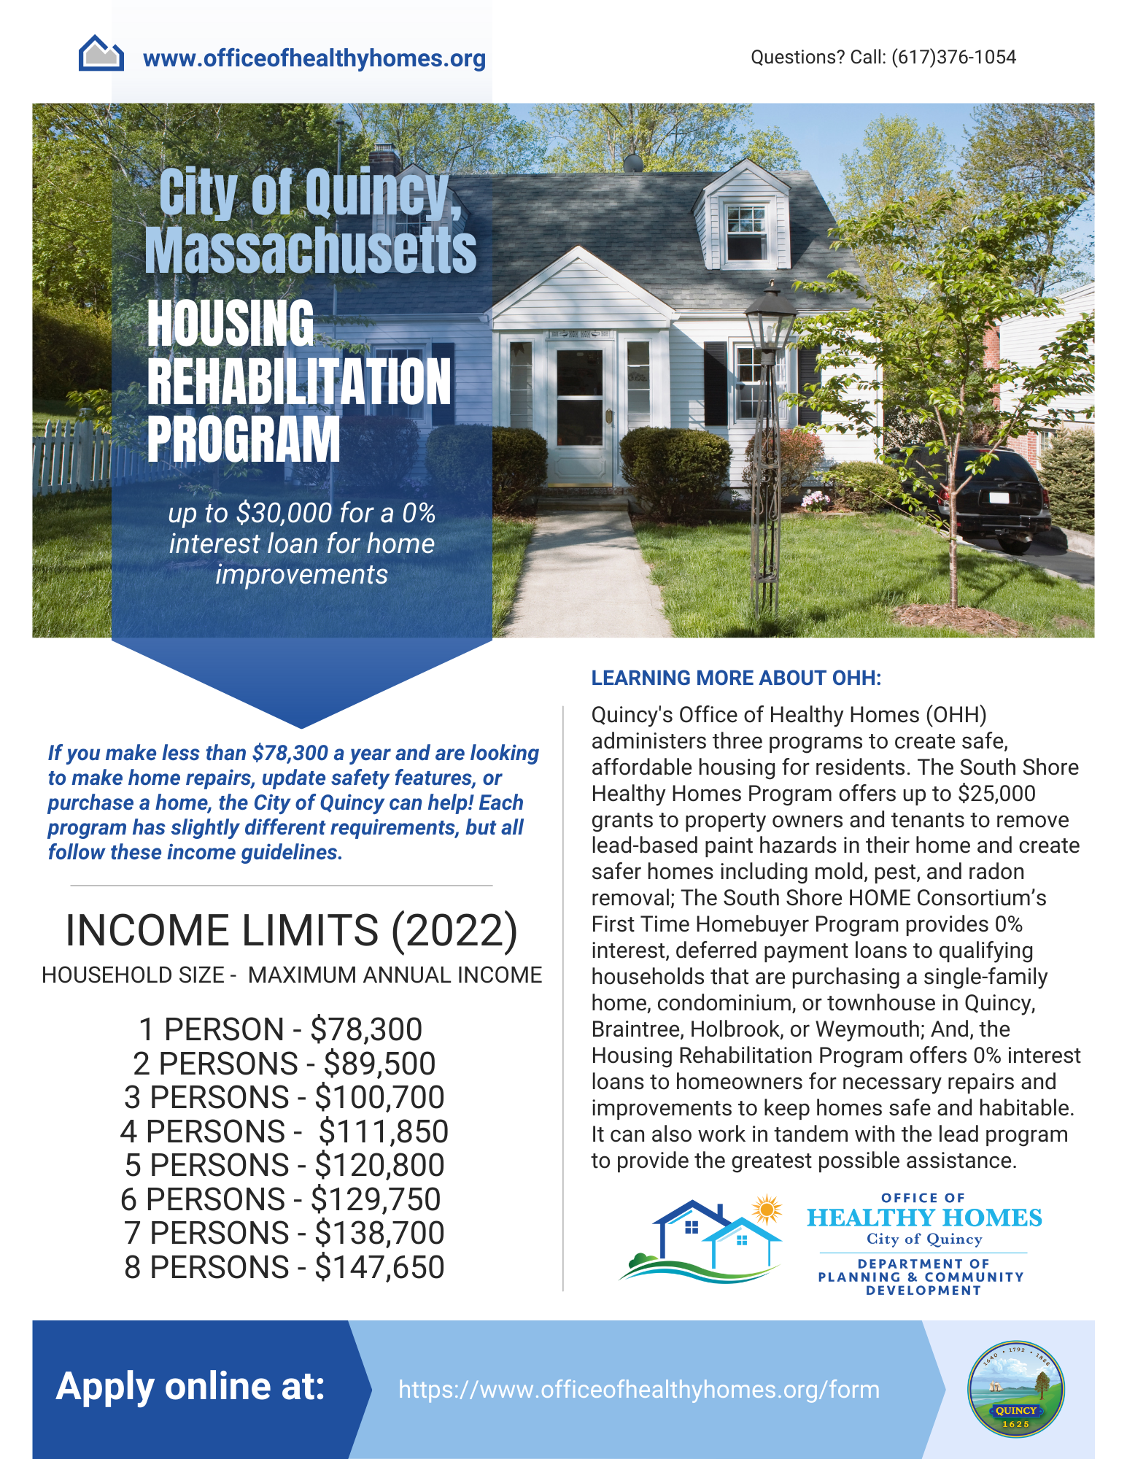
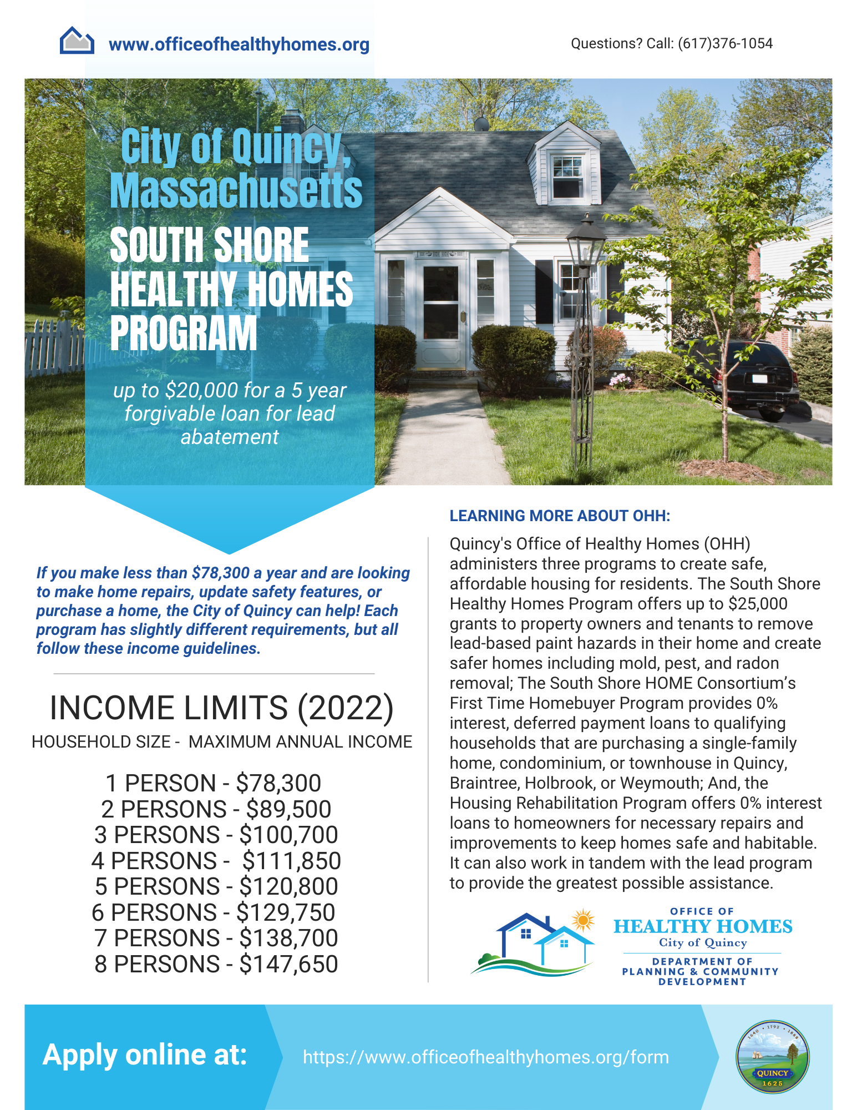
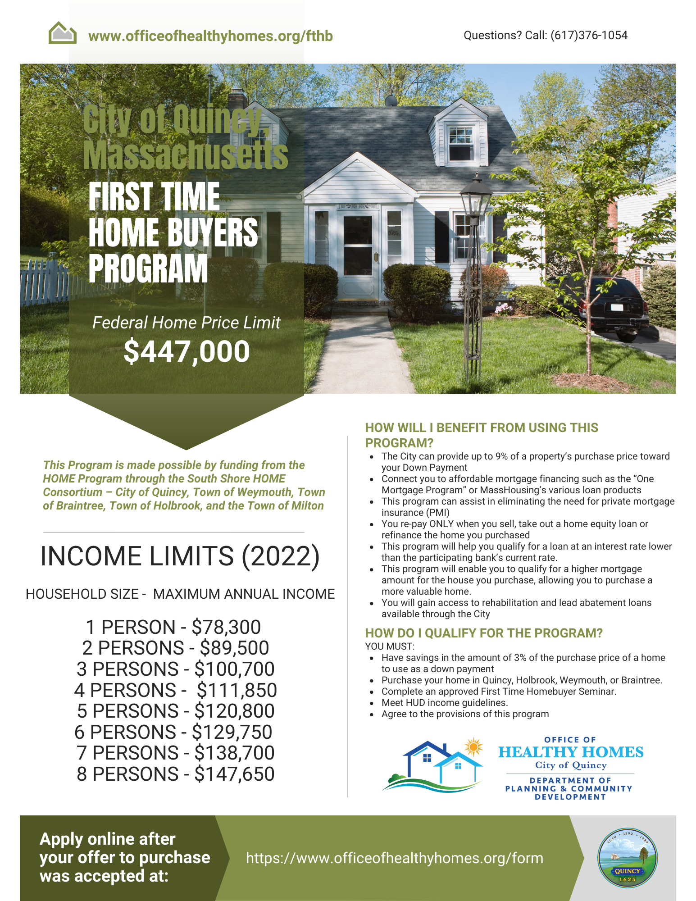
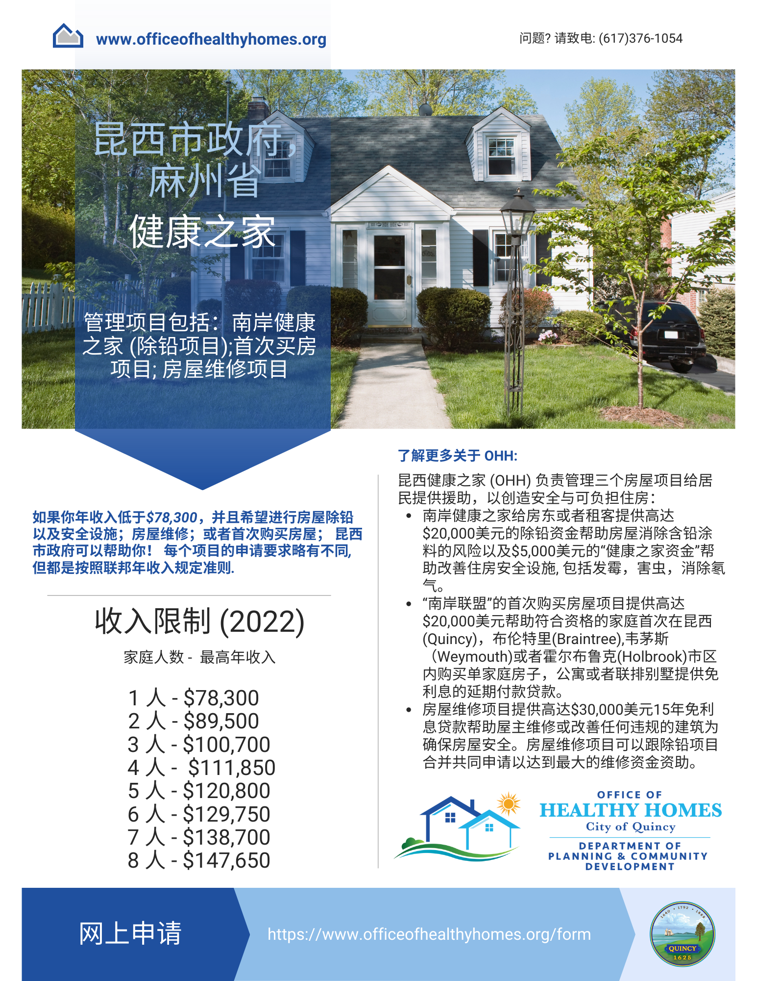
Notes:
This will answer how we are effective and how to implement a program

Slide 13
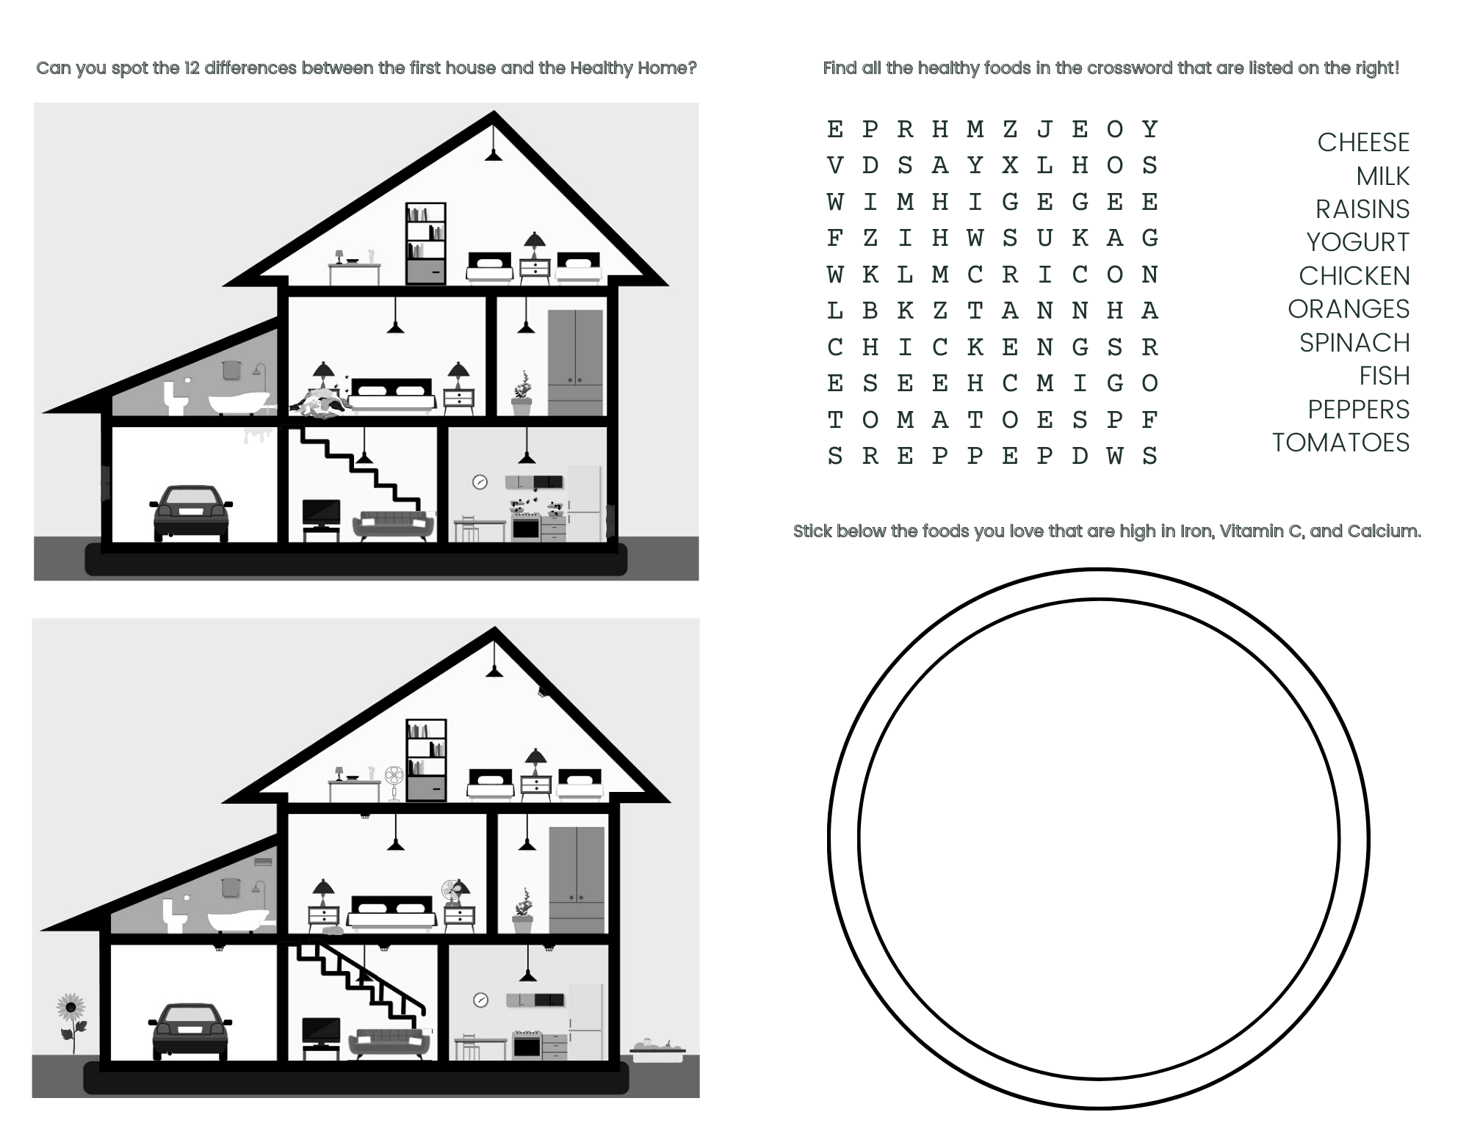
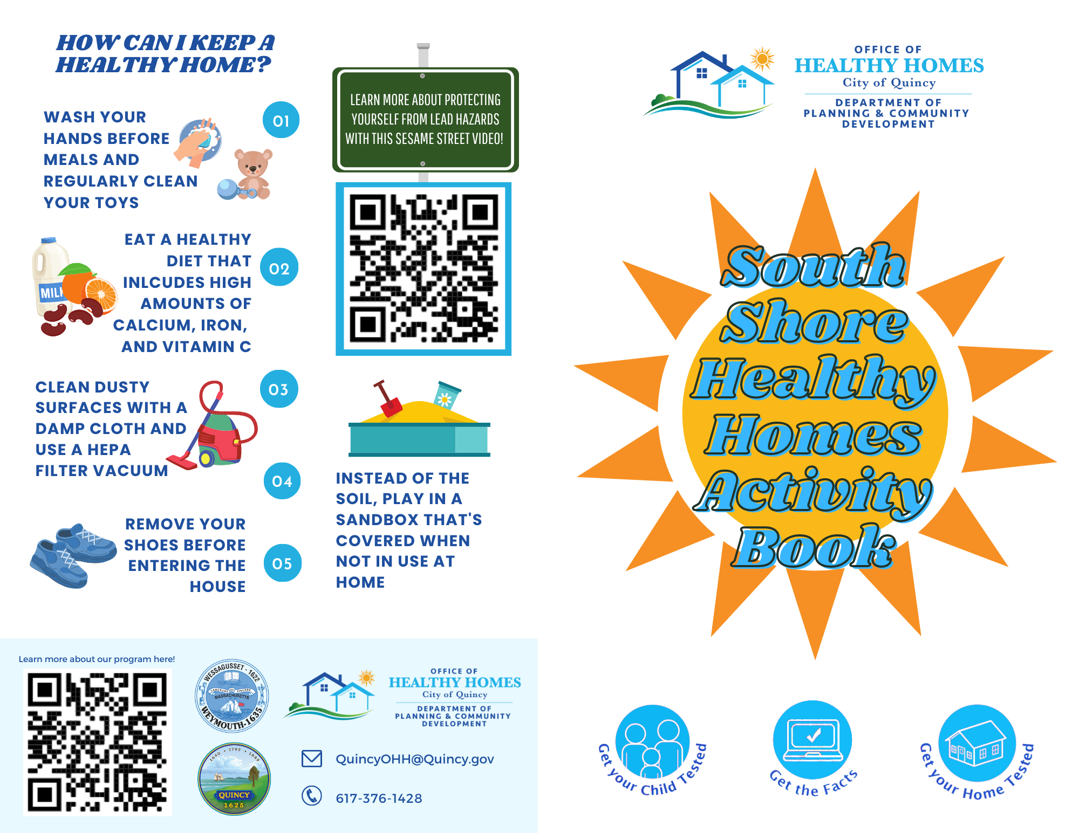
Notes:
This will answer how we are effective and how to implement a program

Slide 14
Looking to the Future:
High Impact Practices
Successes
Goals
Community Events, particularly with 500-1,000 families
Partnering with those in the community: QARI, BCNC, QCAP, Manet, etc.
Marketing
Using funding sources to their fullest potential
40 total rehabs in 2022, a 20% increase from 202, 2021 was a 15% increase from 2020
Accessibility throughout our community
New Grant Opportunities: Older Adults Home Modification Grant
More Contractors
Additional Partnerships
Continuous community education

Slide 15
Questions?
Sherry Zou, szou@quincyma.gov | 617-745-7168
Jane Berry, jberry@quincyma.gov | 617-376-1054
www.OfficeOfHealthyHomes.org

