Slide 1

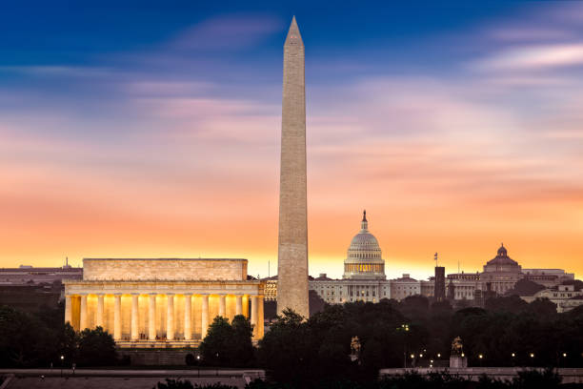

NCDA Winter Legislative, Policy, and Professional Development Meeting 2023
Leveraging your CDBG funds through HUD’s Section 108
Notes:
Seema

Slide 2
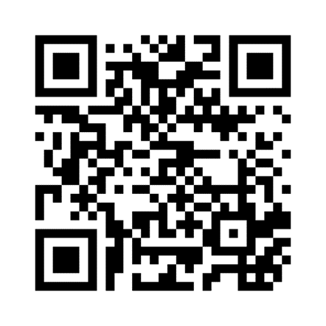
Today's Presenters
Seema M. Thomas, Deputy Director, Financial Management
Division
Jorge L. Morales, Loan Origination Team Lead Community Planning
and Development Specialist
Erik Pechuekonis, Loan Officer, Community Planning and
Development Specialist
https://www.hudexchange.info/programs/section-108/

Slide 3
Today’s Topics
Section 108 Loan Guarantee Loan Program
  Program and Financial Requirements
  Program Processes
Approaches to Section 108 Financing and Projects
  Creation of Loan Funds
  Mixed-Use Projects

Slide 4
Notes:
General Intro / Warm up & lead in:

Slide 5

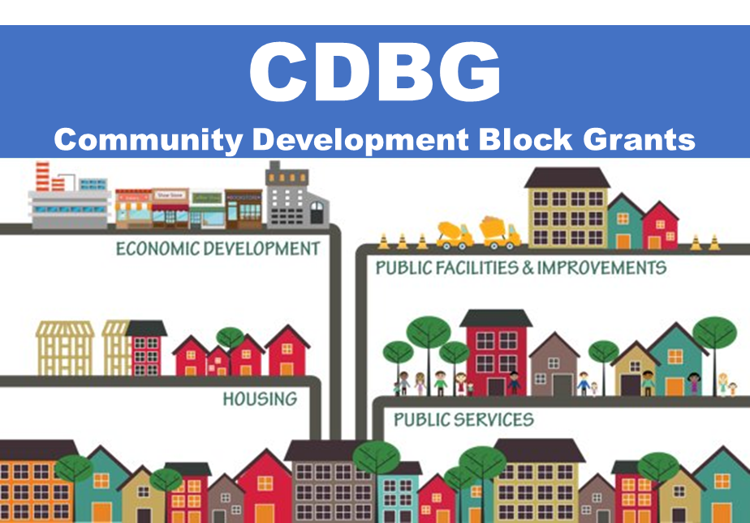

Community Development Block Grants
Annual grants to states, cities, and counties
Develop viable communities
    Providing decent housing
    Suitable living environment
    Expand economic opportunities
Principally for low- and moderate-income persons
Notes:
Key Info:
Must benefit at least 70% LMI persons = Primary objective of CDBG.

Slide 6




Uses CDBG Framework
Provides loan guarantees, not grants
Section 108 Loan Guarantee Program
1 on 1 Technical Assistance
Flexible Terms and Rates
Notes:
Key Info:
HUD is guarantor not lender. Main takeaways.

Slide 7
Types of Section 108 Projects
Loan Funds for Developers
Adaptive Reuse
Supporting New Housing Construction
Rehab of private housing stock and public housing
Community Centers
Park Upgrades
Hospitals
Gov’t Bldgs serving Residents
Central Business District Support
Retail/Office and Manufacturing
Small Business Financing
Business Retention
Broadband Line Extensions
Devastated Landscapes
Water & Sanitation
Streets, Curbs and Gutter Improvements
Economic Development
Housing
Public Facilities
Infrastructure

Slide 8










DEPLOYMENT & ELIGIBLE USES
Pre-Development
Development
  Acquisition
    Real Estate Development
  Demolition
    Machinery & Equipment
    Site Prep & Remediation
    Working Capital
    Relocation
    Infrastructure

Slide 9




Who is Eligible for
Section 108
CDBG Entitlements
  Cities (50K+)
  Urban Counties (200K+)
States and small cities
Subrecipient entities (e.g. economic development or public housing authorities, non-profits)
Other partners may receive Section 108 funds directly from HUD if they are a designated public agency (DPA) of the CDBG Entitlement grantee
CDBG Entitlement
Communities
States
Smaller Units of Local Government
Notes:
Key Info:
DPA Definition. Non-Profit Entities that can issue debt.

Slide 10

Section 108 Borrowing Capacity
Annual CDBG Allocation
Max available borrowing capacity
Outstanding 108 commitments
Outstanding 108 loan balance
Available borrowing capacity
$3,000,000
x 5 = $15,000,000
- $800,000
- $2,000,000
= $12,200,000
Check your calculation on our website:
https://www.hudexchange.info/resource/5197/current-availability-of-section-108-financing-cdbg-entitlement-and-state-grantees/

Slide 11
Financing Strategy
STANDALONE
COMBINED
GAP
Notes:
Key info:

Slide 12


Program Requirements
Section 108 Requirements
Financial Requirements
Notes:
Key Info:
Both have equal importance!

Slide 13
PROGRAM REQUIREMENTS
Eligible Activities
National Objective
24 CFR 570.703
24 CFR 570.208
Public Benefit Standards
Crosscutting Requirements
24 CFR 570.209
Environmental Review, Davis Bacon, Uniform Administrative Requirements, Relocation (URA), Fair Housing& Lead-Based Paint, BABA
Notes:
Key info: For 108 activities must cite 570.703 not 570.201 activities
Eligible Activities Example:
Acquisition of improved or unimproved real property in fee or by long-term lease, including acquisition for economic development purposes.
Rehabilitation of real property owned or acquired by the public entity or its designated public agency. .
Payment of interest on obligations guaranteed under this subpart.
Relocation payments and other relocation assistance for individuals, families, businesses, nonprofit organizations, and farm operations who must relocate permanently or temporarily as a result of an activity financed with guaranteed loan funds, where the assistance is: (1) Required under the provisions of § 570.606(b) or (c); or (2) Determined by the public entity to be appropriate under the provisions of § 570.606(d).
Clearance, demolition, and removal, including movement of structures to other sites and remediation of properties with known or suspected environmental contamination, of buildings and improvements on real property acquired or rehabilitated pursuant to paragraphs (a) and (b) of this section. Remediation may include project-specific environmental assessment costs not otherwise eligible under § 570.205.
Site preparation, including construction, reconstruction, installation of public and other site improvements, utilities or facilities (other than buildings), or remediation of properties (remediation can include project-specific environmental assessment costs not otherwise eligible under § 570.205) with known or suspected environmental contamination, which is: (1) Related to the redevelopment or use of the real property acquired or rehabilitated pursuant to paragraphs (a) and (b) of this section, or (2) For an economic development purpose.
Payment of issuance, underwriting, servicing, trust administration and other costs associated with private sector financing of debt obligations under this subpart.
Housing rehabilitation eligible under § 570.202.
The following economic development activities: (1) Activities eligible under § 570.203; and (2) Community economic development projects eligible under § 570.204.
Construction of housing by non-profit organizations for homeownership under section 17(d) of the United States Housing Act of 1937 (Housing Development Grants Program, 24 CFR part 850).
A debt service reserve to be used in accordance with requirements specified in the contract entered into pursuant to § 570.705(b)(1).
Acquisition, construction, reconstruction, rehabilitation or historic preservation, or installation of public facilities (except for buildings for the general conduct of government) to the extent eligible under § 570.201(c), including public streets, sidewalks, other site improvements and public utilities, and remediation of known or suspected environmental contamination in conjunction with these activities. Remediation may include project-specific environmental assessment costs not otherwise eligible under § 570.205.
In the case of applications by public entities which are, or which contain, “colonias” as defined in section 916 of the Cranston-Gonzalez National Affordable Housing Act (42 U.S.C. 5306 note), as amended by section 810 of the Housing and Community Development Act of 1992, acquisition, construction, reconstruction, rehabilitation or installation of public works and site or other improvements which serve the colonia.
Payment of fees charged by HUD pursuant to § 570.712.
National Objective Example:
Benefit to low- and moderate- income (LMI) persons;
Aid in the prevention or elimination of slums or blight
Meet a need having a particular urgency (referred to as urgent need).

Slide 14
FINANCIAL REQUIREMENTS
Repayment
Collateral
CDBG
Third party loan proceeds
Parking revenue
Tax Increment Financing revenue
Other
Primary Source:
Pledge of current and future CDBG
Sources of Additional Collateral:
Property lien
Full faith and credit
Reserves
Other
Notes:
Key Info:
Need primary and secondary sources of collateral
Main different ways of collateralizing loans.

Slide 15



Application
Financing
PROCESS FOR LOAN GUARANTEE
Project
Management / Servicing
Notes:
Key info:

Slide 16






Financing Process
HUD / FMD
2
1
  FISCAL AGENT
BORROWER
3
$$
$$
      LENDER
  3RD PARTY

Slide 17
Section 108 Loan Guarantee
Creation of a Loan Fund
Notes:
144
Paul

Slide 18
Approaches to using Section 108
Project Specific
    Application is for a specific project or projects
    Requires a higher level of project detail & specificity for underwriting by HUD
Loan Fund
  Application describes type of projects to be funded along with the community’s underwriting process
  Individual projects must have a Field Office eligibility determination for funds to be drawn
Notes:
Seema

Slide 19
Benefits of a Loan Fund
  Allows local governments to fund multiple projects under a single loan guarantee commitment.
  Ideal for local governments who:
    Wants to target investment into a particular geographic area, or that have a pipeline of projects that need financing.
  An advantage of a loan fund - provides flexibility in a local government’s loan portfolio i.e., ability to finance small and large loans with a combination of more and less risk.
Notes:
Section 108 loan funds allow local governments to fund multiple projects under a single loan guarantee commitment (and avoid having to submit separate applications).
This use of Section 108 is ideal for local governments who are wanting to target investment into a particular geographic area, or that have a pipeline of projects that need financing.
An advantage of a loan fund is that it provides flexibility in a local government’s loan portfolio i.e., ability to finance small and large loans with a combination of more and less risk.
Section 108 Loan funds are similar to a line of credit, giving the borrower the ability to draw down funds over time as the needed for individual projects.
Loan funds are ideal for borrowers that have several projects in the pipeline or if they are looking to target resources in a specific geographic area.
Loan funds allow borrowers to diversify their loan portfolio by funding multiple projects of varying risk. Borrowers can fund multiple projects with low risk that can support loan fund projects with more risk.

Slide 20
Flow of Funds: Project with a Third-Party Borrower
HUD
(Guarantor)
Investors
(Money Market)
Note, Guarantee
Repayment $$
Advances $$
Fiscal Agent (Bank of New York Mellon)
Loan Contract, Note
Third Party Borrower
Borrower
Repayment $$
Third Party Repayment $
Advances $$
to Borrower
Borrower
(Its Designated Public Agency
or Subrecipient)
Third Party Loan
Notes:
Borrower includes its Designated Public Agency or Subrecipient

Slide 21
Loan Terms
Loan rates and terms must at least match the terms of the loan between HUD and the local government borrower.
  Interest rates cannot be lower on the business loan, but local government borrowers can charge a spread over the HUD loan to their business borrowers.
Section 108 loan term can be up to 20 years therefore, business loans made using Section 108 loan funds cannot exceed 20 years.
Notes:
HUD Section 108 Program policy is that business loan rates and terms at least match the rates and terms of the loan between HUD and the local government borrower.
Local government borrowers may charge an additional amount of interest, and/or a loan fee to business borrowers to help local governments cover its costs of operating a business loan program.
Section 108 loan term can be up to 20 years. Loan term may be less than 20 years but cannot exceed 20 years.
There are two types of financing offered by the Section 108 program, interim and permanent. Permanent rates are offered about once every 3 years while interim financing is offered on a rolling basis. Interim rates are based off the 3-month London Interbank Offering rate plus a 20 basis point spread. For more information on Section 108 rates and fees, contact the HUD Section 108 office.
In limited circumstances, local government borrowers may find it pertinent to provide Section 108 guaranteed loan funds as a grant to a local business. This is allowed under the program regulations.

Slide 22
Flow of Funds Example (Loan Terms)
Local Government’s
Section 108 Commitment
$3,000,000
Loan Term: 20-year Interest: 3-month Treasury Bill Auction Rate + 35 Basis Points
HUD Note #1 ($1,000,000)
Loan Term: 15-year Interest: 3-month Treasury Bill Auction Rate + 35 Basis Points
HUD Note #2 ($1,000,000)
Loan Term: 12-year Interest: 3-month Treasury Bill Auction Rate + 35 Basis Points
HUD Note #2 ($1,000,000)
Loan Term: 20-year Interest: 3-month Treasury Bill Auction Rate + 60 Basis Points
Business Borrower 1
Loan Term: 15-year Interest: 3-month Treasury Bill Auction Rate + 55 Basis Points
Business Borrower 2
Loan Term: 12-year Interest: 3-month Treasury Bill Auction Rate + 45 Basis Points
Business Borrower 3
Notes:
Paul This is an example of how local government borrowers can structure individual business loans.
: 3-month Treasury Bill Auction Rate + 35 bps =
As you can see each business loan’s rates and terms at least match the rates and terms between the local government borrower and HUD.
The local government borrower has chosen to charge a spread for the 1st and 3rd business loan as well as have a shorter loan term for the first business loan.

Slide 23
Section 108 Loan Guarantee
Mixed Use Projects
Notes:
144
Jorge

Slide 24
Why is 108 a good resource for mixed-use development?
Opportunities to gain access to investment are more limited.
Projects continue to be single-use focused, which Wall Street still prefers
Lack of a secondary market for mixed use properties
Some institutional capital is still not compatible
Notes:
A real estate investment trust (“REIT”) is a company that owns, operates or finances income-producing real estate.
Opportunities to gain access to the mixed-use asset class through REITs and other traded vehicles are more limited.
While some publicly owned developer/owner/operators do mixed-use, most continue to be single-use focused, which Wall Street still prefers
Historically, there was a lack of a secondary market for mixed use properties because Fannie Mae/Freddie Mac/other HUD programs set limits on % of square footage/income that could come from non-housing uses in secured properties
Some institutional capital is still not compatible with the complexity of mixed-use development/repositioning of underperforming mixed-use properties

Slide 25
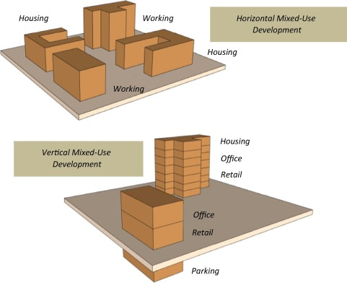
Mixed-Use Development
Notes:
Mixed-use projects involve at least two discrete activities within one of two physical configurations: a single structure or an area-based development.
Single-structure projects consist of multiple uses within a single structure. For example, one building may contain space dedicated to housing and other space to commercial or retail uses.
Area-based projects are typically composed of a mix of residential, retail and/or commercial buildings in close proximity to one another (and are related to one another, e.g., they have the same owner or developer, are on the same parcel, etc.).

Slide 26
Mixed-Use Development
  Section 108 is often used to finance portions of mixed-use developments
    For adaptive reuse of existing buildings
      Fewer limitations on uses of Section 108 funds
    For new construction that involves housing,
      More restrictions → solution: consult us early on in the process
    Section 108 helps to fill a ‘gap’
Notes:
Section 108 is often used to finance portions of mixed-use developments
For adaptive reuse of existing buildings, fewer limitations on uses of Section 108 funds
For new construction that involves housing, more restrictions → solution: consult us early on in the process
Generally, Section 108 helps to fill a ‘gap’ in budget, so it’s about matching it to eligible uses

Slide 27
There is a need for guidance on mixed-use development projects
  Increase Section 108 loan applications for projects with mixed-use components.
  The potential issues raised in connection with these applications
  Applying the same analytical framework in determining the eligibility of any CDBG-funded activity
Notes:
There has been an increase in Section 108 loan applications seeking funding to carry out projects with mixed-use components.
The issues raised in connection with these applications have demonstrated the need for guidance in determining the permissible uses of Section 108 funds for mixed-use projects.
As this guidance will explain, grantees must apply the same analytical framework they would use in determining the eligibility of any CDBG-funded activity in deciding whether CDBG funds may be used to finance any portion of a mixed-use project

Slide 28
Mixed-Use Development
The component activity(ies) within the mixed-use development must be:
Authorized as an eligible use of CDBG/Section 108 funds
Meet the national objectives criteria
Comply other federal requirements, such as public benefit standards
The costs paid with CDBG/Section 108 funds must comply with the applicable cost principles
  For cost allocation, use General Accepted Accounting Principles (GAAP), most often involves cost allocation related to square footage of different uses
Notes:
Let take a look at some of the requirements that needs to be present before we can assist a mixed-used project.
The component activity(ies) must be eligible, specifically authorized as an eligible use of CDBG funds (pursuant to 24 CFR 570.201-570.204 or § 570.482 and Section 105(a) of the HCDA) or Section 108 Loan Guarantee financing (pursuant to 24 CFR 570.703);
(2) the activity must meet the national objectives criteria at § 570.208 or § 570.483;
(3) the activity must comply with any other federal requirements, such as public benefit standards (see § 570.209(b) or § 570.482(f)); and
(4)the costs paid with CDBG/Section 108 funds must comply with the applicable cost principles.
For cost allocation, use General Accepted Accounting Principles (GAAP), most often involves cost allocation related to square footage of different uses’
Don’t forget that portion of common areas costs can be assigned to specific uses

Slide 29
Step 1: Break It Up
Break the mixed-use project into discrete activities
Determine if each proposed activity falls within an authorized CDBG/Section 108 eligibility category.
Accurately distinguishing activities in a mixed-use project is critical
  Each activity must be evaluated separately in order to determine its eligibility for receiving funds.
Example: A Borrower providing assistance to a for-profit developer to finance the rehabilitation of a building that will contain both commercial and residential housing uses must divide the project into two component activity categories: special economic development (§ 570.703(i) pursuant to 570.203(b) and housing rehabilitation (§ 570.703(h) pursuant to § 570.202.)
Notes:
Break the mixed-use project into discrete activities
Determine if each proposed activity falls within eligible category.
The borrower must accurately distinguish activities in a mixed-use project because each activity must be evaluated separately in order to determine its eligibility for receiving funds.
Example: A Borrower providing assistance to a for-profit developer to finance the rehabilitation of a building that will contain both commercial and residential housing uses must divide the project into two component activity categories: special economic development (§ 570.703(i) pursuant to 570.203(b) and housing rehabilitation ((§ 570.703(h) pursuant to § 570.202.)

Slide 30
Step 1: Break It Up (Example)
A Borrower providing assistance to a for-profit developer to finance the rehabilitation of a building that will contain both commercial and residential housing uses
  must divide the project into two component activity categories:
    special economic development § 570.703(i) pursuant to 570.203(b)
    and housing rehabilitation (§ 570.703(h) pursuant to § 570.202.
Notes:
Break the mixed-use project into discrete activities
Determine if each proposed activity falls within eligible category.
The borrower must accurately distinguish activities in a mixed-use project because each activity must be evaluated separately in order to determine its eligibility for receiving funds.
Example: A Borrower providing assistance to a for-profit developer to finance the rehabilitation of a building that will contain both commercial and residential housing uses must divide the project into two component activity categories: special economic development (§ 570.703(i) pursuant to 570.203(b) and housing rehabilitation ((§ 570.703(h) pursuant to § 570.202.)

Slide 31
Step 2: Determine if the activity meets the criteria for a national objective
Each activity must meet a national objective.
This is a key point with respect to mixed-use projects that include acquisition of real property.
Notes:
The second step in evaluating eligibility for CDBG funding is to determine that each component activity identified in Step 1 meets the criteria for a national objective at 24 CFR 570.208 or § 570.483.
Each component activity must (i) benefit low- or moderate-income persons; (ii) aid in the prevention or elimination of slums or blight; or (iii) meet community development needs having a particular urgency.
Note that, except as authorized by regulation, each activity in its entirety must meet a national objective. This is a key point with respect to mixed-use projects that include acquisition of real property.
The use of CDBG funds to acquire property that has different uses (e.g., housing and commercial) is permissible provided each use can be shown to meet the national objectives criteria.
This may limit the use of CDBG funds for mixed-use projects because using such funds for land acquisition means that all the component uses of the property are CDBG-assisted.
For example, if the uses of the acquired property include housing and commercial components and each component complies with the national objectives criteria, the activity in its entirety meets the national objectives requirements. On the other hand, if the property to be acquired in a mixed-use project contains some component(s) that do not meet the criteria for national objectives, the CDBG funds cannot be used for acquisition of real property.

Slide 32
Step 2: Determine if the activity meets the criteria for a national objective
Example: (see Step 1): If one of the component activities meets the applicable national objective criteria while the other does not, the use of CDBG funds will be limited to the component activity that complies.
If both components meet the applicable national objectives criteria, CDBG/Section 108 funds may be used to assist both activities.
Notes:
The second step in evaluating eligibility for CDBG funding is to determine that each component activity identified in Step 1 meets the criteria for a national objective at 24 CFR 570.208 or § 570.483.
Each component activity must (i) benefit low- or moderate-income persons; (ii) aid in the prevention or elimination of slums or blight; or (iii) meet community development needs having a particular urgency.
Note that, except as authorized by regulation, each activity in its entirety must meet a national objective. This is a key point with respect to mixed-use projects that include acquisition of real property.
The use of CDBG funds to acquire property that has different uses (e.g., housing and commercial) is permissible provided each use can be shown to meet the national objectives criteria.
This may limit the use of CDBG funds for mixed-use projects because using such funds for land acquisition means that all the component uses of the property are CDBG-assisted.
For example, if the uses of the acquired property include housing and commercial components and each component complies with the national objectives criteria, the activity in its entirety meets the national objectives requirements. On the other hand, if the property to be acquired in a mixed-use project contains some component(s) that do not meet the criteria for national objectives, the CDBG funds cannot be used for acquisition of real property.
Example (see Step 1): If one of the component activities meets the applicable national objective criteria (i.e., the special economic development activity satisfies § 570.208(a)(4) or § 570.483(b)(4), providing at least 51% of its jobs go to low- and moderate-income persons) while the other does not (i.e., the housing is market-rate and not in a slum or blighted area, pursuant to § 570.208(b) or 570.483(c)), the use of CDBG funds will be limited to the component activity that complies. If both components meet the applicable national objectives criteria, CDBG funds may be used to assist both activities.

Slide 33
  Step 3: Determine the amount of Section 108 financing for the proposed activity
The Borrower must determine the amount pursuant to OMB cost principles.
OMB cost principles, found in Part 200 - Uniform Administrative Requirements, Cost Principles, And Audit Requirements For Federal Awards, Subpart E. Including the Public Benefit Standards (see § 570.209(b)).
The key step is determining the amount of Section 108 funds allowable and allocable.
Borrowers cannot allocate costs based on the percentage of beneficiaries of the activity.
Notes:
The borrower must be able to document that the amount of Section 108 funds used for the eligible component of the mixed-use project does not exceed the costs allocable to that component pursuant to the principles in 2 CFR 200.
The borrower must implement procedures to ensure that guaranteed loan funds are used solely to pay costs allocable to the approved activity.
Such procedures should include the imposition of a requirement on the Developer that it maintain cost accounting records that support the determination and allocation of costs related to the approved activity in accordance with generally accepted accounting principles.
One aspect of the cost allocation merits special attention. Financing of mixed-use projects involving a single structure often include “common costs” that benefit all uses within the building and cannot be readily identified with a particular use. Examples of common costs are those related to the purchase and installation of HVAC systems, certain construction costs (e.g., for common areas, foundations, and roofs), site preparation costs, and certain soft costs (engineering, design, architectural) that can be capitalized. The purposes for which these costs are incurred will produce benefits that accrue to each use within the project, including one or more uses that may be ineligible for assistance.
Consequently, in order to document the eligibility of the use of CDBG funds or Section 108 financing for such common costs, the grantee must ensure that the Developer’s cost accounting records highlight the methodology for measuring, assigning, and allocating common costs to the assisted component. If the borrower does not possess the in-house expertise to evaluate the adequacy of the Developer’s cost accounting records, it should require the Developer to have the allocation reviewed and accepted by a qualified and independent accountant.
Example: Grantees cannot pay 30 percent of the cost of constructing a water system with CDBG funds where low- and moderate-income persons compose 30 percent of the population served by the water system.

Slide 34
Step 4: Determine if the use of Section 108 meets other applicable requirements
The component activities of a mixed-use project may require compliance with other applicable requirements
  Public Benefit Standards
  Eminent Domain
  Job Pirating (Relocating jobs to another labor market)
  HUD Underwriting Guidelines. Appendix A to Part 570 - Guidelines and Objectives for Evaluating Project Costs and Financial

Slide 35
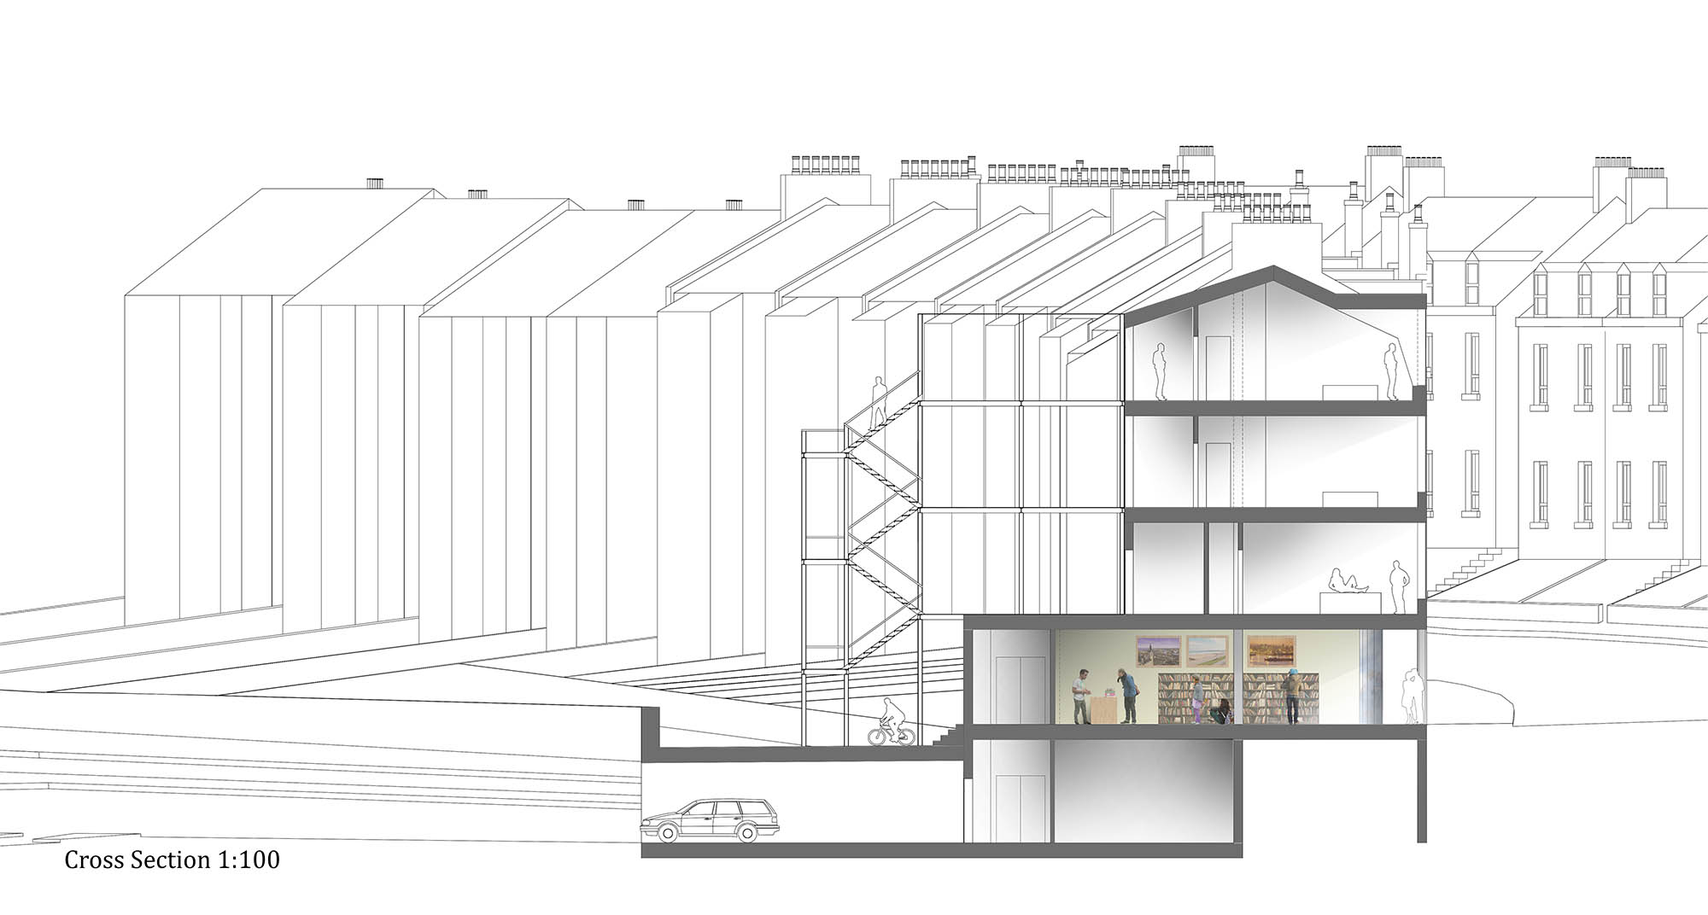
$1 million gap in $5 million project

Slide 36
Scenario 1
Only 1 unit of LMI housing out of 4
$500K in Section 108 → Projected to serve 500 LMI clients/year
Housing Rehab
Housing Rehab
$500K in Section 108 → serves neighborhood residents (>51% LMI)
Health Clinic primarily for LMI persons
Public Facility (Library)
Infrastructure improvements
Parking (both for residential & public facility use)

Slide 37
Scenario 2
$700K in Section 108 → 6 units (4 of which are for LMI households)
$200K in Section 108 → 4 FTE jobs (3 of which are held by LMI persons)
Housing Rehab
Housing Rehab
Tech company, no LMI jobs
Office Space
Commercial Space (Coffee Shop/Bookstore)
Parking (both for residential & commercial)
$100K in Section 108 for construction of parking lot rehab, except for portion for office space

Slide 38
For new construction (especially involving housing), please contact us early in the process. Our program counsel often recommends that separate ownership structures be set-up.
Scenario 3
$200K in Section 108 → 4 FTE jobs (3 of which are held by LMI persons)
Housing New Construction
Housing New Construction
Office Space
$800K of property under Slum/Blight Area
Cannot fund portion of these costs unless more jobs created b/c of public benefit standard
Retail Space- Bookstore
Parking (both for residential & commercial)
Acquisition

Slide 39
For new construction (especially involving housing), please contact us early in the process. Our program counsel often recommends that separate ownership structures be set-up.
Scenario 4
$800k in Section 108 → Pharmacy to serve primarily residential, LMI area
Housing New Construction
Housing New Construction
Office Space
$200K portion of parking used for retail customers
Retail Space- Pharmacy
Parking (both for residential & commercial)

Slide 40

Available on HUD.gov and HUDexchange.info
Borrowing capacity [updated annually] Link
Application Tool Link
Single certifications document Link
Section 108 Application & Finance Process Infographic Link
Project profiles for all applications approved in recent fiscal years Link
General Resources
Join our mailing list to get email updates!
Notes:
Key Info:
HUD has created resources on HUD Exchange to assist potential borrowers with developing applications:
FMD is willing to provide 1-on-1 Technical Assistance for CDBG Grantees during any project cycle stage for interested applicants.

Slide 41
For More Information
Paul Webster, Director: Paul.Webster@hud.gov
Seema Thomas, Deputy Director: Seema.M.Thomas@hud.gov
Jorge Morales, Loan Origination Team Lead: Jorge.L.Morales@hud.gov
Erik Pechuekonis, CPD Specialist: Erik.S.Pechuekons@hud.gov
Section 108 Program: https://www.hudexchange.info/programs/section-108

Slide 42
Section 108 Loan Guarantee
EXAMPLES / CASE STUDIES

Slide 43
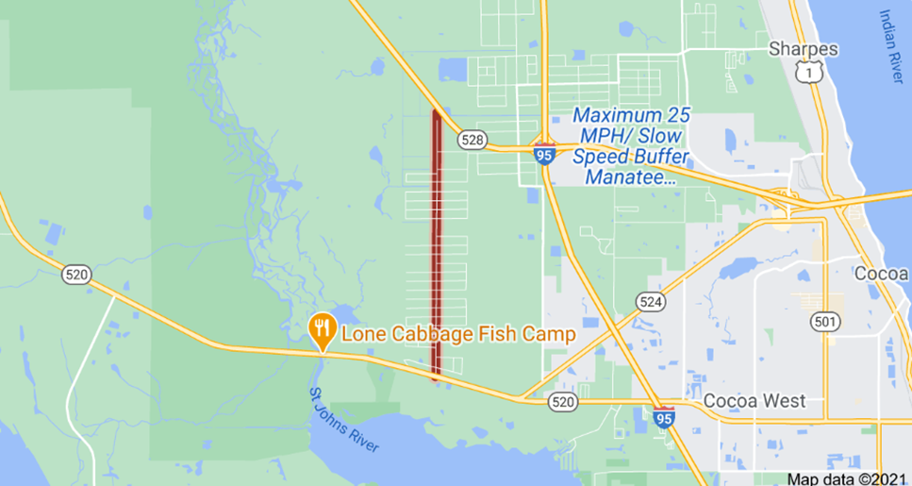
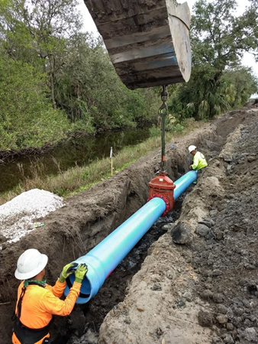
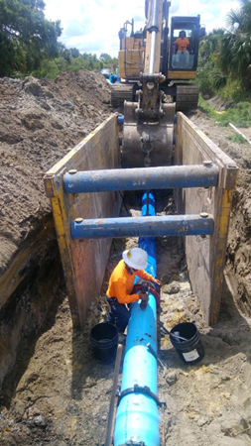
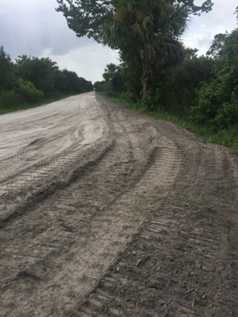
Infrastructure/Water Supply Line Example
Potable Water Line
Brevard County, FL ($1.548M)
The Borrower built a new 20,000-foot, 12-inch potable water line to connect the West Canaveral Grove area to the municipal water system.
Before approximately 180 homes in this primarily residential area are served by individual water wells and septic systems have some water contamination that raise issues of public health.
A CDBG 2010 feasibility study for the proposed project found that six of the homes in the service area had levels of lead or arsenic that exceeded safe water standards.
The County is repaying the Section 108 loan over a 20-year term with the repayment source of CDBG funds.
For Additional Security, the County will pledge funds from its general fund.
43

Slide 44
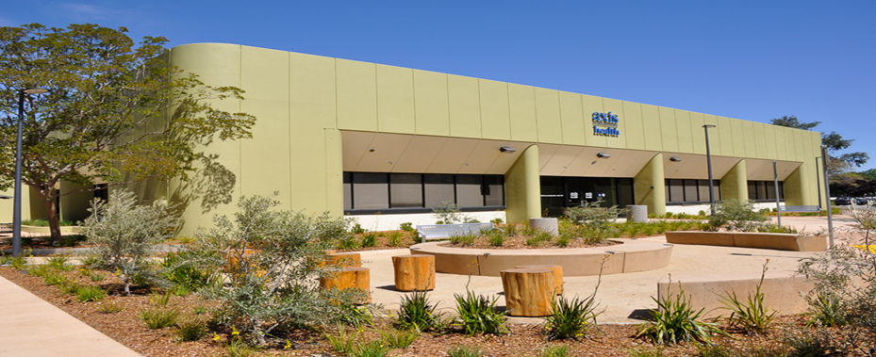
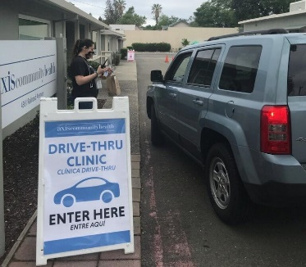
Adaptive Reuse Example
Axis Community Health
Pleasanton, CA ($1.25M)
Purchased & renovated a 24,000 square foot warehouse
Only community clinic in region serving Eastern Alameda County, California
Repaid by Dublin, Livermore and Pleasanton
Cities entered into a Public Participating Jurisdiction agreement with building as collateral.
Repayment with CDBG and pro-rated on the number of clients.
Partners included California Endowment & Capital Partners Group, Capital Campaign, Stanford Health Care & Kaiser Permanente, Local Foundations, and Alameda County

Slide 45
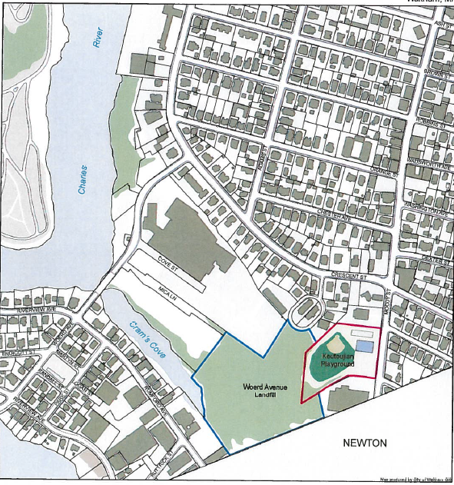
Landfill Cap + Remediation + Park Space Examples
Waltham, Massachusetts
TOTAL 108 FINANCING: $4.195M
Landfill Remediation
The City used 108 funds to complete the testing for the final cap and construct the cap. Once the cap is in place, the City designed and built a park at the City-owned site. The current site of the former landfill occupies 8.69 acres of land in one of Waltham’s lowest income neighborhoods.
The landfill was originally used as a dump site for ashes from coal and heating furnaces in 1912, with up to 35,000 tons of ash dumped on site annually until 1971 when the site was closed.
The task of the scope of work, to be funded by Section 108 loan funds, is to complete an evaluation of alternative corrective actions to be implemented to address the specific conditions of contamination. With the cap in place, the City will be able to develop a viable and sustainable neighborhood amenity that will reduce blight and improve the lives of residents in the area
Notes:
This is an example of a project using 108 to meet multiple community goals. The City of Waltham will use about $4M to test, cap and revitalize Waltham’s former municipal landfill. This former landfill site is non-operational but it occupies critical land in one of Waltham’s lowest income neighborhoods. It’s located on the Waltham-Newton border and occupies almost 9 acres. The landfill began as a small dump for coal ashes from home heating furnaces in the early 1900s until the 1970s. The landfill has been closed since the early 1970’s and has remained untouched since.
The City plans to use Section 108 to continue testing and capping the landfill and ultimately building a park. The funding up-front would allow the City to start all stages of the project rather than phase or sequence the project over the course of the years.

Slide 46
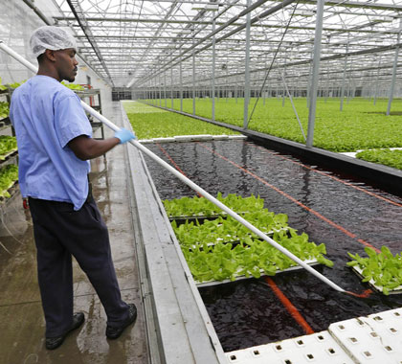
Remediation + Urban Ag + Economic Development
Cleveland, Ohio
TOTAL 108 FINANCING: $3.97M
Green City Growers Greenhouse Cooperative
108 funds were used to remediate and redevelop 10.68 acres of an industrial/residential site into an employee-owned cooperative greenhouse that created 42 full-time jobs producing 2 million pounds of healthy greens and 200,000 pounds of fresh herbs annually.
The City assembled the parcels and then sold the site to a developer to carry put the project.
Notes:
This is another exciting and interesting project. It too combines multiple goals with Section 108 financing. The City of Cleveland used Section 108 financing for the remediation and the redevelopment of almost 11 acres of industrial and residential properties into an employee-owned cooperative greenhouse. After the site was developed, the developer leased the facility to the Green City Growers (GCG), who now operate the greenhouse as an Ohio employee cooperative.

Slide 47
Demolition + Remediation + Flood Control Example
Meriden, Connecticut
$1,500,00
Demolition and Flood Control
Section 108 funded the demolition of abandoned structures on
The City created flood control infrastructure to prevent future
For Additional Security, the City pledged its full faith and credit.
Notes:
Section 108 funded the demolition of abandoned structures on a seven-acre Factory H Brownfield site as a precursor to the installation of flood control infrastructure and creation of an open/green space public facility.
The City created flood control infrastructure to prevent future flooding in low- and moderate-income neighborhoods surrounding Factory H. This improved the immediate area from one that can currently only contain water from a 25-year storm to one that can contain water from a 100-year storm.
The City is repaying the Section 108 loan over a 15-year term using its annual CDBG allocation as the source of its repayment.
For Additional Security, the City pledged its full faith and credit.

Slide 48
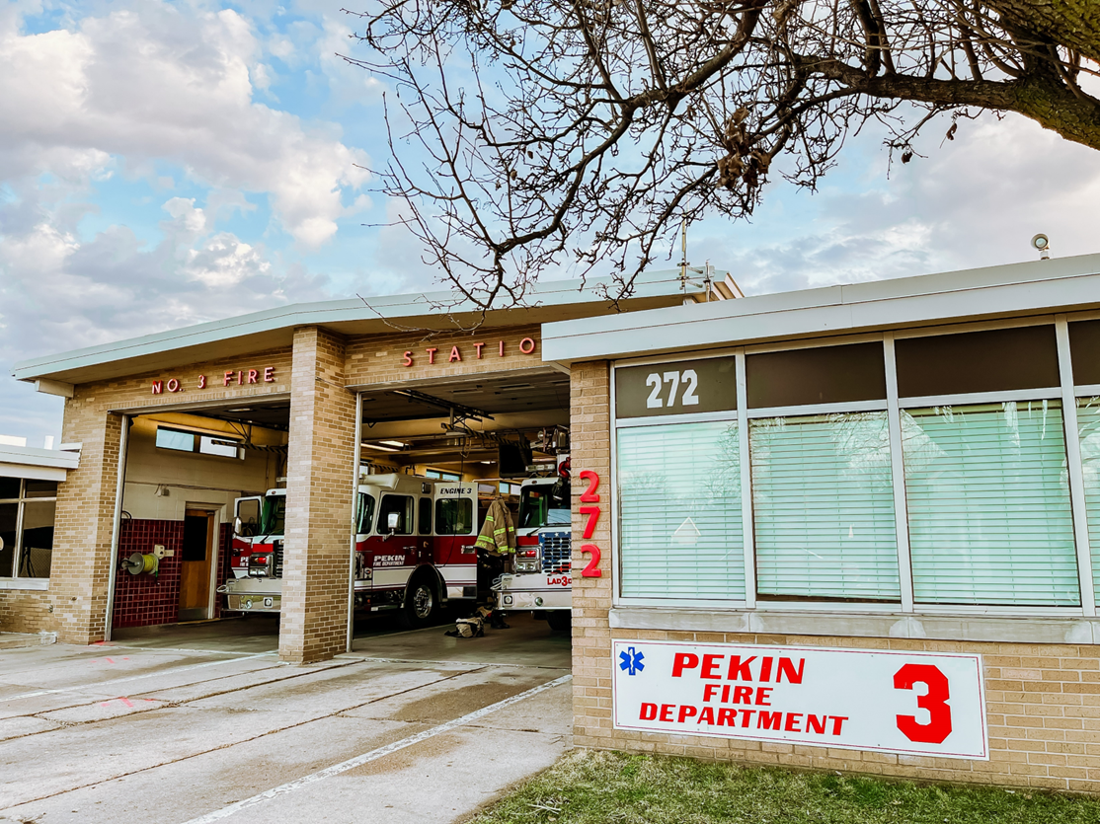
Fire Equipment Purchase Example
Fire Apparatus Acquisition $700k
  Funds used to replace an obsolete firetruck.
  The fire station that will house the firetruck serves a predominately low-to-moderate income area.
Street Improvement Example

Slide 49
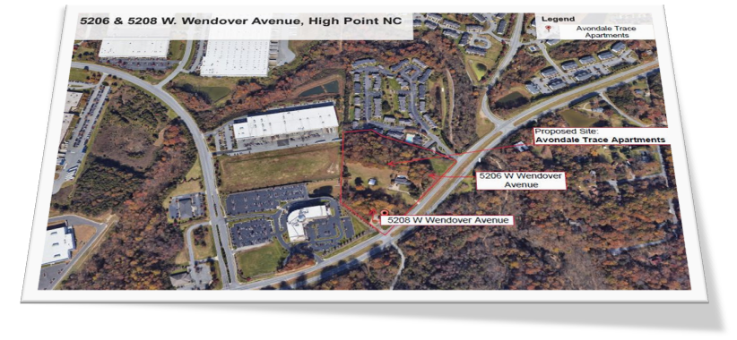
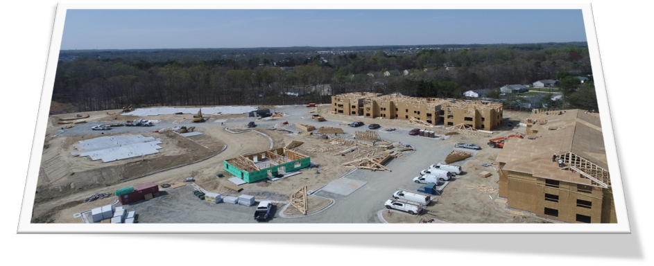
Supporting New Construction Example
Avondale Trace Affordable Housing High Point, NC ($650K)
In Phase 1, the Borrower requested Section 108 funds for site acquisition and/or improvements
In Phase 2, after the eligible activities were complete, the Borrower conveyed the improved project site to the developer.

Slide 50
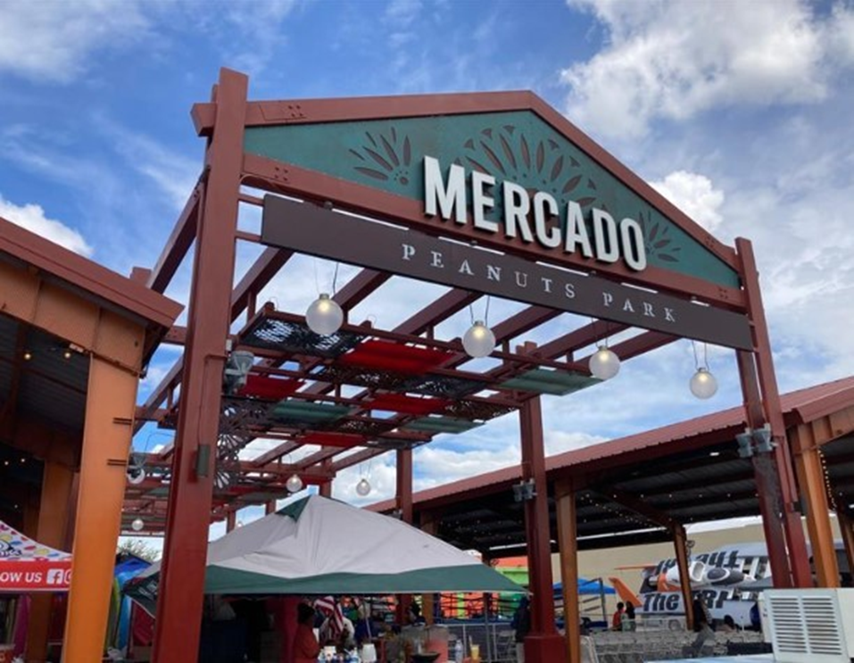
Public Facility Example
Pasco Market Redevelopment
Pasco, WA ($3.781M)
Restoration and expansion of the market
Restoration of adjacent
Complements the City’s investment in the Pasco Specialty Kitchen, a state-of-the-art certified commercial kitchen
This dining hall created create multiple new food businesses and provide a launch site for future Pasco Specialty Kitchen incubator clients.
Notes:
Restoration and expansion of the market allows for increased flexibility and use by the community.
Restoration of adjacent park updated it to modern standards, creating a more open and inviting public space that will also benefit surrounding businesses.
Complements the City’s investment in the Pasco Specialty Kitchen, a state-of-the-art certified commercial kitchen for local entrepreneurs located across the street from the park.
The City has secured a commitment from one of the market’s neighboring property owners to redevelop/repurpose another building into a public dining hall that will be designed to open towards the Market.
This dining hall will create multiple new food businesses and provide a launch site for future Pasco Specialty Kitchen incubator clients.

