Slide 1
54th NCDA Winter Conference:
Overview of Section 108 Projects in Washington, DC
January 27, 2023
Tsega Bekele, Chief of Staff

Slide 2
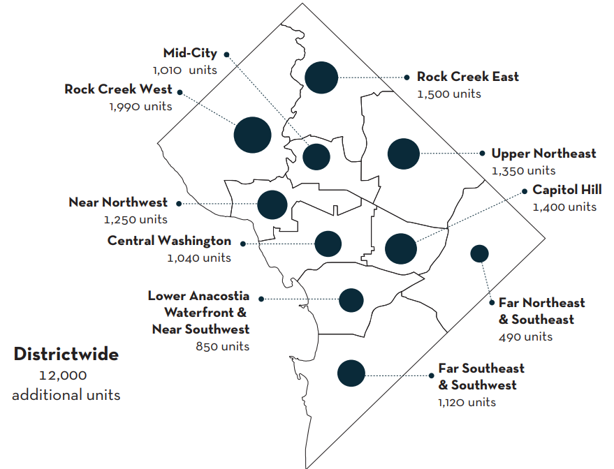
#36000x2025: 12,000 Affordable Across 10 Planning Areas

Slide 3
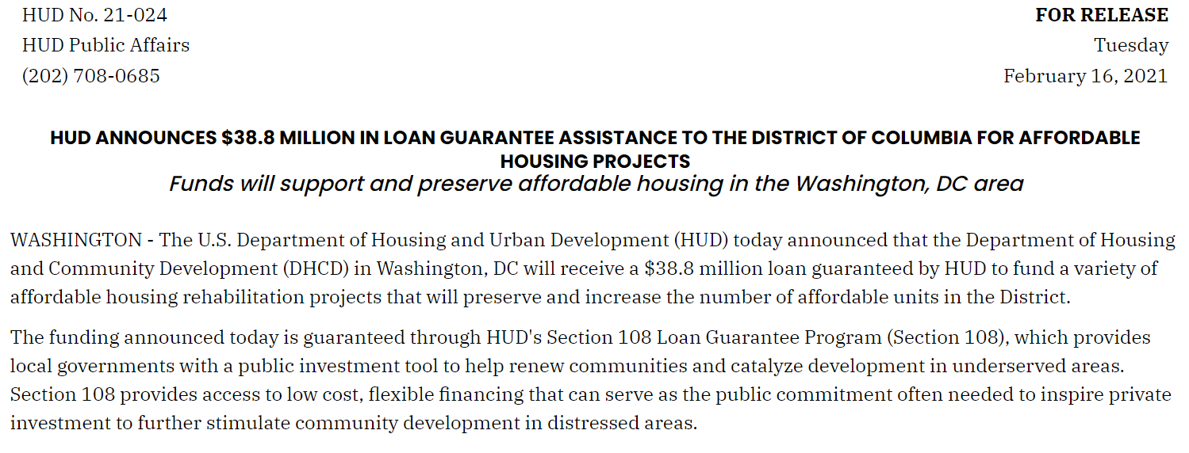
DC Approved for Section 108 Loan Fund

Slide 4
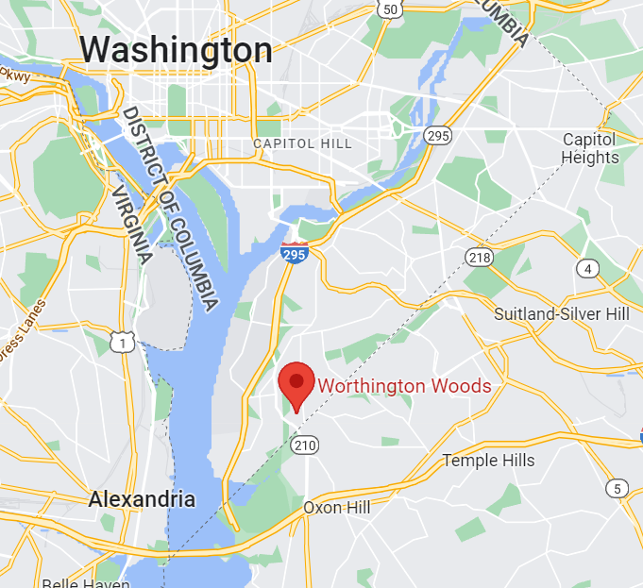
Preservation Project - Worthington Woods Apartments

Slide 5
Preservation Project - Worthington Woods Apartments

Slide 6
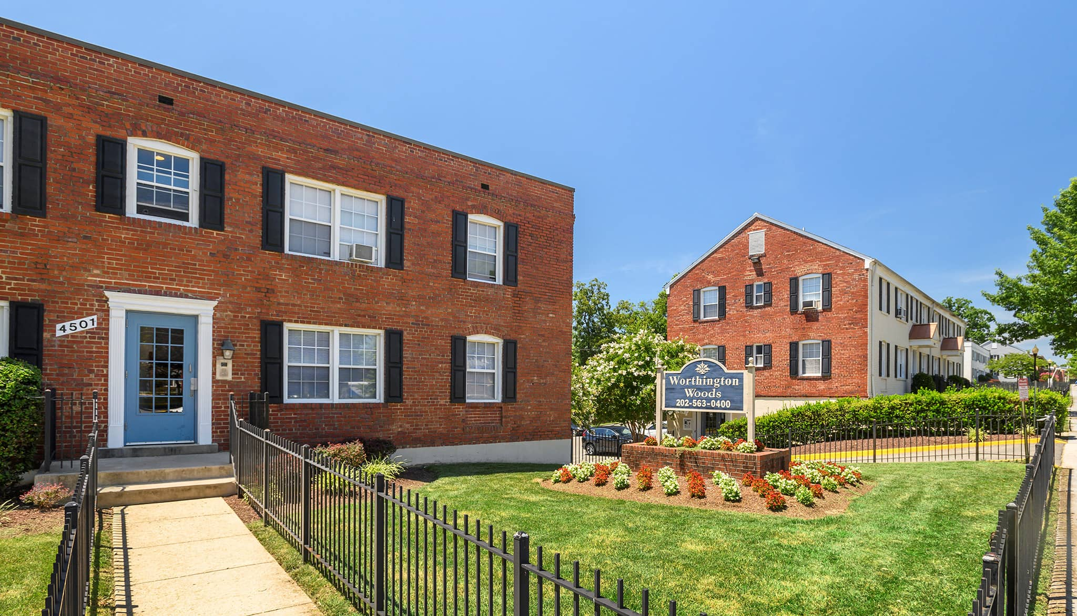
Preservation Project - Worthington Woods Apartments

Slide 7
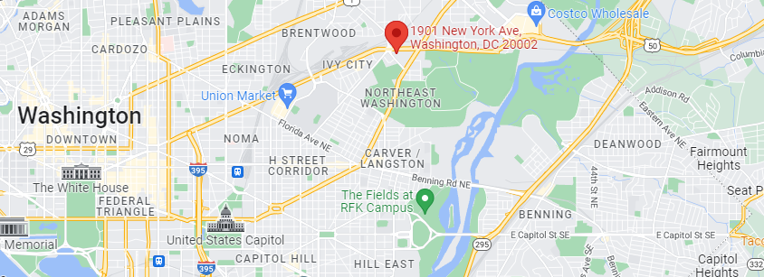
Mixed Use Economic Development – New City DC

Slide 8
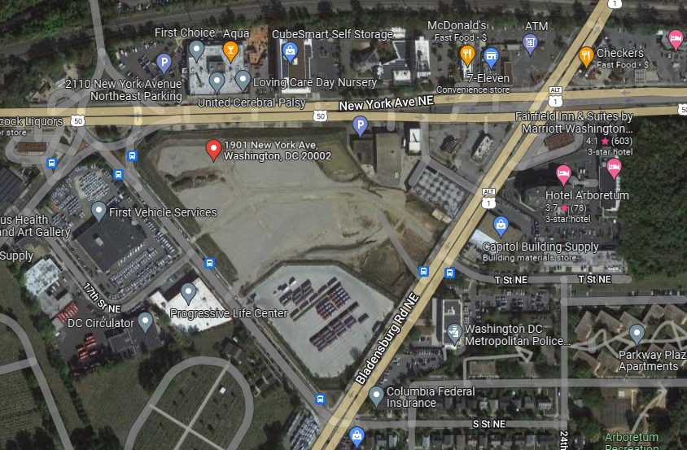
Mixed Use Economic Development – New City DC

Slide 9
Mixed Use Economic Development – New City DC

Slide 10
Final Thoughts on Section 108
From our initial call with HUD HQ to the application process to the project level implementation, we have really appreciated the collaboration between HUD HQ, the Field Office, and our team!

