Slide 1
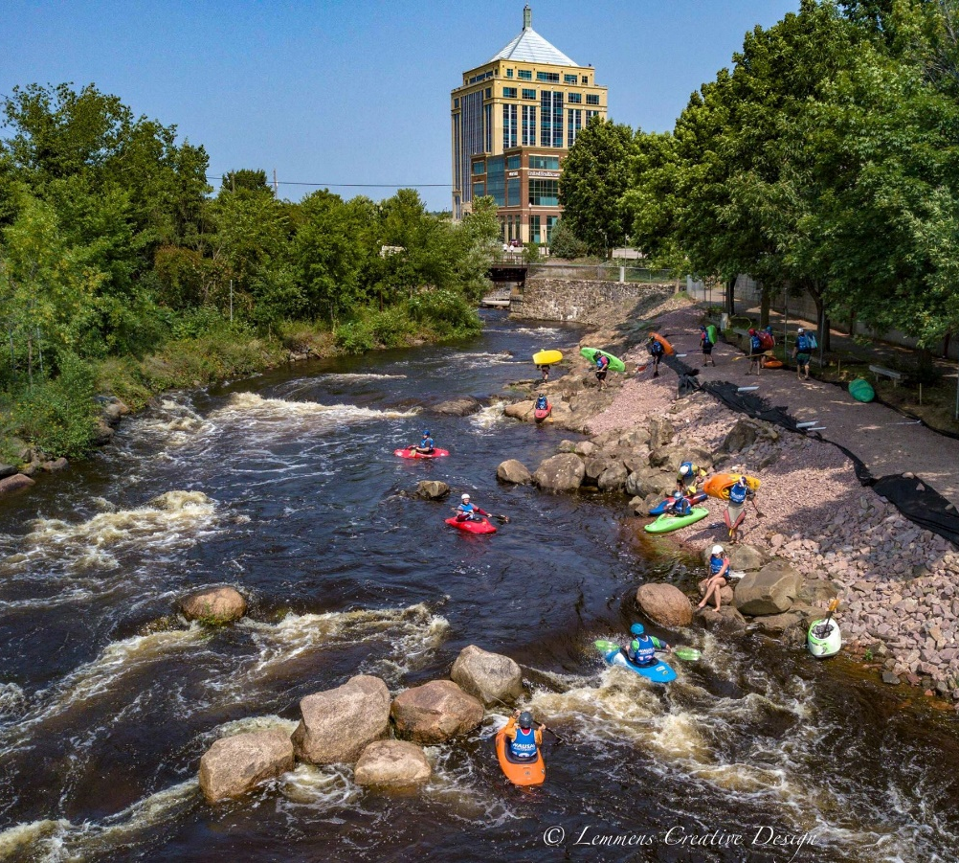
Ponderosa Motel Redevelopment

Slide 2
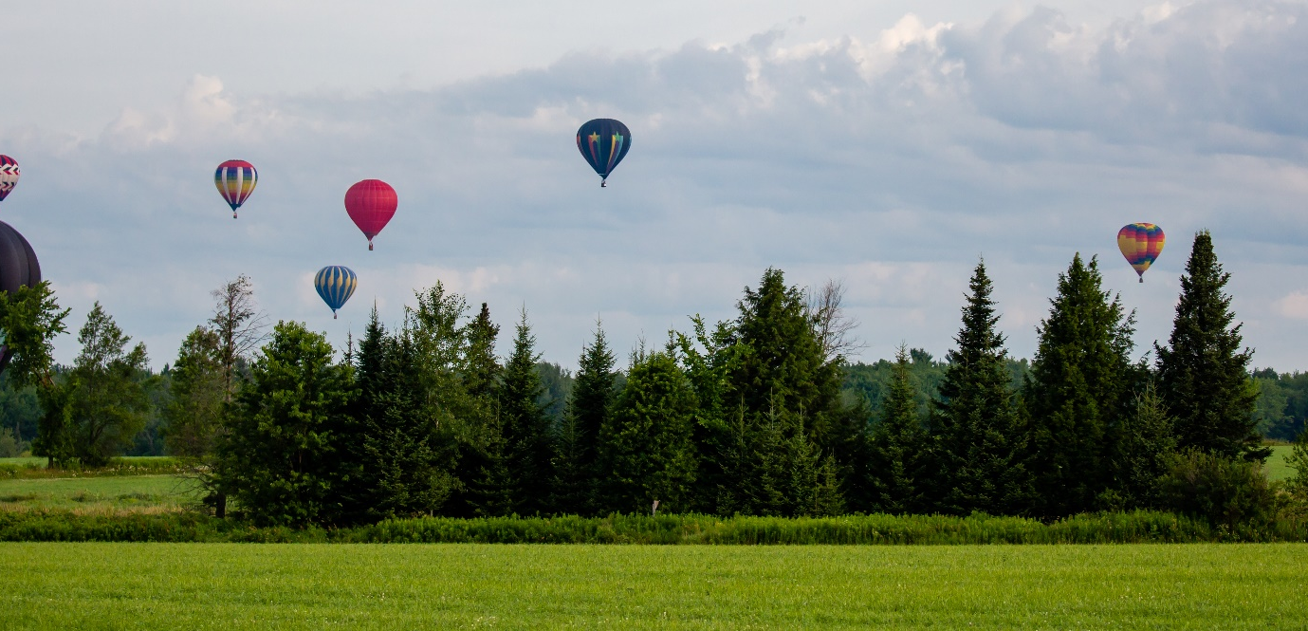
Where is Wausau?
Located in Central Wisconsin
Population just under 40,000*
The principal city of a Metropolitan Statistical Area
CDBG Allocations have ranged between $597,000 – $611,000 the past 4 years.

Slide 3
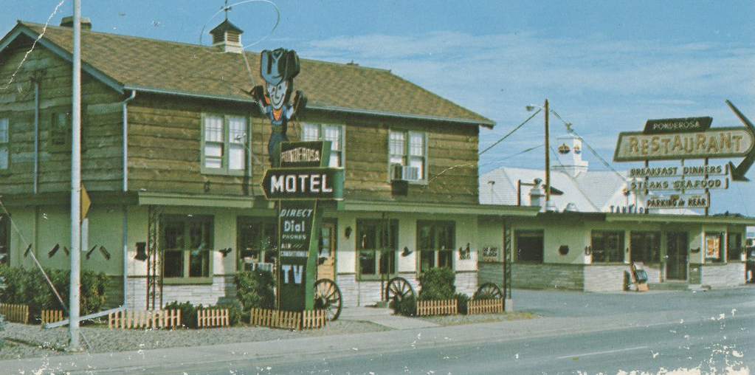
Ponderosa Motel History
Built in 1946, the quaint 17-unit motel was once a popular motel in the area
Located on Wausau’s busy main street leading Downtown
Abuts a popular, family-oriented neighborhood
New Ownership in 1997. Motel slowly transitioned into efficiency apartments
Building began deteriorating quickly, and owners failed to maintain/improve it
Criminal activity dramatically increased over the years
Property value declined from $217,900 in 1998 to $150,000 in 2016

Slide 4
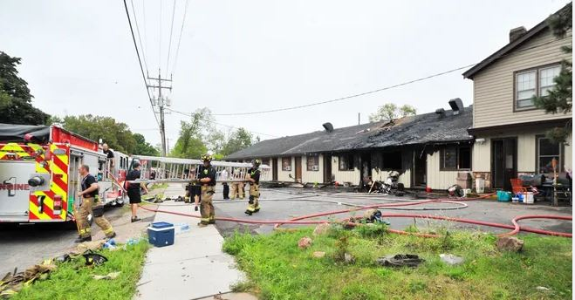
More Ponderosa Motel History
Taxes were delinquent since 2011, totaling more than $63,000
Property was listed for sale and received an accepted offer in 2015
A fire destroyed the building August 17, 2015, displacing 27 people
Sale was set to close the day of fire. Buyer and Seller walked away from the property
Although already blighted, the fire left it destroyed, decayed and uninhabitable.
It became the home of transients and criminal activity continued

Slide 5
Years in the Making
Since 2015, the City pleaded with the County to take ownership for back taxes
In 2018, neighborhood residents were angry nothing was being done and took matters in their own hands. Residents met with the County Administrator and Treasurer to demand action
In mid 2018, the County finally claimed the property and offered it to the City after completing environmental assessments
The appraised value for the land and building, as it stood, was $65,000
In fall 2019, the City purchased the property for $52,500

Slide 6
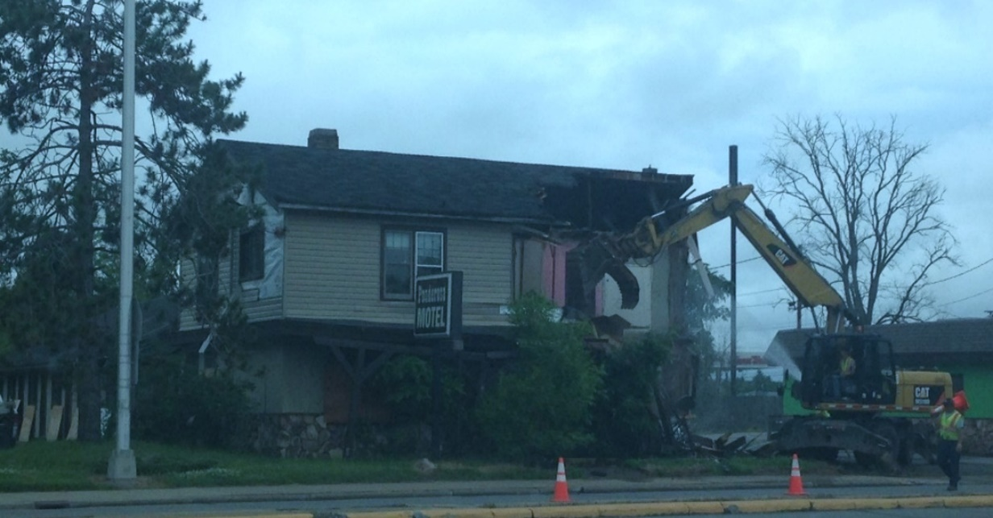
Demolition Day!
Summer of 2020

Slide 7
Redevelopment Process
Subrecipient agreement signed by Community Development Authority through their Redevelopment Authority (new partnership)
December 2019, CDA released a Request for Proposals
Received 3 proposals. Chose proposal from Emmerich & Associates to build a new 8-unit apartment complex
Restrictive covenants for 5 units for low/mod tenants and fair market rents
Developer purchased property for $10,000 but did not ask for any additional funds

Slide 8
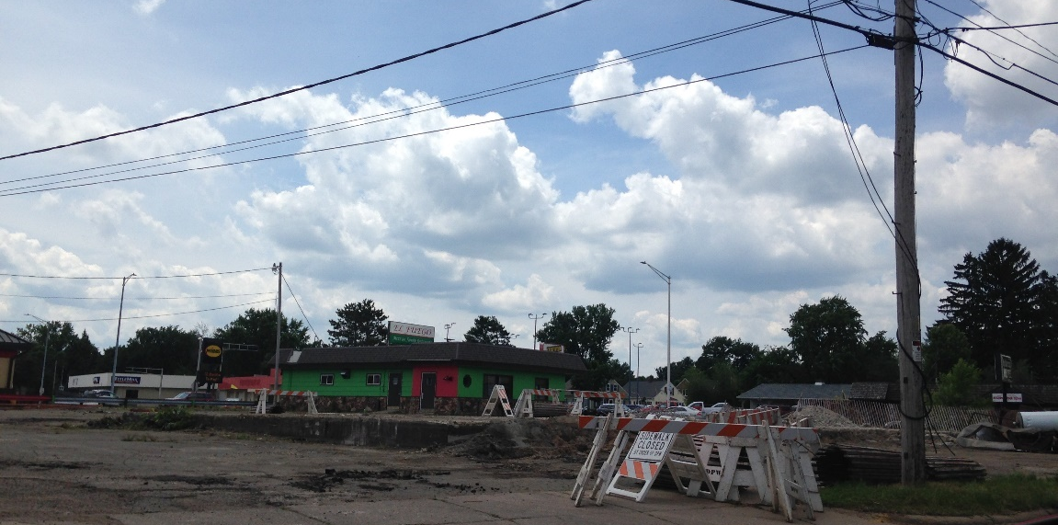
Developments After Agreement
Developer purchased neighboring building
Demolished the 2nd building and added the sites together
Increased the proposed number of units from 8 to 16

Slide 9
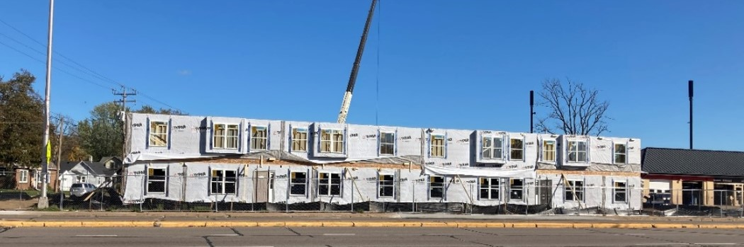
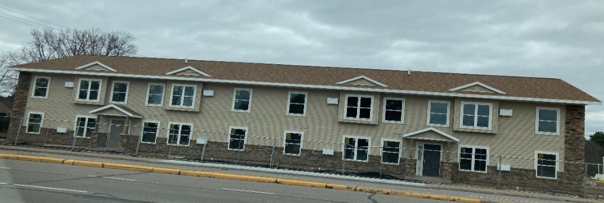
Before & After

Slide 10
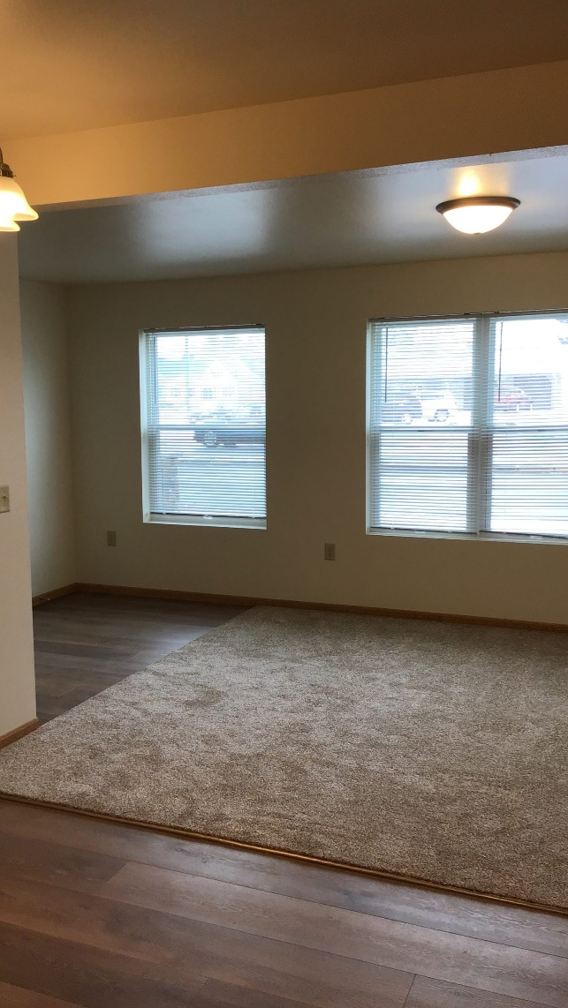
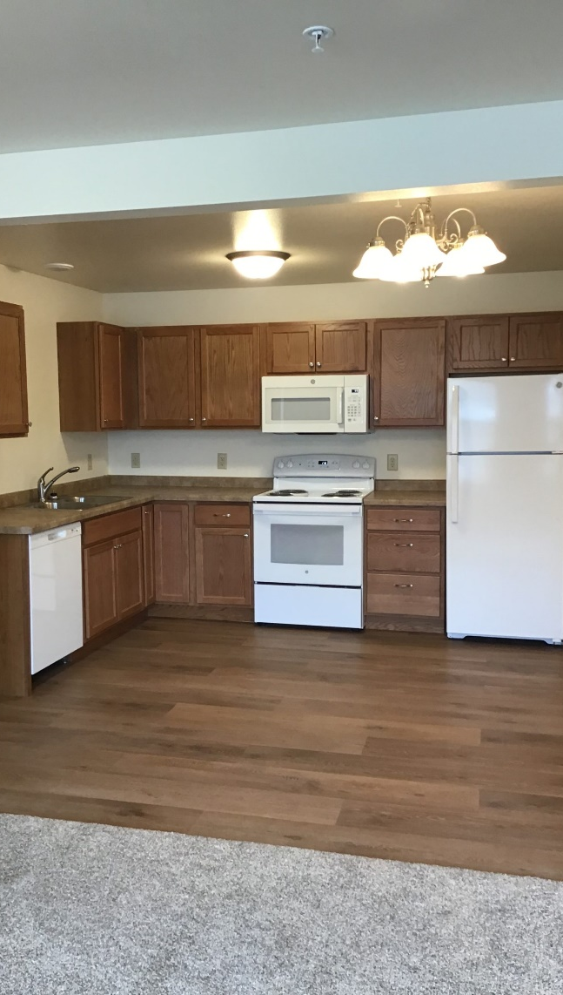
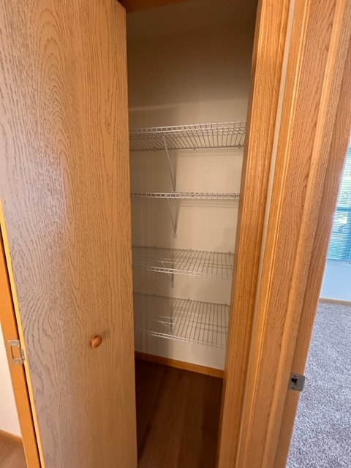
Living Room, Kitchen & Pantry

Slide 11
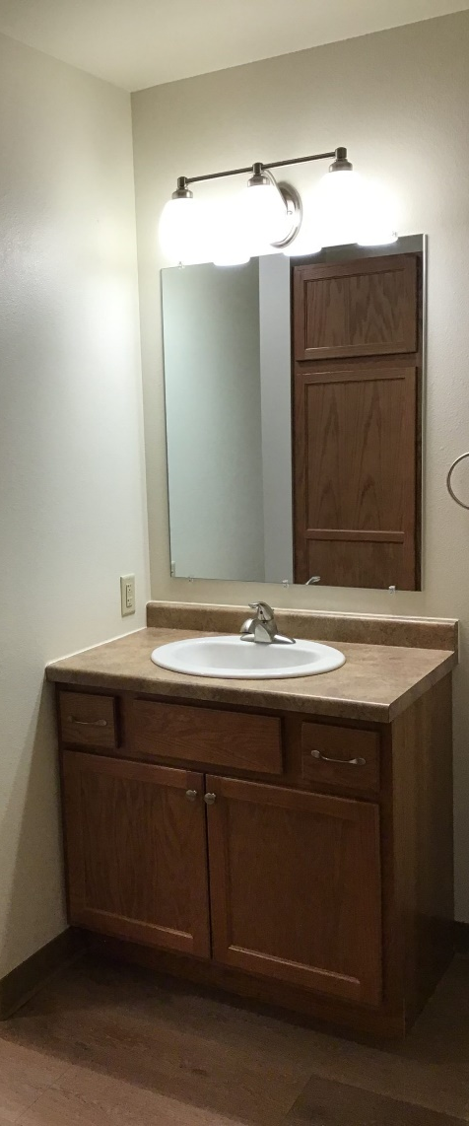
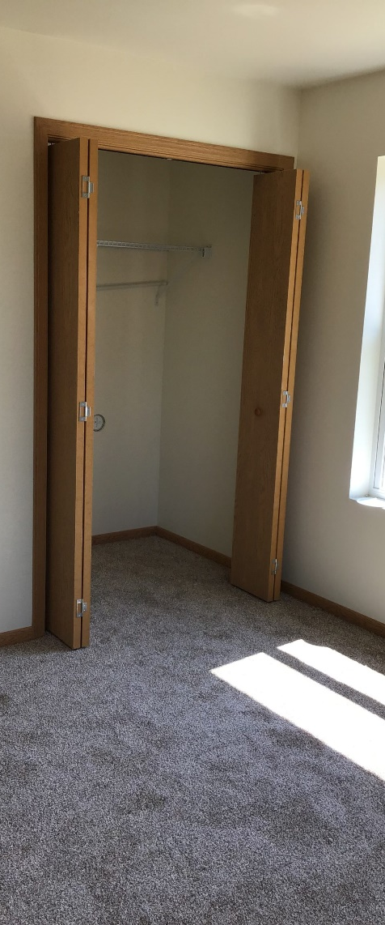
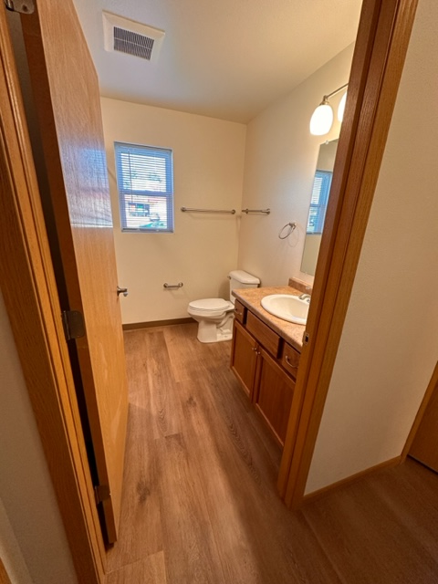
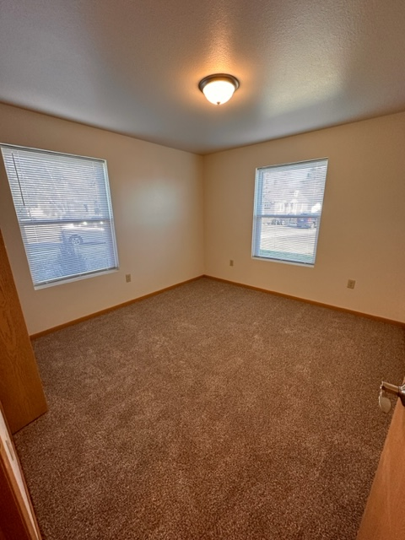
Bathroom & Bedroom

Slide 12
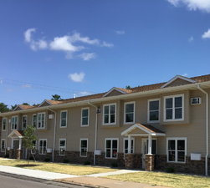
Leveraging Funds
CDBG = $94,252
Acquisition
Testing
Abatement & Demolition
Site Prep
Sale of Property = $10,000 which was returned to CDBG as Program Income and was used for next blighted property
CDA Covered Cost of Request for Proposal
Developer utilized just over $1M of own funds to purchase neighboring site, demo and build an additional complex
Second building slated to start this year with no assistance requested

Slide 13
Local Impact
Removal of Blighted Building Equals Happy Neighborhood Residents! ☺
Increase in City Housing Stock & Increase to Initial Agreements from 8 to 16 units With Another 16 on The Horizon!
Increase in Real Estate Taxes From $3,772 to $19,274. 5X THE INITIAL VALUE!!
Increase in Parcel Value From $150,000 to $755,900, With Just The 1st Building!
City Will Recapture The $100,000 Investment In Only 5 Years!!

Slide 14
Open House/Celebration
Don’t forget to Celebrate!
Invite your local and state representatives
Hold an open house for the neighborhood
Pat yourself on the back

