Slide 1
Fairlawn Village
Plenary Session: Community Development Best Practices January 27, 2023
Notes:
Emily: Good Morning, my name is Emily Thompson, I am a Project Development Coordinator with the City of Orlando Housing and Community Development Department. Here with me today is Shawn Wilson, President of Blue Sky Communities, and Scott Eller, CEO of CASL. We are honored to be here today to talk about the award-winning Fairlawn Village.

Slide 2
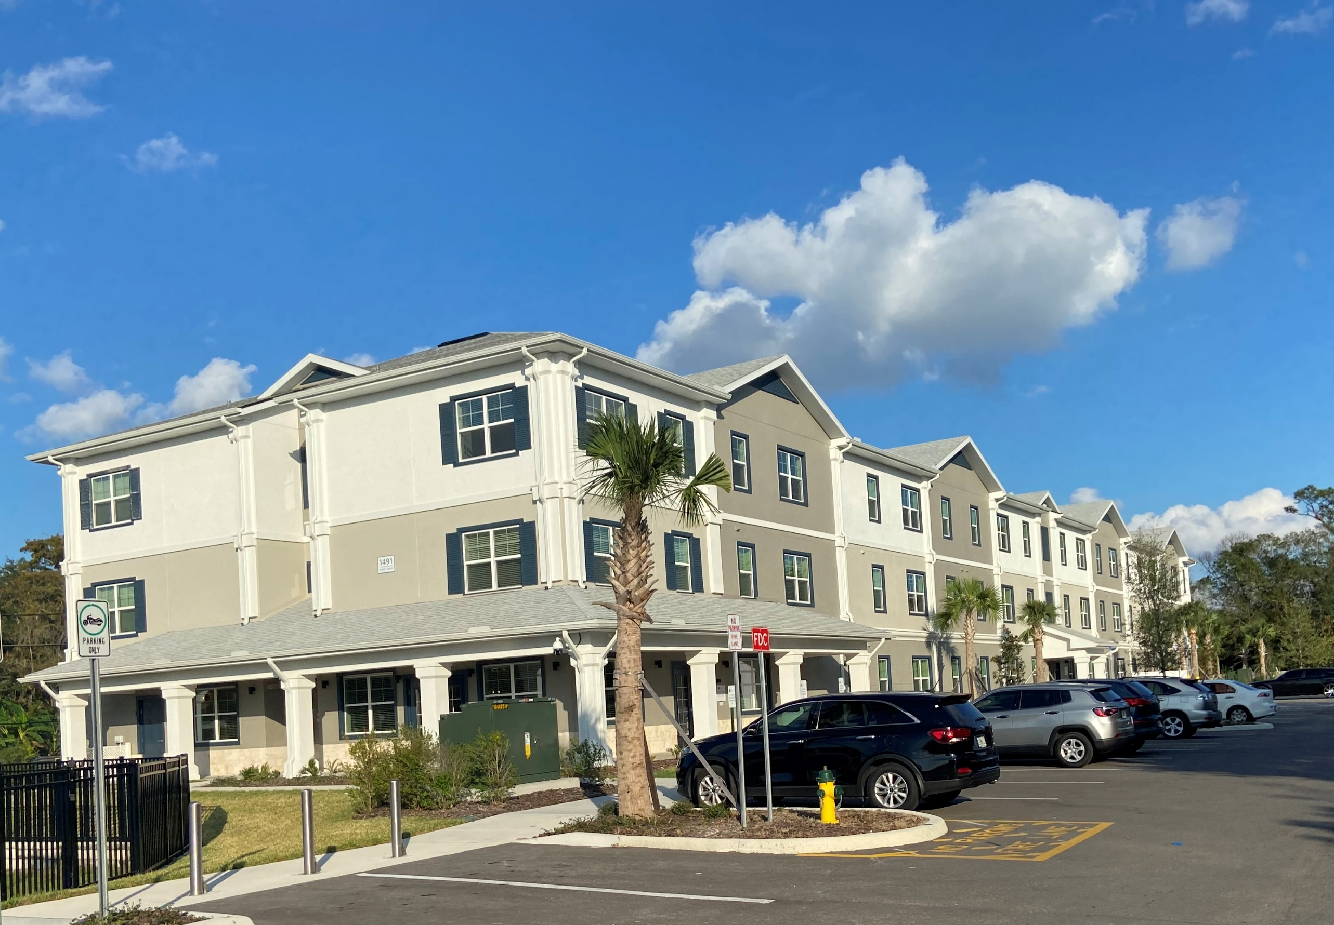
Fairlawn Village
Location
Background
Development
Funding Sources
Partnerships
Photos
Notes:
I’m going to quickly provide information about the project’s location and background, and then I’ll turn it over to Shawn to go into the development details, funding sources, partnerships, and share some photos with you.

Slide 3
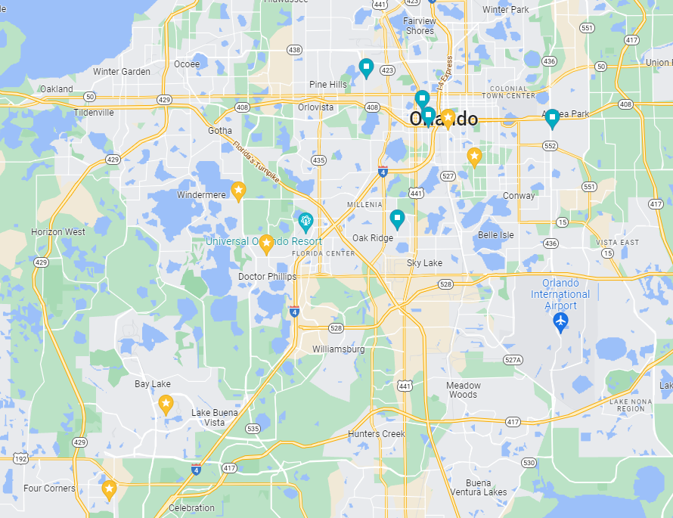
Location
Fairlawn Village
Downtown Orlando
Universal Studios
I-Drive
Disney
Notes:
Fairlawn Village is in the City of Orlando, in Orange County, in Central Florida. It’s northwest of Downtown Orlando and you can see its location here in reference to some well-known Orlando sites – I-Drive, Universal and Disney

Slide 4
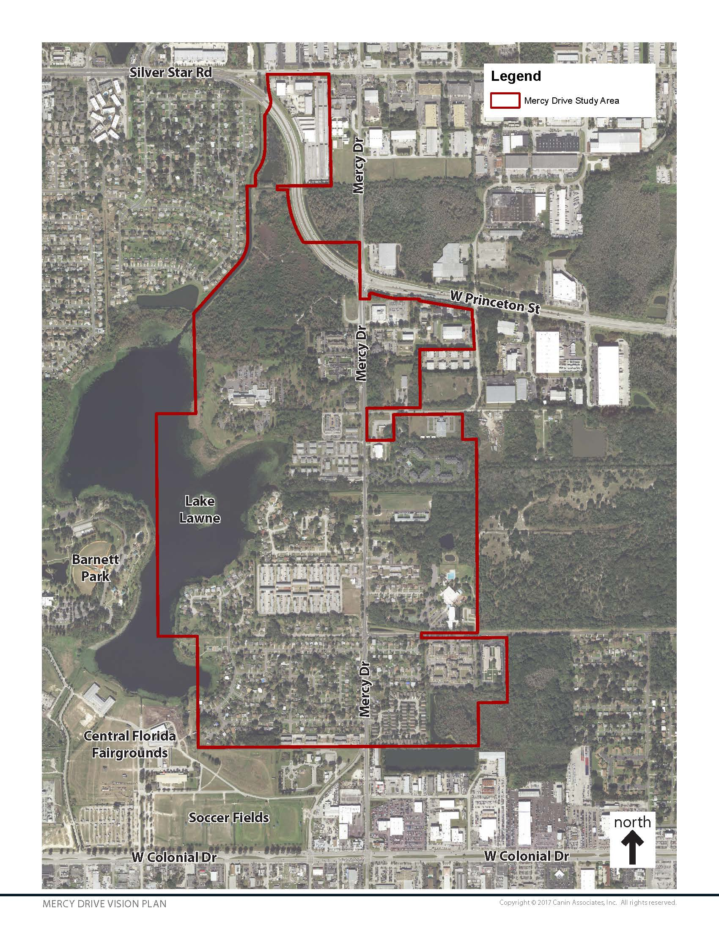
Location: Mercy Drive
West Orlando
Commissioner District 5
Mercy Drive Vision Plan
Notes:
Emily - Summarize:
Fairlawn Village is two sites - highlighted in yellow on the map - the north site located at 1491 Mercy Drive and the south site located at 1050 Mercy Drive.
Mercy Drive is the major north-south thoroughfare of the Mercy Drive Neighborhood, located in West Orlando in Commissioner District 5. This community is situated between important Central Florida commercial corridors, located south of Silver Star Road, west of N. John Young Parkway, and north of W. Colonial Drive.
In 2017, the city creation a vision plan for the neighborhood. In recent years prior to the development of the Vision Plan, there had been a substantial loss of affordable multi-family housing and many area residents had to move away, causing breaks in important familial and communal ties.
With combined input from the community and stakeholders, the Mercy Drive Vision Plan expressed the desire for the revitalization of the corridor into a safe, attractive and connected community with quality, yet affordable housing options and equitable access to resources and opportunities for neighbors of all ages to grow and succeed. The plan identified recommendations summarizing the community’s vision for the future and the various implementation projects and programs needed to make this a reality. Among these proposed design concepts and community building programs were new housing opportunities.

Slide 5
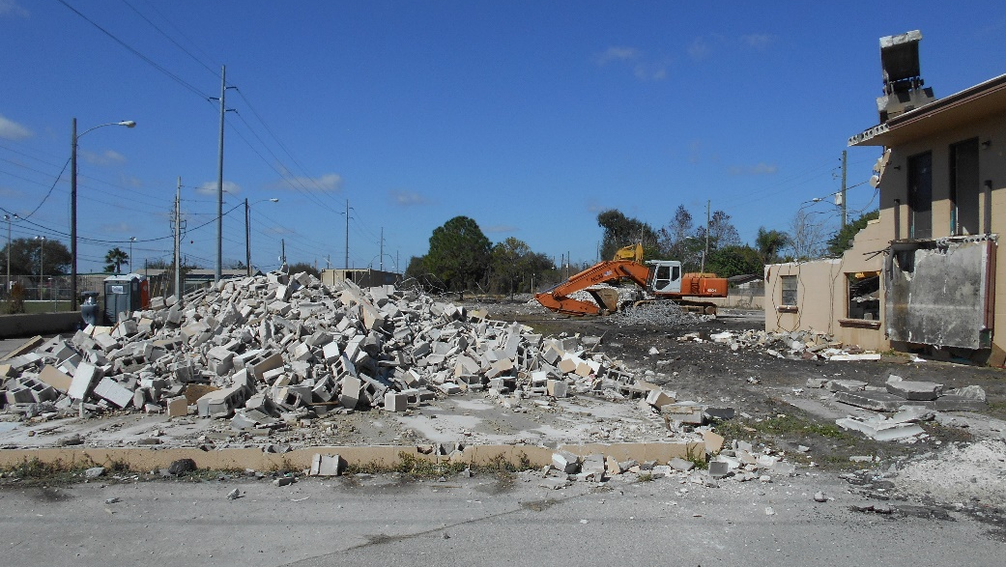
Background
Housing Challenges
City of Orlando Key Priorities
2015 Site Purchase
2018 RFP
Notes:
Summarize:
Like many communities across the country, the City of Orlando is working to address the challenges of homelessness and affordable housing.
The Orlando metro area is one of the fastest-growing major metropolitan areas in the U.S., with 1,000 people moving to the Central Florida region each week.
63% of Orlando residents are renters
The average rent in Orlando is $1,937
A snapshot of apartment rent ranges in Orlando show only 2% of units are within the $701 to $1,000 rent range.
One of the City of Orlando’s Key Priorities is access to quality housing.
We remain committed to ensuring that every person that calls Orlando home, regardless of economic status, has access to quality housing that is safe and affordable.
In 2015, we invested nearly $7 million in general funds to purchase seven vacant, foreclosed, and uninhabitable properties from Fannie Mae, with the ambitious goal of transforming these sites into safe, attractive and affordable housing for residents.
We used HUD NSP funds to address environmental issues and begin demolition of the existing, vacant and dilapidated apartments on-site, and used Code Enforcement lien funds to complete the demolition.
In 2018, we released an RFP and selected Blue Sky Communities to redevelop this site.

Slide 6
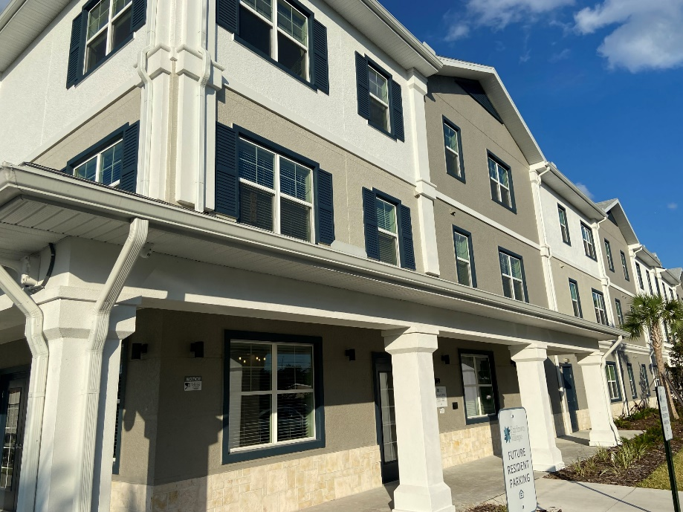
Development
116 Affordable Apartments
Mercy Drive Neighborhood
AMI levels
22% (NHTF)
35% (ELI)
50% (Low HOME)
60% (4% HC)
20 PSH Units
Fall 2022/Spring 2023
Notes:
Shawn:
Fairlawn Village provides 116 affordable units, for households at or below 60% AMI (Area Median Income), and includes 20 Permanent Supportive Housing units with accompanying support services.
There are a variety of configurations to accommodate different family sizes, including 28 one-bedroom, 54 two-bedroom and 34 three-bedroom units. All apartments are equipped with multiple energy efficient features, including a kitchen, bathroom(s), and storage closets. Amenities include a clubhouse, on-site laundry, playground and free parking. The demographic set-aside for Fairlawn Village is Family.
The north site was completed and started leasing in the Fall of 2022. We look forward to a grand opening ceremony in Early Spring 2023 when the south site has completed construction and leasing.

Slide 7
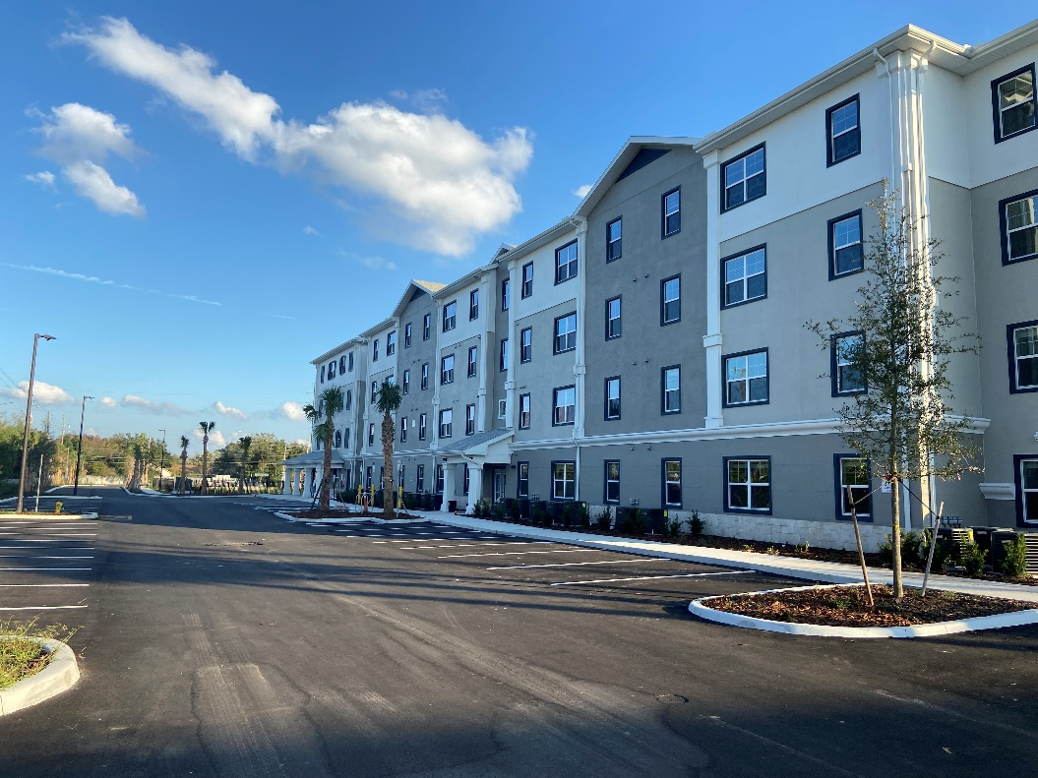
Funding Sources (@Closing, Fall 2020)
HOME Funds: $2,000,000
First Mortgage: $5,000,000
SAIL: $6,250,000
SAIL ELI: $600,000
NHTF: $1,308,000
Tax Credit Equity: $7,820,102
Deferred Developers Fees: $1,560,149
Total Development Costs: $24,538,251 ($211K/U)
Notes:
Project Funds
In addition to $2,000,000 in HOME Investment Partnerships Program (HOME) funds allocated from the city, the project also received a first mortgage of $4,300,000; a State Apartment Incentive Loan (SAIL) of $6,250,000; a SAIL Extremely Low Income (ELI) loan of $600,000; $1,308,000 from the National Housing Trust Fund (NHTF); Tax Credit Equity in the amount of $8,257,752; and deferred developers fees in the amount of $761,130; for a total of $23,476,882.
*HOME funds were used to fill the gap in project funding.
This smart and innovative funding approach allows all 116 units to be available to households with various income levels, at or below 60% of AMI:
59% (68) of the units will be for households at or below 60% of AMI
26% (30) of the units will be for households at or below 50% of AMI
10% (12) of the units will be for households at or below 35% of AMI
5% (6) of the units will be for households at or below 22% of AMI

Slide 8
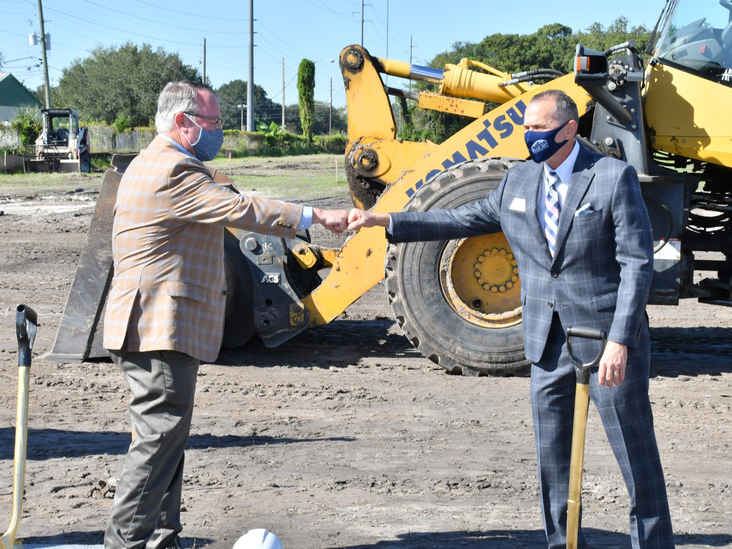
Partnerships
City of Orlando
Blue Sky Communities
CASL, Inc.
Carteret Management Corporation
Notes:
*Shawn, I just listed below the info from the award application, but I changed “they” to “we” and “their” to “our” under the Blue Sky section
This project would not have been possible without the partnerships between the City of Orlando, Blue Sky Communities, LLC (Blue Sky), Carteret Management Corporation (Carteret) and CASL Developer, Inc. (CASL). In addition, the Homeless Services Network, which is the lead agency that runs the local Continuum of Care, will refer tenants for the Permanent Supportive Housing units, in an effort to better support the coordinated entry system.
In September 2022, Blue Sky celebrated 10 years of inspiring positive change in communities across Florida through creating high-quality workforce and affordable housing developments. We are a leader in development, property management and advocacy. With our expertise in public funding, including 9% Housing Credits, 4% Housing Credits, Tax Exempt Bonds, CDBG, HOME, SHIP, SAIL, and many other incentives, we help local governments and nonprofit groups reach their affordable housing goals by developing state of the art and environmentally sound affordable housing units.
Our portfolio of work includes over 20 communities within the State of Florida, with a multitude of affordable units and Permanent Supportive Housing units, benefitting disabled, elderly, formerly homeless and Veteran residents and families.
Blue Sky values property management as the key to the long-term success of our properties. All Blue Sky properties have on-site management offices and well-stocked maintenance shops to ensure repairs are completed timely and maintenance is kept up so that residents are happy and local leaders are proud whenever they drive by.
Our affiliate, Carteret, provides these services and more at every Blue Sky property. Our staff and Carteret’s work together to seamlessly transition each property from construction, to leasing, to occupancy. Formed in 1971, Carteret is a service-oriented, privately held and family operated corporation with over 50 years’ experience in managing apartments throughout Florida, in the private sector and under multiple affordable housing programs.
Blue Sky has successfully partnered with CASL, a Sarasota based non-profit, to provide ongoing services and support within their communities. CASL is a housing service provider for people with a mental health diagnosis and/or developmental disabilities. Since 2017, this partnership has paired individually tailored case management supportive services with permanent apartment-style housing, enabling residents to thrive independently and become an active member of the community.
Supportive housing focuses on those populations who are or who may become homeless, including:
Those with a mental health diagnosis
Those diagnosed with intellectual and developmental disabilities
Working families who are low-income
Elderly
Veterans
Those emerging from domestic violence
CASL’s on-site support team ensures residents have access to necessary services such as transportation and essential health care services. Their mission is to provide safe, affordable and supportive housing for adults with disabilities and to expand housing options for working families to reduce homelessness in our community.

Slide 9
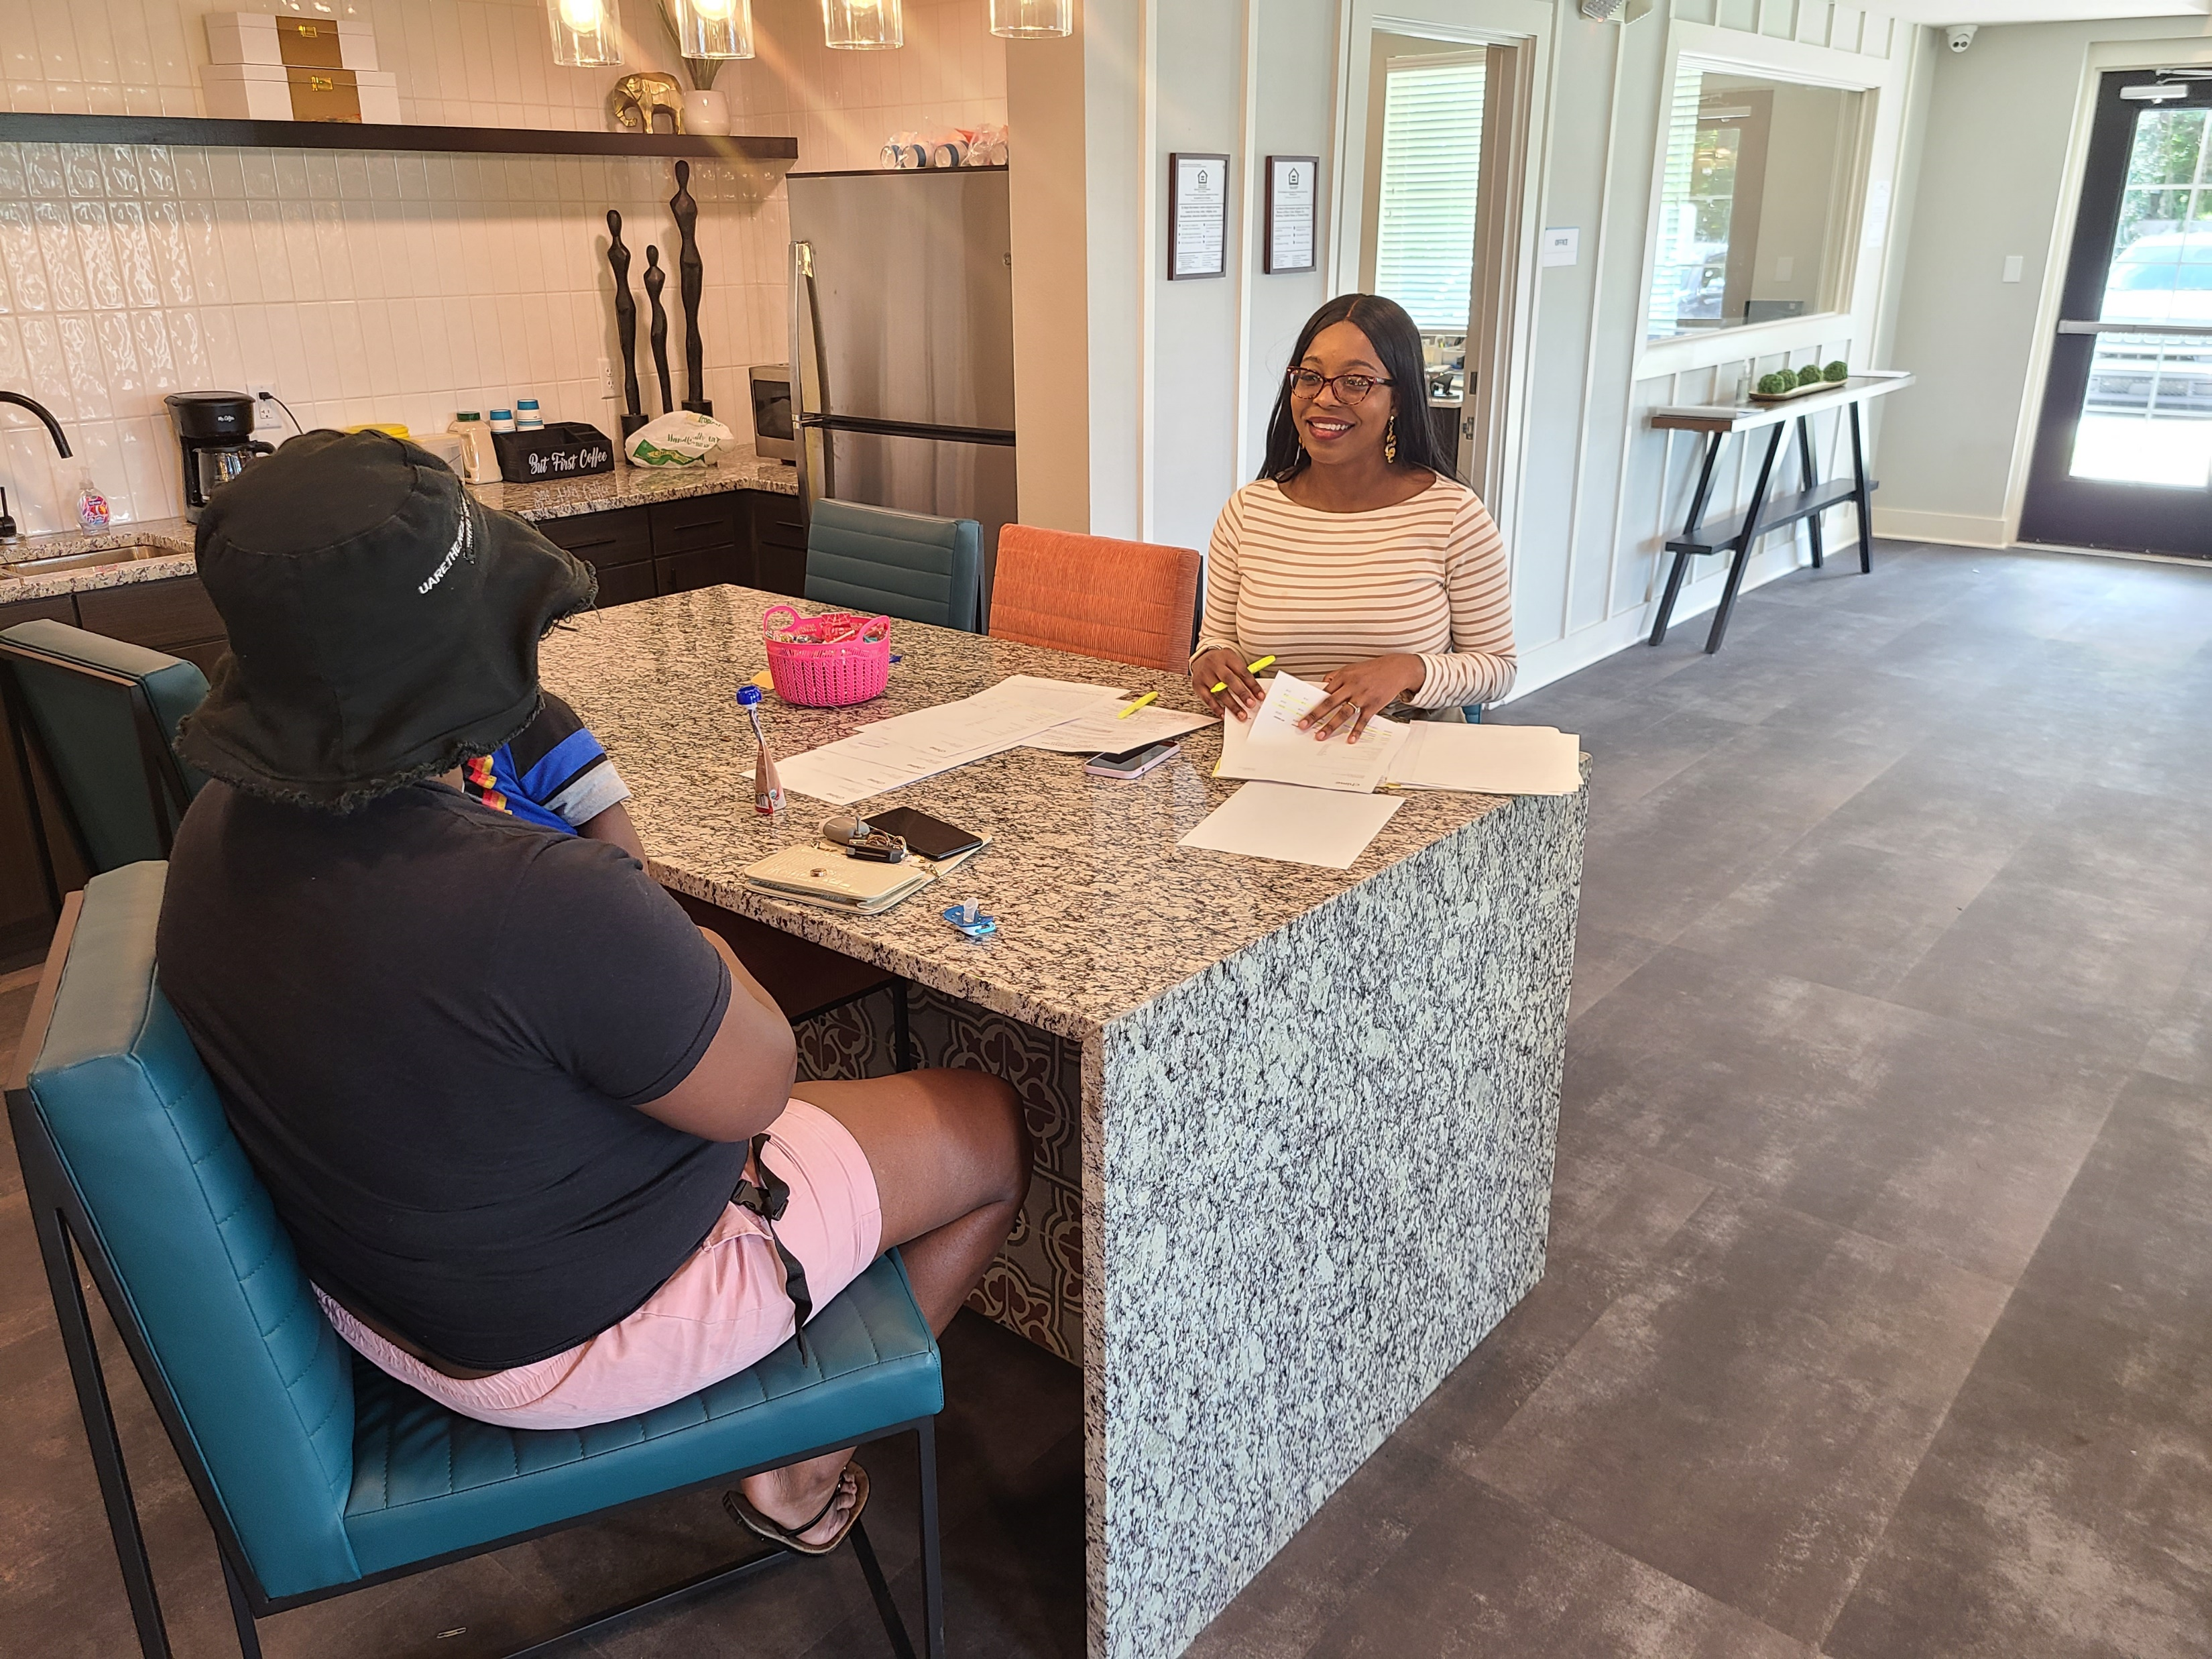
Timeline
City of Orlando RFP – May 2018
FHFC Application (SAIL, ELI, NHTF, 4% HC, TE Bonds) – Nov. 2018
FHFC Board Prelim. Approval – May 2019
FHFC Board Final Approval – August 2020
Start Construction – November 2020
First Residents Moved In – November 2022

Slide 10
Groundbreaking: November 17, 2020
Notes:
Media coverage from the groundbreaking event on November 17, 2020

Slide 11
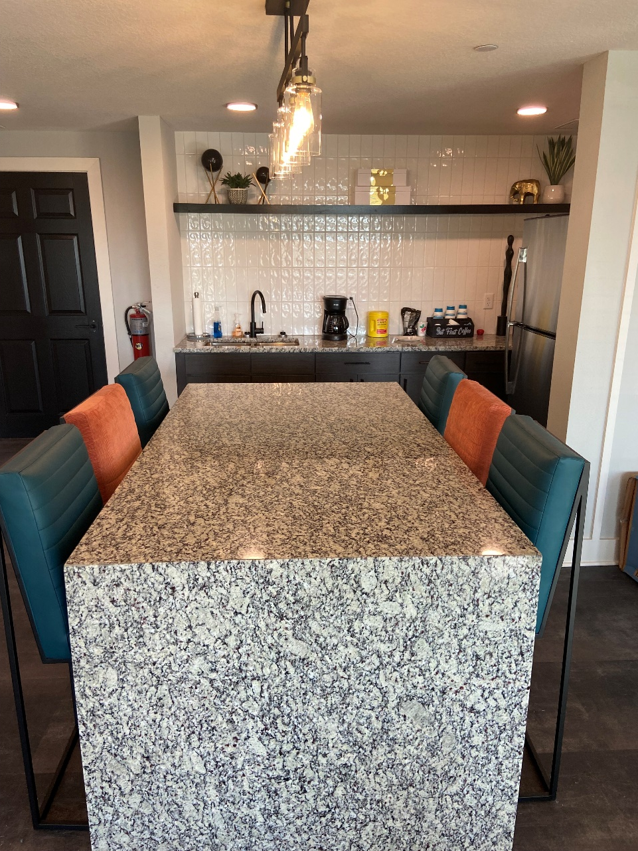
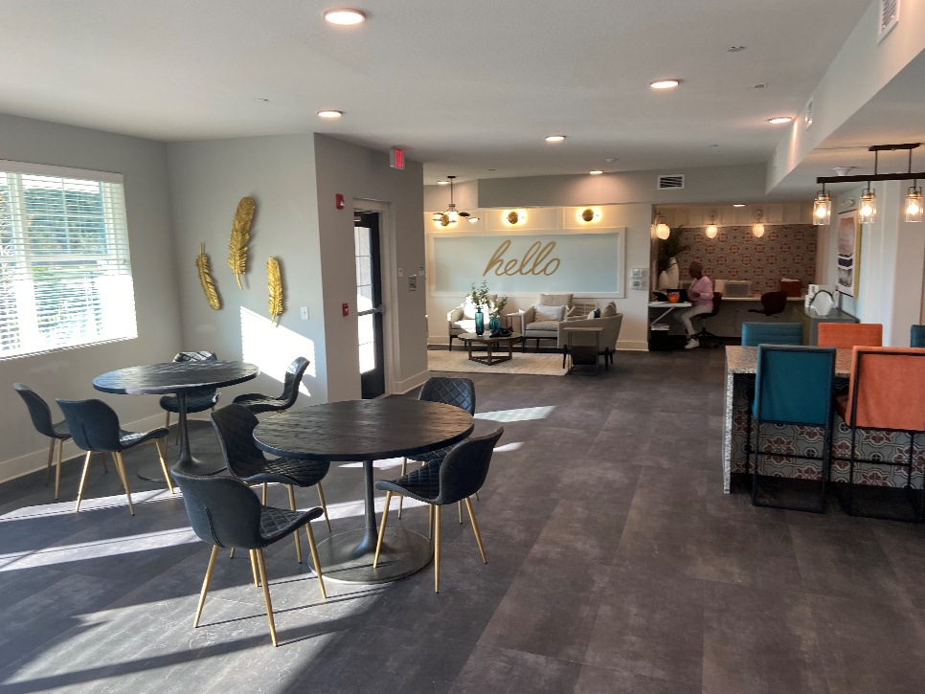
Photos

Slide 12
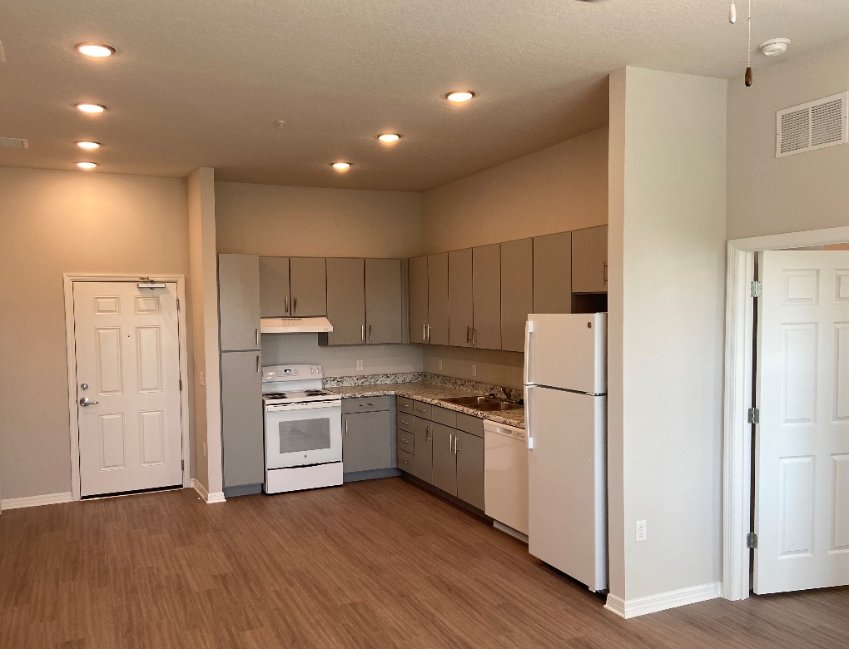
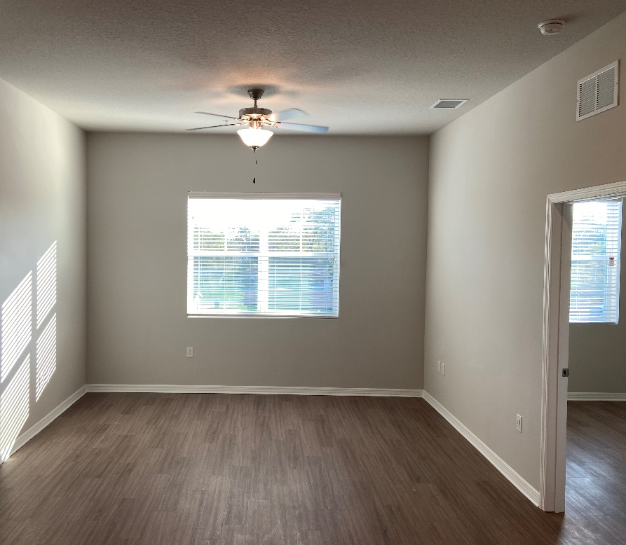
Photos

Slide 13
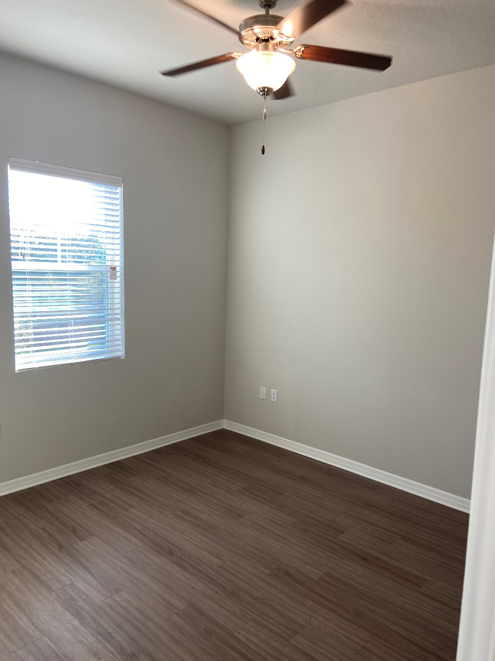
Photos

Slide 14
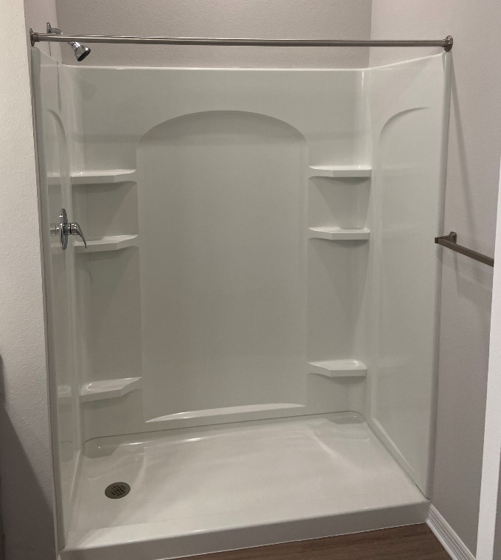
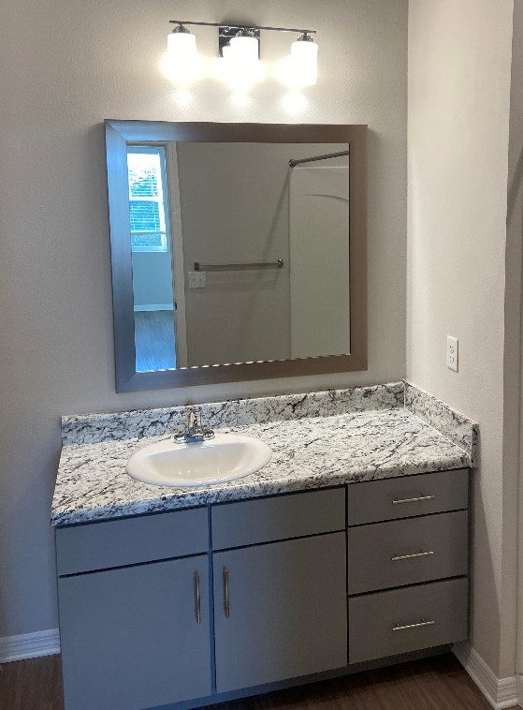
Photos

Slide 15
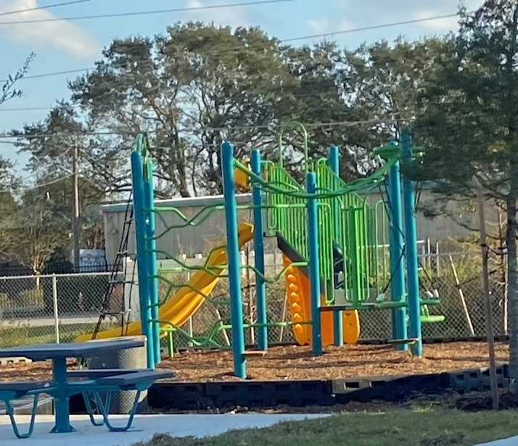
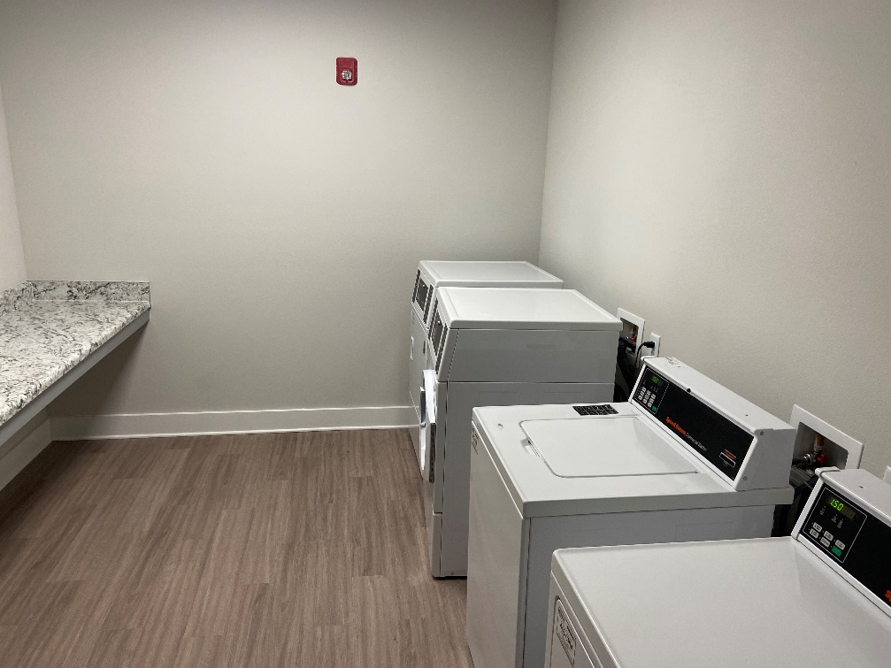
Photos

Slide 16
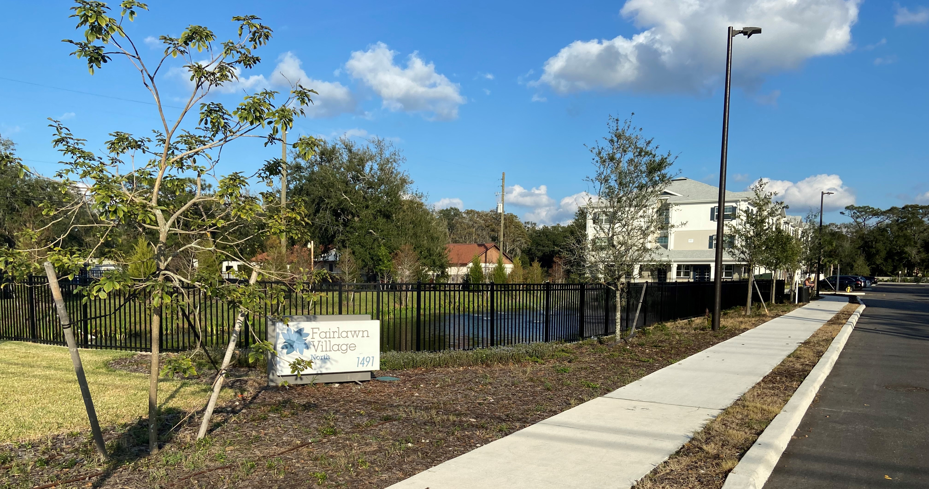
Photos

