Slide 1
Courtyard Homeless Resource Center (HRC)
City of Las Vegas

Slide 2
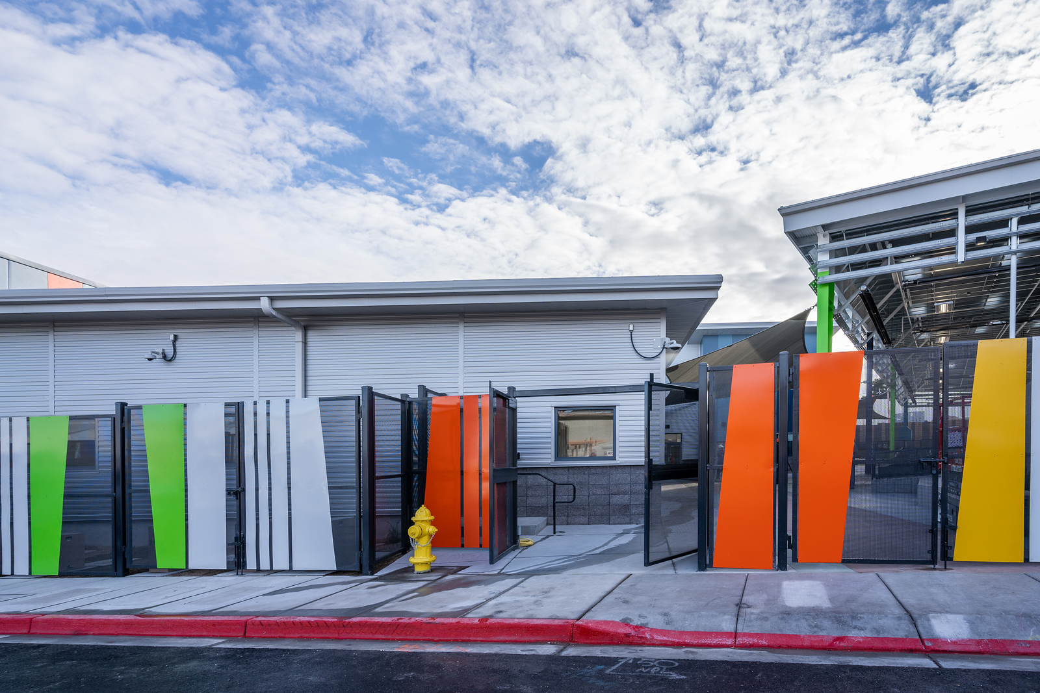
About
The Courtyard HRC opened initially in 2017 and provides a safe outdoor area for guests needing temporary shelter and access to basic services to gain stability.

Slide 3
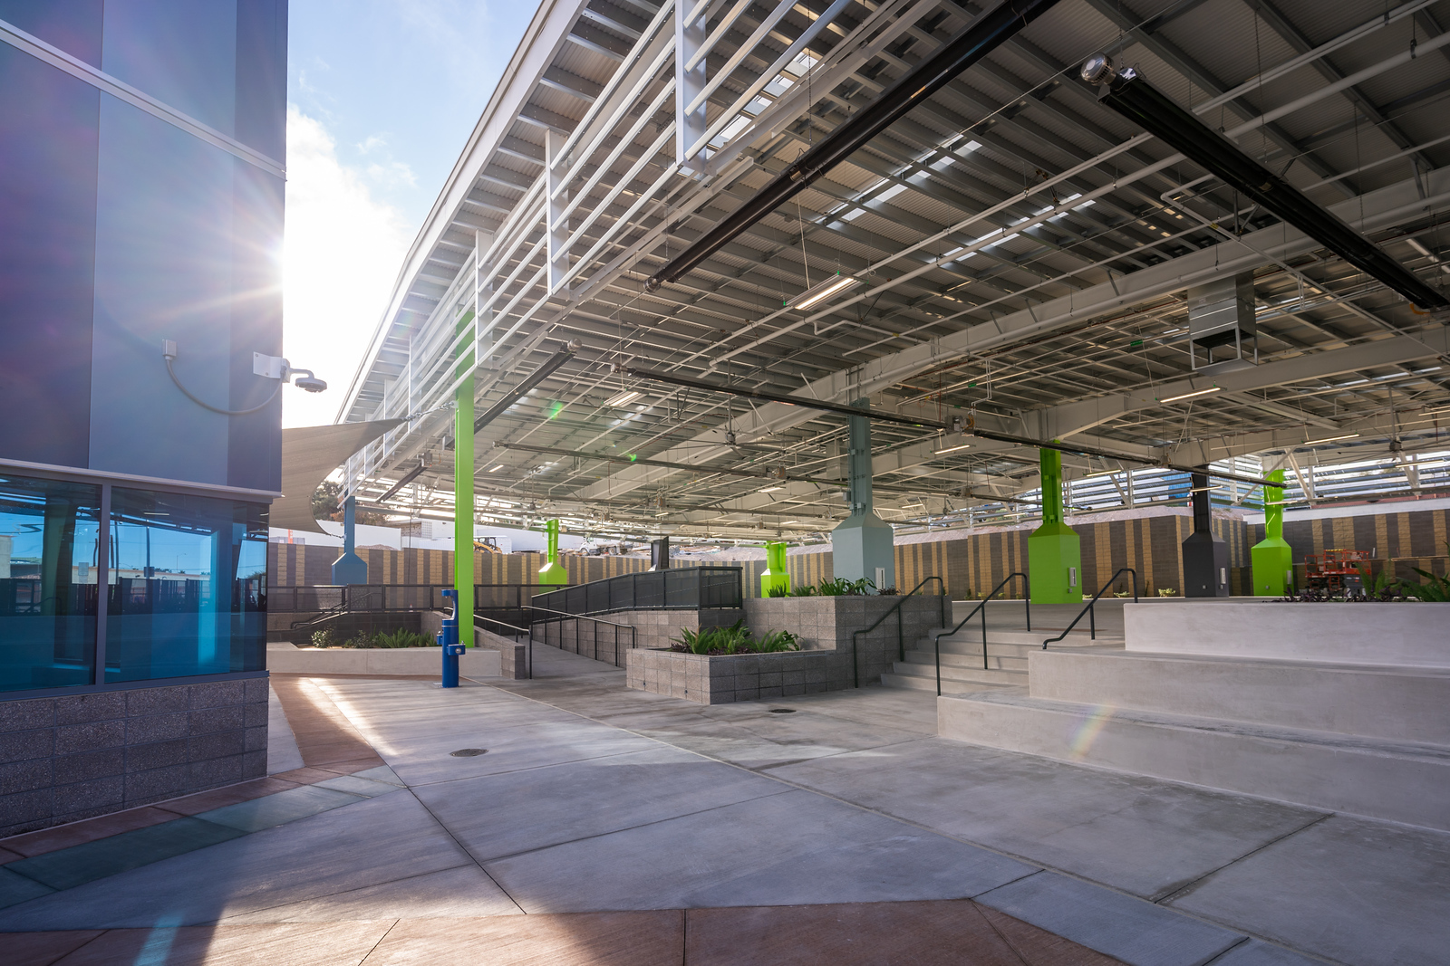
About (continued)
The operating budget for the Courtyard HRC $7.7 mil. annually.
The city of Las Vegas bonded CDBG to acquire $20 mil. of the $26 mil. the Courtyard HRC cost in construction.

Slide 4
About (continued)
The Courtyard HRC provides a safe outdoor area for guests needing temporary shelter and access to basic services to gain stability.
Courtyard HRC Funding sources comprised of:
Redevelopment Set-Aside (RDA – State Funding)
Environmental Surcharge
General Funds
Private Donations

Slide 5
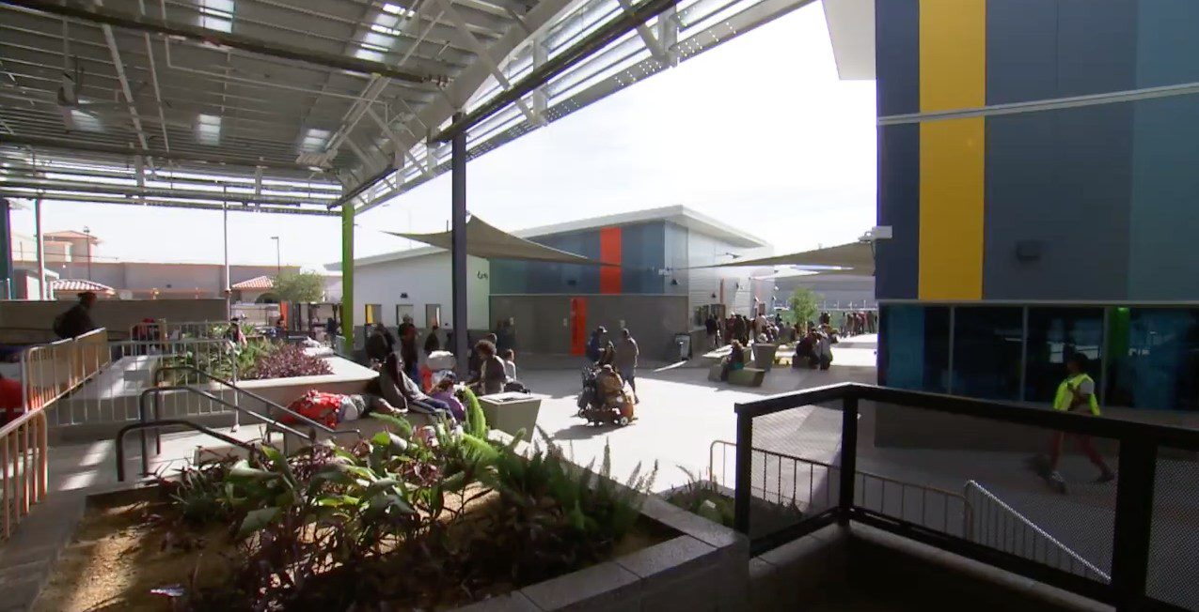
About (continued)
The project brings services and service providers to a central, predictable location to provide homeless guests and their pets with access to wrap-around services.

Slide 6
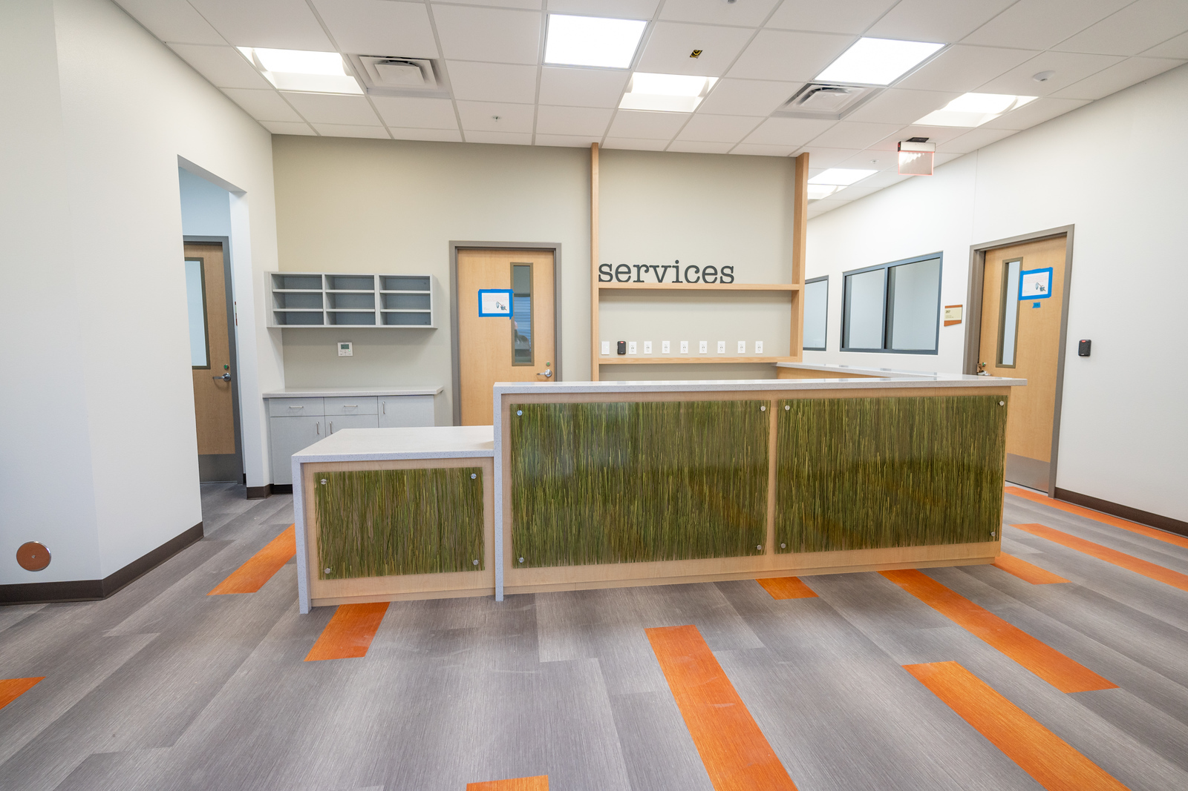
Services
Benefit Attachment (EBT/SSI/SSDI)
Case Management Services
Bin Storage/Daily & Longer-Term
Bridge Housing
The Arrow Shuttle Referral Access/Bus Passes
Computer, Telephone, Charging Station Access

Slide 7
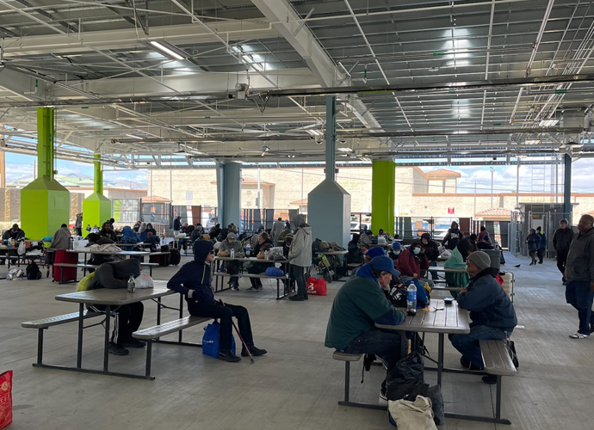
Services (continued)
Housing Assessments (driven through Coordinated Entry)
Employment Assistance
Legal Referrals
Hygiene Items, Showers, Bathrooms
Identification & Documentation Assistance/DMV Vouchers
Mail/Deliveries

Slide 8
Services (continued)
Pet Kennel/Mobile Veterinarian (no cost)
Medical Access (FQHC Partner – on-site)
Referrals to Behavioral Health Services
Overnight Stay
Rental & Move-In Assistance
Ticket-to-Home

Slide 9
Providers
Assurance Wireless (phones)
Division of Welfare & Supportive Services (EBT/Insurance)
Hope Christian Health Centers (FQHC)
Notary Services
The Giving Project (monthly community fair)
Manage Care Organization engagement (Medicaid/Medicare)

Slide 10
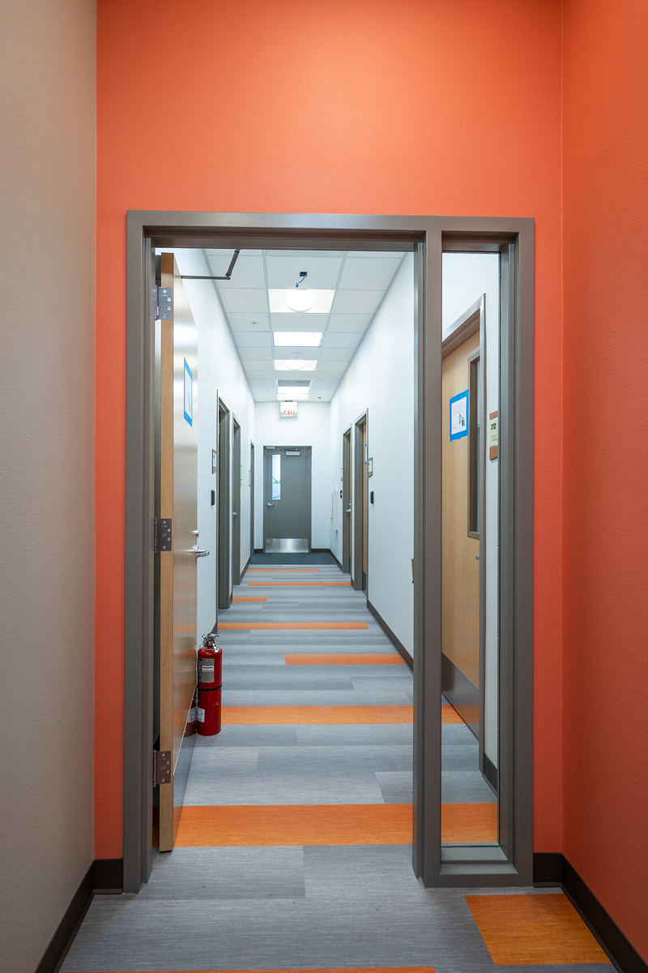
Providers (continued)
The Vets (Mobile Veterinary Services)
Southern Nevada Health District
(Vaccinations)
J.R. Disability (SOAR)
Vegas Stronger (SUD/ETOH Services)
Nevada Homeless Alliance (ID Restoration)
SafeNest (DV Training)

Slide 11
Statistics (2nd Quarter 2022: Oct. – Dec.)
5,708 Guests Served
2,007 Unduplicated
2,110 Received Benefit/Documentation Assistance
1,323 Unduplicated
386 Average Overnight Stayers
456 High
322 Low

