Slide 1
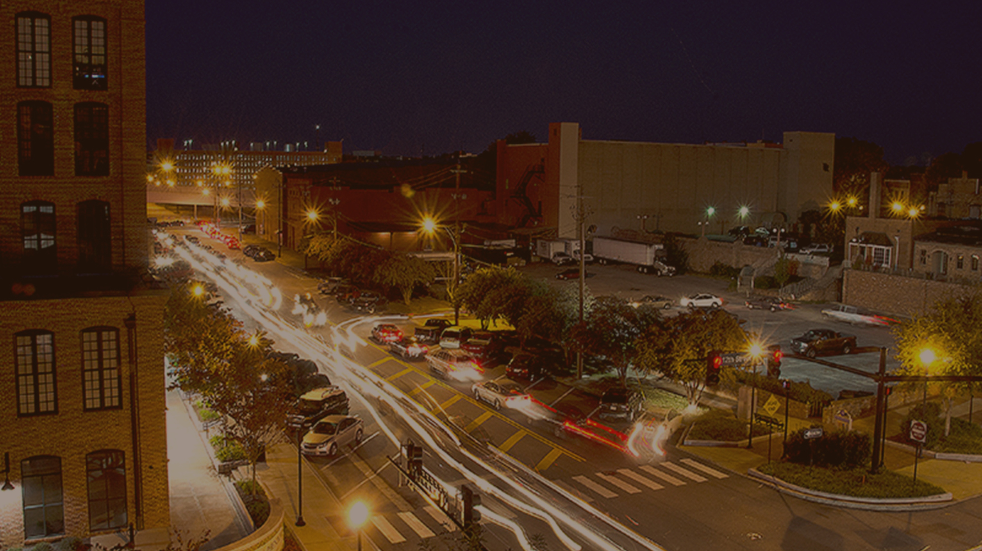
COLUMBUS CONSOLIDATED GOVERNMENT
SMALL BUSINESS ECONOMIC RELIEF GRANT PROGRAM

Slide 2
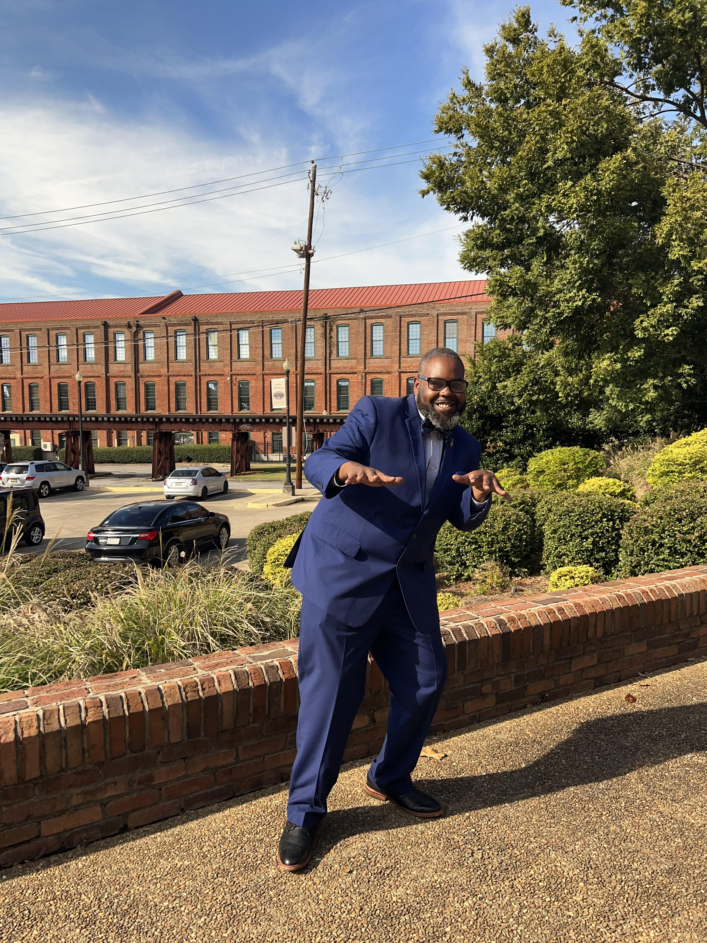
COMMUNITY REINVESTMENT DIRECTOR ROBERT SCOTT
Robert Scott has had significant impact on many communities across the metropolitan Atlanta landscape to include City of Atlanta, DeKalb and Gwinnett counties. In 2020, he became the Director of Community Reinvestment for the Columbus Consolidated Government.

Slide 3
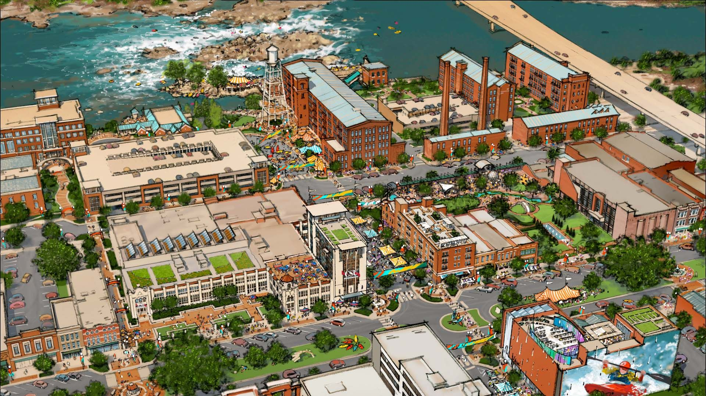
COLUMBUS, GA DEMOGRAPHY
2nd Largest City in the State of Georgia
The Three Largest Racial/Ethnic Groups (2020)
49.7% Black or African American alone (Non-Hispanic)
41.5% White alone (Non-Hispanic)
7.9% Hispanic or Latino

Slide 4
COLUMBUS, GA DEMOGRAPHY
Median Household Income: $50,542
Persons in Poverty: 19.5%
Bachelor's Degree or higher (age 25+): 27.6%
(2017-2021)
CDBG and HOME Entitlement Community

Slide 5
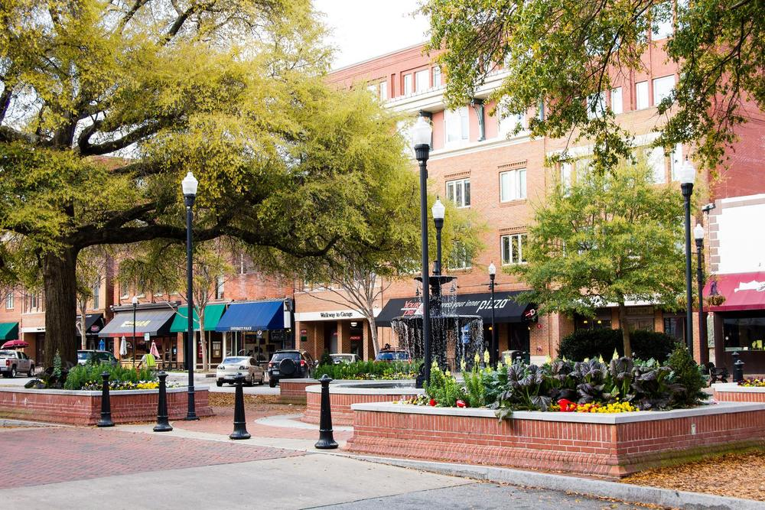
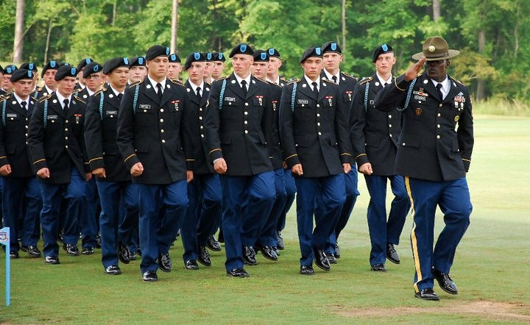
WE ARE COLUMBUS

Slide 6
COVID-19 IMPACT
Universal
Every citizen's experience has been different, the global pandemic has impacted every businesses and residents of the City of Columbus in one way or another.
Opportunity
City officials were championing and creating opportunities for social and economic security for both its citizenry, with a focus on the small business community as they were fighting day in and day out to keep both roofs over their heads and their doors open.
Focus
For many small businesses during this period, finding and retaining qualified employees was a vital concern, more than both inflation and supply chain issues.

Slide 7
CDBG-CV RESPONSE
Funding Amount
The City of Columbus Received $981,189 in CDBG-CV funding to prevent, prepare for and respond to COVID-19's impact on our community.
Distribution
Direct Client Benefit to Low-to-Moderate Income Clientele (LMC)
Low to Moderate Job Benefit (LMJ)
Funding Goal
To make leveraged investments that holistically address as many needs as possible while ensuring the social service infrastructure and capacity development afforded would impact the city for years to come.

Slide 8
PARTNERSHIP
StartUP Columbus is an entrepreneurial support organization and startup incubator
$289K CDBG Funded startup incubator
Job Retention
Job creation
Business Persistence
Business Expansion

Slide 9
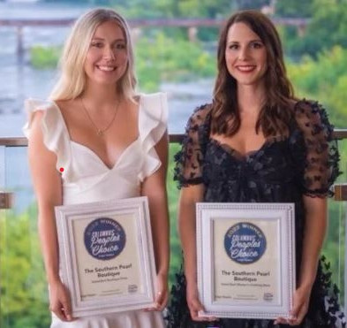
CDBG-CV SMALL BUSINESS PROGRAM OUTCOMES
27 Businesses Served
61 Jobs Created / Retained
CDBG-CV Funding - $108,000

Slide 10
LOCAL ARPA RESPONSE
Funding Amount
The City of Columbus received $78,482,038 in American Rescue Plan funding to support the response to and recovery from the COVID-19 pandemic.
Distribution
The City of Columbus allocated $5,000,000 in American Rescue Plan funding toto support the small business, nonprofit, and hospitality communities.
Funding Goal
To continue to invest in small business persistence to continue to achieve similar outcomes experienced in the CDBG-CV Small Business Program.

Slide 11
Small Business
Nonprofit
Hospitality Tourism
$ 3,000,000
$ 1,000,000
$ 850,000
Up to $40,000 in reimbursable
awards for small business with
1-25 employees
Up to $25,000 in reimbursable
awards for nonprofit entities
Up to $25,000 in reimbursable
awards for nonprofit entities and small business with 1-25 employees

Slide 12
PARTNERSHIP
The Greater Columbus Georgia Chamber of Commerce is the voice of business in West Georgia.
The Greater Columbus Georgia Chamber of Commerce serves the local community with programs, services and initiatives that address every aspect of business development.

Slide 13
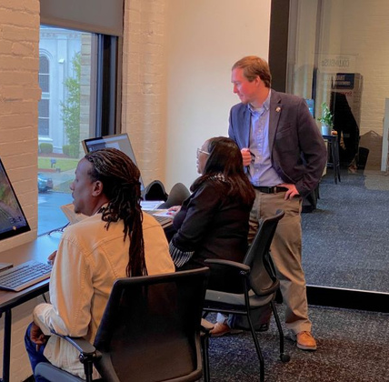
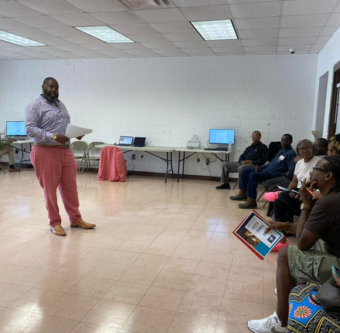
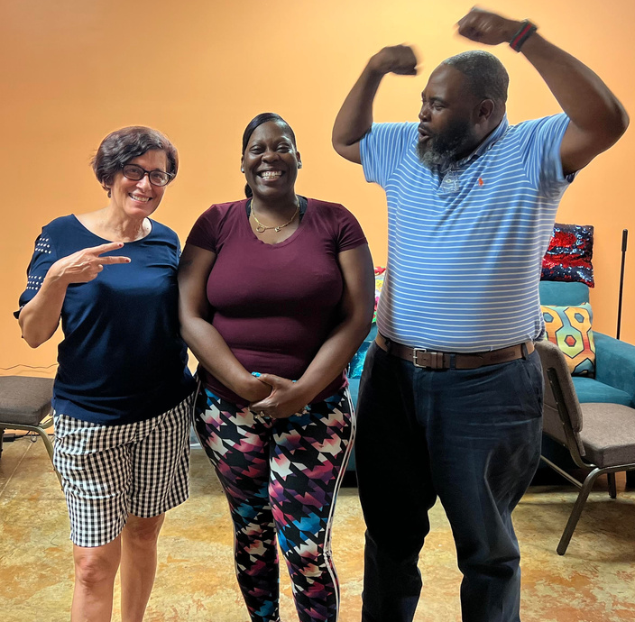
OUTREACH
Chamber of Commerce
Juneteenth Unity Week
The Life Center
Overflow Outreach Center

Slide 14
ARP
SMALL BUSINESS OUTCOMES
127
Businesses
Served
Small Business ARP Funding - $4,150,774.740

Slide 15
ARP
SMALL BUSINESS OUTCOMES
127
Businesses
Served
Small Business ARP Funding - $4,150,774.740

Slide 16
ARP
SMALL BUSINESS OUTCOMES
127
Businesses
Served
Small Business ARP Funding - $4,150,774.740

Slide 17
ARP
DEMOGRAPHY
46%
9%
Women Owned
Hispanic
Women Owned - 46%
Hispanic – 9%
Black/AA – 45%
White – 46%
45%
46%
Black/AA
White

Slide 18
ARP
INDUSTRY
IMPACT
23%
15%
12%
Retail
Restaurant
Medical
Retail - 23%
Restaurant - 15%
Medical - 12%
Cosmetology - 12%
Industrial - 8%
Financial - 8%
12%
8%
8%
Cosmetology
Industrial
Financial

Slide 19
ARP
NONPROFIT OUTCOMES
27
Nonprofits
Served
Nonprofit ARP Funding - $595,847.14

Slide 20
ARP
NONPROFIT OUTCOMES
27
Nonprofits
Served
Nonprofit ARP Funding - $595,847.14

Slide 21
STATE OF GEORGIA ARPA RESPONSE
Funding Amount
The City of Columbus received $4,000,000 in State of GA American Rescue Plan funding to support the response to and recovery from the COVID-19 pandemic.
Distribution
The City of Columbus allocated $3,000,000 in American Rescue Plan funding to support small business, and $1,000,00 to support nonprofit communities.
Funding Goal
To continue the investment in small businesses to achieve similar outcomes experienced in the Local ARP Grant Programs.

Slide 22
STATE OF GA ARP CURRENT STATUS
Applications opened October 31, 2022
Total of 343 Applications Initiated
111 applications approved or submitted
216 applications in progress
63%
33%
In
Process
Approved
or
Submitted

Slide 23
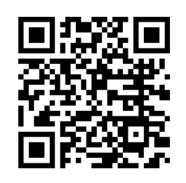
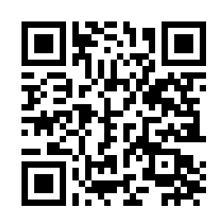
THANK YOU
Rob Scott
Community
Reinvestment
COLUMBUS CONSOLIDATED GOVERNMENT

