Slide 1
Pasco County Audrey Nelson Award 2023 Family Service Shelter
NCDA Legislative Conference
January 27, 2023
Marcy Esbjerg
Community Development Director
Hilary Bruno
Community Development Assistant Director
Don Anderson
Coalition for the Homeless of Pasco County CEO
Margaret Rogers
Catholic Charities, Diocese of St. Petersburg Executive Director

Slide 2
Mission Statements
Our mission at Community Development:
Improving the lives of Pasco’s citizens through homeless initiatives, neighborhood revitalization, affordable housing and community partnerships using state and federal funding.
Our mission is to support, coordinate and unify the efforts of all stakeholders and expand resources, while providing education and advocacy to prevent and reduce homelessness in Pasco County.
Catholic Charities serves with charity and compassion to promote the sanctity and dignity of all people with God. As a member of Church, Catholic Charities offers hope by helping house those in need and unites with others in service.

Slide 3
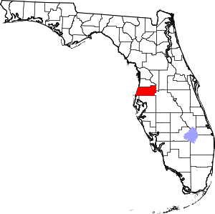
About Pasco County, FL
Population – 553,000 (just under 200,000 households)
Location – north of Tampa, FL on the Gulf of Mexico
Square Miles – 747
Owner-occupied/rental housing – 72/28%
LMI – 40% LMI, 54% Cost Burdened
CDBG - $2.9 million
HOME - $1.3 million
ESG - $255,000
CDBG-CV - $1.7 million/$1.99 million
ESG-CV - $834,000/$3.8 million

Slide 4
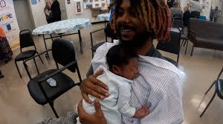
Family Homelessness in Pasco County
2017 Point in Time Count – 2500 persons
2017 Homeless and part of a family unit – 1800 – 72%
# of Emergency Shelter serving entire households - 0
Temporary residential housing allows the entire family to remain intact in their journey from homelessness, working on goals as a family unit.

Slide 5
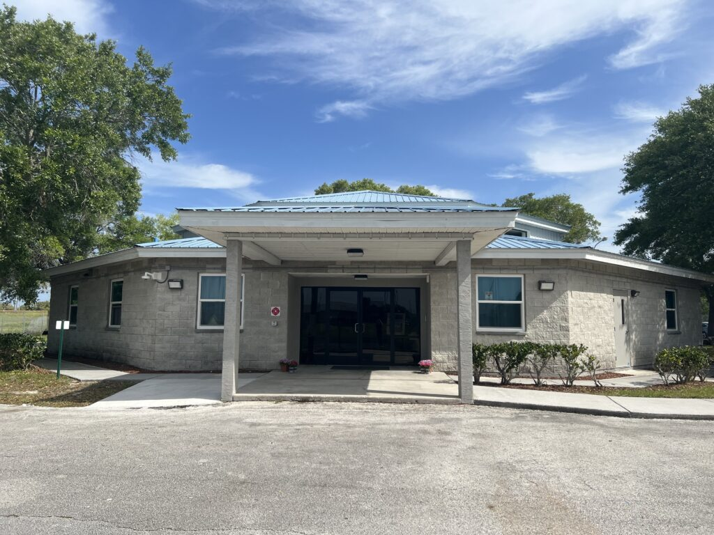
THE FUNDING – Leverage of Other Funds
The Pasco County Board of County Commissioners granted permission to rent and rehabilitate two vacant buildings owned by the county to the Coalition for the Homeless of Pasco County.
Total Rehab costs: $1,255,680 CDBG
$491,342 CDBG-CV to support shelter operations since opening October 2021-October 2023
$305,000 CDBG to support shelter operations 2023-2024
Creation of Community Partnerships

Slide 6
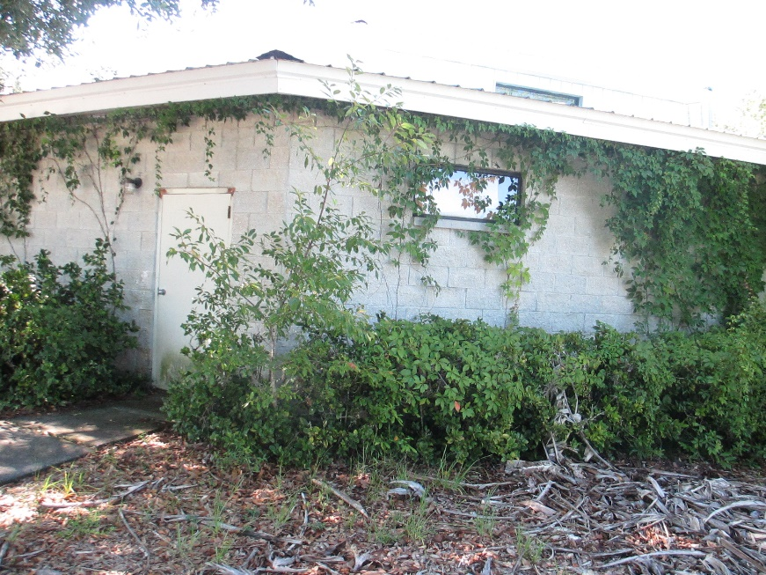
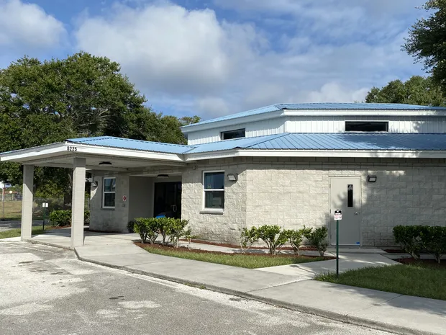
THE RESULTS – Family Service Shelter
Renovations created 9 sleeping pods that can be easily reconfigured based on family size
Up to 38 people can be served at any given time
34 households served in the first year – 62% moved to permanent housing opportunities of their choice
Households all came from unsheltered status and are referred through Coordinated Entry

Slide 7
Virtual Tour

Slide 8
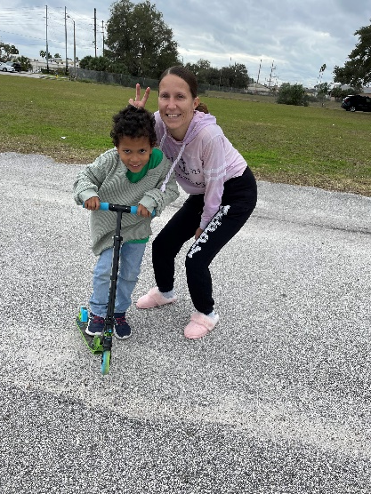
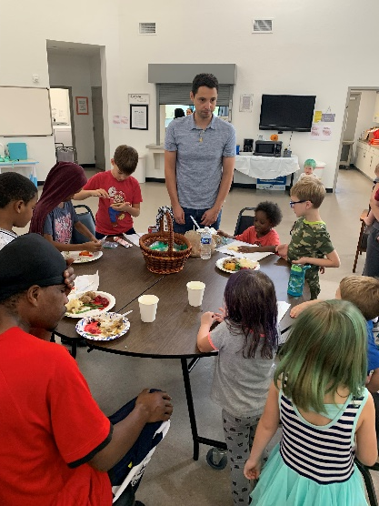
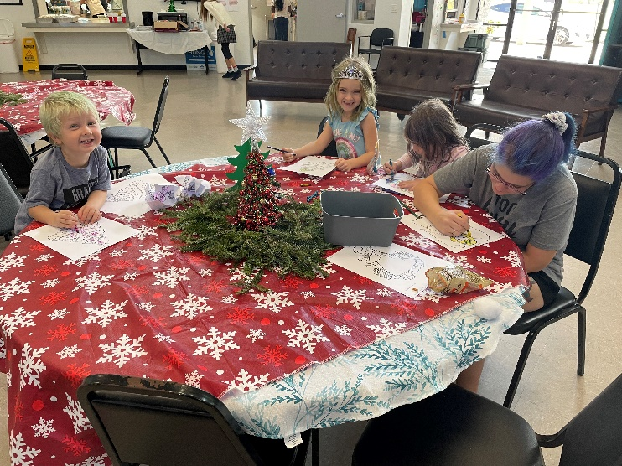
MORE ABOUT THE FAMILY SERVICES CENTER
First shelter in Pasco County to serve entire families
Strong partnership with Board of Education helps the children remain in their schools of origin by providing transportation
Family oriented – picnic tables, playground
Case management with a housing focus

Slide 9
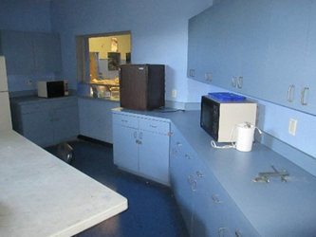
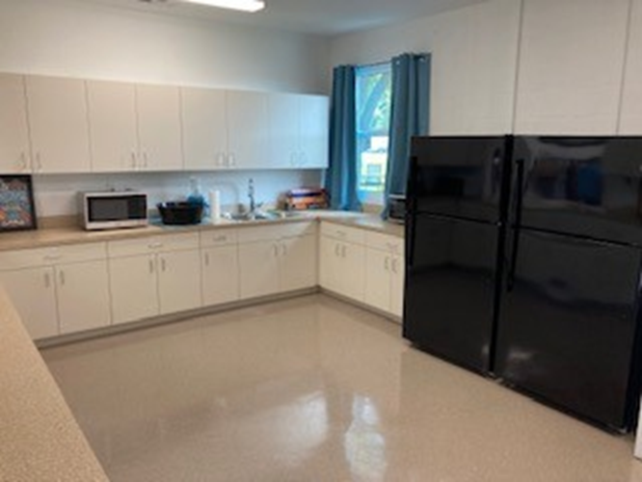
Before and After - Kitchen

Slide 10
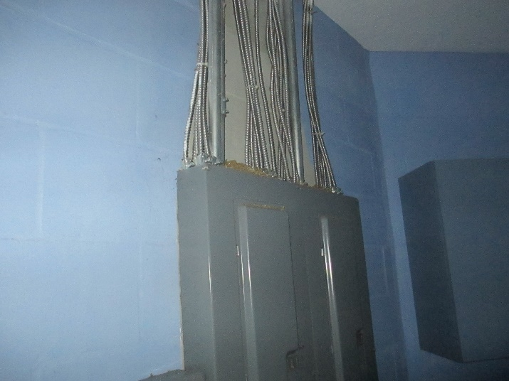
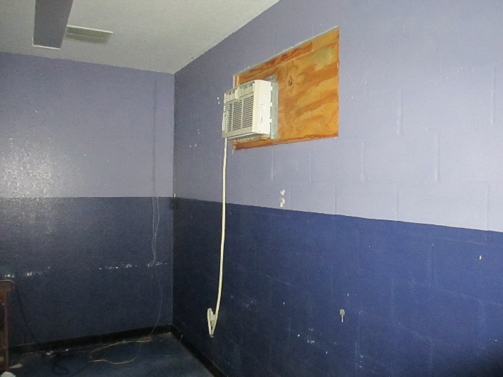
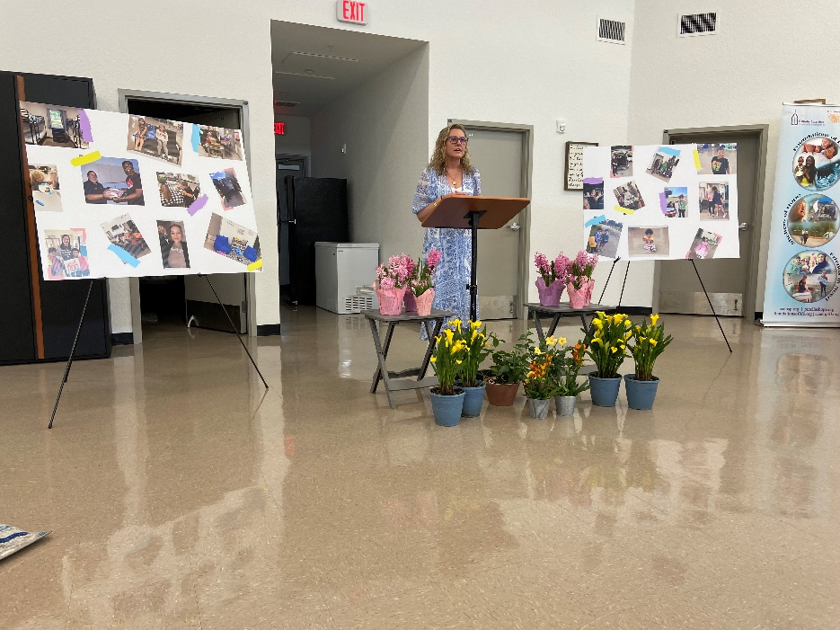
Before and After -

Slide 11
KEYS TO SUCCESS
Innovation – The Family Service Shelter has rooms that can be reconfigured based on family size. The Shelter building is owned by Pasco County, which ensures long term affordability of the program, and the rehabilitation of the building took significantly less time than new construction.
Collaboration – Key partners in this collaboration include the Coalition for the Homeless of Pasco County and Catholic Charities as non-profit partners, Pasco County Community Development, the Continuum of Care of Pasco County and our religious community that provides meals.
Sustainability – Grant funds enabled the renovation to take place without additional debt on the property. The long-term lease between Pasco County and the Homeless Coalition of Pasco County ensures ongoing affordability.

Slide 12
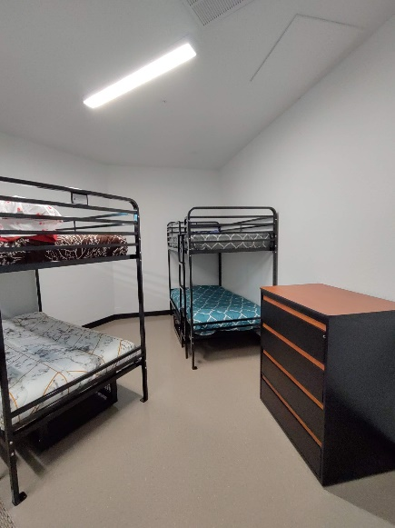
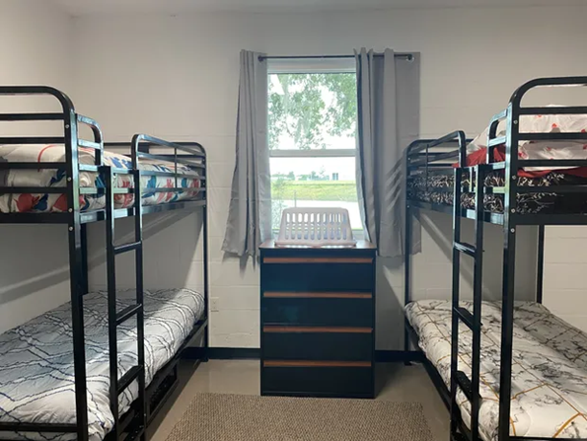
Timeline for Family Services Shelter
June 2018 – The Board of County Commissioners approved the lease to the Coalition for the Homeless of Pasco County.
April 2019 – bids for rehabilitation opened and awarded
Delays in rehabilitation attributable to areas of concern not identified in initial scope of work and COVID-19
First families moved in on October 21, 2021

Slide 13
Questions?
Pasco County Community Development
mesbjerg@pascocountyfl.net
727-834-3447
hbruno@pascocountyfl.net
727-834-3447
don@pascohomelesscoalition.org
727-842-8605
mrogers@ccdosp.org
727-893-1314

