Slide 1
2022 NCDA
Audrey Nelson Award
Palladium Redbird
City of Dallas
February 4, 2022
Kyle Hines, Assistant Director
Housing & Neighborhood Revitalization
City of Dallas
Shanee Weston, Outreach Specialist
Budget & Management Services
City of Dallas

Slide 2
Presentation Overview
Introduction
Project Overview
City of Dallas Participation
Questions

Slide 3
Introduction
Office of Budget & Management Services – Grant Administration Division manages program oversight, budget development, financial management, citizen participation
Chan Williams
Assistant Director
Justus Bolo
Program Manager
Shanee Weston
Outreach Specialist
Mary Kate Bevel
Grant Strategic Program Analyst

Slide 4
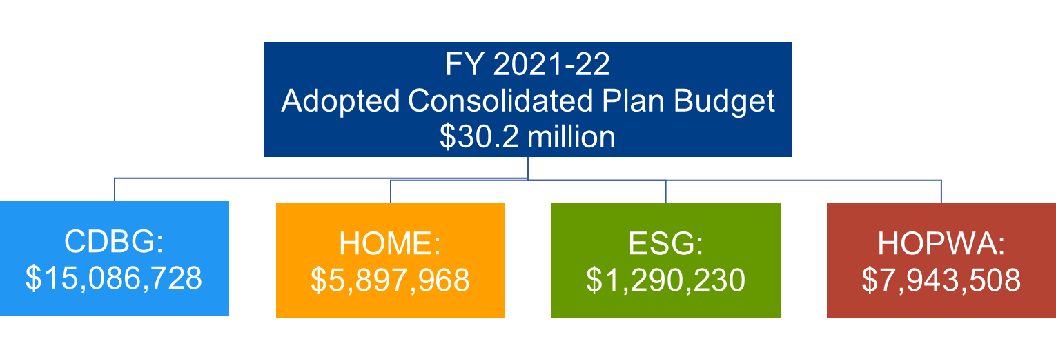
City of Dallas HUD Allocation
Grant Administration team partners with City departments to manage HUD Grant fund projects
Partnerships with Community Housing Development Corporations and other developers used to construct and provide affordable housing for LMI households

Slide 5
Project Overview
Palladium Redbird is located at 7502 S. Westmoreland Road
300 Total Units
210 units reserved for residents earning at or below 80% area median income (AMI)
90 units at market rate/non-income restricted
4-Story construction with structured parking
Class A amenities such as:
Resort style pool, outdoor kitchen/grilling stations, community clubhouse, fitness center, business center, granite counter tops, stainless steel appliances, private balconies/patios
$60,000,000+ investment into mixed-income, workforce housing for the City of Dallas

Slide 6
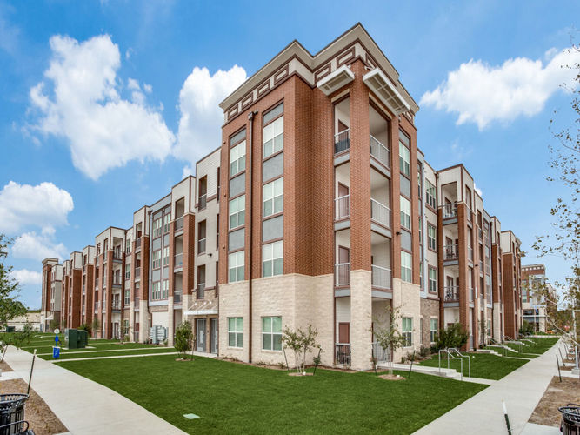
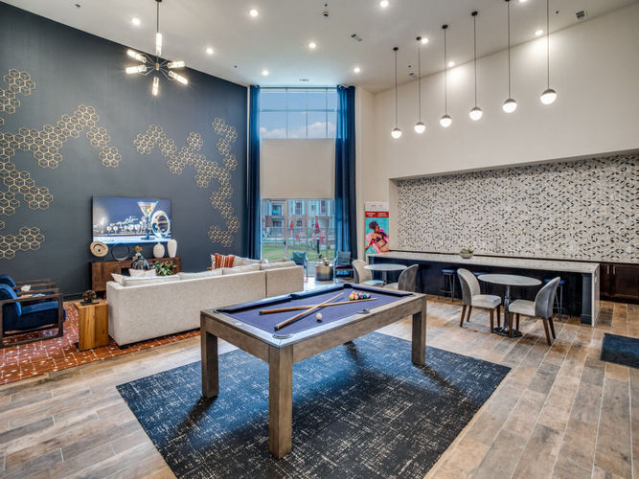
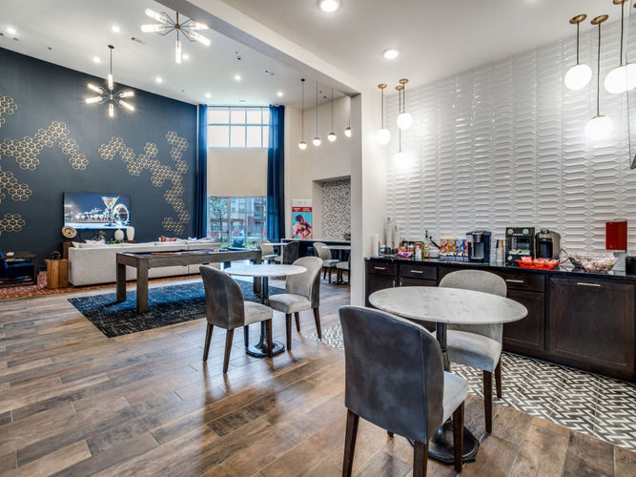
Project Overview
Project completed in 2021 and 100% occupied

Slide 7
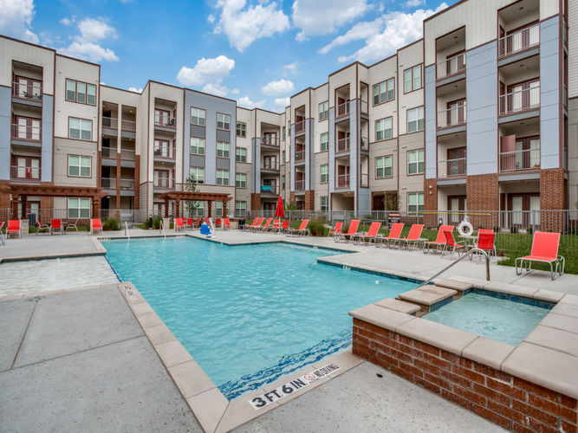
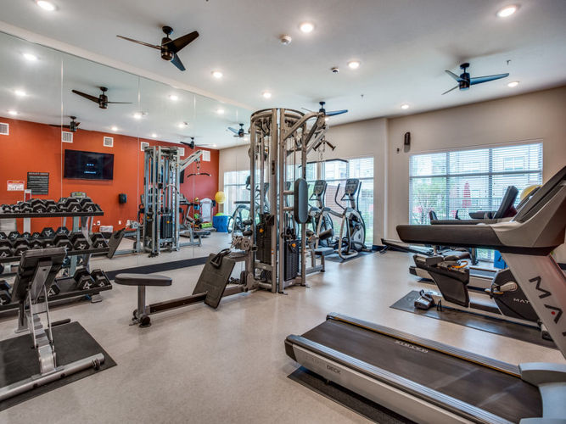
Project Overview
Class A Amenities

Slide 8
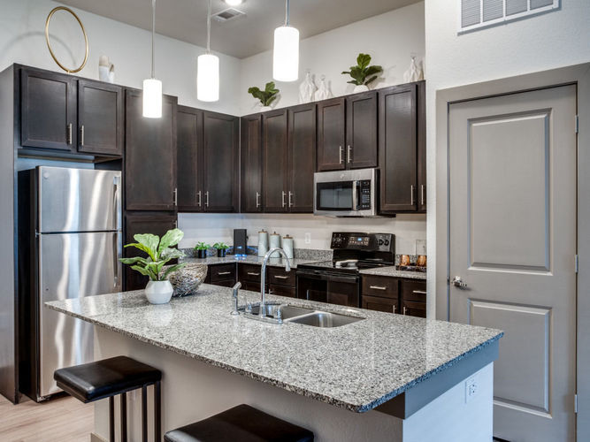
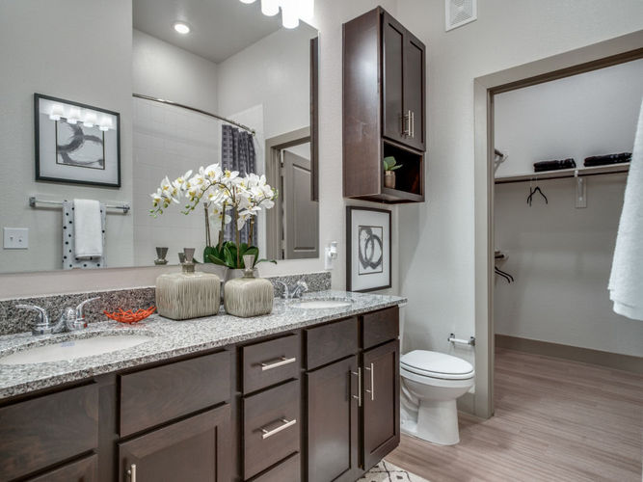
Project Overview
Interiors

Slide 9
Project Overview
Located 15 minutes from CDB and near other employment centers such as the I-20 Inland Port
Palladium Redbird

Slide 10
Project Overview
Palladium Redbird serves as a catalyst project for the Red Bird Community and is part of a 95-acre redevelopment of the Southwest Center Mall
In addition to Palladium Redbird, the redevelopment will include over 200,000 SF of office space and 150,000 SF of retail space in converted mall space
Non-residential development will total over $200M
City providing $20M in incentives and gap financing for the redevelopment
Tenants include Parkland Hospital, UT Southwestern Medical Center, Chime Solutions, Marriott (Courtyard + Residence Inn), other retailers

Slide 11
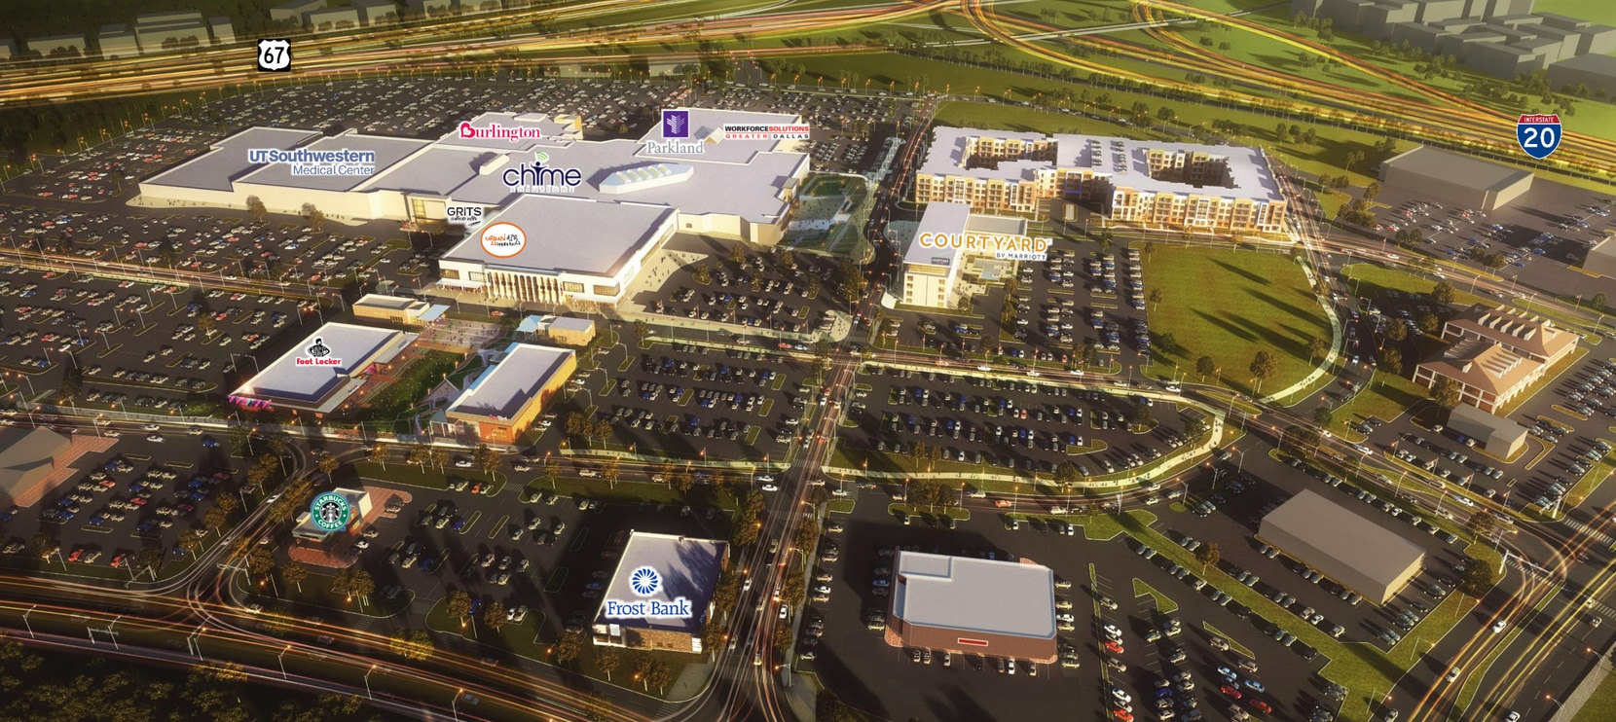
Project Overview
Palladium Redbird

Slide 12
City of Dallas Participation
The City of Dallas invested CDBG, HOME, and Bond Funds
CDBG: $1,271,576
HOME: $5,000,000
Bond: $2,028,424
Total: $8,300,000
Funds awarded through the Department of Housing & Neighborhood Revitalization’s 2018 Notice of Funding Availability
City of Dallas Housing Finance Corporation (DHFC) is the general partner of the Palladium Redbird ownership entity to provide a property tax exemption
DHFC issued $30,000,000 in private activity bonds
Remaining balance was funded using 4% low-income housing tax credits

Slide 13
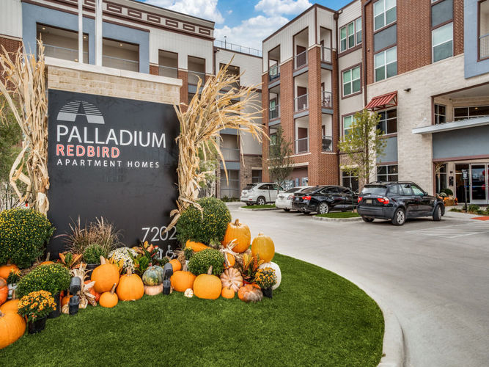
Questions

Slide 14
2022 NCDA
Audrey Nelson Award
Palladium Redbird
City of Dallas
February 4, 2022
Kyle Hines, Assistant Director
Housing & Neighborhood Revitalization
City of Dallas
Shanee Weston, Outreach Specialist
Budget & Management Services
City of Dallas

