Slide 1
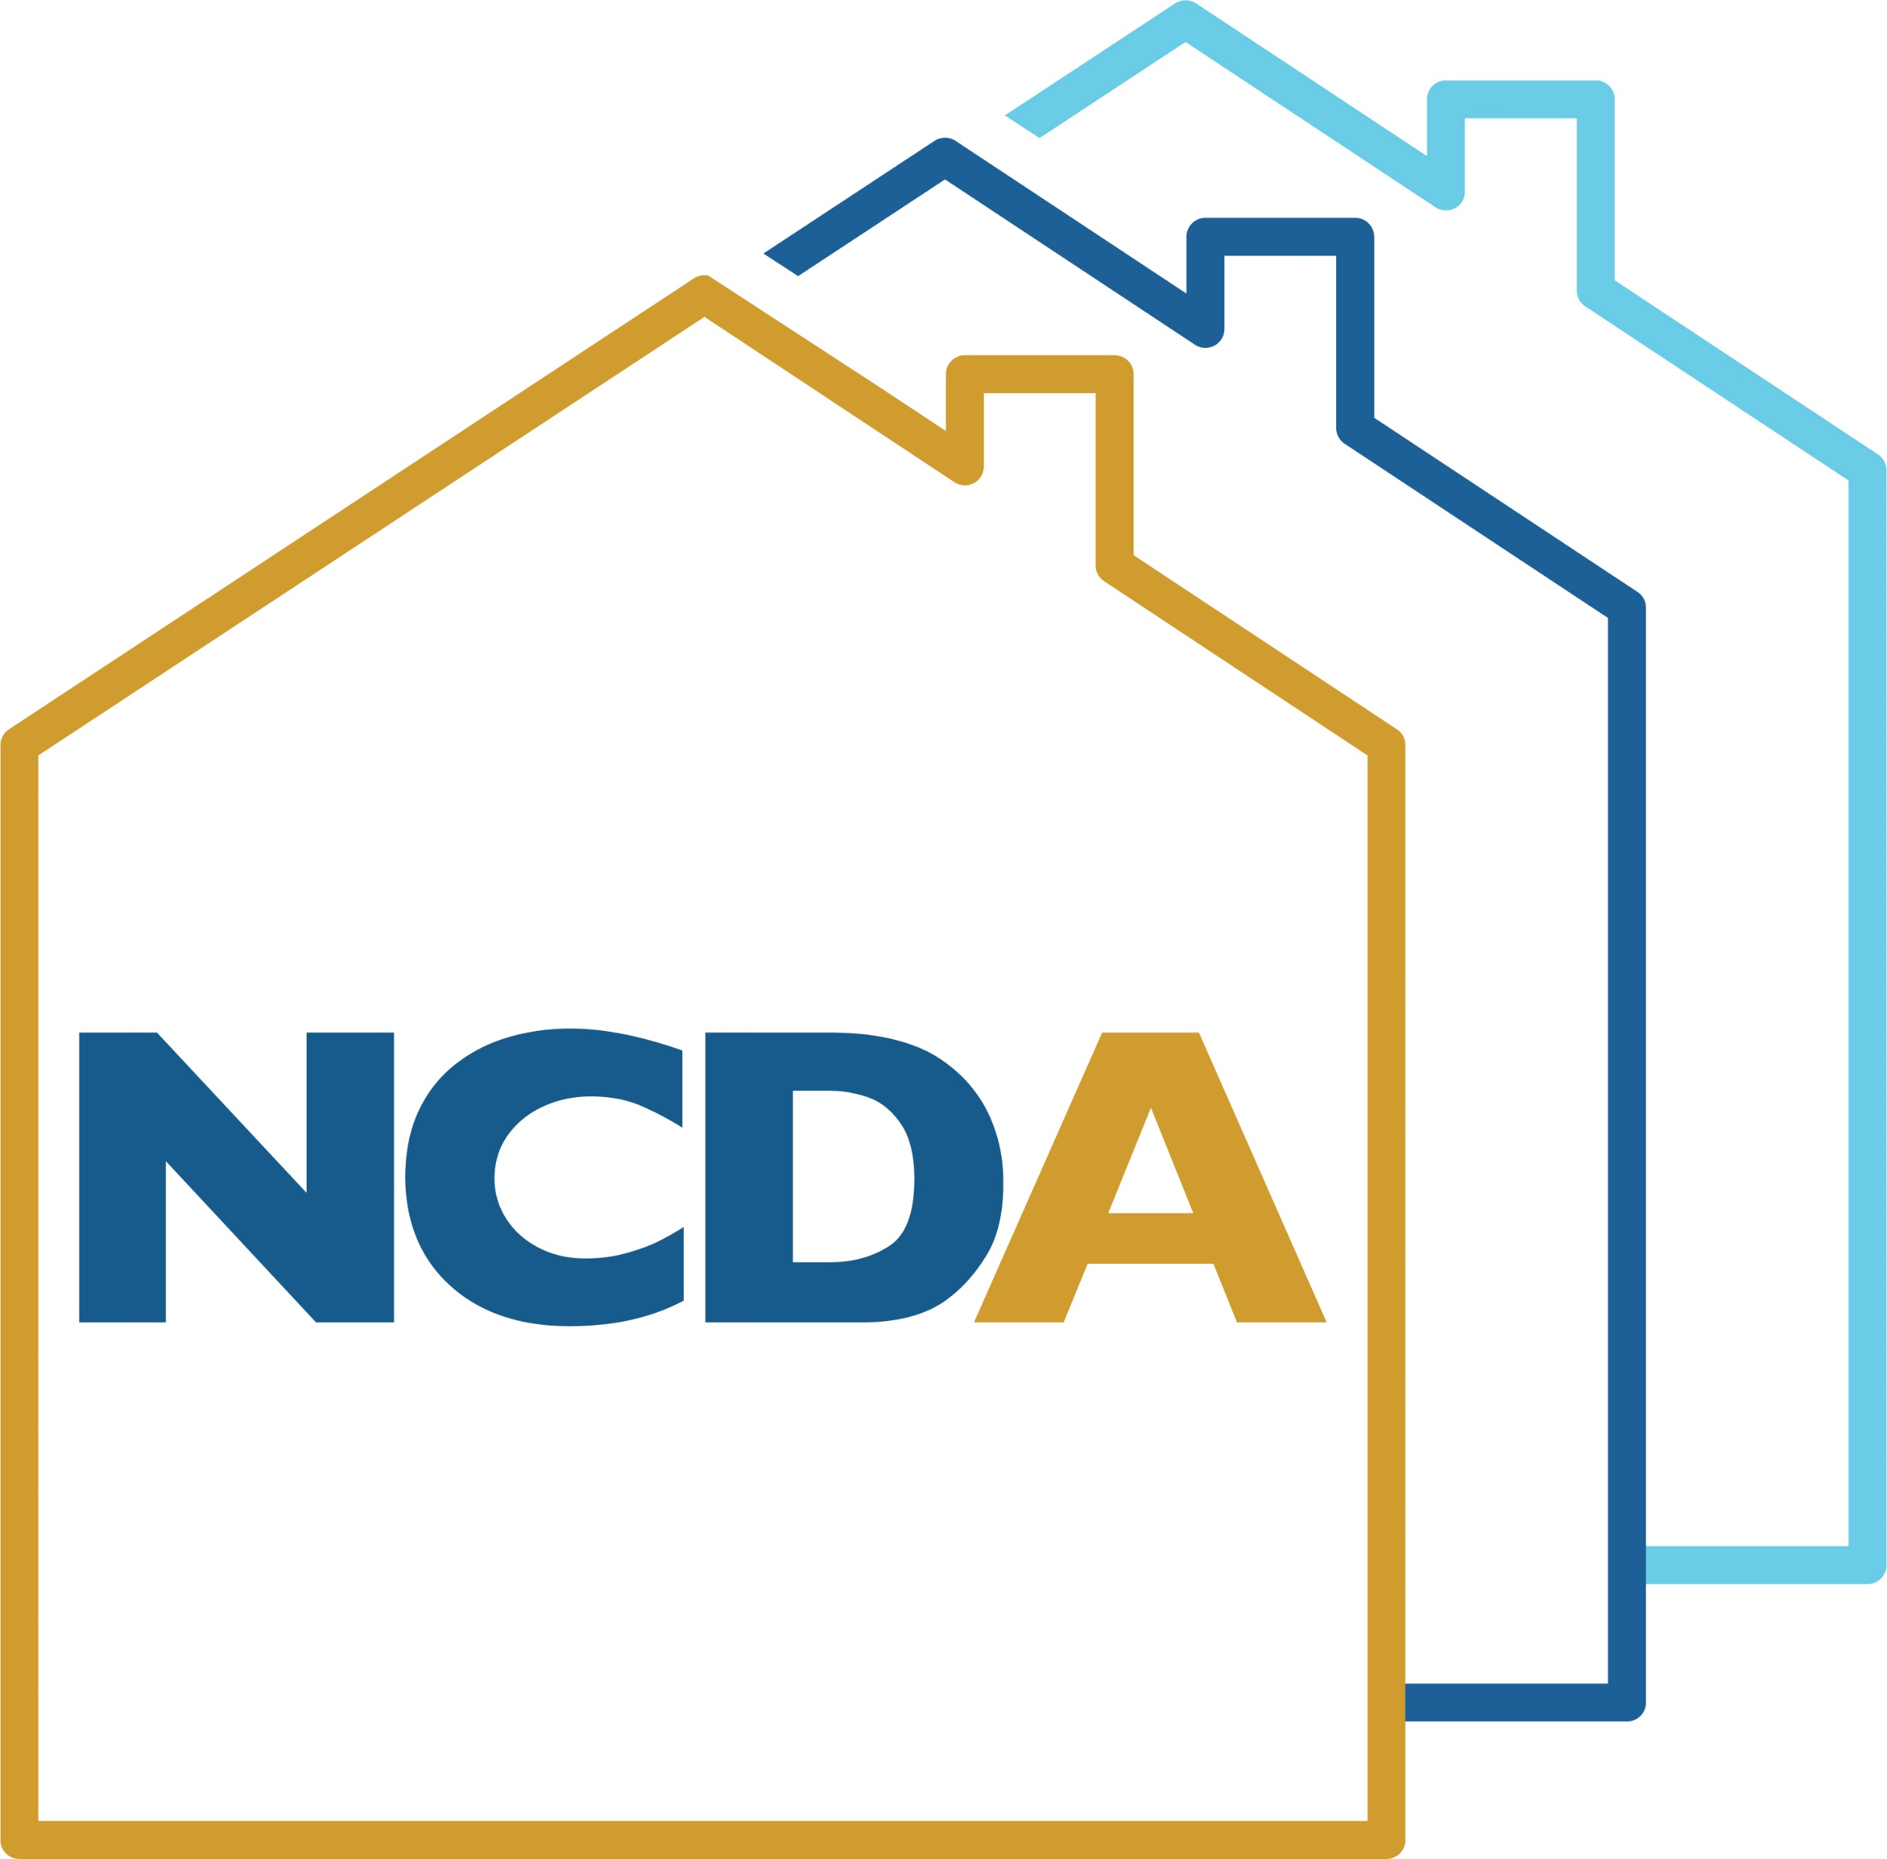
HUD CPD Policy Priority Resources
Using CPD Funds to Advance Climate Resilience, Economic Recovery, and Housing Priorities

Slide 2
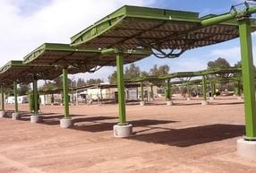
Community Planning and Development
The Office of Community Planning and Development (CPD) is dedicated to empowering local communities by ensuring:
Access to decent affordable housing
Safe and sustainable living environment
Strong economic opportunities
Community-centered development
Equity and inclusion

Slide 3
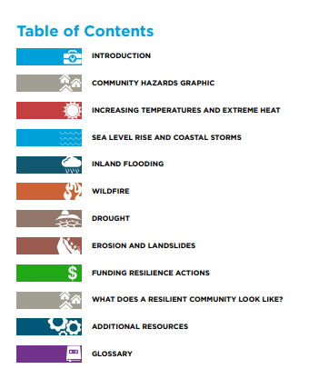
Community Resilience Toolkit
User-friendly tool for grantees outlining a range of climate actions to increase the resilience of LMI populations
Developed in response to 2016 rule Modernizing HUD’s Consolidated Planning Process to Narrow the Digital Divide and Increase Resilience to Natural Hazards, which requires jurisdictions to consider climate-related natural hazard risks, and how to build resilience to those risks, in developing their Consolidated Plan.
Supporting Local Climate Action - HUD Exchange

Slide 4
Community Resilience Toolkit Continued
Simplified risk assessment to build an understanding of risks your community may face
Features six hazards a range of resilience actions and funding strategies
Supporting Local Climate Action - HUD Exchange

Slide 5
Resilience Implementation Guides
Step-by-step instructions on how to implement specific climate resilience activities
Topics include:
Nature-based Solutions
Community Resilience Education
Resilient Single-family Retrofits
Community Resilience Hubs
Community-driven Relocation
Cool Roofs: Mitigating Extreme Heat
Supporting Local Climate Action - HUD Exchange
Notes:
In addition to the Community Resilience Toolkit, HUD is producing a set of activity implementation guides that will serve as step-by-step instructions for how to complete a climate resilience activity.
These guides will focus on a specific activity and walk through each step, from design through implementation to reporting on outcomes.

Slide 6
Economic Recovery Toolkit
Comprehensive guide outlining common economic development and recovery strategies
Focuses on building equitable and resilient economies that support local businesses
Toolkit in response to the economic impact of the COVID-19 pandemic

Slide 7
Economic Recovery Toolkit Continued
The Toolkit Provides –
Guidance on seven common and high-impact economic development activities
An overview of when and how to launch the specific strategy within a community
Where and how CPD funding can fit in
Case studies

Slide 8
Economic Recovery Implementation Guides
Step-by-step guides outlining process for implementing specific economic development strategies
Topics include:
Equity and Planning
Job Training
Commercial Redevelopment
Small and Microenterprise Activities
State Grantee Activities
Small Grantee Activities
Notes:
As with the Community Resilience Toolkit, the Economic Recovery Toolkit will also be accompanied by implementation guides.
HUD knows that it can be difficult to get activities started
the hope with the implementation guides is that they demystify economic development strategies and provide clear steps to equitable implementation.

Slide 9
Housing Supply Toolkit
Outlines 4 key affordable housing supply strategies
Connects equity to the development of affordable housing
Addresses the need to cultivate and maintain partnerships to combat NYMBYism
Expands the notion of housing as merely “bricks-and-mortar.”
Highlights case studies that deployed local strategies and used CPD funding sources

Slide 10
Mayor’s Guides to CPD Programs
2-page policy briefs
Outline how CPD programs can support community and economic development priories
Targeted at elected officials
Link to CPD field office contacts

