Slide 1


Online Mapping Tools
A Review of
CPD Maps | ArcGIS | HUD Open Data

Slide 2
Session Overview
Introduction
Overview
CPD Maps
ArcGIS
HUD Open Data
Add/Edit Layers
Resources
Questions
Omri Gross
CPD Representative
U.S. Dept of HUD
Columbus Field Office
          omri.gross@hud.gov
Notes:
Hello everyone and Thank You
My name is Omri Gross
HUD CPD Rep
But before HUD, I worked for Franklin County, Ohio and before that the Mid Ohio Regional Planning Commission
Had to learn how to use various mapping and navigate the limitations and restrictions by resources like HUD CPD Maps
That’s why today..
Have the pleasure of showing you how to easily create, customize and share your own CPD Maps.

Slide 3

Introduction
In this session, you will learn how to:
Use and navigate HUD CPD Maps
Utilize HUD Open Data map layers
Create and use a free, ArcGIS public account
Create customizable layers and maps in ArcGIS that can be edited, saved and shared

Slide 4



Introduction
Resources
PowerPoint
ArcGIS Map Template
Index – Glossary
PDF
Click on an icon above to access a resource
Notes:
In addition to this PPT and a CPD Map I created for this session (which I will make available), I also put together a handy PDF Manual that covers everything I’ll go over today during this session.
The (fully searchable) Manual consists of:
Step-by-step instructions (with screenshots)
An Index (with clickable links)
A Glossary (of key terms)

Slide 5
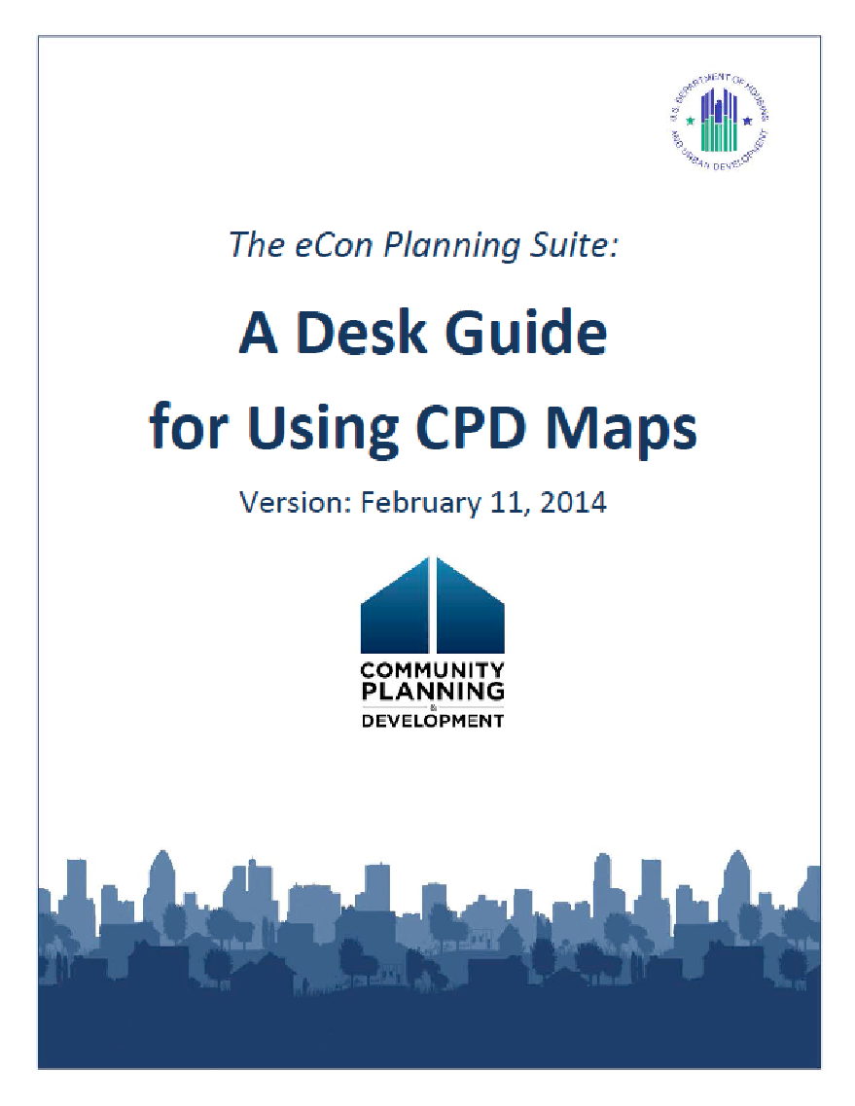
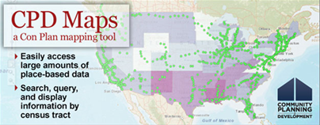
Overview
What is CPD Maps?
Located in HUD’s eCon Planning Suite, CPD Maps is an online mapping tool that offers a large amount of data for grantees and the general public to search, query, display, identify and analyze the needs of their community.
Geographic, census and IDIS data
Generate reports
Can NOT save or share maps
Limited customizability
Created as a tool for communities to generate the maps, data and reports for the 5-year Consolidated Plan
Click for CPD Maps
Click for CPD Maps Desk Guide

Slide 6

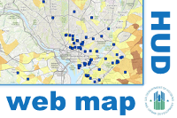

Overview
What is HUD Open Data?
HUD Open Data provides interested researchers with access to the original data sets generated and compiled by HUD data collection efforts.
American Housing Survey
HUD median family income limits
Housing discrimination data
HUD-insured multifamily housing data
Public Housing data
Geographic, census and HUD IDIS data
Configured map layers
Map layer data server
Click for HUD Open Data Sets
Click for HUD Official Content on ArcGIS

Slide 7
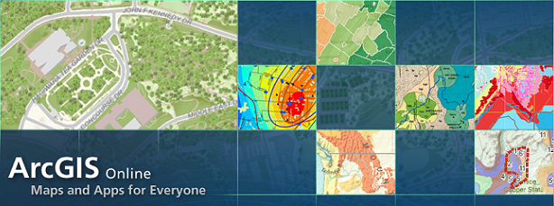
Overview
What is ArcGIS?
ArcGIS is a public online geographic information system (GIS) for maps and geographic information.
Creating and using maps
Compiling geographic data
Analyzing mapped information
Sharing geographic information
Click Image for ArcGIS Online

Slide 8
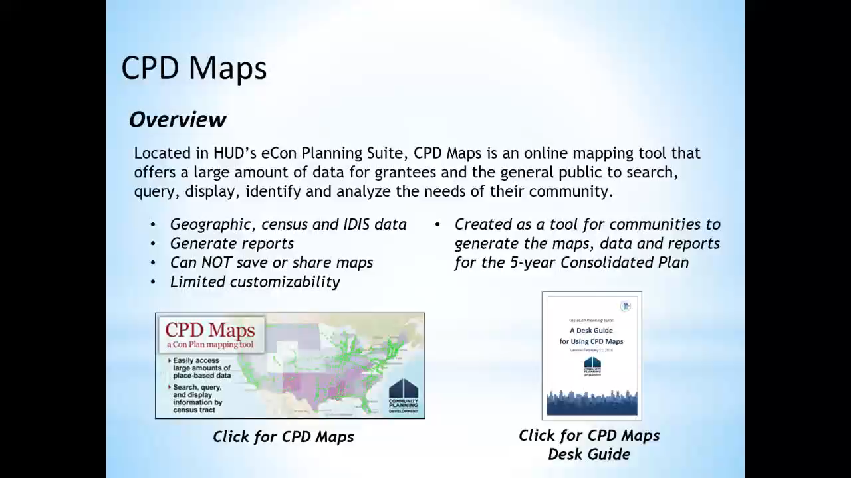
CPD Maps
Overview and Reports
CLICK HERE TO WATCH VIDEO

Slide 9

CPD Maps
Submitting Content Directly to Consolidated Plan (IDIS)
The IDIS Consolidated Plan Template can pull maps, data tables and other content directly from CPD Maps and other resources online.
Maps, Reports, Data Tables, Images
Attaching maps to Con Plan is not required, but extremely useful
Maps easily illustrate the boundaries of target areas where narrative cannot
Maps help satisfy Con Plan requirements to describe areas of low-income and minority concentration.
Maps from other sources can be added to the plan using the “Add Image” feature.

Slide 10
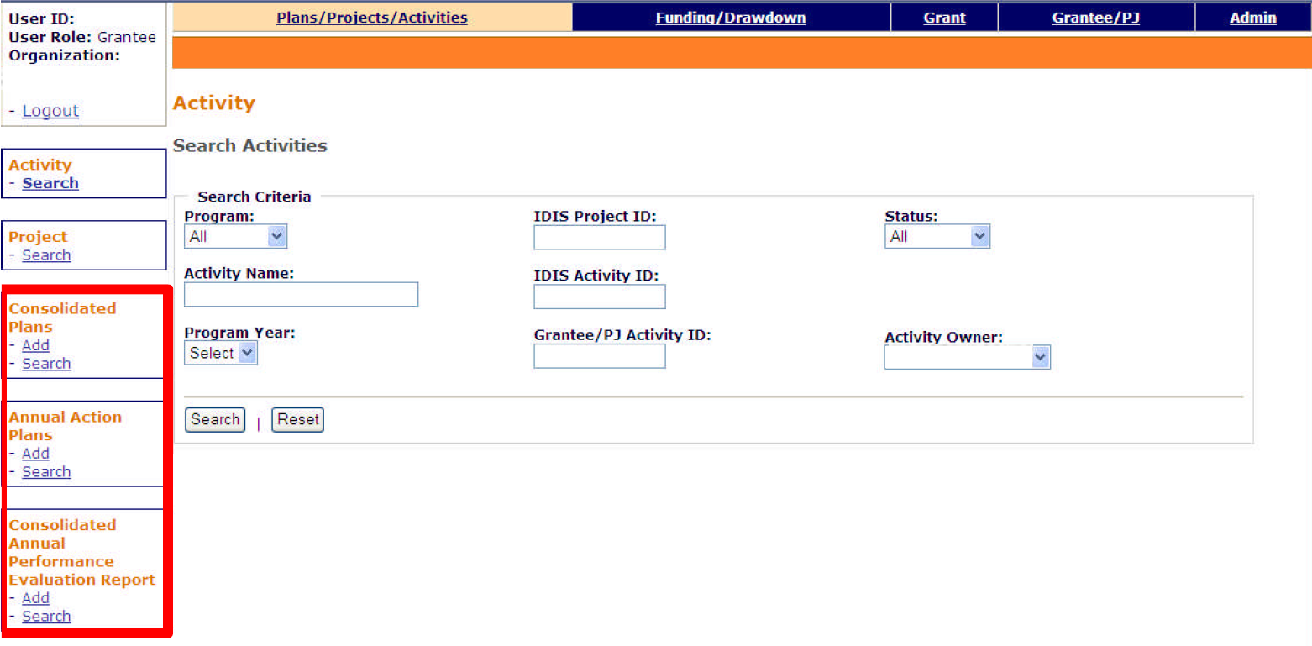
CPD Maps
Submitting Content Directly to Consolidated Plan (IDIS)

Slide 11
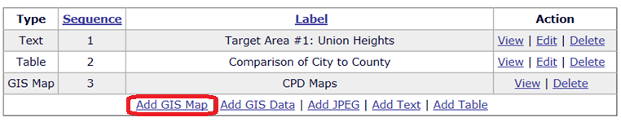
CPD Maps
Adding a GIS Map to Consolidated Plan (IDIS)
Take the following steps to add a map to the template:
Click on the <Add GIS Map> link. A new browser window will open to display HUD CPD Maps.
Use the Layers widget to create the grantee’s desired map.
To send the map back to IDIS Online, click on the Print widget, provide title, and click the <Export to IDIS> button.
A popup box will appear that reads “Map & Legend image successfully exported to IDIS.” Click <Ok> to close the box.
Back in IDIS, click the <Save> or the <Save and Return> button to save the changes. The map will now be listed under the selected narrative or data table. To view the map, click on the <View> link.
The browser window that CPD Maps opened in can be closed. A new browser window will open each time the <Add GIS Map> link is clicked.

Slide 12
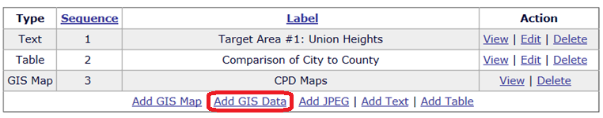
CPD Maps
Adding GIS Data to Consolidated Plan (IDIS)
Take the following steps to add a data table to the template:
Click on the <Add GIS Data> link. A new browser window will open to display CPD Maps.
Click the Reports widget to open it.
Select one or more target geographies and change the Dataset name.
Ensure that the “Export to IDIS” box is checked and click <Next>.
Select the data table to insert by choosing a table.
Click the <Finish> button. A popup box will appear that reads “Report successfully exported to IDIS.” Click <Ok> to close the box.
Back in IDIS, click the <Save> or <Save and Return> button to save the changes.
The browser window that CPD Maps opened in can be closed. A new browser window will open each time the <Add GIS Data> link is clicked.

Slide 13
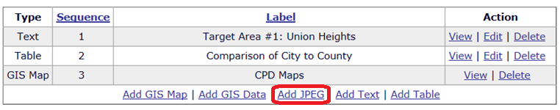
CPD Maps
Adding Images Directly to Consolidated Plan (IDIS)
Take the following steps to add a data table to the template:
Click the <Save> button to save any changes to the page before adding the .jpeg.
Click on the <Add JPEG> link. A new browser window will open.
Provide a label in the Label field. This label will display below the image in the printed version of the template.
Click on the <Choose File> button. In the resulting box, locate the desired .jpeg file and click the <Open> button.
Click the <Save> button in the dialog box to close it and click <Save> on the IDIS screen to save the change.

Slide 14
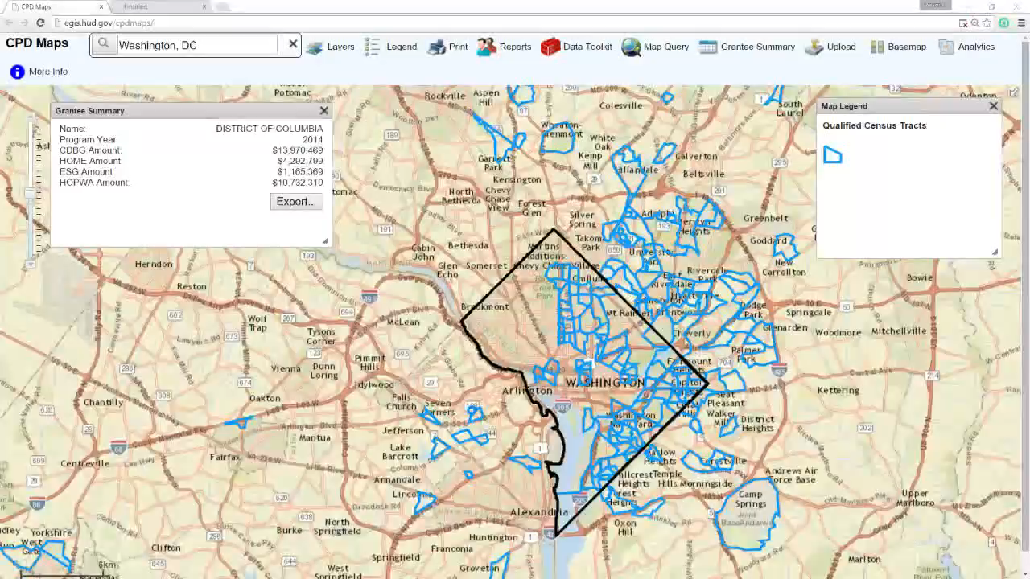
CPD Maps
Data Toolkit
The Data Toolkit is used to compare data of designated geographic areas to the national averages for those topics.
CLICK HERE TO WATCH VIDEO

Slide 15
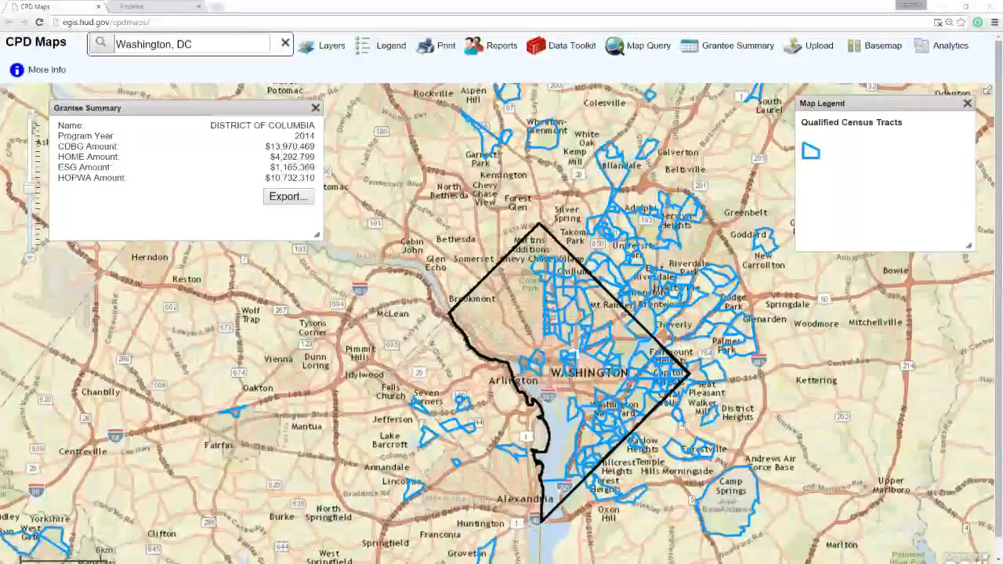
CPD Maps
Map Query
The Map Query Tool is used to identify designated geographic areas that share similar data with each other.
Video
Click Map Query
Select Grantee Jurisdiction & Tract
Click Next
Select 3 topics (Old people + Vacancy Rate)
29%,20%,15%
Finish
Select one of the tracts in window
Click Export
CLICK HERE TO WATCH VIDEO

Slide 16
Overview
What is ArcGIS?
ArcGIS is a public online geographic information system (GIS) for maps and geographic information.
Creating and using maps
Compiling geographic data
Analyzing mapped information
Sharing geographic information
Click Image for ArcGIS Online

Slide 17
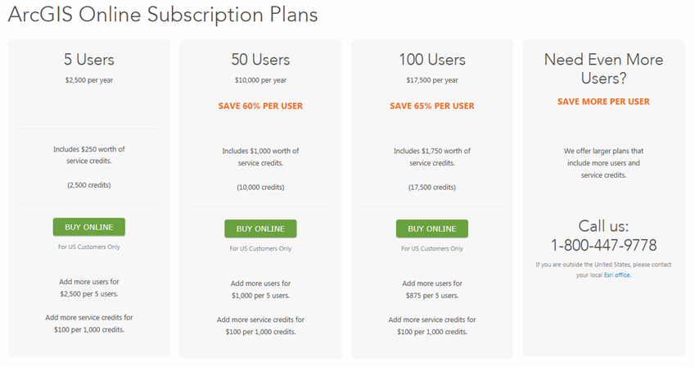

ArcGIS
Paid Plans
Features

Slide 18
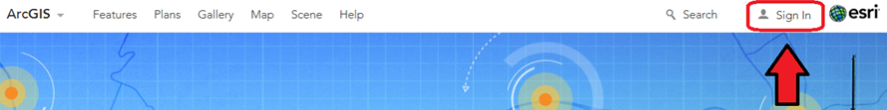
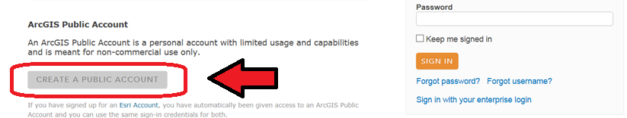
ArcGIS
Signing up for a Public Account
  Visit www.arcgis.com
  Click “Sign In” (top-right)
  Click “Create Public Account”

Slide 19
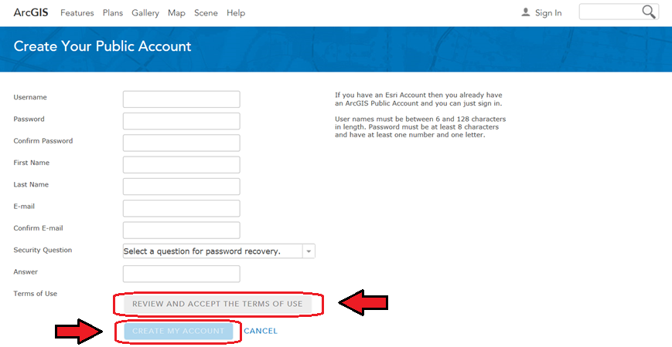
ArcGIS
  Complete Form
  Click “Review and Accept Terms “
  Click “Create My Account”

Slide 20
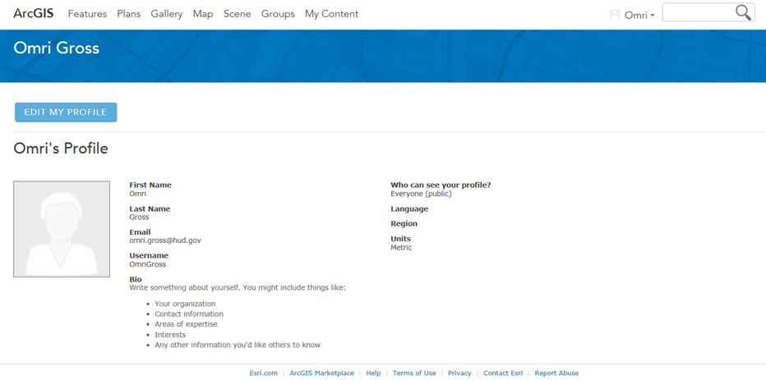
ArcGIS
Profile Page

Slide 21
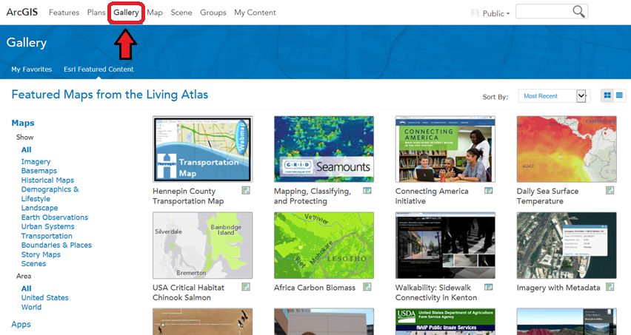
ArcGIS
Gallery

Slide 22
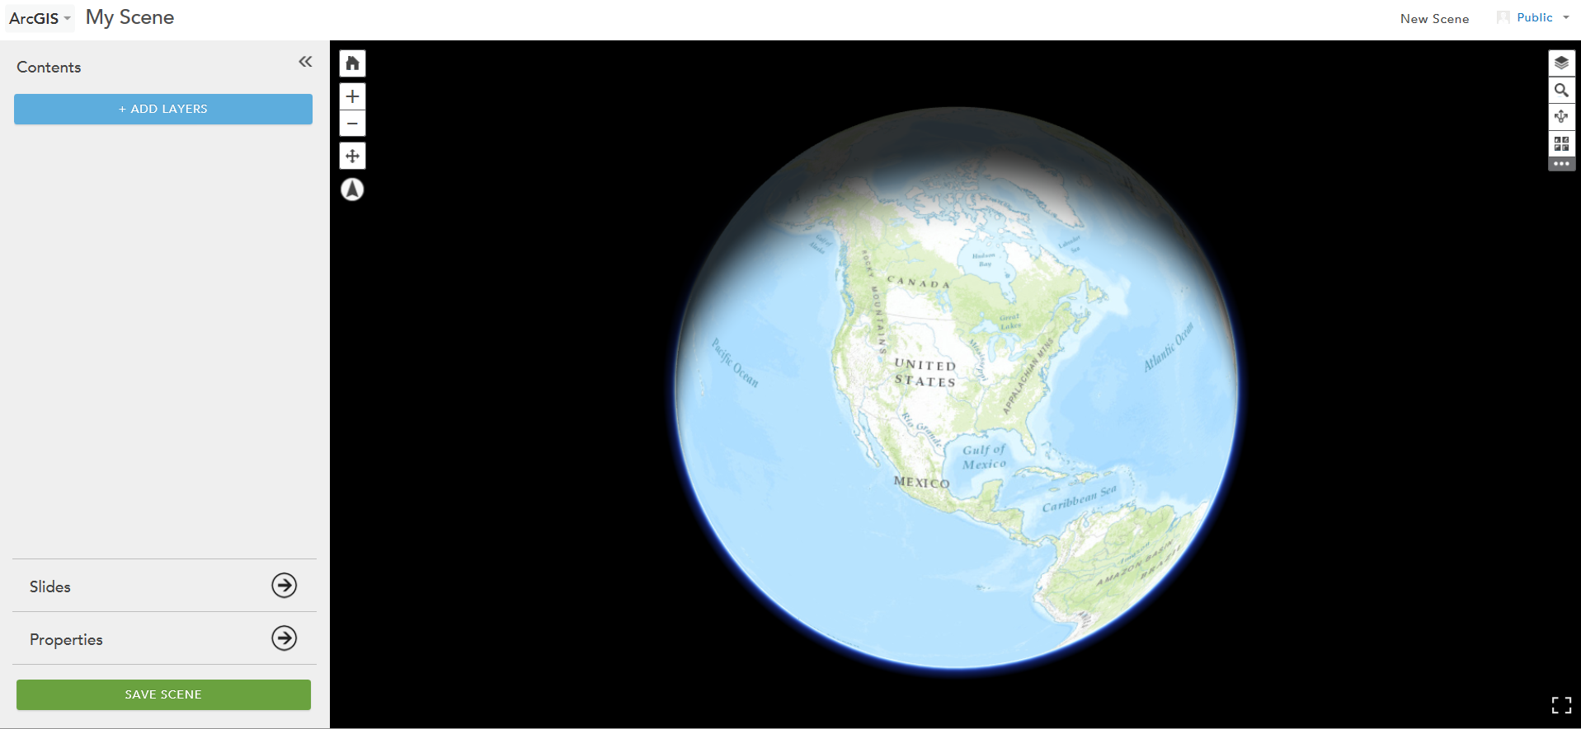
ArcGIS
Scene

Slide 23
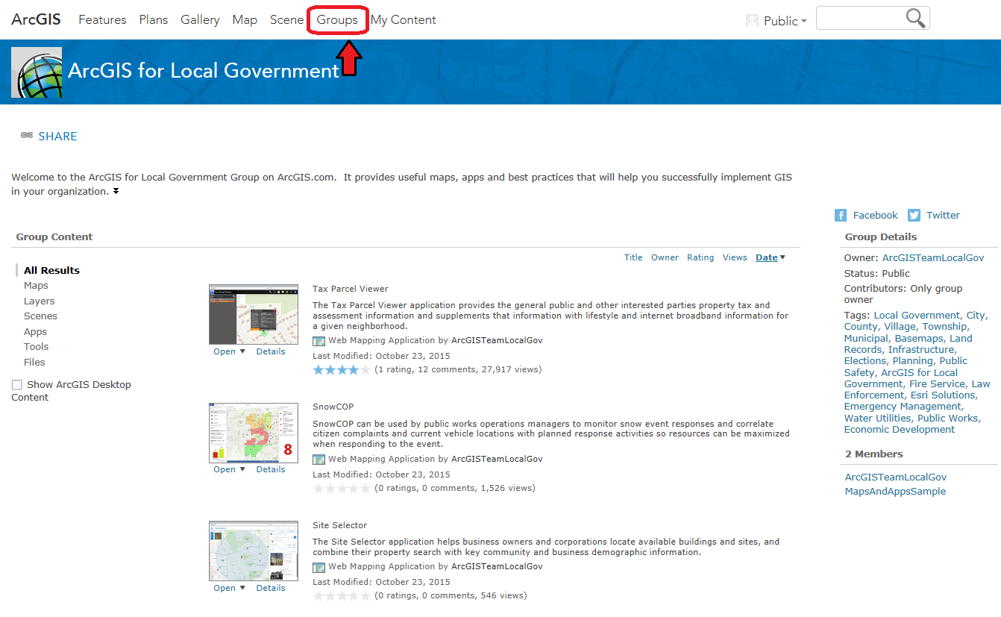
ArcGIS
Groups

Slide 24
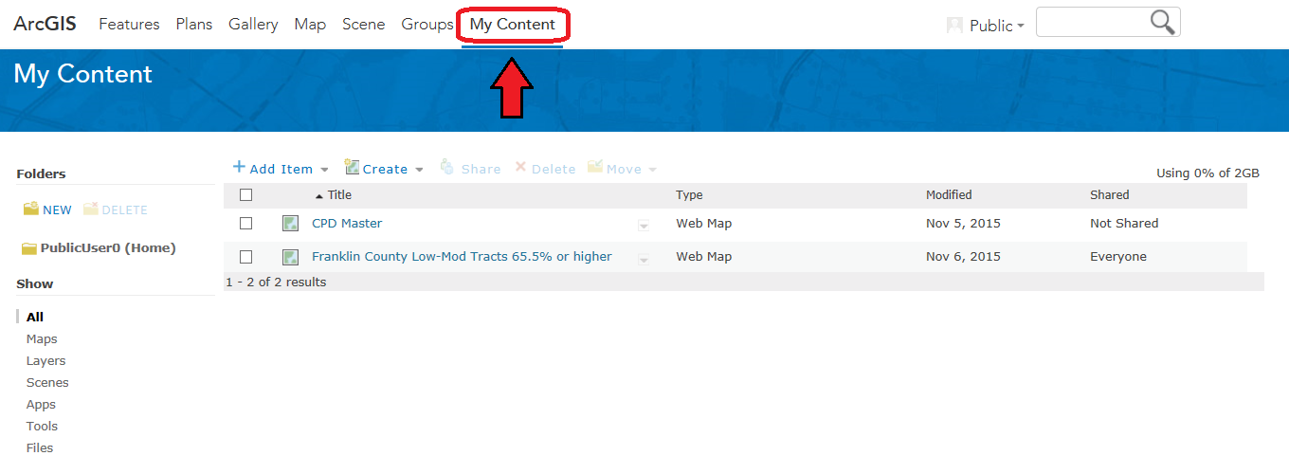
ArcGIS
My Content

Slide 25
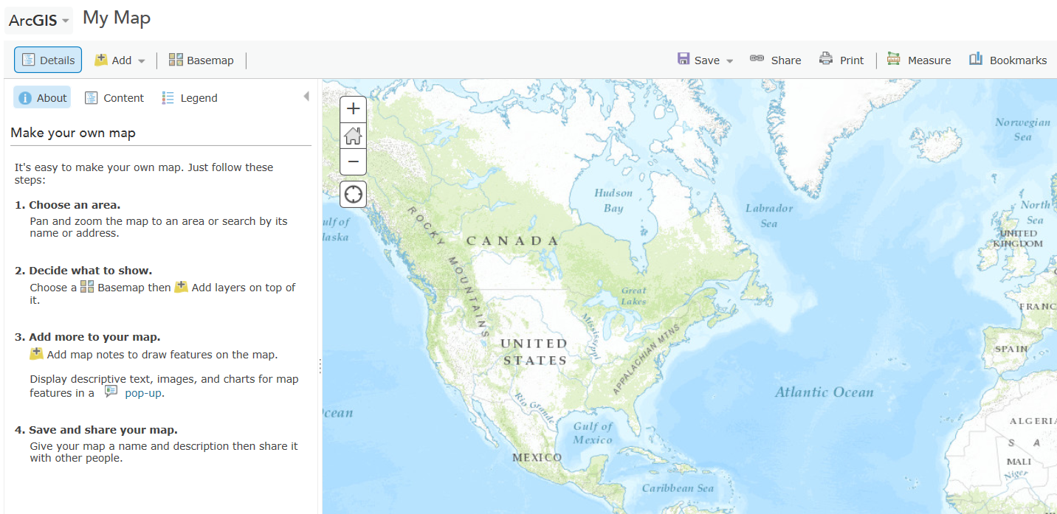
ArcGIS
MAP!

Slide 26
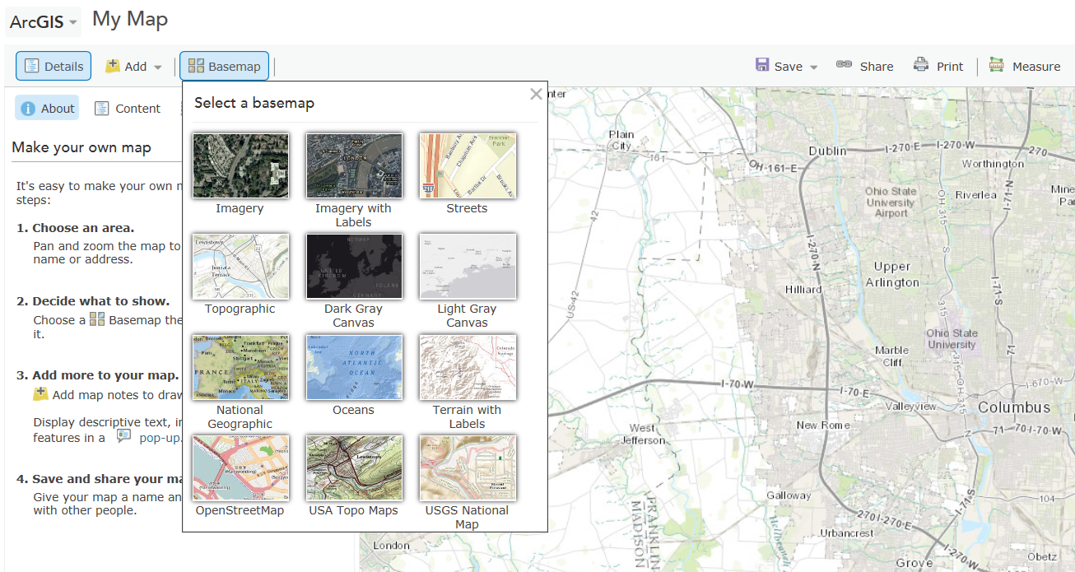
ArcGIS
Select Basemap

Slide 27
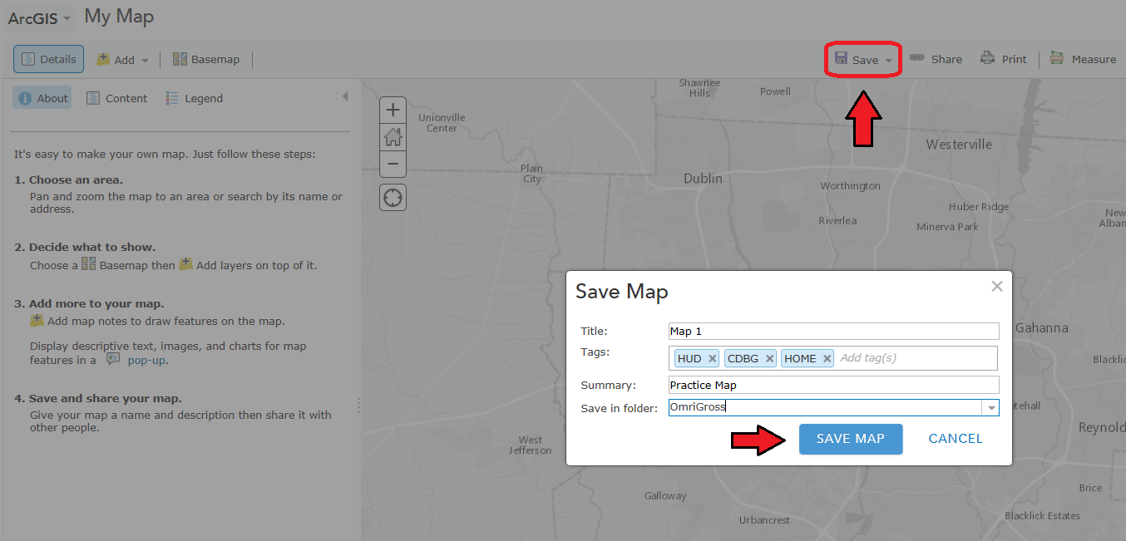
ArcGIS
Save Map

Slide 28
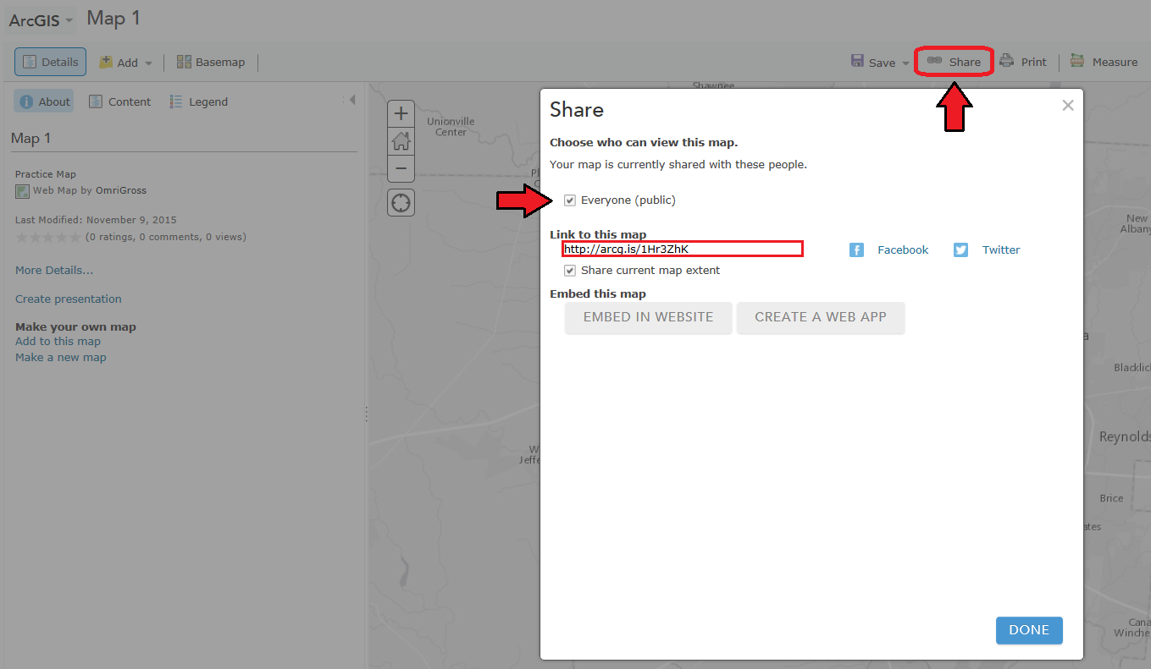
ArcGIS
Share Map

Slide 29
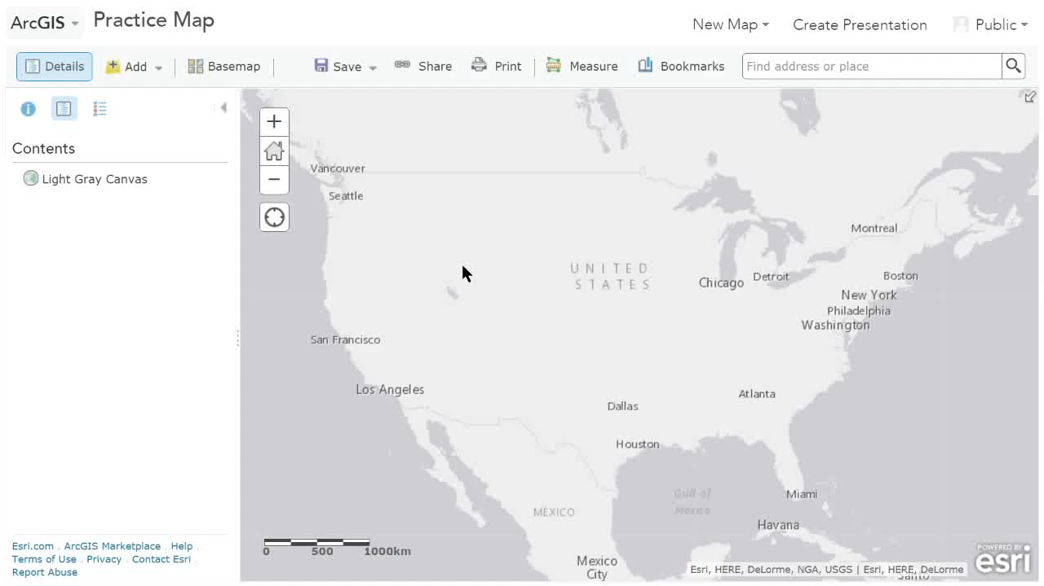
ArcGIS
Search for Layers
CLICK HERE TO WATCH VIDEO

Slide 30
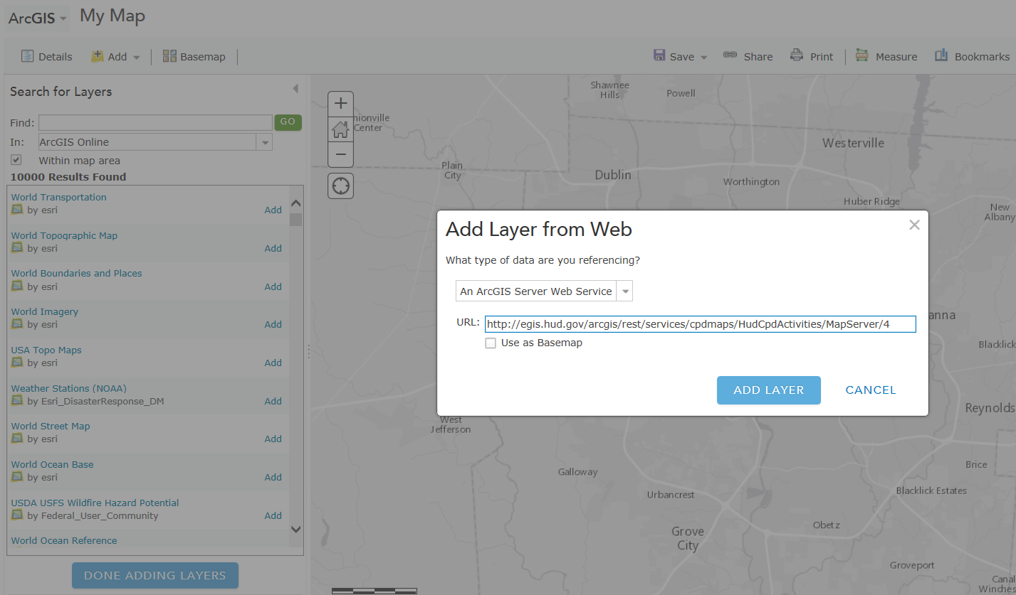
ArcGIS
Add Layer from Web

Slide 31
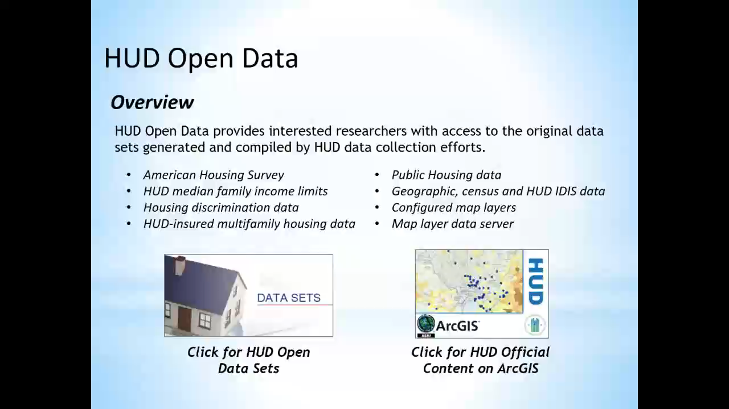
HUD Open Data
Adding HUD Layers to ArcGIS Map
Video
Go to HUD.Official.Content on ArcGIS
Search for low income
Add layer to map (low mod block groups)
Go to contents
Check and uncheck layer
Show Legend
Scroll over options
We’ll get back to the options
CLICK HERE TO WATCH VIDEO

Slide 32
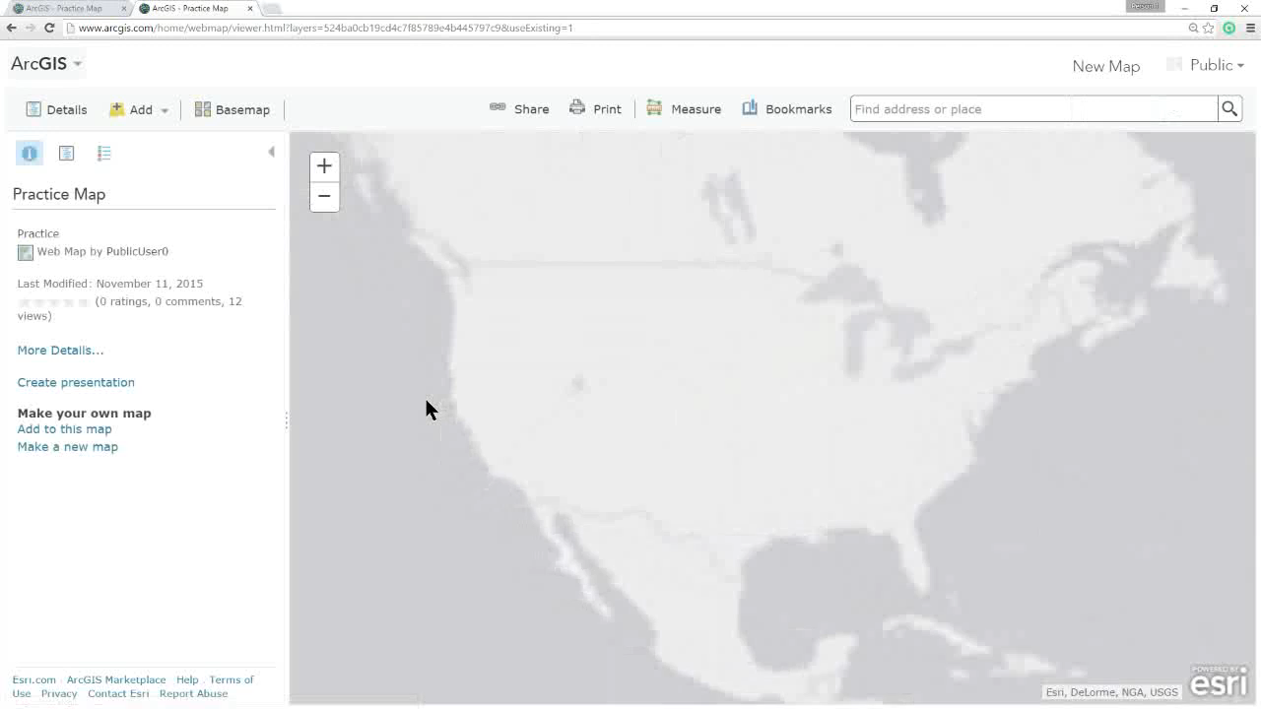
Filtering Map Layers in ArcGIS
Video
Click on Table
Click on Census Tract on Map (Identifier)
Highlight the ID# on both map and table
Click Filter Button
Select GEOID
Select Starts With
Enter 39049
Click Apply
Click on Tract (Identify)
Scroll Down & Highlight lowmod %
Click Filter Again
Click Edit Tab
Click add an expression
Show Any/All drop down
Select %lowmod
Select “is at least”
Enter 80.00
Click Apply
CLICK HERE TO WATCH VIDEO

Slide 33
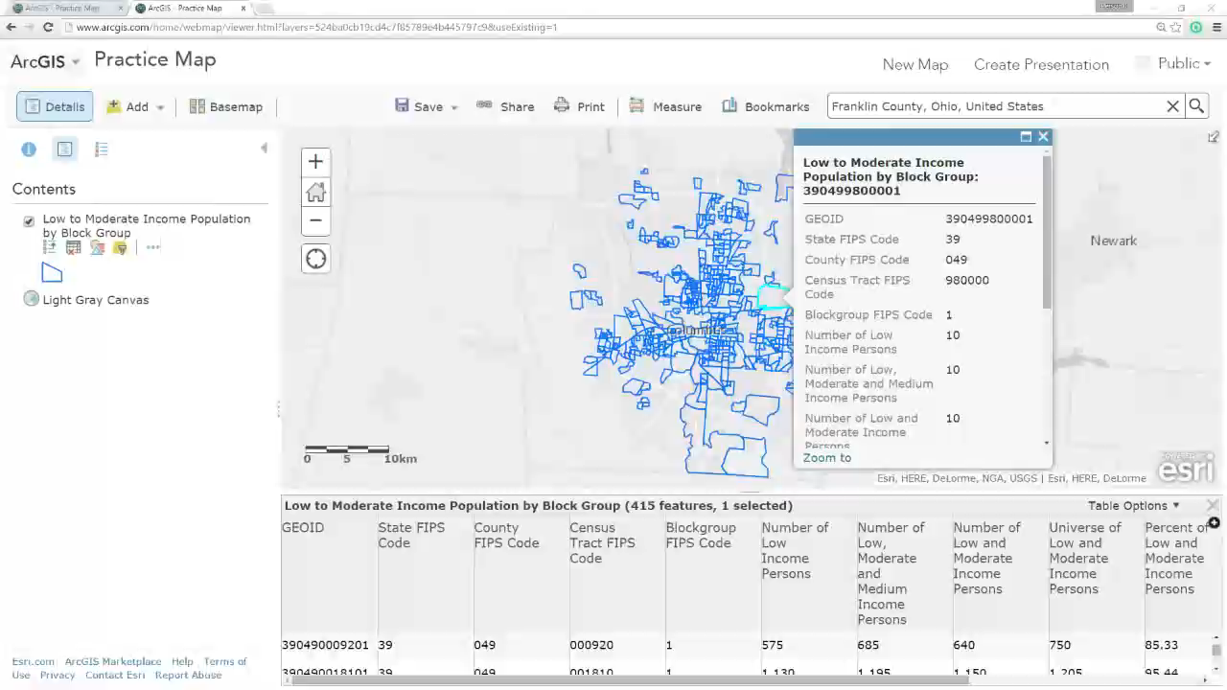
Multiple Filters
Video
Click on Table
Click on Census Tract on Map (Identifier)
Highlight the ID# on both map and table
Click Filter Button
Select GEOID
Select Starts With
Enter 39049
Click Apply
Click on Tract (Identify)
Scroll Down & Highlight lowmod %
Click Filter Again
Click Edit Tab
Click add an expression
Show Any/All drop down
Select %lowmod
Select “is at least”
Enter 80.00
Click Apply
CLICK HERE TO WATCH VIDEO

Slide 34
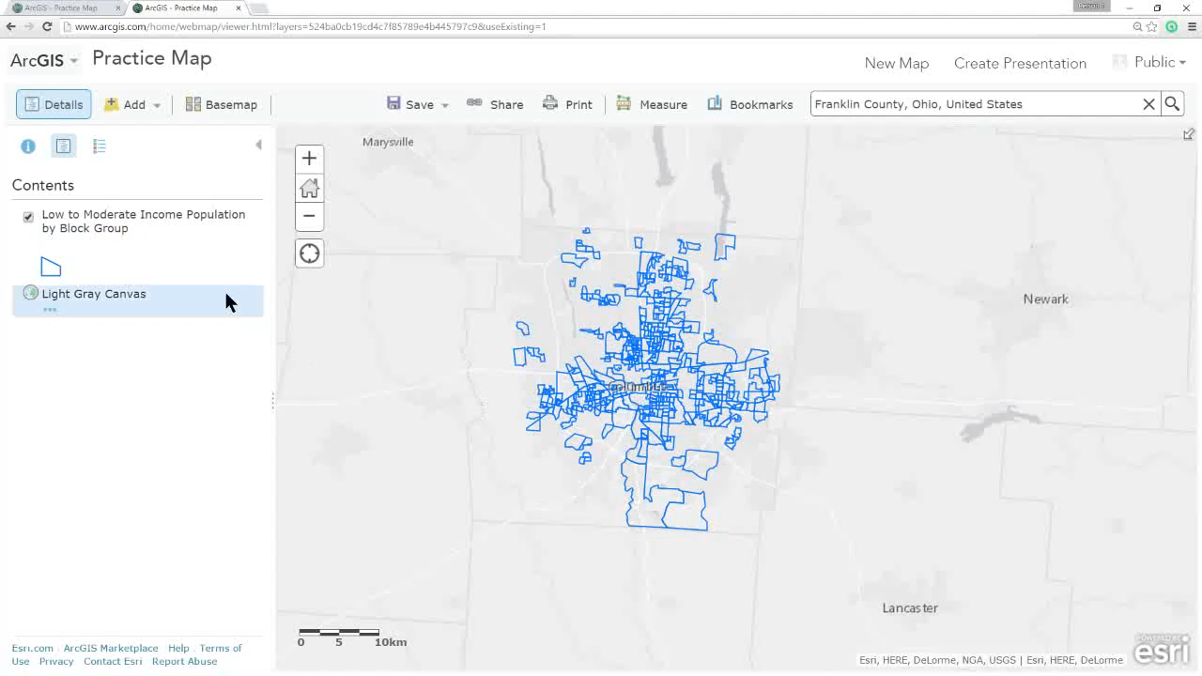
Styling Map Layers in ArcGIS
Video
Click on Style
Show drop down, stay on location
Click Symbol, change color
Mess with transparency and visibility
Click Done
Change drop-down to %lowmod
Select Counts and Amounts Size & Hover for description
Select Counts and Amounts Colors & Hover for description
Hover around the shaded areas & Legend
Click Options for Counts and Amounts (Color)
Divided by drop down – then hover over description
Drop-down High-Low and description
Symbols – Change Color and Outline
Manually change the levels
Check Classify Data – Natural Breaks, Even, Rounded to 10, Uncheck
Draw features with no data
Transparency & visibility
CLICK HERE TO WATCH VIDEO

Slide 35
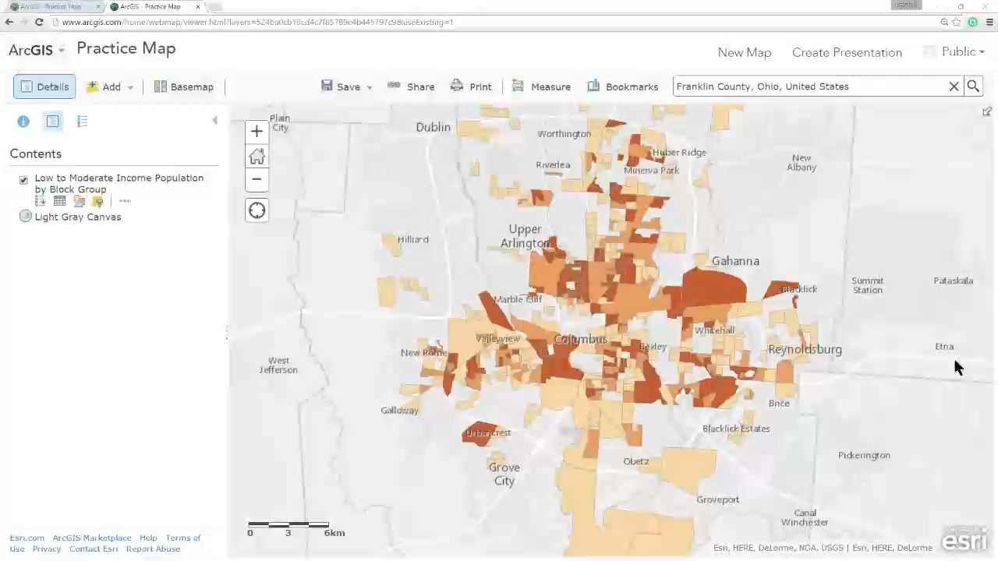
Map Layer Settings in ArcGIS
CLICK HERE TO WATCH VIDEO

Slide 36
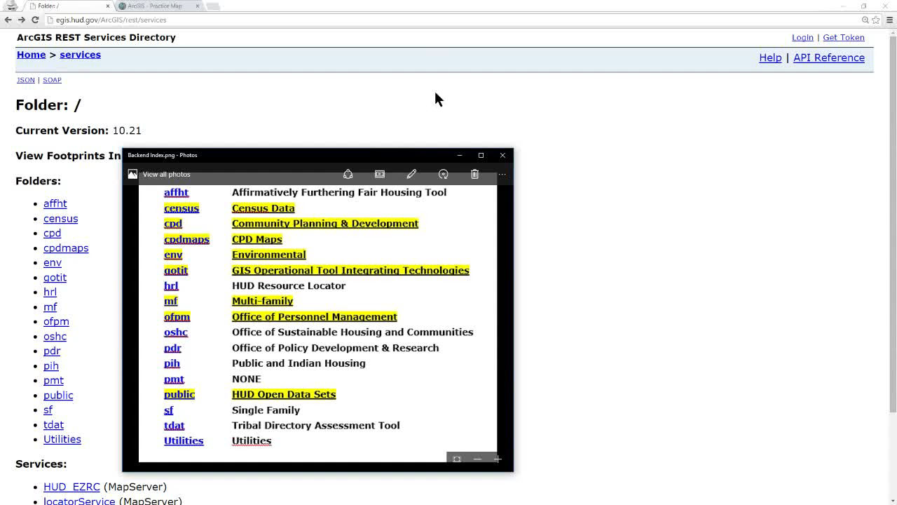
HUD Open Data Server
HUD’s Map Data Server - egis.hud.gov/ArcGIS/rest/services
Map Data Glossary - https://drive.google.com/open?id=0B4lh3y0lJtirVkdXazNaQ1RLaDQ
Video
Go to Data Server
Show Definitions
Follow path to CPDActivities > CDBG Activities
Copy layer URL
Paste in ArcGIS Add Layer from Web
Go to contents
Check and uncheck layer
Show Legend
Table, Filter for COLUMBUS and FC
Copy Layer
Style by Grouping change symbols
CLICK HERE TO WATCH VIDEO

Slide 37
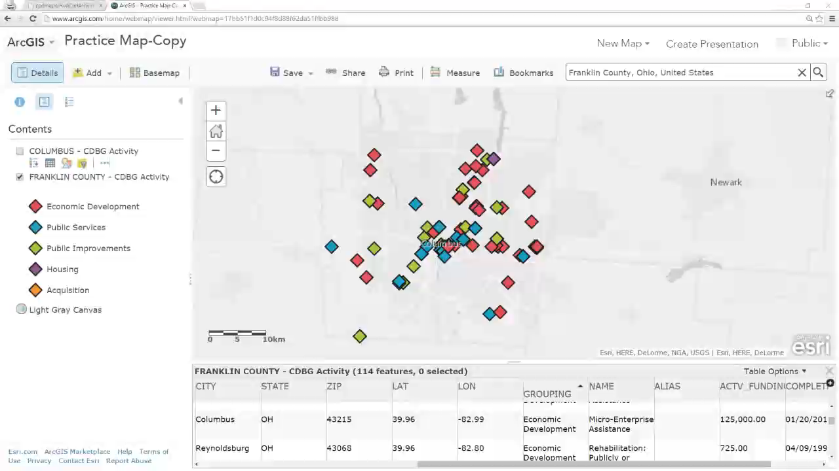
ArcGIS
Specific Economic Development Activities
CLICK HERE TO WATCH VIDEO

Slide 38
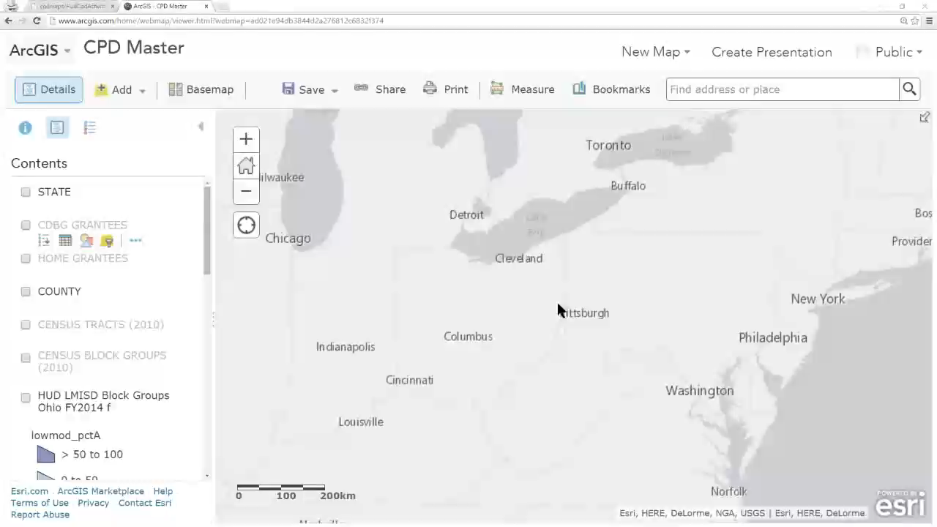
ArcGIS
Sample Map Layers
CLICK HERE TO WATCH VIDEO

Slide 39
Resources
ArcGIS
http://www.arcgis.com
CPD Maps
http://egis.hud.gov/cpdmaps/
CPD Maps Desk Guide
http://www.hud.gov/offices/cpd/about/conplan/pdf/cpdmaps_deskguide.pdf
HUD Open Data
http://egis.hud.opendata.arcgis.com
HUD Official Content (ArcGIS)
http://www.arcgis.com/home/search.html?q=owner%3AHUD.Official.Content&focus=layers
HUD Map Data Server
http://egis.hud.gov/ArcGIS/rest/services
Index - Glossary
https://drive.google.com/open?id=0B4lh3y0lJtirVkdXazNaQ1RLaDQ
ArcGIS Map Template
http://arcg.is/1iV5oBP

Slide 40
Questions?
Omri Gross
CPD Representative
          U.S. Department of Housing and Urban Development
          Office of Community Planning and Development
          Columbus Field Office
          200 N. High St., 7th Floor
          Columbus, OH 43215
          Ph: 614.280.6200 | Fax: 614.280.6175
          omri.gross@hud.gov

