Slide 1
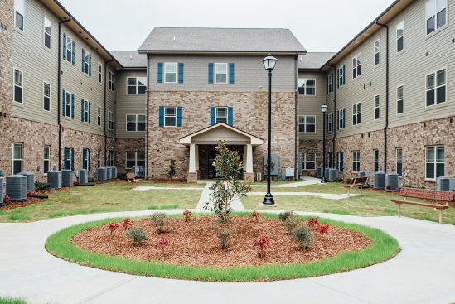


Community Development Directors and Affordable Housing Developers
By: Vantage Development

Slide 2
Community Development Departments
Primary Concerns:
  Galvanizing the community and its stakeholders in an effort to implement holistic community development
  Effectively managing and leveraging government resources for housing and community revitalization.
  Revitalization of downtown and economic corridors of the city
  Revitalizing properties primarily located in Qualified Census Tracts or low income neighborhoods
  Enhancing the lives and well-being of the residents of the city
Primary Issue:
  Lack of investment

Slide 3
Affordable Housing Developers
Primary concerns:
  Providing quality affordable housing that is financially sustainable
  Locating land that is suitable for housing development
  Obtaining the financing for affordable housing
    LIHTCs
      Financially underwriting affordable housing developments that meet all of the LIHTC regulations and requirements
      Successfully applying for LIHTC from state allocating agencies
      Identifying conventional lending ( construction and permanent loans)
      Identifying low cost financing or “soft loans” such as CDBG, HOME, FHLB-AHP, NSP or potentially Housing Trust Funds
      Identifying LIHTC equity partners
  Revitalizing communities and assisting with community revitalization efforts
  Enhancing the lives and well-being of the tenants with support programs
Primary Issues:
  Lack of investment and local support

Slide 4

Financing Options for Affordable Housing
Rehabilitation and New Construction of Affordable Housing
4% LIHTCs- Non competitive
9% LIHTCs - Competitive
HOME funds
CDBG funds – with restrictions
Federal Home Loan Bank – AHP
Recycled Neighborhood Stabilization Program funds (NSP)
Housing Trust Fund

Slide 5

How Do Housing Tax Credits Work
Rental units with tenants earning no more than 60% of area median income
Investors earn dollar-for-dollar credits against their federal tax liability
Investors also get tax benefits from losses
Generally, tax credits are received over the first 10 years of operation

Slide 6
LIHTC Process
Developers Investors
Gov’t
IRS
Dev- A
$500,000
Bank - A
State
Agency
Tax Credits
Dev- B
700,000
Bank- B
Tax Credits/Losses
Dev –C
$950,000
Funding/Equity
Bank- C
Dev – D
$600,000
Syndicator -A

Slide 7
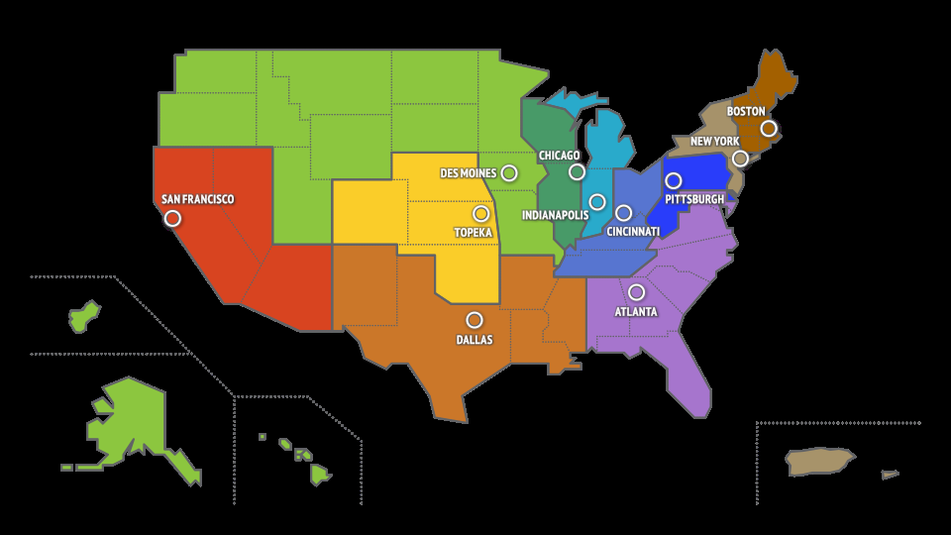
FHLB – AHP Banking Centers

Slide 8
Housing Trust Fund
Funds from Fannie and Freddie Mac starting in January 2015
Block Grants to States
Allocations made to States in 2016
Funds will be regulated like HOME funds
Each state will receive a minimum of $3MM (see handout)
In most cases, State Allocating Agencies will receive funds

Slide 9
Community Development Directors/Departments- Possible Takeaways
General
Locate land/expiring affordable housing development that has the potential for new construction or rehabilitation of existing affordable housing.
Establish revitalization plans meeting Fair Housing requirements
Become familiar with State Allocating Agency’s Qualified Plan
Become familiar with funding options
Lobby the State’s Allocating Agency for Housing Trust Funds

Slide 10
Community Development Directors/Departments- Possible Takeaways
Affordable Housing Developer’s Due Diligence
References from State Allocating Agencies
Review information on State Allocating Agencies website regarding developer
Obtain affordable housing track record from Developer
Ask about development and management philosophy
Request Investor/Financing references

Slide 11
Community Development Directors/Departments- Possible Takeaways
After Selecting the Developer
  Assistance with Affordable Housing Tax Credit Applications
      Leveraging of resources – if available HOME and CDBG funds
      Assist with removal of blighted or abandoned properties
      Assist with the coordination of rezoning request
      Assist with reduction of building permit fees or other city fees that may be waived
      Assistance with establishing community green space and playgrounds
  Act as a liaison between the housing authority and city officials
  Educate the city and local residents about the transformation undergoing with HUD and housing authority properties

