Slide 1
low-income housing tax-credits
Working with your developer
George Mensah
Director of Community & Economic Development Dept
City of Miami

Slide 2
The LIHTC Program
Established under the Tax Reform Act of 1986
An effort to partially privatize the affordable housing industry
Program works by providing investor equity, thus reducing the amount of debt service on a project, allowing lower rents to be charged to tenants while still producing positive cash flow
Provides a dollar-for-dollar reduction in tax liability for owners (and the partners of the owners)
Tax credit received during 10 years of operation of the development

Slide 3
LIHTC Requirements
Low Income Units
  Rent & Income restricted to a minimum of either
        20% of units at 50% of AMI or
        40% of units at 60% of AMI
  Most Finance agencies provide additional points for lower income targeting.
Affordability Period
  A minimum of 15 years compliance period, however, most Finance agencies require extended use agreement.
  Extended use requirement in Florida is an additional 35 years for a total of 50 years affordability

Slide 4
LIHTC Project Structure
Miami Apartments, L.P. (Project Owner)
Citibank (Lender)
FHFC
(Tax Credit Allocation)
GAP Financing (HOME, CDGB etc)
Non-Profit or For Profit Sponsor \ Developer (.01% General Partner)
Tax Credit Investor (99.99 % Limited Partner)

Slide 5
Typical LIHTC Construction Financing
Lender | Amount
JP Morgan Chase | $ 5,000,000
First Housing | $ 3,000,000
Miami Dade County Surtax | $ 1,600,000
Equity Investor (Tax Credits) | $ 1,836,500
City of Miami (HOME) | $ 343,000
Deffered Developer Fee | $ 787,000
Total | $ 11,779,500

Slide 6
Typical LIHTC Permanent Financing
Lender | Amount
RBC Capital (Tax-Credit Equity) | $ 9,100,000
Miami Dade County Surtax | $ 1,600,000
City of Miami (HOME) | $ 343,000
Deferred Developer Contribution | $ 736,500
Total | $ 11,779,500

Slide 7
LIHTC Applications
  Each State has a Tax Credit allocating agency (Agency). In Florida, the Florida Housing Finance Corporation (FHFC) allocates LIHTC and other state affordable housing funds
  The Agency publishes a Qualified Allocation Plan (QAP) which provides guidelines for the distribution
      Income targeting
      Geographic distribution
      Special needs targeting .
  Tax credits are allocated through a competitive process

Slide 8
Working with Developers
  In most jurisdictions, LIHTC provides the best opportunity for the production of affordable housing
  Take part in the meetings leading to the adoption of the QAP
  Be familiar with the application schedules in your state
  Be familiar with the LIHTC application
  Schedule your RFP’s to ensure commitments can be provided prior to the tax-credit application deadline
  Be prepared to provide commitment for gap financing subject to the development receiving tax-credits
  Use land controlled by the municipality to entice developers to your community

Slide 9
Working with Developers II
  Have a process in place to provide the necessary local sign-offs required by the tax-credit application
      Verification of the availability of infrastructure (roads, electric, water, etc)
      Zoning verification forms, etc
      QCT or DDA certifications
  Have a good relationship with your developers

Slide 10

Parkview Gardens

Slide 11

Coral Place
Notes:
Total Delopment Cost=

Slide 12
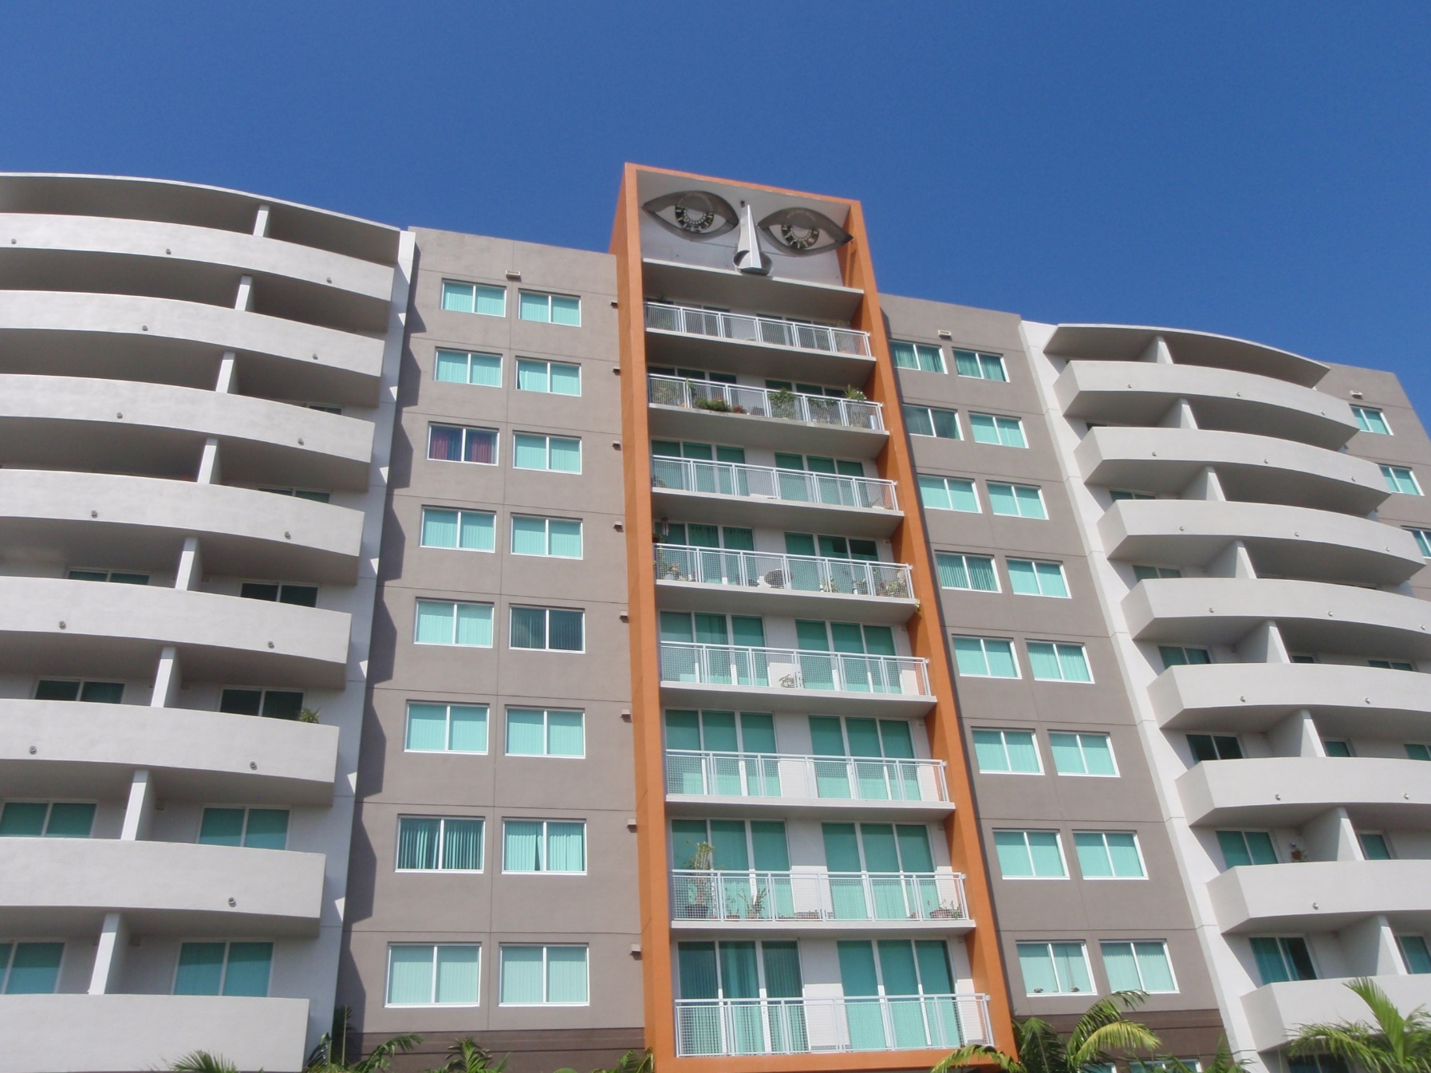
Pinnacle Place

Slide 13
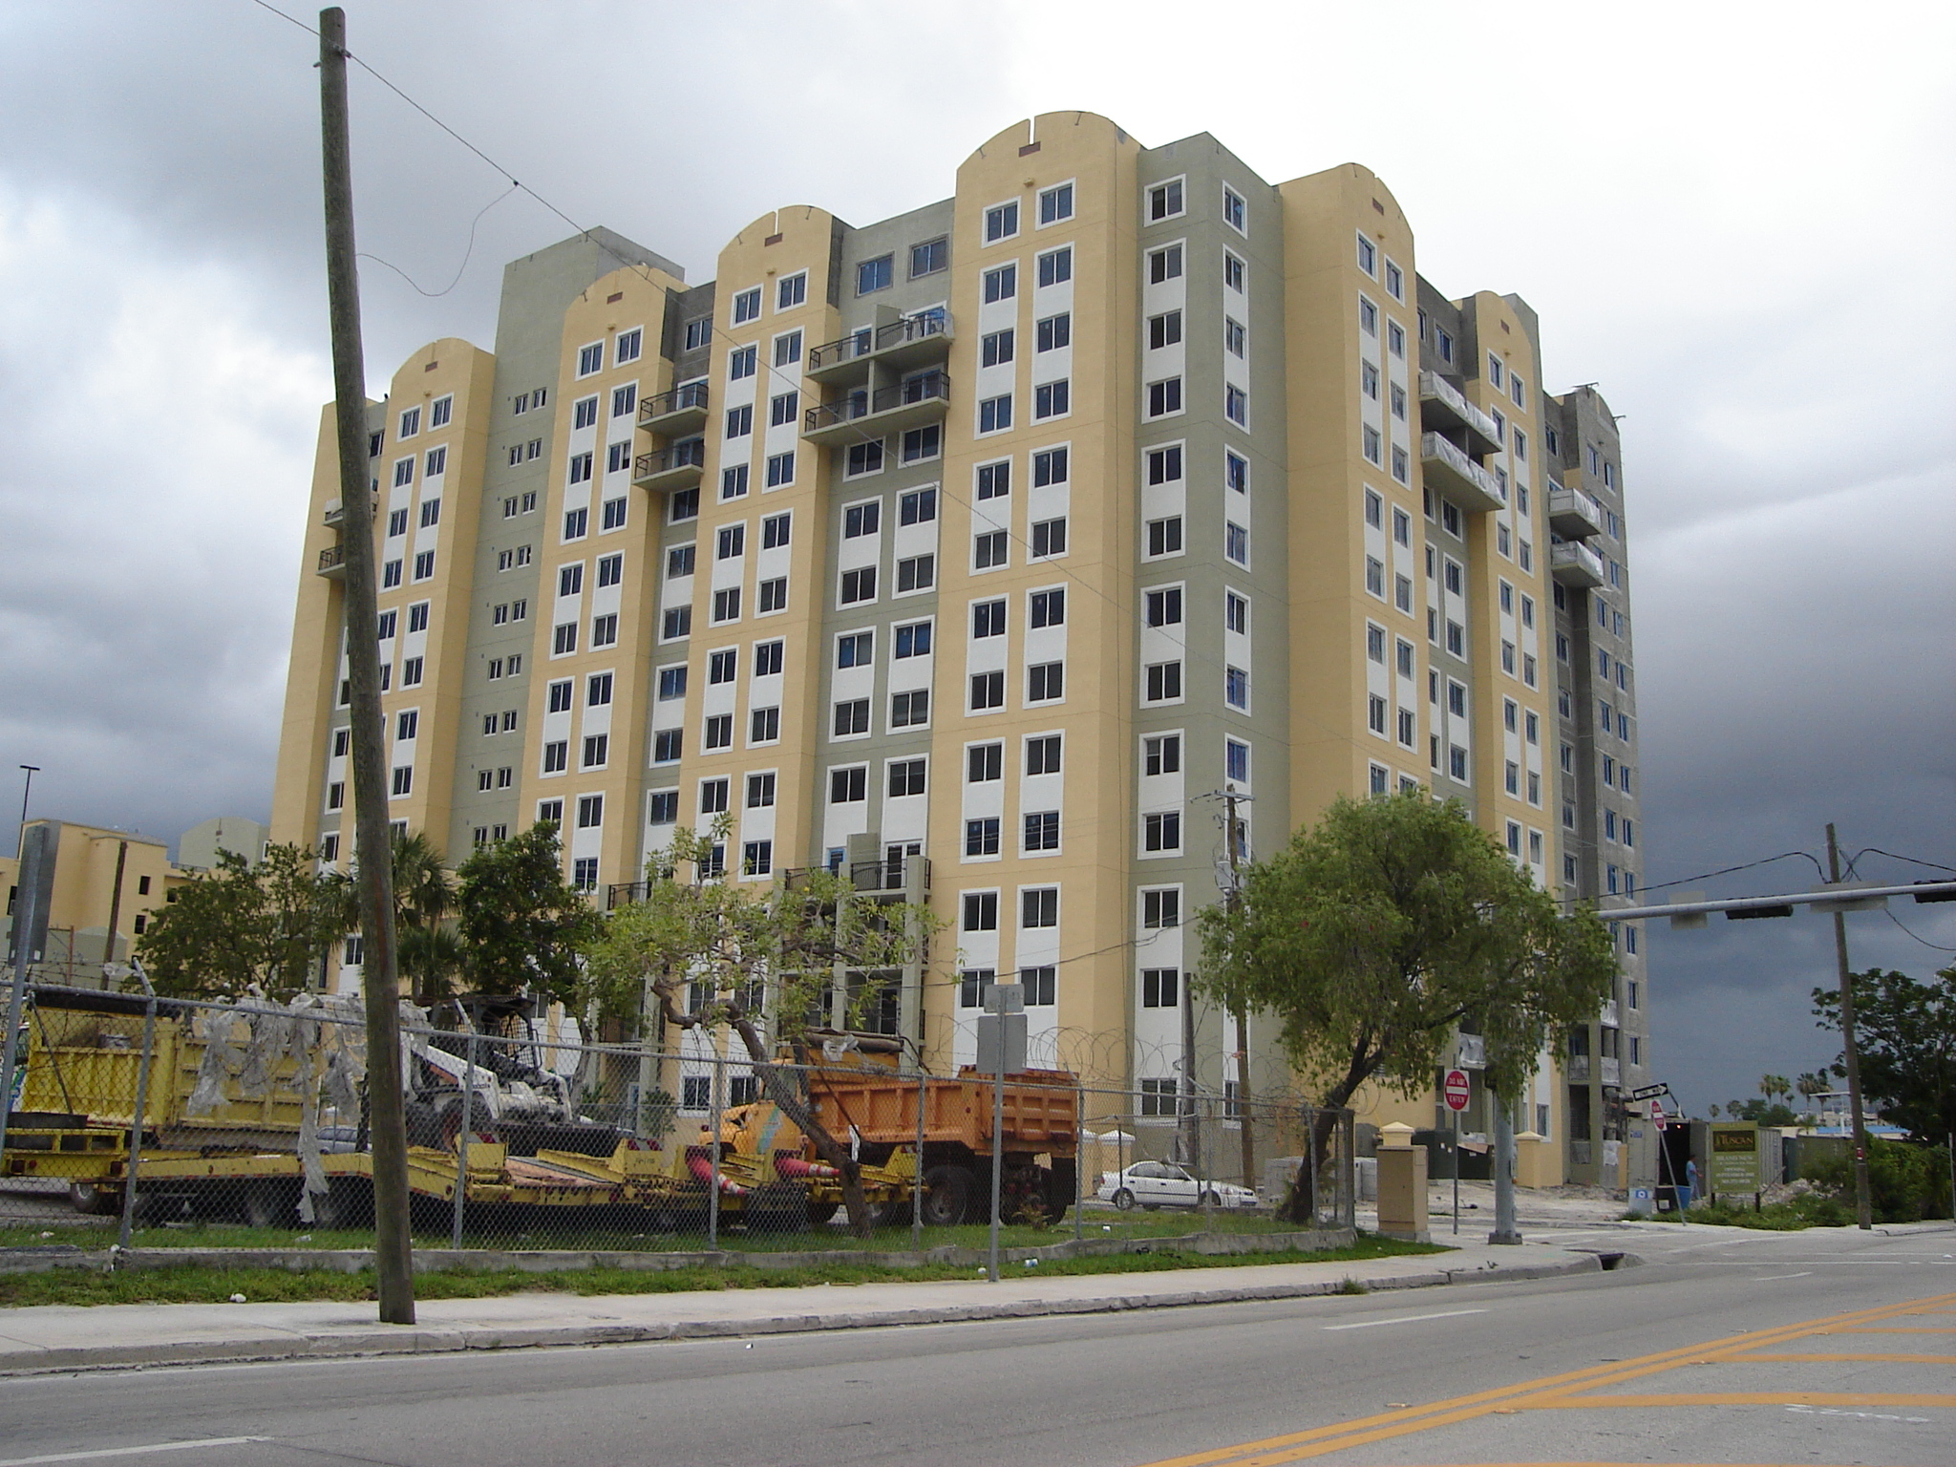
Tuscan View

Slide 14
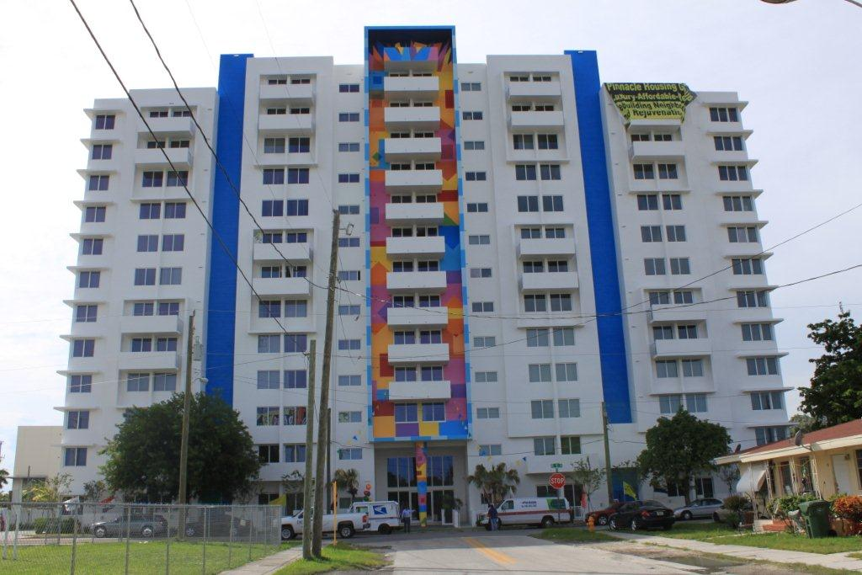
VISTA MAR

Slide 15
Project | Number of units | Total Development Cost | Tax Credit | City of Miami Funding | Type of City Funding
Parkview | 60 | $11,779,500 | $9,100,000 | $343,000 | HOME
Coral Place | 100 | $24,608,033 | $19,302,816 | $812,717 | HOME
Pinnacle Place | 137 | $33,210,843 | $23,556,269 | $949,938 | AHTF (local funding)
Tuscan View | 175 | $ 26,137,488 | $16,827,372 | $1,500,000 | CDBG
Vista Mar | 110 | $28,900,863 | $21,768,500 | $733,333 | NSP

