Slide 1


Affirmatively Furthering
Fair Housing (AFFH) and the New AFFH Rule
(NCDA Presentation 1/22/2016)

Slide 2
Introduction to the
AFFH Rule

Slide 3
Purpose of the AFFH Rule
Provide for better fair housing planning
Promote better understanding by program participants of AFFH
Address issues raised by HUD grantees, civil rights advocates, other stakeholders, and the Government Accountability Office

Slide 4
Authority
Section 808(e)(5) of the Fair Housing Act
The United States Housing Act of 1937
The Housing and Community Development Act of 1974
Executive Order 11063 (1962) prohibited discrimination in federal housing assistance and imposed affirmative requirements
Executive Order 12892 (1994) expanded E.O. 11063 to more protected classes, expanded its application to housing loan programs, and required federal coordination.
In addition to the statutory obligation to AFFH, program regulations include fair housing requirements, including an AFFH certification.

Slide 5
What activities does AFFH cover?
The duty to affirmatively further fair housing extends to all of a program participant’s activities and programs relating to housing and urban development.

Slide 6
The Final AFFH Rule

Slide 7
Which program participants are subject to the Rule?
Jurisdictions and Insular Areas that are required to submit consolidated plans for the following programs:
  Community Development Block Grant (CDBG)
  HOME Investment Partnerships Program (HOME)
  Housing Opportunities for Persons With AIDS (HOPWA)
  ESG (Emergency Solutions Grants)
Public Housing Agencies (PHAs) receiving assistance under sections 8 or 9 of the United States Housing Act of 1937
[see 24 CFR § 5.154(b)]

Slide 8
AFFH Rule Highlights
Program participants must:
Set goals to address identified significant contributing factors and related fair housing issues and follow through on these goals in the Consolidated Plan and/or PHA Plan. See 24 CFR § 5.154(d)(4)(iii).
Take meaningful actions that AFFH and not take any action that is inconsistent with the duty to AFFH. See 24 CFR § 5.150 and § 5.162.
Look back and make adjustments to previously established fair housing goals to ensure that progress occurs. See 24 CFR § 5.154(d)(7).

Slide 9
AFFH Process:
Collaboration
To combine resources and address fair housing issues from a broader perspective, program participants are encouraged to collaborate to conduct and submit a single AFH, either a joint AFH or regional AFH.
[See 24 CFR § 5.156]

Slide 10
AFFH Process:
Community Participation
The AFFH rule links existing community participation, consultation, and coordination requirements to the AFH process.
Community participation as required in 24 CFR § 5.158 “means a solicitation of views and recommendations from members of the community and other interested parties, a consideration of the views and recommendations received, and a process for incorporating such views and recommendations into decisions and outcomes.”
[See 24 CFR § 5.152]

Slide 11
AFFH Process:
Link to Subsequent Planning
The AFFH rule establishes specific requirements for incorporating the analysis and goals in the AFH into consolidated plans and PHA Plans.
To implement goals and priorities in an AFH, strategies and actions shall be included in program participants’ consolidated plans, Annual Action Plans, and PHA Plans (including any plans incorporated therein), and need not be reflected in their AFH.
[See 24 CFR § 5.154(d)(5)]

Slide 12
Initial AFH Timeline
AFH due to HUD
Notify of AFH status
Program Year Start Date
HUD review period
Con Plan/ PHA Plan Due
HUD
Review Period
[60 Days]
[45 Days]
[270 Days]

Slide 13
The AFH

Slide 14
The AFH
The AFH is intended to help communities understand and identify local barriers to fair housing choice and disparities in access to opportunity.
Analyze and discuss HUD-provided data as well as local data and knowledge.
Identify fair housing issues in the jurisdiction and region and related contributing factors.
Create goals that are designed to overcome significant contributing factors and related fair housing issues.
[See 24 CFR § 5.154(c) and (d)]

Slide 15
Key Fair Housing Issues
  Local or regional segregation
  Racially or ethnically concentrated areas of poverty
  Disparities in access to opportunity
  Disproportionate housing needs
  Evidence of discrimination or violations of civil rights law or regulations
  [See 24 CFR § 5.154(d)(3)]

Slide 16
Fair Housing Goals
Fair housing goals in an AFH are designed to overcome one or more contributing factors and related fair housing issues. For each goal, a program participant must:
Identify one or more contributing factors that the goal is designed to address;
Describe how the goal relates to overcoming the identified contributing factor(s) and related fair housing issue(s);
Identify the metrics and milestones for determining what fair housing results will be achieved.
  [See 24 CFR § 5.154(d)(4)]

Slide 17
AFH Template
AFH Template for local governments published on December 31, 2016.
AFH Template has been approved for one year and will undergo further review pursuant to the PRA process
First AFHs will be due on October 4, 2016 (for a few grantees only—timing for CPD consolidated plan grantees is based on 3-5 year consolidated plan cycle).

Slide 18
AFH Outline
  Executive Summary
  Community Participation Process
  Assessment of Past Goals and Actions
  Fair Housing Analysis
    Demographics
    General Issues
      Segregation/Integration
      R/ECAPs
      Disparities in Access to Opportunity
      Disproportionate Housing Needs
    Publicly Supported Housing Analysis
    Disability and Access Analysis
    Fair Housing Enforcement, Outreach Capacity, and Resources Analysis
  Fair Housing Goals and Priorities

Slide 19
Sample AFH Questions (R/ECAPs)
Analysis
  Identify any R/ECAPs or groupings of R/ECAP tracts within the jurisdiction.
  Which protected classes disproportionately reside in R/ECAPs compared to the jurisdiction and region?
  Describe how R/ECAPs have changed over time (since 1990).
Additional Information
  Beyond the HUD-provided data, provide additional relevant information, if any, about R/ECAPs in the jurisdiction and region affecting groups with other protected characteristics.
  The program participant may also describe other information relevant to its assessment of R/ECAPs, including activities such as place-based investments and mobility options for protected class groups.

Slide 20
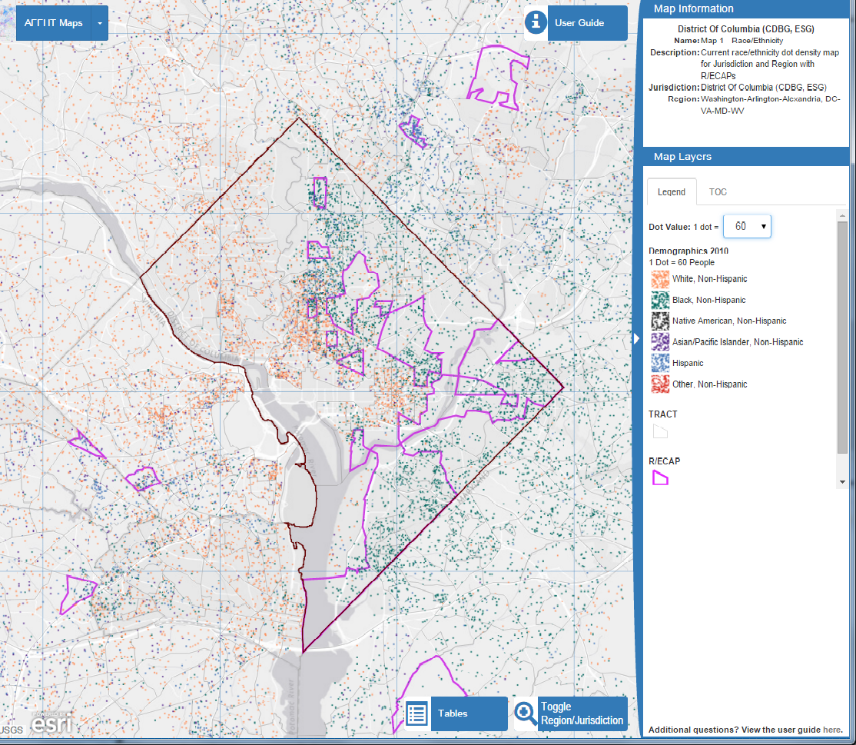
AFH Data & Mapping Tool http://egis.hud.gov/affht/#

Slide 21
Sample Contributing Factor Analysis (R/ECAPS
Contributing Factors of R/ECAPs
Consider the listed factors and any other factors affecting the jurisdiction and region. Identify factors that significantly create, contribute to, perpetuate, or increase the severity of R/ECAPs.
Community Opposition
Deteriorated and abandoned properties
Displacement of residents due to economic pressures
Lack of community revitalization strategies
Lack of private investments in specific neighborhoods
Lack of public investments in specific neighborhoods, including services or amenities
Lack of regional cooperation
Land use and zoning laws
Location and type of affordable housing
Occupancy codes and restrictions
Private discrimination
Other

Slide 22
Resources: HUD Exchange
The Assessment of Fair Housing Tool
AFFH Rule Guidebook
AFFH Data and Mapping Tool
Final Rule
Guidebook and Fact Sheets
AFFH Data and Mapping Tool

Slide 23
Questions: HUD Exchange
https://www.hudexchange.info/prorams/affh
Fill out the Requestor Information form (note that this form is available directly at the following URL: https://www.hudexchange.info/get-assistance/my-question/).
Once the question is successfully submitted, you will receive a confirmation email.

