Slide 1

NCDA Winter Legislative & Policy Meeting
January 20, 2016

Slide 2
Funding Infrastructure Projects

Slide 3
Streets
STREET RECONSTRUCTION – 2015 budgets
Total cost of 2015 street project $172,656.00
CDBG assisted funding $133,000.00
City funding $ 39,565.00
HOMEOWNER’S SAVINGS
Street assessment for non-CDBG funded street projects $38.00/foot
Street assessment for CDBG funded street projects $15.00/foot
Average frontage per homeowner 66.70 feet
Cost for homeowner on non-CDBG funded project $2,534.60
Cost for homeowner on CDBG funded project $1,000.50
Average savings per homeowner $1,534.10

Slide 4
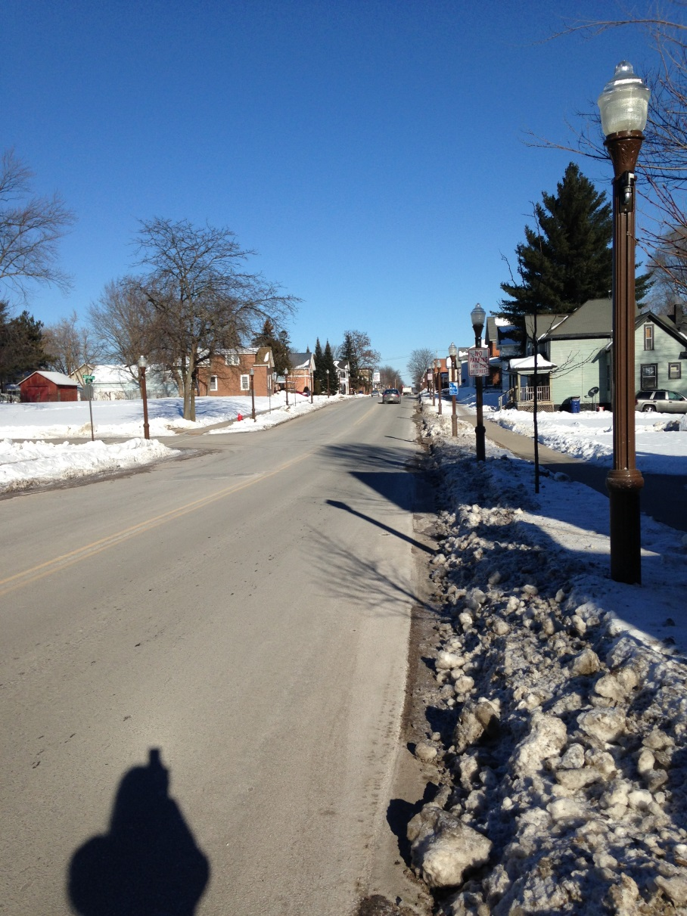
Third Street

Slide 5
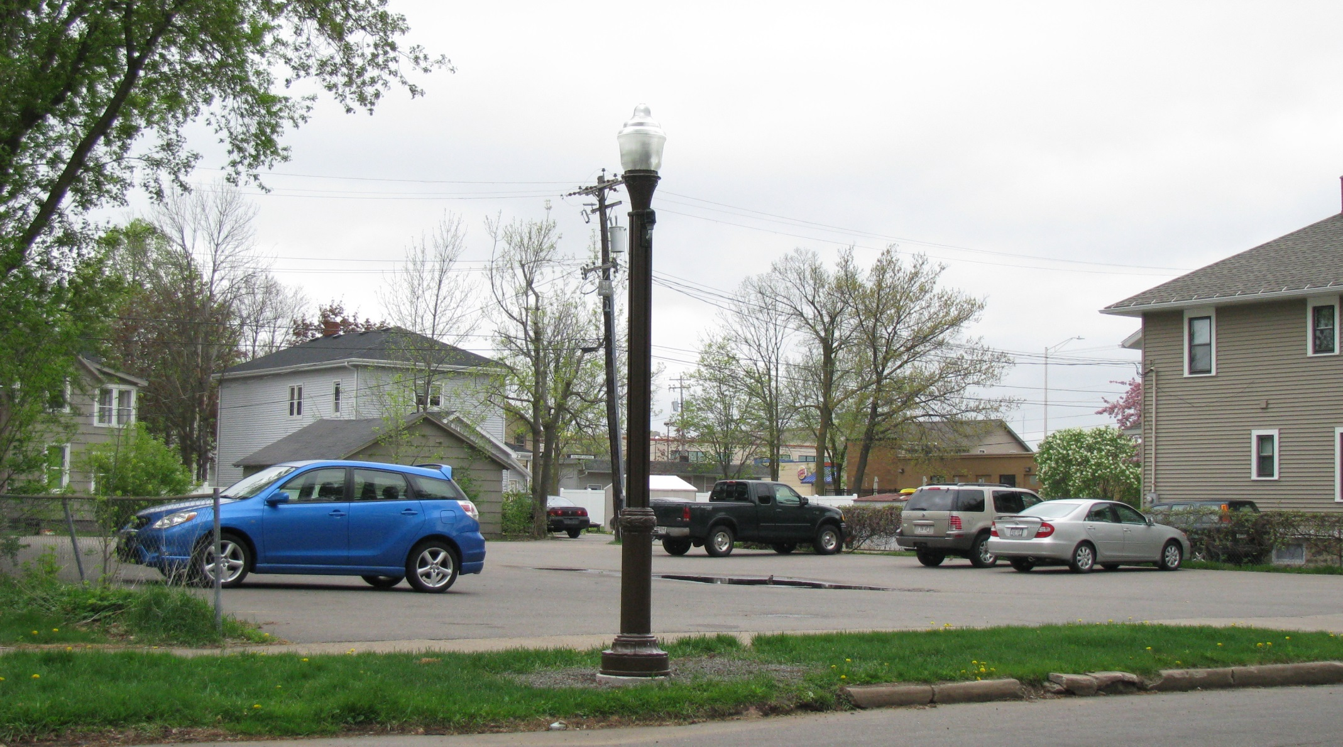
Lights

Slide 6
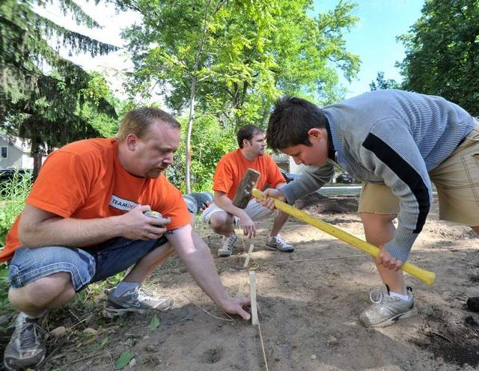
Community Gardens

Slide 7
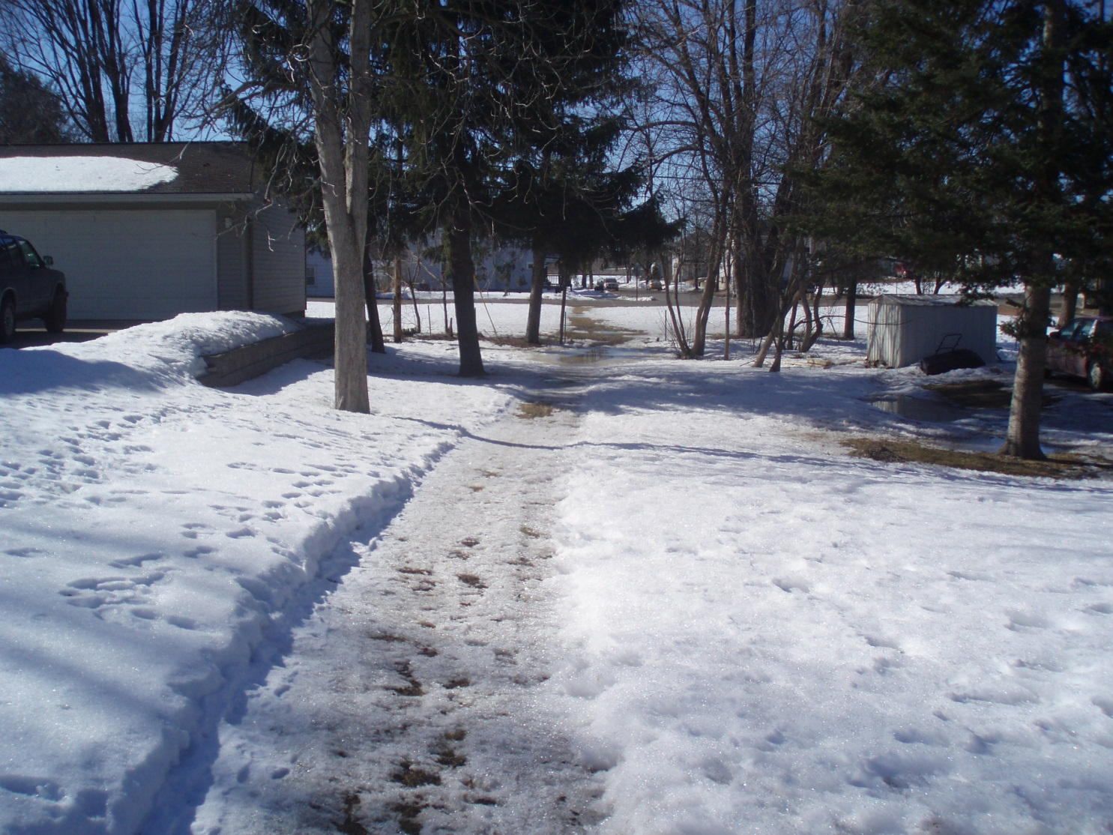
Alexander Walkway - Before

Slide 8
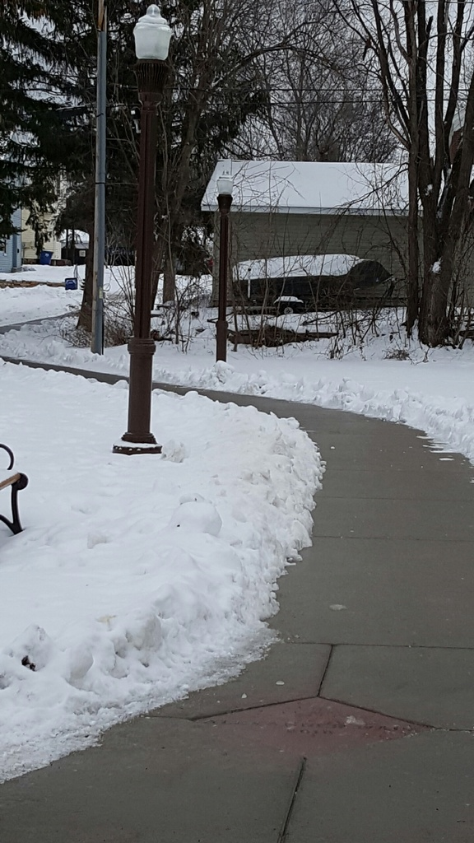
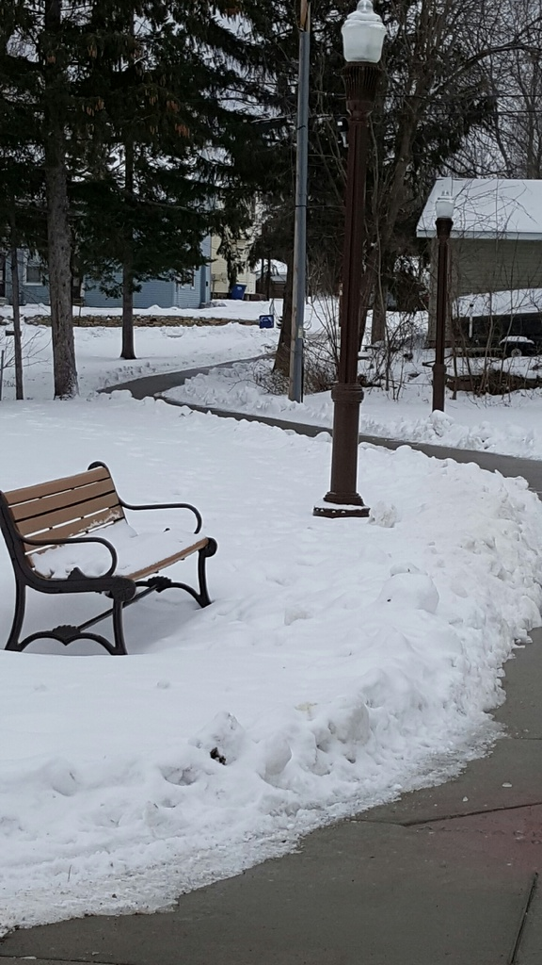
Alexander Walkway - After

Slide 9
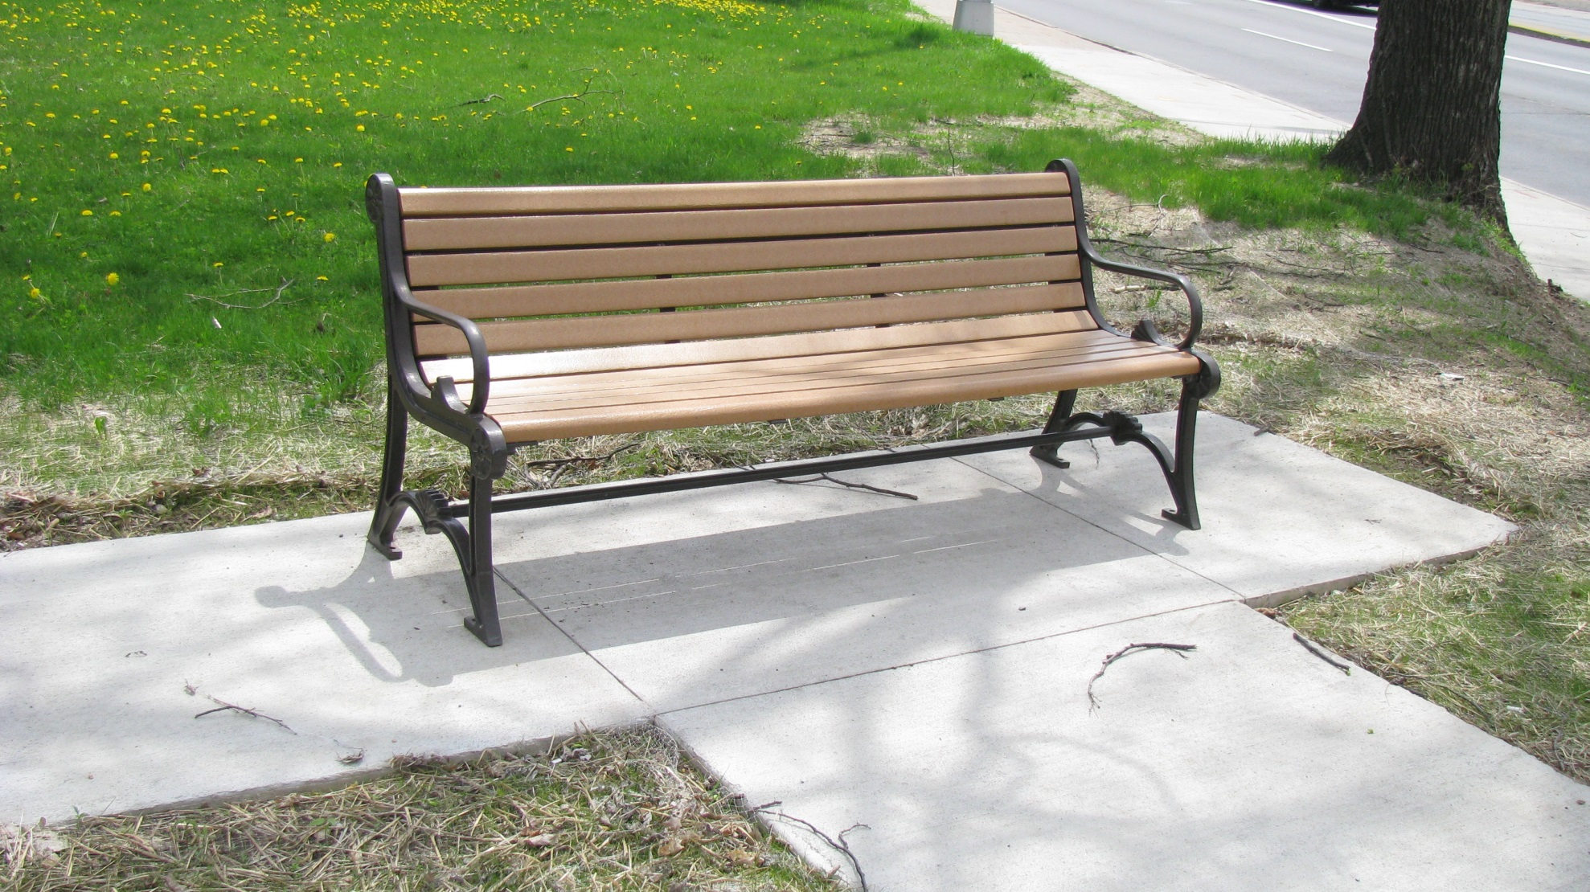
Park Benches

Slide 10
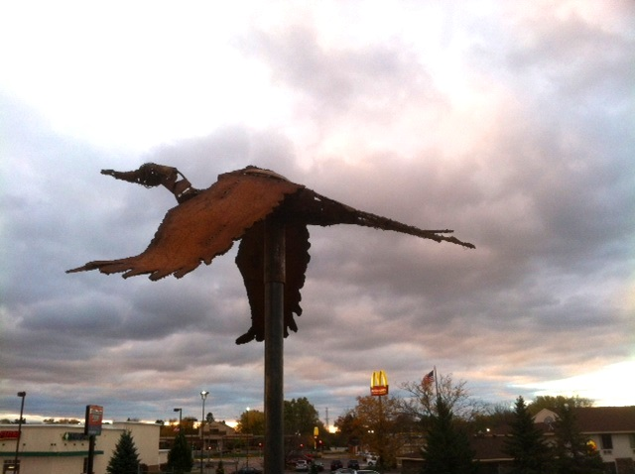
Public Art

Slide 11
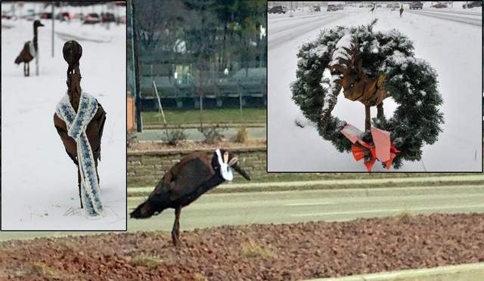
Public Art

Slide 12
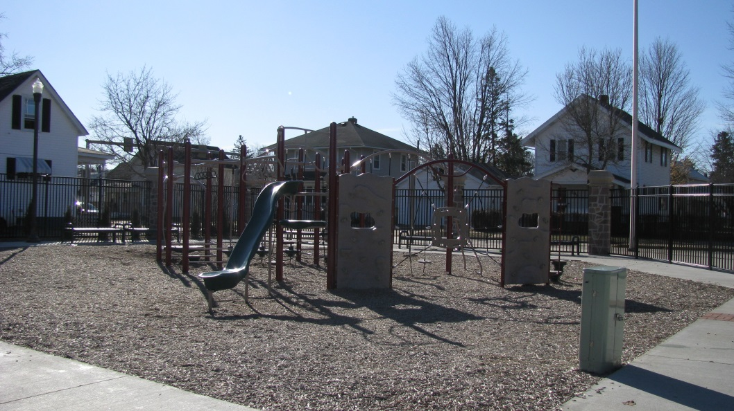
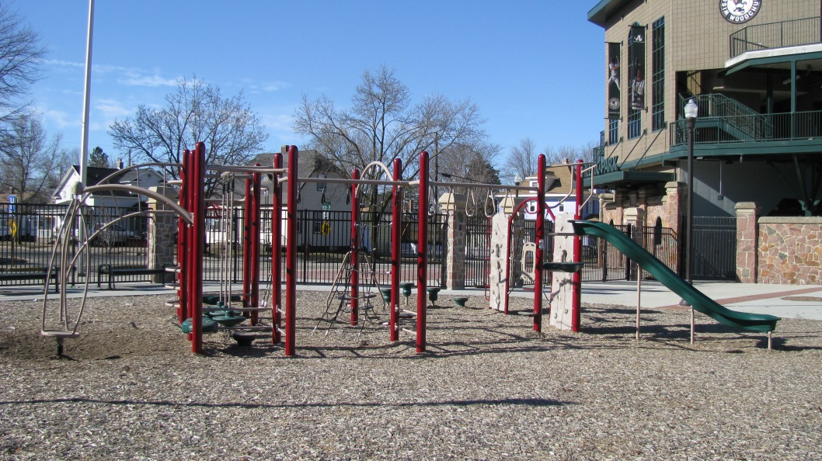
Parks

Slide 13
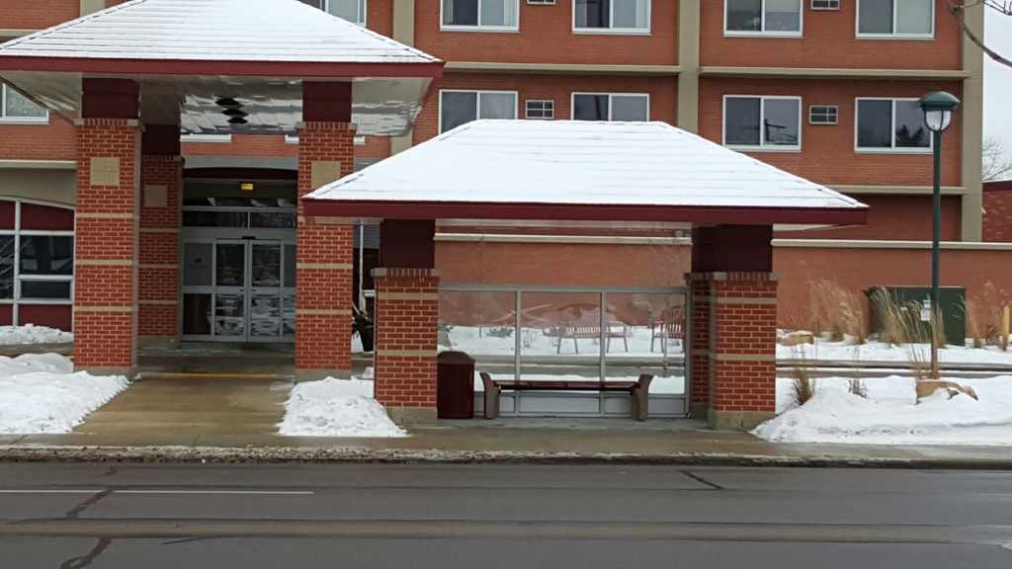
Bus Stops

