Slide 1



Providing Safe, Decent, Affordable Housing
Expanding homeownership opportunities can create a strong economy.
Robust housing markets mean higher property values and local tax revenues,
more job opportunities and
safer, stable, healthier communities

Slide 2



Slide 3
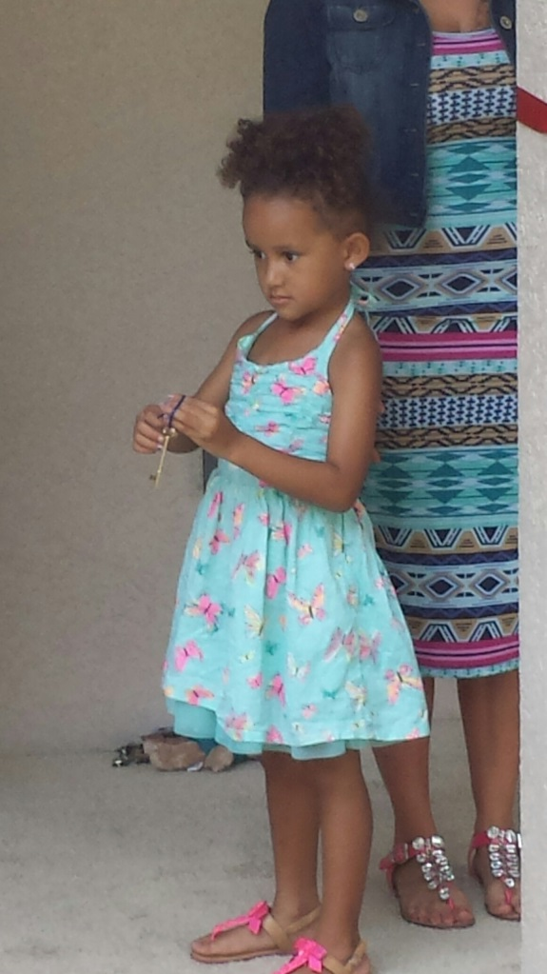
There is no greater joy than holding the keys to homeownership.
“It’s so easy to stay stuck, to be stuck in poverty. Some people inherit money, some people inherit houses, but some people inherit poverty. To think outside the scope of poverty is hard. So when you have a hand-up, what Habitat offers, that hand-up turns out to be a different type of inheritance. You pass along hope.”
-Jose Tobar, son of a Habitat homeowner

Slide 4

Safe, Decent, Affordable Housing
Habitat Seminole Apopka by the numbers:
Serving
46,570 adults
36,599 children
Living in substandard housing
in the Seminole & Greater Apopka area
1 Global mission
2000+ Volunteers
per Year
24 years in action
Contributed more than $27.5 million to the local economy last year!
More than
150
Homes
Completed
170 Adults
235 Children (and counting!)
Living in an affordable, safe, home environment
ReStore
Resale Outlets
2

Slide 5
Why We Build
Working minimum wage ($7.67/hour), an individual must work
2.7 full-time jobs to be able to afford the
$1024 for the average two bedroom rent.
Homeownership can create a better future for families. Compared to renters of the same age, income and race, homeowners in the US are:
12 times wealthier
15% more likely to vote
One out of every seven low income families live in severely substandard and inadequate housing.

Slide 6
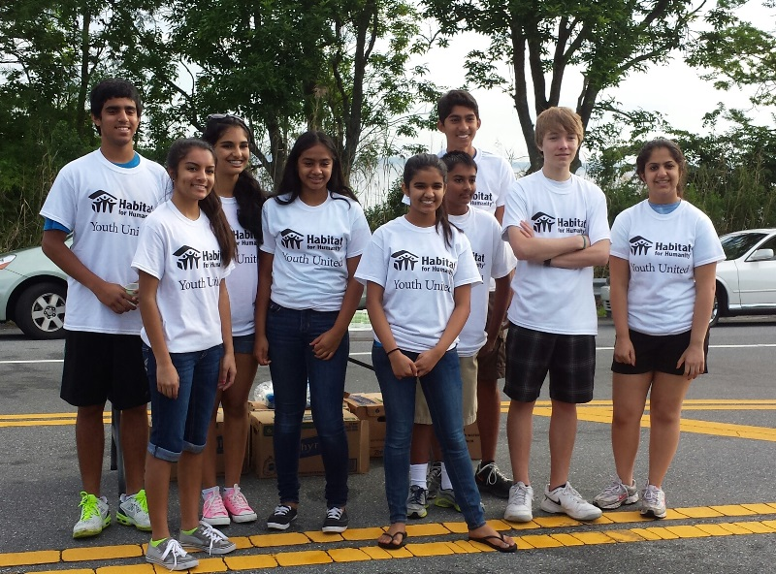
Children of homeowners are
25% more likely to graduate from High School
116% more likely to graduate from College
And 16% more likely to belong to a school or community organization
59% more likely to own their own home within ten years of leaving their parent’s household
20% less likely to become teenage parents
Math scores are 36% higher for children of homeowners while reading scores are 31% higher.

Slide 7

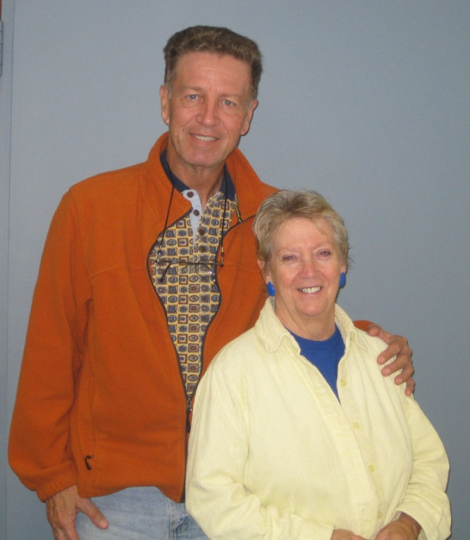
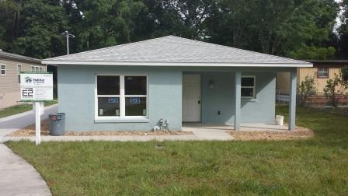
Habitat for Humanity partnered with E2 Homes , Seminole County and the City of Casselberry to build two homes at 1521 Oak Lane and 1481 Park Drive in Casselberry during Habitat for Humanity’s nationwide Builders Blitz 2014. The homes were 1200 sq. ft. with three bedrooms and two bathrooms, both completed during the week long event. The home on Park Drive was also part of the Veterans Build Program with support from Florida Surety Bonds.
Allen and Laura Spencer have been married almost 40 years. Allen is a veteran of the Navy who served in Vietnam. After they retired, Allen became a volunteer at the Habitat ReStore in Casselberry. While volunteering, they learned about the program and applied. Together they worked hard on their sweat equity - working in the ReStore, the office and on the construction site. The Spencers are enjoying their retirement in their first home.

Slide 8
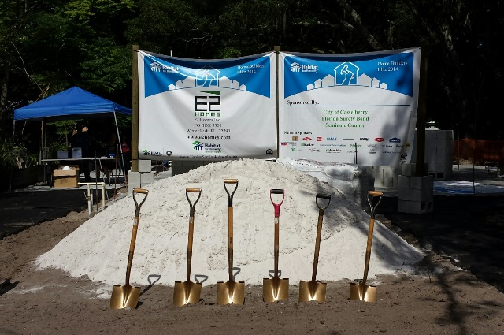
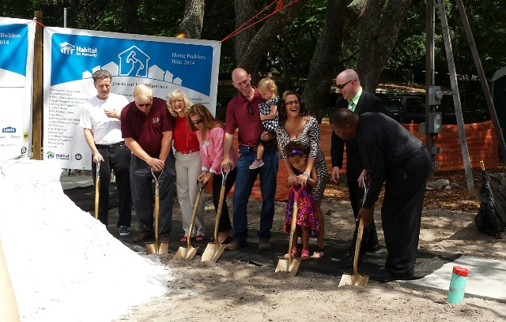
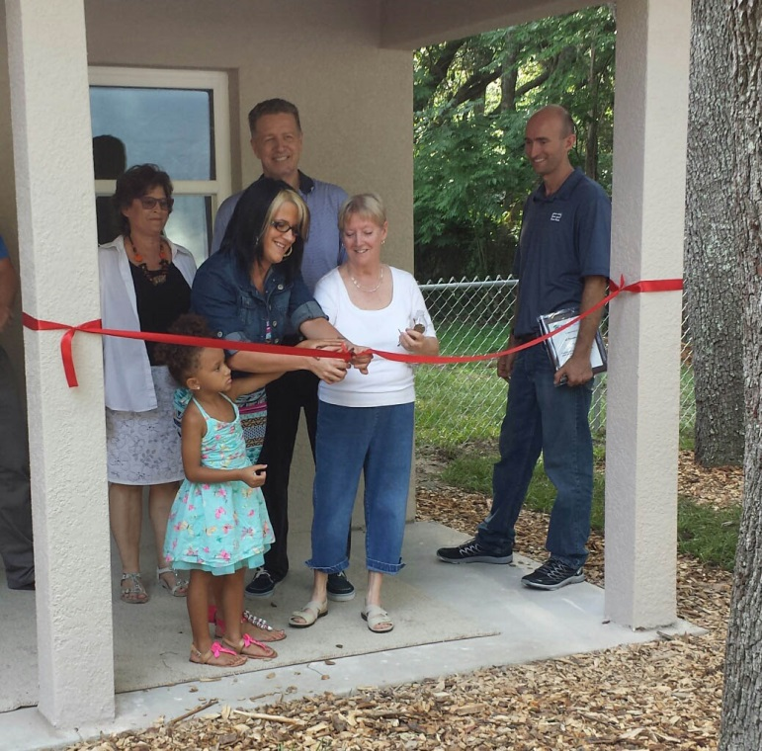
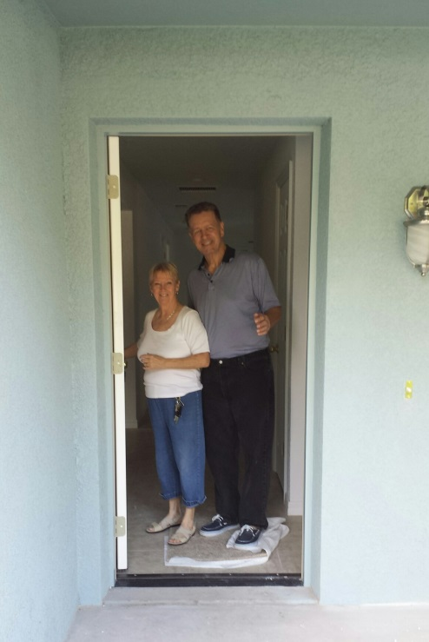
More than 50 local companies came together to build the homes. The blighted properties went from a burden on the city to back on the tax rolls. The project changed the lives of 2 families and improved a neighborhood.

Slide 9

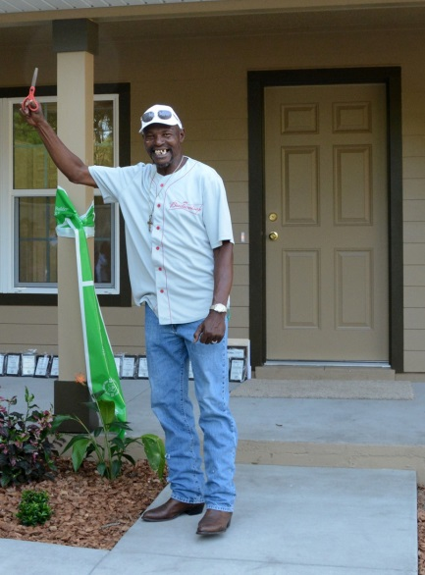
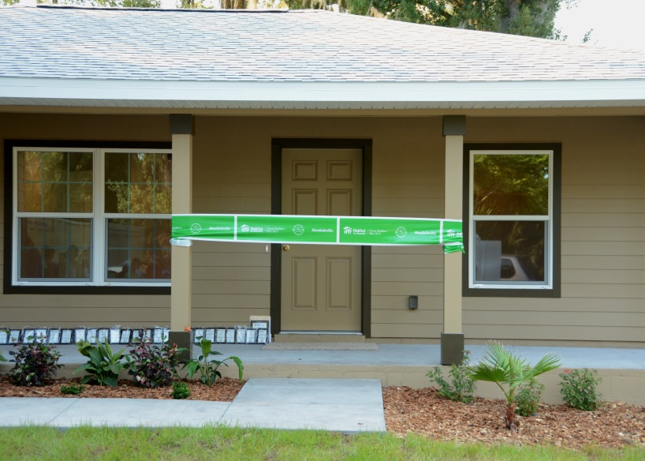

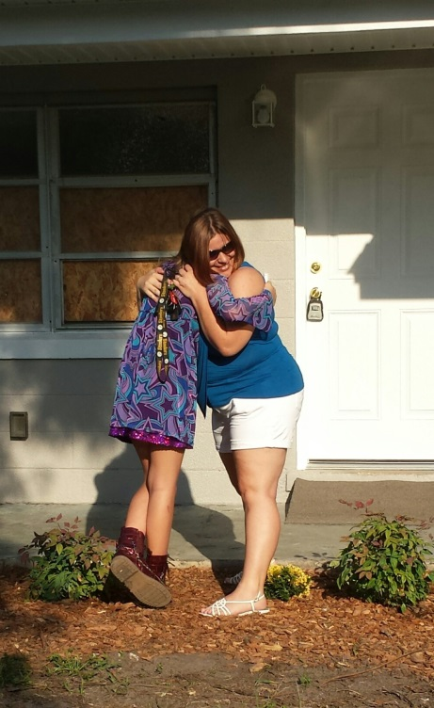
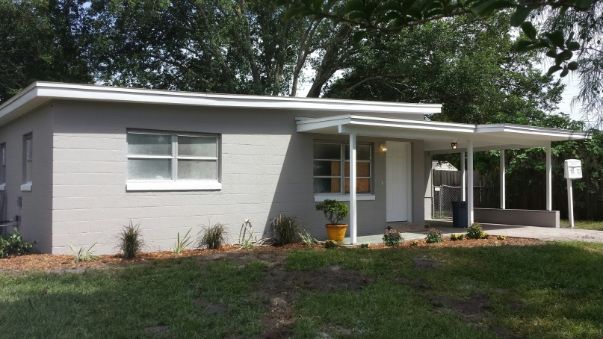
National Opening Ceremony
Host Site!
922 W. 11th St, Sanford
Clarence Grayson has been living with friends in overcrowded conditions. Now retired, he is looking forward to becoming a homeowner for the very first time.
119 Garrison St, Sanford
Jennifer Wible has been spending 81% of her income providing a home for her daughter, Jazmin. Worse yet, the home has water damage which the landlord refuses to repair.

Slide 10
Homeowner Qualification
Demonstration of Need
  Living in conditions that are overcrowded, hazardous, transitional, poorly maintained or unaffordable
  Ability to Pay
  Ability to pay a zero interest mortgage
  Stable income
  Fair credit rating
  Meets income guidelines (dependent on family size)
  Willingness to partner with Habitat
  Meet sweat equity requirements
  Attend financial & homeowner workshops
  Present at jobsite

Slide 11
Community Impact
Good housing attracts
economic investment and development.
Contributes to thriving school systems and community organizations.
A catalyst for civic activism and a stimulus for community-based organizations.
Safe homes and neighborhoods help to build social stability and security.
Improved standard of living reduces the need for assistance or other costly services from the state or other non-profits.
Proven, successful program model produces contributing members of the community.

Slide 12

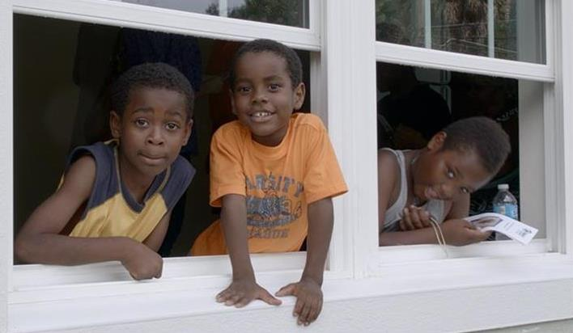
Thank you for your time today. We hope to see you again soon!

