Slide 1
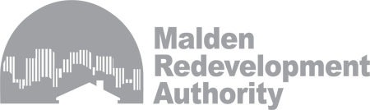
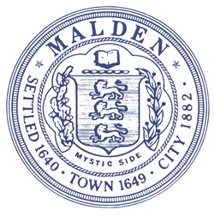
2016 AUDREY NELSON COMMUNITY DEVELOPMENT AWARD PRESENTATION

Slide 2
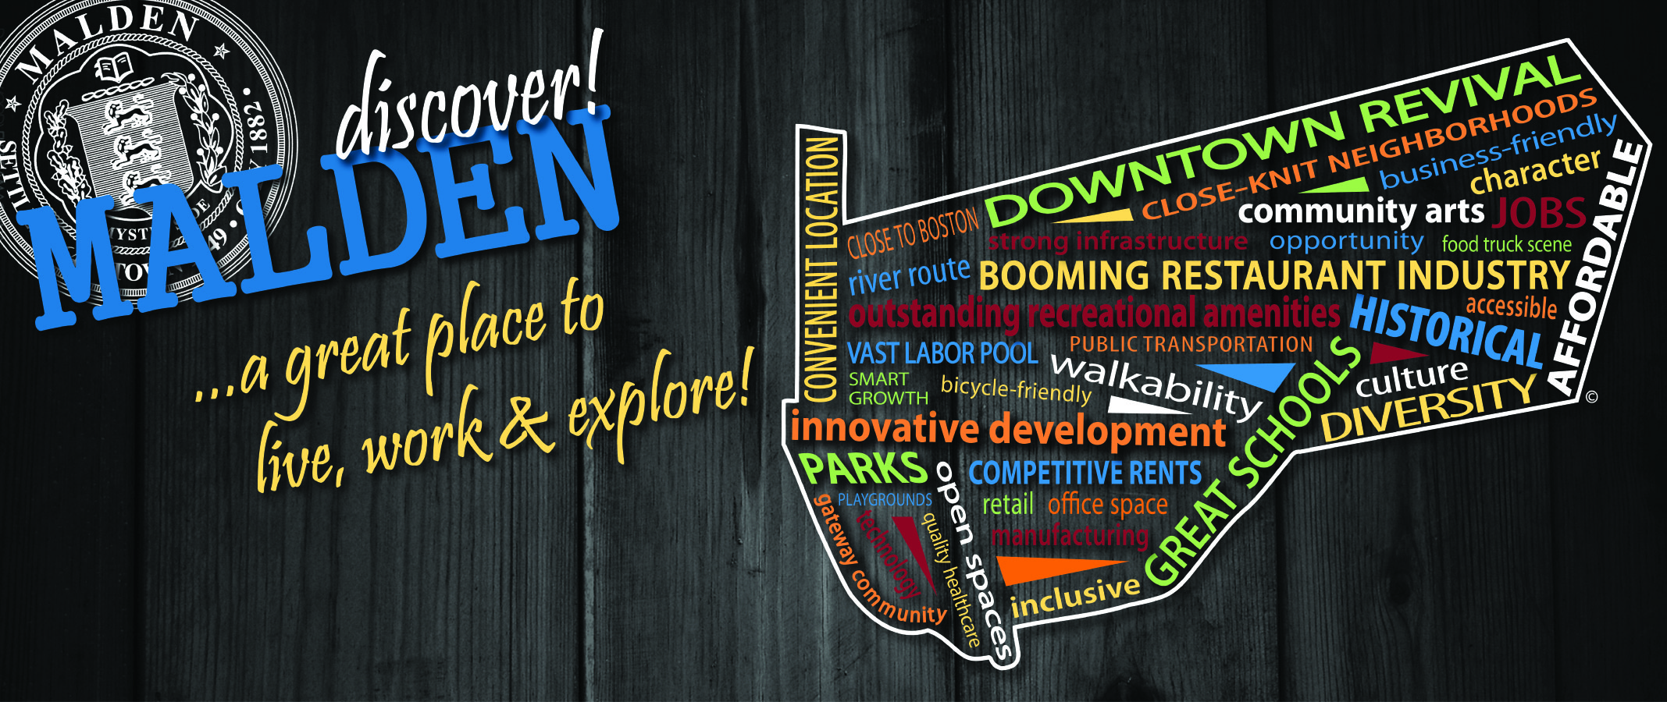
Settled 1640
60k Population
2009 “Best Place to Raise Your Kids “ in state of MA
Area Median Income: $55,471
Gateway City
Annual Recipient of approx. 2.7 million in Federal funds
61% Free/Reduced Lunch at High School
Notes:
Settled 1640, incorporated as a city in 1882- Just 6 miles north of Boston.
60k Population according to 2010 Census Data, 37% of the residents are foreign born (Second highest foreign born residents in MA after Chelsea)
Median Household Income: $55,471, estimated 50.5% Low to Moderate Income Population
Voted in 2009 as one of the Best place to Raise your Kids in state of MA according to Bloomberg Businessweek
Gateway City
Population greater than 35,000 and less than 250,000
Median household income below the state average
Rate of educational attainment below the state average
61% Free/Reduced Lunch at High School
Malden Received approximately 2.7 million a year in federal funds through the HOME & CDBG programs

Slide 3
MRA
Economic Development
Planning & Improvements
Community Development
www.maldenredevelopment.com
Notes:
The Malden Redevelopment Authority (MRA) is the economic development and urban planning agency for the City of Malden. The MRA plays a significant role in helping to shape the City of Malden. The MRA is a self-sustaining agency that works in partnership with city government leaders and community groups to help Malden maintain its edge as a great place to live, work and explore. The agency has a long history, having been created by an Act of the State Legislature in 1958. On behalf of the City, the MRA administers the federal Community Development Block Grant (CDBG) and HOME Programs, oversees development in urban renewal areas, administers low-interest loan and mortgage programs, manages a variety of public works improvement projects and oversees the downtown off-street parking program, affordable housing in the North Suburban region.

Slide 4

CEDAR HOUSE
Total Development Cost: $ 2.14 M
Purchase & Rehab of a rooming house into 14 Single Room Occupancy Units
Service Partners:
Jewish Family & Children’s Services
Malden Housing Authority
Notes:
The project involved purchase and rehabilitation of an existing rooming house in Malden, MA, to 14 Single Room Occupancy, 2 of which are occupied by support services staff.
Project Total Development Cost- $2,135,000
HOME Funds- $400,000
Eastern Savings Bank -Permanent Financing -$1,200,000
Non-Profit Investment - Beth Israel (BISCHI) - $500,000
Owner Equity/Developer – New England Communities Inc. - $35,000
Leverage Ratio– 1:5
HOME funds represent 19% of the total development cost.
Collaboration: The project would not have been possible without the support of local & Regional agencies, including the Malden Housing Authority, which contributed 12 Section 8 project-based vouchers to the project, and Jewish Family & Children's service that provides on-site supportive services for the residents. It was a truly collaborative effort among all the local entities involved.

Slide 5
Ribbon Cutting
Dec 2014
Inaugural Ceremony
Mayor Christenson With Residents

Slide 6
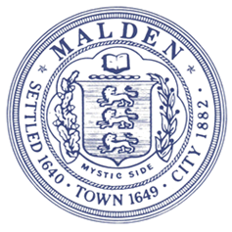
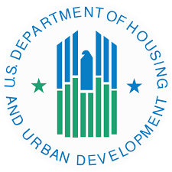
RICHARD C. HOWARD PARK
Total Funds Leveraged : $ 9.7 M
Neighborhood Improvements covering approx. 8 Acres
Notes:
The Richard C. Howard Park was a multifaceted project that initially began with conceptual site development in late 2008, and completed in October 2015.
The Richard C. Howard Park is located in an area of which 68% of the population is low to moderate income residents. The park and surrounding area was in need of much attention and underutilized. Approximately 760 truckloads of petroleum and metal-impacted soils was disposed of offsite opening up previously contaminated land, drainage and adaptive measures were incorporated to increase resiliency given susceptibility to flooding, and lighting, turf fields, and a tot lot was added to accommodate a broad range of youth and families. Over the long term more of the park will now be able to be utilized longer in the day and by residents in all life stages.
Multi-level coordination was instrumental in achieving economies of scale, getting local private/government, community, state and federal support to reassemble and develop what is approximately 8 acres.
LEVERAGE RATIO 1:0.11
CDBG leveraged state, private and city funds, and represents approximately 11% of the total project cost phased over multiple years.
Actual Development Cost was $6.7 MIL with $2MIL leveraged from local/ regional schools set aside for future improvements (?)

Slide 7
RICHARD C. HOWARD PARK
KEY IMPROVEMENTS
New Synthetic Turf Field
Dugouts, Bull Pens & Batting Cages
Night Lights and Seating
Tennis Courts
Tot Lot
Additional Improvements: Bike Racks, Pedestrian Walkways, Reduced Traffic Congestion, Improved Drainage and utilities in the surrounding areas...
Notes:
New synthetic turf field which provides several advantages that include:
1) Does not require irrigation, thus saving potable water.
2) Does not require the application of fertilizers, pesticides or herbicides reducing operating costs and exposure to non-organic compounds.
3) Does not require weekly or bi-weekly mowing and edging, thus reducing emissions due to the use of gasoline powered maintenance equipment and reducing operating costs
Dugouts, bullpens, and batting cages
Lights for night play, spectator seating, and four tennis courts.
Tot lot designed to accommodate a broad range of ages from toddlers to elementary school.
Additional improvements include lit parking areas, bike racks, pedestrian walkways, benches, site lighting and landscaping throughout the park; a utility building for maintenance equipment and storage; and the relocation of overhead utilities through the project area to underground.

Slide 8
BEFORE CONSTRUCTION

Slide 9
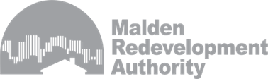
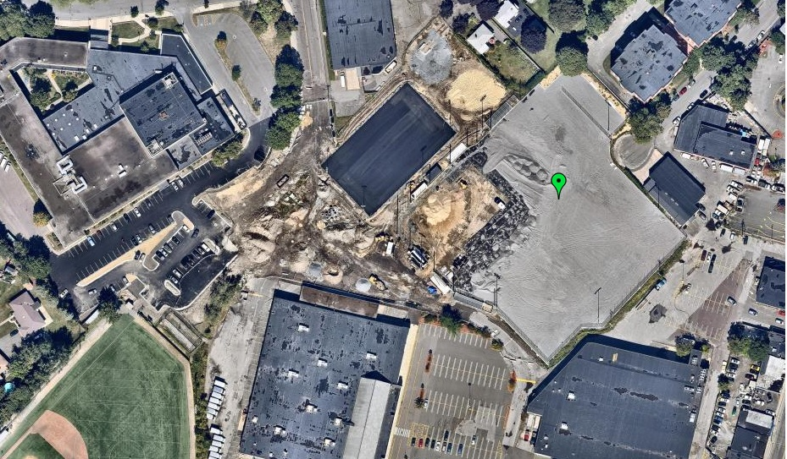
IN PROGRESS

Slide 10
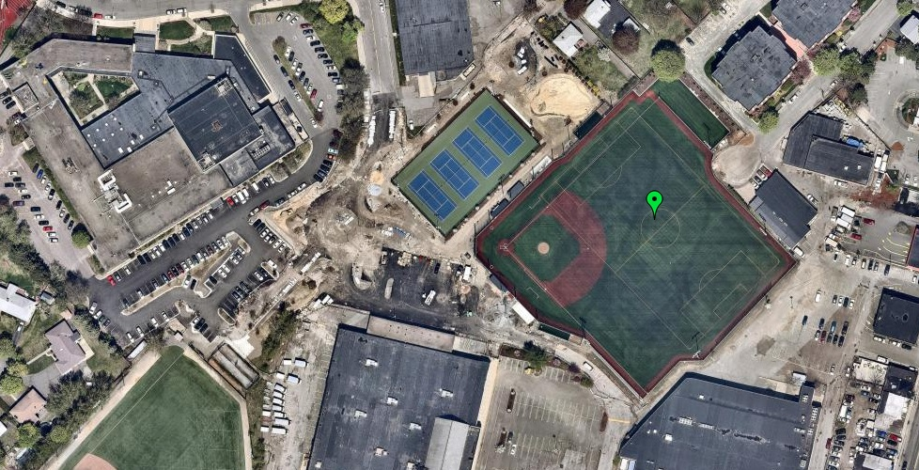
FINAL STAGES…

Slide 11
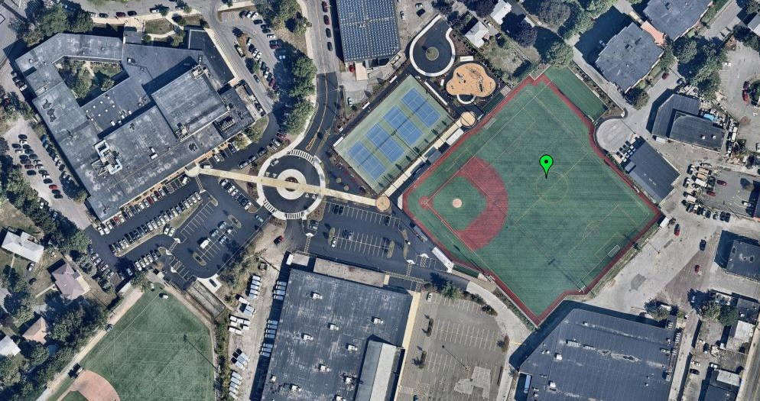
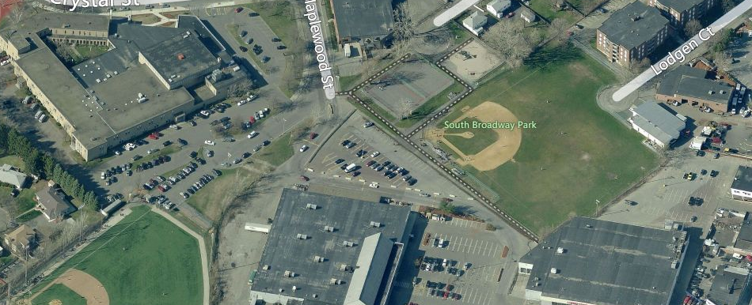
TRANSFORMATION COMPLETE

Slide 12

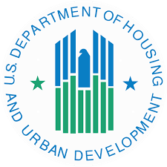
LESSONS LEARNED…

