Slide 1

Washington Oaks a Rental Rehabilitation Program Project
City of Knoxville
Funded with HOME and CDBG funds

Slide 2
was initiated by the City of Knoxville, Community Development Department, in response to the local need for standard, rental housing that is affordable to low income tenants.
The Rental Rehabilitation Program
The Program is designed to accomplish a two-fold objective:
To increase the supply and long-term availability of affordable, decent, safe and energy efficient housing for low income families: and
To revitalize and strengthen Knoxville’s inner-city neighborhoods by correcting substandard rental housing conditions within the community

Slide 3
Rental Rehab Program Participants
  The Program is available to owners of substandard residential rental property.
  Eligible owners can be private individuals, public agencies or non-profits. All owners must have financial stability and successful management and property maintenance of any owned rental properties.
  Participants must document proven development capacity for the type and size of project.
  Participants are required to attend a Fair Housing/Rental Rehab Compliance Training provided by City staff.

Slide 4
Rental Rehabilitation Property
Property can be single family, multi family or supportive housing.
Properties are brought up to the City’s Neighborhood Standards, which include the 2012 ICC Housing Maintenance Code, existing codes related to health and safety, lead based paint requirements and cost effective energy conservation measures.
Properties must be located in a neighborhood where current market conditions indicate a need for the proposed rental project.

Slide 5
Financial Assistance
Program provides a subsidy toward the cost of rehabilitation in the form of a forgivable loan called “Deferred Payment Loan” (DPL).
DPL’s are limited to the minimum amount necessary to make a project feasible based on projected rents and expenses and a reasonable return on owner’s investment.
Total DPL is also limited to 80% of cost or $20,000 per unit.
A grant is provided for lead based paint remediation in an amount up to 25% of the cost of the non-lead work.
Property must have a positive cash flow after rehabilitation.

Slide 6
Rental Rehabilitation Program
The City takes applications on an on-going basis from property owners.
The Program was active from 1993-2010 and was re-opened in 2013.
We have assisted projects ranging from a small one-bedroom house to a 100 unit apartment complex.

Slide 7
Washington Oaks Project
Helen Ross McNabb Center, Inc., a local non-profit whose mission’s include affordable, supportive housing, purchased a property in 2013 in the Whittle Springs community containing 13 two bedroom units, spread throughout three separate apartment buildings.
All units were vacant and had been vacant for some time.
The planned rehabilitation included conversion of two basement storage areas to new residential units resulting in a total of 15 units. Two of these units were designed to be fully accessible.

Slide 8
Washington Oaks Project
The Washington Oaks project is one of two that Helen Ross McNabb determined was needed as supportive housing for homeless veterans. HRMC partners with the Veteran’s Administration and receives referrals from them. These 15 units are leased to homeless veterans who and involved with the HRMC program.
Community Involvement – HRMC reached out to community leaders regarding the project. An open neighborhood meeting was held at a local church to provide information regarding the plans for the property and for informal discussion about these plans. The community was pleased to be involved and had virtually no objections to the project

Slide 9
Washington Oaks Project-Project Based Rental Assistance
HRMC applied to Knoxville’s local housing authority for project based rental assistance for these units. They were awarded this assistance before the rehabilitation began.

Slide 10
Rehabilitation Work
Asbestos remediation
Two fully accessible units
Water heaters and plumbing fixtures
Floor coverings
Painting
Doors
Cabinets and appliances
Roof and gutters
Insulation and Siding
New HVAC units
Sprinkler system
New electrical panels
Fire alarms
Outlets and switches

Slide 11
Washington Oaks Final Sources and Uses
FHLB AHP Grant 560,000
THDA HTF Grant 300,000
COK HOME funds 260,000
Private funds 23,499
Total 1,143,499
Acquisition 425,000
Construction 637,536
Soft costs 30,000
Furniture/Fixtures 29,963
Consulting fee/FHLB 21,000
Total 1,143,499

Slide 12
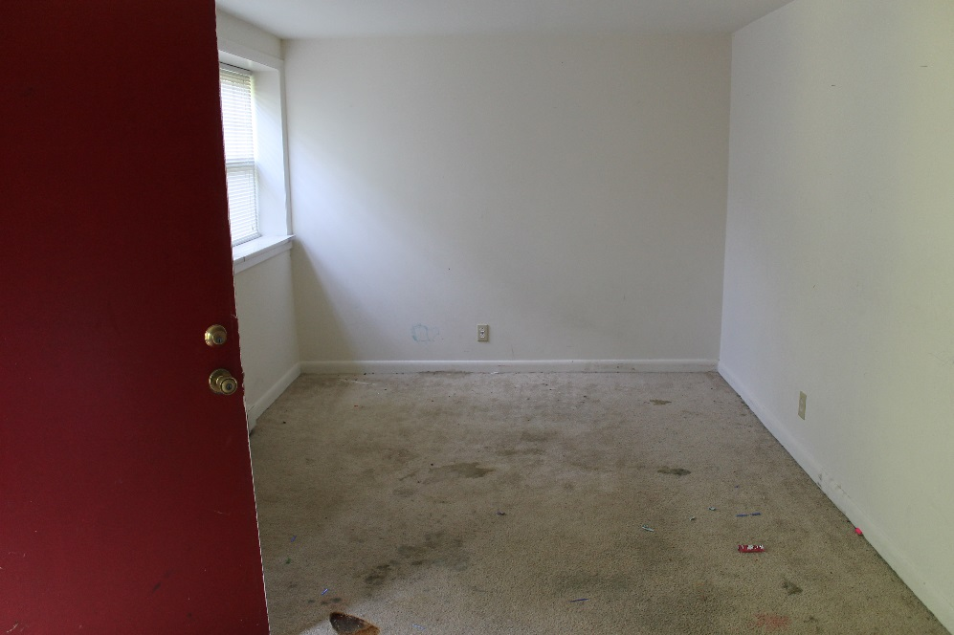
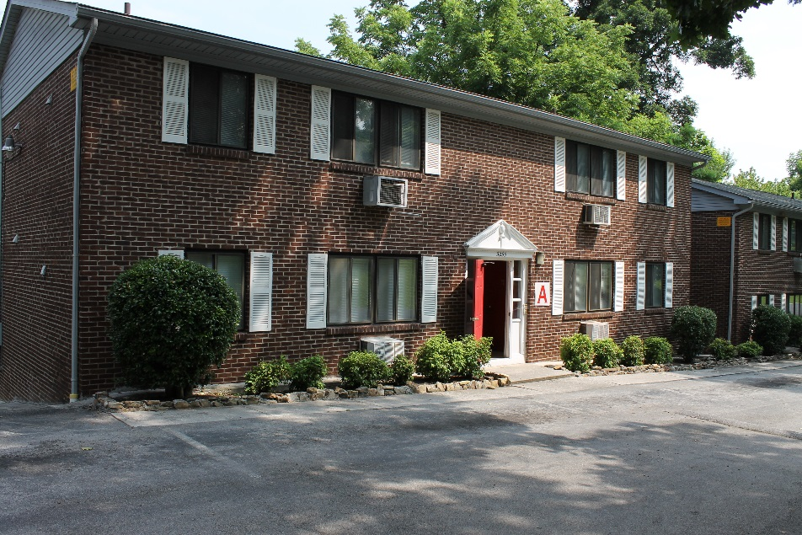
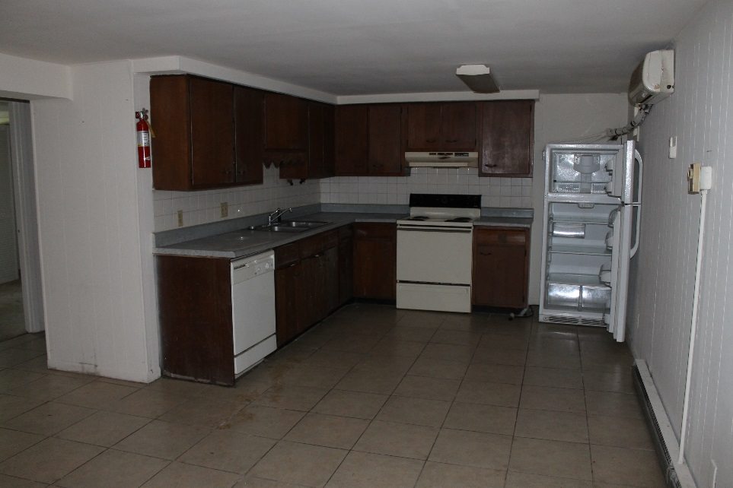
Washington Oaks - before pictures

Slide 13
Washington Oaks Completion
This rehabilitation project was issued a Certificate of Completion in May, 2015.
Lease up took approximately four months.
All apartments are leased at this time for $600/month including utilities. Rental assistance varies from $104 to $373 with tenants paying 30% of their income.
All tenant households are less than 50% median income

Slide 14
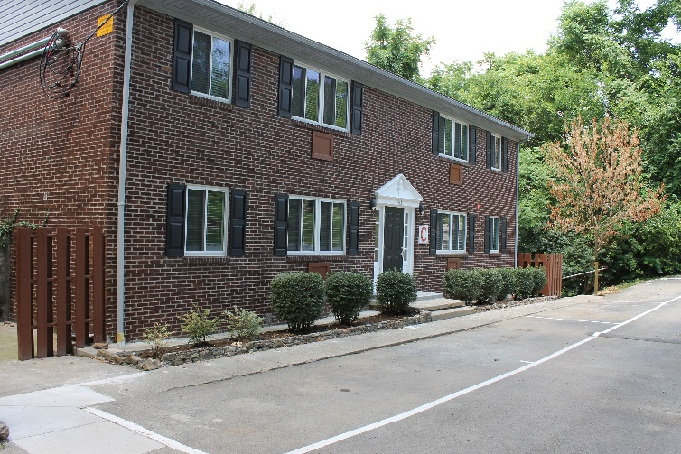
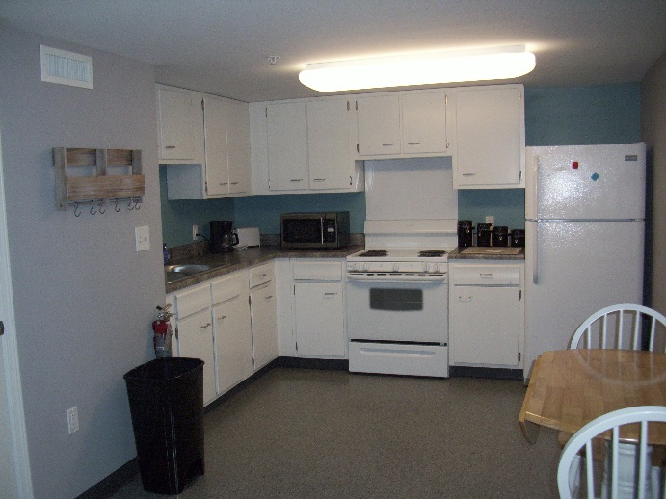
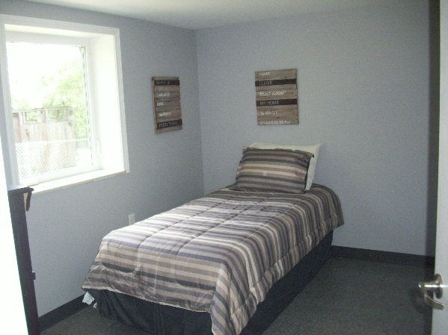
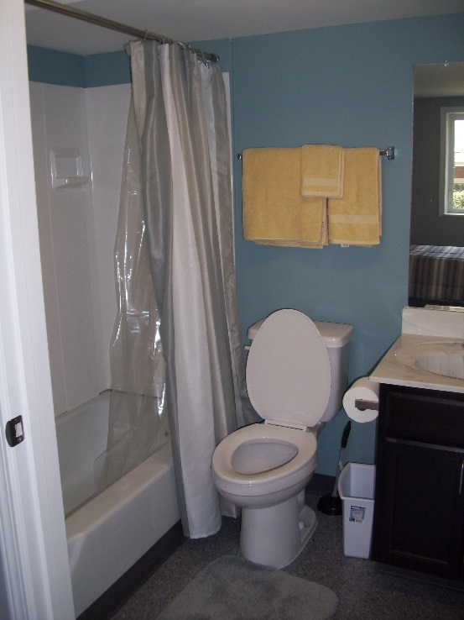
Washington Oaks Completion

Slide 15
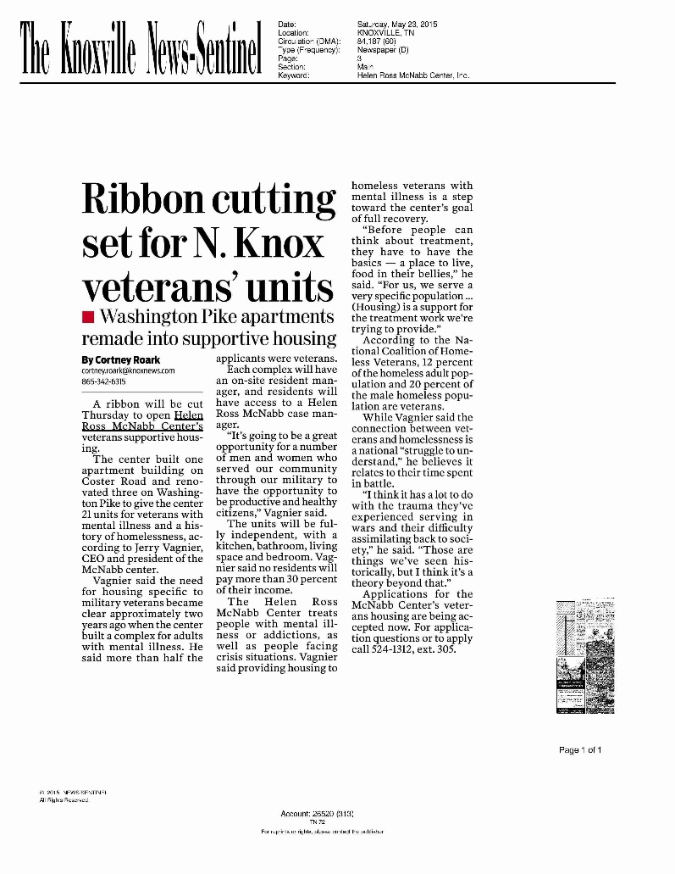
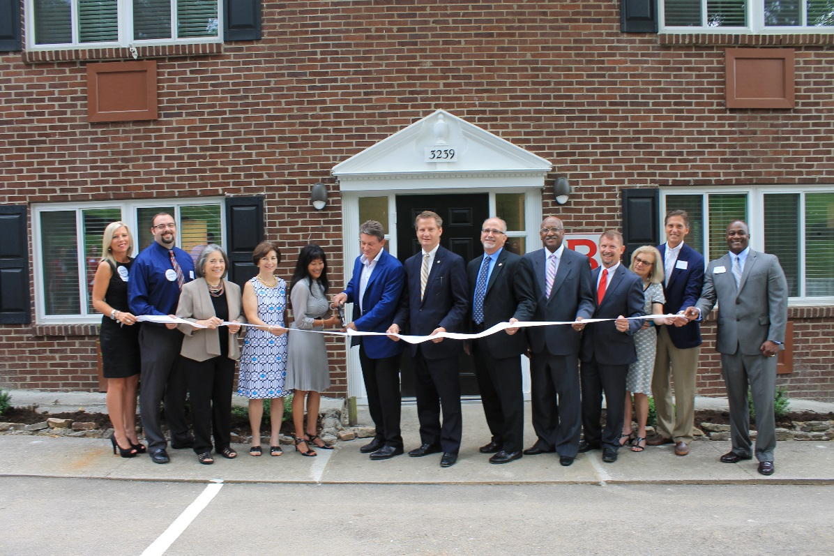
Washington Oaks Completion

